Slide 1
Keypad interfacing
Module 7

Slide 2
Introduction
Keyboards are organized in a matrix of rows and columns.
The CPU accesses both rows and columns through ports
Therefore, with two 8-bit ports, a 4x4 matrix of keys can be connected to a microcontroller.
When a key is pressed, a row and a column make contact.
Otherwise, there is no connection between rows and columns.

Slide 3
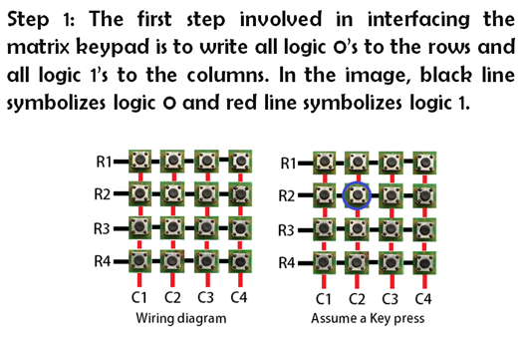
Keypad interfacing with 8051

Slide 4
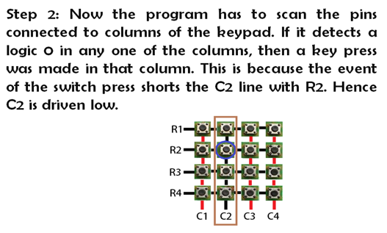

Slide 5
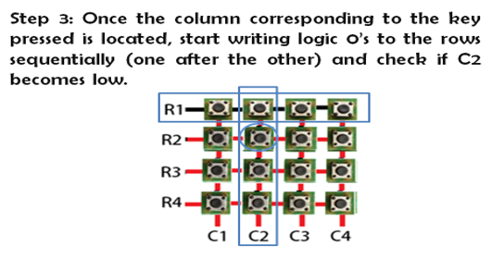

Slide 6
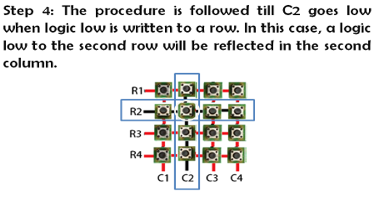

Slide 7
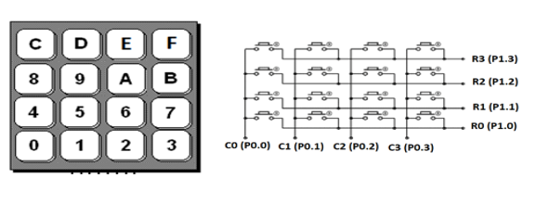

Slide 8
Solve
Identify the row and column of the pressed key for each of the following.
(a) D3 – D0 = 1110 for the row, D3 – D0 = 1011 for the column
(b) D3 – D0 = 1101 for the row, D3 – D0 = 0111 for the column
(c) D3 – D0 = 1011 for the row, D3 – D0 = 1110 for the column

Slide 9
LED Interfacing
Module 7

Slide 10
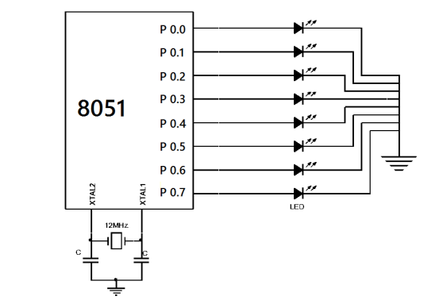
LED interfacing

Slide 11
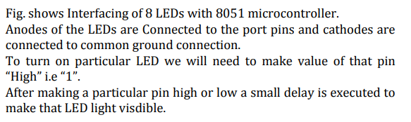

Slide 12
Seven-segment display interfacing
Module 7

Slide 13
A seven segment display consists of seven LEDs arranged in the form of a squarish ‘8’ slightly inclined to the right and a single LED as the dot character.
Different characters can be displayed by selectively glowing the required LED segments.

Slide 14
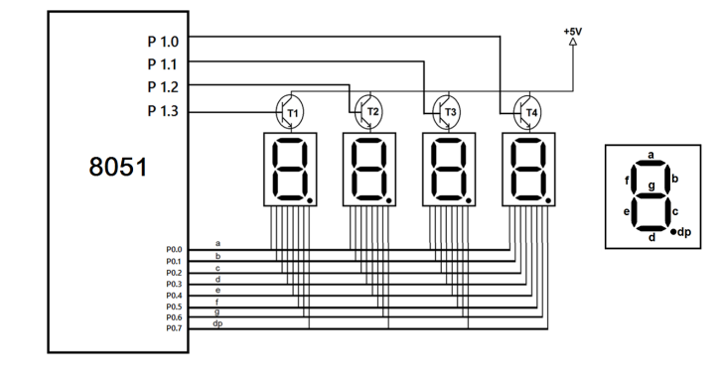

Slide 15
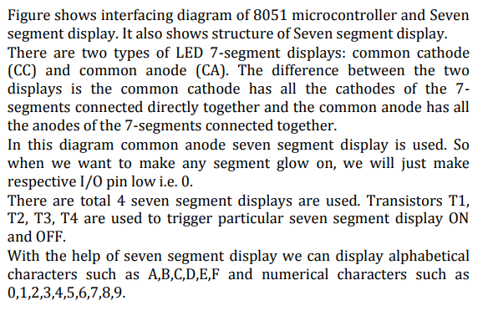

Slide 16
solve
Which LEDs will glow?
3
9
A

Slide 17
