Slide 1
ADC and DAC

Slide 2
adc
ADCs are used for data acquisition.
Physical quantities, like temperature, pressure, humidity, velocity, etc., are converted to electrical (voltage, current) signals using a device called a transducer or sensor.
We need an Analog-to-Digital Converter to translate the analog signals to digital numbers so the microcontroller can read and process them.
An ADC has n-bit resolution where n can be 8, 10, 12, 16 or even 24 bits.

Slide 3
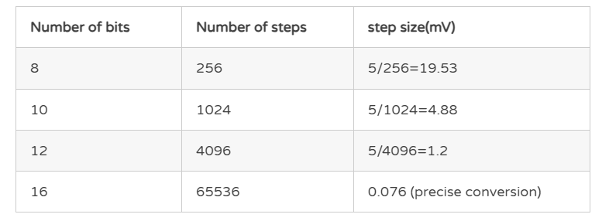
The higher-resolution ADC provides a smaller step size, where step size is the smallest change that can be discerned by an ADC.

Slide 4
In addition to resolution, conversion time is another major factor in judging an ADC.
Conversion time is defined as the time it takes the ADC to convert the analog input to a digital number.
In parallel ADC, we have 8 of more pins dedicated to bringing out the binary data, but in serial ADC we have only one pin for data out.

Slide 5
Adc 0808
The ADC 0808 is a popular 8-bit ADC with a step size of 19.53 millivolts.
It does not have an internal clock. Therefore, it requires a clock signal from an external source.
It has eight input pins, but only one of them can be selected at a time because it has eight digital output pins.

Slide 6
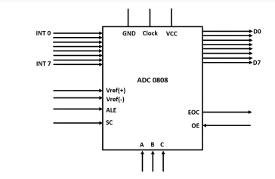
Pin diagram

Slide 7
Pin details
Input pins (INT0-INT7)
The ADC 0808 has eight input analog pins. These pins are multiplexed together, and only one of them can be selected using three select lines.
Select lines and ALE
It has three select lines, namely A, B, and C, that are used to select the desired input lines. The ALE pin also needs to be activated by a low to high pulse to select a particular input.
Output pins (D0-D7)
The ADC has eight output pins that give the binary equivalent of a given analog value.

Slide 8
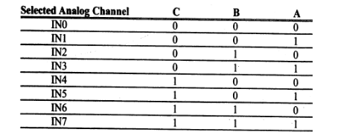

Slide 9
VCC and Ground
These two pins are used to provide the required voltage to power the microcontroller. In most cases, the ADC uses 5V DC to power up.
Clock
The 0808 does not have an internal clock and needs an external clock signal to operate. It uses a clock frequency of 20Mhz, and using this clock frequency it can perform one conversion in 100 microseconds.
VREF (+) and VREF (-)
These two pins are used to provide the upper and the lower limit of voltages which determine the step size for the conversion. Here Vref(+) has a higher voltage, and Vref(-) has the lower voltage. If Vref(+) has an input voltage 5v and Vref(-) has a voltage of 0v then the step size will be 5v-0v/2⁸= 15.53 mv.

Slide 10
The following are steps to get data from an ADC0808/0809.
Select an analog channel by providing bits to A, B, and C addresses.
Activate the ALE (address latch enable) pin. It needs an L-to-H pulse to latch in the address.
Activate SC (start conversion) by an L-to-H pulse to initiate conversion.
Monitor EOC (end of conversion) to see whether conversion is finished. H-to- L output indicates that the data is converted and is ready to be picked up. If we do not use EOC, we can read the converted digital data after a brief time delay. The delay size depends on the speed of the external clock we connect to the CLK pin.
Activate OE (output enable) to read data out of the ADC chip. An L-to H pulse to the OE pin will bring digital data out of the chip.
The speed of conversion depends on the frequency of the clock connected to the CLK pin, it cannot be faster than 100 microseconds

Slide 11
dac

Slide 12
The DAC is a device widely used to convert digital pulses to analog signals.
The two method of creating a DAC is binary weighted and R/2R ladder.
The Binary Weighted DAC, which contains one resistor or current source for each bit of the DAC connected to a summing point.
These precise voltages or currents sum to the correct output value.
This is one of the fastest conversion methods but suffers from poor accuracy because of the high precision required for each individual voltage or current.
Such high-precision resistors and current sources are expensive, so this type of converter is usually limited to 8-bit resolution or less

Slide 13
The R-2R ladder DAC, which is a binary weighted DAC that uses a repeating cascaded structure of resistor values R and 2R.
This improves the precision due to the relative ease of producing equal valued matched resistors (or current sources).
However, wide converters perform slowly due to increasingly large RC-constants for each added R-2R link.
The first criterion for judging a DAC is its resolution, which is a function of the number of binary inputs.
The common ones are 8, 10, and 12 bits.
The number of data bit inputs decides the resolution of the DAC since the number of analog output levels is equal to 2n , where n is the number of data bit inputs.
Therefore, an 8-input DAC such as the DAC0808 provides 256 discrete voltage (or current) levels of output.

Slide 14

Dac 0808
The digital inputs are converted to current (Iout), and by connecting a resistor to the Iout pin, we can convert the result to voltage.
The total current provided by the Iout pin is a function of the binary numbers at the D0-D7 inputs of the DAC0808 and the reference current (Iref), and is as follows
Usually reference current is 2mA.

Slide 15
Ideally we connect the output pin to a resistor, convert this current to voltage, and monitor the output on the scope.
But this can cause inaccuracy; hence an opamp is used to convert the output current to voltage.
Now assuming that Iref = 2mA, if all the inputs to the DAC are high, the maximum output current is 1.99mA.

