Slide 1
Interfacing Temperature sensor

Slide 2
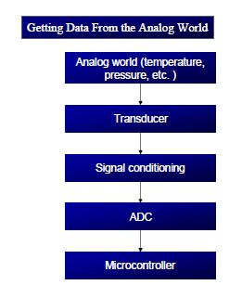

Slide 3
Signal conditioning
Signal conditioning is a widely used term in the world of data acquisition.
It is the conversion of the signals (voltage, current, charge, capacitance, and resistance) produced by transducers to voltage, which is sent to the input of an ADC.

Slide 4
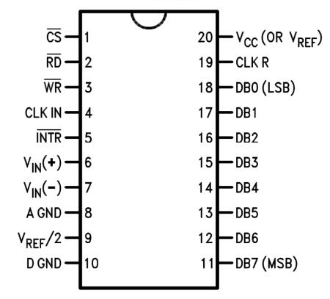
Adc 804

Slide 5

CLK IN and CLK R
CLK IN is an input pin connected to an external clock source
To use the internal clock generator (also called self-clocking), CLK IN and CLK R pins are connected to a capacitor and a resistor, and the clock frequency is determined by
Typical values are R = 10K ohms and C =150 pF
We get f = 606 kHz, and the conversion time is 110 μs

Slide 6
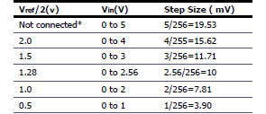
Vref/2
If this pin is open (not connected), the analog input voltage is in the range of 0 to 5 volts (the same as the Vcc pin)
If the analog input range needs to be 0 to 4 volts, Vref/2 is connected to 2 volts

Slide 7
A ground and d ground
Analog ground is connected to the ground of the analog Vin
Digital ground is connected to the ground of the Vcc pin
CS – used to activate the ADC
RD – OE
INTR – EOC
WR - SC

Slide 8
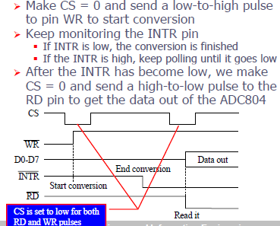
Steps to be followed for data conversion

Slide 9
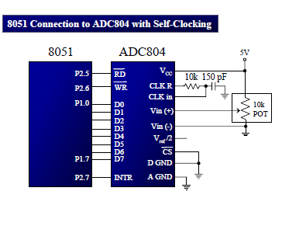

Slide 10
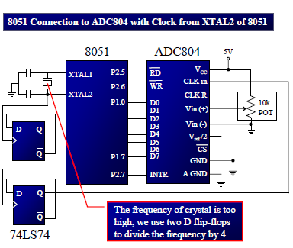

Slide 11
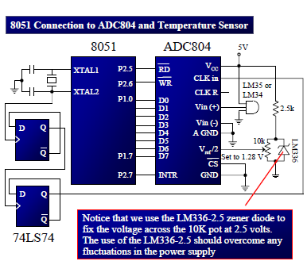
Interfacing 8051 with temperature sensor

Slide 12
The sensors of the LM34/LM35 series are precision integrated-circuit temperature sensors whose output voltage is linearly proportional to the Fahrenheit/Celsius temperature.
The LM34/LM35 requires no external calibration since it is inherently calibrated
It outputs 10 mV for each degree of Fahrenheit/Celsius temperature

