Slide 1
Dashboard Nodes and User Interface(UI) in Node Red
Dr.V.Berlin Hency
Professor
SENSE
VIT Chennai

Slide 2
Objective
To install necessary tools for dashboard nodes and UI
To create a flow and incorporate various Dashboard nodes
To create Layout and wizards
Visualize the output in UI and Debug monitor

Slide 3
Install Dashboard (cmd window)
npm i node-red-dashboard

Slide 4
UI Gauge
npm install node-red-contrib-ui-artless-gauge

Slide 5
To trigger Node Red
node-red -v

Slide 6
http://127.0.0.1:1880/

Slide 7
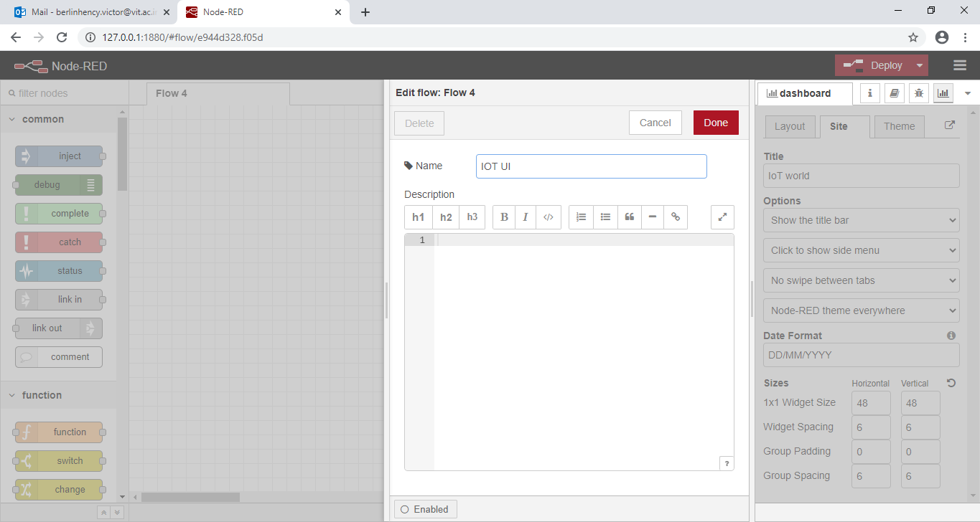

Slide 8
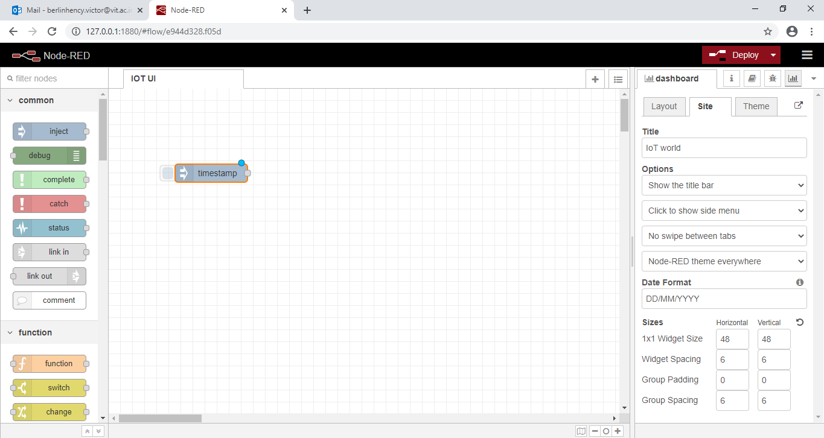
Insert inject node

Slide 9
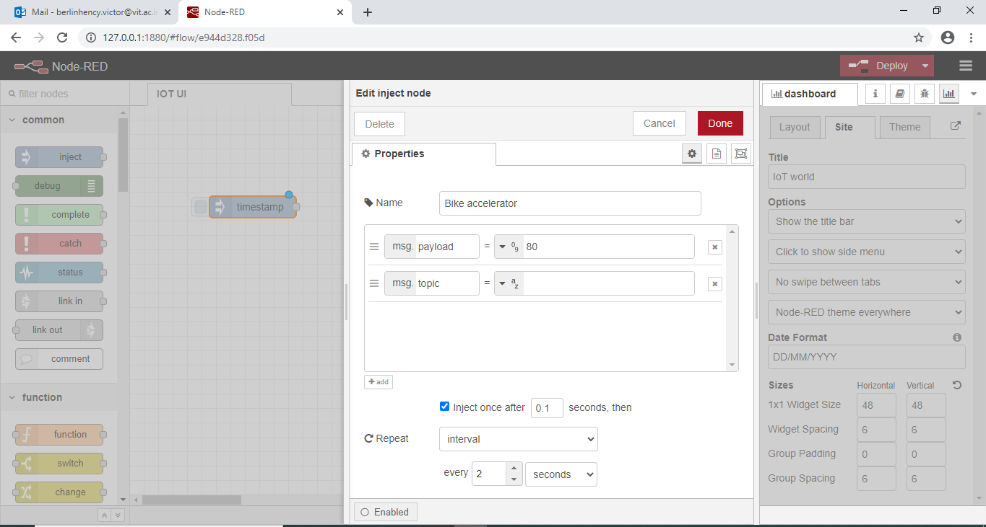

Slide 10
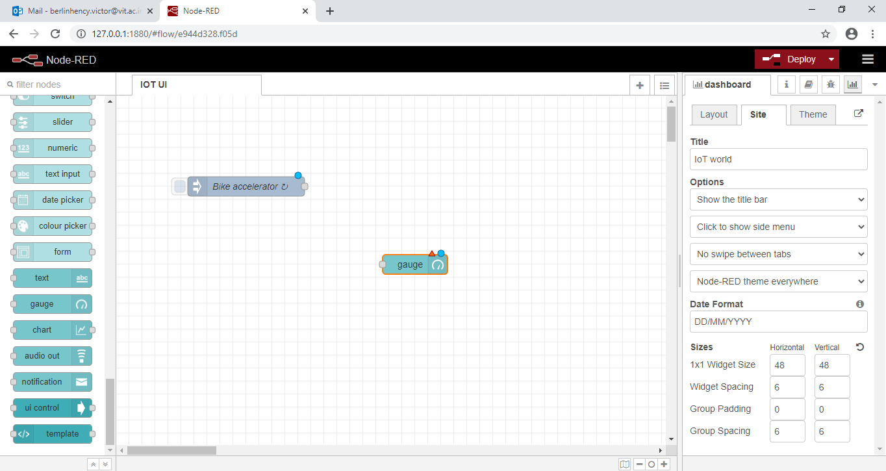
Insert gauge node

Slide 11
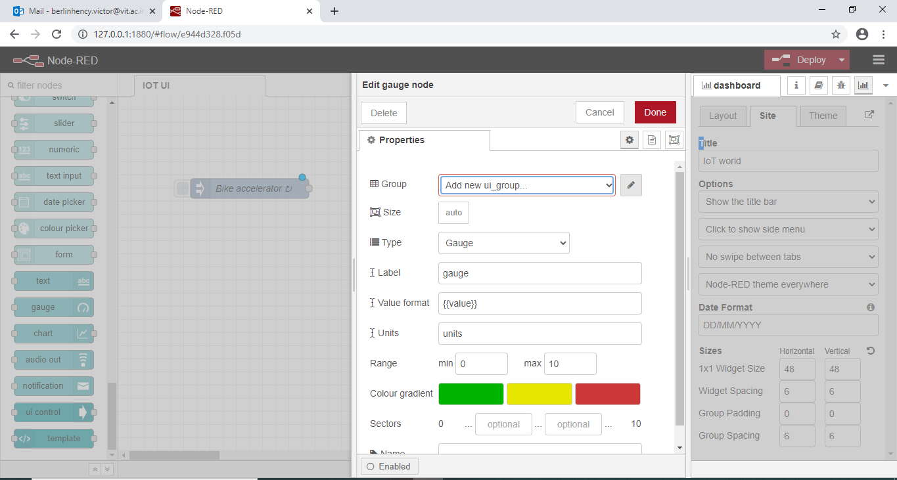

Slide 12
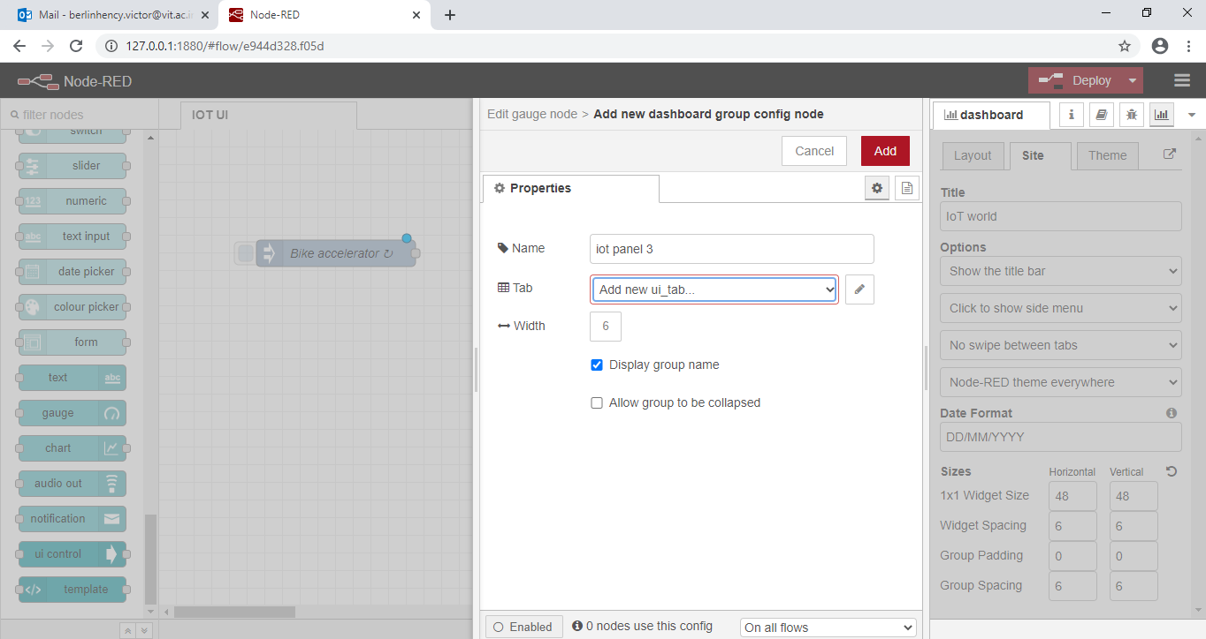

Slide 13
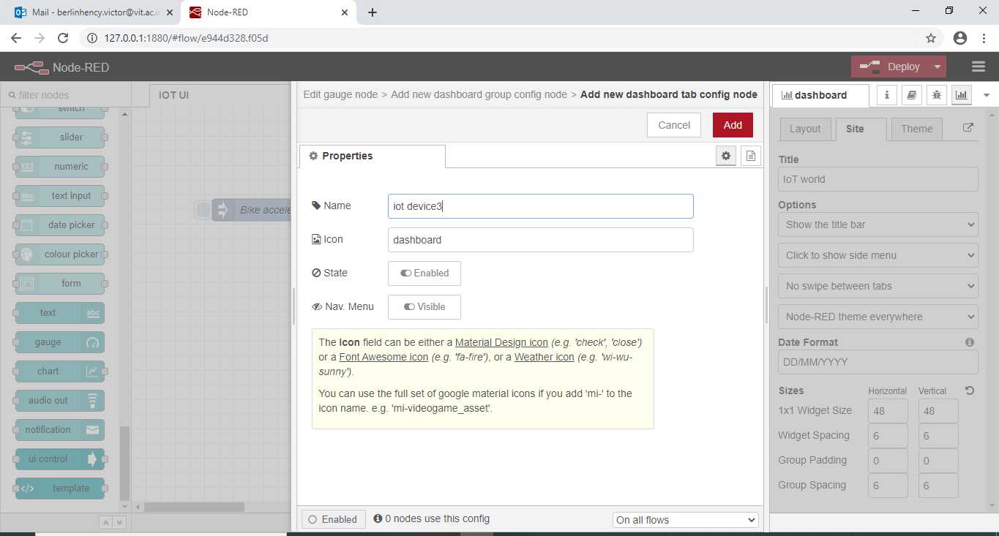

Slide 14
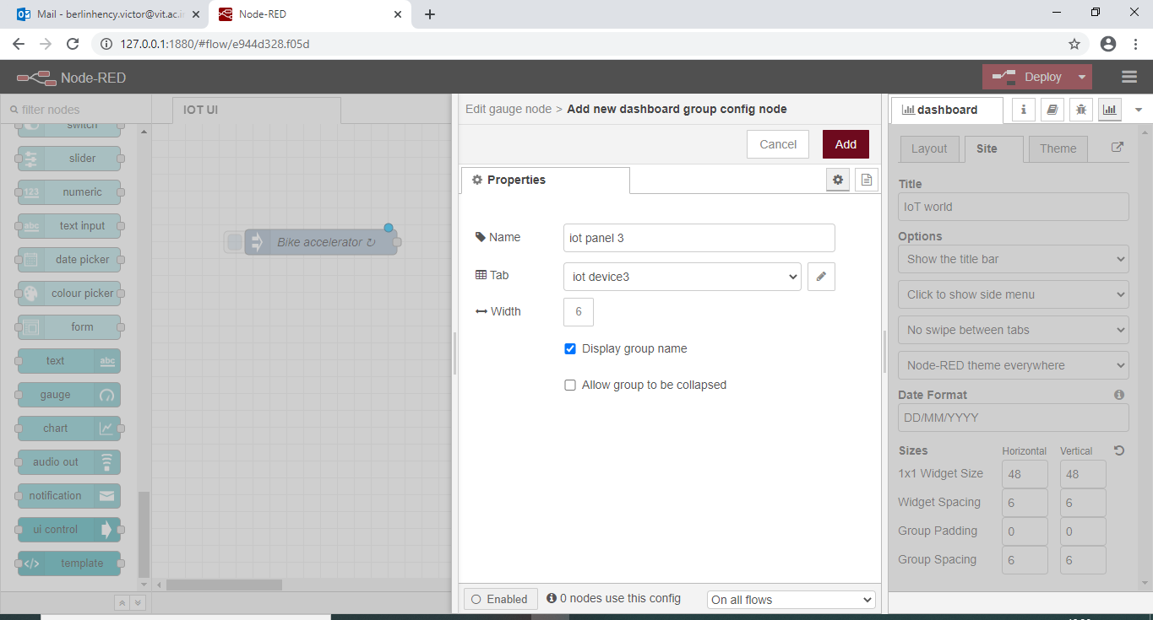

Slide 15
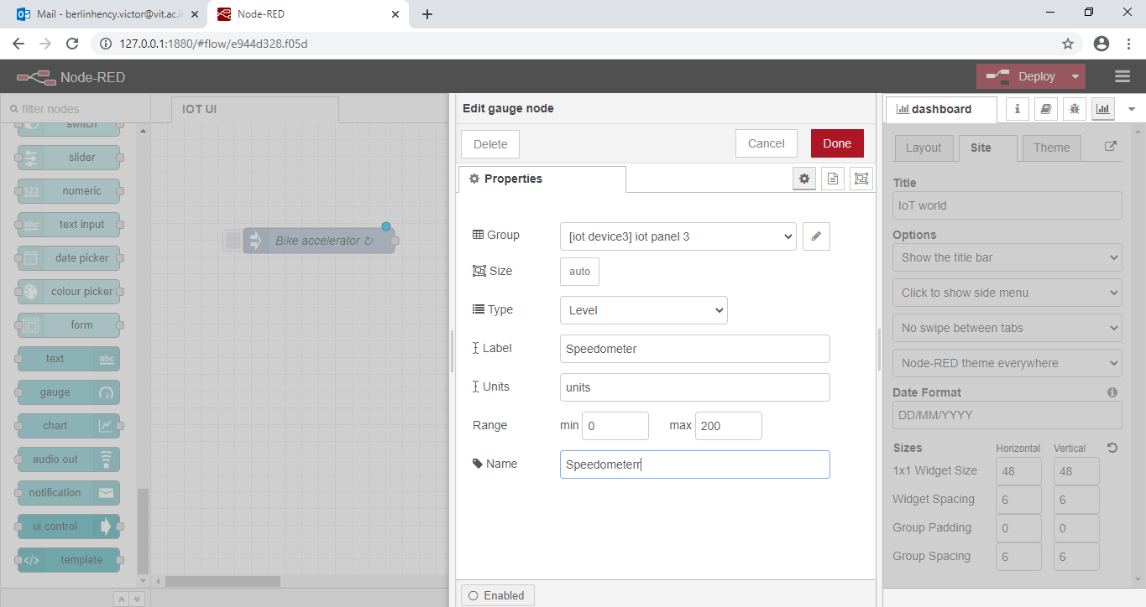

Slide 16
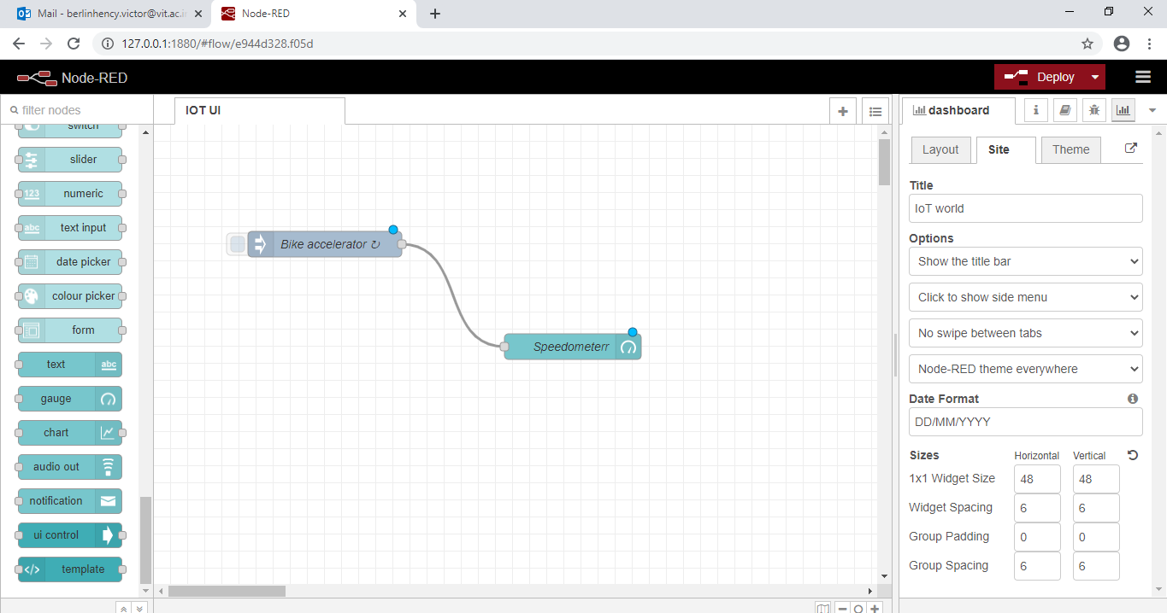

Slide 17
Deploy
Execute

Slide 18
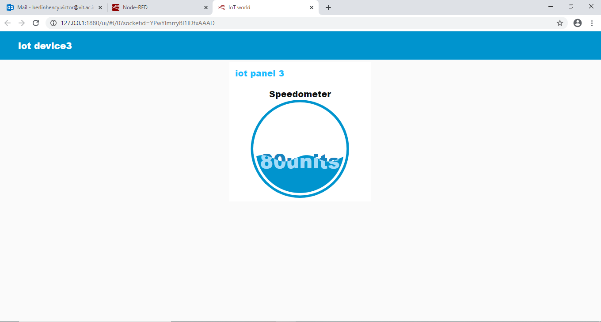

Slide 19
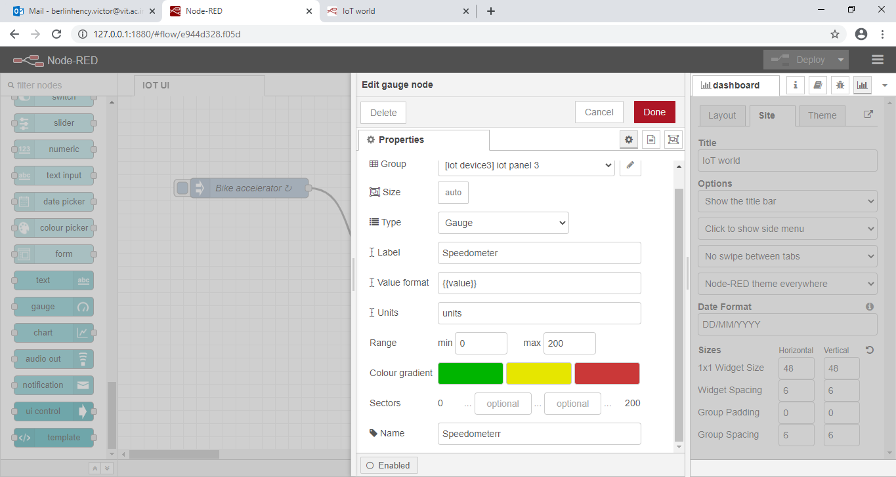

Slide 20
Deploy
Execute

Slide 21
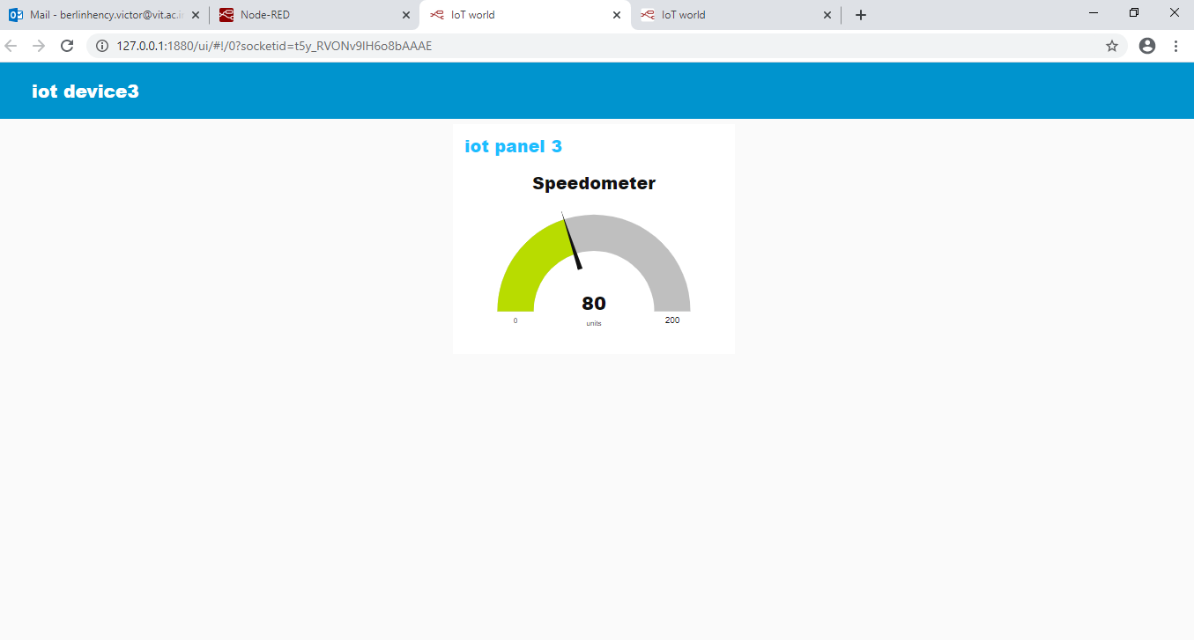

Slide 22
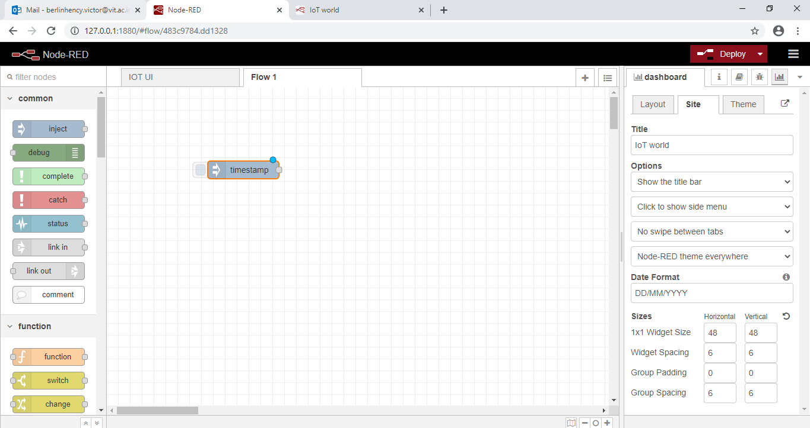
OTP Generator-Insert inject node

Slide 23
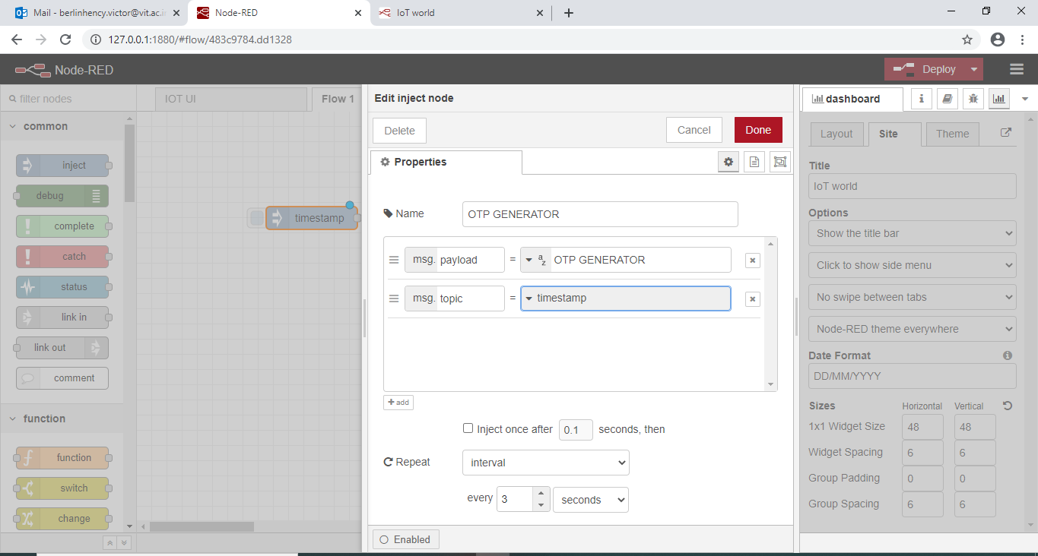

Slide 24
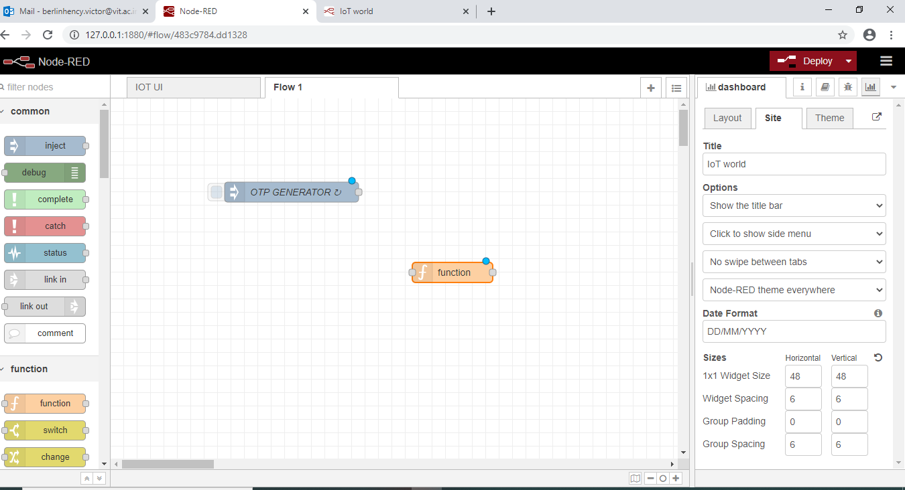
Insert function node

Slide 25
msg.payload = Math.round(Math.random()*10000);return msg;

Slide 26
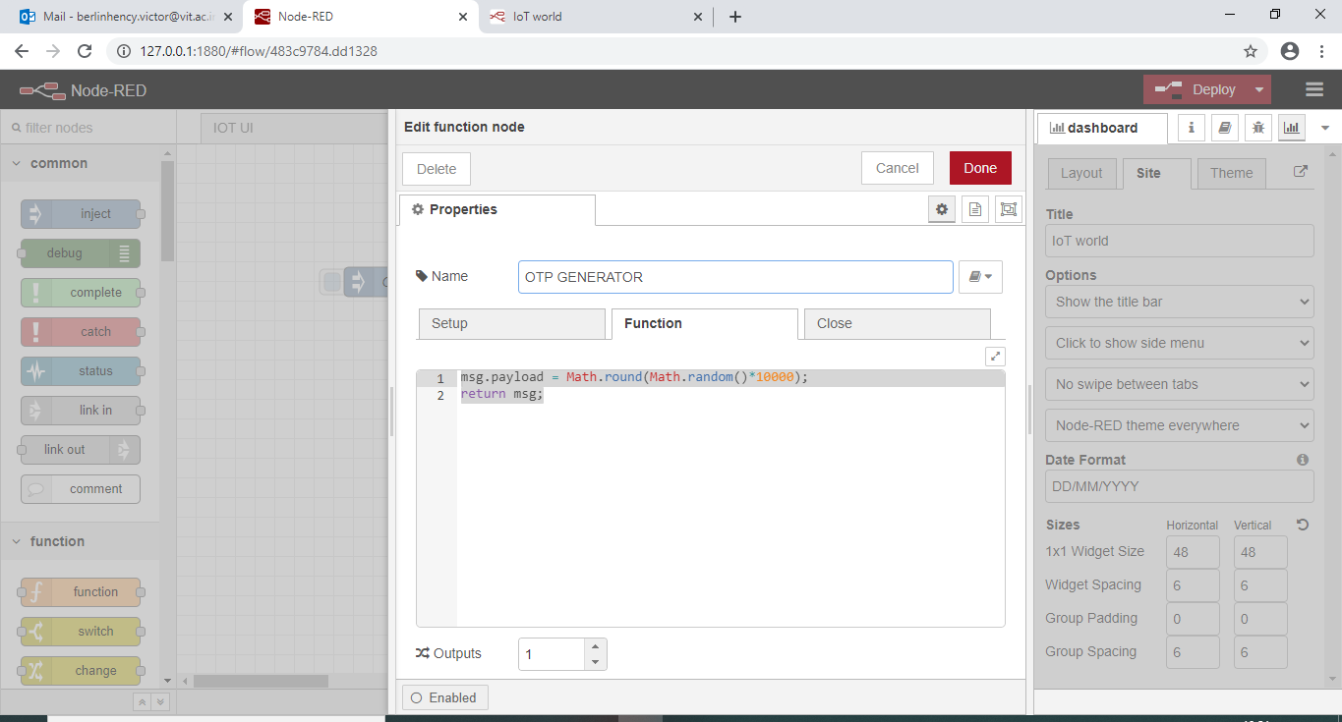

Slide 27
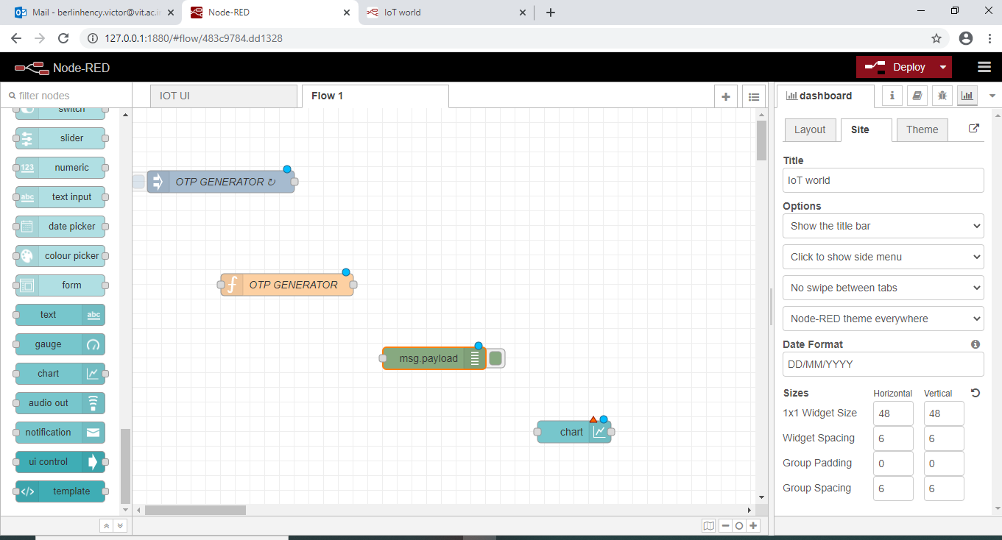
Insert Debug node and chart node

Slide 28
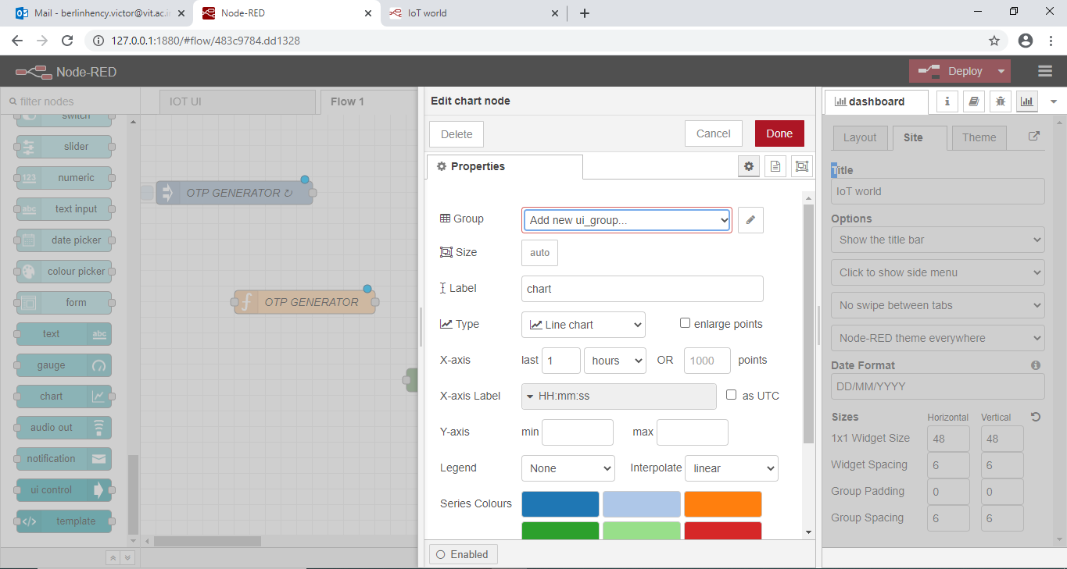

Slide 29
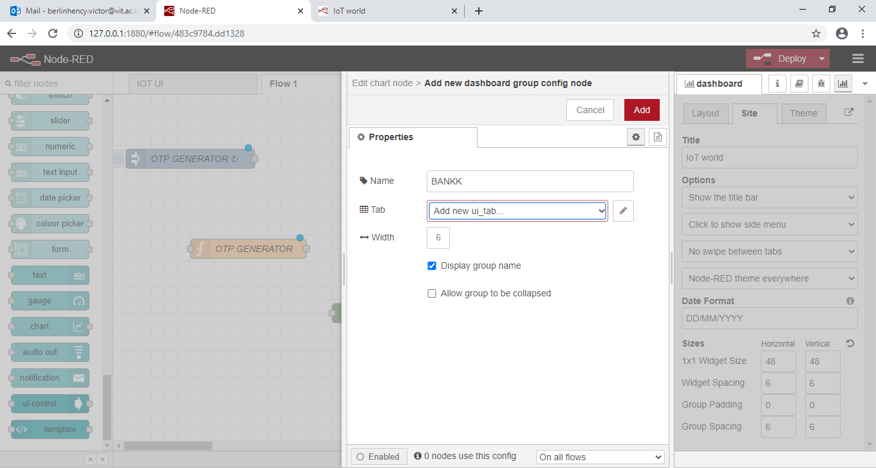

Slide 30
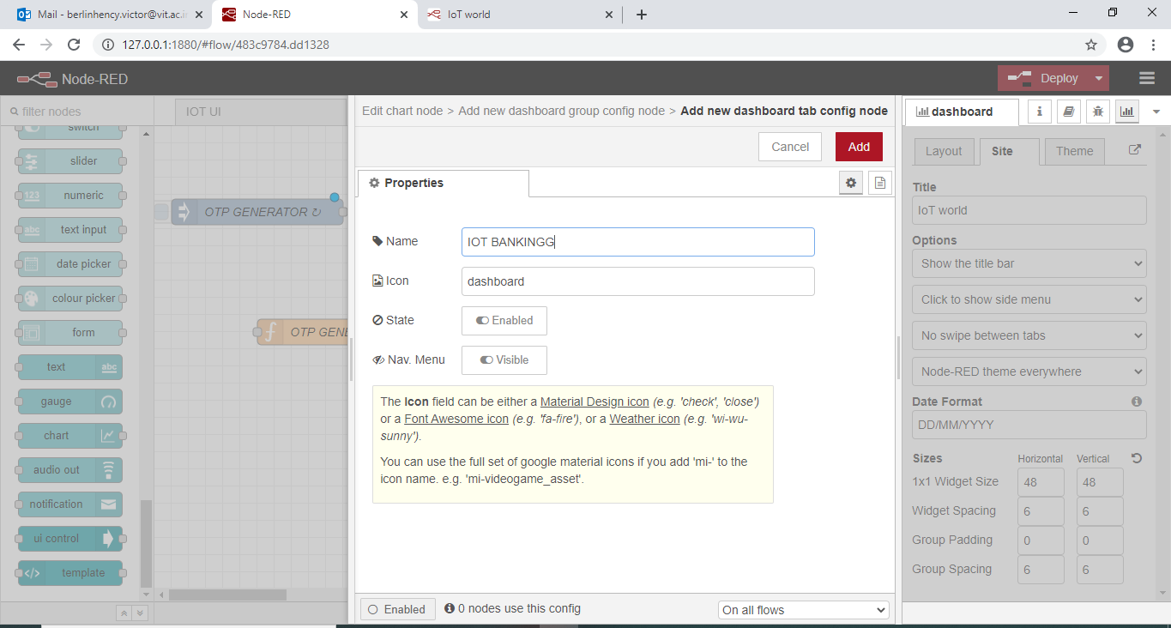

Slide 31


Slide 32
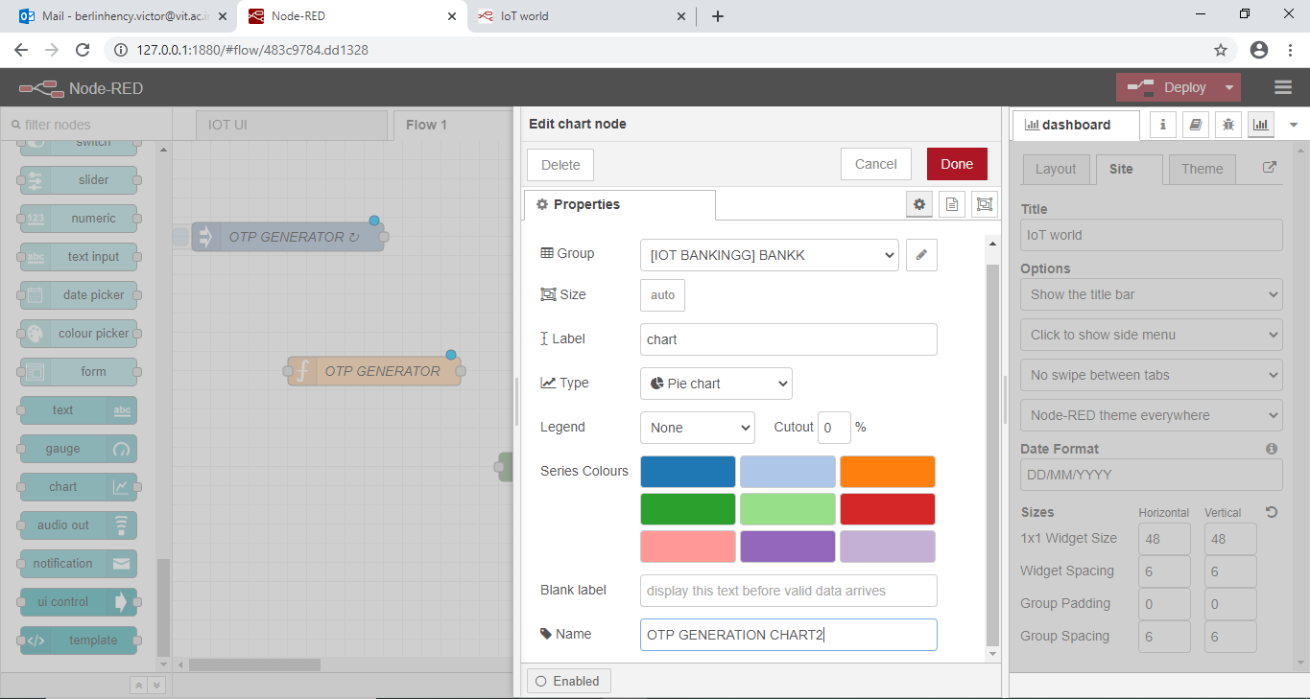

Slide 33
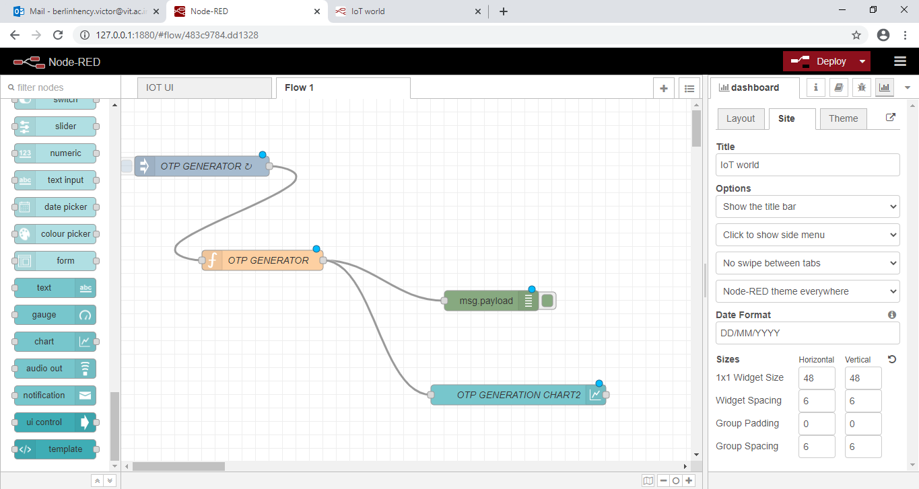

Slide 34
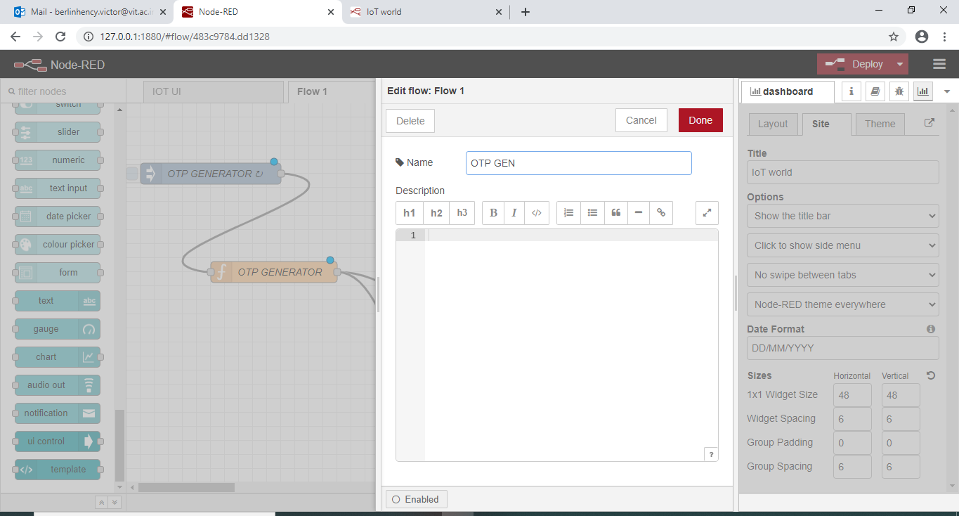

Slide 35
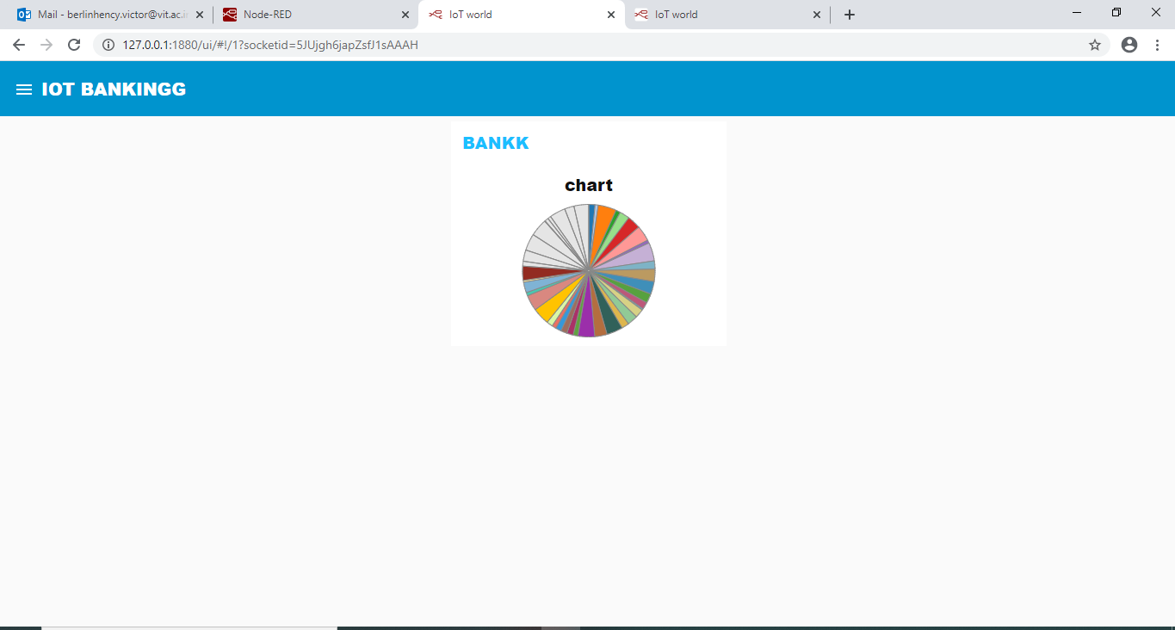

Slide 36
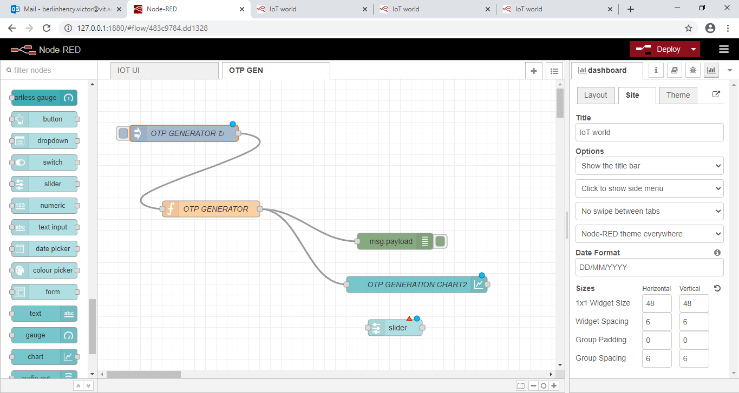
Slider node

Slide 37
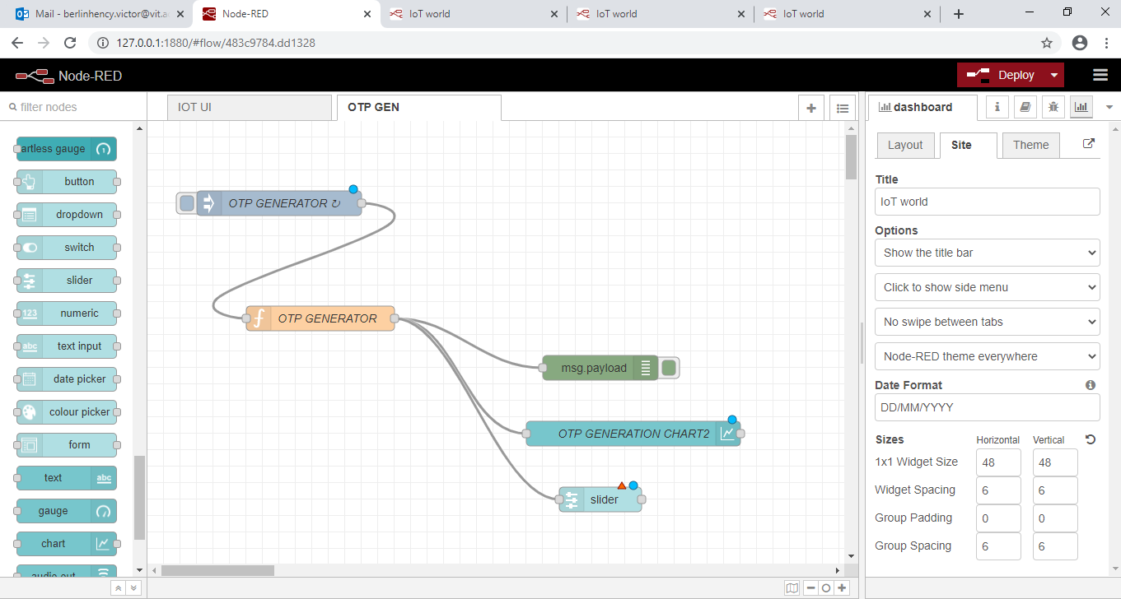

Slide 38
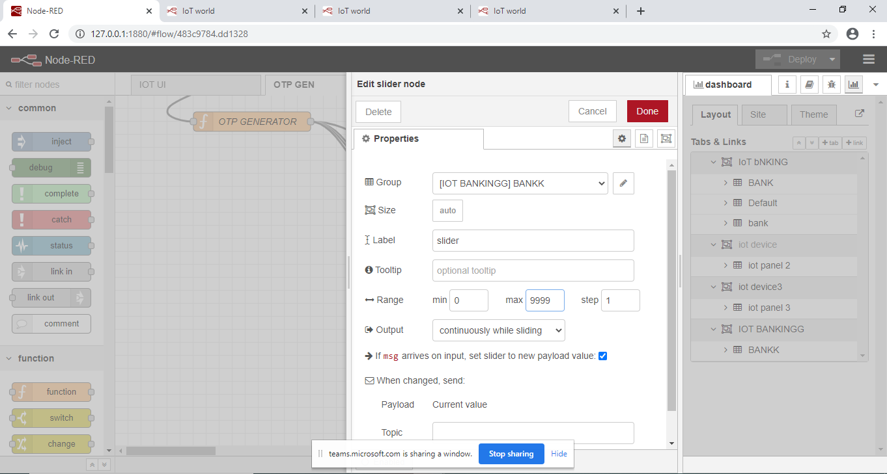

Slide 39
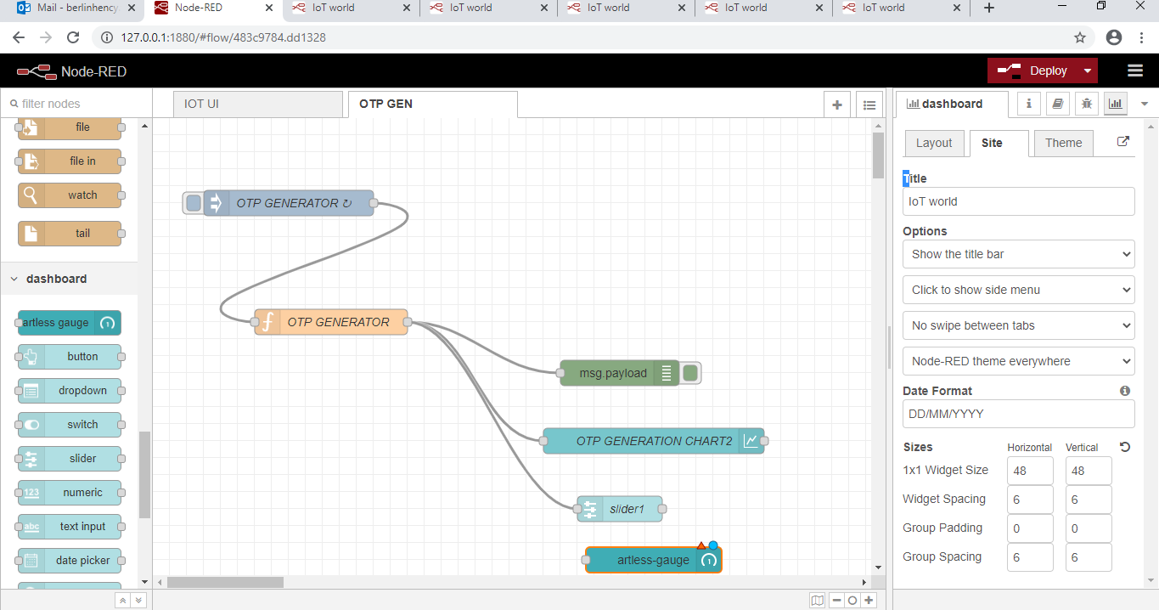

Slide 40
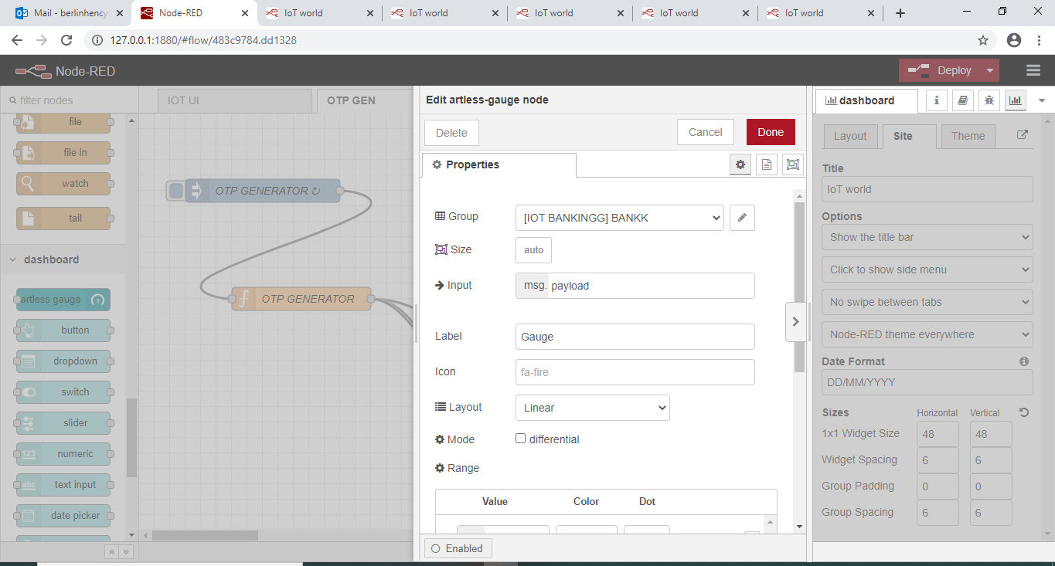

Slide 41
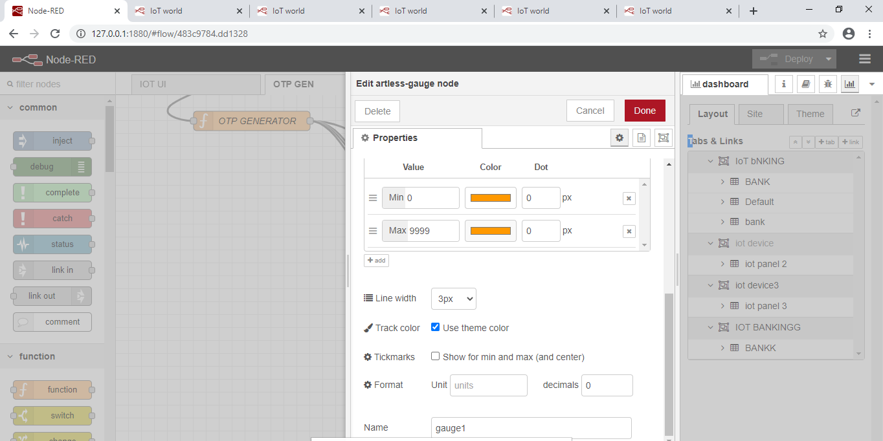

Slide 42
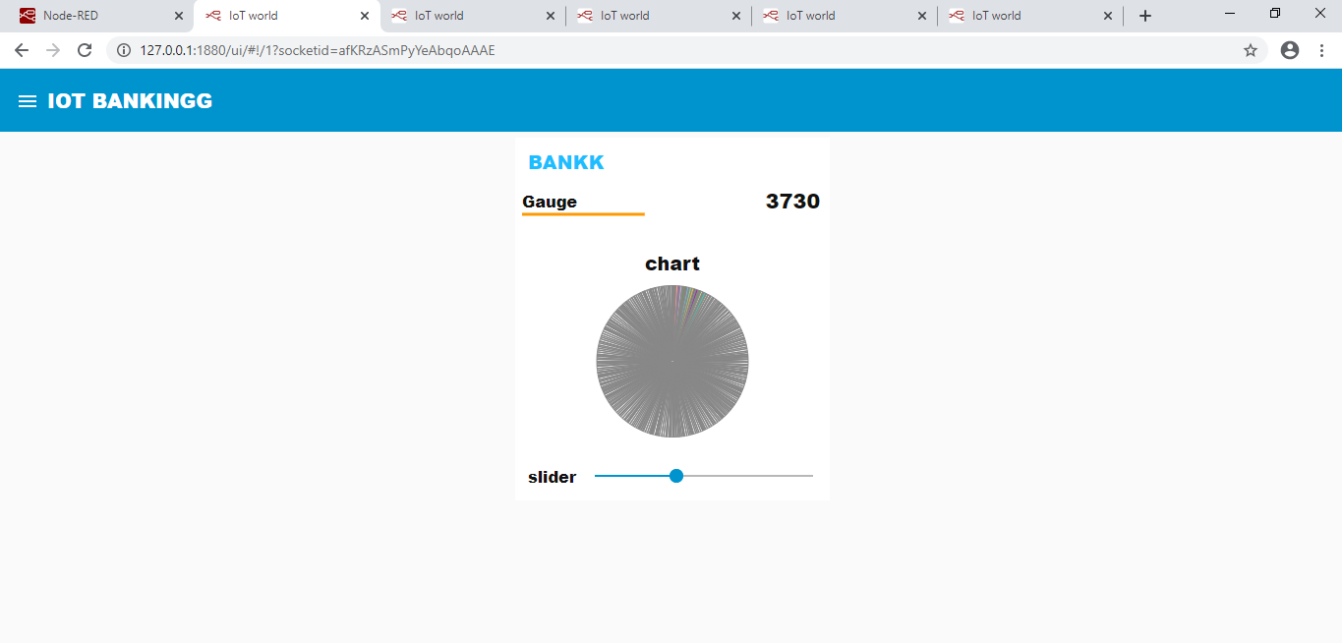

Slide 43
Create a home automation system using the various dashboard nodes. Create various layout groups and ensure each dashboard nodes should have separate function node associated with it to perform some functions related to home automation. Visualize your output in debug monitor and user interface

Slide 44
Thank u

