Slide 1
IoT Automation and Data Transmission through MQTT Broker in Node Red
Dr.V.Berlin Hency
Associate Professor
SENSE
VIT Chennai

Slide 2
Objective
MQTT
JSON
MOTT In node and MQTT Out Node Properties
Sample flow with MQTT Broker – Debug Monitor
MQTT publish data in UI interface

Slide 3
MQTT
Message Queuing Telemetry Transport Protocol
Light weight protocol
Bandwidth efficient
Little Battery power
Uses Publish /Subscribe Architecture

Slide 4
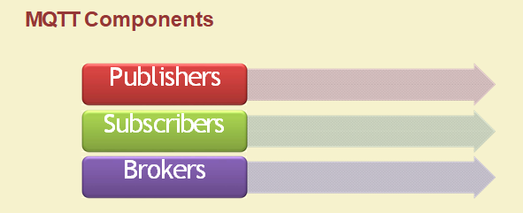

Slide 5
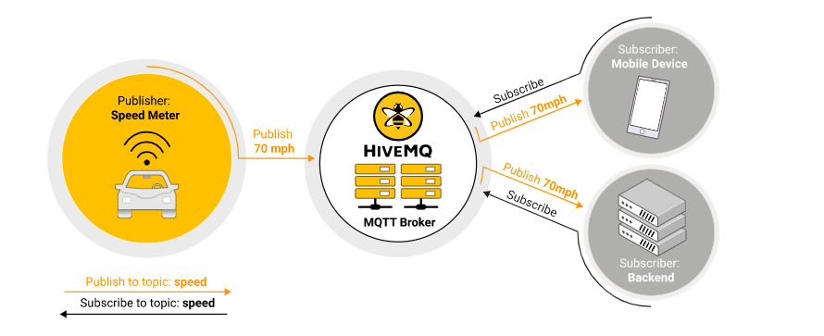
MQTT

Slide 6
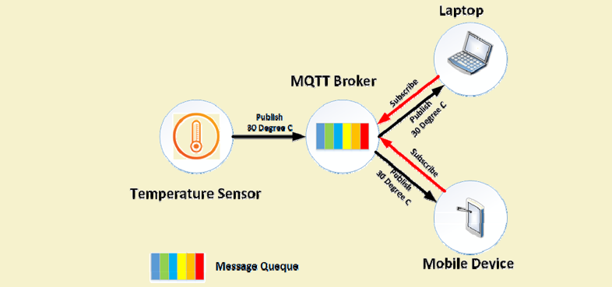
Example

Slide 7
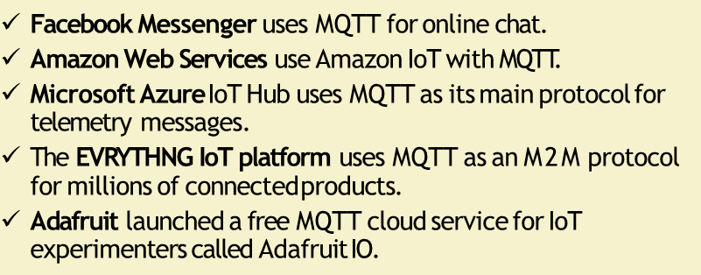
Application

Slide 8
JSON-Java script Object Notation
JSON is a language independent lightweight data interchange format
JSON is text
We can convert any JavaScript object into JSON and easy to send JSON to the server
While exchanging data between a browser and a server the data can only be text for easy transmission

Slide 9
Connecting to an MQTT Broker to Server
To connect to an MQTT broker or server, need to know
The Broker IP address or name
The port address (Default 1883)
In addition a client needs to provide
A client name to identify itself
ie each client connection requires a unique client name

Slide 10
Flag and Parameter
Flag/Parameter that the client can set are
Clean Session Flag
Time to Live

Slide 11
Clean Session Flag
MQTT clients by default establish a clean session with a broker.
A clean session is one in which the broker will not remember anything about the client when it is disconnected.
With a non clean session the broker will remember client subscriptions and may hold undelivered message for the client.

Slide 12
Time to Live
The mechanism used to determine whether a connection is still alive
The default interval is 60 seconds

Slide 13
Publishing using the publish Node
While client publishes a message to boker it needs to send
The message topic
The message QoS
Retain flag ( Whether the message should be retained.default : False,If “True” then last message will be retained)

Slide 14
QoS
QoS 0- Once
Message delivered once or not ;not guaranteed
QoS 1- At least once
Message delivered atleast once or more times and quaranteed
The message will continue to be resent at regular intervals until the sender receives the ack
QoS 2 Only Once
Guaranteed
Slow, both receiver and sender sends ack

Slide 15
MQTT hosting Providers
Cloudmqtt
Flespi
Myqtthub.com
Beebotte
Mosquitto
HiveMQ
mosca

Slide 16
Online Cloud Base MQTT Brokers/Servers
Broker Type | Broker Address and Port
Mosquitto | test.mosquitto.org and 1883
HiveMQ | broker.hivemq.com and 1883
Mosquitto | iot.eclipse.org
mosca | test.mosca.io and 1883

Slide 17
MQTT Server
Server : broker.mqttdashboard.com
Port : 1883

Slide 18
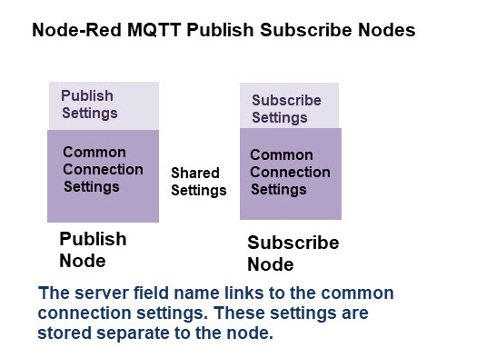
Node red MQTT Publish subscribe nodes
Common connection settings for both publish and subscribe

Slide 19
Configuration of MQTT Publish and Subscribe Nodes in node red
Node Red Provides
MQTT input – Subscribe Node
MQTT Output – Publish Node

Slide 20
Command Prompt
Cmd (Go to command prompt)
Node-red –v (to trigger node red)
http://127.0.0.1:1880/

Slide 21
Part A
To display RFID Reader content to Node Red Debug window using HiveMQ (MQTT Broker)

Slide 22
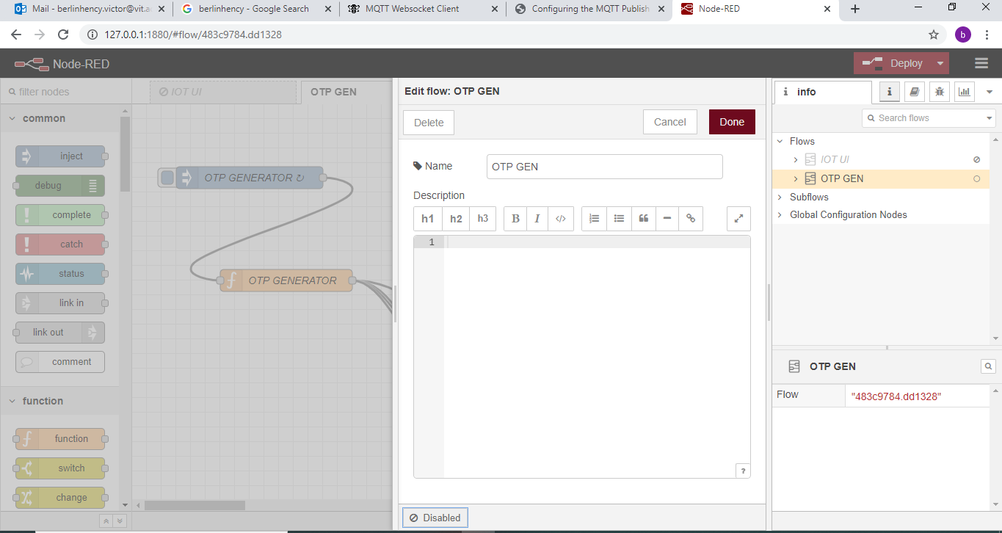
To Disable previous flow if any

Slide 23

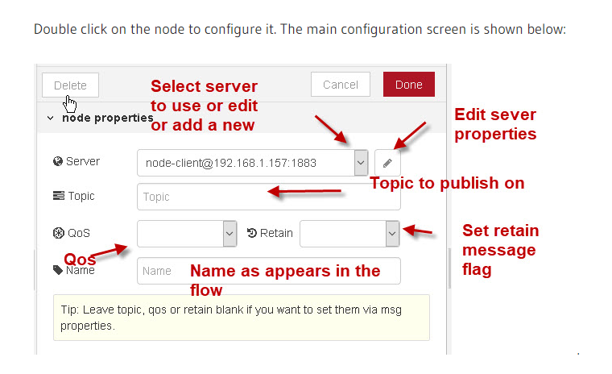
Configure MQTT in Node

Slide 24
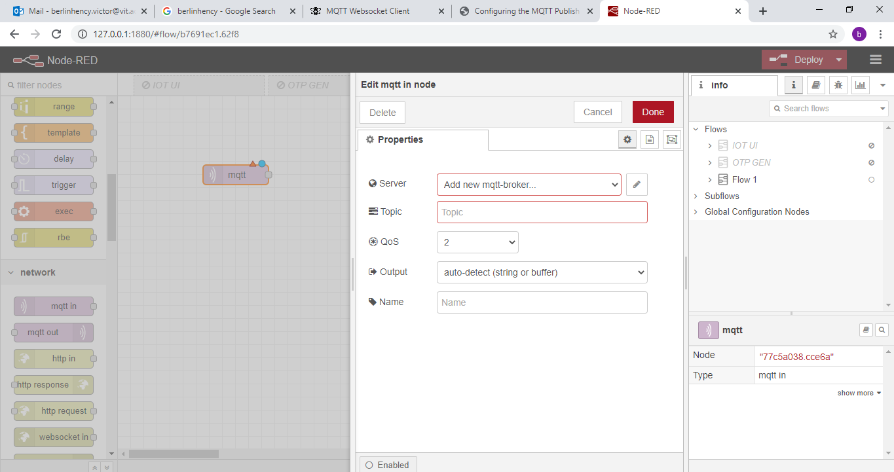

Slide 25
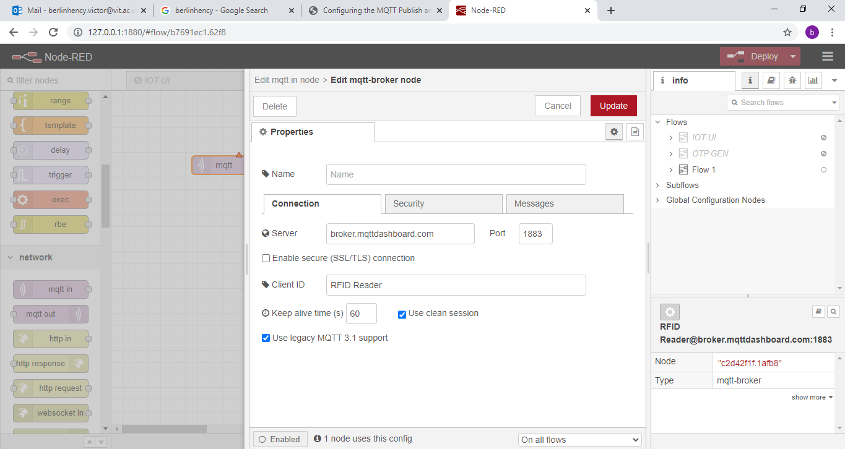

Slide 26
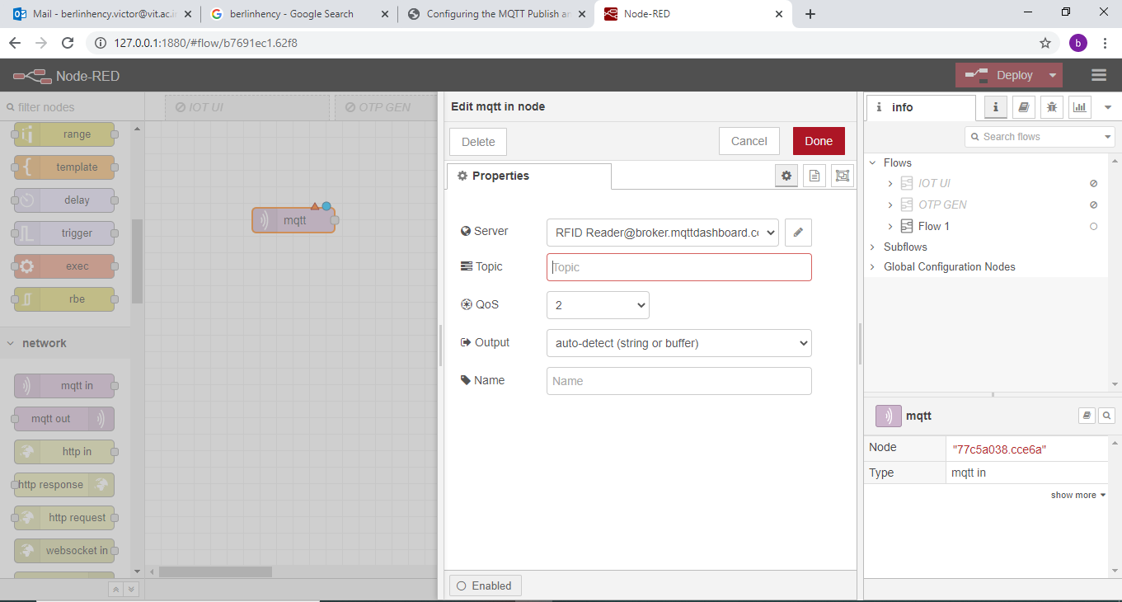

Slide 27
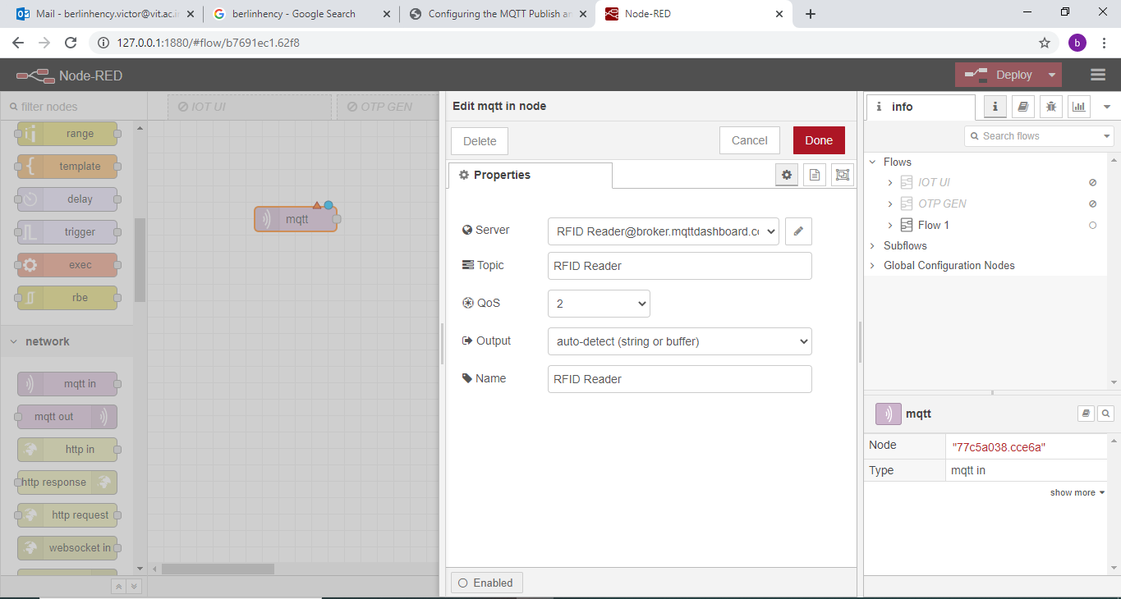

Slide 28
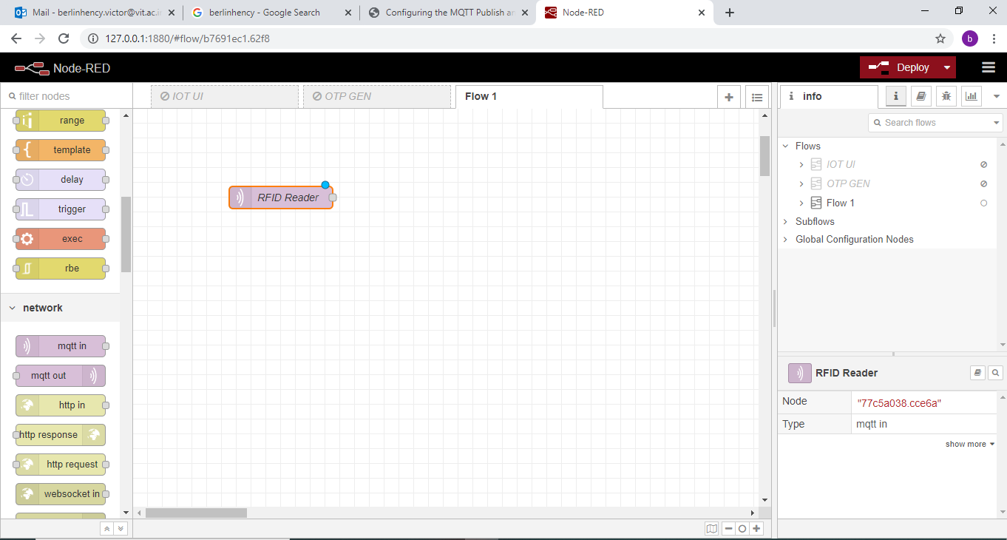

Slide 29
HiveMq
http://www.hivemq.com/demos/websocket-client/

Slide 30
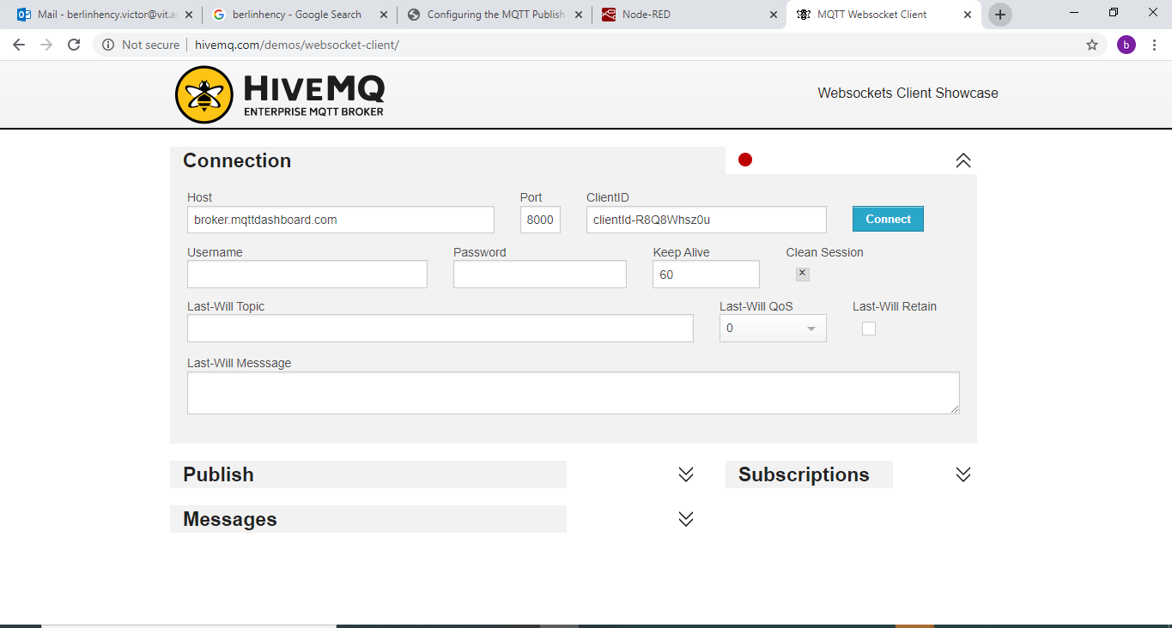
Click Connect

Slide 31
{"Name":"BERLIN","Organization": "VIT","EmpID":50619}

Slide 32
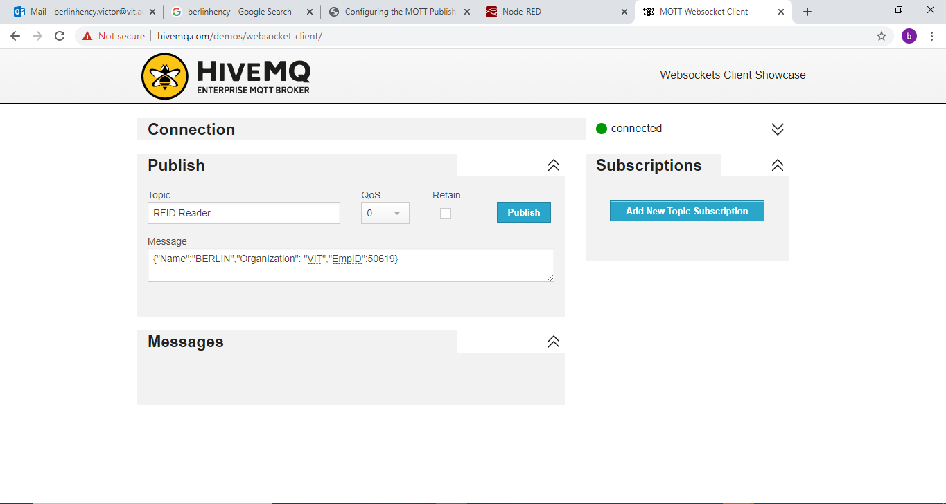

Slide 33
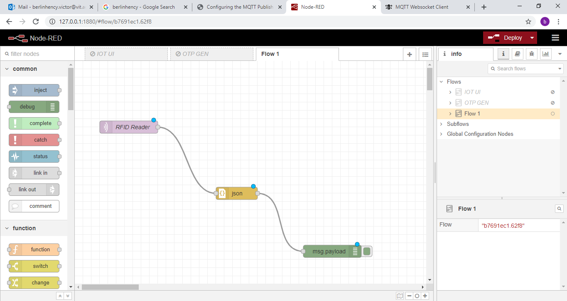
Insert json node and debug node and wire

Slide 34
Deploy

Slide 35
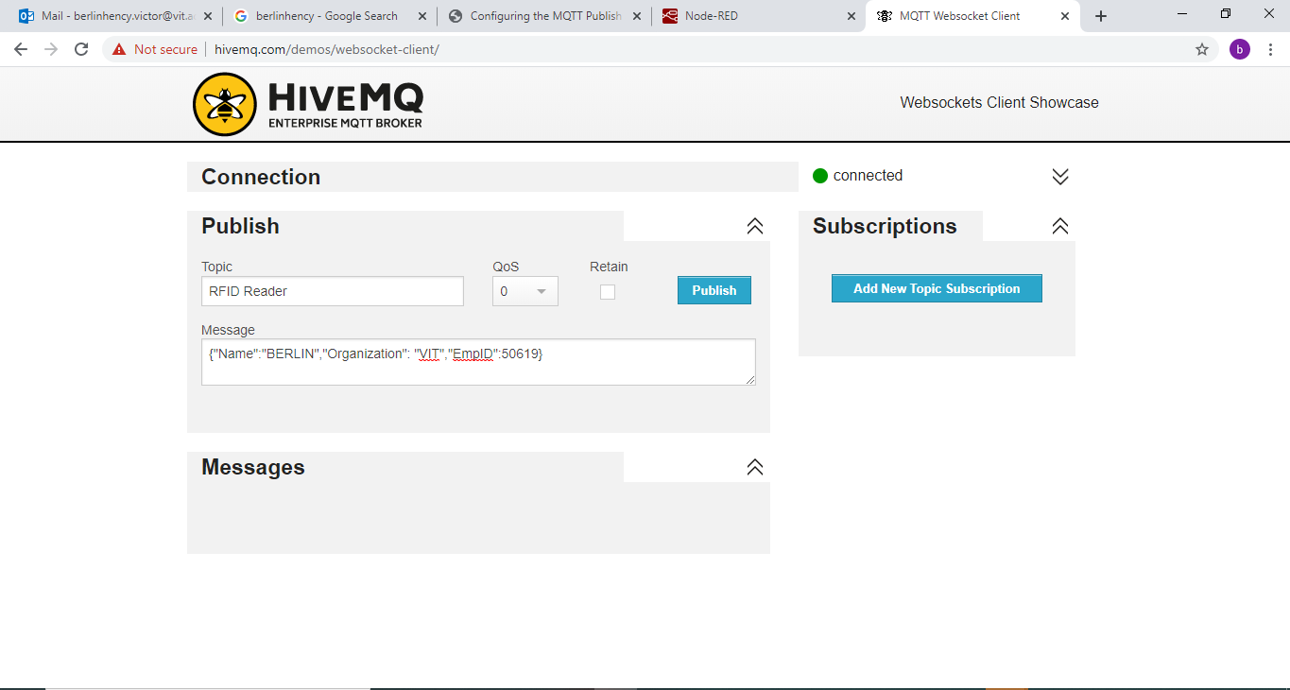
Click Publish

Slide 36
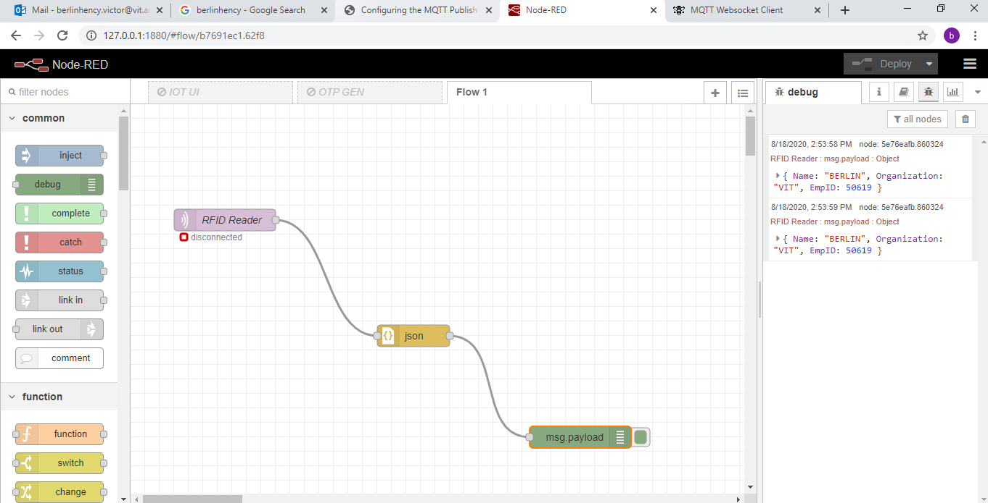
Output in Node red Debug Window

Slide 37
PART B
To Display Bike speed to Node Red Dashboard using HiveMQ (MQTT Broker)

Slide 38
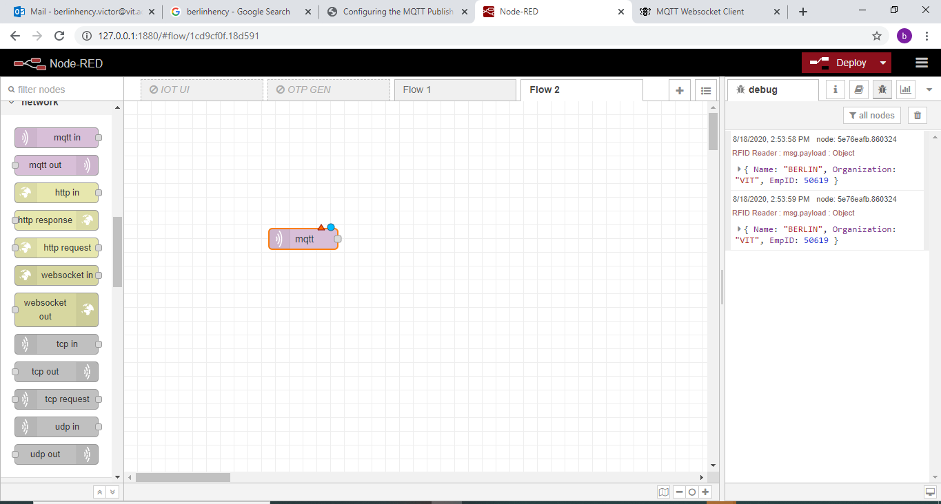
Configure MQTT in -Speed Sensor

Slide 39
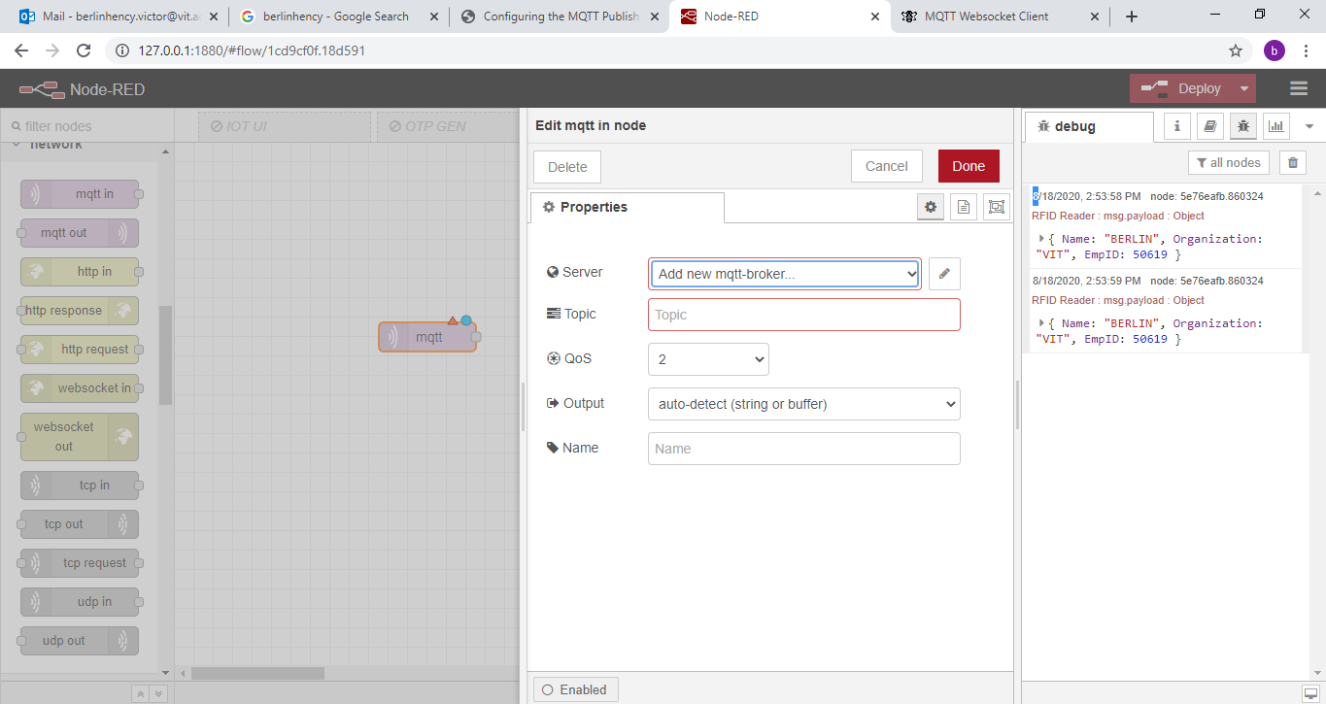

Slide 40
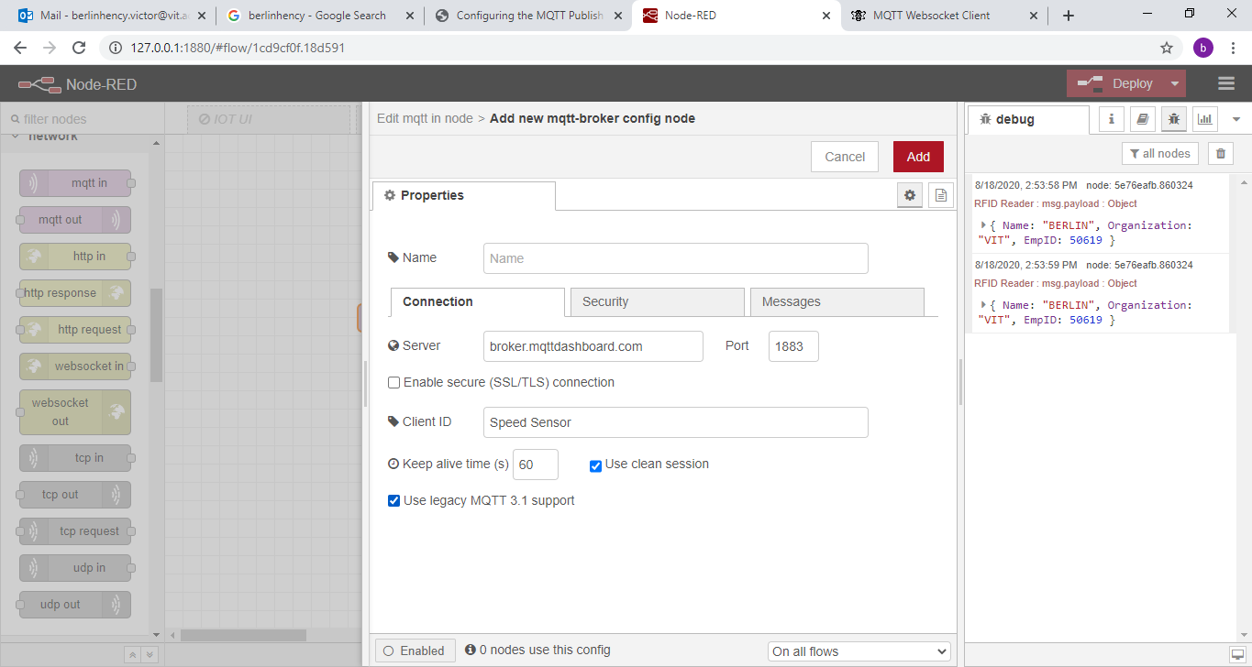

Slide 41
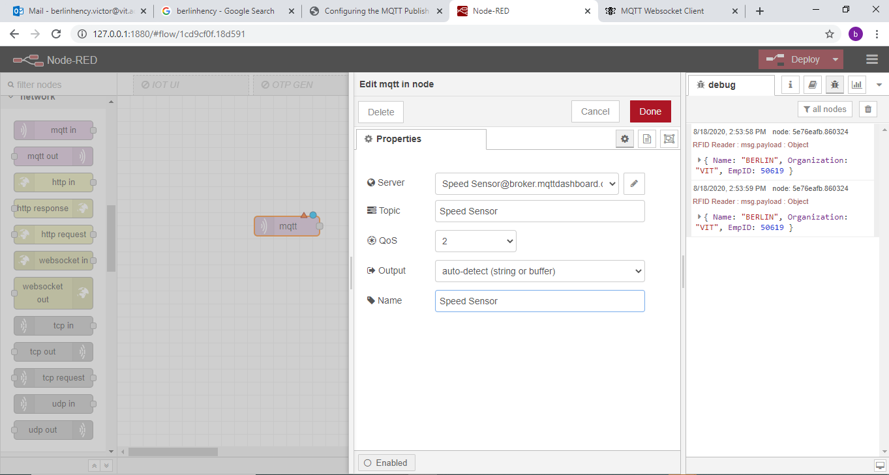

Slide 42
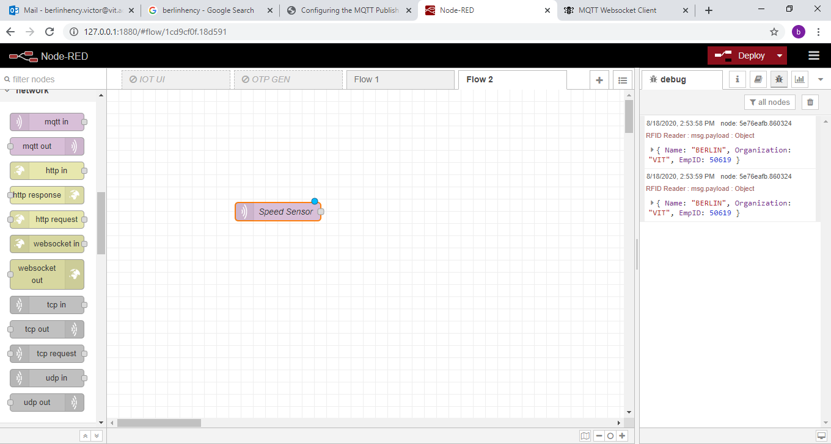

Slide 43
Insert Debug node Slider node gauge node
And text input node

Slide 44
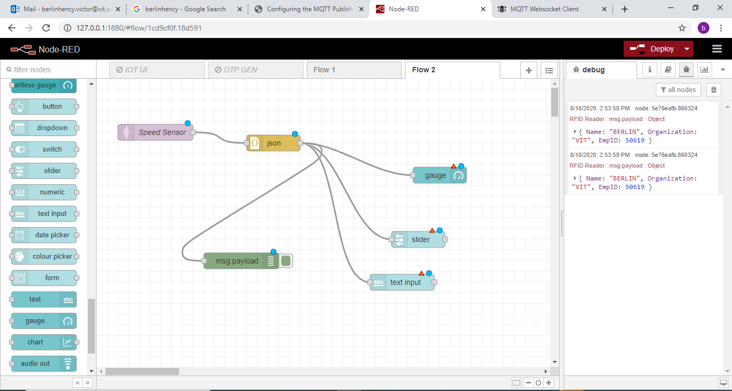

Slide 45
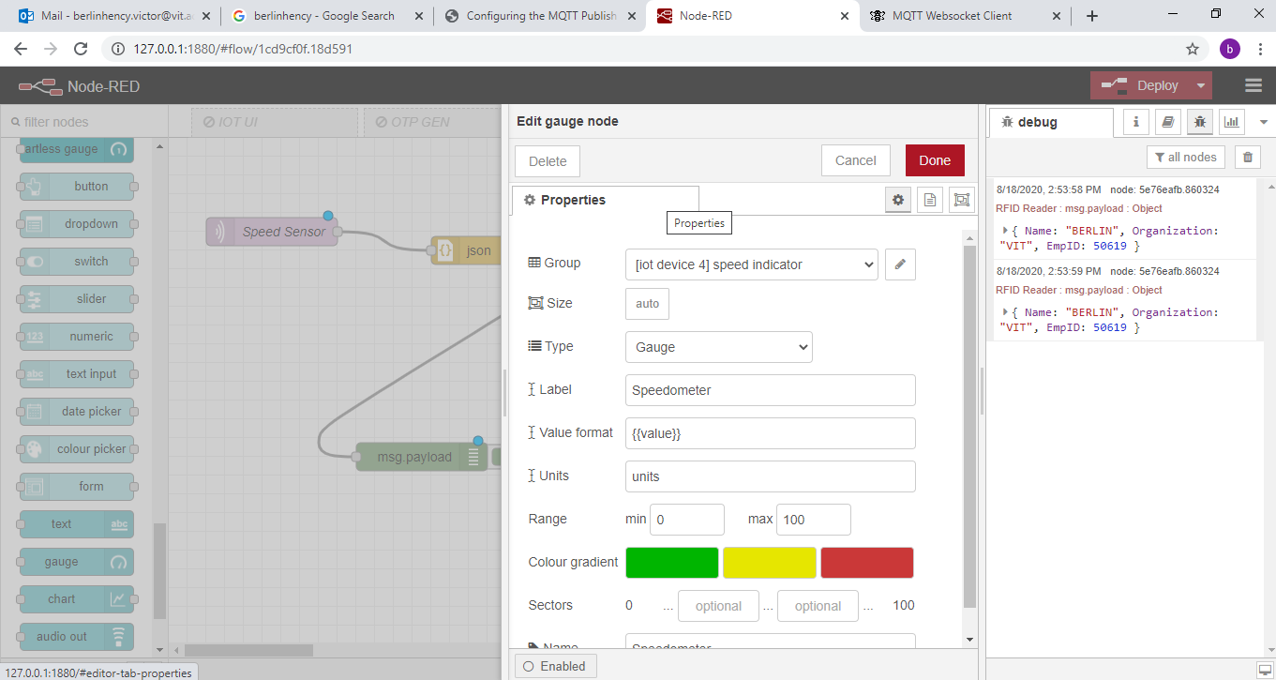
Configure Guage node

Slide 46
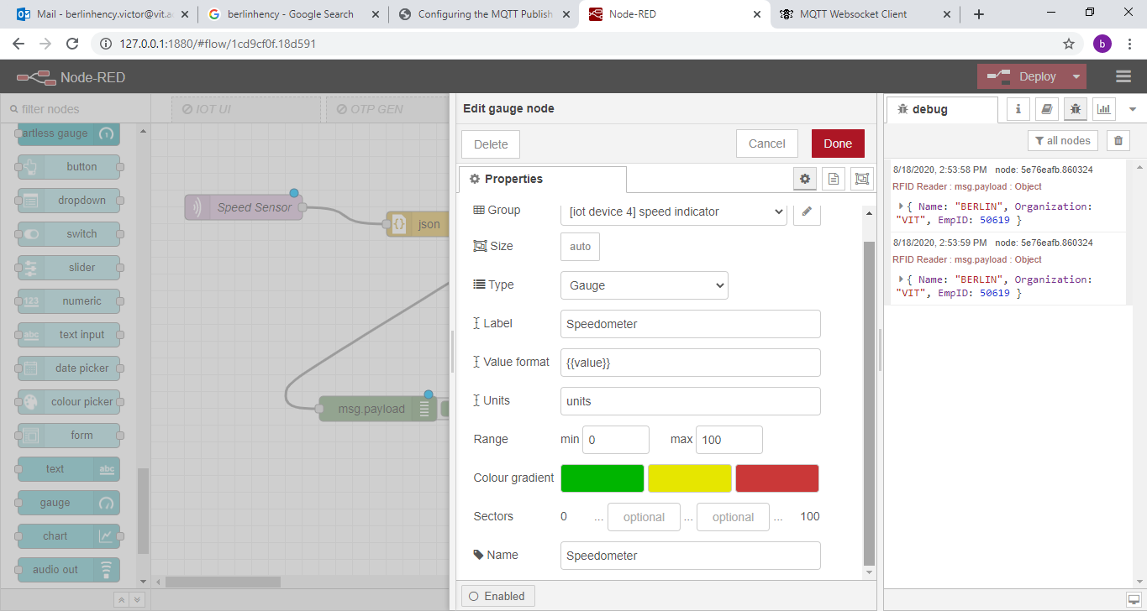

Slide 47
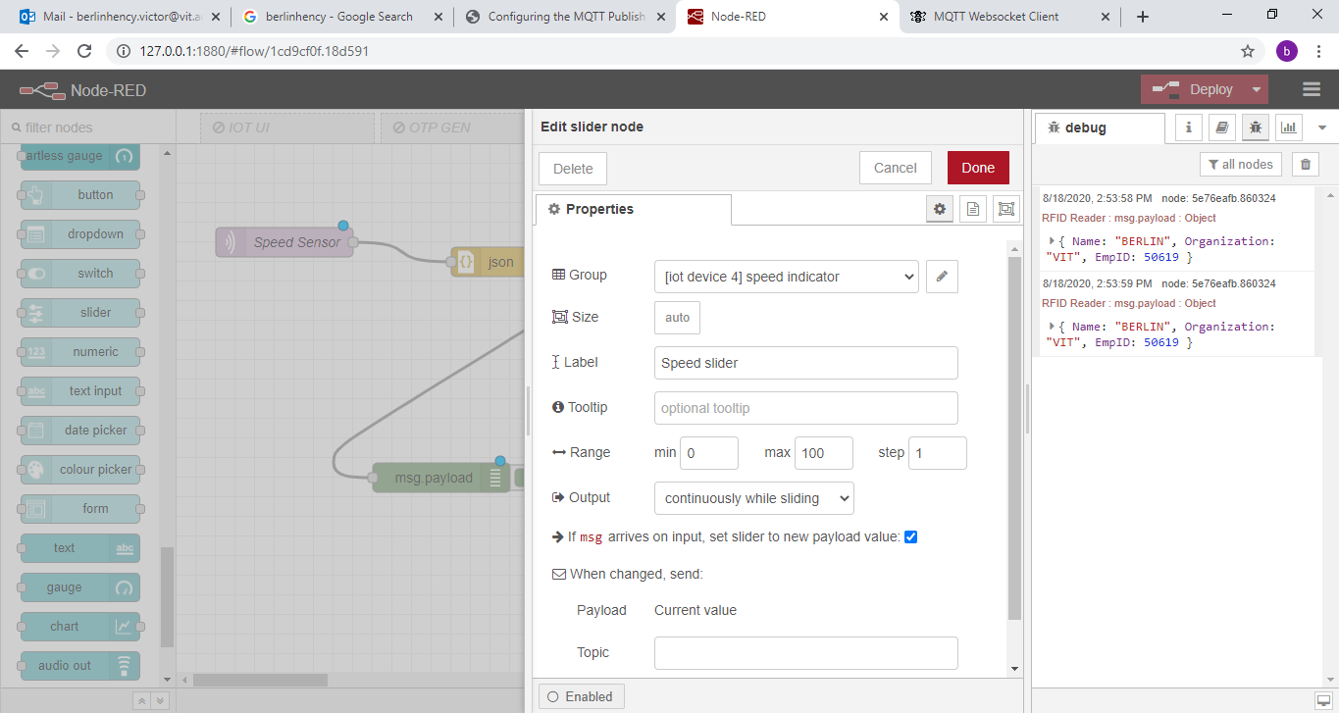
Configure Slider node

Slide 48
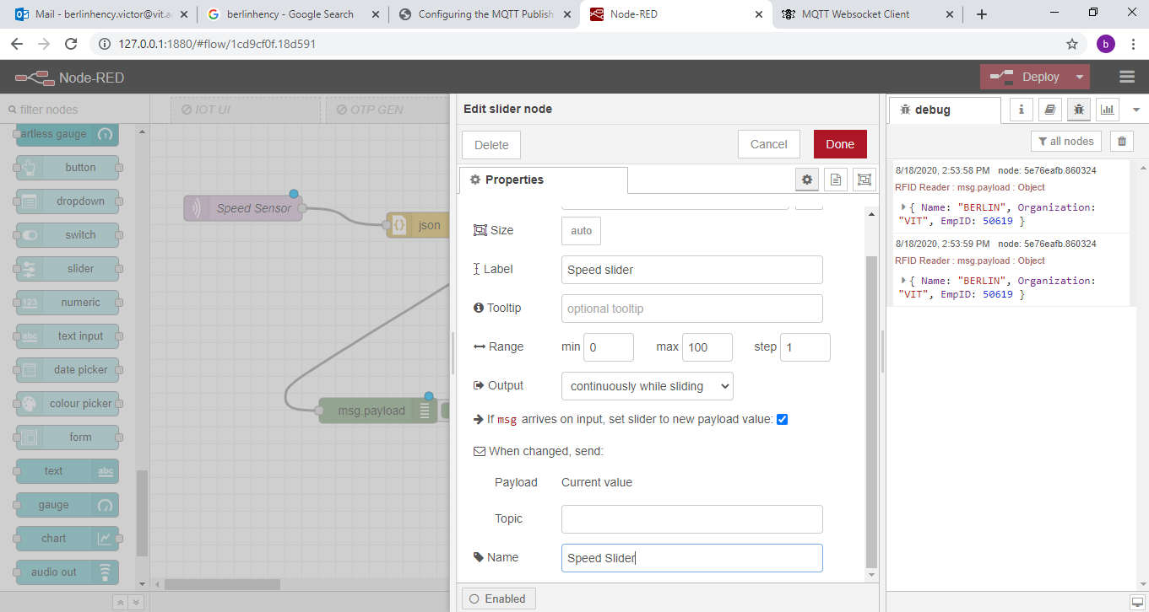

Slide 49
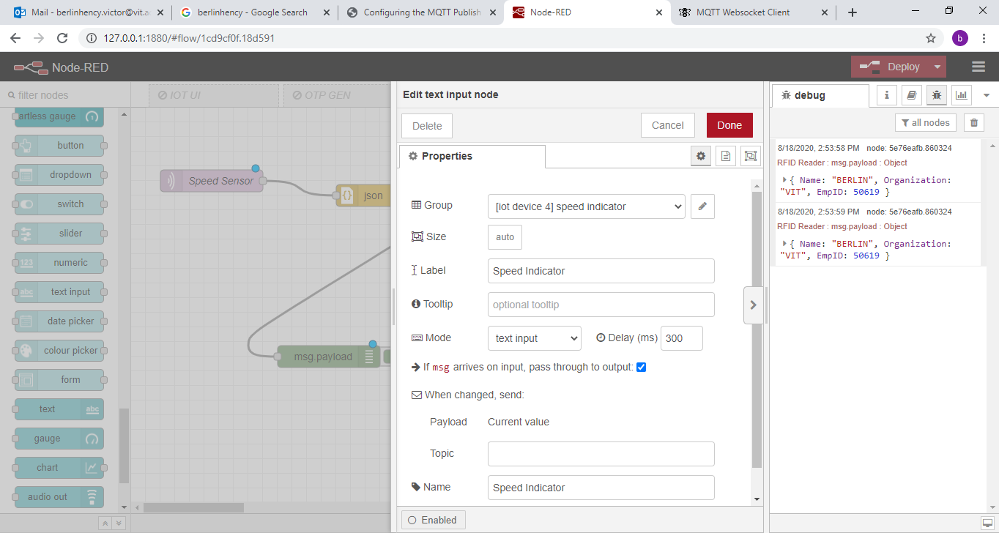
Configure Text Input Node

Slide 50
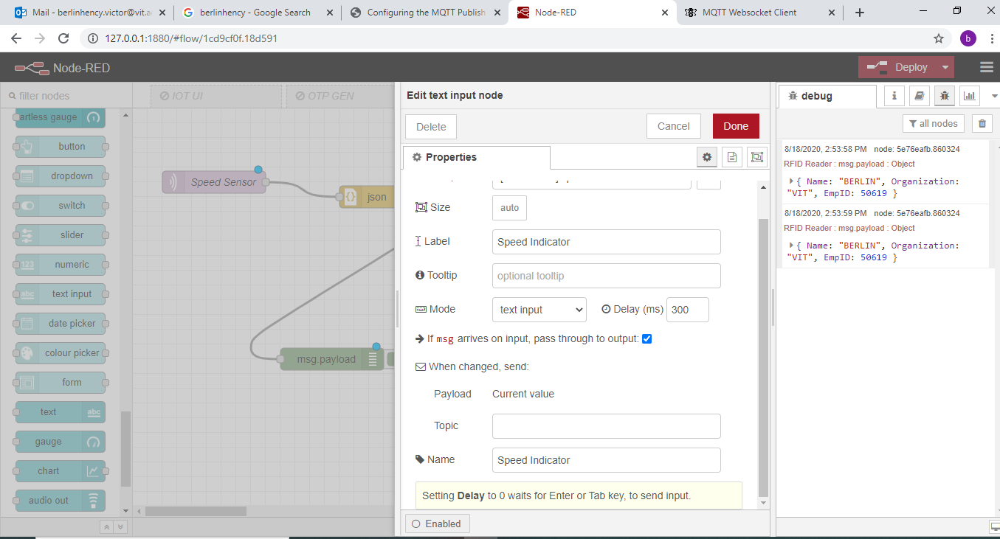

Slide 51
Deploy

Slide 52
http://www.hivemq.com/demos/websocket-client/

Slide 53
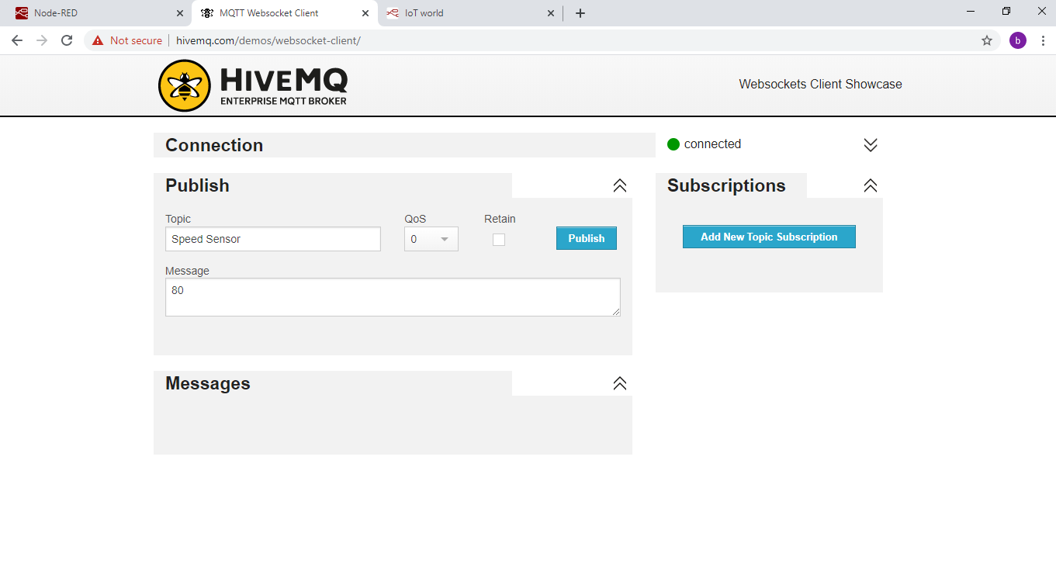
Click Publish

Slide 54
http://127.0.0.1:1880/ui

Slide 55
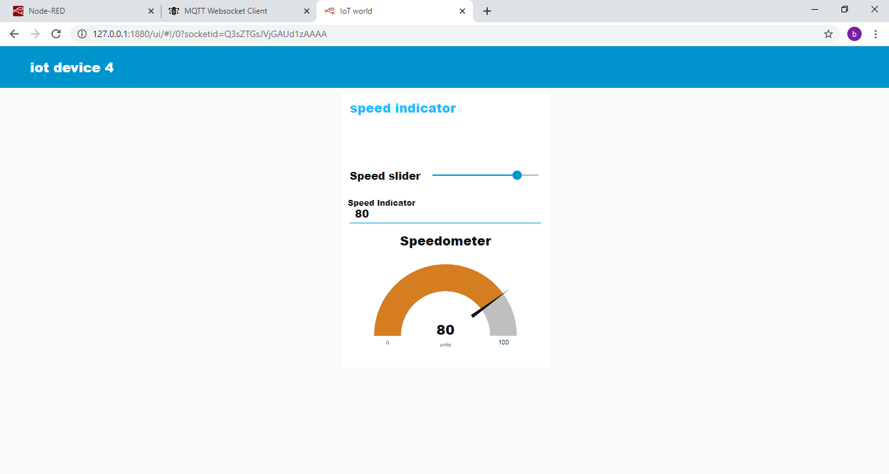

Slide 56
MQTT Out Node
Refrigerator automation
Insert 3 inject nodes
Insert one MQTT Out node
Insert One Debug node
Wire All nodes

Slide 57
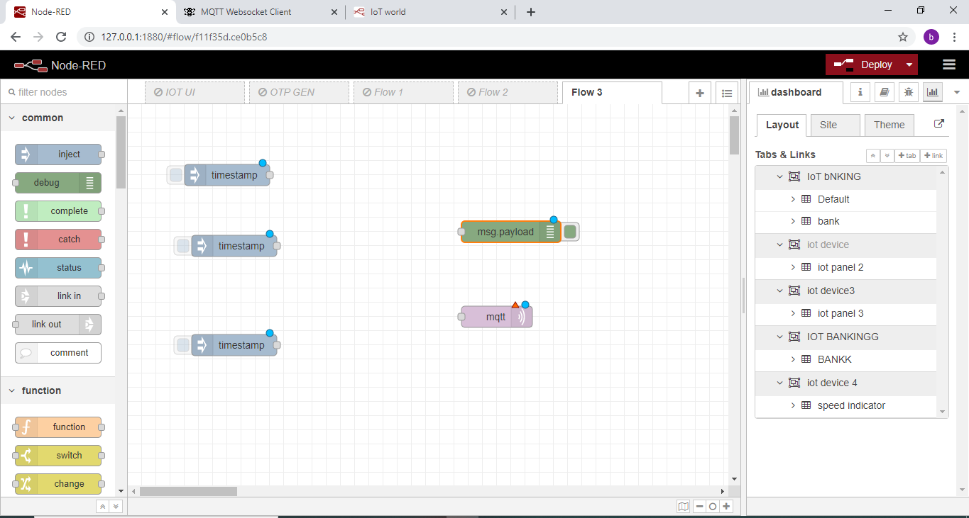

Slide 58
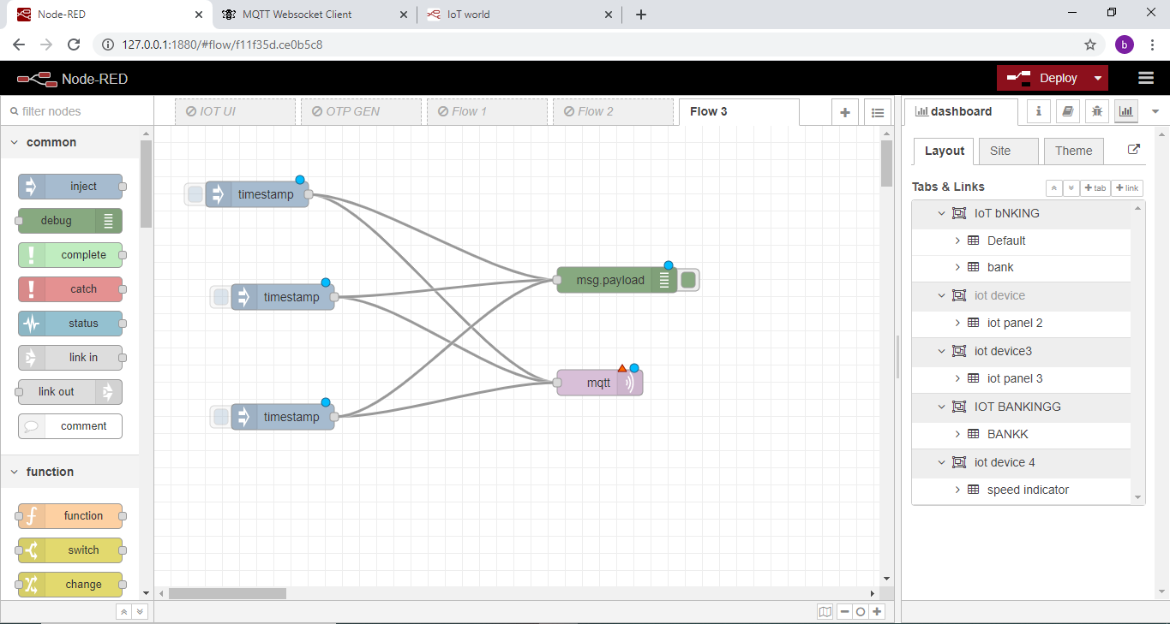

Slide 59
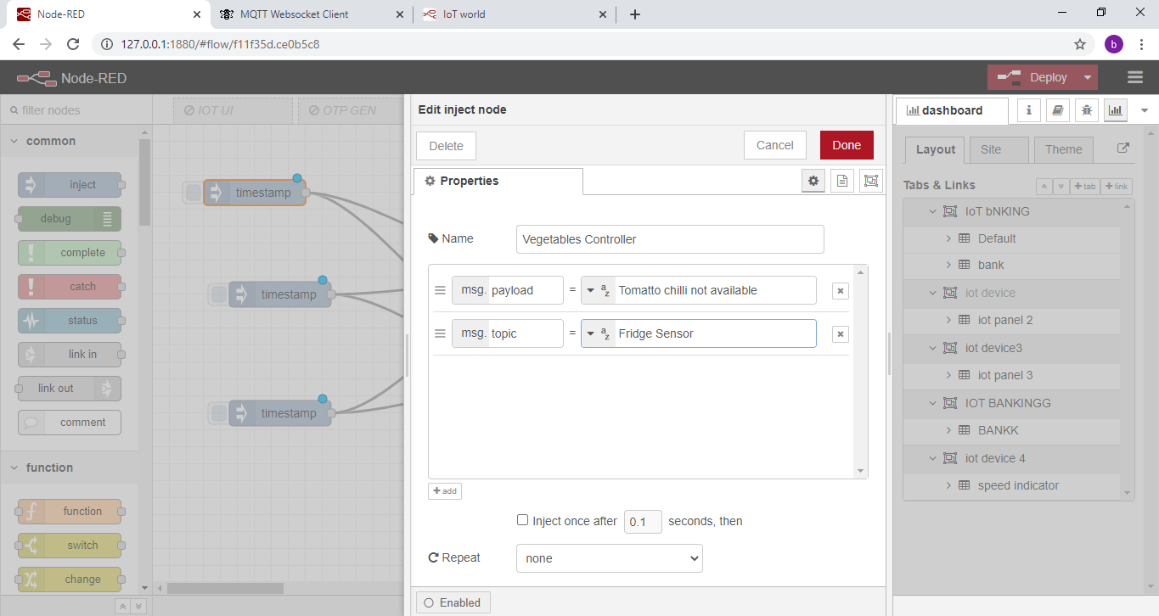

Slide 60
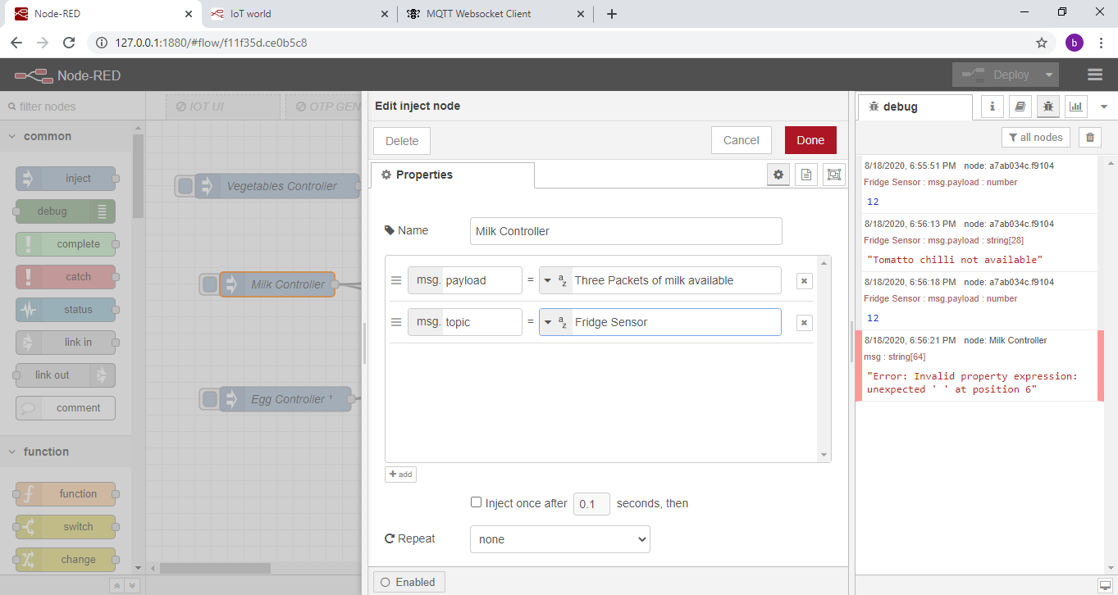

Slide 61
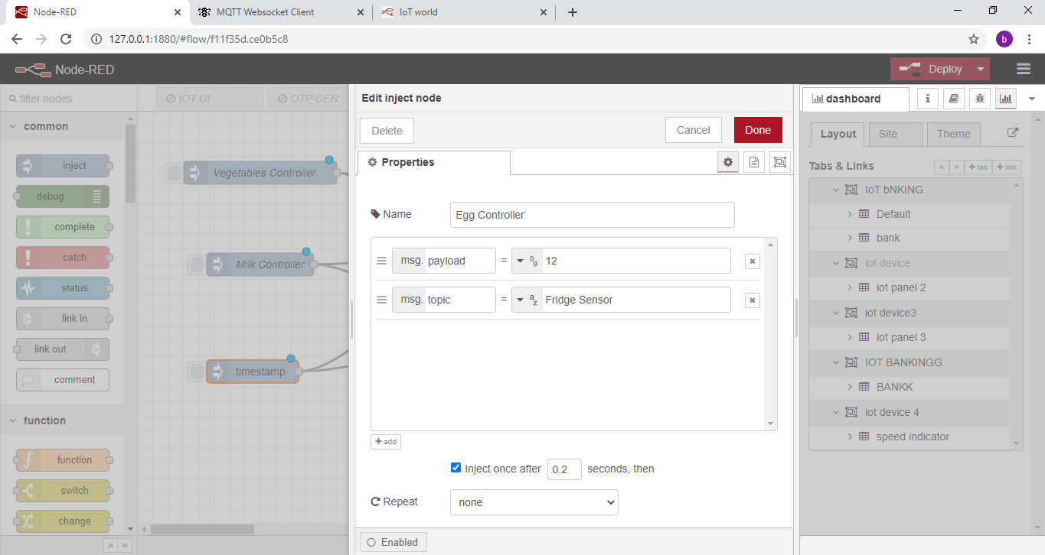

Slide 62
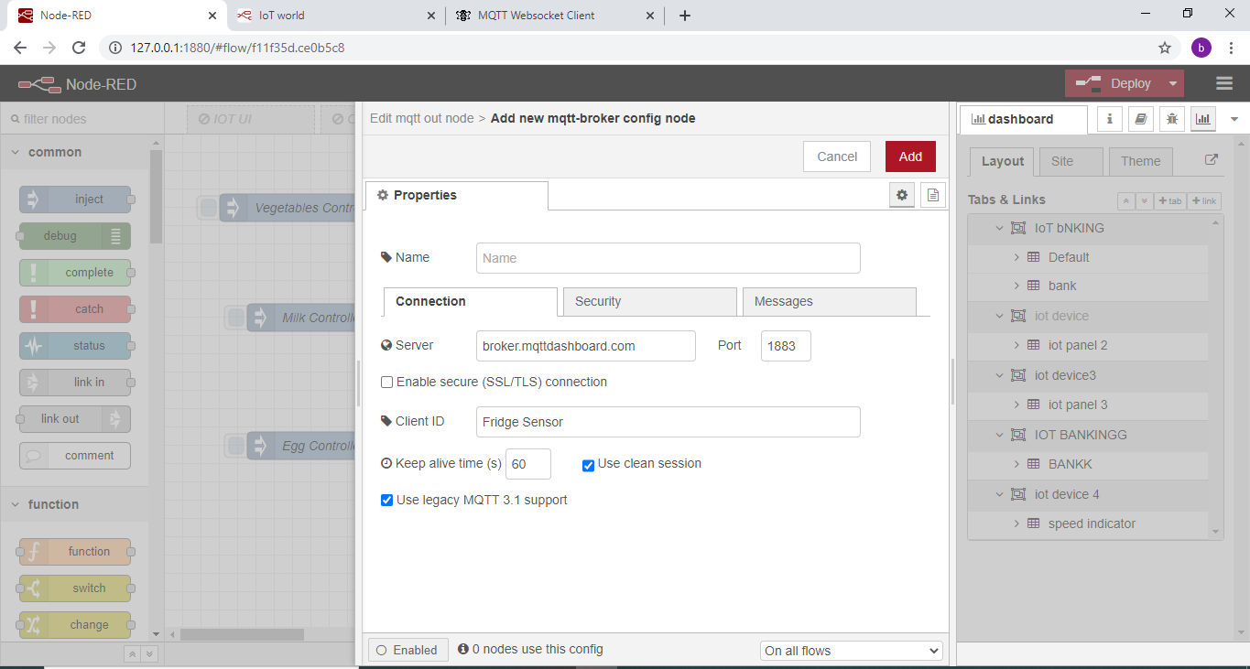
Config MQTT Broker

Slide 63
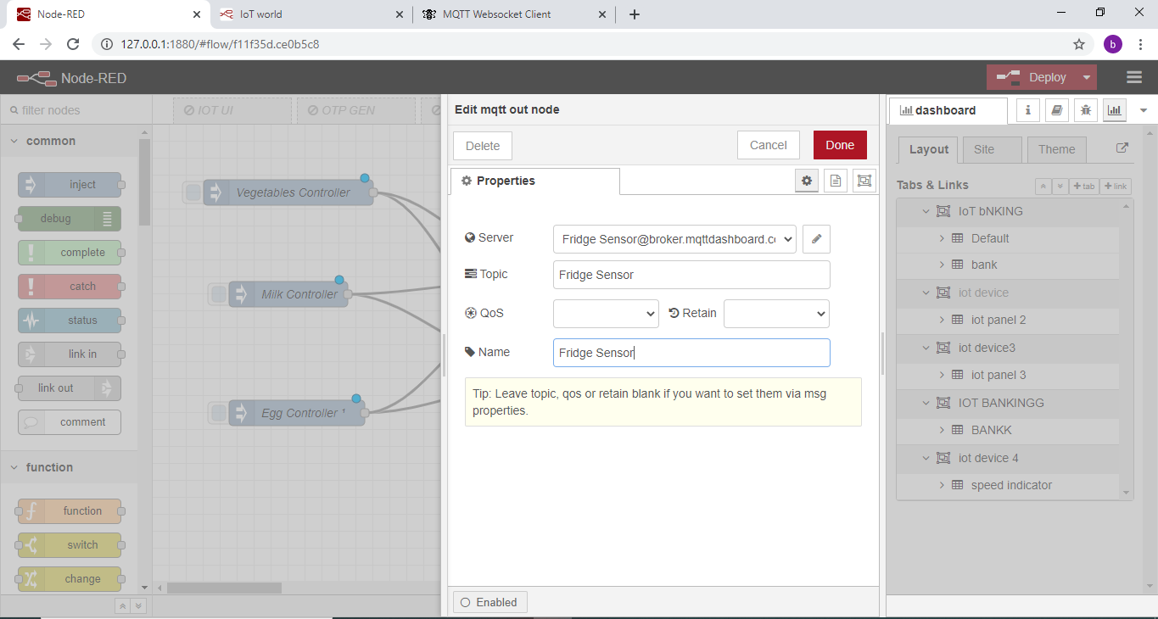

Slide 64
http://www.hivemq.com/demos/websocket-client/

Slide 65
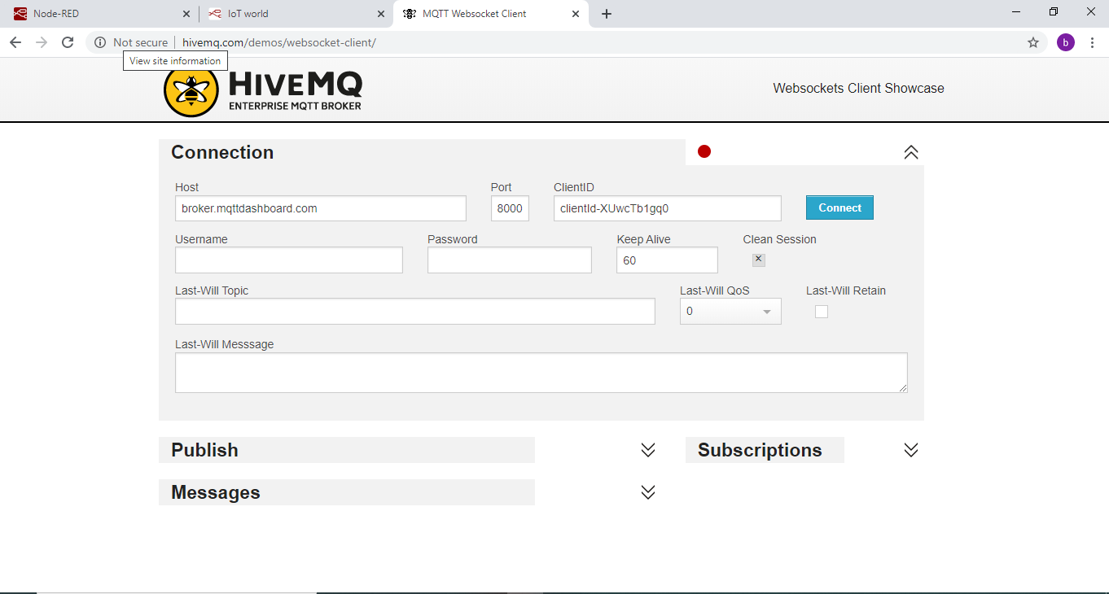
Click Connect

Slide 66
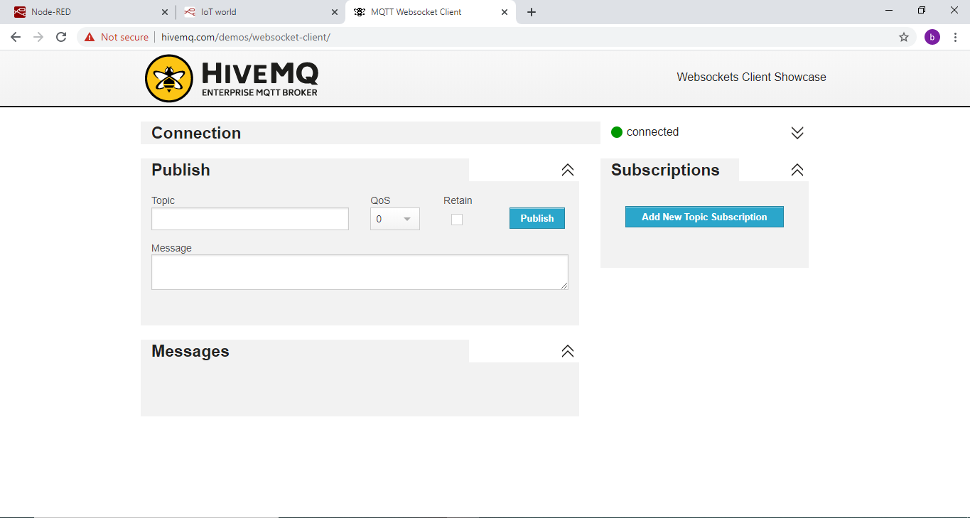
Click add New topic subscription

Slide 67
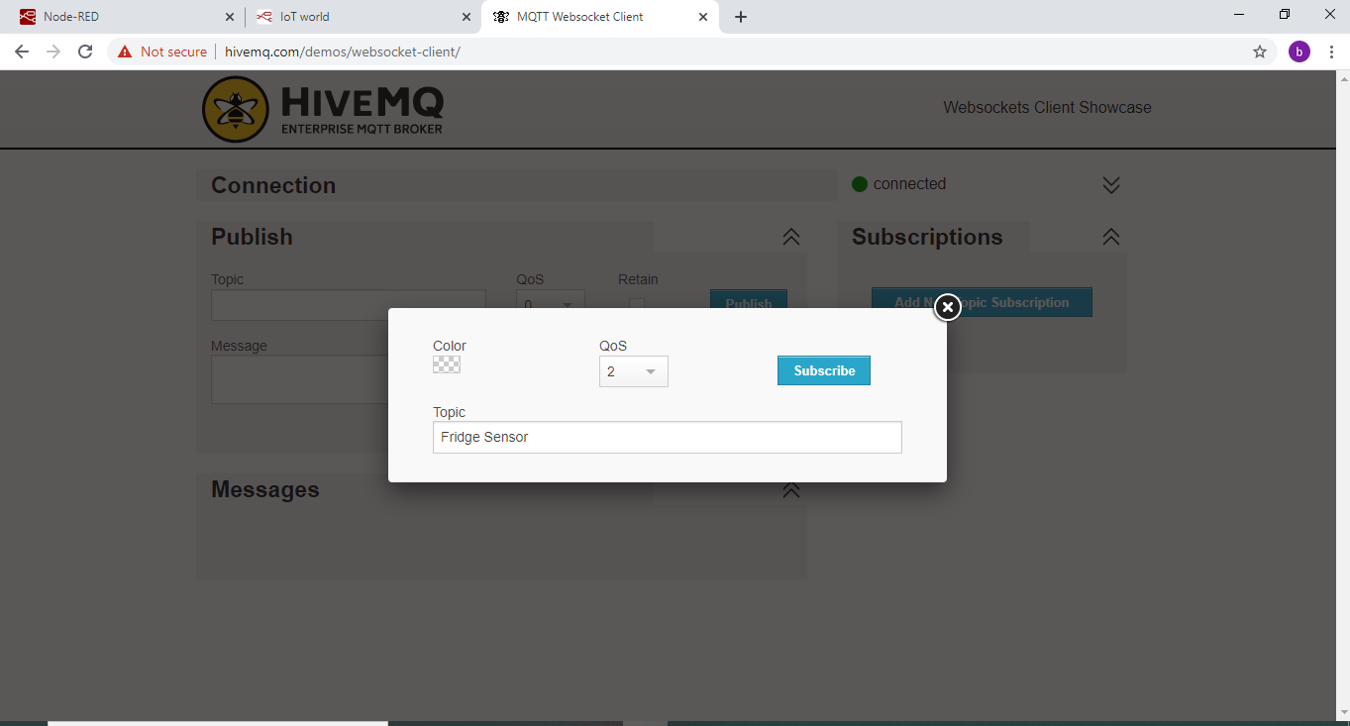

Slide 68
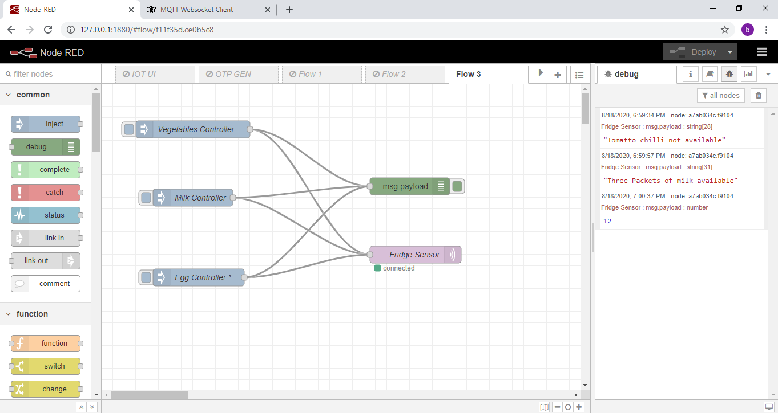

Slide 69
Deploy
Trigger inject Node

Slide 70
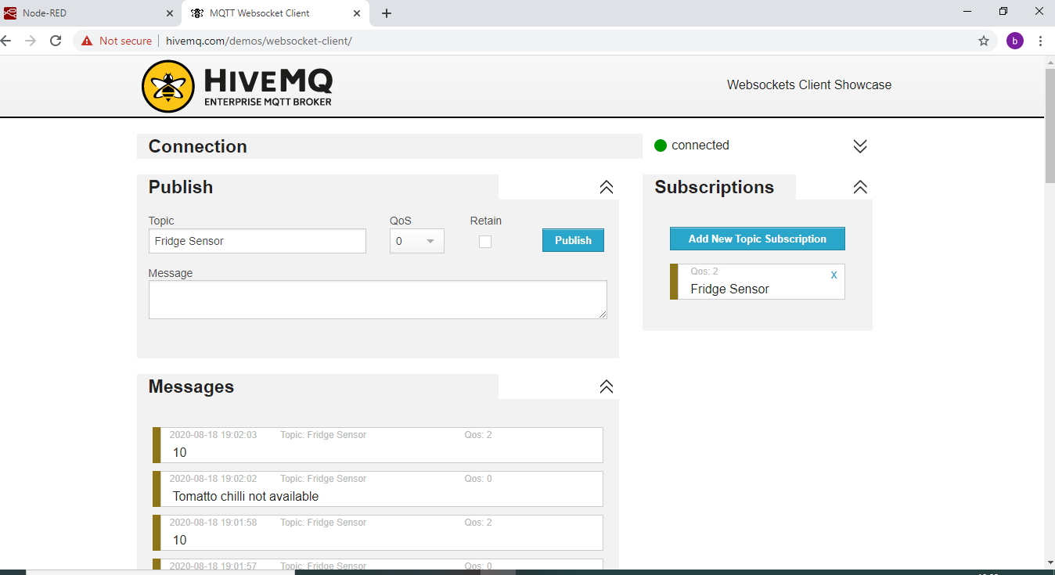

Slide 71
Reference
http://www.steves-internet-guide.com/configuring-the-mqtt-publish-node/

