Slide 1
ECE 3501 – IoT Fundamentals
INTRODUCTION
Dr.V.Berlin Hency
Associate Professor
SENSE
VIT Chennai

Slide 2
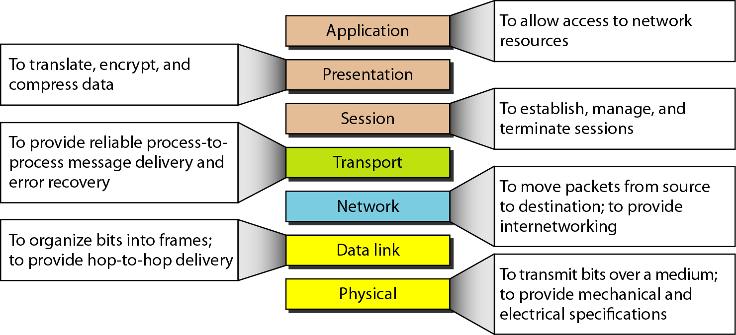
OSI Model

Slide 3
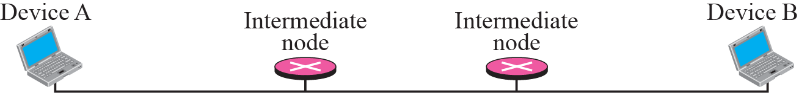
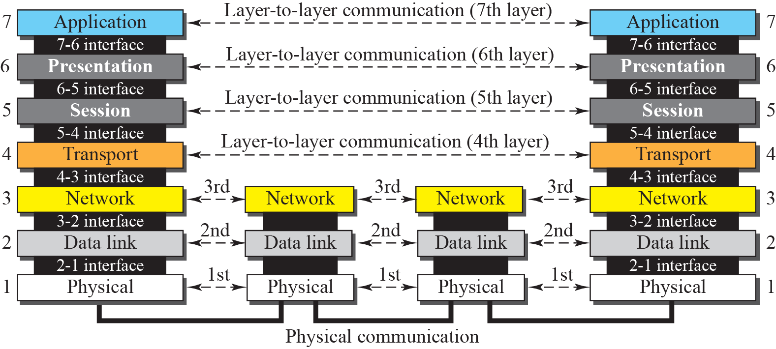

Slide 4
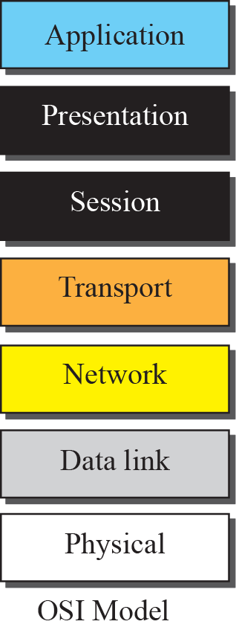
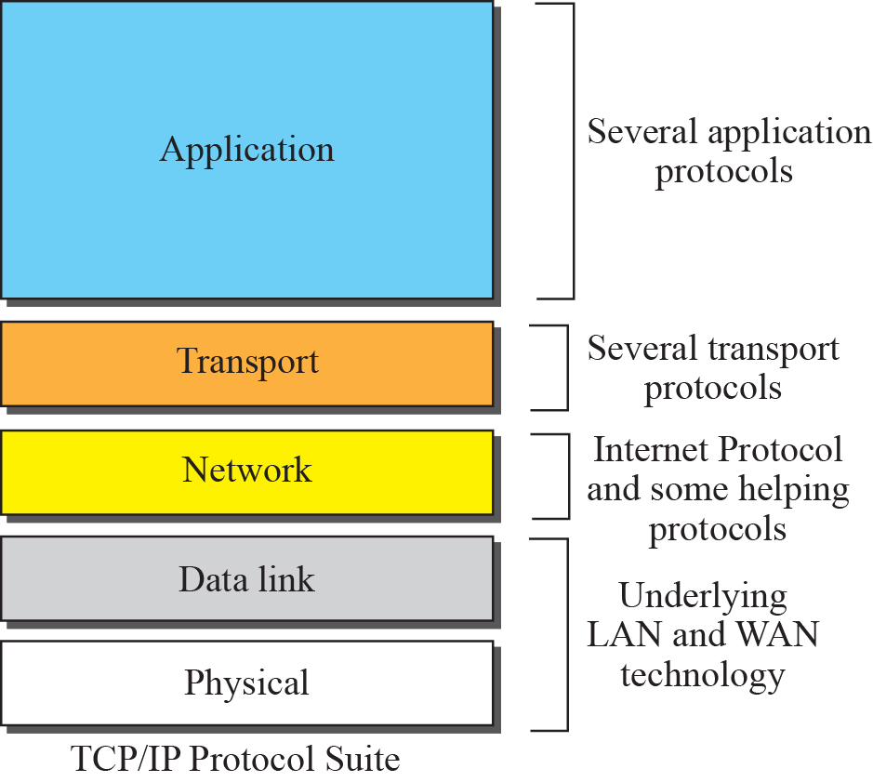

Slide 5
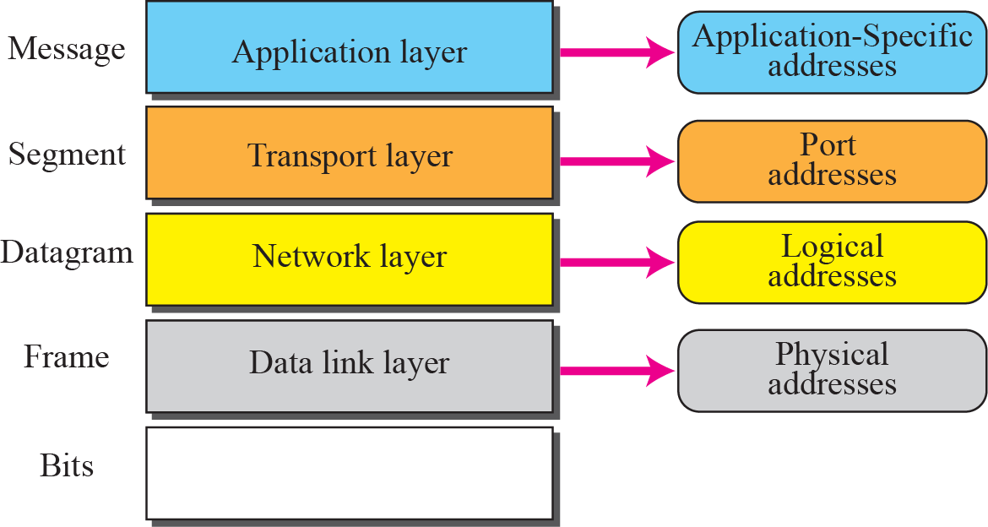

Slide 6
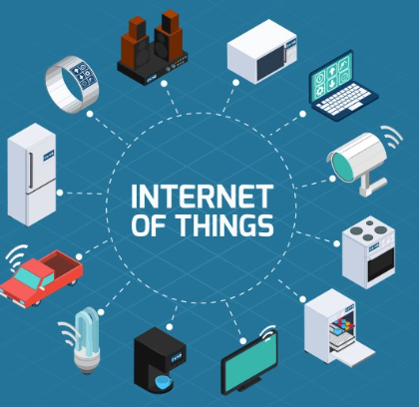
IoT

Slide 7
IoT - Definition
The Internet of things is a system of interrelated computing devices, mechanical and digital machines provided with unique identifiers and the ability to transfer data over a network without requiring human-to-human or human-to-computer interaction-Wikipedia
The Internet of Things (IoT) is the networking of physical devices ("connected devices" or "smart devices") embedded with electronics, softwares, sensors, actuators and network connectivity that enable these objects to collect and exchange data

Slide 8
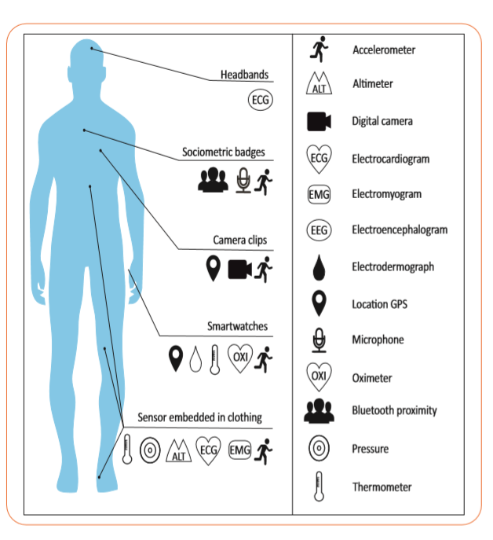
IoT Application in Medical Electronics

Slide 9
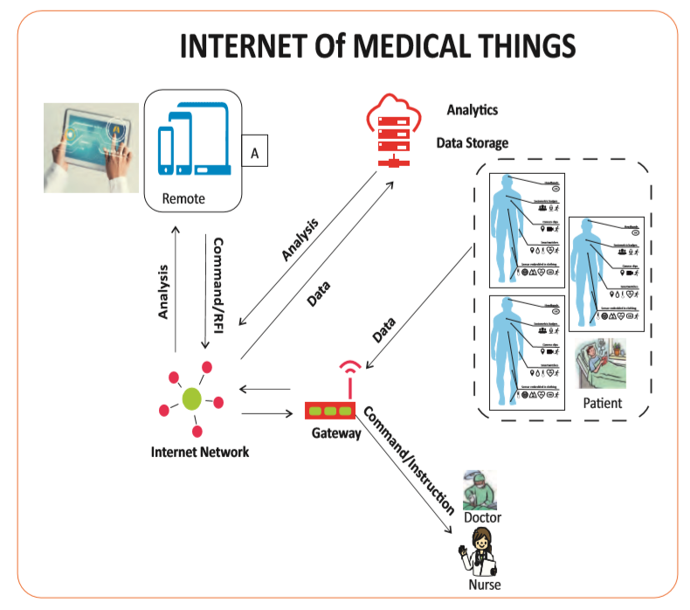

Slide 10
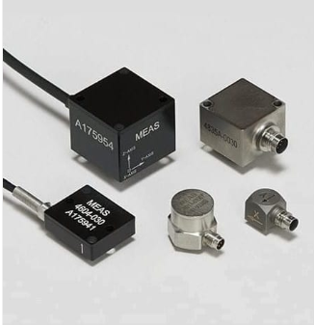
Accelerometer Sensor

Slide 11
Accelerometer
An accelerometer is an electromechanical device used to measure acceleration forces
Acceleration is the measurement of the change in velocity, or speed divided by time

Slide 12
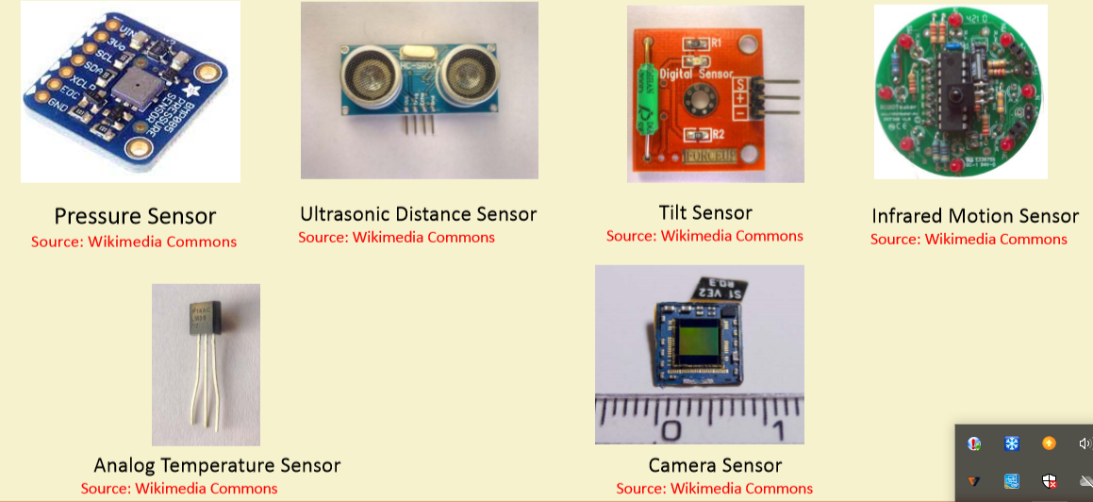
Sensors

Slide 13
References
Foundation Skills in Internet of Things ( IoT ) - NASSCOM

Slide 14
THANK YOU

