Slide 1
ECE 3501 – IoT Fundamentals
Evolution of IoT
Dr.V.Berlin Hency
Professor
SENSE
VIT Chennai

Slide 2
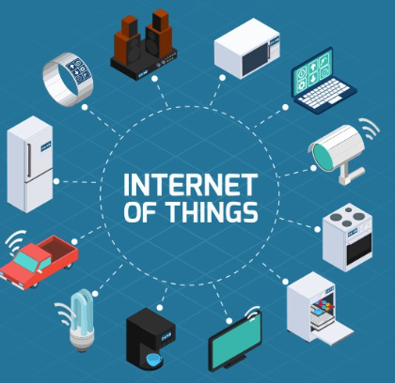
IoT : expressvpn.com

Slide 3
IoT - Definition
The Internet of things is a system of interrelated computing devices, mechanical and digital machines provided with unique identifiers and the ability to transfer data over a network without requiring human-to-human or human-to-computer interaction-Wikipedia
The Internet of Things (IoT) is the networking of physical devices ("connected devices" or "smart devices") embedded with electronics, softwares, sensors, actuators and network connectivity that enable these objects to collect and exchange data.

Slide 4
Thing
A thing in the context of the Internet of things is an entity or physical object that has a unique identifier an embedded system and the ability to transfer data over a network.

Slide 5
History of IoT
M2M technology in 1980 with wired connection for SCADA (Supervisory control and data acquisition)-factory floor, home, business security system
M2M wireless Technology in 1990. ADEMCO built radio network for intrusion and smoke detection as budding cellular connectivity was too expensive
Siemens introduced first cellular module M2M in 1995

Slide 6
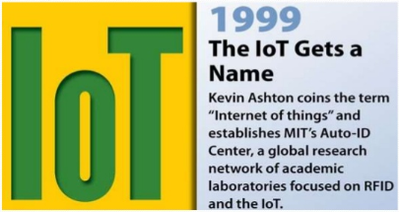
History of IoT

Slide 7
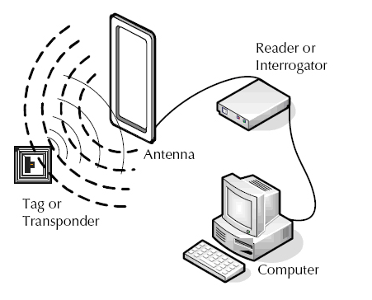
RFID

Slide 8
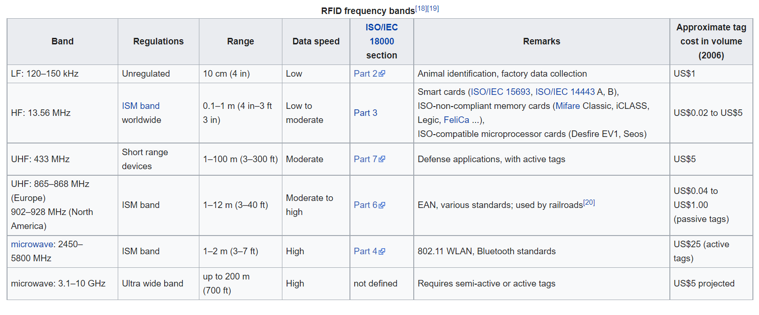

Slide 9
History of IoT
“Internet of Things” was coined by Kevin Ashton in 1999 during his work at Procter & Gamble.
Ashton who was working in supply chain optimization, wanted to attract senior management’s attention to a new exciting technology called RFID.
Because the internet was the hottest new trend in 1999 and because it somehow made sense, he called his presentation “Internet of Things”.

Slide 10
History of IoT
2003-2004: The term is mentioned in main-stream publications like The Guardian, Scientific American and the Boston Globe.
2005: The IoT hit another level when the UN's International Telecommunications Union ITU published its first report on the topic.
2008: A group of companies launched the IPSO Alliance to promote the use of Internet Protocol (IP) in networks of "smart objects" and to enable the Internet of Things. The IPSO alliance now boasts over 50 member companies, including Bosch, Cisco, Ericsson, Intel, SAP, Sun, Google and Fujitsu.

Slide 11
History of IoT
2012-13 : IPv6 Deployed, AllSeen Alliance launched
2014 : Alliances formed to promote standardisation
Thread group
Open internet consortium
Industrial Internet consortium

Slide 12
History of IoT
2015 : Alliances formed to promote standardisation
Apple Home Kit
Lorra Alliance
2020 : to address the standardization requirements of Internet of Things (IoT) technologies, with an initial focus on IoT applications in smart cities and communities

Slide 13
References
https://www.postscapes.com/iot-history/
Foundation Skills in Internet of Things ( IoT ) - NASSCOM

Slide 14
Thank You

