Slide 1
BECE351L
IOT Fundamentals
IOT_ETH_M1_01
Dr. Sritama Roy
Assistant Professor (SG-2)
SENSE
VIT University

Slide 2
Course Syllabus
Modules | Module Topic | Time
Module:1 | Essentials of Internet of Things | 2 hours
Module:2 | Architecture Reference Model | 2 hours
Module:3 | Protocol Suite | 2 hours
Module:4 | Edge Computing | 2 hours
Module:5 | Security Engineering | 2 hours
Module:6 | IOT Platforms for Use case Development | 2 hours
Module:7 | IOT Verticals | 1 hours

Slide 3
Course Objectives
1. To impart knowledge on the infrastructure, communication and networking technologies of IoT.
2. To analyze, design and develop Industrial IoT solutions.
3. To develop IoT architecture for use cases under discussion.

Slide 4
Course Outcomes
1. To focus on the technologies that enable IoT and to interpret the different components in IoT architecture.
2. Comprehend the concepts of edge computing and edge enabled solutions for
real-time industrial applications.
3. Envision the IoT architecture models and the protocol stack for the design and
development of IoT applications on different platforms.
4. Interpret the security threats and to design a resilient IoT Architecture.
5. Program the controller and sensors as part of IoT.
6. Assess different Internet of Things technologies and their applications.
7. To apply the concepts of Internet of Things in the real world scenarios

Slide 5
Text Books
1. Arshdeep Bahga, Vijay Madisetti, “Internet of Things: A hands-on Approach”,University Press, 2015.
2. Ammar Rayes,Samer Salam, “ Internet of Things from Hype to Reality- A road to Digitization” Second Edition, Springer, ISBN 978-3-319-99515-1.
3. Rajkumar Buyya, Amir Vahid “ Internet of Things Principles and Paradigms”,
Elsevier, 2016.

Slide 6
Reference Books
Brian Russell, Drew Van “Practical Internet of Things Security “Packt Publishing, ISBN 978-1-78588-963-9 ,2016.
Adrian McEwen & Hakim Cassimally, “Designing the Internet of Things”, Wiley, 2017 , Second Edition.

Slide 7
Module:1
Essentials of Internet of Things

Slide 8
Module: 1 Essentials of Internet of Things
IOT Emergence.
Definition and Characteristics of IOT.
Impact of IOT on business and society.
IOT product development life cycle.
IOT enabling Technologies.
Applications.

Slide 9
Essentials of Internet of Things

Slide 10
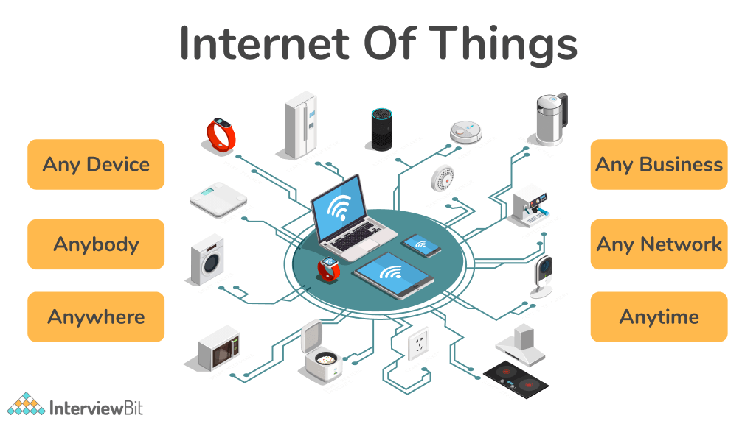

Slide 11
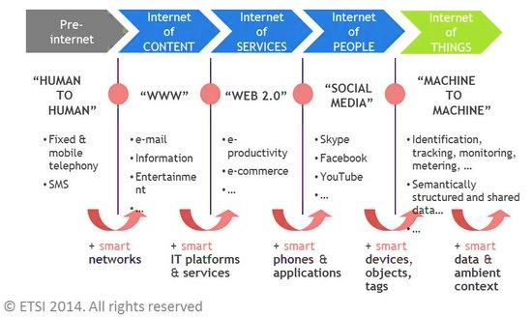
IOT Emergence

Slide 12
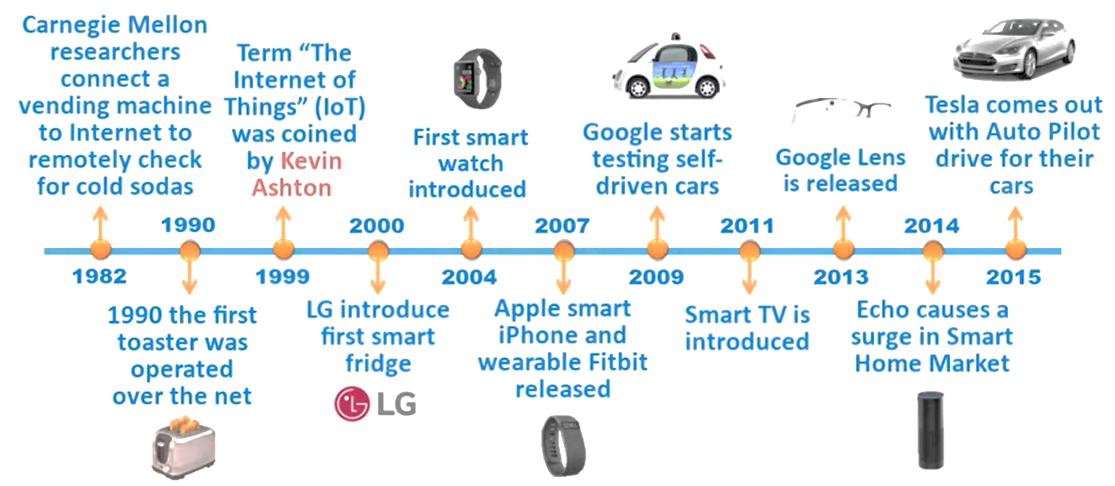
History of IOT

Slide 13
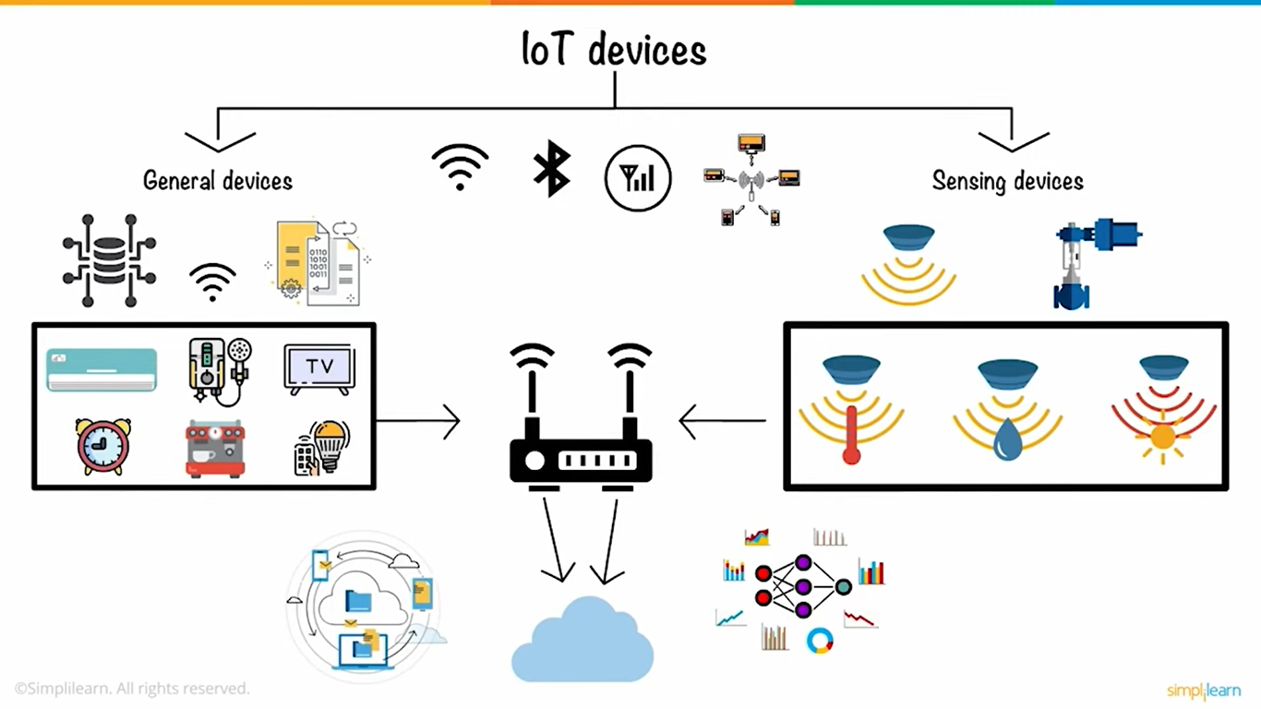
Classification of IOT

Slide 14
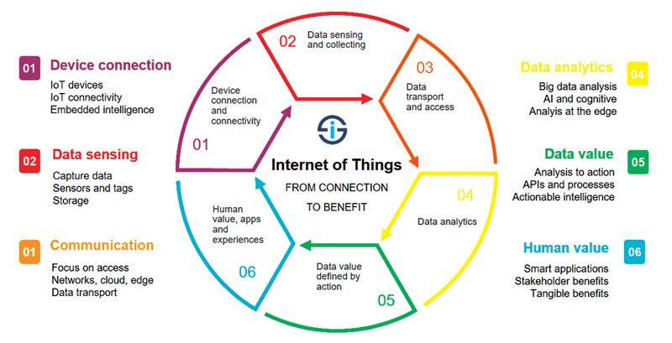
IOT Emergence

Slide 15
Definition of IOT
The Internet of Things (IoT) is the networking of physical devices ("connected devices" or "smart devices") embedded with electronics, software's, sensors, actuators and network connectivity that enable these objects to collect and exchange data.
A network of items each embedded with sensors which are connected to the Internet. IEEE
IoT is a world-wide network of interconnected objects uniquely addressable, based on standard communication protocols. IETF

Slide 16
Definition of Things
A thing in the context of the Internet of things is an entity or physical object that has a unique identifier an embedded system and the ability to transfer data over a network.
The Things in the Internet of Things
IoT-enabled assets, devices, physical objects, sensors, anything connected the physical world, appliances, endpoints, the list goes on.

Slide 17
History of IOT
M2M technology in 1980 with wired connection for SCADA (Supervisory control and data acquisition)-factory floor, home, business security system.
M2M wireless Technology in 1990. ADEMCO built radio network for intrusion and smoke detection as budding cellular connectivity was too expensive.
Siemens introduced first cellular module M2M in 1995.
“Internet of Things” was coined by Kevin Ashton in 1999 during his work at Procter & Gamble.

Slide 18
History of IOT
Ashton who was working in supply chain optimization, wanted to attract senior management’s attention to a new exciting technology called RFID.
Because the internet was the hottest new trend in 1999 and because it somehow made sense, he called his presentation “Internet of Things”.
2003-2004: The term is mentioned in main-stream publications like The Guardian, Scientific American and the Boston Globe.
2005: The IoT hit another level when the UN's International Telecommunications Union ITU published its first report on the topic.

Slide 19
History of IOT
2008: A group of companies launched the IPSO Alliance to promote the use of Internet Protocol (IP) in networks of "smart objects" and to enable the Internet of Things. 2012-13 : IPv6 Deployed, All Seen Alliance launched
2014 : Alliances formed to promote standardization
2015 : Alliances formed to promote standardization, Apple Kits.
2020 : to address the standardization requirements of Internet of Things (IoT) technologies, with an initial focus on IoT applications in smart cities and communities.

Slide 20
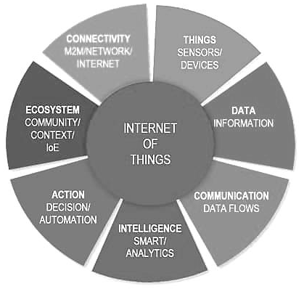
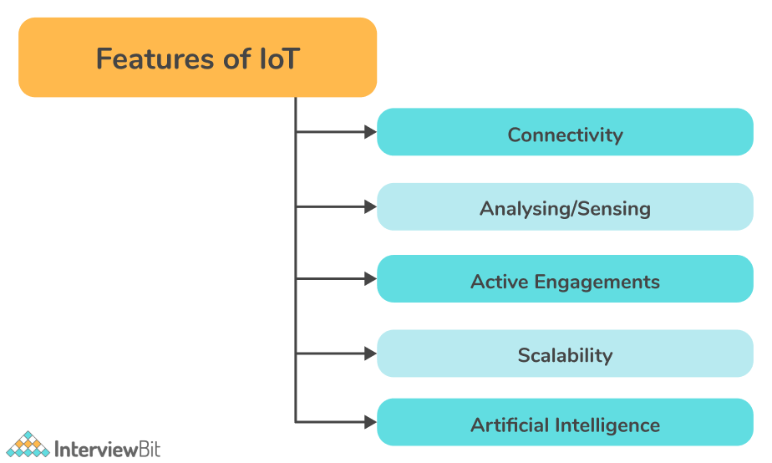
Characteristics of IOT

Slide 21
Characteristics of IOT
The Things in the Internet of Things
IoT-enabled assets, devices, physical objects, sensors, anything connected the physical world, appliances, endpoints, the list goes on.
2. The Internet of Things and Data
This is part of that intelligent notion but it also brings us far closer to the essence.
3. Communication in the Internet of Things
Data as such is maybe not without value but it sure is without meaning unless it is used for a purpose and it is turned into meaning, insights, intelligence and actions.

Slide 22
Characteristics of IOT
4. Internet of Things, Intelligence and action
We just touched upon this aspect. However, in most definitions we see that intelligence is attributed to just the network(s) and/or the devices.
5 . Automation
There is always a degree of automation, no matter the scope of the project or the type of Internet of Things application.
6. Ecosystem
Meaning and hyper-connectedness is what we miss in many answers on the questions regarding what the Internet of Things is.

Slide 23
Features of IOT
Connectivity:
Connectivity is the most important aspect of IoT. The IoT ecosystem (i.e. sensors, compute engines, data hubs, etc.) cannot operate properly without seamless communication among the interrelated components or objects. There are many ways to connect IoT devices including radio waves, Bluetooth, Wi-Fi, and Li-Fi.
Analyzing/Sensing:
Once all the relevant things are connected, the next step is to analyze data that is being collected and use it to build effective business intelligence. It is very important to extract knowledge from the generated data. A sensor, for example, generates data, but those data won't be of much use unless they are interpreted properly by us.

Slide 24
Features of IOT
Active Engagements:
A lot of today's interactions with connected technology occur via passive engagement. Through IoT, multiple products, cross-platform technologies, and services work together on an active engagement basis. The use of cloud computing in blockchain enables active engagements among IoT components in general.
Scalability:
Each day, more and more elements are connecting to the IoT zone. IoT setups should therefore be able to handle massive expansion. The data generated as a result is immense, and it should be handled correctly.

Slide 25
Features of IOT
Artificial Intelligence:
The IoT essentially makes things such as mobile phones, wearables, vehicles, etc., smart and enhances life by making use of data collection, artificial intelligence algorithms, and networked technologies. For example, if you have a coffee machine whose beans are going to end, it will order coffee beans from the retailer of your choice.

Slide 26
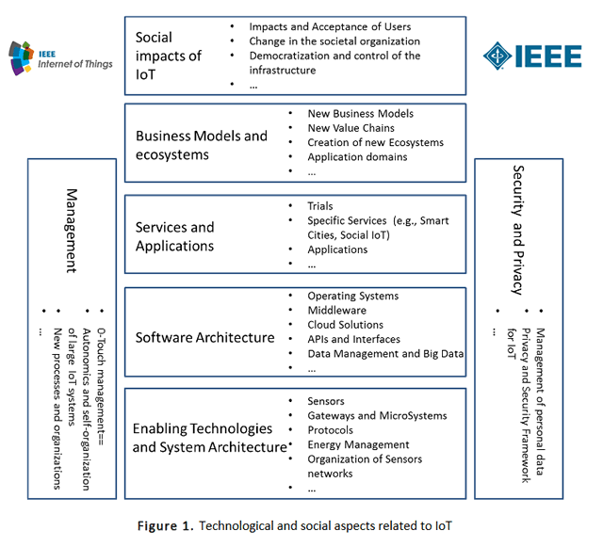
Impact of IOT on business and society

Slide 27
Impact of IOT on business
How IoT change the Business World?
Inventory management
Increased Productivity
Remote working
Data collection and exchange
Customer engagement
Easy Buying process
2. Some Drawbacks of IoT
Privacy and Security
Complex in Nature
Dependency

Slide 28
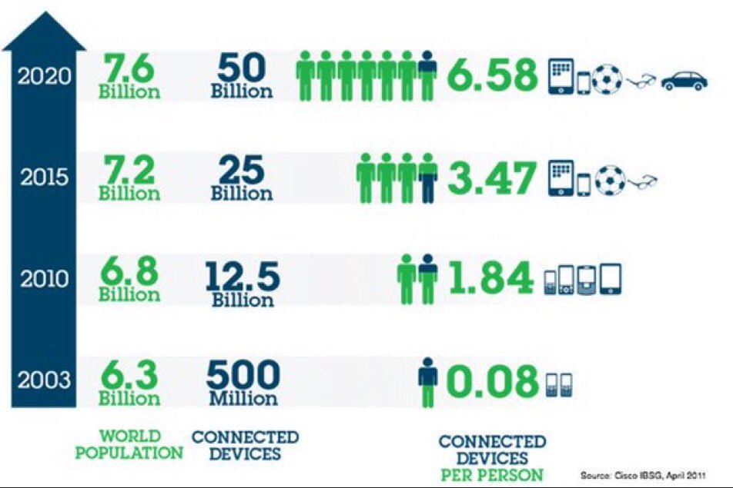
Impact of IOT on business and society

Slide 29
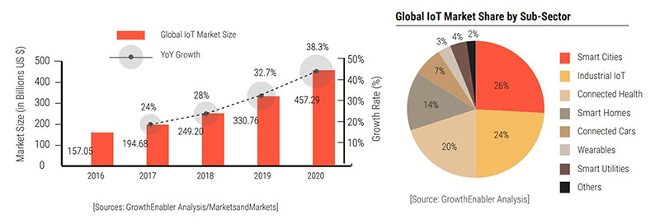
Impact of IOT on business and society

Slide 30
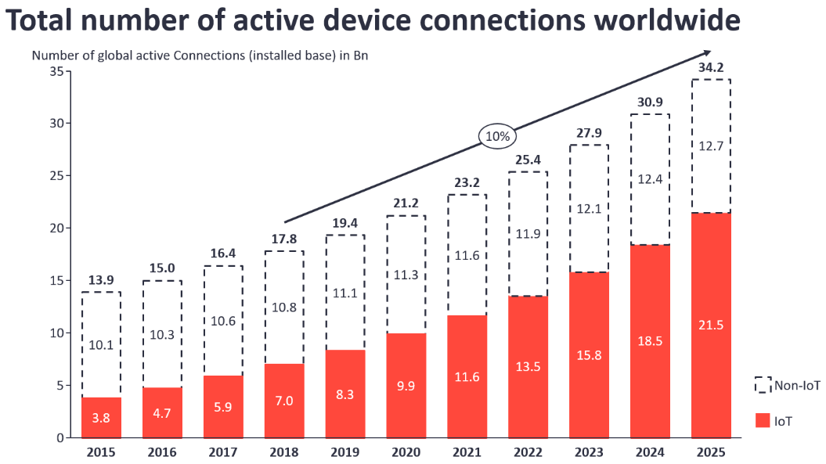
Impact of IOT on business and society

Slide 31
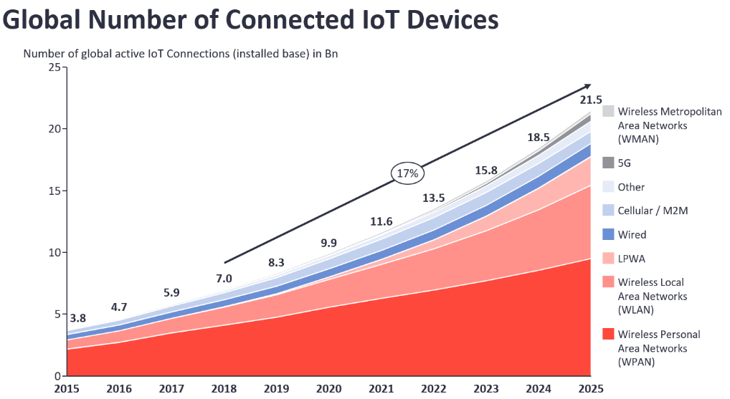
Impact of IOT on business and society

Slide 32
Impact of IOT on society
Smart homes and offices can save energy costs.
Offering better security by constant surveillance.
Taking active action, such as alerting the local police body in case of a security breach.
Remote monitoring of patients and providing medication for them is an impact of the Internet of Things on society through improved health care.
Reminders of daily tasks such as payment of utility bills.
Smart lighting of streets and auto-sensing as well as control of traffic signal.
Remote Monitoring of assembly line and production system to maximize efficiency, safety, and reliability in a manufacturing firm.
Smart automobiles that can provide assistance if required, assist in controlling vehicle speed on the basis of traffic and environmental conditions.

Slide 33
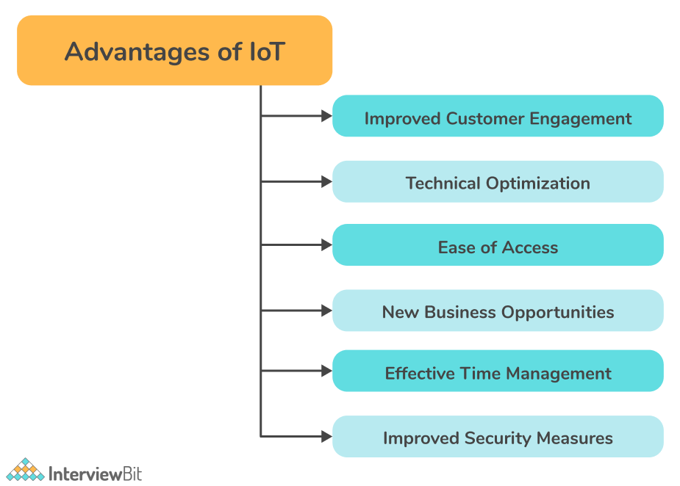
Advantages of IOT

Slide 34

Dr. Sritama Roy Assistant Professor (SG-2) SENSE, VIT University 7873842031 Email Id : sritama.roy@vit.ac.in

