Slide 1

Architecture Reference Model
Module 2
Of
IoT fundamentals
Text Book: “Chapter 5” - Arshdeep Bahga, Vijay Madisetti - Internet of Things_ A Hands-On Approach-Universities Press (India) Private Limited (2015)

Slide 2
Module 2 - Topics
Domain Model,
Information Model,
Functional Model,
Communication and security model,
SOA based architecture.

Slide 3
IoT Design Methodology that includes:
Purpose & Requirements Specification
Process Model Specification
Domain Model Specification
Information Model Specification
Service Specifications
IoT Level Specification
Functional View Specification
Operational View Specification
Device & Component Integration
Application Development

Slide 4
Introduction
Designing IoT systems can be a complex and challenging task as these systems involve interactions between various components such as IoT devices and network resources, web services, analytics components, application and database servers.
IoT system designers - often tend to design IoT systems keeping specific products/services in mind.
IoT System design are tied to specific product/service choices made.
IoT System designed in such away in updating the system design to add new features or replacing a particular product/service choice for a component becomes very complex, and in many cases may require complete re- design of the system.

Slide 5
Introduction
IoT system design are:
- independent of specific product, and
- service or programming language.
IoT systems designed with the proposed methodology –
- reduced design,
- testing and maintenance time,
- better interoperability, and
- reduced complexity.

Slide 6
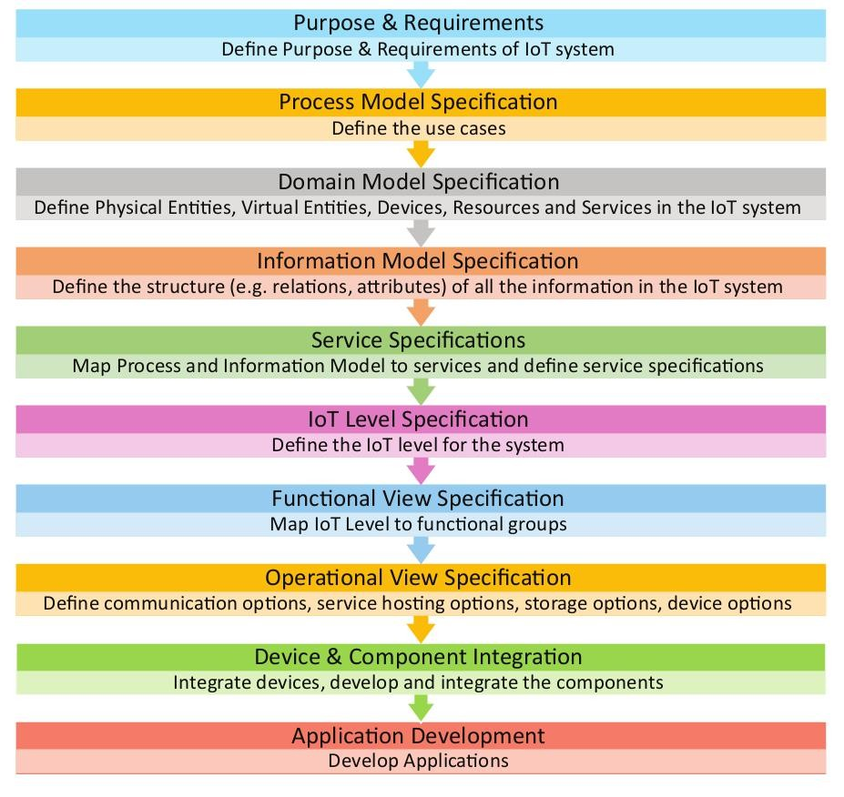
IoT Design Methodology Steps

Slide 7
Purpose & Requirements Specification
The first step in IoT system design methodology is to define the purpose and requirements of the system.
In this step, involves the following steps such as
the system purpose,
behavior and
requirements such as (such as data collection requirements, data analysis requirements, system management requirements, data privacy and security requirements, user interface requirements, ...) are captured.

Slide 8
Purpose & Requirements Specification
Purpose : A home automation system that allows controlling of the lights in a home remotely using a web application.
Behavior : The home automation system should have auto and manual modes. In auto mode, the system measures the light level in the room and switches on the light when it gets dark. In manual mode, the system provides the option of manually and remotely switching on/off the light.
System Management Requirement : The system should provide remote monitoring and control functions.

Slide 9
Process Specifications
The second step in the IoT design methodology is to define the process specification.
In this step, the use cases of the IoT system are formally described based on and derived from the purpose and requirement specifications.

Slide 10
Process Specifications
Purpose : A home automation system that allows controlling of the lights in a home remotely using a web application.
Behavior : The home automation system should have auto and manual modes. In auto mode, the system measures the light level in the room and switches on the light when it gets dark. In manual mode, the system provides the option of manually and remotely switching on/off the light.
System Management Requirement : The system should provide remote monitoring and control functions.

Slide 11
Process Specifications
Data Analysis Requirement : The system should perform local analysis of the data.
Application Deployment Requirement : The application should be deployed locally on the device, but should be accessible remotely
Security Requirement : The system should have basic user authentication capability.

Slide 12
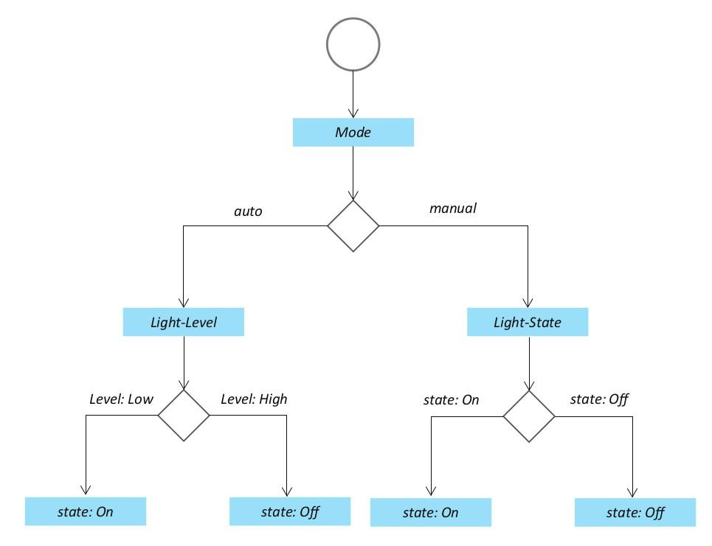
Process Specifications
In this step, the use cases of the IoT system are formally described based on and derived from the purpose and requirement specifications.

Slide 13
Domain Model Specification
The third step in the IoT design methodology is to define the Domain Model.
The domain model describes the main concepts, entities and objects in the domain of IoT system to be designed. Domain model defines the attributes of the objects and relationships between objects.
Domain model provides an abstract representation of the concepts, objects and entities in the IoT domain, independent of any specific technology or platform.

Slide 14
Domain Model Specification
The entities, objects and concepts defined in the domain model include:
Physical Entity : Physical Entity is a discrete and identifiable entity in the physical environment (e.g. a room, a light, an appliance, a car, etc.).
Virtual Entity : Virtual Entity is a representation of the Physical Entity in the digital world.
Device provides a medium for interactions between Physical Entities and Virtual Entities. Devices are either attached to Physical Entities or placed near Physical Entities.

Slide 15
Domain Model Specification
Resource :- Resources are software components which can be either "on-device" or "network-resources". On-device resources are hosted on the device and include software components that either provide information on or enable actuation upon the Physical Entity to which the device is attached.
Service : Services provide an interface for interacting with the Physical Entity. Services access the resources hosted on the device or the network resources to obtain information about the Physical Entity or perform actuation upon the Physical Entity.

Slide 16
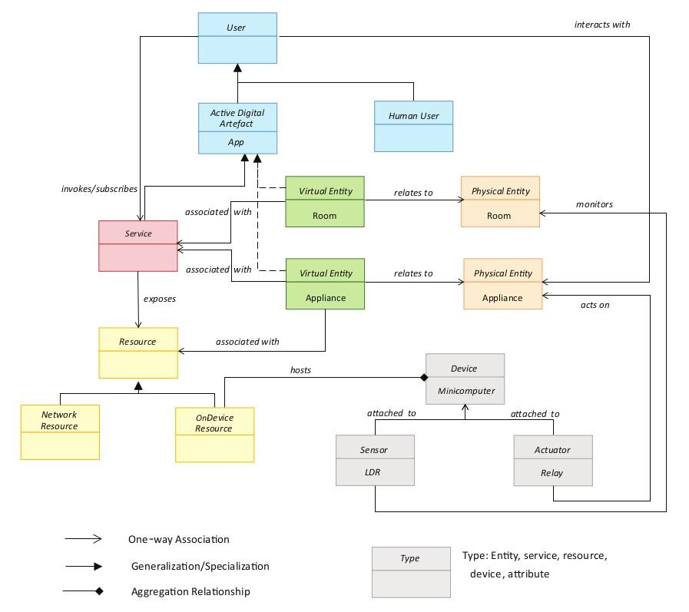
Domain Model Specification

Slide 17
Information Model Specification
The fourth step in the IoT design methodology is to define the Information Model.
Information Model defines the structure of all the information in the IoT system, for example, attributes of Virtual Entities, relations, etc.
Information model does not describe the specifics of how the information is represented or stored.
To define the information model, we first list the Virtual Entities defined in the Domain Model.
Information model adds more details to the Virtual Entities by defining their attributes and relations

Slide 18
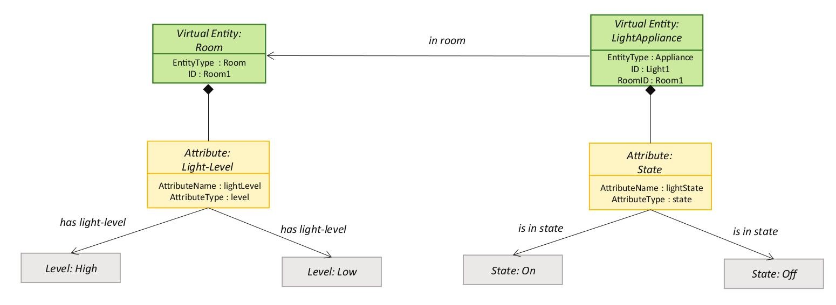
Information Model Specification

Slide 19
Service Specifications
The fifth step in the IoT design methodology is to define the service specifications.
Service specifications -define the services in the IoT system,
service types,
service inputs/output,
service endpoints,
service schedules,
service preconditions and
service effects.

Slide 20
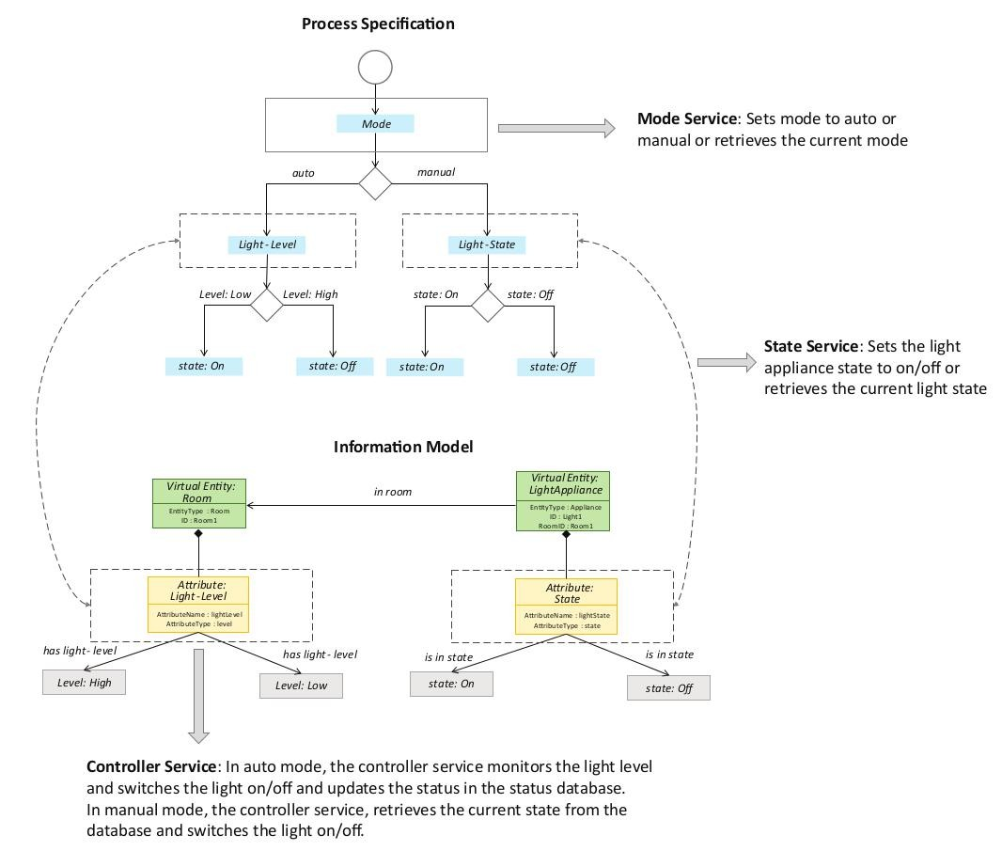
Service Specifications
From the process specification and information model, we identify the states and attributes.
For each state and attribute we define a service.
These services either change the state or attribute values or retrieve the current values.

Slide 21
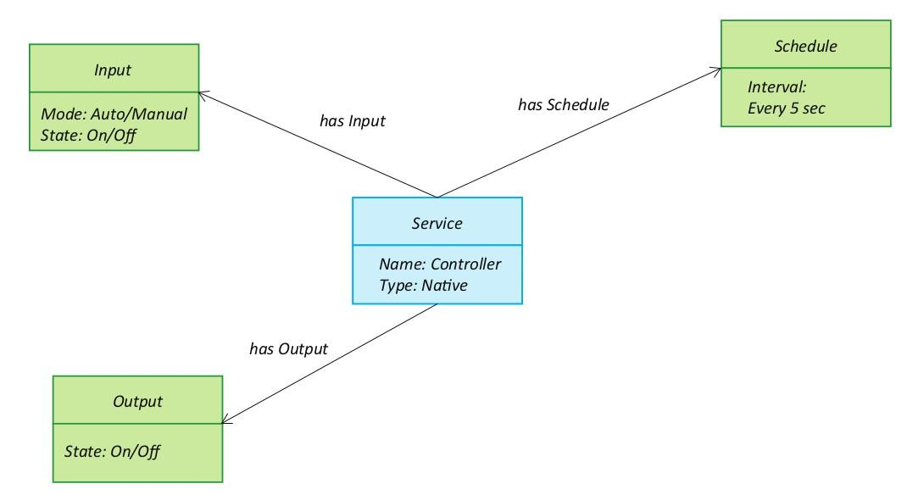
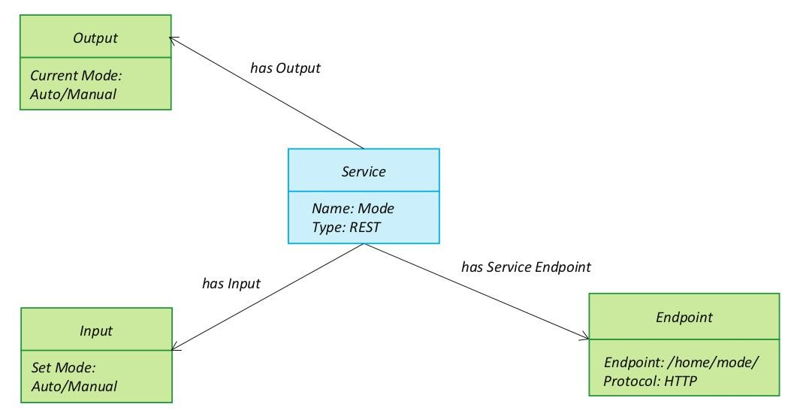
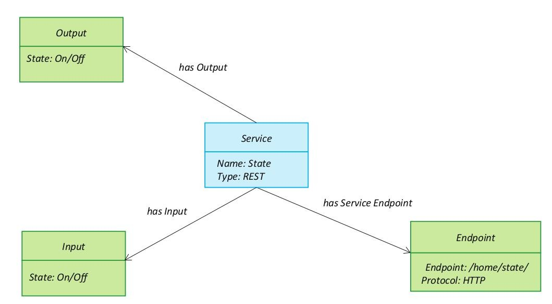
Service Specifications

Slide 22
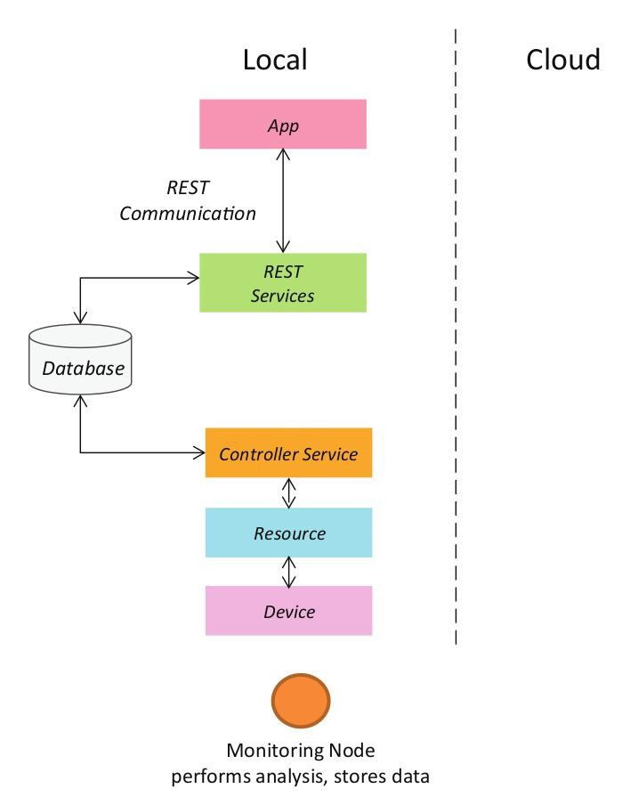
IoT Level Specifications
The sixth step in the IoT design methodology is to define the at least one of the IoT level for the system.
Representational State Transfer (REST) is a set of architectural principles by which you can design web services and web APIs that focus on a system's resources and how resource states are addressed and transferred. REST APIs follow the request-response communication model described in previous section. The REST architectural constraints
apply to the components, connectors, and data elements, within a distributed hypermedia system.

Slide 23
Functional View Specification
The Functional View (FV) defines the functions of the IoT systems grouped into various Functional Groups (FGs).
Each Functional Group either provides functionalities for interacting with instances of concepts defined in the Domain Model or provides information related to these concepts.

Slide 24
Functional View Specification
The Functional Groups (FG) included in a Functional View include:
Device : The device FG contains devices for monitoring and control. In the home automation example. the device FG includes a single board mini-computer, a light sensor and relay switch(actuator).
Communication : The communication FG handles the communication for the IoT system. The communication FG includes the communication protocols that form the backbone of IoT systems and enable network connectivity.
The communication FG also includes the communication APis (such as REST and WebSocket) that are used by the services and applications to exchange data over the network.

Slide 25
Functional View Specification
Services: The service FG includes various services involved in the IoT system such as services for device monitoring , device control services, data publishing services and services for device discovery.
Management: The management FG includes all functionalities that are needed to configure and manage the loT system .
Security : The security FG includes security mechanisms for the loT system such as authentication, authorization, data security, etc.
Application : The application FG includes applications that provide an interface to the users to control and monitor various aspects of the IoT system. Applications also allow users to view the system status and the processed data.

Slide 26
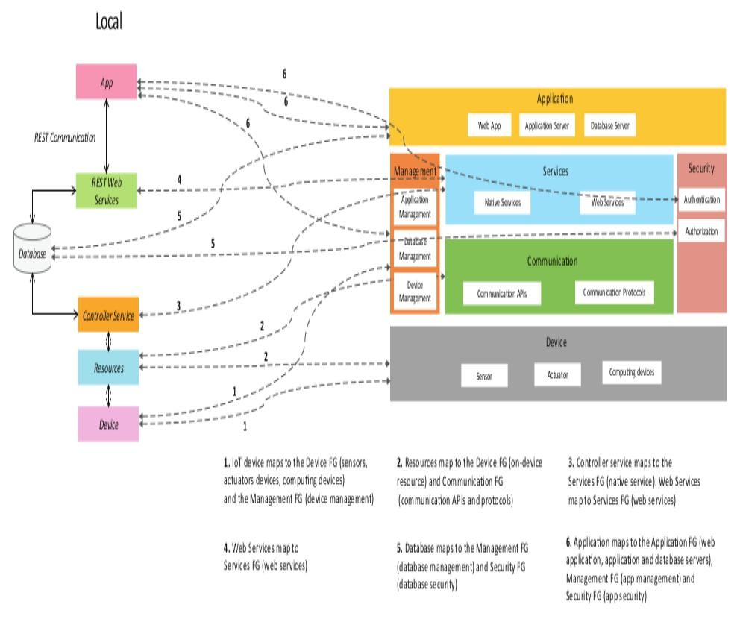
Functional View Specification

Slide 27
Functional View Specification – Major Functions
loT device maps to the Device FG (sensors, actuators devices, computing devices) and the Management FG {device management)
Resources map to the Device FG (on-device resource) and Communication FG (communication APls and protocols)
Controller service maps to the Services FG (native service).
Web Services map to Services FG (web services) Web Services map to Services FG (web services)
Database maps to the Management FG (database management) and Security FG {database security)
Application maps to the Application FG (web application, application and database servers), Management FG (app management) and Security FG (app security)

Slide 28
Operational View specifications
In this step, various options pertaining to the loT system deployment and operation are defined, such as, service hosting options, storage options, device options, application hosting options, etc.
Operational View specifications for the home automation example are s follows:
Devices: Computing device (Raspberry Pi), light dependent resistor (sensor), relay switch (actuator).
Communication APls: REST APIs
Communication Protocols: Link Layer - 802.11, Network Layer - 1Pv4/1Pv6, Transport TCP, Application - HTTP.

Slide 29
Operational View specifications
Operational View specifications for the home automation example are as follows:
Services:
Controller Service - Hosted on device, implemented in Python and run as a native service.
Mode service - REST-ful web service, hosted on device, implemented with Django-REST Framework.
State service - REST-ful web service, hosted on device, implemented with Django-REST Framework.
Application:
Web Application - Django Web Application, Application Server - Django App Server, Database Server - MySQL.

Slide 30
Operational View specifications
Operational View specifications for the home automation example are as follows:
Security:
Authentication: Web App, Database Authorization: Web App, Database
Management:
Application Management - Django App Management Database Management - MySQL DB Management, Device Management - Raspberry Pi device Management.

Slide 31
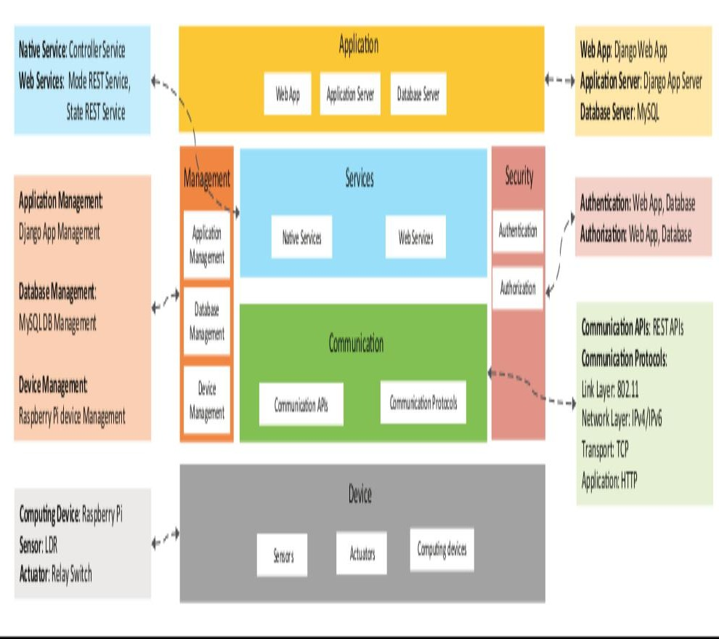
Operational View specifications

Slide 32
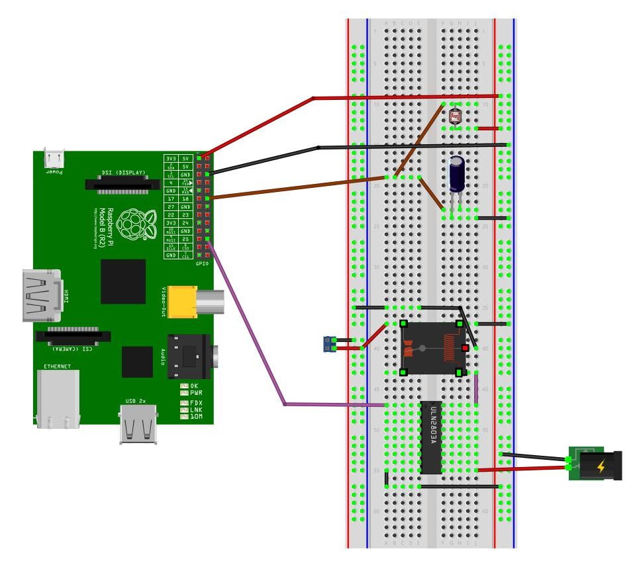
Device and Component Integrations
The ninth step in the IoT design methodology is the integration of the devices and components.

Slide 33
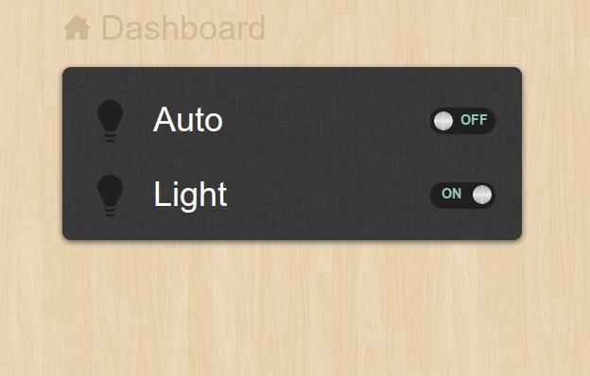
Application Development
The application has controls for the mode (auto on or auto off) and the light (on or off).
In the auto mode, the IoT system controls the light appliance automatically based on the lighting conditions in the room.
When auto mode is enabled the light control in the application is disabled and it reflects the current state of the light.
When the auto mode is disabled, the light control is enabled and it is used for manually controlling the light.

Slide 34
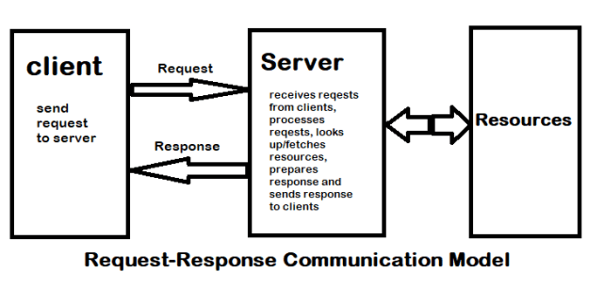
Communication and security model
Request-Response is a communication model in which the client sends requests to the server and the server responds to the requests.
When the server receives a request, it decides how to respond, fetches the data, retrieves resource representations, prepares the response, and then sends the response to the client.
Request-Response model is a stateless communication model and each request-response pair is independent of others.

Slide 35
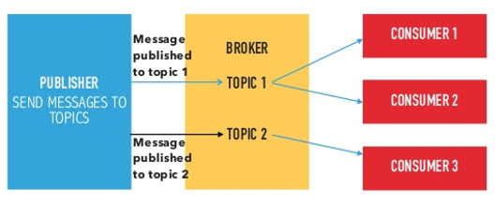
Communication and security model
Publish-Subscribe is a communication model that involves publishers, brokers and consumers.
Publishers are the source of data. Publishers send the data to the topics which are managed by the broker.
Publishers are not aware of the consumers. Consumers subscribe to the topics which are managed by the broker.
When the broker receives data for a topic from the publisher, it sends the data to all the subscribed consumers.

Slide 36
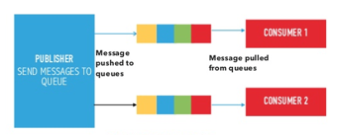
Communication and security model
Push-Pull : Push-Pull is a communication model in which the data producers push the data to queues and the consumers pull the data from the queues.
Producers do not need to be aware of the consumers. Queues help in decoupling the messaging between the producers and consumers.
Queues also act as a buffer which helps in situations when there is a mismatch between the rate at which the producers push data and the rate rate at which the consumers pull data.

Slide 37
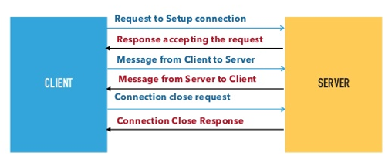
Communication and security model
Exclusive Pair : Exclusive Pair is a bi-directional, fully duplex communication model that uses a persistent connection between the client and server.
Once the connection is setup it remains open until the client sends a request to close the connection.
Client and server can send messages to each other after connection setup.
Exclusive pair is a stateful communication model and the server is aware of all the open connections.

Slide 38
Various Layers of Communication loT Model
Device : An loT system comprises of devices that provide sensing, actuation, monitoring and control functions.
Communication: The communication block handles the communication for the loT system.
Services : An loT system uses various types of IoT services such as services for device monitoring, device control services, data publishing services and services for device discovery.
Management : Management functional block provides various functions to govern the loT system.
Security: Security functional block secures the loT system and by providing functions such as authentication, authorization, message and content integrity, and data security.
Application : loT applications provide an interface that the users can use to control and monitor the loT system. Applications also allow user to view the system status and view or analyze the processed data.

Slide 39
IoT Communication API – ReST REpresentational State Transfer
Client–server – By separating the user interface concerns from the data storage concerns, we improve the portability of the user interface across multiple platforms and improve scalability by simplifying the server components. This means that the client user interface should not be concerned with the storage of data as that is looked after by server. Similarly, server should not be concerned with user interface which is handled by client.
Stateless – Each request from client to server must contain all of the information necessary to understand the request, and cannot take advantage of any stored context on the server. Session state is therefore kept entirely on the client.
Cacheable – Cache constraints require that the data within a response to a request be implicitly or explicitly labeled as cacheable or non-cacheable. If a response is cacheable, then a client cache is given the right to reuse that response data for later, equivalent requests.

Slide 40
IoT Communication API – ReST REpresentational State Transfer
Uniform interface – Method of interaction between client and server should be uniform. All resources are identified by unique identifiers and these ID's are mentioned in the client requests. Based on the requested resource the client is provided a representation of the resource.
Layered system – The layered system style allows an architecture to be composed of hierarchical layers by constraining component behavior such that each component cannot “see” beyond the immediate layer with which they are interacting.
Code on demand (optional) – REST allows client functionality to be extended by downloading and executing code in the form of applets or scripts. This simplifies clients by reducing the number of features required to be pre-implemented.

Slide 41
IoT Communication API – ReST REpresentational State Transfer
Resource The key abstraction of information in REST is a resource. Any information that can be named can be a resource: a document or image, a temporal service, a collection of other resources, a non-virtual object (e.g. a person), and so on. REST uses a resource identifier to identify the particular resource involved in an interaction between components.
The state of the resource at any particular timestamp is known as resource representation. A representation consists of data, metadata describing the data and hypermedia links which can help the clients in transition to the next desired state.
Resource Methods- These are to be used to perform the desired transition

Slide 42
Service-Oriented Architecture (SOA) based architecture
SOA is a style of software design where services are provided to the other components by application components, through a communication protocol over a network. Its principles are independent of vendors and other technologies.
In SOA, a number of services communicate with each other, in one of two ways: through passing data or through two or more services coordinating an activity. This is just one definition of Service-Oriented Architecture.

Slide 43
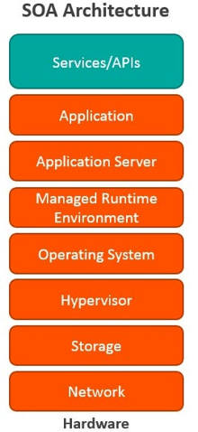
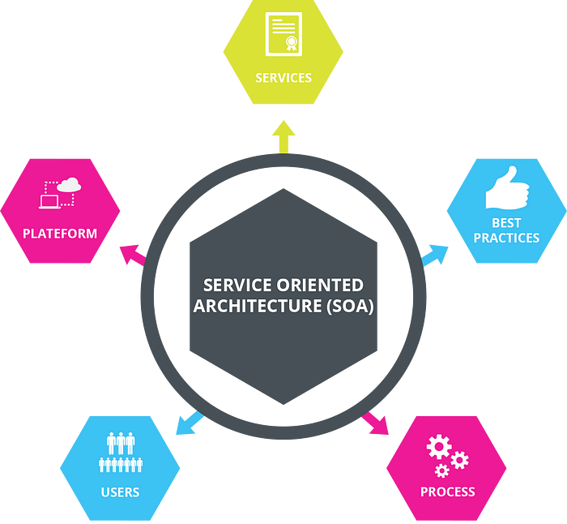
SOA based architecture
Typically, Service-Oriented Architecture is implemented with web services, which makes the “functional building blocks accessible over standard internet protocols.”

Slide 44
Services
A mechanism enabling the provisioning of access to one or more capabilities described in service description
An Interface for the service providing the access to capabilities
Applications or enterprise can subscribe on selection among number of services
A service level agreement (SLA) binds the enterprise application and service.
The access to each capability consistent with the constraints and policies
A collection of self contained, distinct and reusable components
Providing the logically grouped and encapsulated functionalities. Example: Traffic lights synchronizing service

Slide 45
Types of Services
There are four basic types of services:
Functional service: these define core business operations.
Enterprise service: these implement the functionality defined by the functional services
Application service: these are confined to specific application content
Infrastructure service: implements non-functional tasks such as authentication, auditing, security, and logging

Slide 46
Characteristics Of Service-Oriented Architecture
While the defining concepts of Service-Oriented Architecture vary from company to company. These core values include:
Business value
Strategic goals
Intrinsic inter-operability
Shared services
Flexibility
Evolutionary refinement

Slide 47
Benefits Of Service-Oriented Architecture
Use Service-Oriented Architecture to create reusable code: Not only does this cut down on time spent on the development process, but there’s no reason to reinvent the coding wheel every time you need to create a new service or process. Service-Oriented Architecture also allows for using multiple coding languages because everything runs through a central interface.
Use Service-Oriented Architecture to promote interaction: With Service-Oriented Architecture, a standard form of communication is put in place, allowing the various systems and platforms to function independent of each other. With this interaction, Service-Oriented Architecture is also able to work around firewalls, allowing “companies to share services that are vital to operations.”

Slide 48
Benefits Of Service-Oriented Architecture
Use Service-Oriented Architecture for scalability: It’s important to be able to scale a business to meet the needs of the client, however certain dependencies can get in the way of that scalability. Using Service-Oriented Architecture cuts back on the client-service interaction, which allows for greater scalability.
Use Service-Oriented Architecture to reduce costs: With Service-Oriented Architecture, it’s possible to reduce costs while still “maintaining a desired level of output.” Using Service-Oriented Architecture allows businesses to limit the amount of analysis required when developing custom solutions.

Slide 49
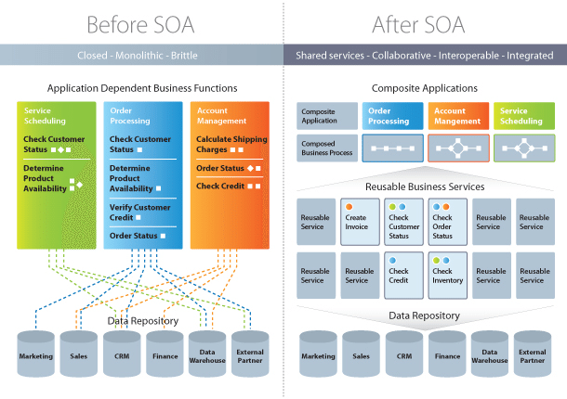

Slide 50
Assignments
Write in details about the communication model with necessary block diagrams.
Briefly explain SOA with necessary diagrams.
Brief about the weather monitoring IoT system modeling based on steps involved in IoT architecture models.
Write notes on the steps involved in IoT architecture model with flow diagram.

