Slide 1
ECE 3501 – IoT Fundamentals
Module 3
Dr.V.Berlin Hency
Professor
SENSE
VIT Chennai

Slide 2
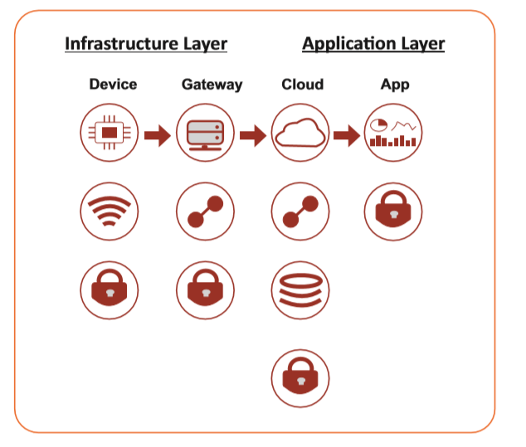
IoT Working Mechanism

Slide 3
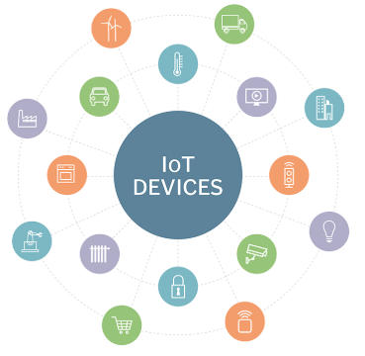

Slide 4
IoT device
An IoT device is a piece of hardware with a sensor that transmits data from one place to another over the Internet.
Types of IoT devices include
wireless sensors
software
Actuators
computer devices.
They can be imbedded into mobile devices, industrial equipment, environmental sensors, medical devices, and more

Slide 5
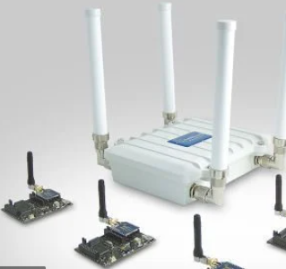
IoT Gateway

Slide 6
IoT Gateway
An Internet of Things (IoT) gateway is a physical device or software program that serves as the connection point between the cloud and controllers, sensors and intelligent devices.
Another benefit of an IoT gateway is that it can provide additional security for the IoT network and the data it transports.

Slide 7
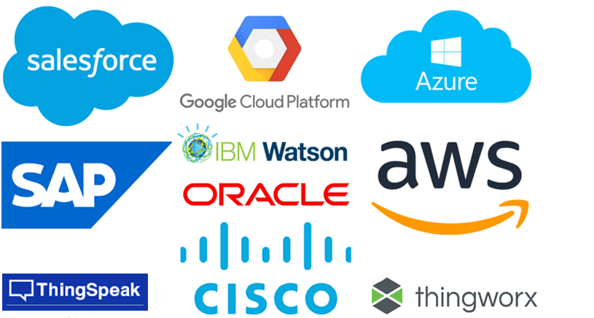
Cloud

Slide 8
Cloud
The IoT cloud is a platform for storing and processing data from the “Things” on the internet.
The platform is designed to capture and process the massive amounts of data generated by internet-connected devices, sensors, web sites, customers and other connected applications.
An IoT cloud platform mainly includes features like
connectivity
network management
device management
data acquisition
processing analysis and visualization
application enablement
Integration
storage.

Slide 9
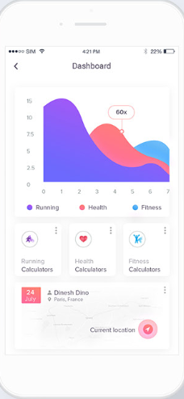
App/Dashboard
The application help the end user to control and monitor the device from remote location
Ex: Fitness App

Slide 10
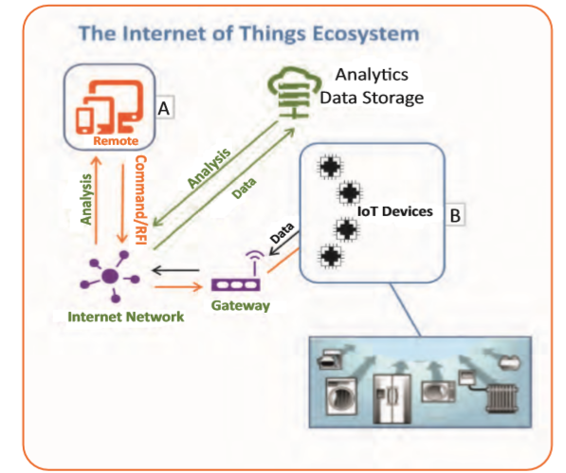
The IoT Ecosystem

Slide 11
The Principle technologies that drive IoT System
Wireless Sensor Networks
Embedded Systems
Communication Protocols
Cloud Computing
Big Data Analytics

Slide 12
Wireless Sensor Networks
A Wireless Sensor Network (WSN) is a network formed by a large number of sensor nodes
where each node is equipped with a sensor to detect physical phenomenon such as light, heat, pressure, etc.
With the rapid technological development of sensors, WSNs will become the key technology for IoT.
A sensor has the ability to capture anything from location to the device orientation.
Collectively, these sensors produce a huge amount of data, both in unstructured form (such as picture or videos) as well as structured (such as GPS or acceleration data).
These “devices” are perpetually connected to the Internet over WiFi, 3G or 4G. 5g 6g
The devices can be connected through WiFi, modem, cloud etc.

Slide 13
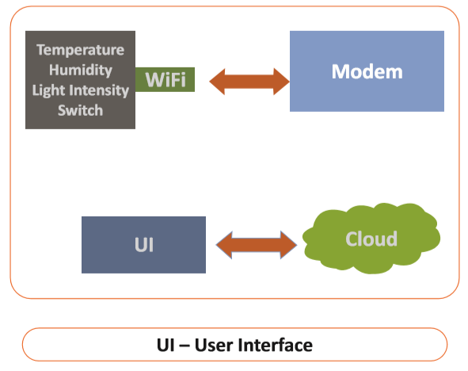
Wi-Fi Module

Slide 14
Embedded Systems
Embedded hardware devices, micro controllers etc, are the ones that process the data.
The data from the sensors are not directly usable and a process for using them is implemented by the embedded system.
All the connected devices are intelligent devices using a microcontroller or a processor.
Processors are the brain of the IoT system.
Their main function is to process the data from the sensors according to an algorithm to extract the valuable information like status, parameter values, alerts etc., and control actuators in some cases in the system.
Processors work on a real time basis. Changes in their operational limits can be set by applications depending on customer requirements.
These are also responsible for securing the data i.e. performing encryption and decryption of the data.

Slide 15
Communication Protocols
IoT connects various devices through Internet and devices talk to each other through a communication channel.
The deﬁned communication channel is called as 'Communication Protocol'

Slide 16
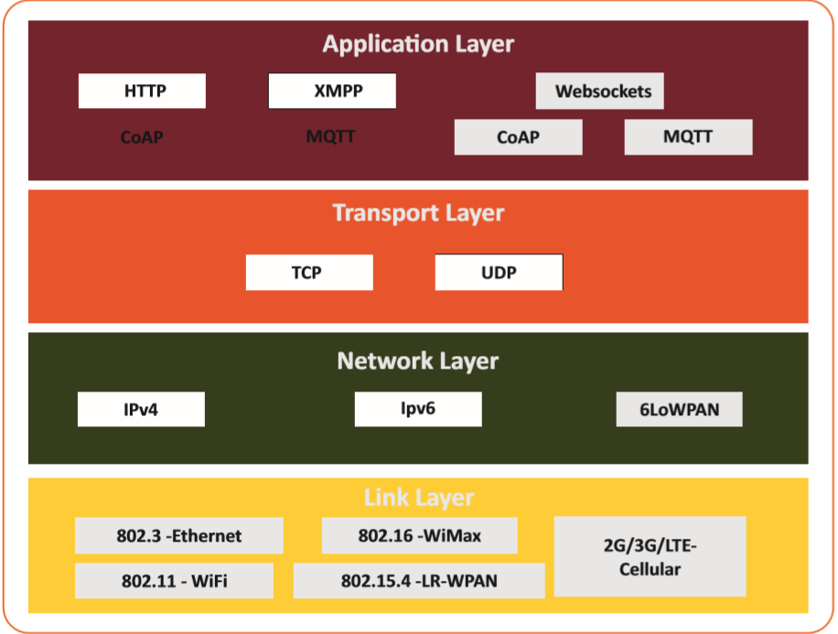
Communication Protocols

Slide 17
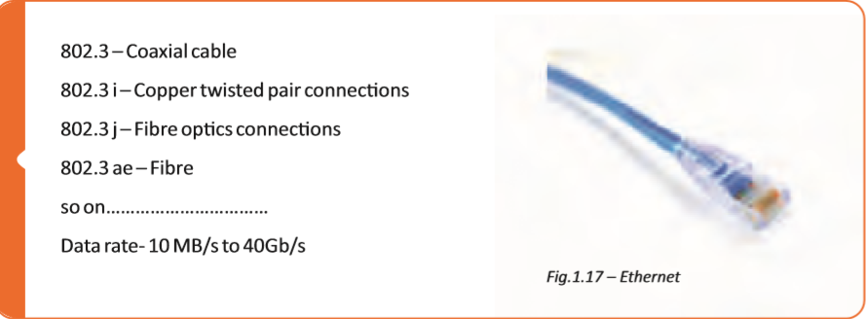
Link Layer Protocol

Slide 18
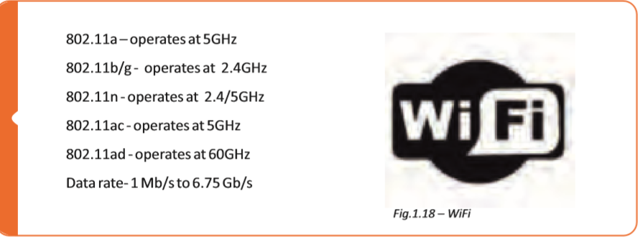
802.11 – Wi-Fi

Slide 19
802.16- WiMax
Collection of wireless broadband standards
1.5Mbps to 1Gbps data rate

Slide 20
802.15.4 – LR-WPAN
Low-rate wireless personal area networks ex: LoRa
40Kbps to 250Kbps data rate
Provides low-cost, low-speed communication for low-power devices

Slide 21
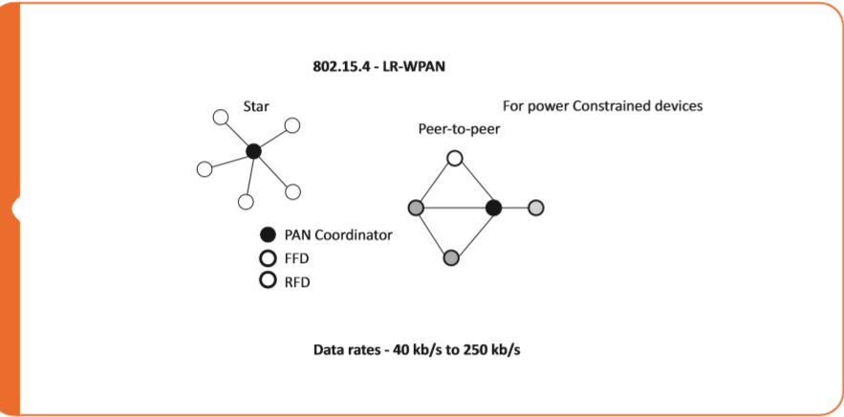
802.15.4 – LR-WPAN

Slide 22
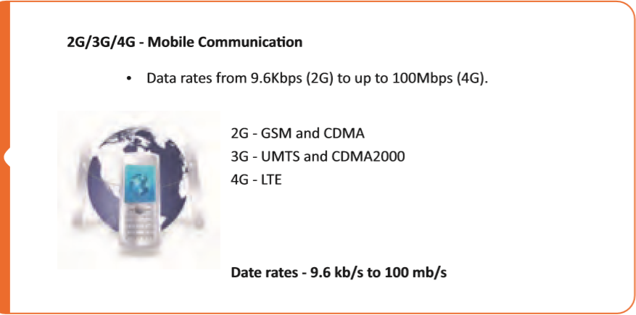
Mobile Communication

Slide 23
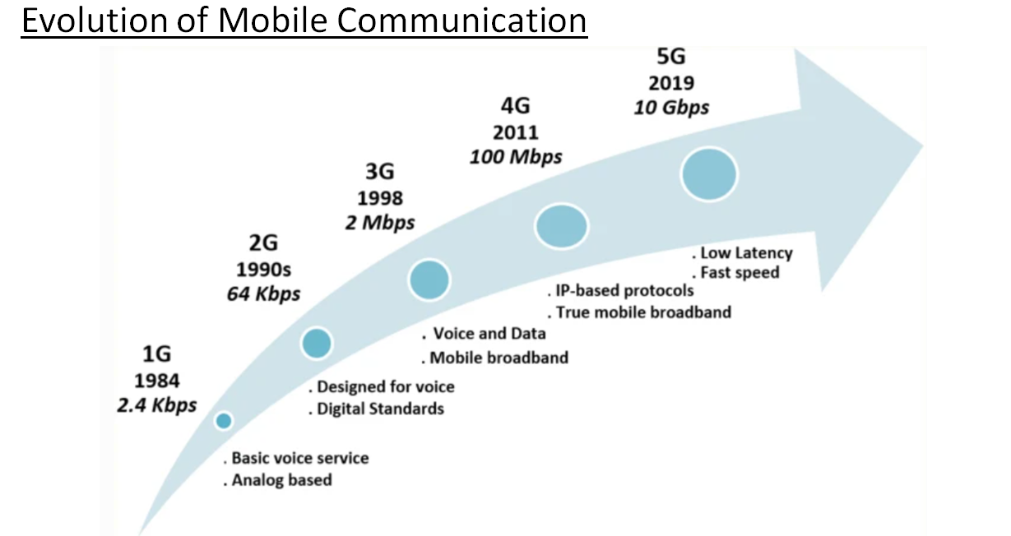

Slide 24
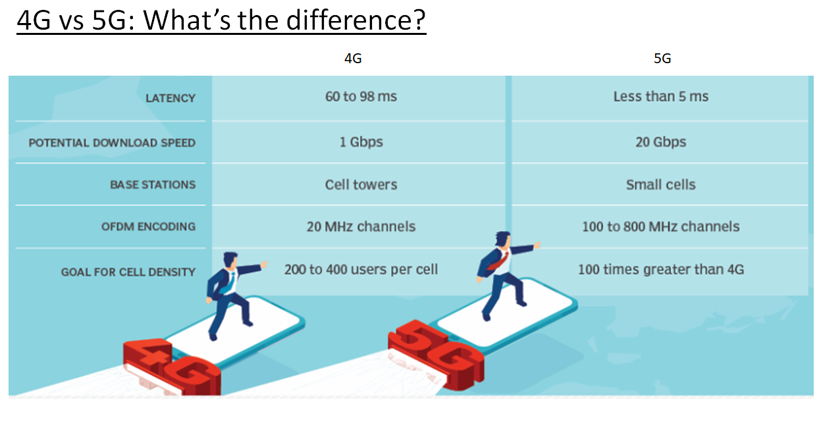

Slide 25
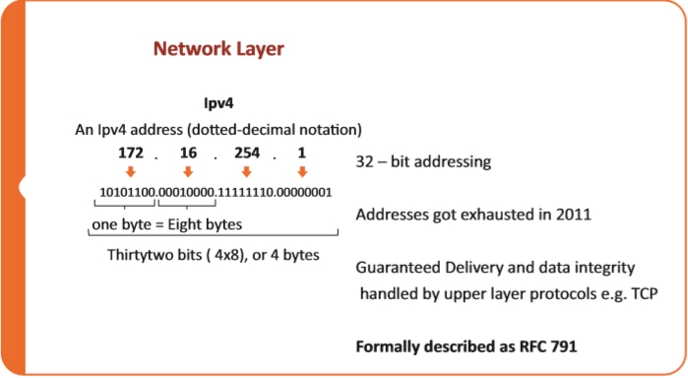
Network Layer

Slide 26
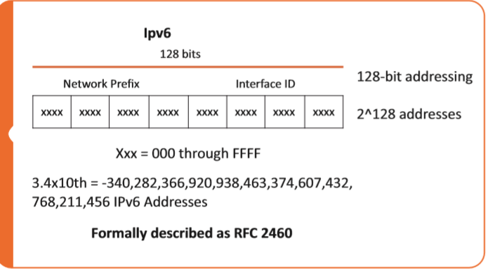
Network Layer

Slide 27
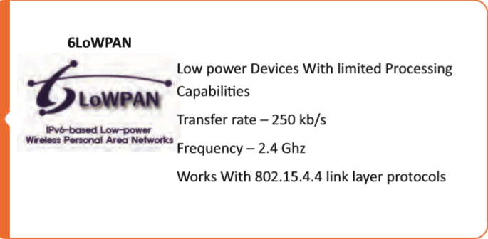
Network Layer

Slide 28
Transport Layer
Transmission Control Protocol
Connection oriented and state full protocol
Ensures reliable transmission, provides error detection, ﬂow control and congestion control

Slide 29
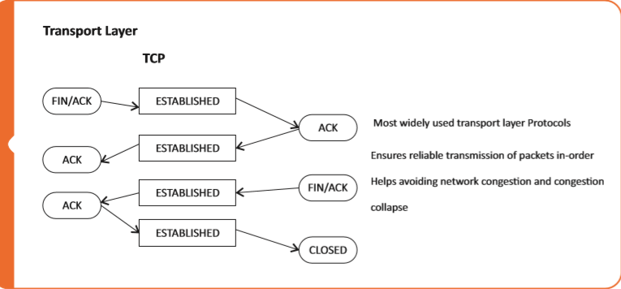
TCP

Slide 30
Transport Layer
User Datagram Protocol
Conneconless and stateless protocol
Asynchronous protocol

Slide 31
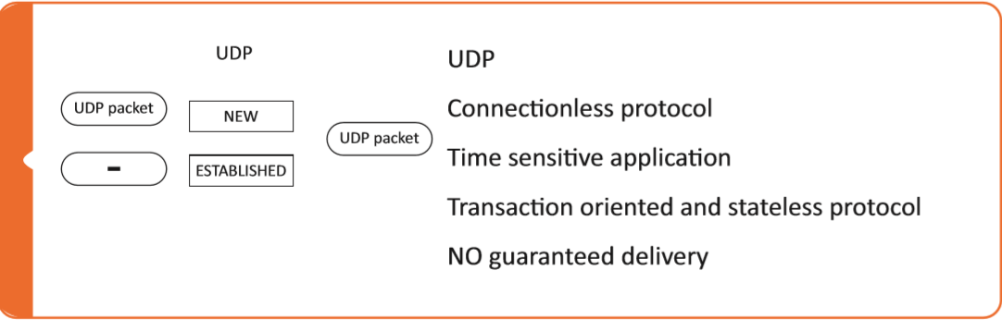
UDP

Slide 32
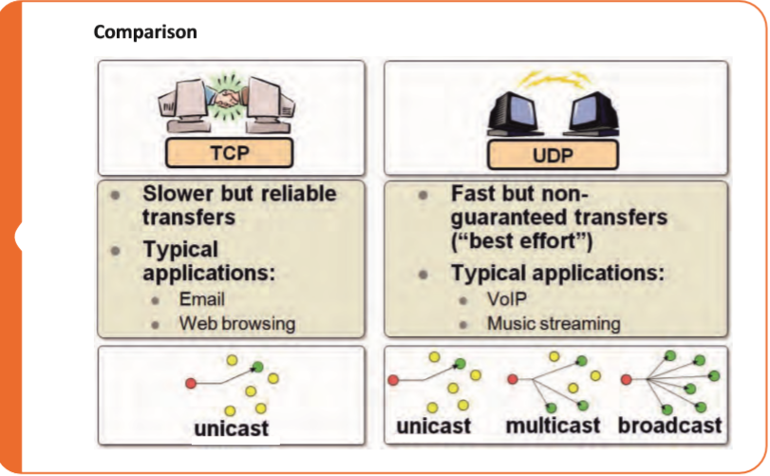
Comparision

Slide 33
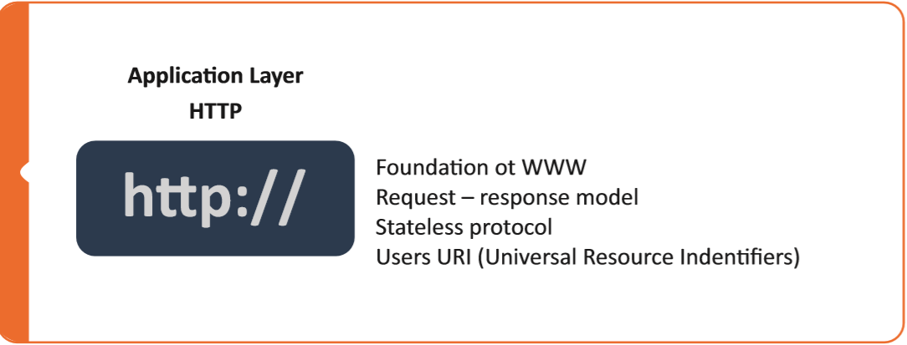
Application Layer

Slide 34
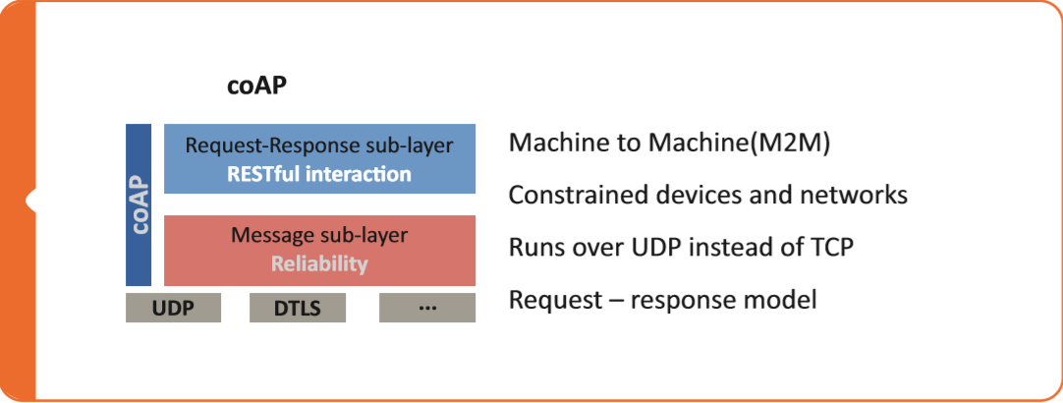
Application Layer

Slide 35
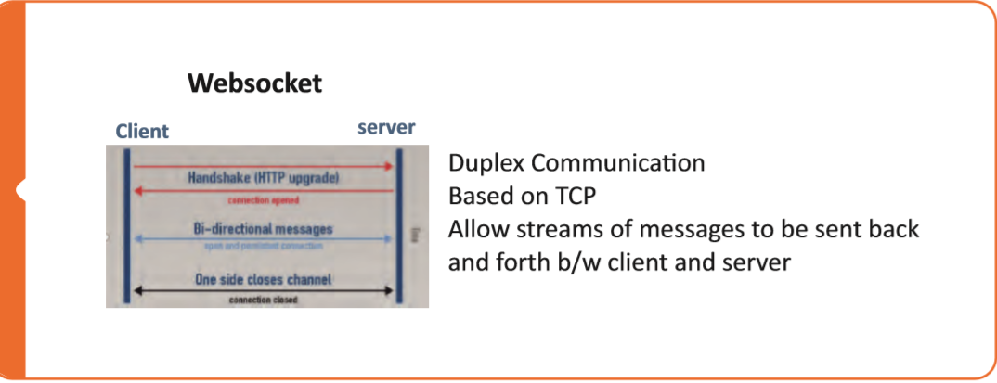
Application Layer

Slide 36
Application Layer
Message Queue Telemetry Transport
Based on Publish-Subscribe model
Low data rate, low packet size, requires low bandwidth

Slide 37
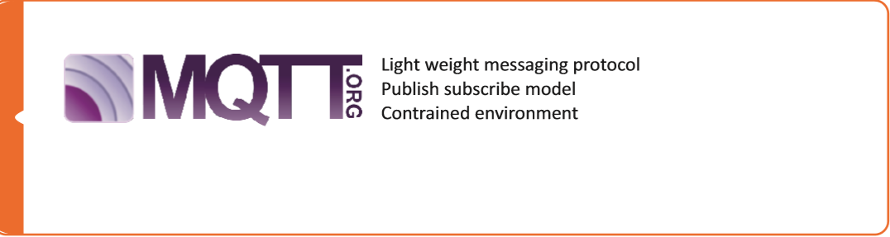
MQTT

Slide 38
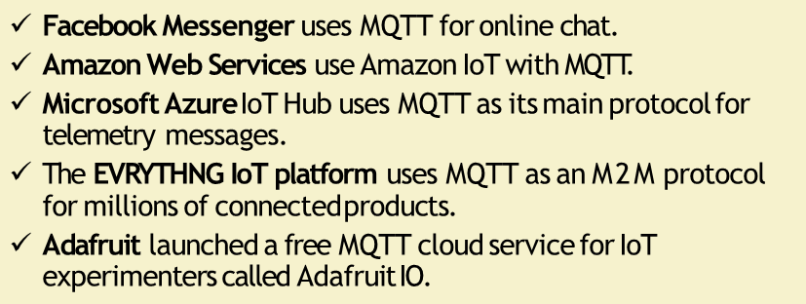
Applications

Slide 39
XMPP
Extensible Messaging and Presence Protocol
Used for real time communication and streaming XML data

Slide 40
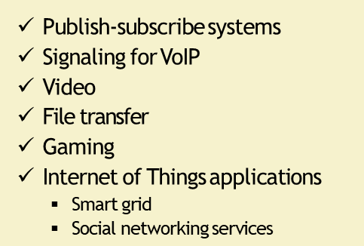
Applications

Slide 41
DDS
Data Distributed Service
Based on publish – subscribe model

Slide 42
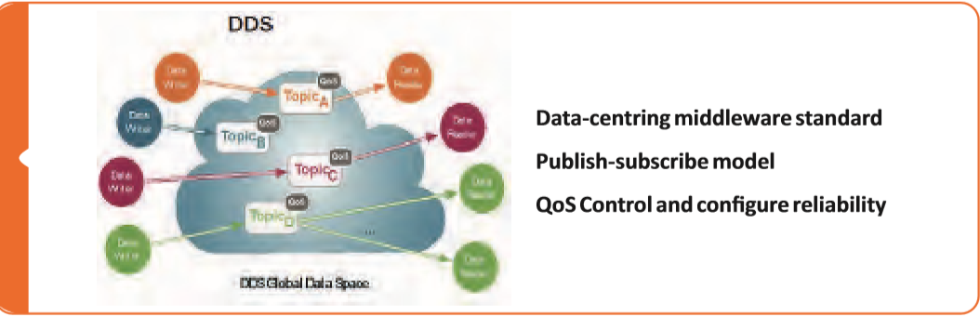
DDS

Slide 43
AMQP
Advanced Message Queuing Protocol
Supports publish – subscribe model,
point-to-point and routing and queuing

Slide 44
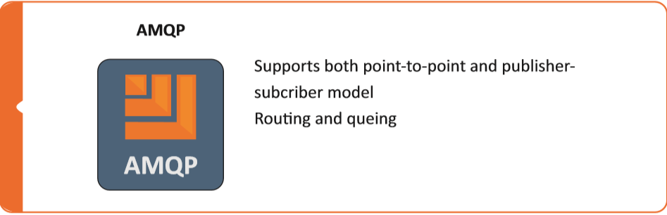
AMQP

Slide 45
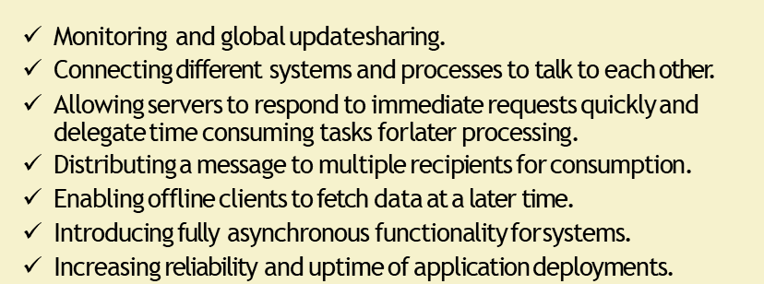
Application

Slide 46
dashboard
Tableau
https://public.tableau.com/en-us/s/download

Slide 47
References
https://www.forbes.com/sites/janakirammsv/2016/08/22/10-steps-to-implementing-a-successful-enterprise-iot-strategy/#587b31968b9e
https://www.postscapes.com/iot-gateways/
https://iotdesignpro.com/articles/top-10-iot-cloud-platforms
https://www.behance.net/gallery/54994393/Fitness-App-Dashboard
https://www.theverge.com/2017/12/1/16723186/elon-musk-battery-launched-south-australia
Foundation Skills in Internet of Things ( IoT ) - NASSCOM

