Slide 1
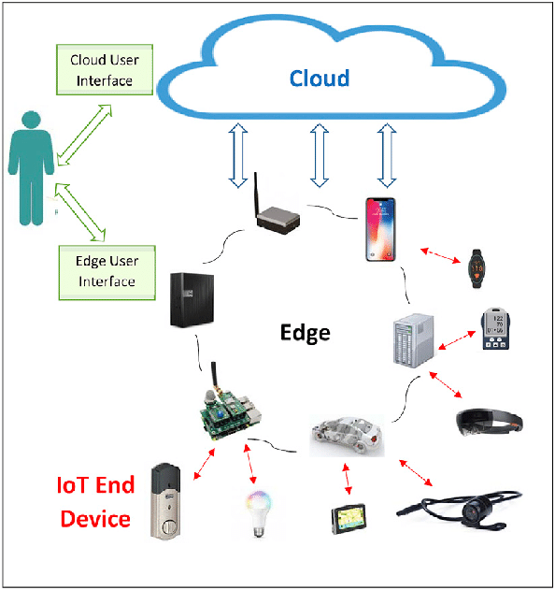
Topics in Module 6 – User centric IoT Architecture
Enabling Technologies
Personalizing the IoT
User Sensitized IoT Architecture
Tweaked Data Layer
Personalization Layer

Slide 2
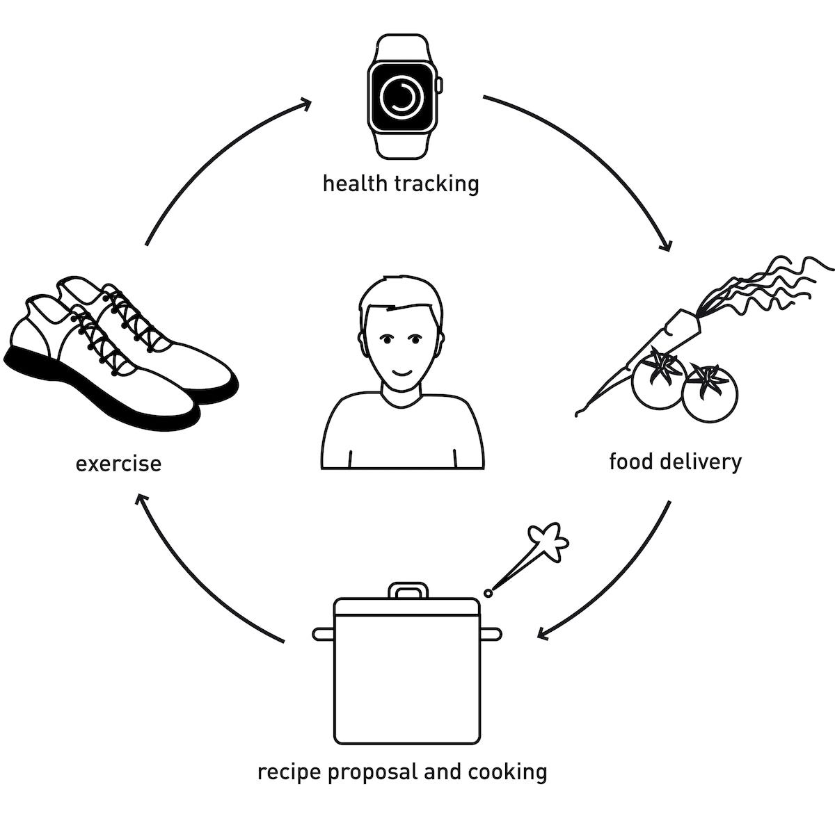
INTRODUCTION
User-centric IoT architecture is an approach to designing IoT (Internet of Things) systems that places the user's needs, preferences, and experiences at the forefront of the design process
It aims to create IoT solutions that are intuitive, user-friendly, and tailored to meet the specific requirements and expectations of end-users

Slide 3
INTRODUCTION
The integration of Big Data Analytics (BDA) with the IoT applications has led to the successful development of many complex systems such as smart cities, smart homes, smart security systems, etc.
These systems have been able to deliver the promised physical comfort and ease of doing things to the end‐user
However, it is important to distinguish between connected systems that deliver the designated functionality and truly smart systems
A smart system should possess the intelligence of being able to automatically learn, adapt, and respond back relevantly to the needs of an end‐user. Also, many connected systems fail to climb the ladder of popularity and are merely rejected by the users because they seem irrelevant to the user, i.e. they fail to strike a chord with the end‐user that would guarantee them a place in their life.

Slide 4
INTRODUCTION
Personalization
Personalization can be defined as the ability to incorporate the needs, preferences, constraints, and sentiments of the users
It is a powerful instrument that has the potential of shaping the quality of future IoT products and services to keep pace with constantly evolving customer needs
Key technologies like ML and sentiment analysis can be used for BDA to provide novel insights about the user's personal habits, daily routines, preferred actions, moods and sentiments, etc
Using these personal insights, IoT systems can establish a personal bond with the users, taking into consideration their little wants and adapting themselves to comfort them
Importantly, only the products or services which have the power to capture a user's interests can influence their choices, the way they spend their money and time
The power of granting pleasurable experience to the users ensures their engagement and makes them come back for more
The organizations gain by increased profits, customer base, and brand value
Thus, personalizing IoT systems presents a win‐win situation for both the businesses and the end‐users

Slide 5
KEY ELEMENTS IN USER CENTRIC IoT ARCHITECTURE
User Interface (UI)
A well-designed user interface is crucial for interacting with IoT devices and applications. It should be intuitive, easy to navigate, and visually appealing.
UI elements may include web dashboards, mobile apps, voice interfaces, or augmented reality (AR) interfaces, depending on the specific use case and user preferences
User Experience (UX)
User experience design focuses on ensuring that interactions with IoT systems are seamless, efficient, and satisfying for users.
This involves understanding user behaviors, conducting usability testing, and continuously refining the design based on feedback
Personalization and Context Awareness
IoT systems should be able to adapt to individual user preferences and changing contexts.
Personalization features may include customizing settings, recommendations based on user behavior, and proactive notifications tailored to the user's needs.
Privacy and Security
Protecting user data and privacy is paramount in IoT architecture.
Strong security measures, such as encryption, authentication, and access control, are essential to safeguard user information from unauthorized access or misuse

Slide 6
KEY ELEMENTS IN USER CENTRIC IoT ARCHITECTURE
Edge Computing and Data Processing
Edge computing brings computational capabilities closer to IoT devices, reducing latency and improving response times.
By processing data at the edge, IoT systems can provide real-time insights and actions tailored to user requirements without relying solely on centralized cloud servers
Interoperability and Integration
User-centric IoT architectures should support interoperability between different devices, platforms, and protocols.
Integration with existing systems and services, such as third-party applications or enterprise software, enhances the overall user experience and expands the functionality of IoT solutions
Scalability and Flexibility
The architecture should be scalable to accommodate a growing number of devices and users without sacrificing performance or usability.
Flexibility allows for easy adaptation to evolving user needs, technological advancements, and changes in the IoT ecosystem
Feedback mechanism
Incorporating feedback mechanisms enables users to provide input, report issues, and suggest improvements.
This feedback loop is essential for continuous refinement and optimization of IoT systems based on user insights and preferences

Slide 7
ENABLING TECHNOLOGIES FOR BDA OF IoT SYSTEMS
The maturity of database technology and the development of enormous processing power have led to the collection of massive amounts of data
The gigantic mountains of data are being continually fed by endless data sources, which are present almost everywhere around us, such as transactions at the online retail mega marts, e‐wallet transactions, point of sales transactions, stock ticks, meteorological sensors, bio‐medical data sequences, consumer behavior data, employee profile data, web clickstream data, textual data and media exchanges on social media platforms, etc
This ubiquitous data hides gleaming gems of knowledge in its bowels - It is itself an asset that can reveal insights for an organization to hone its capabilities and gain a competitive advantage
Using patterns mined from this ubiquitous data, technologies such as Knowledge Discovery in Databases (KDD), Data Mining, and ML have demonstrated the power to completely transform the world scenario by revealing novel item sales patterns and customer tendencies in businesses; providing valuable inputs for stock markets; design of highly successful electoral campaigns; characterization of moods and preferences of patients for psychological treatments; spatiotemporal analysis of global pandemics and clustering the genetic databases for prediction of lifestyle diseases, evolutionary research, and drug design, to name a few

Slide 8
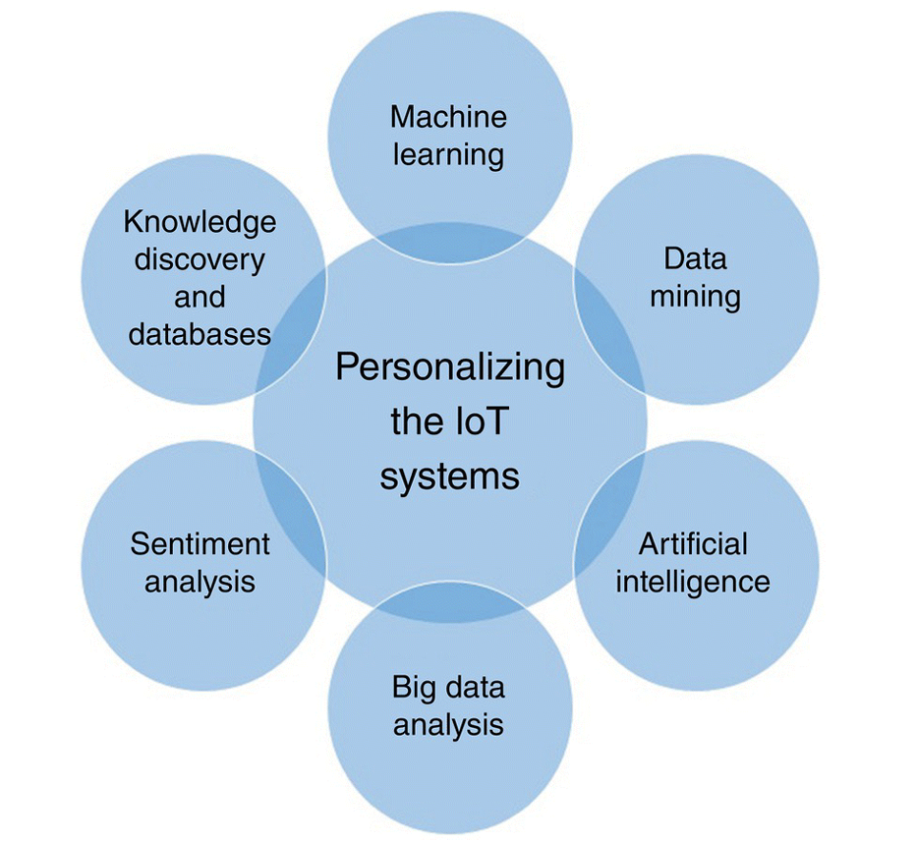
PERSONALIZING IoT SYSTEMS

Slide 9
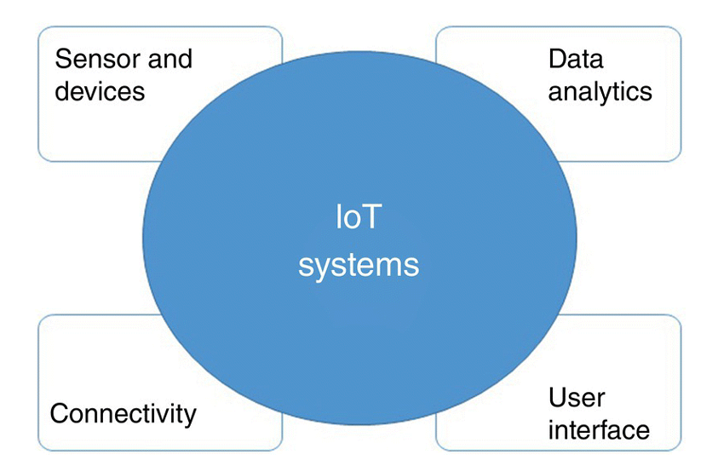
PERSONALIZING IoT SYSTEMS
Personalization is a powerful tool for organizations to establish a personal bond with the end‐user
To meet the end‐user's needs and increase user satisfaction, an organization may adapt its IoT services or products according to the insights into the user's personal habits, tastes, mood, and preferences
Any IoT application is based on four building blocks - interconnected sensors and devices, Internet and connectivity to the cloud, data analytics, and user interface.

Slide 10
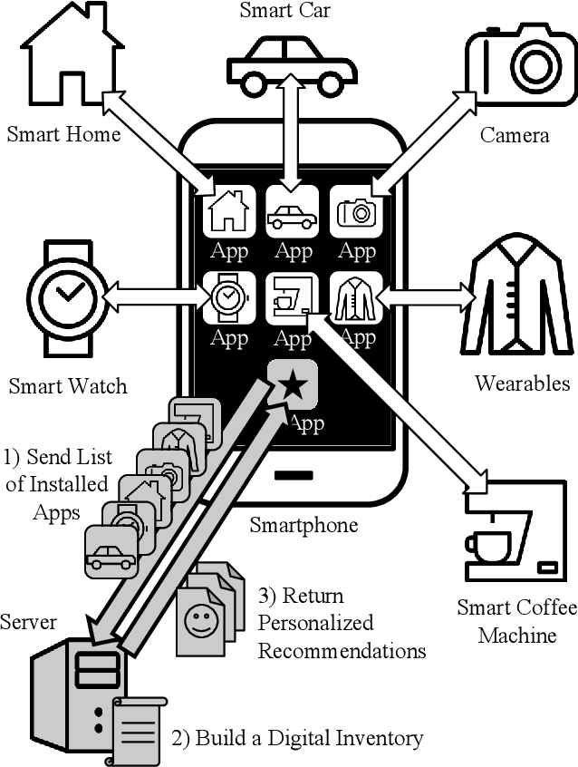
PERSONALIZING IoT SYSTEMS
The interaction with users is thus one of the major building blocks of this quadrangle that facilitates IoT applications
The idea of laying enough emphasis on incorporating users' preferences into the design for IoT applications is therefore not overemphasized
Applying a personal touch to the IoT application can yield numerous benefits.

Slide 11
PERSONALIZATION FOR BUSINESS
Businesses have been increasingly devoting resources to study their customers. They are making use of their customers' insights to offer them customized services
Resultantly, the customers are not just satisfied, but happy and engaged with the product or service that they are using
This helps businesses retain their customer bases, increase the value of their brands, and stay ahead of their competitors
For instance, in addition to maintaining a shopping list for the owner, the virtual marts are maintaining a list of items liked or purchased by them in the past
Setting up a smart grocery list already populated with the frequently purchased items makes the shopping experience faster and easier
Reminder for things that a customer may have missed putting in a basket and automatically recommending the items with better offers also enhance the overall user experience.

Slide 12
PERSONALIZATION FOR MARKETING
Based on the usage patterns and individualized customer experiences, the companies are segmenting their consumers and targeting them accordingly
Personalized advertising campaigns and promotional marketing strategies are designed to target specific audiences that increase revenue and customer base
The rationale is that the set of the population which has responded positively to similar products in the past is more likely to fall for an interesting promotion of a similar product, rather than targeting a new customer who may not even be inclined toward the category of products being offered
Also, companies are increasingly being benefited by sharing personal data about customer interests with other organizations and lending them space to place personalized ads

Slide 13
PERSONALIZATION FOR PRODUCT IMPROVEMENT AND SERVICE OPTIMIZATION
User's personal insights have the power of broadening the scope of commercial and industrial IoT products and services
Personalization of these services can considerably improve their functionality, thereby transforming how various underlying organizations operate
For instance, fitness‐oriented wearables are quickly being converted into health‐oriented devices aimed at helping patients overcome various ailments
They also allow the patient to view how they are progressing
These connections can substantially improve the quality of care to the patient while reducing the cost of healthcare delivery for the provider
Fitness apps are being personalized for improved healthcare
Smart wearables are tracking the health of patients
They can log the vital statistics such as blood pressure, heart rate, and raise alarm and call on default emergency numbers, in case of need

Slide 14
PERSONALIZATION FOR PRODUCT IMPROVEMENT AND SERVICE OPTIMIZATION
These new health monitors enable doctors to closely track their patients' vital signs
The detailed logs can help the doctor diagnose and corroborate the patients' activity patterns with their health problems
The patients are also benefited as they can view their routine and progress using many visualization tools
These visualization tools can be developed to graphically display the logged data
Depending upon these data, diet and fitness plans may be customized to suit particular users, helping them manage their diseases
The users may be ranked on a global board, competitively judged against other users, and offered incentives for making progress

Slide 15
PERSONALIZATION FOR PRODUCT IMPROVEMENT AND SERVICE OPTIMIZATION
Ride‐hailing companies such as Ola and Uber are using data generated from various sensors attached to their vehicles to monitor the status and location of their cab, the status of a ride (canceled/ongoing/completed), the average driving speed of the driver, and use these statistics to identify issues before they become real problems
Personalizing this analysis to match the driver, cab, passenger, and ride area can help to further improve the performance and efficiency
For instance, assurance of a consistent environment by ensuring the same driver, vehicle, and settings in the cab for regular, long‐distance customers can make them feel more welcome and keep them glued to the company's services
Similarly, putting drivers en route on their accustomed route can improve their driving efficiency and simplify their daily chores of refueling and locating service stations for cleaning and maintenance tasks, etc

Slide 16
PERSONALIZATION FOR PRODUCT IMPROVEMENT AND SERVICE OPTIMIZATION
Another example is improving the search results returned by a web service by using personalization for automatic filtering of search results
When a user searches the web for some information, he is usually overwhelmed by a large number of search results
It takes a lot of time, effort, and patience to manually go through the irrelevant results to finally be able to zero in on what one wants to find
Based upon parameters such as the location of the user, his previous searches, the kinds of sites that he visits, or the comments that he posts on the web, search engines filter and order the results differently for different users to make the results more relevant for the user
For web publishers, relevant content and ads mean more clicks and ultimately more money

Slide 17
PERSONALIZATION FOR AUTOMATED RECOMMENDATIONS
Automated recommendations have been in place for almost two decades now
This involves automatically generating suggestions for similar products or services based on a blend of products or services used by the customer in the past, his preferences as ascertained from his search keywords or his reviews or ratings, past transaction records, surfing details on the product site, etc
For instance, Amazon uses a ML‐based service called Personalize that helps its developers generate individualized product and content recommendations for its customers
Similarly, numerous Music apps are offering personalized playlists based upon the genre of music, artist, and language liked by the user
Interestingly, recently some studies have focused on correlating the user insights such as their mood, geographical location, and time of the day, etc., to further personalize the recommendation of music titles

Slide 18
PERSONALIZATION FOR AUTOMATED RECOMMENDATIONS
However, it is pertinent to note here that a random recommendation for products or services will just lead to irritated users
The recommendations need to be suited to the customer being targeted, strategically timed, and maybe analyzed later for results and fine‐tuning future recommendations.

Slide 19
PERSONALIZATION FOR IMPROVED USER EXPERIENCE
The end‐user is undoubtedly the foundation of any organization's success
Customization of an application or device in accordance with the end user's preferences helps to establish a personal connection, thereby making the users feel valued and important
Resultantly, the underlying service becomes more relevant and enjoyable by the user

Slide 20
PERSONALIZATION FOR IMPROVED USER EXPERIENCE
Many web‐based video streaming services like Netflix and Amazon Prime personalize the viewing experience differently for different users even under the umbrella of a single login
This not only enables different viewing experiences for each member of the family but also safeguards the privacy and interest of all users
These streaming giants use small nothings like greeting the user with their names and storing the cue of their last played video to spell convenience and increase the quality of the user's experience with the web service
The list of titles viewed in the past by the users is used to recommend flicks of similar genre, language, period, and cast
Cross recommendations are also done
The users are offered recommendations for the content that has been watched and liked by other users, which is similar to the end‐user's type
Recommendations such as these make a user's task of searching the titles quicker and easier

Slide 21
PERSONALIZATION FOR IMPROVED USER EXPERIENCE
Similarly, enrolling for new services and setting up new devices can be made an enjoyable process for the user
Multiple services such as a video streaming, music streaming, and news streaming service can be integrated to use the preferential settings of the end‐user to offer a common look and feel, similar settings for data usage, screen resolution, subtitle font, language settings, payment renewal options, etc.
Seamlessly integrating new devices based on the preferences set on older devices and automatically syncing them would save a lot of user effort and time

Slide 22
User Sensitized IoT Architecture
The user-centric IoT architecture is designed to prioritize user needs and preferences, ensuring a seamless and personalized experience across IoT devices and applications.
It is composed of the following four layers:
1. Perception layer
2. Personalization layer
3. Tweaked data layer
4. Platform layer.

Slide 23
Perception layer
The perception layer, also known as the IoT device layer or the IoT layer, is the client‐side layer.
This layer's main responsibility is to collect useful information and data from the environment.
This comprises heterogeneous devices, sensors, and real‐world objects that are embedded in IoT products.
It thus supports the products and services being used by the end‐user.
For example, in a smart home environment, sensors embedded in appliances, thermostats, and security cameras collect data on temperature, energy consumption, and occupancy.

Slide 24
Platform layer
The platform layer is the bottom‐most layer. It is fundamental for supporting the Internet and other infrastructural requirements.
The platform layer serves as the foundation for hosting and integrating IoT applications and services.
It provides infrastructure and middleware components for data storage, processing, and communication.
Cloud platforms and edge computing systems are commonly used in the platform layer to support scalability, reliability, and interoperability.
For instance, a smart city platform may leverage cloud-based services to aggregate and analyze data from various IoT devices, such as traffic sensors and environmental monitors, to optimize urban infrastructure and services.

Slide 25
The Tweaked Data Layer
The data layer resides on the server‐side and houses data storage, management, and analytical tools for managing the big data captured and streamed in by the perception layer.
The proposed user‐centric IoT architecture segments the data layer used by the conventional IoT architecture into a context‐aware database, behavioral database, and a sentiment database.
The context‐aware database stores the external details of events associated with the IoT products and services being used by the end‐user. These include the details of time, location, and device, and the product or service being used, etc.
The objective of the context‐aware database is to be able to resurrect the context in which the user is deploying a particular IoT device or service.

Slide 26
The Tweaked Data Layer
The user‐centric IoT architecture

Slide 27
The Tweaked Data Layer- Behavioral Database
The behavioral database on the other hand logs in the details required to study how the users behaves or wishes to conduct themself in a particular situation or respond to an external stimulus.
This is possible by logging in details about what activities or actions are being performed by the user like page views, clicking on hyperlinks, email sign‐ups, registration, etc.
The motivation to store these behavioral details is to be able to understand why an end‐user performs the logged actions.
It may also be meaningful to store details that indicate how some activity has been performed.
For instance, the sequence of hyperlinks clicked for product views before making a final selection.
These can reveal important insights about the user's decision‐making process, which in turn may help in customizing the IoT systems.

Slide 28
The Tweaked Data Layer- Sentiment database
The third segment of the data management layer is the sentiment database. The objective of this segment is to be able to capture the emotional makeup of an end‐user when he deploys a particular product or a service.
Tapping sentiment data and being able to relate it with user actions will be a key leveraging aspect both for the end user and the IoT system.
Every organization wishes to understand how an end‐user feels about their product. This understanding of user emotions and sentiments holds a key to determine how the IoT system being deployed captures the user's interest.
The products or services which have the power to capture users’ interests can influence their choices, the way they spends their money and time. This knowledge can also guide the design of future IoT systems.
The sentiment database stores the explicit requests made by the users or the preferences set by them for using the IoT service at hand.
Their feedback and reviews about various products and services are also stored in this segment of the database.

Slide 29
The Tweaked Data Layer
Thus, context‐aware, behavioral, and sentimental segments of the data layer together enable the corroboration of data in the physical, behavioral, and sentimental contexts in which the IoT product or service is being used.

Slide 30
The Personalization Layer
The objective of the personalization layer is to transform an IoT system into a smart, user‐sensitized IoT system that has the intelligence to learn and reason about a user's preferred actions, adapt to user's routines, and respond relevantly.
Depending on the knowledge of user characteristics, the IoT system may automate some mundane tasks and automatically set reminders or alarms for some other routine chores that the end‐users perform daily with the IoT product or service they are using.
The IoT system may also be able to offer relevant alternative recommendations.
However, it is pertinent to note here that these little offerings need to be suited to the user being targeted because random customizations and ill‐suited recommendations may just lead to irritated users.

Slide 31
The Personalization Layer
Hence, personal connect is what makes all the difference. The personalization layer, therefore, aims to build a connection with the end‐users by tapping into their routines, mannerisms, and moods.
It consists of the following components: a characterization engine and a sentiment analyzer.

Slide 32
The Personalization Layer- A characterization engine
The characterization engine aims to personalize the IoT system at hand by building a user profile by observing user routines, actions, mannerisms, and behavioural characteristics.
Learns and analyzes user's preferred actions, adapting accordingly.
Accepts data from context-aware and behavioral databases, including events, activities, and metadata.
Builds ML model like rule-based classifier to characterize user and predict preferred actions.

Slide 33
The Personalization Layer- A characterization engine
Integrates IoT system to perform preferred actions automatically, like controlling lights and appliances.
Sets alarms or alerts for other preferred tasks such as exercise, cooking, or studying.
Offers relevant recommendations based on predicted actions, like playlists or recipes.
ML model chosen based on suitability to IoT application and data, using rule-based classifier in proposed user-centric IoT architecture.

Slide 34
The Personalization Layer- A characterization engine
A rule based classifier is a classification algorithm that extracts knowledge from data in the form of If–Then rules.
Widely used for storing knowledge, drawing logical inferences, and supporting decision-making.
Competitive with other classification algorithms, sometimes even superior.
In the personalization layer, the rule‐based classifier, performs the following tasks: (i) Rule induction, (ii) Rule ordering and ranking, (iii) Class prediction.

Slide 35
The Personalization Layer- A characterization engine
(i) Rule induction: The process of learning rules directly from the data is called rule induction or rule learning.
Requires a set of training examples for supervised learning.
Training data derived from log of user's daily tasks for IoT application.
Extracts If-Then rules using data mining classifier.
IF part of rule called rule antecedent, consists of conditions logically ANDed together.
THEN part called rule consequent, leads to prediction of class label.
Any multi-class, multi-label classification algorithm can be used as classifier.

Slide 36
The Personalization Layer- A characterization engine
(ii) Rule ordering and ranking: The rules may be ordered or ranked according to their usefulness for accurate prediction. The redundant or unnecessary rules may be removed thereby increasing the efficiency of the classifier.
(iii) Class prediction: The set of discovered rules represents a rule knowledge base that can help characterize the end‐users and chalk out their profile.
Rules used to assign predefined classes for future instances.
IoT system predicts user actions based on context or series of actions.
Correlates user insights like geographical location and time of day.
Offers personalized recommendations and alternatives.
User requests and preferences indicate comfort level and needs, updated in emotional profile.

Slide 37
The Personalization Layer- The Sentiment Analyzer
Personalization layer's sentiment analyzer augments emotional facets from sentiment database to user profiles.
Popular platforms for expression: Blogging sites, social networking sites like Facebook, Twitter, Google Plus.
Online communities serve as tools for consumers to gather information, get influenced, and make purchase decisions based on feedback and reviews.
Sentiment Analysis, or opinion mining, systematically analyzes written text or speech to extract opinions or attitudes of authors or speakers.
Branch of study associated with tasks like sentiment extraction, classification, subjectivity classification, opinion summarization, and opinion spam detection.
Aims to analyze sentiments, attitudes, opinions, emotions, etc., towards products, individuals, topics, organizations, and services.
Successfully deployed in Big Data Analytics for gaining insights from structured and unstructured sources like social media, blogs, and text documents.

Slide 38
The Personalization Layer- The Sentiment Analyzer
Sentiment database in user-centric IoT architecture contains user opinions on products and services.
Opinions are gathered from feedback, reviews on blogging sites, and social media.
Analysis of opinions reveals insights on user attitudes, preferences, and tendencies.
Sentiment analyzer employs sentiment analysis techniques to detect underlying sentiment.
Sentiments categorized as positive, negative, or neutral to understand user feelings.
Crucial for organizations to gauge user sentiments for product/service enhancement.
Insights used to modify product/service design for enhanced user satisfaction and competitive advantage, leading to increased brand recognition and revenue.

Slide 39
The Personalization Layer- The Sentiment Analyzer
Sentiment analysis techniques: ML and Lexicon analysis.
ML technique involves building models from labeled training data and evaluating accuracy on a test set.
ML algorithms like Naïve Bayes (NB), Ngrams, SVM, and Part-of-Speech tagging commonly used.
Lexicon analysis is unsupervised learning using sentiment dictionaries.
Lexicon contains positive and negative opinion words; example: SentiWordNet.
Scoring function assigns positive, negative, or neutral scores based on word polarity in sentences.
Lexicon-based approach doesn't require large training data but depends on quality of lexical resources.
Challenges include detecting slang, sarcasm, and negation, and inability to discern sentiment from context.

Slide 40
Concerns and Future Directions
Benefits of personalization are extensive, yet it raises serious concerns such as privacy violations and the filter bubble.
Personalization Benefits and Concerns:
Numerous benefits, but raises serious concerns like privacy violations and the filter bubble.
Organizations collect vast user information including social, demographic, geographic, behavioral, and cultural aspects, often without user consent.
Users unaware of data collection and usage, leading to privacy concerns and exploitation by organizations for competitive advantage.
Filter Bubble:
Personalization confines users to a bubble of familiar content, restricting exposure to diverse viewpoints.
Web services tailor results based on user interests, leading to reinforcement of existing beliefs and ignorance of opposing perspectives.
Future Direction:
Development of transparent personalized systems that educate users and obtain their consent before restricting their horizons.
Emphasis on privacy preservation in systems utilizing private user information, promising future research direction in IoT, BDA, and Personalization.

