Slide 1
Introduction
Principles and phases of Value Engineering and Analysis, Frameworks for Value Engineering in IoT solutions
Value engineering is a systematic and organized approach to providing the necessary functions in a project at the lowest cost.
Value engineering promotes the substitution of materials and methods with less expensive alternatives, without sacrificing functionality.
It is focused solely on the functions of various components and materials, rather than their physical attributes.

Slide 2
Principles of Value Engineering
Value Engineering:
Determines the basic function of an item.
Evaluates high-cost areas and finds ways to systematically reduce those costs.
Analyzes a problem area and develops alternative ways of resolving the problem.
Selects the best possible alternative to perform the basic function at the lowest cost.
Also simplifies the solution, resulting in increased reliability and ease of maintenance.
Extends financial, manpower, and material resources.

Slide 3
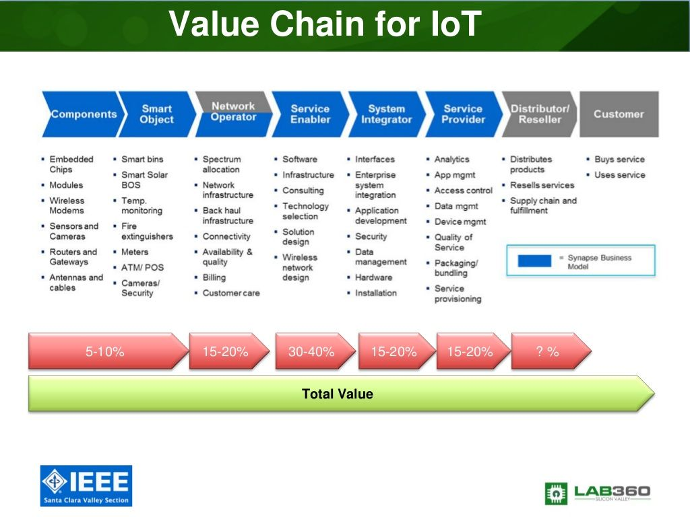

Slide 4
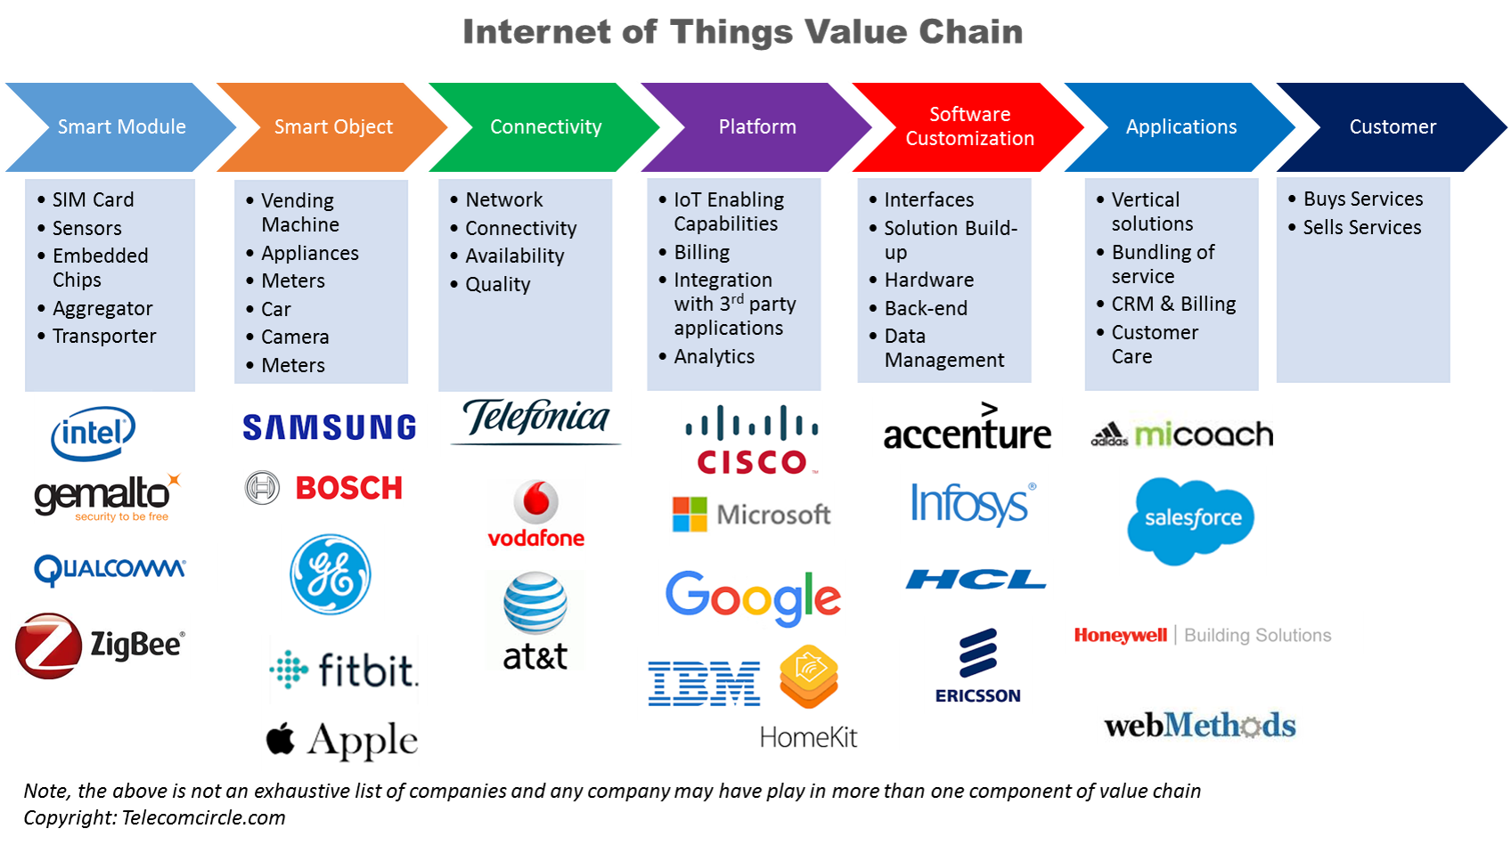

Slide 5
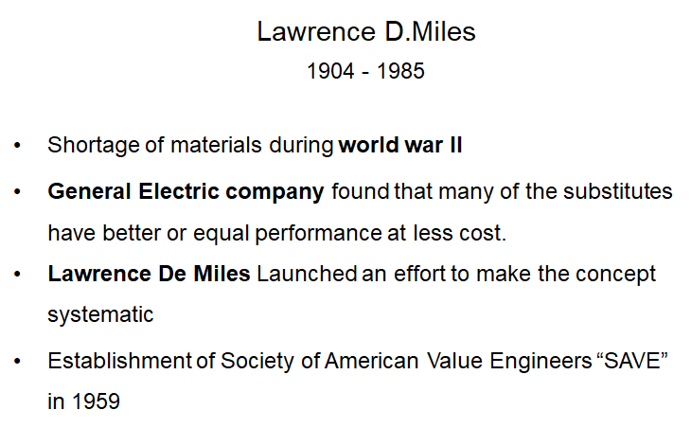
History

Slide 6

Implementation
•How is a Value Engineering Study Conducted?

Slide 7
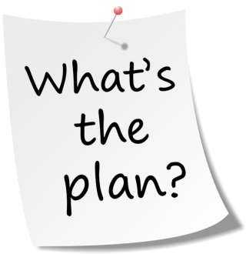
The job plan:
Value engineering is often done by systematically following
a multi-stage job plan. Larry Miles' original system was a six-step procedure which he called the "value analysis job plan."

Slide 8
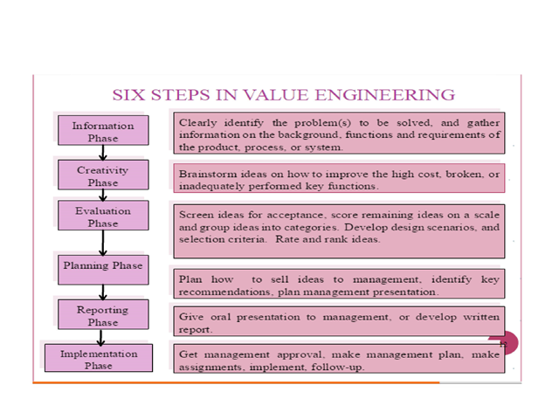

Slide 9
The modern version has the following eight steps:
1.Orientation
2.Information
3.Functional
4.Creative
5.Evaluation
6.Development
7.Presentation
8.Implementation and Follow-up

Slide 10

1.Orientation Phase
Identify issues
Prioritize Issues
Drafts scopes and objective
Establish evaluation factors
Determine Study Team
Collect Data
Prepare for value study

Slide 11

2. Information Phase
Further familiarization of the project by the team; all team members participate in determine the true needs of the project.
Areas of high cost or low worth are identified.

Slide 12




3. Functional Phase
Functional analysis outlines the basic function of a product using a verb and a noun such as ‘boil water’ as in the case of our kettle.
The function analysis phase involves determining the functions of the project and identifying them with a verb/noun combination for every element under evaluation. The function is defined as the set targets to be attained through the execution of an element or a set of elements.
Each of the identified functions is analyzed to determine if there are improvements to be made and if a new function is required. An example of a function can be “disinfect water.”

Slide 13

4. Creative Phase
This step requires a certain amount of creative thinking by the team. A technique that is useful for this type of analysis is brainstorming. This stage is concerned with developing alternative

Slide 14

5. Evaluation Phase
In this phase of the workshop, the VA team judges the ideas developed during the creative phase.
The VA team ranks the ideas.
Ideas found to be irrelevant or not worthy of additional study are disregarded.
Those ideas that represent the greatest potential for cost savings and improvements are selected for development.

Slide 15

6. Development Phase
The team develops the selected ideas into alternatives (or proposals) with a sufficient level of documentation to allow decision makers to determine if the alternative should be implemented.

Slide 16

7. Presentation Phase
The presentation phase is actually presenting the best alternative (or alternatives) to those who have the authority to implement the proposed solutions that are acceptable.

Slide 17
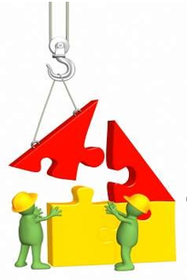
8. Implementation And Follow Up
1.Develop an implementation plan
2.Execute the plan
3.Monitor the plan to completion
Objective: During the implementation and follow-up phase, management must assure that approved recommendations are converted into actions.

Slide 18
Analysis
Teardown analysis
Cost analysis
Value analysis

Slide 19
Teardown Analysis
Methodical analysis of a product to identify key cost drivers and their components & functions.
Following are the formal steps in the Product teardown process.
List Design Issues
Prepare for Product Teardowns
Examine the Distribution and Installation
Disassemble, Measure and Analyze Data by Assemblies
Form a Bill of Materials

Slide 20
Cost Analysis
A functional cost analysis is a method that can be applied to examine the component costs of a product in relation to the value as perceived by the customer. The outcome of the analysis is to improve the value of the product while maintaining costs and/or reduce the costs of the product without reducing value.

Slide 21
Steps in cost Analysis
Create a list of components
Determine the cost of each component
Determine the value of each component
Consider the value of functions
Generate alternatives that lead to reduced costs and/or increased value
Evaluate alternatives

Slide 22
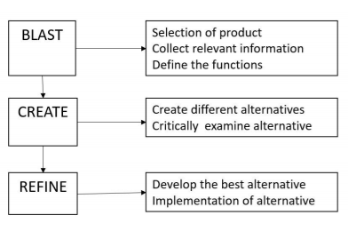
Steps in value Analysis

Slide 23
Value Analysis
Value Analysis (VA) is concerned with existing products. It involves a current product being analyzed and evaluated by a team, to reduce costs, improve product function or both.
A significant part of VA is a technique called Functional Analysis, where the product is broken down and reviewed as a number of assemblies.

Slide 24

What is Value?
The minimum money which has to be expended in purchasing or manufacturing a product to create the appropriate use of esteem factors.

Slide 25
Division of Value
Use of functional Value
Esteem Value
Cost Value
Exchange Value

Slide 26
Advantages of Value Analysis
It leads to improvements in product designs so that, most appropriate products are produced.
High quality (value) is maintained.
All round efficiency is achieved by eliminating waste of various types.
Cost savings provide a measure for judging managerial effectiveness.
New ideas are generated and incorporated.
Team spirit and morale are improved.
Areas requiring attention and improvement are pinpointed.

Slide 27
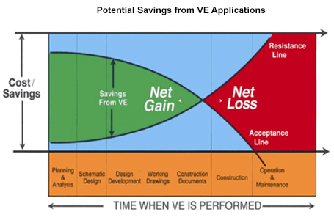
Advantages of Value Analysis
At the Planning stage of development, there are additional benefits to be derived from a Value Engineering Workshop:
Any changes to the program at this stage have very little if any impact on schedule and time and redesign costs.
The project will be developed with fewer changes, redesigns, and a greater understanding by all parties of what the final function and space allocations will be.
An independent team can bring a fresh outside view of alternate solutions from other similar projects.

Slide 28
Procedure of Value Analysis
There is no standard approach or procedure
Ascertaining the needs and wants of customers
Specifying the function of products and components
Determining the appropriate cost of desired performance
Identifying better alternatives in terms of work procedures.

Slide 29
Implementation of Value Analysis
Identifying the function as primary or secondary
Evaluation of the function by comparison
Basic question - Does the function accomplish reliability at the best cost?
Develop alternatives

Slide 30
Value Analysis Steps
Gather information
Measure Performance
Analyse Functions
Generate Ideas
Evaluate and Rank Ideas
Develop and Expand Ideas
Present Ideas

Slide 31
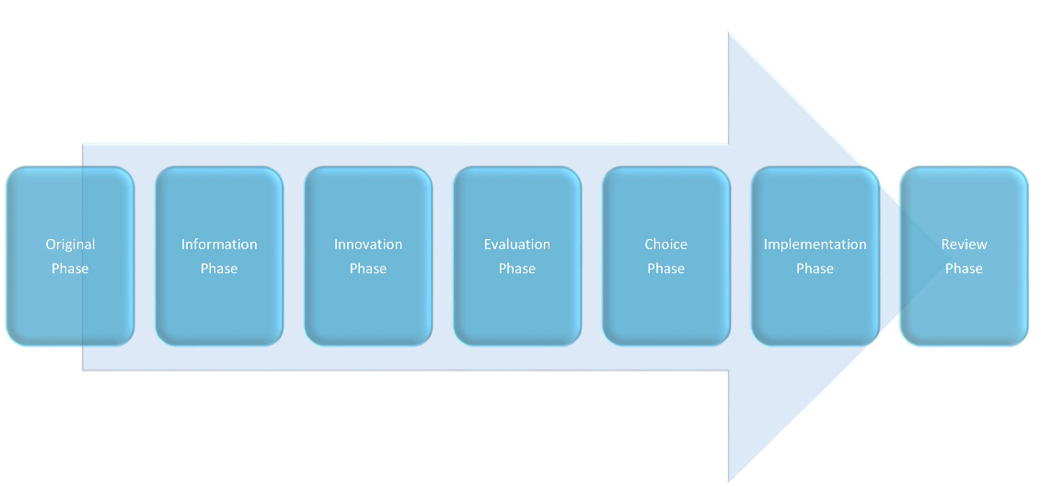
Phases of Value Analysis

Slide 32
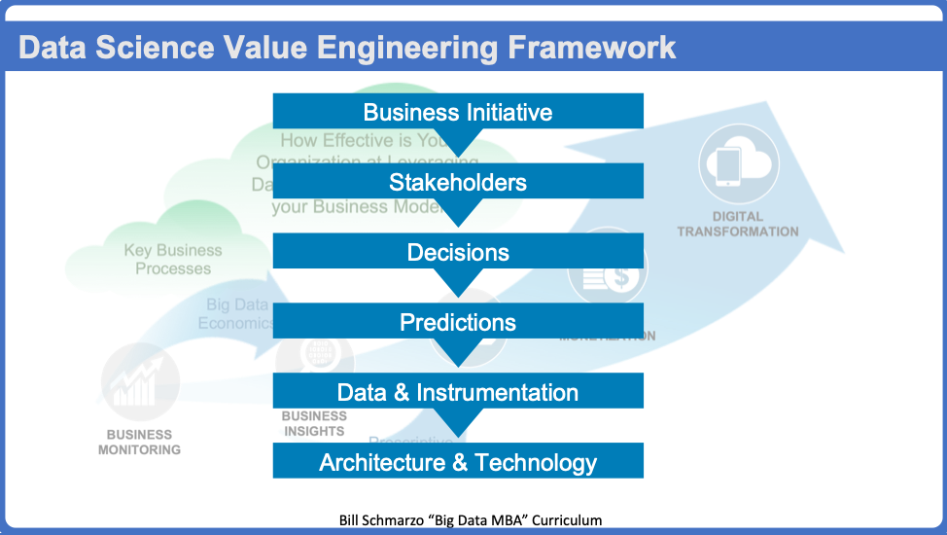
Value Engineering Framework

Slide 33
Step 1: Identify a Key Business Initiatives
We have found that How conversation must start with a focus on the organizations Key Business Initiatives; that is, what is important to the business over the next 12 to 18 months. Your organization may have business initiatives such as:
Reduce inventory costs
Improve supply chain reliability
Reduce unplanned operational downtime
Improve customer retention
Improve yield
Improve “first time fix”
Improve supply chain reliability and quality
These are all most excellent business initiatives. You just need to invest the time to understand and research them thoroughly including the business, customer, environmental and operational benefits, and the metrics and Key Performance Indicators against which progress and success will be measured.

Slide 34
Step 2: Identify Key Business Stakeholders
Once you identify the targeted business initiative, we want to identify the business stakeholders who either impact or are impacted by the targeted business initiative.
This should be at least 4 to 5 different organizations because you want diverse perspectives on how these organizations plan to address or support the targeted business initiative.
You can use Personas (a Design Thinking tool) to help us understand with the stakeholders with respect to their work objectives, work environment, key decisions, questions and impediments.

Slide 35
Step 3: Identify, Validate, Value and Prioritize the Decisions
Now the money step! Yep, once we know the targeted business initiative and the key stakeholders, then we want to drive facilitated collaboration across the different stakeholders to identify, validate, value and prioritize the decisions that these stakeholders need to make in support of the targeted business initiative.

Slide 36
Step 4: Identify Supporting Predictions
For each of the top priority decisions, you want to next identify the predictions that each stakeholder needs to make in support of those decisions.
Sometimes it is easier, when working with the business stakeholders, to ask them what questions they need to answer to support their key decisions.
Then it’s a simple process of converting those questions into predictions.
To help organizations frame or understand the potential of data science, I start my customer conversations with a very simple question: How effective is your organization at leveraging data and analytics to power your business models?

Slide 37
Step 5: Identify Potential Data Sources and Instrumentation Strategy
The next step is to work with the business stakeholders to identify what data you might need to make those predictions. The trick for fueling data brainstorming builds upon the “Predictions” identified in Step 4. We simply add the phrase “and what data might you need to make that prediction?” to the prediction statement.
For example:
What will revenues and profits likely be next year…and what data you might need to make that prediction? The data source suggestions might include commodity price history, economic conditions, trade tariffs, fertilizer and pesticide prices, weather conditions, fuel prices and more.
How much fertilizer will I likely need next planting season…and what data you might need to make that prediction? The data source suggestions might include pesticide and herbicide usage history, weather conditions, crops to be planted, pest forecasts, soil conditions, and more.

Slide 38
Step 6: Identify Supporting Architecture and Technologies
Finally, we’ll need a Big Data and IoT architecture and technologies upon which we can build the solution that delivers the business value.
For example, in an IoT architecture, one will need to consider the architecture and technology choices at the edge, platform (sometimes also referred to as the “Fog”) and at the Enterprise (or Cloud) level

Slide 39
Summary
If what your organization seeks is to exploit the potential of data science to power your business models; then the Data Science Value Engineering Framework provides “How” the organization can do it.
The Value Engineering Framework starts with the identification of a key business initiative that not only determines the sources of value, but also provides the framework for a laser-focus on delivering business value and relevance.
A diverse set of stakeholders is beneficial because it provides more perspectives on the key decisions upon which the data science effort needs to focus.
The heart of the Data Science Value Engineering Framework is the collaboration with the different stakeholders to identify, validate, value and prioritize the key decisions (use cases) that they need to make in support of the targeted business initiative.
After gaining a thorough understanding of the top priority decisions (use cases) the analytics, data, architecture and technology conversations now have a frame within which to work (by understanding what’s important AND what’s not important).

