Slide 1
Module 1

Slide 2
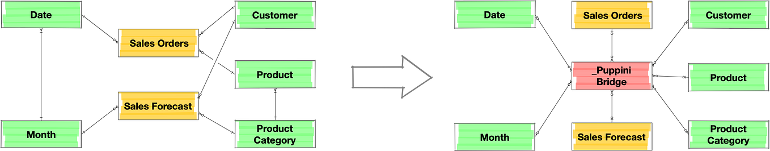
Topics in Module-1-Data Models
SDLC
Development Models – Waterfall
Rapid Application Development
Agile
Spiral Models, Object-Relational databases
Database models

Slide 3
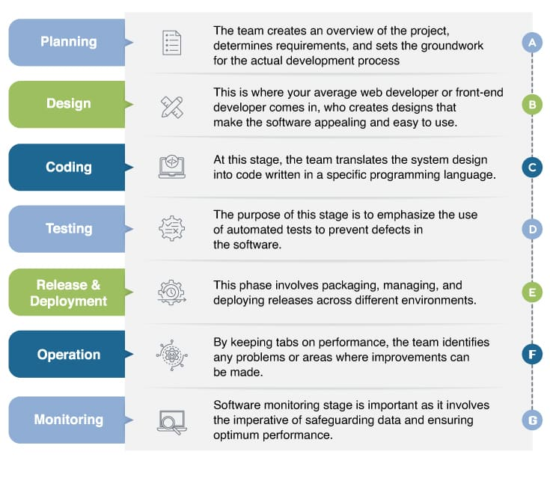
Software Development Life Cycle (SDLC)
A software life cycle model (also termed process model) is a pictorial and diagrammatic representation of the software life cycle.
A life cycle model represents all the methods required to make a software product transit through its life cycle stages.
A life cycle model maps the various activities performed on a software product from its inception to retirement.
Need: The development team must determine a suitable life cycle model for a particular plan and then observe to it.

Slide 4
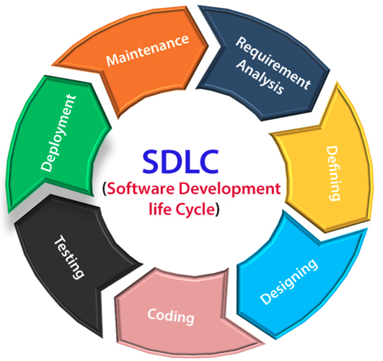
Software Development Life Cycle (SDLC)
Stage1: Planning and requirement analysis: Planning for the quality assurance requirements and identifications of the risks associated with the projects is also done at this stage.
Business analyst and Project organizer set up a meeting with the client to gather all the data like what the customer wants to build, who will be the end user, what is the objective of the product.
Stage2: Defining Requirements: Represent and document the software requirements and get them accepted from the project stakeholders.
"SRS"- Software Requirement Specification document which contains all the product requirements to be constructed and developed during the project life cycle.

Slide 5
Software Development Life Cycle (SDLC)
Stage3: Designing the Software: Bring down all the knowledge of requirements, analysis, and design of the software project.
This phase is the product of the last two, like inputs from the customer and requirement gathering.
Stage4: Developing the project: The actual development begins, and the programming is built.
The implementation of design begins concerning writing code.
Developers have to follow the coding guidelines described by their management and programming tools like compilers, interpreters, debuggers, etc. are used to develop and implement the code.

Slide 6
Software Development Life Cycle (SDLC)
Stage5: Testing: After the code is generated, it is tested against the requirements to make sure that the products are solving the needs addressed and gathered during the requirements stage.
During this stage, unit testing, integration testing, system testing, acceptance testing are done.
Stage6: Deployment: Once the software is certified, and no bugs or errors are stated, then it is deployed.
Then based on the assessment, the software may be released as it is or with suggested enhancement in the object segment.
Stage7: Maintenance: Once when the client starts using the developed systems, then the real issues come up and requirements to be solved from time to time.

Slide 7
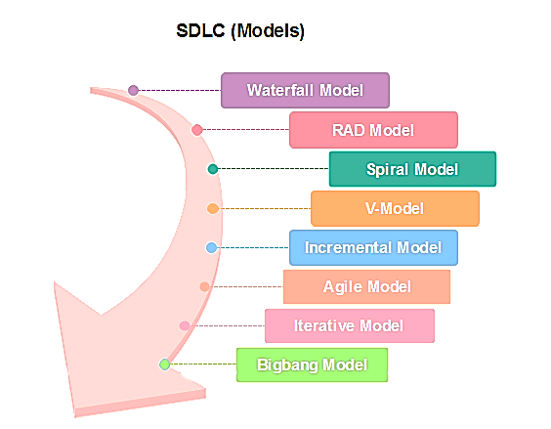
SDLC Models
Software Development life cycle (SDLC) is used in project management that defines the stages included in an information system development project, from an initial feasibility study to the maintenance of the completed application.
There are different SDLC models specified and designed, which are followed during the software development phase.
These models are also called "Software Development Process Models." Each process model follows a series of phases unique to its type to ensure success in the step of software development.

Slide 8
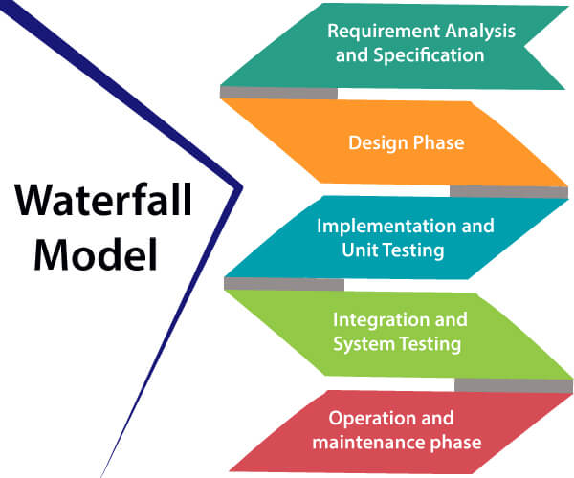
Waterfall model
The steps always follow in this order and do not overlap. The developer must complete every phase before the next phase begins.
“Waterfall Model”-Diagrammatic representation resembles a cascade of waterfalls.
Circumstances where the use of the Waterfall model is most suited are:
When the requirements are constant and not changed regularly.
A project is short
The situation is calm
Where the tools and technology used is consistent and is not changing
When resources are well prepared and are available to use.

Slide 9
Waterfall model
This model has five phases: Requirements analysis and specification, design, implementation, and unit testing, integration and system testing, and operation and maintenance.
1. Requirements analysis and specification phase:
This phase aims to understand the exact requirements of the customer and to document them properly.
Both the customer and the software developer works together to document all the functions, performance, and interfacing requirements of the software.
It describes the “what” of the system to be produced and not “how”.
In this phase, a large document called Software Requirement Specification (SRS) document is created which contains a detailed description of what the system will do in the common language.

Slide 10
Waterfall model
2. Design Phase: This phase aims to transform the requirements gathered in the SRS into a suitable form that permits further coding in a programming language.
It defines the overall software architecture together with high-level and detailed design.
All this work is documented as a Software Design Document (SDD).
3. Implementation and unit testing: During this phase, design is implemented.
If the SDD is complete, the implementation or coding phase proceeds smoothly, because all the information needed by software developers is contained in the SDD.
During testing, the code is thoroughly examined and modified. Small modules are tested in isolation initially. After that these modules are tested by writing some overhead code to check the interaction between these modules and the flow of intermediate output.

Slide 11
Waterfall model
4. Integration and System Testing: This phase is highly crucial as the quality of the end product is determined by the effectiveness of the testing carried out.
The better output will lead to satisfied customers, lower maintenance costs, and accurate results. Unit testing determines the efficiency of individual modules.
However, in this phase, the modules are tested for their interactions with each other and with the system.
5. Operation and maintenance phase: Maintenance is the task performed by every user once the software has been delivered to the customer, installed, and operational.

Slide 12
Waterfall model
Advantages of the Waterfall model
This model is simple to implement and the number of resources that are required for it is minimal.
The requirements are simple and explicitly declared; they remain unchanged during the entire project development.
The start and end points for each phase are fixed, which makes it easy to cover progress.
The release date for the complete product, as well as its final cost, can be determined before development.
It gives easy control and clarity for the customer due to a strict reporting system.

Slide 13
Waterfall model
Disadvantages of the Waterfall model
In this model, the risk factor is higher, so this model is not suitable for more significant and complex projects.
This model cannot accept changes in requirements during development.
It becomes tough to go back to the phase. For example, if the application has now shifted to the coding phase, and there is a change in requirement, it becomes tough to go back and change it.
Since the testing is done at a later stage, it does not allow identifying the challenges and risks in the earlier phase, so the risk reduction strategy is difficult to prepare.

Slide 14
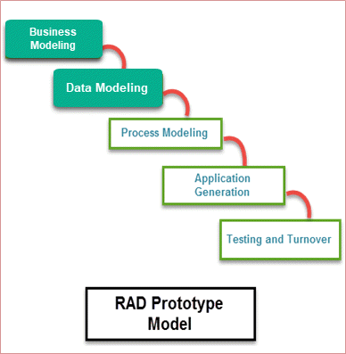
Rapid Application Development Model(RAD)
RAD is a linear sequential software development process model that emphasizes a concise development cycle using an element-based construction approach.
If the requirements are well understood and described, and the project scope is a constraint, the RAD process enables a development team to create a fully functional system within a concise time.
When to use RAD model:
The system should need to create a project that modularizes in a short period (2-3 months).
When the requirements are well-known.
When the technical risk is limited.
When there's a necessity to make a system, which is modularized in 2-3 months of period.
It should be used only if the budget allows the use of automatic code-generating tools.

Slide 15
Rapid Application Development Model(RAD)
RAD (Rapid Application Development) is a concept that products can be developed faster and of higher quality through:
Gathering requirements using workshops or focus groups
Prototyping and early, reiterative user testing of designs
The re-use of software components
A rigidly paced schedule that refers to design improvements to the next product version
There is less formality in reviews and other team communication

Slide 16
Rapid Application Development Model(RAD)
1. Business Modeling: The information flow among business functions is defined by answering questions like what data drives the business process, what data is generated, who generates it, where the information goes, who processes it, and so on.
2. Data Modeling: The data collected from business modeling is refined into a set of data objects (entities) that are needed to support the business. The attributes (character of each entity) are identified, and the relation between these data objects (entities) is defined.

Slide 17
Rapid Application Development Model(RAD)
3. Process Modeling: The information objects defined in the data modeling phase are transformed to achieve the data flow necessary to implement a business function. Processing descriptions are created for adding, modifying, deleting, or retrieving a data object.
4. Application Generation: Automated tools are used to facilitate the construction of the software; even they use the 4th GL techniques.
5. Testing & Turnover: Many of the programming components have already been tested since RAD emphasizes reuse. This reduces the overall testing time. However the new part must be tested, and all interfaces must be fully exercised.

Slide 18
Rapid Application Development Model(RAD)
Advantages of the RAD Model
This model is flexible for change.
In this model, changes are adoptable.
Each phase in RAD brings the highest priority functionality to the customer.
It reduced development time.
It increases the reusability of features.
Disadvantage of the RAD Model
It required highly skilled designers.
All applications are not compatible with RAD.
For smaller projects, we cannot use the RAD model.
On the high technical risk, it's not suitable.
Required user involvement.

Slide 19
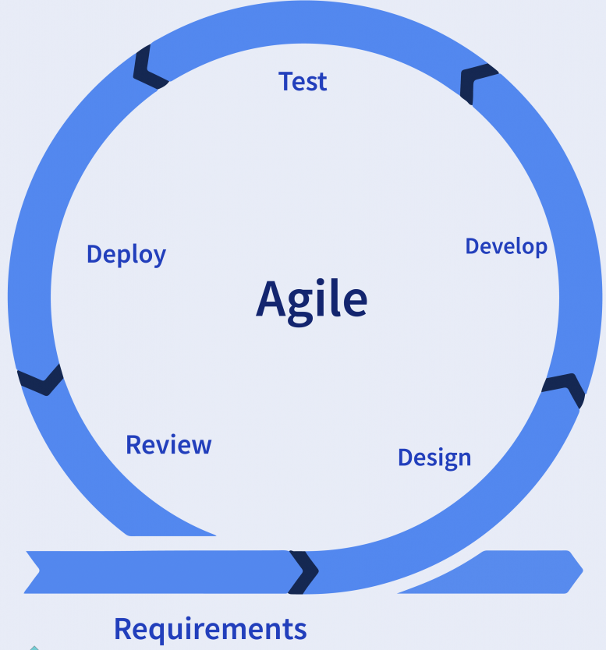
Agile Model
“Agile process model” refers to a software development approach based on iterative development.
Agile methods break tasks into smaller iterations or parts that do not directly involve long-term planning.
The project scope and requirements are laid down at the beginning of the development process.
The plans regarding the number of iterations, the duration, and the scope of each iteration is clearly defined in advance.
Each iteration is considered as a short time “frame” in the Agile process model, which typically lasts from one to four weeks.

Slide 20
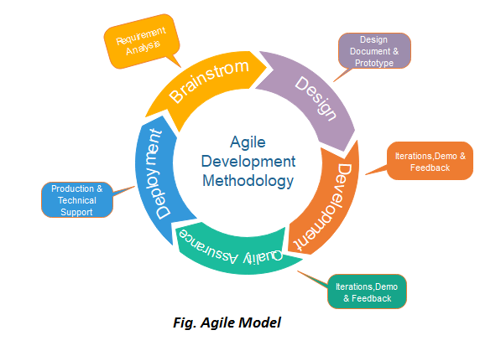
Agile Model
The division of the entire project into smaller parts helps to minimize the project risk and reduce the overall project delivery time requirements.
Each iteration involve a team working through a full software development life cycle including planning, requirements analysis, design, coding, and testing before a working product is demonstrated to the client
When to use Agile:
When frequent changes are required.
When a highly qualified and experienced team is available.
When a customer is ready to have a meeting with a software team all the time.
When the project size is small.

Slide 21
Agile Model
1. Requirements gathering: In this phase, you must define the requirements. You should explain business opportunities and plan the time and effort needed to build the project. Based on this information, you can evaluate technical and economic feasibility.
2. Design the requirements: When you have identified the project, work with stakeholders to define requirements. You can use the user flow diagram or the high-level UML diagram to show the work of new features and show how it will apply to your existing system.

Slide 22
Agile Model
3. Construction/iteration: When the team defines the requirements, the work begins. Designers and developers start working on their project, which aims to deploy a working product. The product will undergo various stages of improvement, so it includes simple, minimal functionality
4. Testing: In this phase, the Quality Assurance team examines the product's performance and looks for the bug.
5. Deployment: In this phase, the team issues a product for the user's work environment.
6. Feedback: After releasing the product, the last step is feedback. In this, the team receives feedback about the product and works through the feedback.

Slide 23
Agile Model
Advantage (Pros) of the Agile Method:
Frequent Delivery
Face-to-face communication with clients.
Efficient design and fulfills the business requirement.
Anytime changes are acceptable.
It reduces total development time.
Disadvantages (Cons) of the Agile Model:
Due to the shortage of formal documents, it creates confusion and crucial decisions taken throughout various phases can be misinterpreted at any time by different team members.
Due to the lack of proper documentation, once the project is completed and the developers allotted to another project, maintenance of the finished project can become difficult.

Slide 24
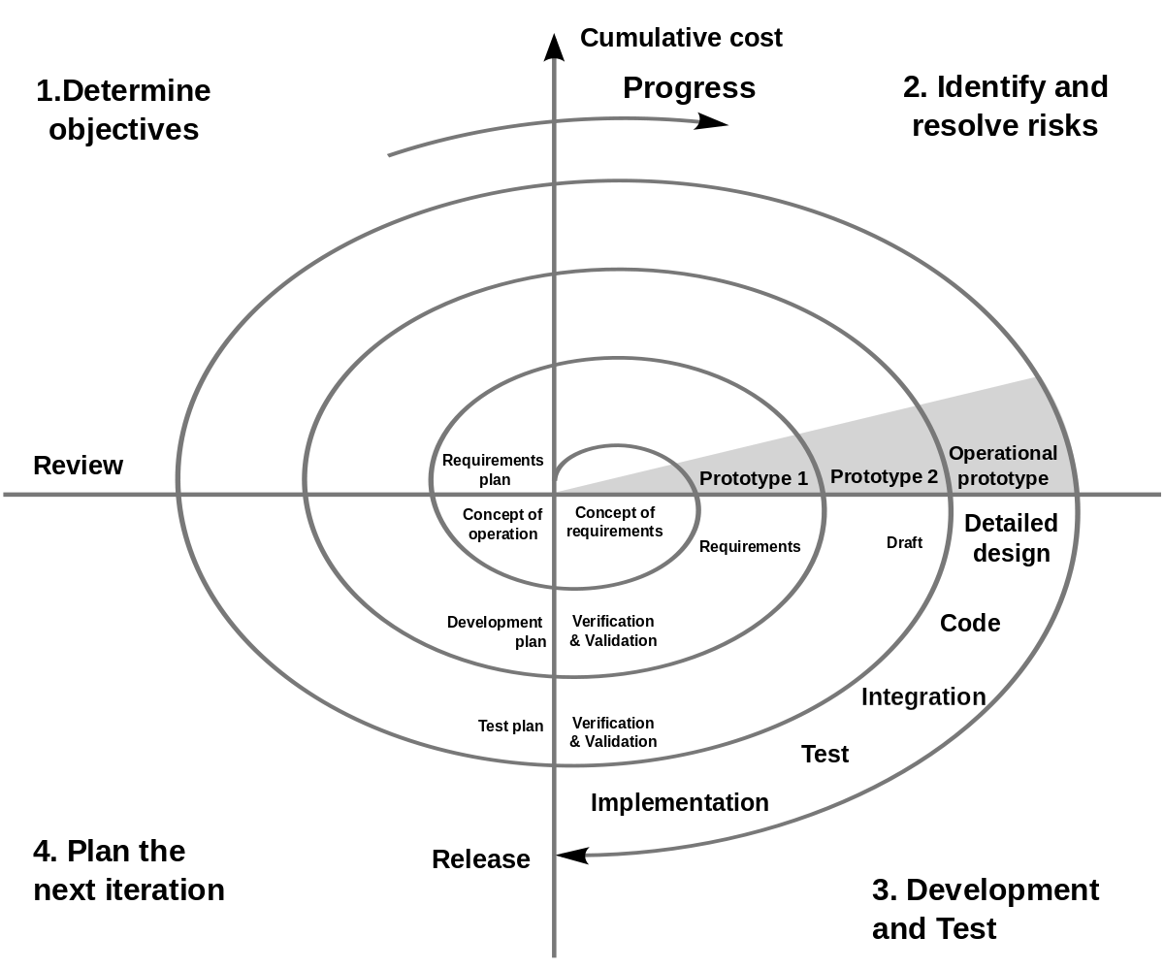
Spiral Model
The spiral model is an evolutionary software process model that couples the iterative feature of prototyping with the controlled and systematic aspects of the linear sequential model.
It implements the potential for rapid development of new versions of the software.
Using the spiral model, the software is developed in a series of incremental releases.
During the early iterations, the additional release may be a paper model or prototype. During later iterations, more and more complete versions of the engineered system are produced

Slide 25
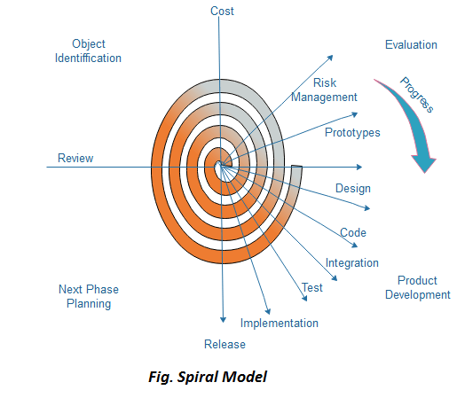
Spiral Model
Objective setting: Each cycle in the spiral starts with the identification of the purpose for that cycle, the various alternatives that are possible for achieving the targets, and the constraints that exist.
Risk Assessment and Reduction: The next phase in the cycle is to calculate these various alternatives based on the goals and constraints. The focus of evaluation in this stage is located on the risk perception for the project.
Development and validation: The next phase is to develop strategies that resolve uncertainties and risks. This process may include activities such as benchmarking, simulation, and prototyping.

Slide 26
Spiral Model
Planning: Finally, the next step is planned. The project is reviewed, and a choice is made whether to continue with a further period of the spiral. If it is determined to keep, plans are drawn up for the next step of the project.
The development phase depends on the remaining risks. For example, if performance or user-interface risks are treated more essential than the program development risks, the next phase may be an evolutionary development that includes developing a more detailed prototype for solving the risks.

Slide 27
Spiral Model
When to use Spiral Model:
When deliverance is required to be frequent.
When the project is large
When requirements are unclear and complex
When changes may be required at any time
Large and high-budget projects
Advantages
A high amount of risk analysis
Useful for large and mission-critical projects.
Disadvantages
Can be a costly model to use.
Risk analysis needs highly particular expertise
Doesn't work well for smaller projects.

Slide 28
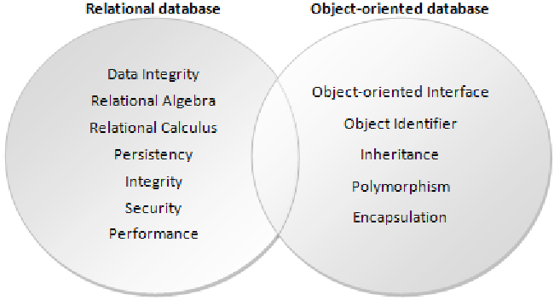
Object and Object-Relational Databases
Object Oriented Databases:
They are designed to store and manipulate objects.
It is similar to object-oriented programming languages, i.e. Java and Python. Objects can contain data, methods, and relationships to other objects.
In OODB, the object itself is the storage rather than the representation of the data. This allows for more efficient and natural handling of complex data structures and relationships between objects.

Slide 29
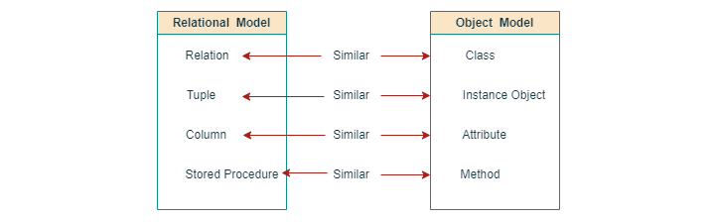
Object and Object-Relational Databases
Advantages of OODBs
They work well with object-oriented programming languages.
OODBs are made to work well with languages like Java and Python. They can work with object-oriented concepts like encapsulation and inheritance.
They can handle complex data structures well.
OODBs are good at handling complex data structures because they store objects, rather than breaking them down into individual parts.
They are fast for object-oriented workloads.
OODBs are fast because they are designed to work with object-oriented programming languages.
They are easy to model.
OODBs are easy to model because they allow developers to work with objects instead of worrying about the underlying database structure.

Slide 30
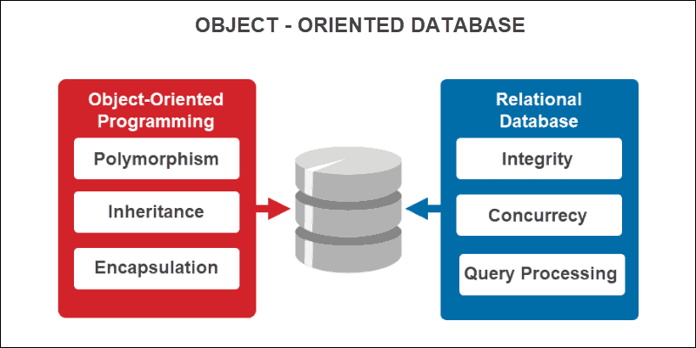
Object-Relational Databases
They are a hybrid between traditional relational databases and OODBs.
They are designed to handle both structured and unstructured data, much like OODBs, but they also support SQL queries and transactions, much like traditional relational databases.
OODBs are designed to store and manipulate objects and are well-suited for complex data structures and object-oriented programming languages.
ORDBs are a hybrid of traditional relational databases and OODBs. It supports SQL queries and transactions. It is good for structured data and integration with existing systems.
The decision to choose between OODBs and ORDBs depends on specific project requirements.

Slide 31
Object-Relational Databases
Object-Relational Databases (ORDBs) have many advantages −
They work with SQL.
ORDBs can use SQL, which is a language that many developers already know. This makes them more familiar and easier to use.
They can be integrated.
ORDBs can be integrated into existing systems. It makes them a good choice for companies that want to upgrade their infrastructure without starting from scratch.
They are good at handling structured data.
ORDBs can handle structured data well. They are good for applications that need to do a lot of searching and sorting.
They have good support for transactions.
ORDBs can handle transactions well. Even if there are errors or problems, the data stays consistent and accurate.
Examples of ORDBs include PostgreSQL, Oracle Database, and Microsoft SQL Server.

Slide 32
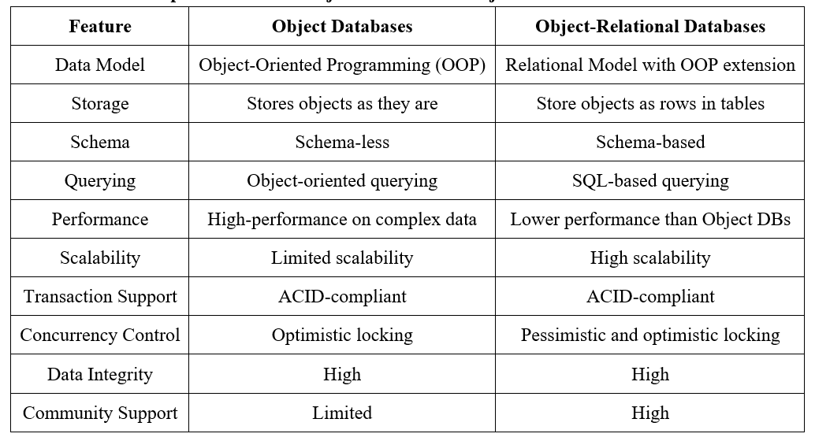
Object vs Object-Relational Databases

