Slide 1
Machine learning algorithms
Supervised Learning
Dr. Sritama
Assistant Professor

Slide 2
k-Nearest Neighbor

Slide 3
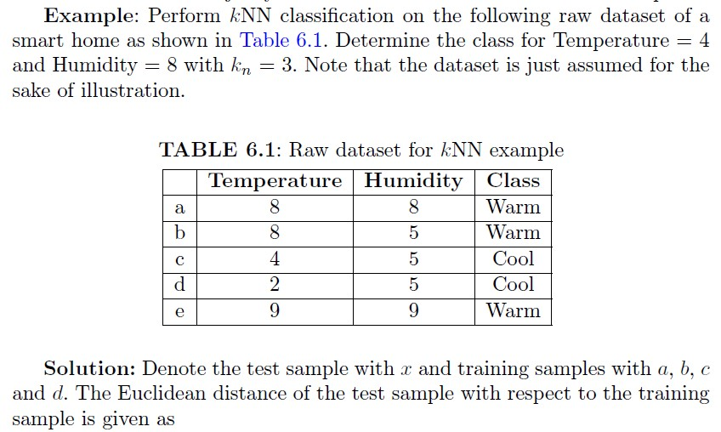
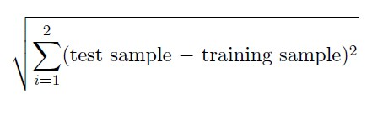

Slide 4
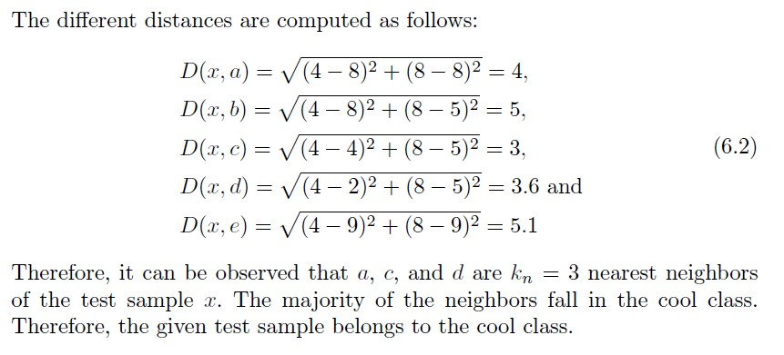

Slide 5
Perform KNN classification Algorithm on following dataset and predict the class for X(P1=3 and P2=7) K=3
Serial No | P1 | P2 | Class
1 | 7 | 7 | False
2 | 7 | 4 | False
3 | 3 | 4 | True
4 | 1 | 4 | True

Slide 6
Naive Bayes Classification

Slide 7
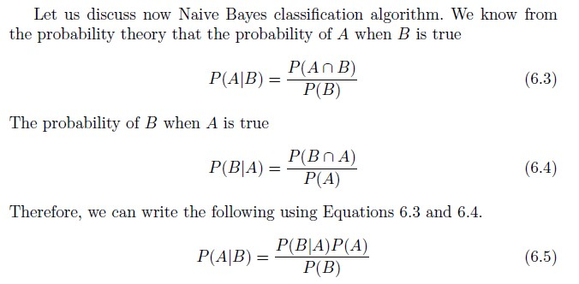

Slide 8
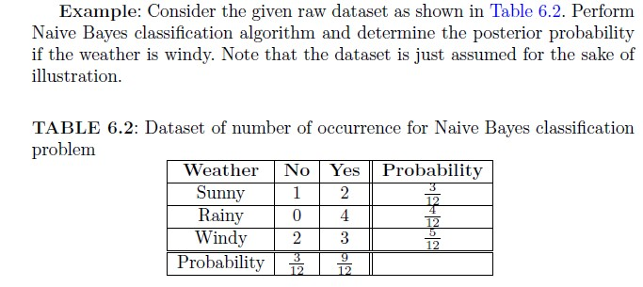
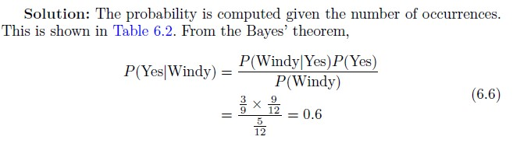

Slide 9
Consider the given data set, Apply Naïve Baye’s Algorithm and predict that if a fruit has the following properties then which type of fruit it is
Fruit= {Yellow, sweet, Long}
Fruit | Yellow | Sweet | Long | TOTAL
Mango | 350 | 450 | 0 | 650
Banana | 400 | 300 | 350 | 400
Others | 50 | 100 | 50 | 150
Total | 800 | 850 | 400 | 1200

Slide 10
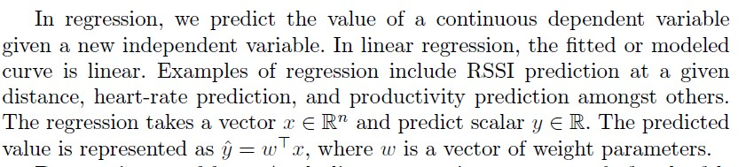
Linear Regression

Slide 11
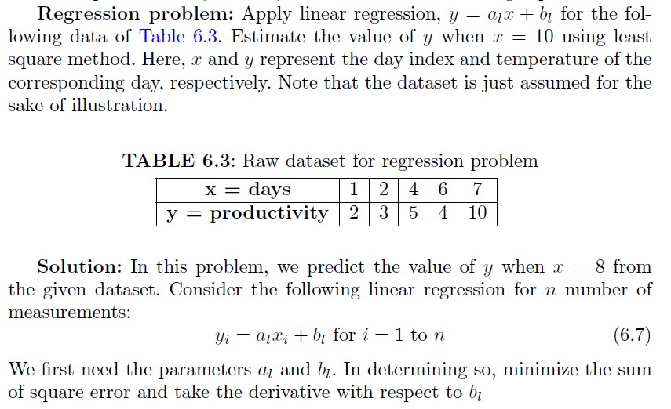

Slide 12
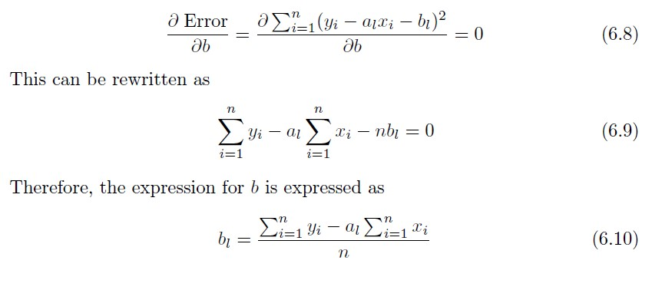

Slide 13
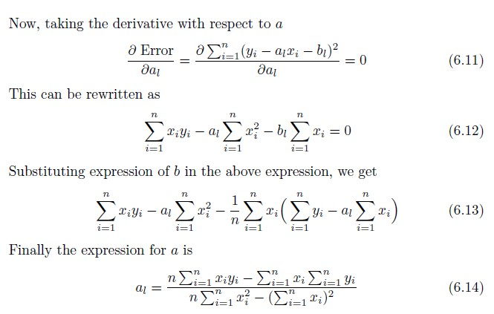

Slide 14
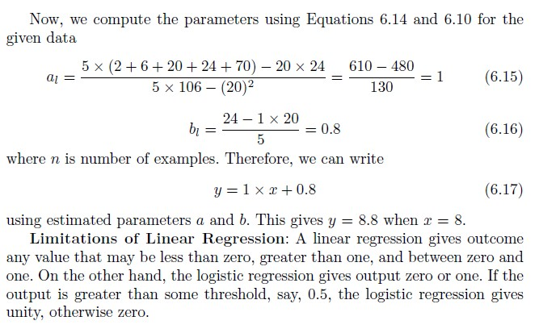

Slide 15
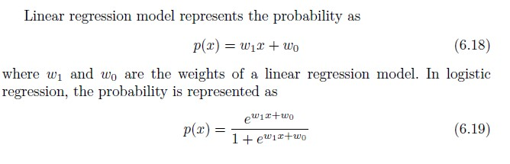
Logistic Regression

Slide 16
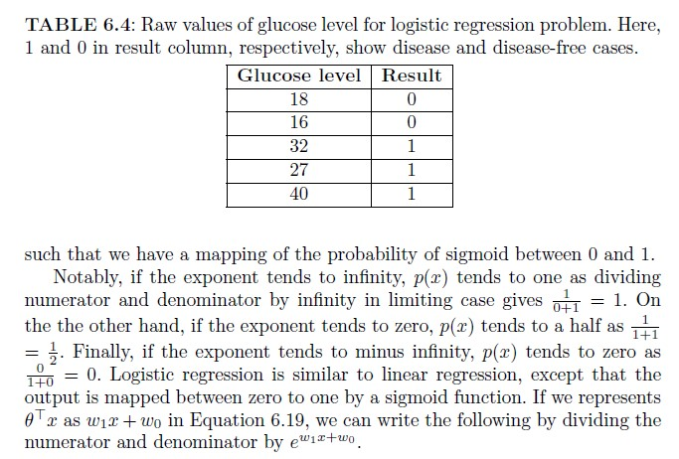

Slide 17
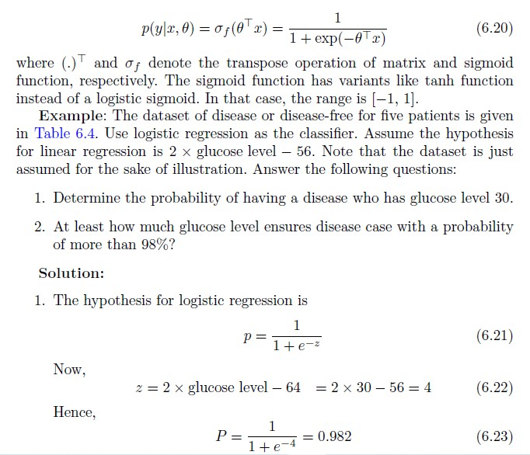

Slide 18
