Slide 1
Machine learning algorithms
Unsupervised Learning
Dr. Sritama
Assistant Professor

Slide 2
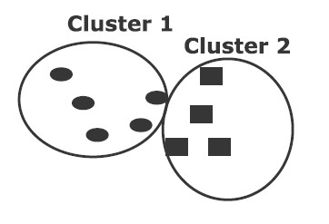
Itro
We use unsupervised learning when labels of data are unknown. We know that the clustering is an example of unsupervised learning.

Slide 3
Principal Component Analysis
Principal Component Analysis (PCA) is an unsupervised learning approach for dimensionality reduction technique of a large dataset. The original large dataset is transformed for dimensionality reduction and reduced dimensionality eliminates redundancy. This maximizes the variance along a few axes or dimensions. Before applying PCA, we make the data set having zero mean using the centering technique.

Slide 4
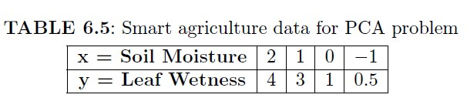
Problem: Find the rst principal component of the following data of Table

Slide 5
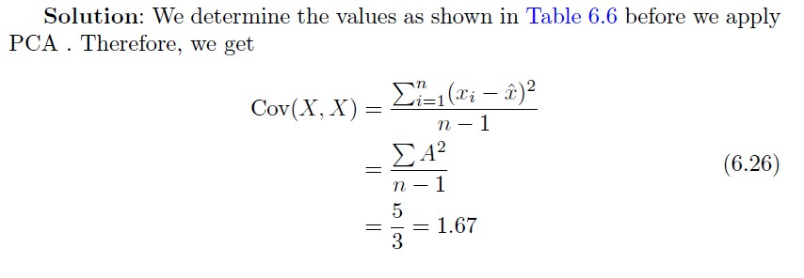
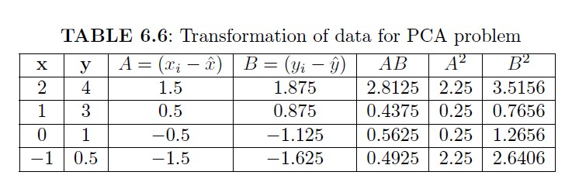

Slide 6
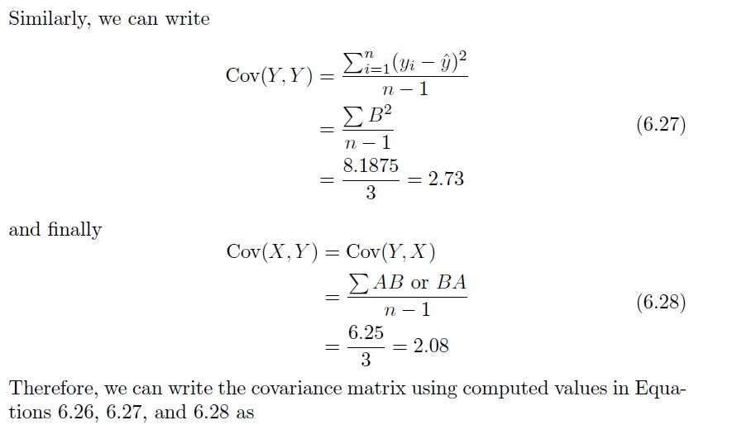

Slide 7
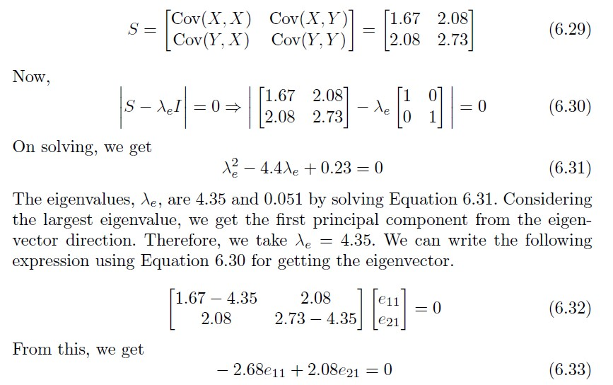

Slide 8
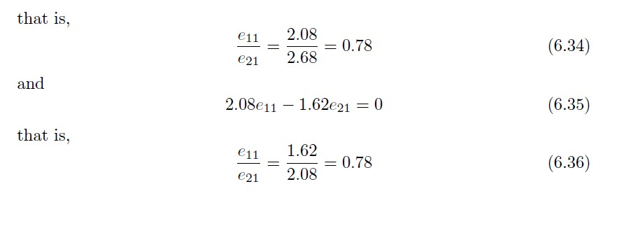

Slide 9
