Slide 1
Things Data Analytics

Slide 2
Introduction
These smart things produce a large volume of data, which needs to be processed to get some insights. There is a need to analyze the data and extract some meaningful patterns or statistics for decision-making. This motivates us to study the things data analytics techniques.
Artificial Intelligence (AI) helps in taking automated intellectual decisions like a human. We can use artificial intelligence algorithms in IoT networks for making decisions from a huge volume of data
Machine learning (ML) algorithms are used to learn from past experiences and data. Deep learning (DL) system involves learning using multi-layer perceptron and takes more intelligent decisions.

Slide 3
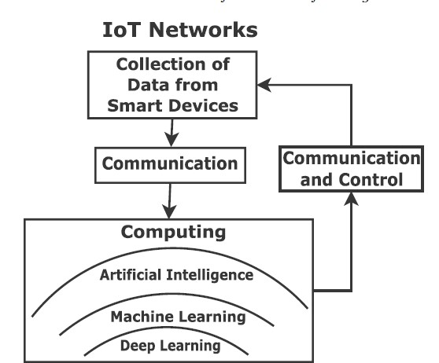

Slide 4
Feature Extraction
The examples of features for face recognition in computer vision applications are the size of the nose, the distance between nose and lips, the number of ears, and the distance between them.
The traditional machine learning techniques suffer from scalability problems, however, deep learning algorithms scale with the data.
The applications of machine learning include analytics for smart environments (say, city, agriculture, health amongst others), social networks, natural language processing, e-commerce to name a few.

Slide 5
Types of Machine learning Algorithm
There are mainly four types of machine learning algorithms.
1. Supervised Learning: Training data includes labels or desired outputs. Example: classification and regression problems.
2. Unsupervised Learning: Training data does not include labels or desired outputs. Example: clustering problem.
3. Semi-supervised Learning: Training data includes a few labels or desired outputs. It is the combination of supervised and unsupervised learning.
4. Reinforcement Learning: Rewards from sequence of actions.

Slide 6
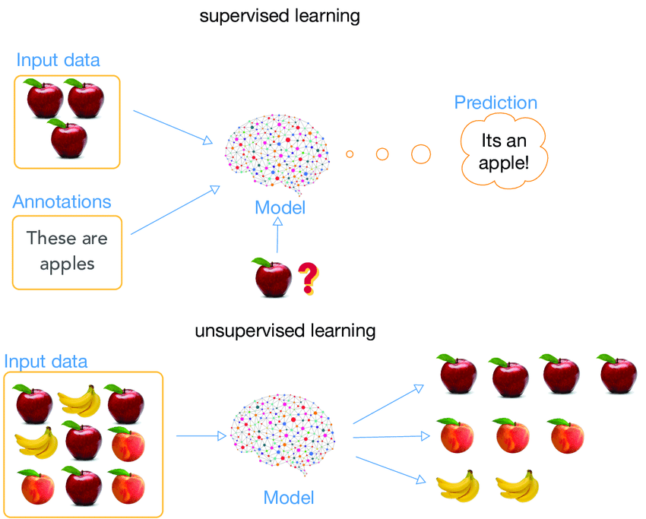

Slide 7
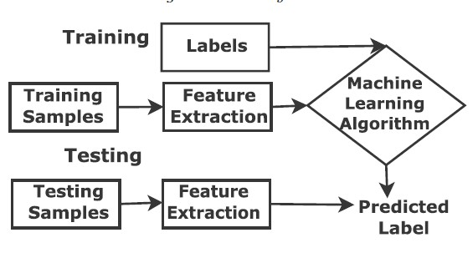
Supervised Learning

Slide 8
There are two types of data samples: Training and Testing.
The training samples are used to extract features and train the machine learning algorithm. In fact, we optimize the weight parameters of the machine learning model in the training phase.
Similarly, from the test samples, features are extracted and classified into a class using a trained machine learning algorithm. The machine learning model is used to predict the label for the given test data.
We use supervised learning for regression and classification tasks.

Slide 9
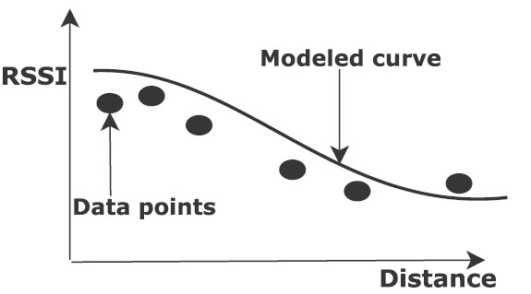
In supervised learning, the data (also called observations, measurements or samples) are labeled with classes. Given x samples for an output function F(x), we use (x; F(x)) in supervised learning. We predict function F(x) for new examples x, where discrete F(x) is for classification problem and continuous F(x) is for regression problem. The supervised learning has target labels. There are two types of supervised learning.

Slide 10
Supervised learning techniques
k-Nearest Neighbour
Naive Bayes Classification
Linear Regression
Logistic Regression

Slide 11
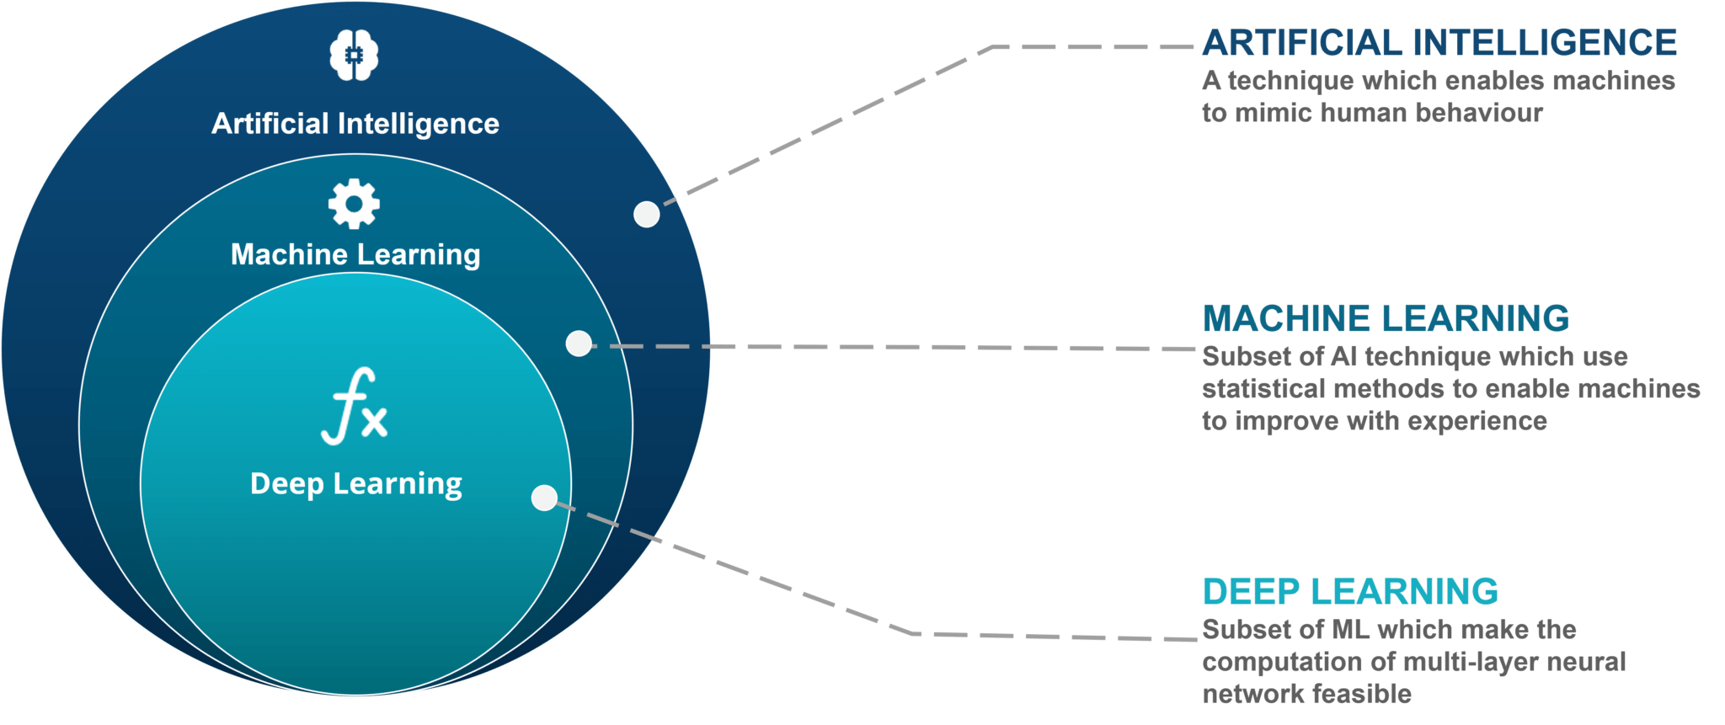
Topics in Module-3-ML & Cloud Computing for IoT
Supervised and Unsupervised ML Algorithms
IoT Data Analytics,
Cloud Computing for IoT
Cloud Based platforms
ML for Cloud IoT Analytics
Challenges.
Learn + Predict + Improve
=
Machine learning

Slide 12
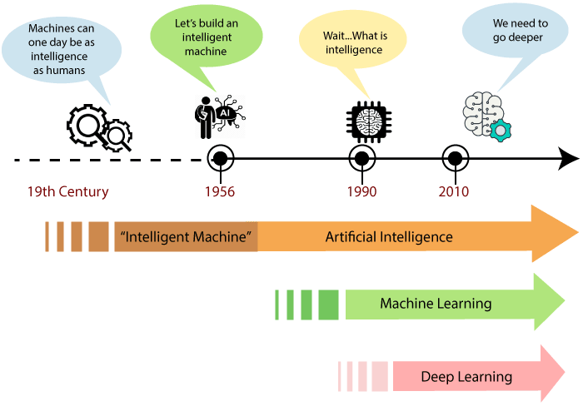
Evolution of ML
Engineering of Machines that Mimic Cognitive Functions
Ability to perform tasks without explicit instructions and relying on pattern
Machine Learning based on Artificial Neural Networks

Slide 13
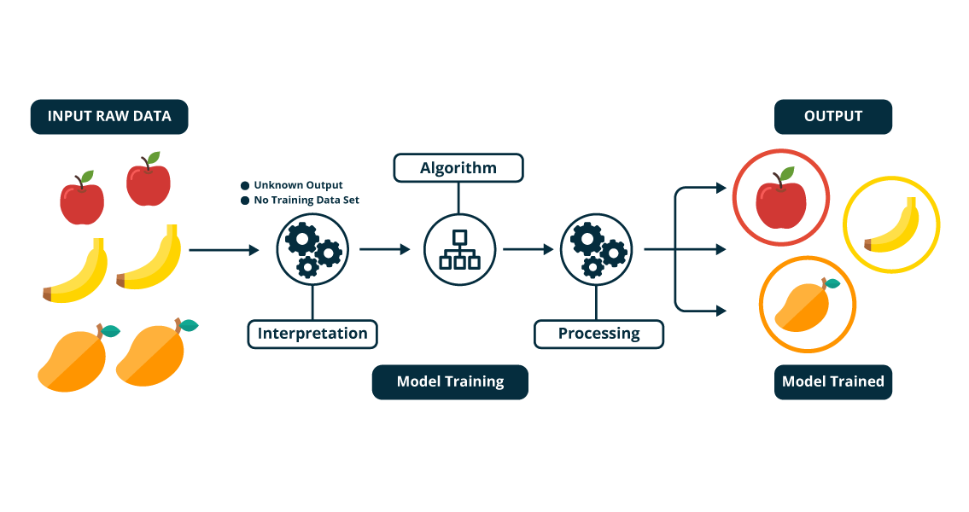
What is Machine Learning?
A canonical definition by Tom Mitchell in 1997: “An agent is said to learn from experience (E) with respect to some class of tasks (T), and the performance measure (P), if the learner's performance at T, as measured by P, improves with E". One has to be very careful about defining the set of tasks T, and the performance measure P. With experience E, the performance P has to improve.”

Slide 14
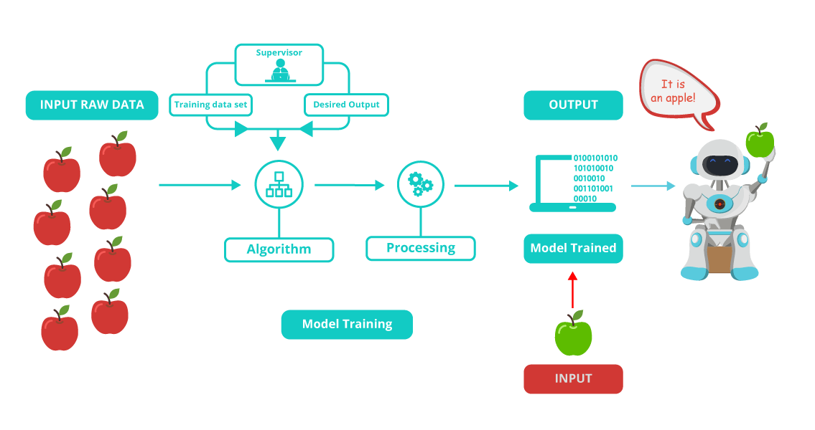
What is Machine Learning?
Machine learning can be defined as a subset of Artificial Intelligence (AI) that allows a system/computer to learn from some available data. The data can either be labelled (with a number, tag or type) or unlabelled.
F

Slide 15


Advantages and Disadvantages of Machine Learning
Advantages
Easy to identify the patterns
No Human Intervention
Wide range of applications
Scope for Continuous improvement
Handling Multi-variety Data
F
Disadvantages
Chances of error
Data acquiring and preprocessing
Time and resource dependent
Human Expertise for result interpretation
F

Slide 16
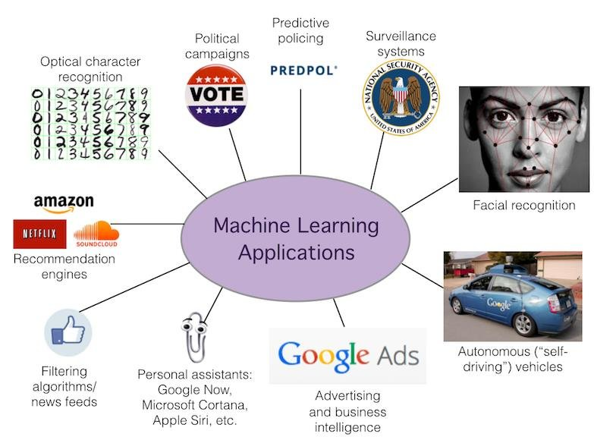
Applications of Machine Learning

Slide 17
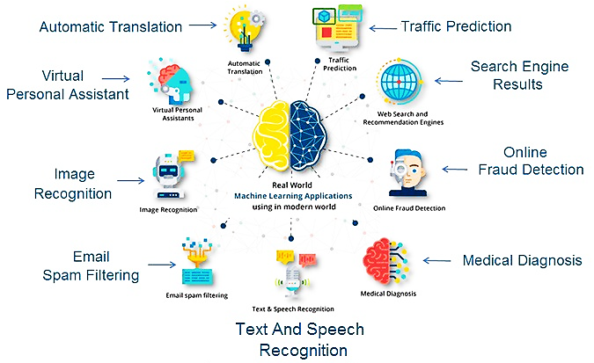
Real world Applications of Machine Learning

Slide 18
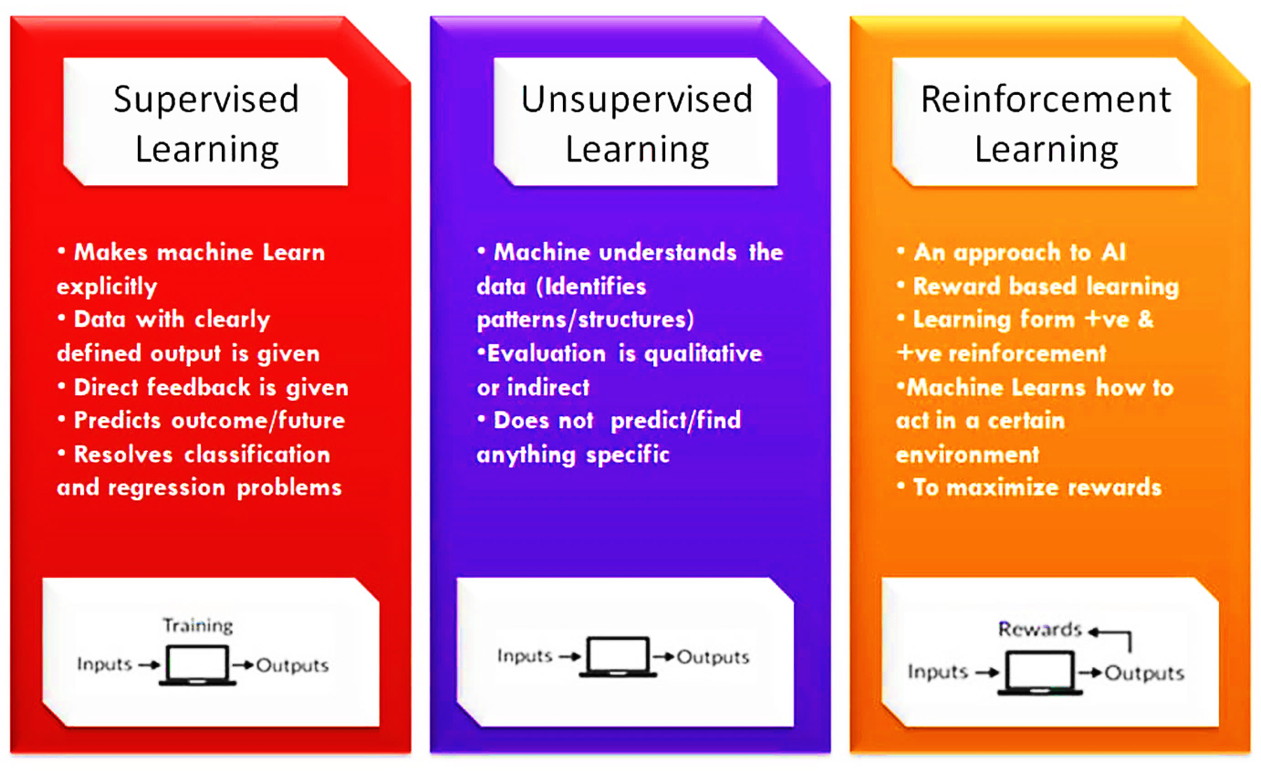
Types of Machine Learning based on Learning

Slide 19
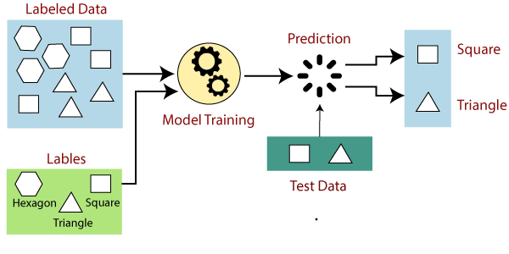
What is Supervised Machine Learning?
Learning an input and output map.
It deals with labelled data.
Labels
If the output happens to be a categorical one, then the supervised learning paradigm is called `classification'.
If the output is a continuous value, then the learning paradigm is called `regression'.

Slide 20
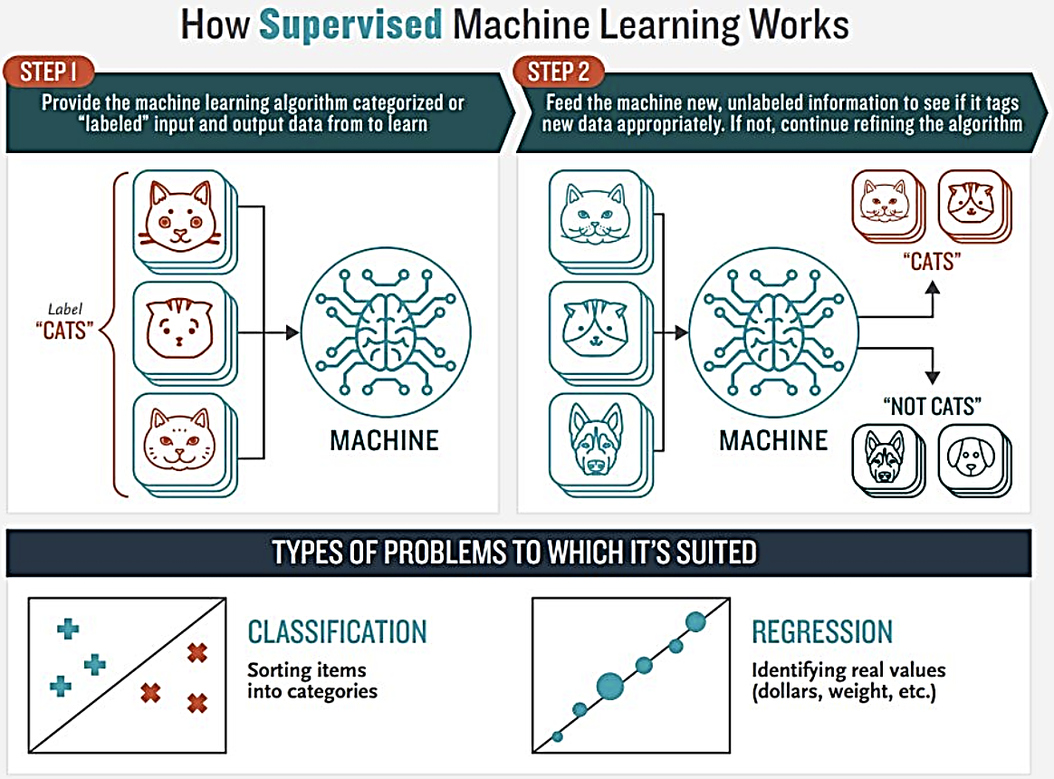
How does Supervised Machine Learning Works?

Slide 21
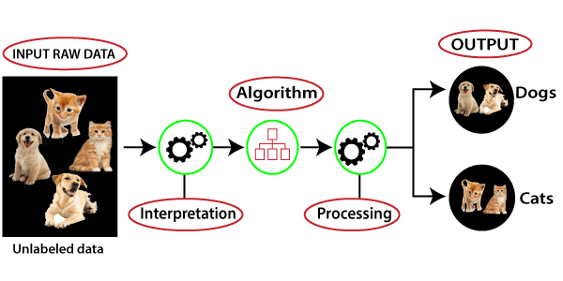
What is Unsupervised Machine Learning?
Discovering patterns in the data.
It deals with unlabelled data.
The process of finding cohesive groups in the input data is called `clustering'.
The process of finding the frequent co-occurance of items in the data is called `association rule mining'.

Slide 22
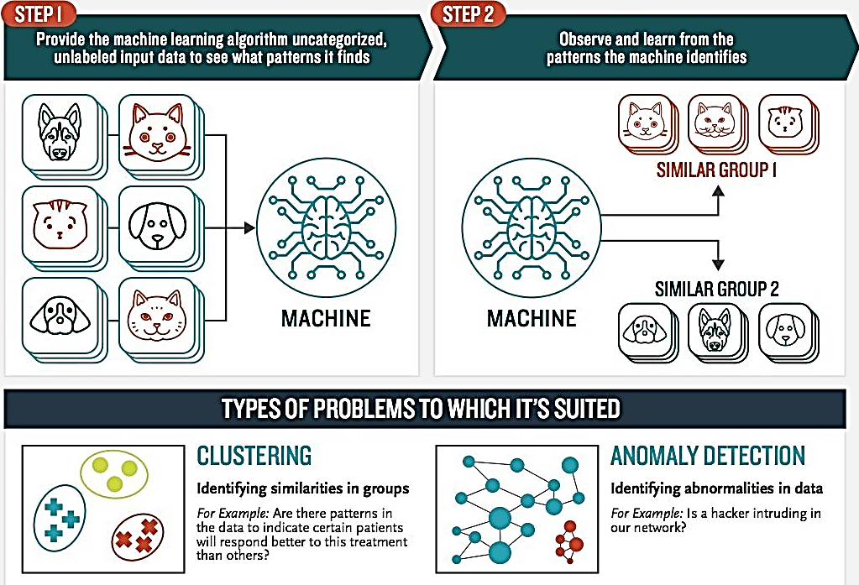
How does Unsupervised Machine Learning Works?

Slide 23
Difference between Supervised and Unsupervised

Slide 24
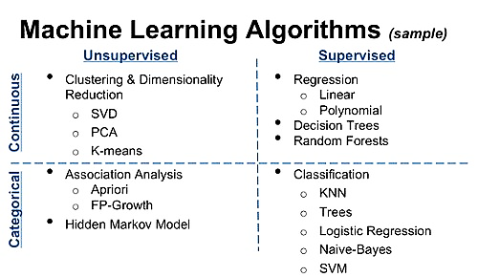
Supervised and Unsupervised Algorithms

