Slide 1
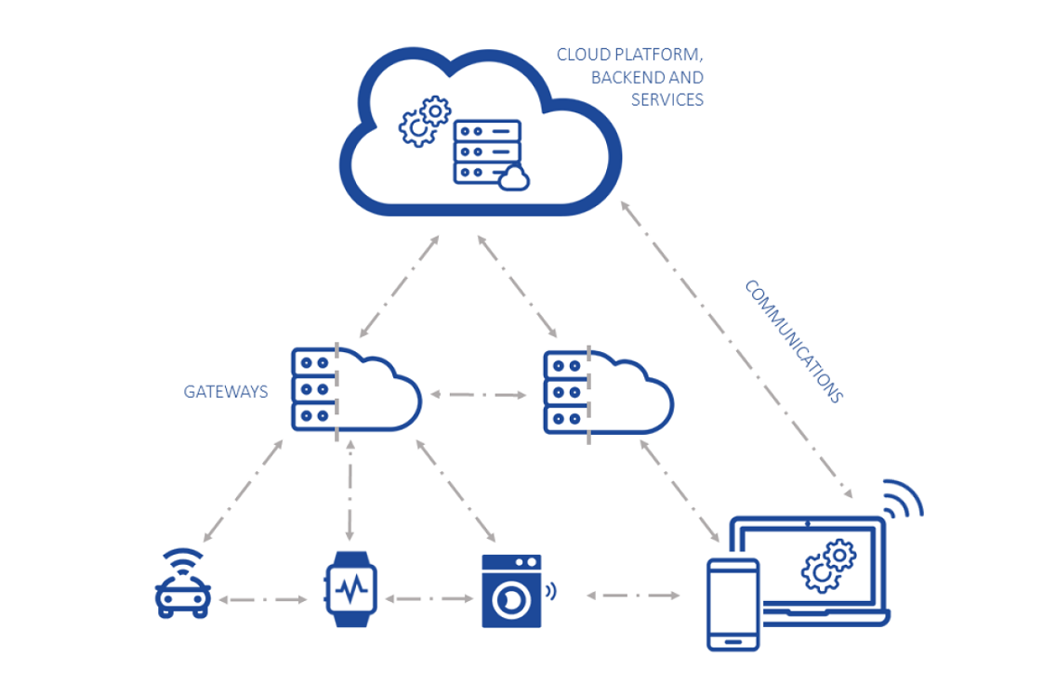
Topics in Module-4-IoT-Cloud Convergence
Opportunities and Challenges
Architectures for convergence
Data offloading and computation
Dynamic Resource Provisioning
Security Aspects

Slide 2
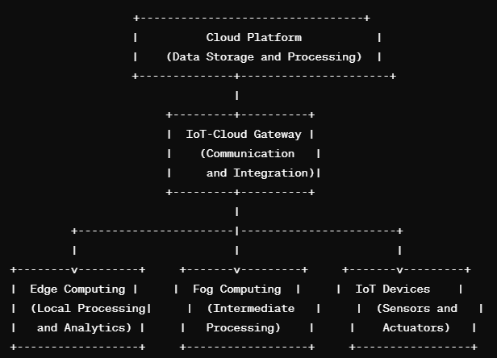
IoT Cloud Convergence
Represents the cloud infrastructure providing storage, data processing, and various services.
IoT-Cloud convergence refers to the integration and collaboration between Internet of Things (IoT) devices and cloud computing infrastructure.
It involves leveraging the capabilities of cloud platforms to enhance the efficiency, scalability, and functionality of IoT applications.
The convergence of IoT and cloud computing brings several benefits and enables the development of more powerful and sophisticated IoT solutions.
Manages communication between IoT devices and the cloud.
Integrates data from IoT devices into the cloud platform.
Edge Computing: Localized processing and analytics near the IoT devices. Reduces latency by handling data processing at the edge.
Fog Computing: Intermediate layer between edge and cloud. Performs additional processing and analysis before data is sent to the cloud.
IoT Devices:
Sensors and actuators generating and receiving data.
Connected to the cloud through the IoT-Cloud gateway.

Slide 3
IoT Cloud Convergence
1. Data Storage and Management:
Cloud platforms provide scalable and reliable storage solutions for the vast amount of data generated by IoT devices.
Historical data can be stored in the cloud for long-term analysis, compliance, and auditing purposes.
2. Data Processing and Analytics:
Cloud computing enables powerful data processing and analytics, allowing for real-time and batch processing of IoT data.
Advanced analytics, machine learning, and artificial intelligence can be applied to gain actionable insights from IoT data.
3. Scalability:
Cloud infrastructure provides on-demand scalability, allowing IoT solutions to handle varying workloads and accommodate a growing number of devices.
Auto-scaling features ensure that computational resources can be dynamically adjusted based on demand.

Slide 4
IoT Cloud Convergence
4. Device Management:
Cloud platforms offer centralized device management capabilities, allowing for remote monitoring, configuration, and firmware updates of IoT devices.
Device health and status information can be easily tracked and managed through cloud-based services.
5. Security and Authentication:
Cloud services provide robust security features, including encryption, access control, and identity management.
Centralized security measures help protect IoT devices and data from potential threats.
6. Real-time Communication:
Cloud-based messaging and communication services facilitate real-time interaction between IoT devices and applications.
Push notifications, alerts, and commands can be delivered efficiently through cloud infrastructure.

Slide 5
IoT Cloud Convergence
7. Cost Optimization:
Cloud services allow organizations to pay for the resources they consume, promoting cost efficiency.
It eliminates the need for significant upfront investments in infrastructure and provides flexibility in resource utilization.
8. Edge and Fog Computing Integration:
IoT-Cloud convergence often involves integrating edge and fog computing models to distribute processing closer to the data source.
Edge and fog computing reduce latency and bandwidth usage by performing initial processing near IoT devices.
9. Standardization and Interoperability:
Cloud platforms often adhere to industry standards, promoting interoperability among diverse IoT devices.
Standardized protocols and APIs facilitate seamless communication and integration within the IoT ecosystem.

Slide 6
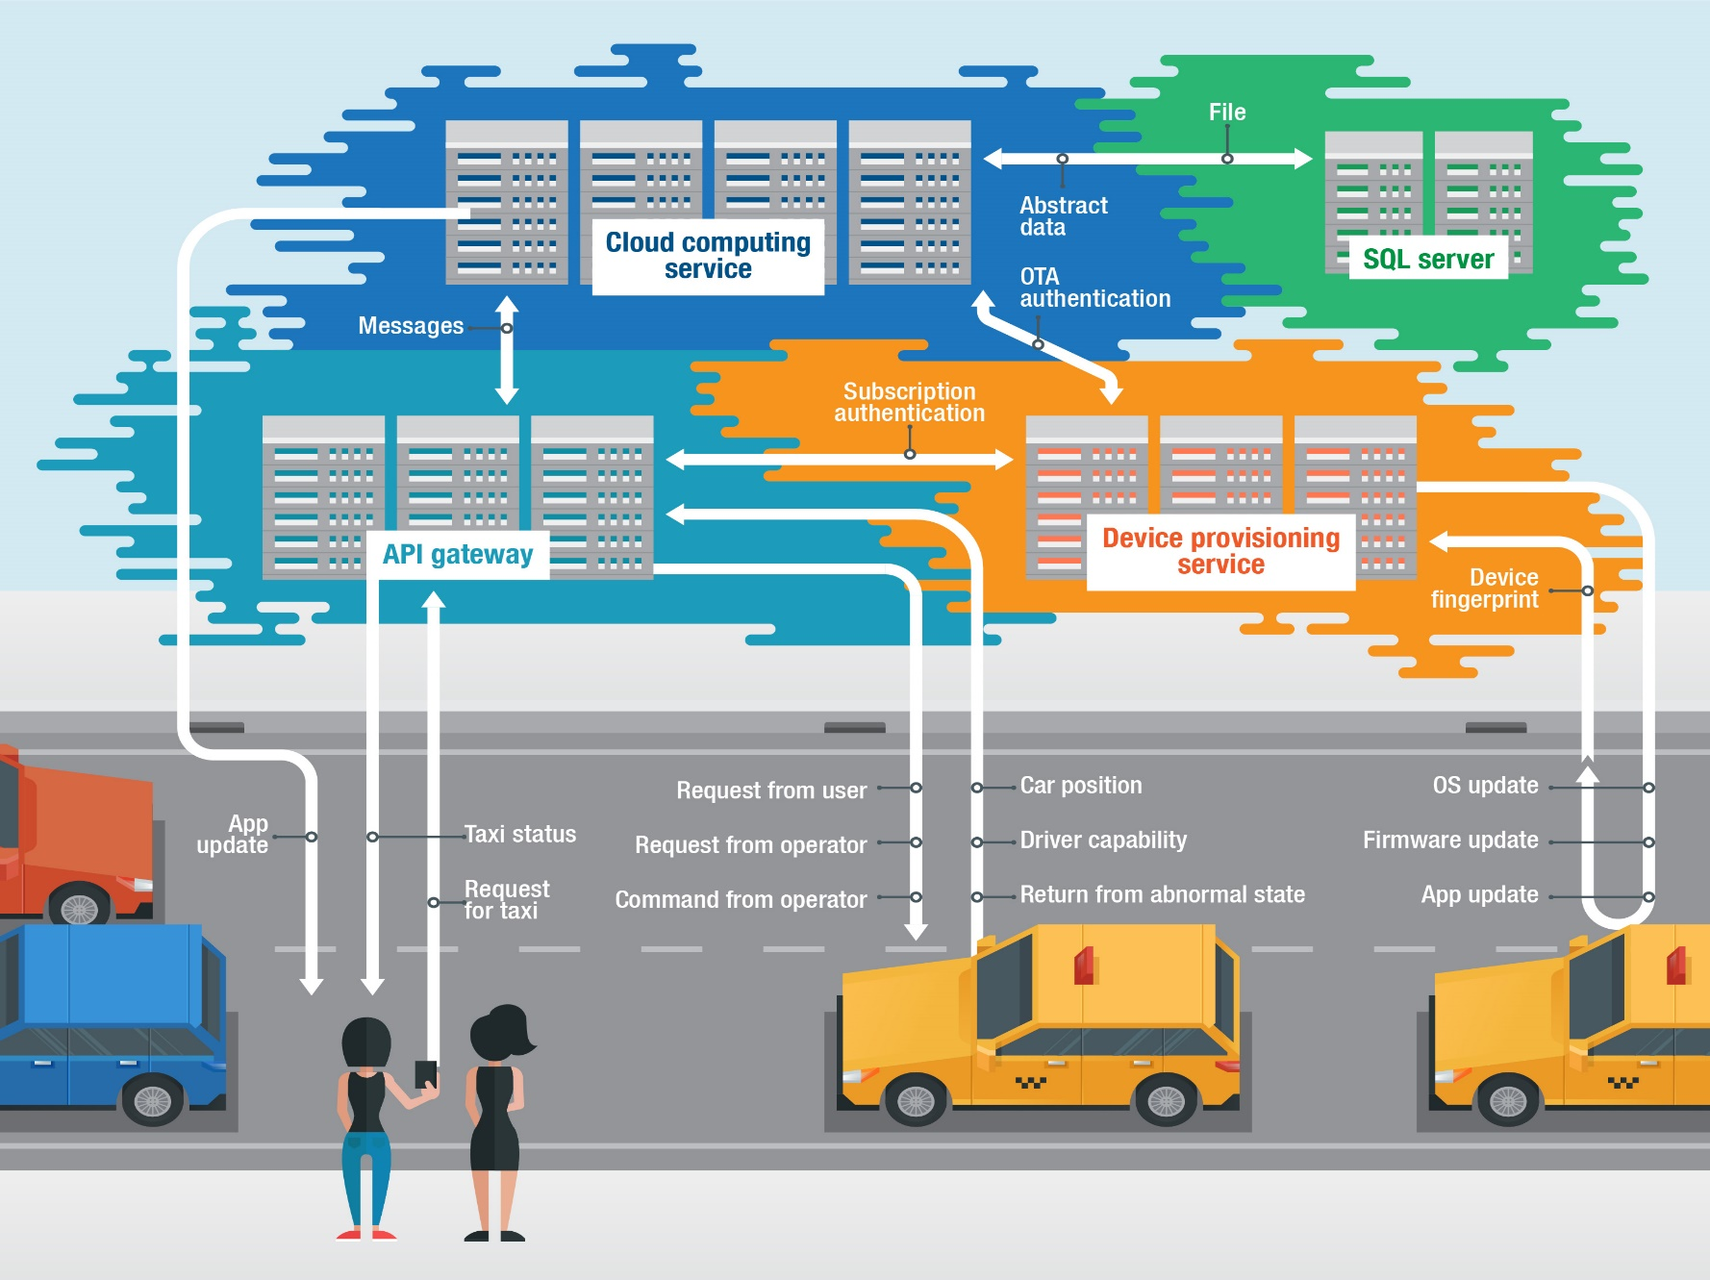
Role of cloud computing in the IoT
IoT works on a diverse selection of devices that fit into the requirements of different industries or settings.
Cloud computing involves storing and accessing data, applications, or services over the internet — that is, in the cloud — instead of in physical servers or mainframes

Slide 7
Advantages of IoT-cloud convergence
Remote operation and interoperability: IoT devices lack interoperability resources, but cloud integration enables remote tasks like asset data gathering and maintenance on deployed devices.
Unlimited data storage: The IoT and cloud technologies efficiently handle unstructured data from multiple sensors, providing more space for data aggregation and analysis when combined.
Unlimited processing capabilities: IoT devices and apps have limited processing capabilities, but cloud integration allows for unlimited virtual processing using AI and ML for data-driven decision-making and improvements.
Added security measures: Cloud technology enhances IoT security by improving authentication mechanisms and device identity verification.

Slide 8
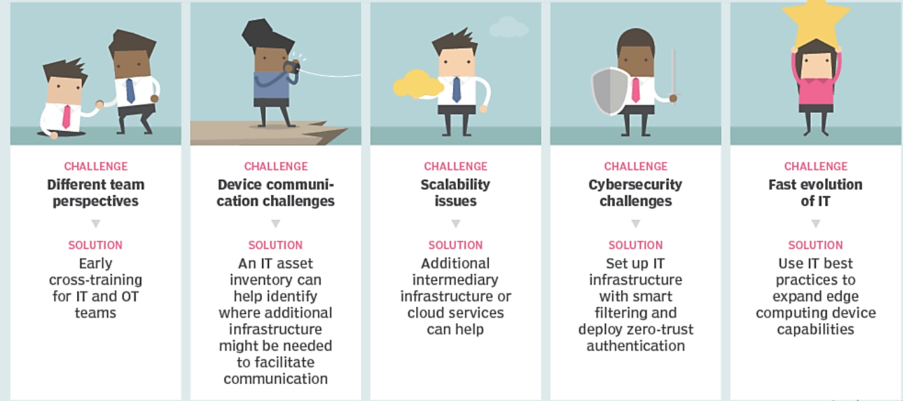
IoT-cloud convergence Challenges and solutions

Slide 9
IoT-cloud convergence Challenges in secure IoT-cloud environments
Risk arising from centralizing the entry into critical infrastructure. The integration of IoT and cloud reduces attack surface by restricting traffic through API gateways. However, a high-end firewall is needed to protect data flow, as a single entry could lead to potential attackers entering the infrastructure.
Unsecure communication and data flow between the edge and the cloud: If the endpoints or the cloud has inadequate security features, such as authentication and encryption, this could put access controls and the integrity of the data sent between these two points at risk.
Privacy and authorization issues: Enterprises must carefully consider IoT devices' handling of sensitive data, particularly in cloud-based ecosystems, and ensure data location is discussed with cloud service providers, particularly in capitalized areas.
Poor implementation of the IoT: Inadequate security measures in an IoT ecosystem, including changing passwords, network segmentation, and physical device security, can lead to vulnerabilities even with cloud integration, such as limited access without a timeout.
Cloud misconfiguration and other vulnerabilities: Misconfiguration in cloud computing allows malicious actors to conduct attacks, potentially causing severe consequences for the IoT ecosystem it's part of.

Slide 10
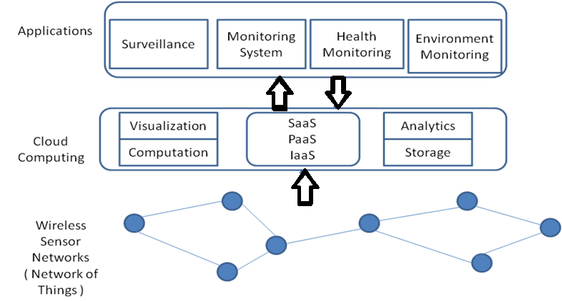
Architectures for IoT convergence
The convergence of Internet of Things (IoT) and cloud computing involves the integration of IoT devices with cloud services to enable efficient data processing, storage, and analysis.
Some common architectures for IoT cloud convergence:
Fog Computing Architecture
Edge Computing Architecture
Hierarchical Architecture
Client-Server Model
Microservices Architecture
Serverless Architecture
Containerization

Slide 11
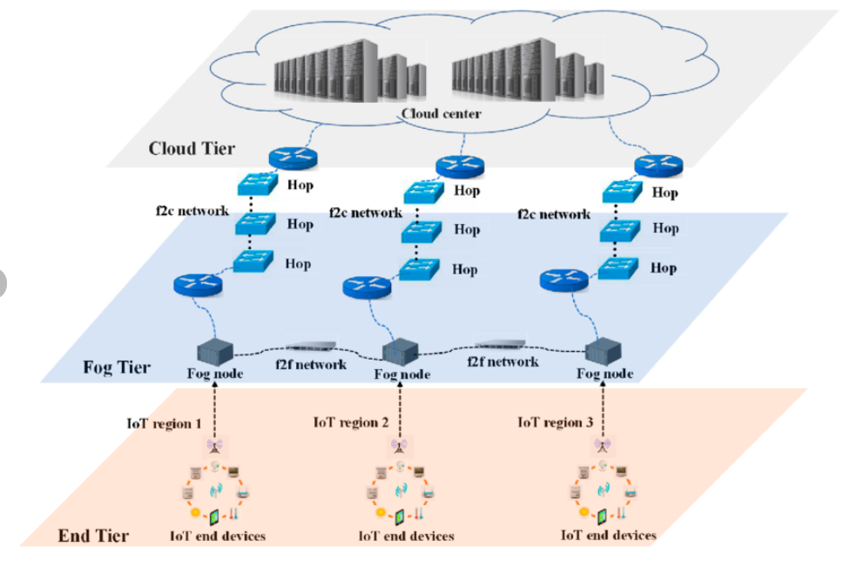
Architectures for IoT convergence-Fog Computing Architecture
Fog computing brings computational resources closer to the edge of the network, reducing latency and bandwidth usage.
IoT devices communicate with nearby fog nodes that can process data locally before sending relevant information to the cloud.
Fog nodes act as intermediaries, providing real-time processing and decision-making capabilities.

Slide 12
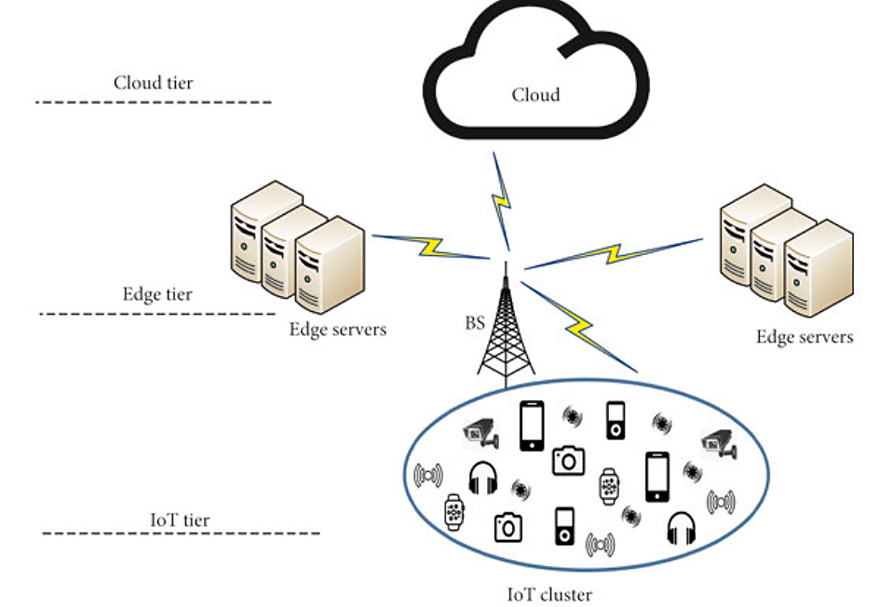
Architectures for IoT convergence –Edge Architecture
Similar to fog computing, edge computing places computational resources closer to the IoT devices at the network's edge.
Edge devices perform initial data processing and filtering, sending only relevant information to the cloud for further analysis.
Reduces latency and bandwidth usage by processing data at the source.

Slide 13
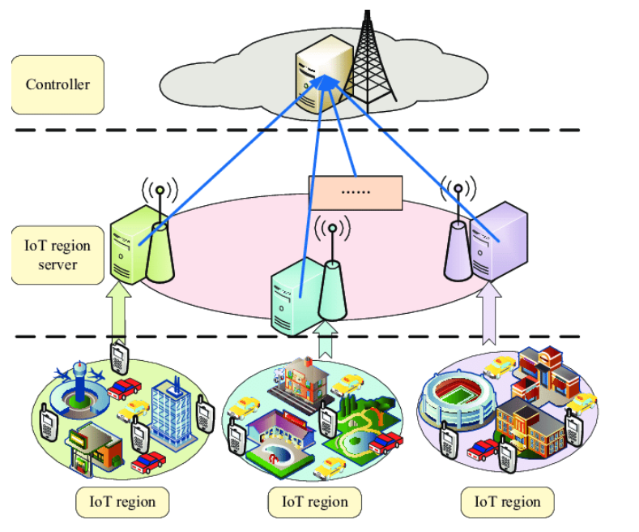
Architectures for IoT convergence- hierarchical architecture
In a hierarchical architecture, IoT devices are organized into layers, each responsible for specific tasks.
The lower layers handle data acquisition and preliminary processing, while higher layers manage aggregation, analysis, and communication with the cloud.
Enables a scalable and organized approach to handling large-scale IoT deployments.

Slide 14
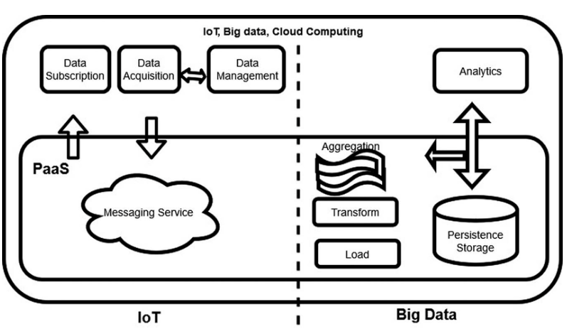
Architectures for IoT convergence -Client-Server Model
IoT devices act as clients that collect and transmit data to cloud servers.
Cloud servers host applications, databases, and analytics engines for processing the received data.
Simple and straightforward, suitable for scenarios where latency is not a critical concern.

Slide 15
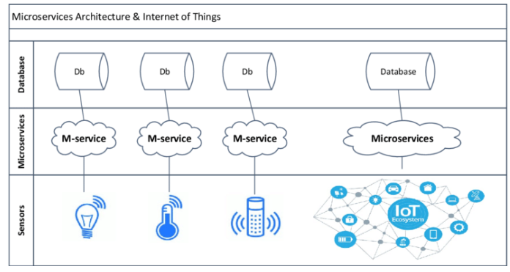
Architectures for IoT convergence-Microservices Architecture
Decomposes the overall system into small, independent, and modular services.
Each service, or microservice, performs a specific function, allowing for scalability and flexibility.
Enables the development and deployment of services for handling various aspects of IoT, such as data storage, analytics, and device management.

Slide 16
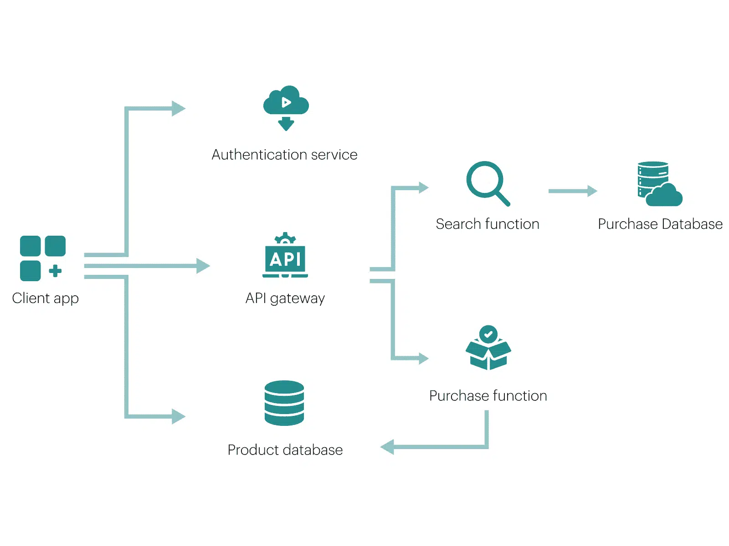
Architectures for IoT convergence- Serverless Architecture
In a serverless architecture, developers focus on writing code without managing the underlying infrastructure.
Cloud providers automatically handle the scaling and execution of functions in response to IoT events.
Offers cost-effectiveness and scalability, as resources are allocated on-demand.

Slide 17
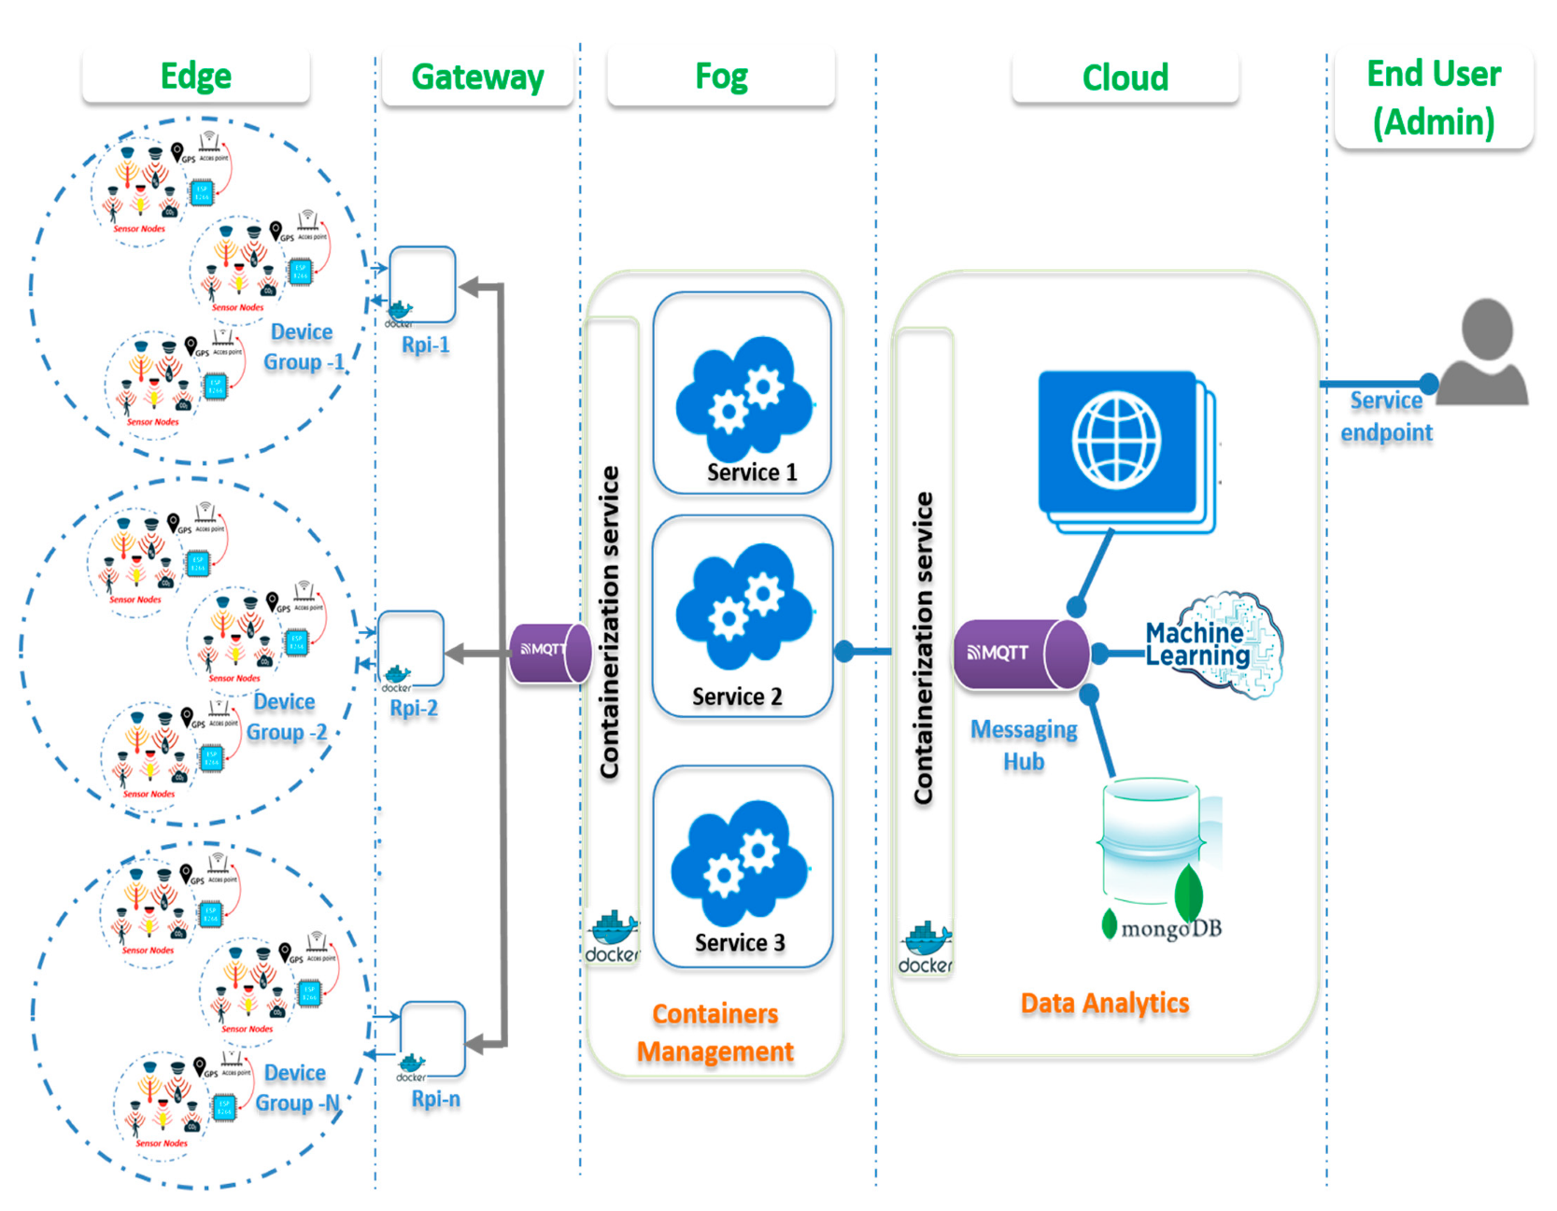
Architectures for IoT convergence Containerization
Containerization technologies, such as Docker, can be used to package IoT applications and their dependencies into portable containers.
Containers provide consistency across development, testing, and deployment environments.
Kubernetes can be employed for container orchestration, managing the deployment and scaling of containerized applications.

Slide 18
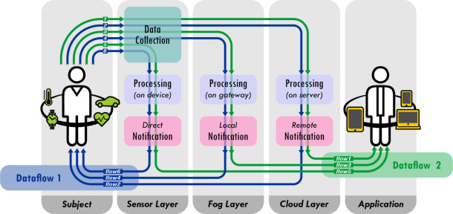
Data offloading and computation
The sensor layer is often in charge of data collection, leveraging a local sensor network. The sensor layer is resource-constrained in terms of processing power and energy budget.
Internet of Things (IoT) raises challenges for devising efficient strategies that offload applications to the fog or the cloud layer while ensuring the optimal response time for a service.

Slide 19
Data offloading and computation
Data offloading and computation in IoT convergence involve the strategic distribution of data processing tasks across different layers of the architecture, including edge devices, fog nodes, and cloud servers.
The goal is to optimize the use of resources, minimize latency, and enhance overall system efficiency.
Computation offloading policies assume the response time is only dominated by the execution time.
For the computation offloading problem, the majority of existing literature presents efficient solutions considering a limited number of parameters (e.g., computation capacity and network bandwidth) neglecting the effect of the application characteristics and dataflow configuration.
Offloading computation is based on the assumption that
(i) the response time is mostly determined by computation time
(ii) shifting the computation toward upper layers can reduce the total response time.
However, this assumption may not always hold, as the migration is often a communication–computation co-optimization problem.

Slide 20
Data offloading
Edge Level:
Description: Initial data processing occurs at the edge, close to the IoT devices where data is generated.
Benefits: Reduces the need to send raw data to the cloud, minimizing latency and conserving bandwidth.
Use Cases: Real-time processing of sensor data, immediate response to local events.
Fog Level:
Description: Intermediate fog nodes between edge and cloud that perform additional processing and filtering of data.
Benefits: Enables distributed computing, allowing for more complex analysis than at the edge alone.
Use Cases: Aggregation of data from multiple edge devices, localized analytics.
Cloud Level:
Description: Centralized cloud servers handle resource-intensive tasks, large-scale analytics, and long-term storage.
Benefits: Provides scalability, global accessibility, and the ability to run advanced algorithms.
Use Cases: Historical data analysis, machine learning model training, global insights.
Hierarchical Offloading:
Description: Divides the processing tasks into hierarchical levels, with initial processing at lower levels and more extensive analysis at higher levels.
Benefits: Optimizes resource usage by performing appropriate processing tasks at each level.
Use Cases: Multi-tiered analysis, where different layers handle specific aspects of data processing.

Slide 21
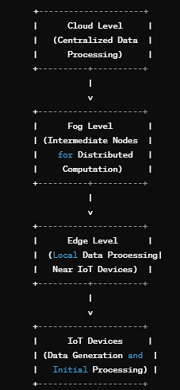
Data Computation
Centralized cloud servers for resource-intensive tasks, large-scale analytics, and long-term storage
Edge Computing:
Description: Localized processing at the edge of the network, near the IoT devices.
Benefits: Reduces latency, enhances real-time decision-making, and conserves bandwidth.
Use Cases: Quick response to local events, filtering of irrelevant data at the source.
Fog Computing:
Description: Fog nodes perform distributed computation, providing intermediate processing between edge and cloud.
Benefits: Improves response time, supports more complex analytics compared to edge-only processing.
Use Cases: Aggregated data analysis, real-time decision-making at an intermediate level.
Intermediate fog nodes performing additional processing and filtering before data is sent to the cloud
Localized processing near IoT devices for initial data processing and filtering
Sensors and devices generating data

Slide 22
Data Computation
Cloud Computing:
Description: Centralized processing in the cloud for resource-intensive tasks, extensive analytics, and storage.
Benefits: Offers scalability, accessibility, and the ability to run complex algorithms.
Use Cases: Machine learning model training, global analytics, storage of large datasets.
Dynamic Computation Allocation:
Description: Dynamically allocates processing tasks based on changing conditions, such as network bandwidth and device capabilities.
Benefits: Adapts to varying demands, optimizing resource utilization in real-time.
Use Cases: Fluctuating workloads, adaptive resource allocation based on network conditions.
Mobile Edge Computing (MEC):
Description: Extends edge computing to mobile networks, allowing offloading of data processing tasks to edge servers.
Benefits: Lowers latency in mobile environments, supports real-time applications.
Use Cases: Mobile IoT devices offloading computation to edge servers in a mobile network.
Hybrid Approaches:
Description: Combines elements of edge, fog, and cloud computing for a flexible and adaptable system.
Benefits: Balances local and centralized processing based on specific application requirements.
Use Cases: Hybrid architectures for diverse IoT applications.

Slide 23
Data offloading and computation systems-Response Time model
Dataflow 1: The actuators are located at the sensor layer, so the action response is issued at the processing unit and is performed at the sensor layer.
Based on this scenario, the data analysis can be performed at the three layers: the sensor node processing unit, the gateway device processing unit, and the cloud processing unit.

Slide 24
Data offloading and computation systems-Response Time model
Dataflow 2: Actuators can be physically distant from sensor nodes, collecting data for analysis and notification on the application layer.
Tele-monitoring IoT systems typically follow this dataflow, assuming end-user connectivity.

Slide 25
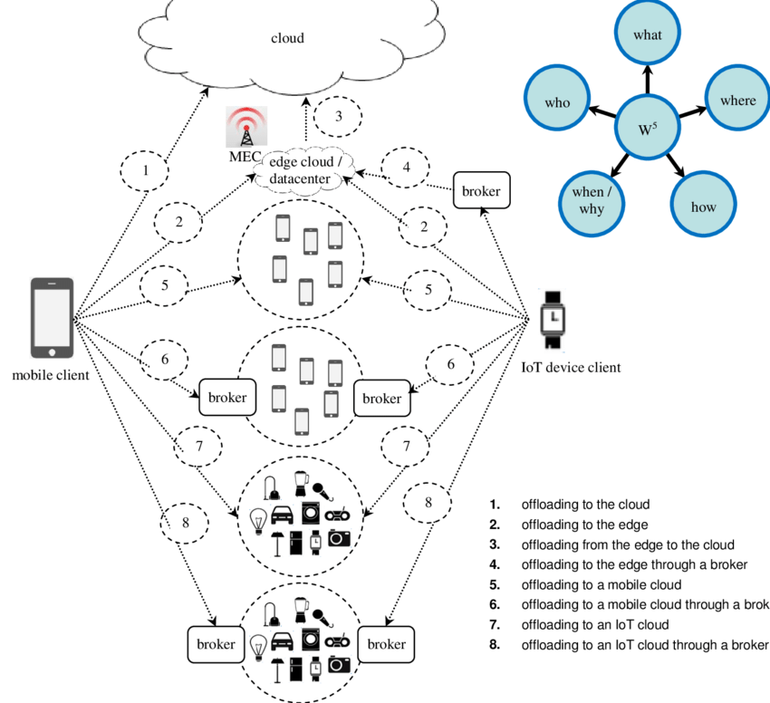
Data offloading and computation systems-Response Time model
The response time is defined as the time difference between the moment when data is collected for decision making and the moment when the result is delivered to the consumer.
Different data flows from sensors to consumers may cause changes in the response time.
The response time is a function of many factors including contextual parameters and application characteristics that can change over time.
Finding optimal computation offloading policy for an unknown and dynamic system is critical since dynamicity of environment e.g., network condition, workload arrival at computing nodes, user traffic, and application characteristics changes over time.

Slide 26
Data offloading and computation systems-Response Time model
(i) Where to offload: the scheduler should determine where the computation is offloaded, depending on the variety of parameters such as objectives, availability of resources, and required computation capacity for performing computations.
Optimum Solution: optimally offloading workloads to more capable computing resources.

Slide 27
Data offloading and computation systems-Response Time model
(ii) When to offload: the scheduler should determine when the computation is offloaded to upper layers to achieve the required QoS due to many uncertainties in the system and environment such as network congestion, overloaded workload, and device battery.
Optimum Solution: Optimal time scheduling of offloading computations.

Slide 28
Data offloading and computation systems-Response Time model
(iii) What to offload: the computation scheduler should determine what portion of workloads is offloaded to upper layers.
According to this fact, offloading solutions can be classified into two classes:
(i) full offloading where the whole workloads are offloaded to external resources such as fog or cloud layers and
(ii) partial offloading where workloads are partitioned into parts to be executed locally or externally.

Slide 29
Data offloading and computation systems-Response Time model
Resource allocation is classified into three main categories as resource placement, resource scheduling, and computation offloading. Resource placement is about where and how resources are placed in IoT systems.
It aims to find optimal set resources in IoT systems to execute tasks or applications while satisfying QoS (Quality of Service) requirements by optimizing specific objective function (minimizing latency, minimizing energy consumption, etc.).
Resource scheduling or scheduling in resource allocation is to determine when and how many resources to allocate in IoT systems.
The resource scheduling determines optimal scheduling of tasks, services, or applications to be executed on resources in order to meet QoS requirements.
Computation offloading is to determine where and how many resources can be moved to execute tasks or applications. The technique in IoT context is the transfer of resource-intensive computational tasks to a separate external device in the network.
The technique of offloading computation over a network can provide computing power and overcome the limitation of an IoTbased device such as computational power, storage, and energy.

Slide 30
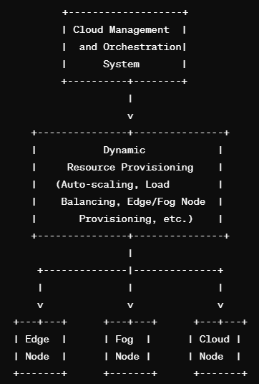
Dynamic Resource Provisioning
Centralized system responsible for managing and orchestrating resources across the entire IoT cloud convergence architecture
Dynamic Resource Provisioning in IoT cloud convergence involves the automatic allocation and deallocation of computational resources based on the changing demands of the system.
This adaptive approach ensures efficient utilization of resources, scalability, and responsiveness to varying workloads.
Core component handling auto-scaling, load balancing, edge/fog node provisioning, and other dynamic resource allocation strategies.
Edge nodes for localized processing near IoT devices
Fog nodes for intermediate processing between edge and cloud.
Cloud nodes for centralized processing and storage.

Slide 31
Dynamic Resource Provisioning
1. Monitoring and Analysis:
Continuous monitoring of IoT device status, network conditions, and application performance.
Analysis of incoming data and workload patterns to identify resource requirements.
2. Resource Scaling:
Vertical Scaling:
Increase or decrease the computing power (CPU, memory) of existing virtual machines or containers based on workload.
Horizontal Scaling:
Add or remove instances of virtual machines or containers to balance the load and handle increased demand.
3. Auto-scaling Policies:
Define policies that trigger resource scaling based on predefined thresholds or performance metrics.
Parameters may include CPU utilization, memory usage, network traffic, or specific application-level metrics.

Slide 32
Dynamic Resource Provisioning
4. Load Balancing:
Distribute incoming requests or data streams evenly across multiple computing resources to prevent overloading specific nodes.
Adjust load balancing strategies dynamically based on current conditions.
5. Edge and Fog Node Provisioning:
Dynamically allocate computing resources at the edge and fog layers to handle localized processing.
Adjust the number of edge and fog nodes based on the proximity to IoT devices and the intensity of processing required.
6. Cloud Bursting:
Offload excess processing tasks to the cloud during peak workloads.
Automatically provision additional cloud resources as needed and release them when demand decreases.
7. Predictive Analytics:
Use historical data and machine learning models to predict future resource demands.
Proactively allocate resources before a surge in demand occurs.

Slide 33
Dynamic Resource Provisioning
8. Policy-based Allocation:
Define policies that govern how resources should be allocated based on specific application requirements, quality of service (QoS), and cost considerations.
9. Real-time Adaptation:
Adapt resource provisioning in real-time based on the evolving nature of IoT data and application requirements.
Respond quickly to sudden changes in workload or network conditions.
10. Automated Configuration Management:
Use configuration management tools to automate the setup and configuration of new resources.
Ensure consistency and reliability across dynamically provisioned resources.
11. Feedback Loops:
Implement feedback loops to continuously assess the effectiveness of resource provisioning.
Adjust provisioning strategies based on the feedback received from monitoring and analytics.

Slide 34
Security aspects of IoT convergence
Cloud Security
Security is a critical aspect in IoT-Cloud convergence, as the integration of Internet of Things (IoT) devices with cloud computing introduces new challenges and vulnerabilities.
Ensuring the security of data, devices, and communications is essential for the successful and safe deployment of IoT solutions.
Network Security
IOT Device Security
Access Control and Identity Management
Security Monitoring
Update and Patch Mangement
Privacy protection and Physical Security

Slide 35
Security aspects of IoT convergence
Device Security:
Authentication: Implement strong authentication mechanisms to ensure that only authorized devices can access the network and cloud services.
Secure Boot: Ensure that devices boot securely, verifying the integrity of their firmware and software components.
Device Identity: Assign unique identities to each device and manage these identities securely.
Data Encryption:
End-to-End Encryption: Encrypt data both in transit and at rest to protect it from interception or unauthorized access.
Data Integrity: Implement measures to ensure the integrity of data during transmission and storage.
Network Security:
Secure Protocols: Use secure communication protocols (e.g., TLS/SSL) for data transmission between devices, edge, and cloud.
Firewalls and Intrusion Detection Systems (IDS): Deploy firewalls and IDS to monitor and protect the network from malicious activities.

Slide 36
Security aspects of IoT convergence
Access Control:
Role-Based Access Control (RBAC): Implement RBAC to restrict access to resources based on the roles and responsibilities of users and devices.
Least Privilege Principle: Grant the minimum level of access necessary for devices and users to perform their functions.
Cloud Security:
Multi-Factor Authentication (MFA): Enforce MFA for accessing cloud services to add an extra layer of security.
Data Center Security: Ensure that the cloud provider maintains robust physical and environmental security measures.
Security Monitoring and Logging:
Security Information and Event Management (SIEM): Implement SIEM solutions to monitor and analyze security events across the IoT-Cloud infrastructure.
Logging: Generate and analyze logs to detect and respond to security incidents.

Slide 37
Security aspects of IoT convergence
Update and Patch Management:
Firmware Updates: Regularly update device firmware to patch vulnerabilities and improve security.
Patch Management: Apply security patches to cloud infrastructure and services to address known vulnerabilities.
Privacy Protection:
Data Minimization: Collect and store only the data necessary for the intended purpose to minimize privacy risks.
Privacy Policies: Clearly communicate privacy policies to users and ensure compliance with applicable data protection regulations.
Physical Security:
Physical Access Controls: Secure physical access to IoT devices, edge infrastructure, and cloud data centers.
Tamper Detection: Implement mechanisms to detect tampering or unauthorized physical access to devices.

Slide 38
Security aspects of IoT convergence
Incident Response and Recovery:
Incident Response Plan: Develop and regularly test an incident response plan to efficiently address and mitigate security incidents.
Backup and Recovery: Implement backup and recovery procedures to minimize data loss in the event of a security incident.
Regulatory Compliance:
Compliance Assessments: Ensure compliance with relevant regulations and standards, such as GDPR, HIPAA, or industry-specific requirements.
Secure Development Practices:
Secure Coding Standards: Adhere to secure coding practices during the development of IoT devices and cloud applications.
Security Testing: Conduct regular security assessments, including penetration testing and code reviews.

Slide 39
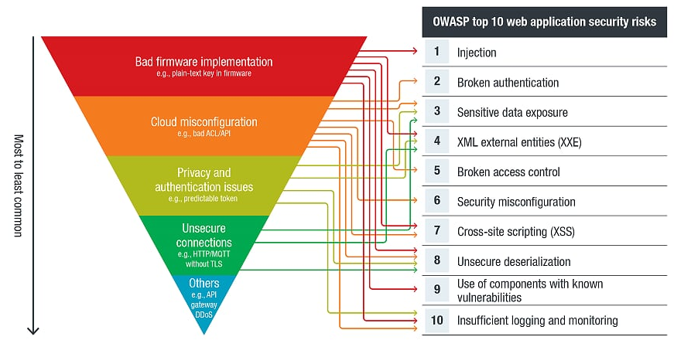
Top 10 web application security risks according to the Open Web Application Security Project (OWASP)

Slide 40
Securing IoT-cloud convergence
Monitor and secure the flow of data early into the process. Enterprises must secure IoT data flow by implementing edge monitoring and filtering tools to detect suspicious activity, anomalies, and identify connected devices early in processing.
Use cloud-based solutions to bring security closer to the edge. Enterprises must protect edge devices from physical and cyber threats, using cloud-based solutions like fog computing to enhance security and processing capabilities.
Perform vulnerability checks regularly. Regular vulnerability testing can detect errors in an ecosystem, allowing enterprises to conduct testing on specific components or the entire ecosystem as long as it's conducted regularly.

Slide 41
Securing IoT-cloud convergence
Ensure continuous updates and patches. Enterprises can effectively and securely distribute software updates using the cloud, which is crucial in preventing IoT vulnerabilities from being exploited.
Use secure passwords for both IoT devices and linked cloud services. Weak passwords contribute to successful data breaches, necessitating stringent password policies for enterprises, as IoT devices and cloud services are susceptible to intrusions due to guessable credentials.
Define a clear, effective, and detailed access control plan. Enterprises should develop a comprehensive access control plan, identifying users, groups, and roles for detailed authentication and authorization policies in the IoT-cloud ecosystem, applying the principle of least privilege.
Employ code or application security best practices. IoT-cloud ecosystems benefit organizations by simplifying control and enabling remote usability through code or applications. Best practices include static and dynamic application analysis.
Adopt the shared responsibility model. Enterprises should consider the shared responsibility model used by cloud service providers and employ cloud-specific security solutions to ensure data protection in cloud-native systems.

Slide 42
Use Cases
IoT-Cloud convergence offers a wide range of use cases across various industries, leveraging the combined power of IoT devices and cloud computing.
Smart Home Automation:
IoT Devices: Smart thermostats, security cameras, doorbell cameras, lights, and appliances.
Cloud Integration: Centralized control and monitoring of devices through a cloud platform. Users can remotely access and manage their smart home devices, receive real-time notifications, and analyze historical data for energy efficiency.
Industrial IoT (IIoT) for Manufacturing:
IoT Devices: Sensors on machinery, RFID tags on products, and monitoring devices for quality control.
Cloud Integration: Real-time monitoring of production lines, predictive maintenance using cloud analytics, and centralized control of manufacturing processes. The cloud enables data storage, analysis, and seamless integration with other enterprise systems.
Healthcare Monitoring:
IoT Devices: Wearable health trackers, smart medical devices, and sensors for patient monitoring.
Cloud Integration: Continuous monitoring of patient health, real-time data transmission to cloud platforms for analysis, and storage of patient records. Cloud-based applications can provide healthcare professionals with insights for personalized patient care.

Slide 43
Use Cases
Environmental Monitoring:
IoT Devices: Sensors for air quality, water quality, and climate conditions.
Cloud Integration: Continuous monitoring of environmental parameters, early detection of pollution events, and data analysis for environmental research. Cloud platforms facilitate collaboration between researchers and government agencies.
Smart Agriculture:
IoT Devices: Soil sensors, weather stations, drones, and GPS-equipped tractors.
Cloud Integration: Precision farming through real-time data analytics, weather predictions, and crop health monitoring. Farmers can optimize irrigation, plan planting schedules, and receive insights for efficient resource utilization.
Connected Cars and Transportation:
IoT Devices: Sensors in vehicles, GPS systems, and connectivity for in-car applications.
Cloud Integration: Real-time tracking, monitoring vehicle health, and predictive maintenance. Cloud services can provide traffic updates, navigation assistance, and facilitate over-the-air updates for vehicle software.
Supply Chain Visibility:
IoT Devices: RFID tags, GPS trackers, and temperature sensors for goods in transit.
Cloud Integration: Real-time tracking of shipments, monitoring of environmental conditions during transportation, and data-driven insights for supply chain optimization. Cloud platforms enhance transparency and collaboration across the entire supply chain.

Slide 44
Use Cases
Smart Cities:
IoT Devices: Smart streetlights, environmental sensors, waste management sensors, and public transportation systems.
Cloud Integration: City-wide data aggregation for monitoring air quality, traffic flow, energy consumption, and waste management. Cloud platforms enable efficient city planning and resource allocation based on real-time and historical data.
Retail and Inventory Management:
IoT Devices: RFID tags, smart shelves, and inventory tracking sensors.
Cloud Integration: Real-time monitoring of inventory levels, demand forecasting, and supply chain optimization. Cloud-based analytics help retailers make data-driven decisions for stock replenishment and improve overall supply chain efficiency
Energy Management:
IoT Devices: Smart meters, sensors in power grids, and energy consumption monitoring devices.
Cloud Integration: Real-time monitoring of energy consumption, predictive maintenance for power infrastructure, and optimization of energy distribution. Cloud analytics help utility companies balance supply and demand efficiently.

Slide 45
Summary-IoT-Cloud Convergence
In order to facilitate effective data processing, storage, and analysis, cloud computing and the Internet of Things (IoT) are merging. This involves integrating IoT devices with cloud services.
Some common architectures for IoT cloud convergence: Fog Computing Architecture, Edge Computing Architecture, Hierarchical Architecture, Client-Server Model, Microservices Architecture, Serverless Architecture and Containerization.
The convergence of the IoT and the cloud redefines the IoT’s scalability for future expansions and gives the cloud an avenue for creating new services and boosting capabilities.
In IoT convergence, data offloading and computation refer to the deliberate allocation of data processing responsibilities among various architectural levels, such as edge devices, fog nodes, and cloud servers.
The integration of IoT devices with cloud computing presents new challenges and vulnerabilities, necessitating the security of data, devices, and communications for the successful and safe deployment of IoT solutions.

