Slide 1
Experiment 2 Data Export and Data Preprocessing for Environmental Real time Data/Other Data

Slide 2
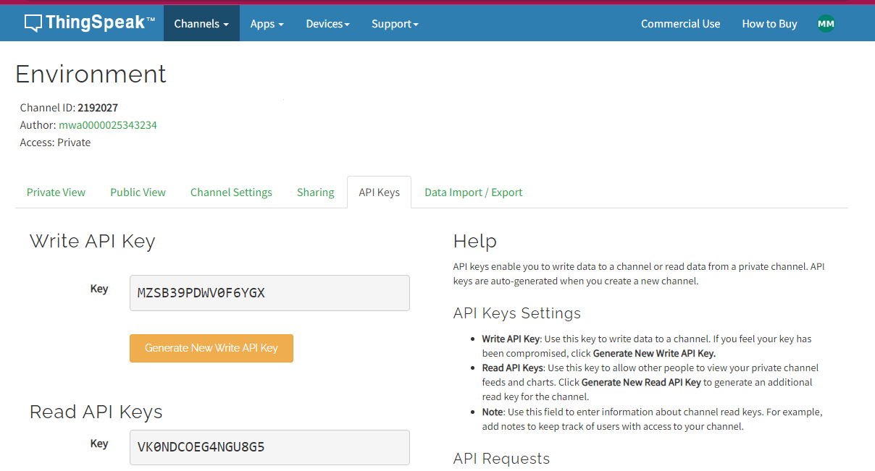
ThingSpeak - Export Data
Export Data for Data Preprocessing

Slide 3
What Is Data Preprocessing?
What Is Data Preprocessing?
Data preprocessing is the task of cleaning and transforming raw data to make it suitable for analysis and modeling. Raw data often includes missing data, outliers, and other inconsistencies, such as formatting issues. Preprocessing steps include data cleaning, data normalization, and data transformation. The goal of data preprocessing is to improve both the accuracy and efficiency of downstream analysis and modeling.
MATLAB® provides apps and functions to preprocess input data to make it suitable for statistical modeling, machine learning algorithms, and other data-driven applications.
Data and Image Courtesy: https://in.mathworks.com/discovery/data-preprocessing.html

Slide 4
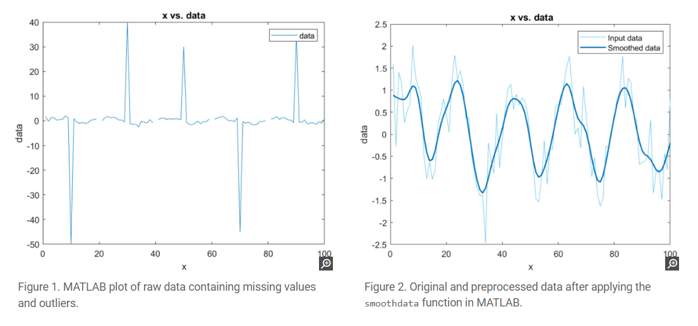
Examples
Data and Image Courtesy: https://in.mathworks.com/discovery/data-preprocessing.html

Slide 5
Data Preprocessing Techniques
Data Preprocessing Techniques
Data preprocessing techniques can be grouped into three main categories: data cleaning, data transformation, and structural operations. These steps can happen in any order and iteratively.
Data Cleaning:Data cleaning is the process of addressing anomalies in the data set using techniques such as:
Managing outliers: Identifying, and then removing outliers, or replacing them with statistically estimated values.
Filling missing data: Identifying missing or invalid data points and replacing them with interpolated values.
Smoothing: Filtering out noise using techniques such as moving mean, linear regression, and more specialized filtering methods.
Data and Image Courtesy: https://in.mathworks.com/discovery/data-preprocessing.html

Slide 6
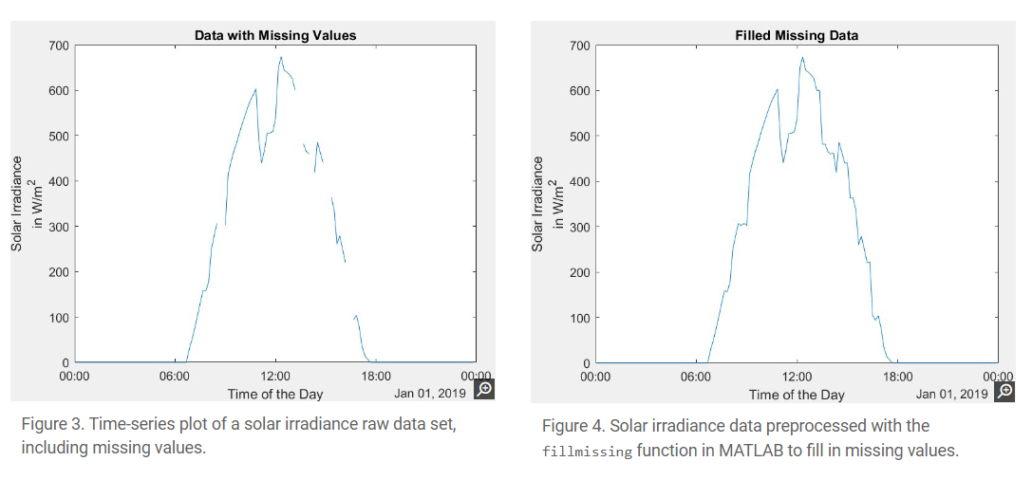
Examples
Data and Image Courtesy: https://in.mathworks.com/discovery/data-preprocessing.html

Slide 7
Data Preprocessing Techniques
Data Transformation
Data transformation is the process of modifying a data set into a preferred format by using operations such as:
Normalization and rescaling:
Standardizing data sets with different scales into a uniform scale
Detrending:
Removing polynomial trends to enhance visibility of variations in the data set
Data and Image Courtesy: https://in.mathworks.com/discovery/data-preprocessing.html

Slide 8
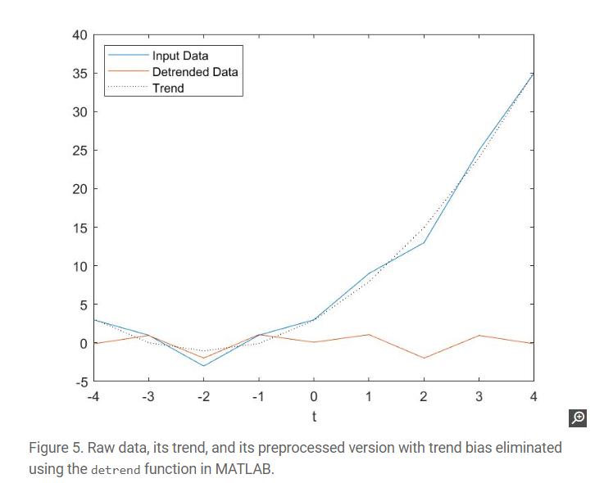
Examples
Data and Image Courtesy: https://in.mathworks.com/discovery/data-preprocessing.html

Slide 9
Structural Operations
Structural Operations
Structural operations are often used for combining, reorganizing, and categorizing data sets and include:
Joining: Combining two tables or timetables by rows using a common key variable
Stacking and unstacking: Reshaping multidimensional arrays to consolidate or redistribute data within the table, making it easier for analysis
Grouping and binning: Reorganizing the data set to extract valuable insights
Calculating pivot tables: Breaking down large tabular data sets into sub-tables to gain focused information
Data and Image Courtesy: https://in.mathworks.com/discovery/data-preprocessing.html

Slide 10
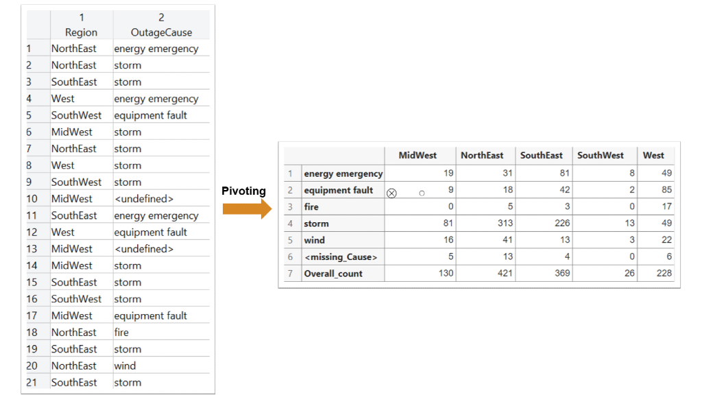
Examples
Data and Image Courtesy: https://in.mathworks.com/discovery/data-preprocessing.html

Slide 11
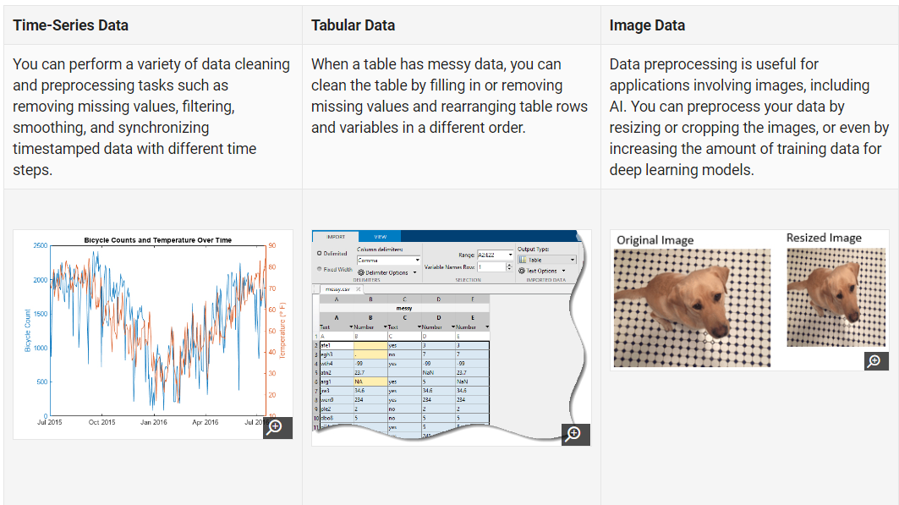
Types of Data Preprocessing
Data and Image Courtesy: https://in.mathworks.com/discovery/data-preprocessing.html

Slide 12
Data Preprocessing Missing data
%% --------------- Importing the dataset -------------------------
% ---------------------------- Code ---------------------------
data = readtable('D:\Data Preprocessing\Data_1.csv')
%%---------------Data Preprocessing -----------------------------
% -------------- Handling Missing Values ------------------------
% -------------- Method 1: Deleting rows or column --------------
% ---------------------------- Code ---------------------------
complete_data = rmmissing(data)
complete_data = rmmissing(data,2)
data = complete_data;
% -------------- Method 1.1: Deleting rows or columns based on
% -------------------------- Relative Percentage of missing---
% ---------------------------- Code ---------------------------
restricted_missing = rmmissing(data,'MinNumMissing',3);
restricted_missing = rmmissing(data,2,'MinNumMissing',2);
restricted_missing = rmmissing(data,2,'MinNumMissing',3);
data = restricted_missing;
Data and Image Courtesy: https://in.mathworks.com/discovery/data-preprocessing.html

Slide 13
Data Preprocessing Missing data
% -------------- Method 2: Using Mean --------------------------
% ---------------------------- Code ---------------------------
%% --------------- Importing the dataset -------------------------
% ---------------------------- Code ---------------------------
data = readtable('D:\Data Preprocessing\Data_1.csv')
M_Age = mean(data.Age, 'omitnan');
U_Age = fillmissing(data.Age, 'constant',M_Age);
data.Age = U_Age;
Data and Image Courtesy: https://in.mathworks.com/discovery/data-preprocessing.html

Slide 14
Data Preprocessing Missing data Dealing with non-numeric data
% ------------- Method 3: Dealing with non-numeric data --------
% ---------------------------- Code ---------------------------
clc
clear all
close all
data = readtable('F:\IoT Lab Session\environmentalmonitoringusecase\Code+and+Data\Machine Learning for Data Science using MATLAB\Data Preprocessing\Data_1.csv')
data.Opinion = categorical(data.Opinion);
Freq_opinion = mode(data.Opinion);
Opinion = fillmissing(data.Opinion,'constant',cellstr(Freq_opinion));
data.Opinion = Opinion;
Data and Image Courtesy: https://in.mathworks.com/discovery/data-preprocessing.html

Slide 15
Data Preprocessing Missing data Handling Outliers
%% -------------- Handling Outliers-------------------------------
clc
clear all
close all
data = readtable('F:\IoT Lab Session\environmentalmonitoringusecase\Code+and+Data\Machine Learning for Data Science using MATLAB\Data Preprocessing\Data_5.csv')
% -------------- Method 1: Deleting Rows ------------------------
% ---------------------------- Code -----------------------------
outlier = isoutlier(data.Age);
data = data(~outlier,:);
% -------------- Method 2: Filling Outliers ---------------------
% ---------------------------- Code -----------------------------
%
Age = filloutliers(data.Age,'clip','mean')
data.Age = Age;
Data and Image Courtesy: https://in.mathworks.com/discovery/data-preprocessing.html

Slide 16
Data Preprocessing Missing data Categorical data
%% -------------- Categorical data------------------
%% -------------- Method 1: Categorical data (no order)----------
% ---------------------------- Code -----------------------------
clc
clear all
close all
data = readtable('F:\IoT Lab Session\environmentalmonitoringusecase\Code+and+Data\Machine Learning for Data Science using MATLAB\Data Preprocessing\Data_6.csv')
% -------------- Method 2: Categorical data (with order)----------
% ---------------------------- Code -----------------------------
new_variable = categorical_data_to_numbers(data.YearlyIncome,{'Average', 'High', 'Very High', 'Low'}, [2 3 5 1]);
data.YearlyIncome = new_variable
Data and Image Courtesy: https://in.mathworks.com/discovery/data-preprocessing.html

Slide 17
Data Preprocessing Missing data Categorical data
%% -------------- Categorical data------------------
%% -------------- Method 1: Categorical data (no order)----------
% ---------------------------- Code -----------------------------
clc
clear all
close all
data = readtable('F:\IoT Lab Session\environmentalmonitoringusecase\Code+and+Data\Machine Learning for Data Science using MATLAB\Data Preprocessing\Data_5.csv')
data = categorical_data_to_dummy_variables(data,data.Location);
data.Location = [];
pause(10)
Data and Image Courtesy: https://in.mathworks.com/discovery/data-preprocessing.html

Slide 18
Data Preprocessing Missing data Feature Scalling
%% -------------- Feature Scalling -------------------------------
% -------------- Method 1: Standardization ----------------------
% ---------------------------- Code -----------------------------
%% -------------- Feature Scalling -------------------------------
clc
clear all
close all
data = readtable('F:\IoT Lab Session\environmentalmonitoringusecase\Code+and+Data\Machine Learning for Data Science using MATLAB\Data Preprocessing\Data_4.csv')
stand_age = (data.Age - mean(data.Age))/std(data.Age)
data.Age = stand_age;
% -------------- Method 2: Normalization ------------------------
% ---------------------------- Code -----------------------------
normalize_age = (data.Age - min(data.Age)) / (max(data.Age) - min(data.Age))
data.Age = normalize_age;
writetable(data,'D:\preprocessed_data.csv');
Data and Image Courtesy: https://in.mathworks.com/discovery/data-preprocessing.html

