Slide 1
Network Layer: Logical Addressing
An IPv4 address is 32 bits long.
Unique – Each address defines one & only one connection to Internet
2 devices can never have same address at same time
Address may be assigned to a device for a time period and then taken away and assigned to another device
The address space of IPv4 is 2³² or 4,294,967,296.
If a device has m connections to the Internet, it needs to have m addresses; router is such a device.

Slide 2


Dotted-decimal notation and binary notation for an IPv4 address

Slide 3
Change the following IPv4 addresses from binary notation to dotted-decimal notation.
10000001 00001011 00001011 11101111
11000001 10000011 00011011 11111111
Solution
We replace each group of 8 bits with its equivalent decimal number and add dots for separation.
a. 129.11.11.239
b. 193.131.27.255

Slide 4
2. Change the following IPv4 addresses from dotted-decimal notation to binary notation.
a. 111.56.45.78 b. 221.34.7.82
Solution
We replace each decimal number with its binary equivalent.
a. 01101111 00111000 00101101 01001110
b. 11011101 00100010 00000111 01010010

Slide 5
3. Find the error, if any, in the following IPv4 addresses.
111.56.045.78
221.34.7.8.20
75.45.301.14
11100010.23.14.67
Solution
There must be no leading zero (045).
There can be no more than four numbers in an IPv4 address.
Each number needs to be less than or equal to 255 (301 is outside this range).
A mixture of binary notation and dotted-decimal notation is not allowed.

Slide 6

Classful Addressing
IPv4 addressing, at its inception, used the concept of classes. This architecture is called classful addressing.
In classful addressing, the address space is divided into five classes: A, B, C, D, and E.
Finding the classes in binary and dotted-decimal notation

Slide 7
Find the class of each address.
00000001 00001011 00001011 11101111
11000001 10000011 00011011 11111111
14.23.120.8
252.5.15.111
Solution
The first bit is 0. This is a class A address.
The first 2 bits are 1; the third bit is 0. This is a class C address.
The first byte is 14 (between 0 and 127); the class is A.
The first byte is 252 (between 240 and 255); the class is E.

Slide 8

Classes and Blocks
One problem with classful addressing is that each class is divided into a fixed number of blocks with each block having a fixed size
In classful addressing, a large part of the available addresses were wasted.

Slide 9
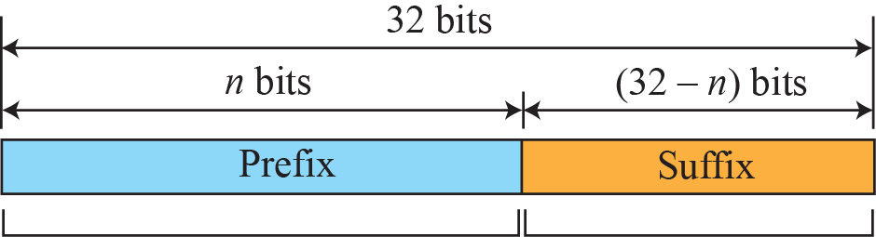
Netid and Hostid
In classful addressing, an IP address in class A, B, or C is divided into netid and hostid.
Network & Host Representation
By IP Address Class
Class
Octet1
Octet2
Octet3
Octet4
Class A
Network
Host
Host
Host
Class B
Network
Network
Host
Host
Class C
Network
Network
Network
Host

Slide 10
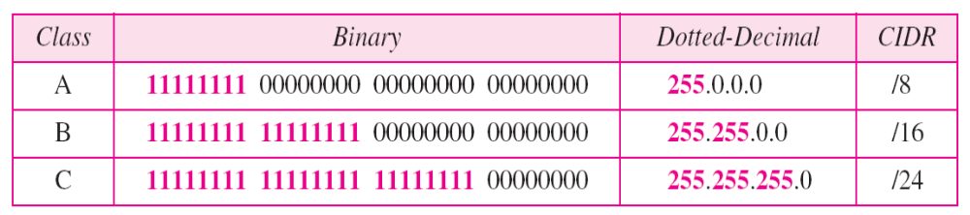
Mask
Although the length of the netid and hostid (in bits) is predetermined in classful addressing, we can also use a mask (also called the default mask), a 32-bit number made of contiguous 1s followed by contiguous 0s
The mask can help us to find the netid and the hostid. For example, the mask for a class A address has eight 1s, which means the first 8 bits of any address in class A define the netid; the next 24 bits define the hostid

Slide 11
Subnetting
During the era of classful addressing, subnetting was introduced.
If an organization was granted a large block in class A or B, it could divide the addresses into several contiguous groups and assign each group to smaller networks (called subnets)
Supernetting
The time came when most of the class A and class B addresses were depleted; however, there was still a huge demand for midsize blocks. The size of a class C block with a maximum number of 256 addresses did not satisfy the needs of most organizations. Even a midsize organization needed more addresses. One solution was supernetting.
In supernetting, an organization can combine several class C blocks to create a larger range of addresses. For example, an organization that needs 1000 addresses can be granted four contiguous class C blocks. The organization can then use these addresses to create one supernetwork.

Slide 12
Address Depletion
The flaws in classful addressing scheme combined with the fast growth of the Internet led to the near depletion of the available addresses.
We have run out of class A and B addresses, and a class C block is too small for most midsize organizations.
One solution that has alleviated the problem is the idea of classless addressing.

Slide 13
Classless Addressing
In this scheme, there are no classes, but the addresses are still granted in blocks.
In classless addressing, when an entity, small or large, needs to be connected to the Internet, it is granted a block (range) of addresses.
The size of the block (the number of addresses) varies based on the nature and size of the entity.
For example, a household may be given only two addresses; a large organization may be given thousands of addresses.
An ISP, as the Internet service provider, may be given thousands or hundreds of thousands based on the number of customers it may serve.

Slide 14
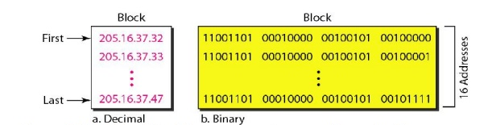
Restrictions in Classless Addressing
The addresses in a block must be contiguous, one after another.
The number of addresses in a block must be a power of 2 (1, 2, 4, 8, ... ).
A block of addresses can be defined if we know - any address in the block and the mask.
As we discussed before, a mask is a 32-bit number in which the n leftmost bits are 1s and the 32-n rightmost bits are 0s. However, in classless addressing the mask for a block can take any value from 0 to 32. It is very convenient to give just the value of n preceded by a slash (CIDR notation).

Slide 15
In IPv4 addressing, a block of
addresses can be defined as
x.y.z.t /n
in which x.y.z.t defines one of the addresses and the /n defines the mask.
The address and the /n notation completely define the whole block (the first address, the last address, and the number of addresses).

Slide 16
The first address in the block can be found by setting the rightmost 32 − n bits to 0s.
The last address in the block can be found by setting the rightmost 32 − n bits to 1s.
The number of addresses in the block can be found by using the formula 2^{32−n}

Slide 17
A classless address is given as 167.199.170.82/27. We can find the above three pieces of information as follows.
The number of addresses in the network is 2^{32− n} = 2⁵ = 32 addresses. The first address can be found by keeping the first 27 bits and changing the rest of the bits to 0s.
The last address can be found by keeping the first 27 bits and changing the rest of the bits to 1s.
18.<number>

Slide 18
A block of 16 addresses is granted to a small organization. We know that one of the addresses is 205.16.37.39/28. What is the first address in the block?
Solution
The binary representation of the given address is
11001101 00010000 00100101 00100111
If we set 32−28 rightmost bits to 0, we get
11001101 00010000 00100101 0010000
or
205.16.37.32.

Slide 19
Find the last address for the block
Solution
The binary representation of the given address is
11001101 00010000 00100101 00100111
If we set 32 − 28 rightmost bits to 1, we get
11001101 00010000 00100101 00101111
or
205.16.37.47

Slide 20
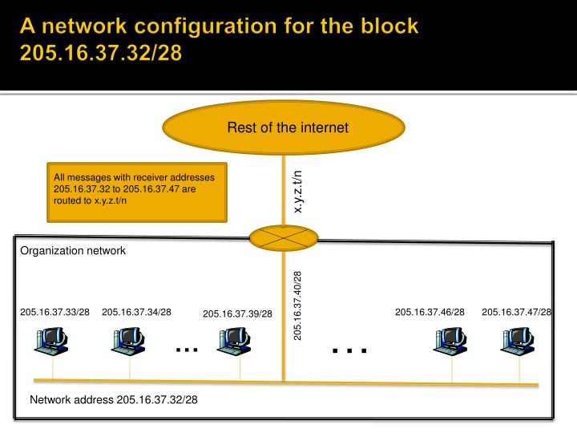
The first address in a block is normally not assigned to any device; it is used as the network address

Slide 21
Subnetting
An organization that is granted a large block of addresses may want to create clusters of networks (called subnets) and divide the addresses between the different subnets.
The rest of the world still sees the organization as one entity; however, internally there are several subnets. All messages are sent to the router address that connects the organization to the rest of the Internet; the router routes the message to the appropriate subnets.
The organization, however, needs to create small subblocks of addresses, each assigned to specific subnets.
As an example, suppose an organization is given the block 17.12.14.0/26, which contains 64 addresses. The organization has three offices and needs to divide the addresses into three subblocks of 32, 16, and 16 addresses.
We can find the new masks by using the following arguments:
Suppose the mask for the first subnet is n1, then 2^{32- n1} must be 32, which means that n1 =27.
Suppose the mask for the second subnet is n2, then 2^{32- n2} must be 16, which means that n2 = 28.
Suppose the mask for the third subnet is n3, then 2^{32- n3} must be 16, which means that n3 =28.
This means that we have the masks 27, 28, 28 with the organization mask being 26.

Slide 22
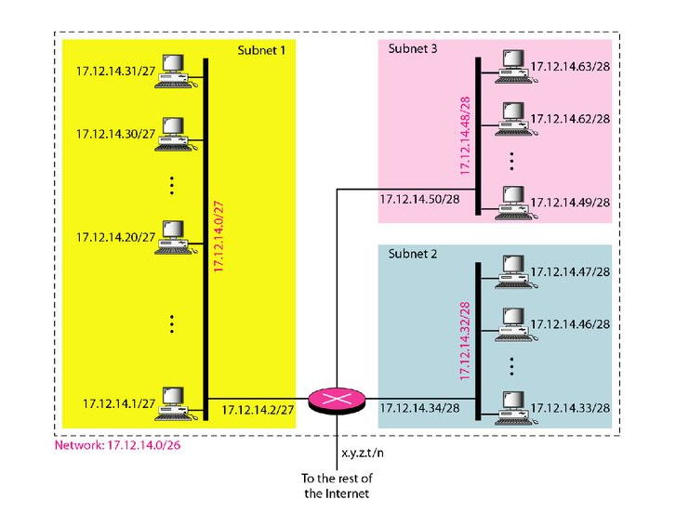

Slide 23
An organization is granted a block of addresses with the beginning address 14.24.74.0/24. The organization needs to have 3 subblocks of addresses to use in its three subnets: one subblock of 10 addresses, one subblock of 60 addresses, and one subblock of 120 addresses. Design the subblocks.
Solution
There are 2^{32– 24} = 256 addresses in this block. The first address is 14.24.74.0/24; the last address is 14.24.74.255/24. To satisfy the third requirement, we assign addresses to subblocks, starting with the largest and ending with the smallest one.
18.<number>

Slide 24
a. The number of addresses in the largest subblock, which requires 120 addresses, is not a power of 2. We allocate 128 addresses. The subnet mask for this subnet can be found as n₁ = 32 − log₂ 128 = 25. The first address in this block is 14.24.74.0/25; the last address is 14.24.74.127/25.
b. The number of addresses in the second largest subblock, which requires 60 addresses, is not a power of 2 either. We allocate 64 addresses. The subnet mask for this subnet can be found as n₂ = 32 − log₂ 64 = 26. The first address in this block is 14.24.74.128/26; the last address is 14.24.74.191/26.
18.<number>

Slide 25
c. The number of addresses in the smallest subblock, which requires 10 addresses, is not a power of 2. We allocate 16 addresses. The subnet mask for this subnet can be found as n₃ = 32 − log₂ 16 = 28. The first address in this block is 14.24.74.192/28; the last address is 14.24.74.207/28.
If we add all addresses in the previous sub-blocks, the result is 208 addresses, which means 48 addresses are left in reserve.
18.<number>

Slide 26
An ISP is granted a block of addresses starting with 190.100.0.0/16 (65,536 addresses). The ISP needs to distribute these addresses to three groups of customers as follows:
a. The first group has 64 customers; each needs 256
addresses.
b. The second group has 128 customers; each needs 128
addresses.
c. The third group has 128 customers; each needs 64
addresses.
Design the subblocks and find out how many addresses are still available after these allocations.
19.<number>

Slide 27

Group 1
For this group, each customer needs 256 addresses. This means that 8 (log2 256) bits are needed to define each host. The prefix length is then 32 − 8 = 24. The addresses are
19.<number>

Slide 28

Group 2
For this group, each customer needs 128 addresses. This means that 7 (log2 128) bits are needed to define each host. The prefix length is then 32 − 7 = 25. The addresses are
19.<number>

Slide 29

Group 3
For this group, each customer needs 64 addresses. This means that 6 (log₂64) bits are needed to each host. The prefix length is then 32 − 6 = 26. The addresses are
Number of granted addresses to the ISP: 65,536
Number of allocated addresses by the ISP: 40,960
Number of available addresses: 24,576
19.<number>

Slide 30

19.<number>

Slide 31

Network Address Translation (NAT)
The number of users that want to use the Internet is ever increasing.
In the beginning, a user was connected to the Internet with a dial-up line, which means that she was connected for a specific period of time. An ISP with a block of addresses could dynamically assign an address to this user. An address was given to a user when it was needed. But the situation is different today.
With the shortage of addresses, this is a serious problem. A quick solution to this problem is called network address translation (NAT).
NAT enables a user to have a large set of addresses internally and one address, or a small set of addresses, externally.
The traffic inside can use the large set; the traffic outside, the small set.
To separate the addresses used inside the home or business and the ones used for the Internet, the Internet authorities have reserved three sets of addresses as private addresses

Slide 32
Any organization can use an address out of this set without permission from the Internet authorities.
Everyone knows that these reserved addresses are for private networks.
They are unique inside the organization, but they are not unique globally.
No router will forward a packet that has one of these addresses as the destination address.
The site must have only one single connection to the global Internet through a router that runs the NAT software.

Slide 33

A NAT implementation
The router that connects the network to the global address uses one private address and one global address. The Internet sees only the NAT router with the address 200.24.5.8.

Slide 34

Addresses in a NAT
Address Translation
All the outgoing packets go through the NAT router, which replaces the source address in the packet with the global NAT address. All incoming packets also pass through the NAT router, which replaces the destination address in the packet (the NAT router global address) with the appropriate private address.

Slide 35

NAT address translation
19.<number>

