Slide 1
Network Layer – Routing
Data Forwarding means to place the packet in its route to its destination.
Forwarding requires a host or a router to have a routing table.
When a host has a packet to send or when a router has received a packet to be forwarded, it looks at this table to find the route to the final destination.
Routing – creation of routing table

Slide 2
UNICAST ROUTING PROTOCOLS
In unicast routing, a packet is routed, hop by hop, from its source to its destination by the help of forwarding tables.
The source host needs no forwarding table because it delivers its packet to the default router in its local network.
The destination host needs no forwarding table either because it receives the packet from its default router in its local network.
This means that only the routers that glue together the networks in the internet need forwarding tables.
With the above explanation, routing a packet from its source to its destination means routing the packet from a source router (the default router of the source host) to a destination router (the router connected to the destination network).
Routing Dr.M.Saranya Nair

Slide 3
UNICAST ROUTING PROTOCOLS
A routing table can be either static or dynamic.
A static table is one with manual entries.
A dynamic table is one that is updated automatically when there is a change somewhere in the Internet.
Routing Dr.M.Saranya Nair

Slide 4
Link State Routing
A least-cost tree is a tree with the source router as the root that visits all other nodes through the shortest path.
In this algorithm the cost associated with an edge defines the state of the link.
Links with lower costs are preferred to links with higher costs.
To create a least-cost tree with this method, each node needs to have a complete map of the network, which means it needs to know the state of each link. The collection of states for all links is called the link-state database (LSDB).
Flooding : Each node can send some greeting messages to all its immediate neighbors (those nodes to which it is connected directly) to collect two pieces of information for each neighboring node: the identity of the node and the cost of the link.
The combination of these two pieces of information is called the LS packet (LSP).
Routing Dr.M.Saranya Nair

Slide 5
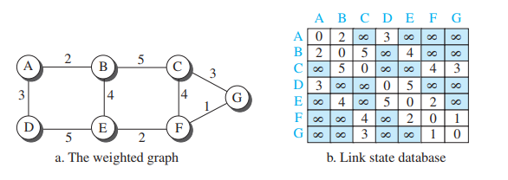
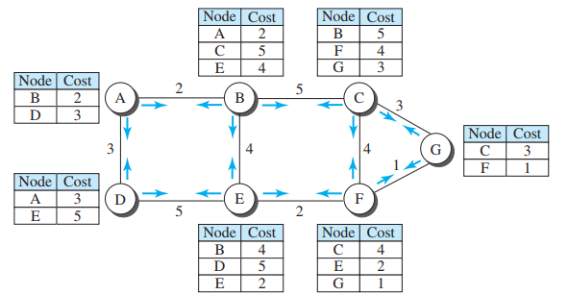
Routing Dr.M.Saranya Nair

Slide 6

To create a least-cost tree for itself, using the shared LSDB, each node needs to run the famous Dijkstra Algorithm.
Routing Dr.M.Saranya Nair

Slide 7

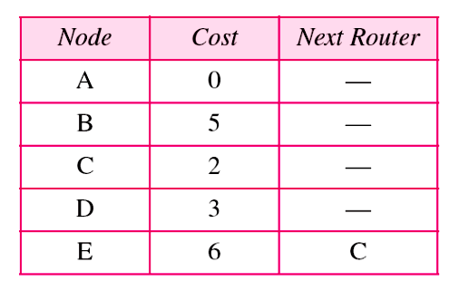
Example of formation of shortest path tree
Routing Dr.M.Saranya Nair

Slide 8
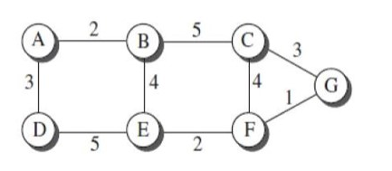
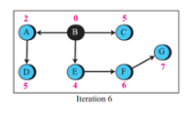
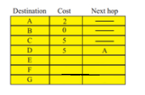
Computing the least cost path from B to all destinations
Routing Dr.M.Saranya Nair
Data Communication Networks
Dr.M.Saranya Nair
SENSE, VIT – Chennai

Slide 9
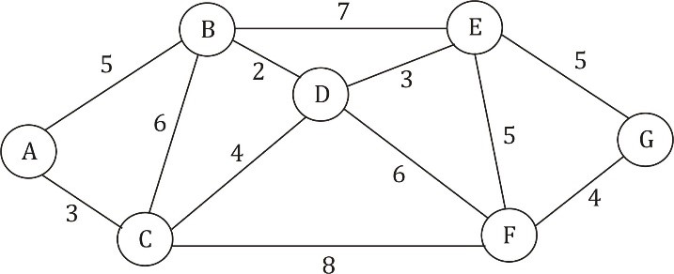
Computing the least cost path from A to all destinations
Routing Dr.M.Saranya Nair

Slide 10
Distance Vector Routing
Routing Dr.M.Saranya Nair

Slide 11

Distance vector routing tables
Routing Dr.M.Saranya Nair

Slide 12

Step 1 : Initialization of tables in distance vector routing
Routing Dr.M.Saranya Nair

Slide 13
Step 2 : Sharing of Routing Tables
In distance vector routing, each node shares its routing table with its immediate neighbors periodically and when there is a change.
How much of the table must be shared with each neighbor?
The third column of a table (next stop) is not useful for the neighbor.
A node therefore can send only the first two columns of its table to any neighbor.
In other words, sharing here means sharing only the first two columns.
Routing Dr.M.Saranya Nair

Slide 14

Step 3 : Updating Routing Tables
The receiving node needs to add the cost between itself and the sending node to each value in the second column.
Routing Dr.M.Saranya Nair

Slide 15
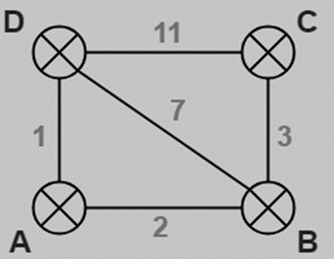
Obtain the routing tables for Router A using Distance Vector Routing
Destination | Distance | Next Hop
A | 0 | –
B | 2 | –
C | ∞
D | 1 | –
Destination | Distance | Next Hop
A | 2 | –
B | 0 | –
C | 3 | –
D | 7 | –
Destination | Distance | Next Hop
A | ∞
B | 3 | –
C | 0 | –
D | 11 | –
Destination | Distance | Next Hop
A | 1 | –
B | 7 | –
C | 11 | –
D | 0 | –
Routing Dr.M.Saranya Nair

Slide 16
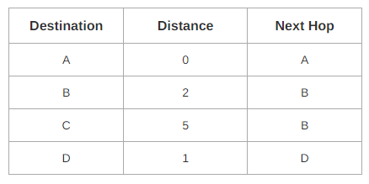
Router A receives distance vectors from its neighbors B and D.
Router A prepares a new routing table.
Routing Dr.M.Saranya Nair

Slide 17
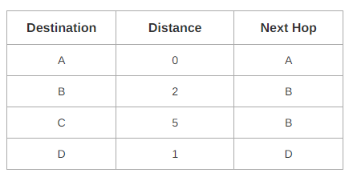
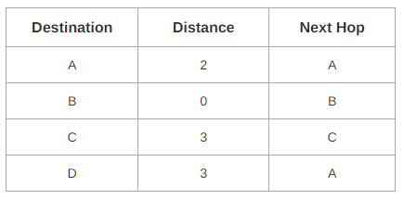
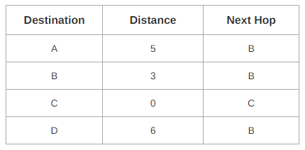
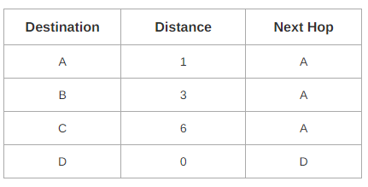
New routing tables
(Not Mandatory to include; but to understand the process)
Routing Dr.M.Saranya Nair

Slide 18
Routing Information Protocol (RIP)
RIP is a very simple protocol based on distance vector routing. RIP implements distance vector routing directly with some considerations:
The destination in a routing table is a network, which means the first column defines a network address.
The metric used by RIP is the number of links (networks) to reach the destination. For this reason, the metric in RIP is called a hop count.
The next-node column defines the address of the router to which the packet is to be sent to reach its destination.
Routing Dr.M.Saranya Nair

Slide 19
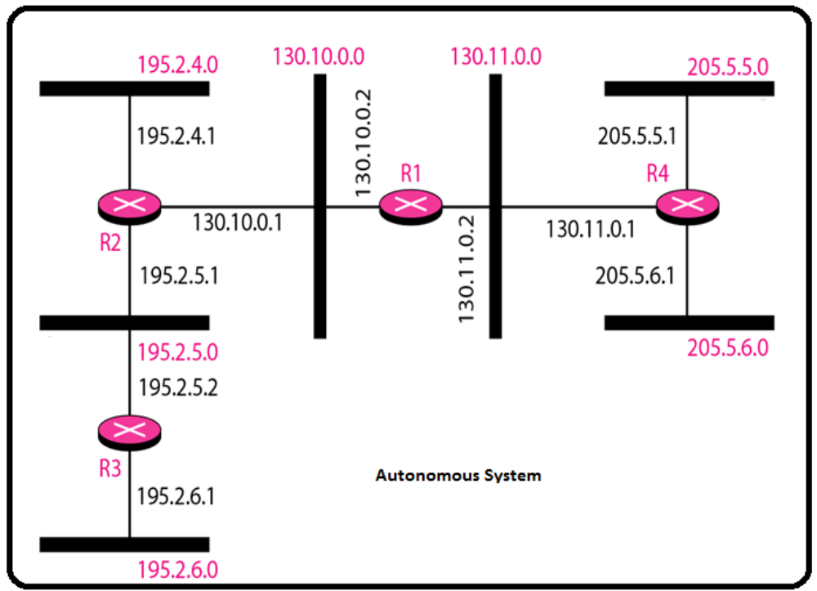
Routing Dr.M.Saranya Nair

Slide 20

Routing Dr.M.Saranya Nair

