Slide 1
TRANSPORT LAYER
Process-to-Process Delivery
What is a process?
What network layer will do?
What Transport layer will do?

Slide 2

Computers often run several programs at the same time.
For this reason, source to destination delivery means delivery not only from one computer to the next but also from a specific process on one computer to a specific process on the other.
The transport layer header must therefore include a type of address called a service-point address in the OSI model and port number or port addresses in the Internet and TCP/IP protocol suite.
UDP & TCP, SCTP - multimedia.
QoS
TRANSPORT LAYER DR M.SARANYA NAIR

Slide 3
Types of data deliveries
In the transport layer, a message is normally divided into transmittable segments.
A connectionless protocol, such as UDP, treats each segment separately.
A connection oriented protocol, such as TCP and SCTP, creates a relationship between the segments using sequence numbers.
Like the data link layer, the transport layer may be responsible for flow and error control. However, flow and error control at this layer is performed end to end rather than across a single link.
TRANSPORT LAYER DR M.SARANYA NAIR

Slide 4
Connectionless / connection oriented service
Connectionless
- no connection establishment / termination, unreliable
- No acknowledgement, not involved in flow or error control
Eg : UDP
Connection oriented
- connection establishment / termination, reliable
- Acknowledgement, use sliding windows for flow control and an acknowledgment system for error control
Eg : TCP
TRANSPORT LAYER DR M.SARANYA NAIR

Slide 5
The transport layer service can be reliable or unreliable.
If the application layer program needs reliability, we use a reliable transport layer protocol by implementing flow and error control at the transport layer. This means a slower and more complex service.
On the other hand, if the application program does not need reliability, because it needs fast service, then an unreliable protocol can be used.
Because the network layer in the Internet is unreliable, we need to implement reliability at the transport layer.
TRANSPORT LAYER DR M.SARANYA NAIR

Slide 6

Error control
TRANSPORT LAYER DR M.SARANYA NAIR

Slide 7
A process on the local host, called a client, needs services from a process usually on the remote host, called a server.
Both processes (client and server) have the same name.
A remote computer can run several server programs at the same time, just as local computers can run one or more client programs at the same time.
For communication, we must define the following:
    1. Local host & Local process
    2. Remote host & Remote process
TRANSPORT LAYER DR M.SARANYA NAIR

Slide 8
Addressing
A frame in the data link layer needs a destination MAC address for delivery and a source address for the next node's reply.
A datagram in the network layer needs a destination IP address for delivery and a source IP address for the destination's reply.
At the transport layer, we need a transport layer address, called a port number, to choose among multiple processes running on the destination host.
The destination port number is needed for delivery; the source port number is needed for the reply.
In the Internet model, the port numbers are 16-bit integers between 0 and 65,535.
The client program defines itself with a port number, chosen randomly by the transport layer software running on the client host. This is the ephemeral port number.
TRANSPORT LAYER DR M.SARANYA NAIR

Slide 9
The server process must also define itself with a port number. This port number, however, cannot be chosen randomly. If the computer at the server site runs a server process and assigns a random number as the port number, the process at the client site that wants to access that server and use its services will not know the port number.
Ofcourse, one solution would be to send a special packet and request the port number of a specific server, but this requires more overhead.
The Internet has decided to use universal port numbers for servers; these are called well-known port numbers.
Every client process knows the well-known port number of the corresponding server process.
  For example, while the Daytime client process, discussed above, can use an ephemeral (temporary) port number 52,000 to identify itself, the Daytime server process must use the well-known (permanent) port number 13.
TRANSPORT LAYER DR M.SARANYA NAIR

Slide 10

Port numbers
Ephemeral port number
Well known port number
TRANSPORT LAYER DR M.SARANYA NAIR

Slide 11
Well-known ports. The ports ranging from 0 to 1023 are
assigned and controlled by lANA. These are the well-known ports.
Registered ports. The ports ranging from 1024 to 49,151 are
not assigned by lANA. They can only be registered with lANA to prevent duplication.
Dynamic ports. The ports ranging from 49,152 to 65,535 are
neither controlled nor registered. They can be used by any process. These are the ephemeral ports.
IANA - Internet Assigned Number Authority
TRANSPORT LAYER DR M.SARANYA NAIR

Slide 12

IP addresses versus port numbers
TRANSPORT LAYER DR M.SARANYA NAIR

Slide 13

Socket address
The combination of an IP address and a port number is called a socket address.
The client socket address defines the client process uniquely just as the server socket address defines the server process uniquely
TRANSPORT LAYER DR M.SARANYA NAIR

Slide 14
Congestion Control and
Quality of Service
Congestion control and quality of service are two issues so closely bound together that improving one means improving the other and ignoring one usually means ignoring the other.
Most techniques to prevent or eliminate congestion also improve the quality of service in a network.
The main focus of congestion control is data traffic. In congestion control we try to avoid traffic congestion.

Slide 15
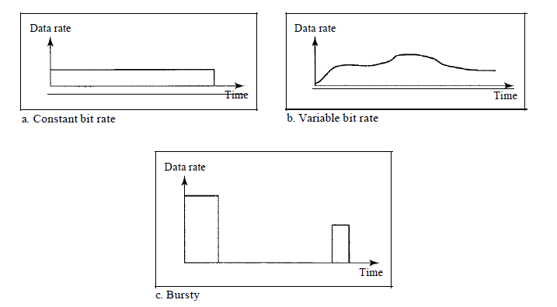
DATA TRAFFIC
A data flow can have one of the following traffic profiles: constant bit
rate, variable bit rate, or bursty. Bursty traffic is one of the main causes of congestion in a network.
TRANSPORT LAYER DR M.SARANYA NAIR

Slide 16
Traffic Profiles
Constant Bit Rate - A constant-bit-rate (CBR), or a fixed-rate, traffic model has a data rate that does not change. This type of traffic is very easy for a network to handle since it is predictable. The network knows in advance how much bandwidth to allocate for this type of flow.
Variable Bit Rate - In the variable-bit-rate (VBR) category, the rate of the data flow changes in time, with the changes smooth instead of sudden and sharp. The maximum burst size is usually a small value.
Bursty - In the bursty data category, the data rate changes suddenly in a very short time. It may jump from zero, for example, to 1 Mbps in a few microseconds and vice versa. This is the most difficult type of traffic for a network to handle because the profile is very unpredictable.
TRANSPORT LAYER DR M.SARANYA NAIR

Slide 17
CONGESTION
Congestion in a network may occur if the load on the network—the number of packets sent to the network—is greater than the capacity of the network—the number of packets a network can handle.
Congestion control refers to the mechanisms and techniques to control the congestion and keep the load below the capacity.
TRANSPORT LAYER DR M.SARANYA NAIR

Slide 18
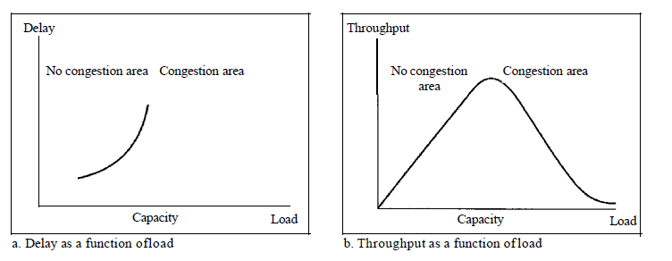
Congestion control involves two factors that measure the performance of a network: delay and throughput.
TRANSPORT LAYER DR M.SARANYA NAIR

Slide 19
Delay Versus Load
When the load is much less than the capacity of the network, the delay is at a minimum.
However, when the load reaches the network capacity, the delay increases sharply because we now need to add the waiting time in the queues (for all routers in the path) to the total delay.
Note that the delay becomes infinite when the load is greater than the capacity.
When a packet is delayed, the source, not receiving the acknowledgment, retransmits the packet, which makes the delay, and the congestion, worse.
TRANSPORT LAYER DR M.SARANYA NAIR

Slide 20
Throughput Versus Load
The reason is the discarding of packets by the routers.
When the load exceeds the capacity, the queues become full and the routers have to discard some packets.
Discarding packet does not reduce the number of packets in the network because the sources retransmit the packets, using time-out mechanisms, when the packets do not reach the destinations.
TRANSPORT LAYER DR M.SARANYA NAIR

Slide 21
Congestion control in TCP
TCP’s congestion control is based on three phases
1. Slow start : exponential increase
2. Congestion detection : multiplicative decrease
3. Congestion avoidance : additive increase
TRANSPORT LAYER DR M.SARANYA NAIR

Slide 22

Slow start, exponential increase
TRANSPORT LAYER DR M.SARANYA NAIR

Slide 23
In the slow-start algorithm, the size of the congestion window increases exponentially until it reaches a threshold.
ssthresh – 65535 bytes
TRANSPORT LAYER DR M.SARANYA NAIR

Slide 24
An implementation reacts to congestion detection in one of the following ways:
- If detection is by time-out
- If detection is by three ACKs, a new congestion avoidance phase starts.
TRANSPORT LAYER DR M.SARANYA NAIR

Slide 25
If detection is by time-out, a new slow start phase starts.
- stronger possibility of congestion
- like segment may drop / no news about the sent segments
- ssthresh = ½ of the current window size
- starts the slow start phase again
If detection is by three ACKs
- weaker possibility of congestion
- ssthresh = ½ of the current window size
- a new congestion avoidance phase starts.
TRANSPORT LAYER DR M.SARANYA NAIR

Slide 26

Congestion avoidance, additive increase: In the congestion avoidance algorithm, the size of the congestion window increases additively until
congestion is detected.
TRANSPORT LAYER DR M.SARANYA NAIR

Slide 27

Congestion example
TRANSPORT LAYER DR M.SARANYA NAIR

Slide 28
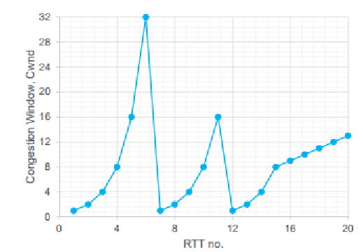
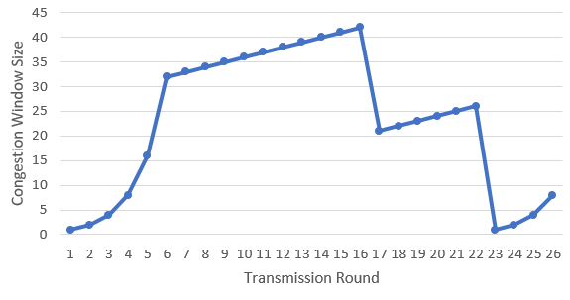
Consider the Figure which shows the behaviour of TCP experienced during its congestion control process. Identify and discuss in detail the different congestion control phases with their respective intervals.
TRANSPORT LAYER DR M.SARANYA NAIR

Slide 29
Assume that a TCP connection is established between two application entities. Consider the maximum window size is 34 segments. The threshold is set to one-half of the maximum window size. When the window size is 16, a three-ACKs event happens. Sketch the congestion window and discuss in detail the different phases of TCP’s congestion control.
TRANSPORT LAYER DR M.SARANYA NAIR

Slide 30
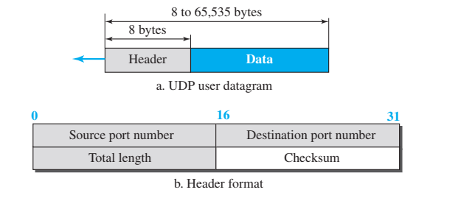
UDP HEADER
TRANSPORT LAYER DR M.SARANYA NAIR

Slide 31
The following is the content of a UDP header in hexadecimal format. CB84000D001C001C
a. What is the source port number?
b. What is the destination port number?
c. What is the total length of the user datagram?
d. What is the length of the data?
e. Is the packet directed from a client to a server or vice versa?
TRANSPORT LAYER DR M.SARANYA NAIR

Slide 32
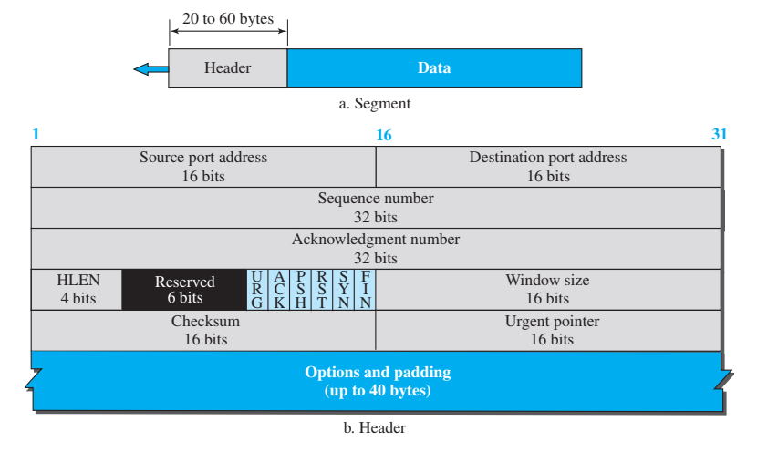
TCP HEADER
TRANSPORT LAYER DR M.SARANYA NAIR

Slide 33
Connection Oriented Service
When a process at site A wants to send and receive data from another process at site B, the following occurs:
    1. The two TCPs establish a connection between them.
    2. Data are exchanged in both directions.
    3. The connection is terminated.
Note that this is a virtual connection, not a physical connection.
Each segment may use a different path to reach the destination. There is no physical connection.
TRANSPORT LAYER DR M.SARANYA NAIR

Slide 34
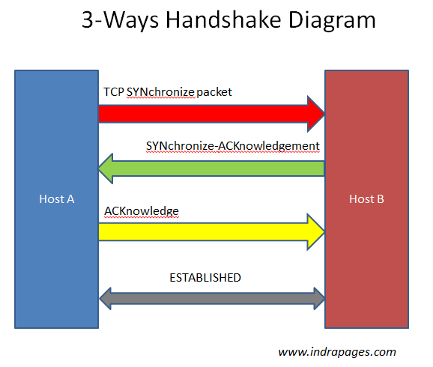
TCP COMMUNICATION PROCESS
TRANSPORT LAYER DR M.SARANYA NAIR

Slide 35
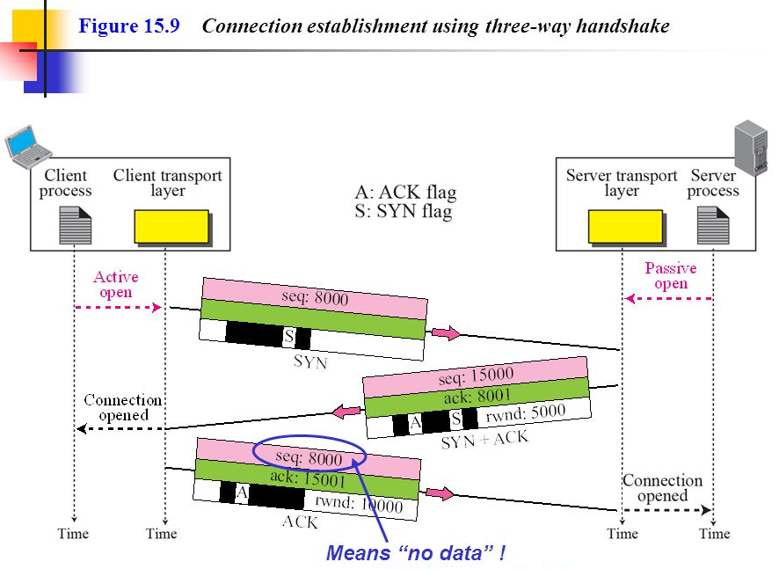
TRANSPORT LAYER DR M.SARANYA NAIR

Slide 36
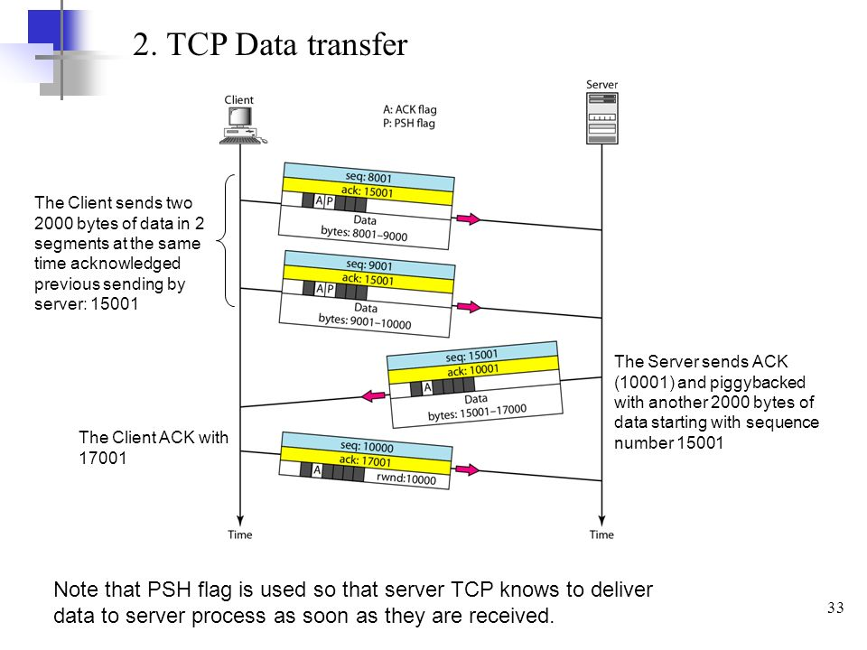
TRANSPORT LAYER DR M.SARANYA NAIR

Slide 37
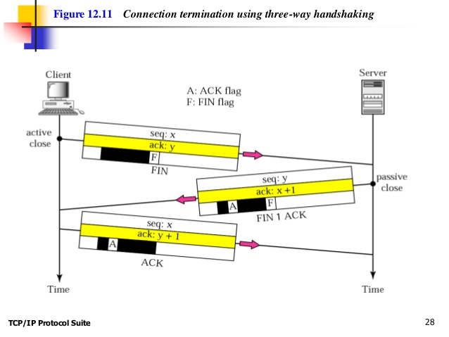
TRANSPORT LAYER DR M.SARANYA NAIR

