Slide 1
MODULE 3 - DATA LINK LAYER
ERROR DETECTION TECHNIQUES
COMPUTER COMMUNICATION AND NETWORKS DR.M.SARANYA NAIR

Slide 2
Link Control & Medium Access Control
are the 2 main functions of
Data Link Layer
COMPUTER COMMUNICATION AND NETWORKS DR.M.SARANYA NAIR

Slide 3
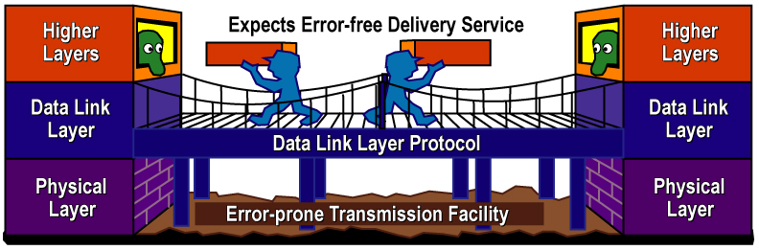
ERROR CONTROL
Physical layer bits – EM signal through transmission media
EM signal susceptible to error
Error detection at the receiver
Error correction at the receiver or discarded & retransmission
COMPUTER COMMUNICATION AND NETWORKS DR.M.SARANYA NAIR

Slide 4

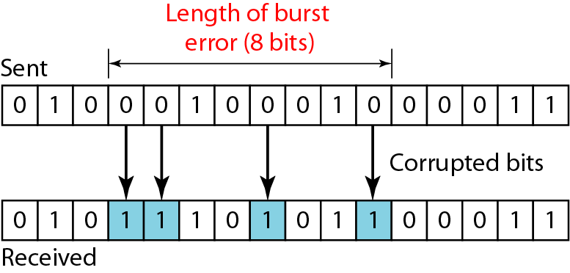
TYPES OF ERRORS
Single bit error
Burst error
The length of the burst is measured from the first corrupted bit to the last corrupted bit.
COMPUTER COMMUNICATION AND NETWORKS DR.M.SARANYA NAIR

Slide 5

ERROR DETECTION : REDUNDANCY
To detect errors, redundant bits of data must be added
COMPUTER COMMUNICATION AND NETWORKS DR.M.SARANYA NAIR

Slide 6
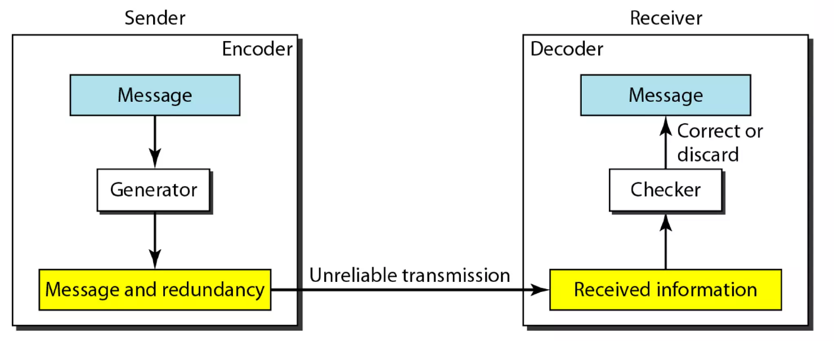
CODING – BLOCK CODING
Process of (sender) adding redundant bits to data provided there should be some relation between data and redundant bits
Message is divided into k-bit blocks
  -Known as datawords
r redundant bits are added
        -Blocks become n=k+r bits; Known as codewords
COMPUTER COMMUNICATION AND NETWORKS DR.M.SARANYA NAIR

Slide 7
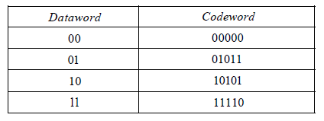
LINEAR BLOCK CODES
A linear block code is a code in which the exclusive OR (addition modulo-2) of two valid codewords creates another valid codeword.
CYCLIC CODES
Cyclic codes are special linear block codes with one extra property. In a cyclic code, if a codeword is cyclically shifted (rotated), the result is another codeword. For example, if 1011000 is a codeword and we cyclically left-shift, then 0110001 is also a codeword.
COMPUTER COMMUNICATION AND NETWORKS DR.M.SARANYA NAIR

Slide 8

CYCLIC REDUNDANCY CHECK – CODE BOOK, CRC(7,4)
COMPUTER COMMUNICATION AND NETWORKS DR.M.SARANYA NAIR

Slide 9
COMMON DETECTION METHODS
Checksum
Cyclic redundancy check
Parity checking
COMPUTER COMMUNICATION AND NETWORKS DR.M.SARANYA NAIR

Slide 10
CHECKSUM – INTERNET PROTOCOLS
BASIC IDEA
A device in a LAN sends a data as four blocks whose contents are as follows: 7,11,12,0, and 6. Use 4-bit checksum at the sender site and show the data items put into the network along with redundant bits. Also, discuss the procedure at the receiver site to check for errors in the information and hence show how to detect the errors if the second data item is changed.
COMPUTER COMMUNICATION AND NETWORKS DR.M.SARANYA NAIR

Slide 11
CYCLIC REDUNDANCY CHECK
COMPUTER COMMUNICATION AND NETWORKS DR.M.SARANYA NAIR

Slide 12
Dataword – k bits
Codeword – n bits
Size of dataword is augmented by adding (n-k) 0’s to right & the n-bit result fed to generator
Generator uses divisor of size (n-k+1)
Append reminder to dataword
COMPUTER COMMUNICATION AND NETWORKS DR.M.SARANYA NAIR

Slide 13
The decoder receives the (possibly corrupted) code-word.
A copy of all n bits is fed to the checker which is a replica of the generator.
The remainder produced by the checker is a syndrome, which is fed to the decision logic analyzer.
The analyzer has a simple function. If the syndrome bits are all 0s, the k leftmost bits of the codeword are accepted as the dataword (interpreted as no error); otherwise, the k bits are discarded (error).
COMPUTER COMMUNICATION AND NETWORKS DR.M.SARANYA NAIR

Slide 14

DIVISION IN CRC ENCODER (MODULO-2)
COMPUTER COMMUNICATION AND NETWORKS DR.M.SARANYA NAIR

Slide 15

DIVISION IN CRC DECODER
COMPUTER COMMUNICATION AND NETWORKS DR.M.SARANYA NAIR

Slide 16

POLYNOMIAL REPRESENTATION
More common representation than binary form
Easy to analyze
Divisor is commonly called generator polynomial
COMPUTER COMMUNICATION AND NETWORKS DR.M.SARANYA NAIR

Slide 17

CRC ENCODER
COMPUTER COMMUNICATION AND NETWORKS DR.M.SARANYA NAIR

Slide 18
CRC EXAMPLE
1. Given the dataword 1010011110 and the divisor 10111,
    a. Show the generation of the codeword at the sender site
    b. Show the checking of the codeword at the receiver site (assume no error).
    ***(using binary division & polynomial division)***
COMPUTER COMMUNICATION AND NETWORKS DR.M.SARANYA NAIR

Slide 19
PARITY CHECKING
Most common, least complex
Single bit is added to a frame
Two schemes:
  Even parity – Maintain even number of 1s
    E.g., 1011 → 10111
  Odd parity – Maintain odd number of 1s
    E.g., 1011 → 10110
COMPUTER COMMUNICATION AND NETWORKS DR.M.SARANYA NAIR

Slide 20
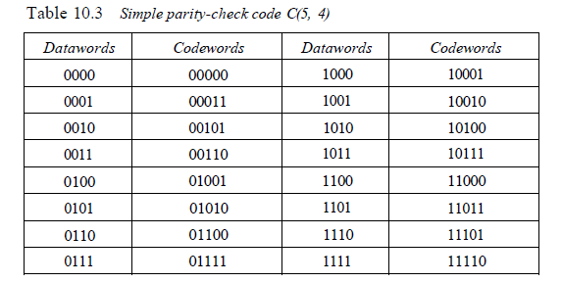
COMPUTER COMMUNICATION AND NETWORKS DR.M.SARANYA NAIR

Slide 21
PARITY CHECKING EXAMPLE
Suppose the sender wants to send the word world. In ASCII the five characters are coded (with even parity) as
1110111 1101111 1110010 1101100 1100100
The following shows the actual bits sent
11101110 11011110 11100100 11011000 11001001
COMPUTER COMMUNICATION AND NETWORKS DR.M.SARANYA NAIR

Slide 22
PARITY CHECKING EXAMPLE
Receiver receives this sequence of words:
11111110 11011110 11101100 11011000 11001001
Which blocks are accepted? Which are rejected?
Can 2-bit errors be detected?
A parity-check code can detect an odd number of errors.
COMPUTER COMMUNICATION AND NETWORKS DR.M.SARANYA NAIR

Slide 23
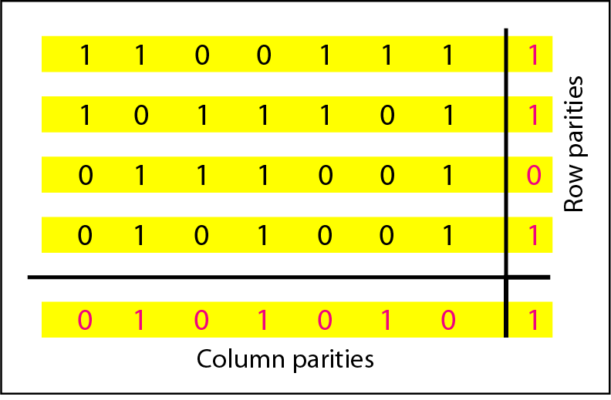
2D PARITY CHECKING
A simple parity-check bit, which is normally added at the end of the data word, cannot detect even numbers of errors. For example, two, four, six, or eight errors cannot be detected in this way.
A better solution is to organize the characters in a table and create row and column parities.
The bit in the row parity is sent with the byte, the column parity is sent as an extra byte
COMPUTER COMMUNICATION AND NETWORKS DR.M.SARANYA NAIR

Slide 24


2D PARITY PERFORMANCE
COMPUTER COMMUNICATION AND NETWORKS DR.M.SARANYA NAIR

Slide 25
Code Analysis - Checksum
Checksum is an error-detecting technique that can be applied to a message of any length.
In the Internet, the checksum technique is mostly used at the transport layer rather than the data-link layer.
However, it is not as strong as the CRC in error-checking capability.
For example, if the value of one word is incremented and the value of another word is decremented by the same amount, the two errors cannot be detected because the sum and checksum remain the same.
Also, if the values of several words are changed but the sum and the checksum do not change, the errors are not detected.
If two data items are transposed in transmission, the checksum cannot catch this error.
COMPUTER COMMUNICATION AND NETWORKS DR.M.SARANYA NAIR

Slide 26
Cyclic Code Analysis using Polynomial
The divisor in a cyclic code is normally called the generator polynomial or simply the generator.
→ How to choose the efficient generator ?
Dataword: d(x) Codeword: c(x) Generator: g(x) Syndrome: s(x) Error: e(x)
If s(x) is not zero, then one or more bits is corrupted. However, if s(x) is zero, either no bit is corrupted or the decoder failed to detect any errors.
In our analysis we want to find the criteria that must be imposed on the generator, g(x) to detect the type of error we especially want to be detected
COMPUTER COMMUNICATION AND NETWORKS DR.M.SARANYA NAIR

Slide 27

Received codeword = c(x) + e(x)
The receiver divides the received codeword by g(x) to get the syndrome.
The first term at the right-hand side of the equality has a remainder of zero (according to the definition of codeword).
So the syndrome is actually the remainder of the second term on the right-hand side.
If this term does not have a remainder (syndrome = 0), either e(x) is 0 or e(x) is divisible by g(x).
We do not have to worry about the first case (there is no error); the second case is very important. Those errors that are divisible by g(x) are not caught.
COMPUTER COMMUNICATION AND NETWORKS DR.M.SARANYA NAIR

Slide 28

Single-Bit Error
What should be the structure of g(x) be to guarantee the detection of a single-bit error?
A single-bit error is e(x) = x^{i} , where i is the position of the bit.
If a single-bit error is to be caught, then x^{i} is not divisible by g(x). (Note that when we say not divisible, we mean that there is a remainder.)
If g(x) has at least two terms (which is normally the case) and the coefficient of x⁰ is 1, then e(x) cannot be divided by g(x).
COMPUTER COMMUNICATION AND NETWORKS DR.M.SARANYA NAIR

Slide 29
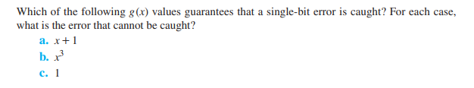
COMPUTER COMMUNICATION AND NETWORKS DR.M.SARANYA NAIR

Slide 30

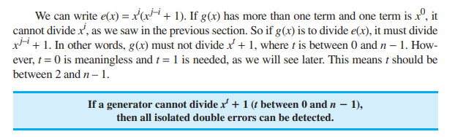
Two Isolated Single-Bit Errors
What should be the structure of g(x) be to guarantee the detection of two isolated single-bit errors?
We can show this type of error as e(x) = x^{j} + x^{i} . The values of i and j define the positions of the errors, and the difference j − i defines the distance between the two errors.
COMPUTER COMMUNICATION AND NETWORKS DR.M.SARANYA NAIR

Slide 31
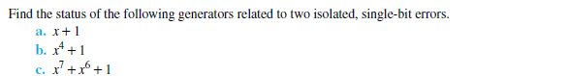
COMPUTER COMMUNICATION AND NETWORKS DR.M.SARANYA NAIR

Slide 32
Burst Errors
A burst error is of the form e(x) = (x^{j} + . . . + x^{i}).
Note the difference between a burst error and two isolated single-bit errors. The first can have two terms or more; the second can only have two terms.
We can factor out x^{i} and write the error as x^{i}(x^{j–i} + . . . + 1).
If our generator can detect a single error (minimum condition for a generator), then it cannot divide x^{i}.
What we should worry about are those generators that divide x^{j–i} + . . . + 1. In other words, the remainder of (x^{j–i} + . . . + 1)/(x^{r} + . . . + 1) must not be zero.
COMPUTER COMMUNICATION AND NETWORKS DR.M.SARANYA NAIR

Slide 33
Burst Errors
If j − i < r, the remainder can never be zero. We can write j − i = L − 1, where L is the length of the error. So L − 1 < r or L < r + 1.
In some rare cases, if j − i = r, or L = r + 1, the syndrome is 0 and the error is undetected. It can be proved that in these cases, the probability of undetected burst error of length r + 1 is (1/2)^{r–1}. For example, if our generator is x¹⁴ + x³ + 1, in which r = 14, a burst error of length L = 15 can slip by undetected with the probability of (1/2)^{14–1}.
In some rare cases, if j − i > r, or L > r + 1, the syndrome is 0 and the error is undetected. It can be proved that in these cases, the probability of undetected burst error of length greater than r + 1 is (1/2)^{r}. For example, if our generator is x¹⁴ + x³ + 1, in which r = 14, a burst error of length greater than 15 can slip by undetected with the probability of (1/2)¹⁴.
COMPUTER COMMUNICATION AND NETWORKS DR.M.SARANYA NAIR

Slide 34


Burst Errors
COMPUTER COMMUNICATION AND NETWORKS DR.M.SARANYA NAIR

