Slide 1
ARQ PROTOCOLS
(AUTOMATIC REPEAT REQUEST)
COMPUTER COMMUNICATIONS AND NETWORKS DR.M.SARANYA NAIR

Slide 2
Error control is both error detection and error correction.
It allows the receiver to inform the sender of any frames lost or damaged in transmission and coordinates the retransmission of those frames by the sender.
In the data link layer, the term error control refers primarily to methods of error detection and retransmission.
Error control in the data link layer is based on automatic repeat request, which is the retransmission of data.
COMPUTER COMMUNICATIONS AND NETWORKS DR.M.SARANYA NAIR

Slide 3

ERROR CONTROL
To detect /correct corrupted frames, we need to add redundancy bits to our data frame.
When the frame arrives at the receiver site, it is checked and if it is corrupted, it is silently discarded. The detection of errors in this protocol is manifested by the silence of the receiver.
If not corrupted, send to network layer & Inform the sender by ACK frame
Lack of ACK – sent frame corrupted
COMPUTER COMMUNICATIONS AND NETWORKS DR.M.SARANYA NAIR

Slide 4
NOISY CHANNEL
Realistic
    Error can and will happen; Require error control
Mechanisms:
    Stop-and-Wait ARQ
    Go-Back-N ARQ
    Selective Repeat ARQ
COMPUTER COMMUNICATIONS AND NETWORKS DR.M.SARANYA NAIR

Slide 5
STOP-AND-WAIT ARQ
If the receiver does not respond when there is an error, how can the sender know which frame to resend? To remedy this problem, the sender keeps a copy of the sent frame. At the same time, it starts a timer. If the timer expires and there is no ACK for the sent frame, the frame is resent, the copy is held, and the timer is restarted.
Sender keeps a copy of sent frame until successful delivery is ensured
Receiver responds with an ack when it successfully receives a frame
Lost frames are more difficult to handle than corrupted ones. The solution is to number the frames. When the receiver receives a data frame that is out of order, this means that frames were either lost or duplicated.
Both data and ack frames must be numbered
COMPUTER COMMUNICATIONS AND NETWORKS DR.M.SARANYA NAIR

Slide 6
FRAME NUMBERING
Frames need to be numbered – extra field
A field is added to the data frame to hold the sequence number of that frame. One important consideration is the range of the sequence numbers. Since we want to minimize the frame size, we look for the smallest range that provides unambiguous communication. The sequence numbers of course can wrap around. For example, if we decide that the field is m bits long, the sequence numbers start from 0, go to 2^{m} - 1, and then are repeated.
The acknowledgment numbers always announce the sequence number of the next frame expected by the receiver.
  if frame 0 has arrived safe – ACK frame with 1
  if frame 1 has arrived safe – ACK frame with 0
COMPUTER COMMUNICATIONS AND NETWORKS DR.M.SARANYA NAIR

Slide 7

STOP-AND-WAIT ARQ
Variable S_{n} points to the slot that matches the sequence number of the frame that has been sent, but not acknowledged;
Rn points to the slot that matches the sequence number of the expected frame.
COMPUTER COMMUNICATIONS AND NETWORKS DR.M.SARANYA NAIR

Slide 8
Sender has a control variable, S_{n}
Wait for the event from network layer
If network layer send data – seq.no is S_{n} = 0
Keep a copy and send the frame; Start Timer
If valid ACK received, stop the timer, discard the copy, increment S_{n} and send the next frame
If ACK not received till timer expires – start timer and resend the frame with seq. no S_{n} = 0.
COMPUTER COMMUNICATIONS AND NETWORKS DR.M.SARANYA NAIR

Slide 9

NORMAL OPERATION
Sender
Receiver
S = 0
R = 0
Frame 0
Deliver
ACK 1
S = 1
R = 1
Frame 1
Deliver
ACK 0
R = 0
Time
Time
COMPUTER COMMUNICATIONS AND NETWORKS DR.M.SARANYA NAIR

Slide 10

LOST FRAME
Sender
Receiver
S = 0
Frame 0
R = 0
Deliver
ACK 1
S = 1
R = 1
Frame 1
Timeout
Frame 1
Deliver
ACK 0
R = 0
COMPUTER COMMUNICATIONS AND NETWORKS DR.M.SARANYA NAIR

Slide 11
LOST ACK
Sender
Receiver
S = 0
Frame 0
R = 0
Deliver
ACK 1
S = 1
R = 1
Frame 1
Deliver
ACK 0
Timeout
S = 1
R = 0
Frame 1
Frame 0 expected; discard
ACK 0
R = 0
S = 0
COMPUTER COMMUNICATIONS AND NETWORKS DR.M.SARANYA NAIR

Slide 12
There is a difference between the protocols we discuss here and those used in real networks.
All the protocols we discuss are unidirectional in the sense that the data frames travel from one node, called the sender, to another node, called the receiver. Although special frames, called acknowledgment (ACK) and negative acknowledgment (NAK) can flow in the opposite direction for flow and error control purposes, data flow in only one direction.
In a real-life network, the data link protocols are implemented as bidirectional; data flow in both directions.
In these protocols the flow and error control information such as ACKs and NAKs is included in the data frames in a technique called piggybacking.
Because bidirectional protocols are more complex than unidirectional ones, we chose the latter for our discussion. If they are understood, they can be extended to bidirectional protocols.
COMPUTER COMMUNICATIONS AND NETWORKS DR.M.SARANYA NAIR

Slide 13
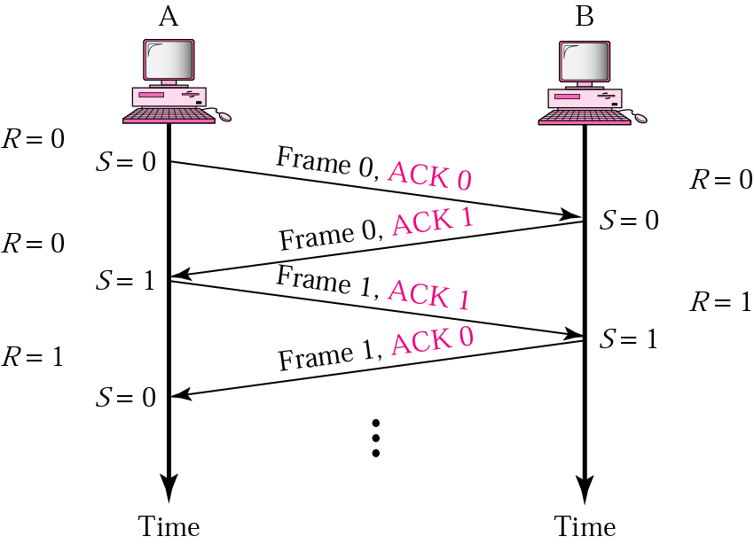

BIDIRECTIONAL TRANSMISSION - PIGGYBACKING
In real life network, data flow in both the directions
DATA and ACK are piggybacked
COMPUTER COMMUNICATIONS AND NETWORKS DR.M.SARANYA NAIR

Slide 14
The Stop-and-Wait ARQ is very inefficient if our channel is thick and long.
By thick, we mean that our channel has a large bandwidth; by long, we mean the round-trip delay is long.
The product of these two is called the bandwidth delay product.
We can think of the channel as a pipe. The bandwidth-delay product then is the volume of the pipe in bits. The pipe is always there. If we do not use it, we are inefficient. The bandwidth-delay product is a measure of the number of bits we can send out of our system while waiting for news from the receiver.
COMPUTER COMMUNICATIONS AND NETWORKS DR.M.SARANYA NAIR

Slide 15
PROBLEM WITH STOP AND WAIT ARQ
Assuming a communication system where:
  Stop-and-Wait ARQ is used
  Bandwidth of the link is 1 Mbps
  Propagation delay is 10 ms
  One-way data flow
Questions
  What should be an appropriate time-out value?
  What is the bandwidth-roundtrip-delay product?
  If the system data frames are 1000 bits in length, what is the utilization percentage of the link?
The system can send 20,000 bits during the time it takes for the data to go from the sender to the receiver and then back again. However, the system sends only 1000 bits. We can say that the link utilization is only 1000/20,000, or 5 percent. For this reason, for a link with a high bandwidth or long delay, the use of Stop-and-Wait ARQ wastes the capacity of the link.
COMPUTER COMMUNICATIONS AND NETWORKS DR.M.SARANYA NAIR

Slide 16
WHAT IS THE PROBLEM????
Previous example demonstrates major disadvantage of Stop-and-Wait ARQ; Prefer to send more frames before waiting for ACK
Example: Recalculate the link utilization if we allow up to 15 frames to be sent before waiting for an ACK
In networking and in other areas, a task is often begun before the previous task has ended. This is known as pipelining. There is no pipelining in Stop-and-Wait ARQ because we need to wait for a frame to reach the destination and be acknowledged before the next frame can be sent.
Pipelining improves the efficiency of the transmission
COMPUTER COMMUNICATIONS AND NETWORKS DR.M.SARANYA NAIR

Slide 17
Go-Back-N Automatic Repeat Request
To improve the efficiency of transmission, multiple frames must be in transition while waiting for acknowledgment.
In other words, we need to let more than one frame be outstanding to keep the channel busy while the sender is waiting for acknowledgment.
In Go-Back-N Automatic Repeat Request, we can send several frames before receiving acknowledgments; we keep a copy of these frames until the acknowledgments arrive.
COMPUTER COMMUNICATIONS AND NETWORKS DR.M.SARANYA NAIR

Slide 18
GO-BACK-N ARQ
Allows multiple frames to be sent before waiting for ACK
      These frames must be numbered differently
      Frame numbers are called Sequence numbers
Frames must be received in the correct order
If a frame is lost, the lost frame and all of the following frames must be retransmitted
Frame header contains m bits for sequence number
That allows up to 2^{m} different frame numbers
The Acknowledgment number is cumulative and defines the sequence number of the next frame to be expected; Eg. ACK7
COMPUTER COMMUNICATIONS AND NETWORKS DR.M.SARANYA NAIR

Slide 19
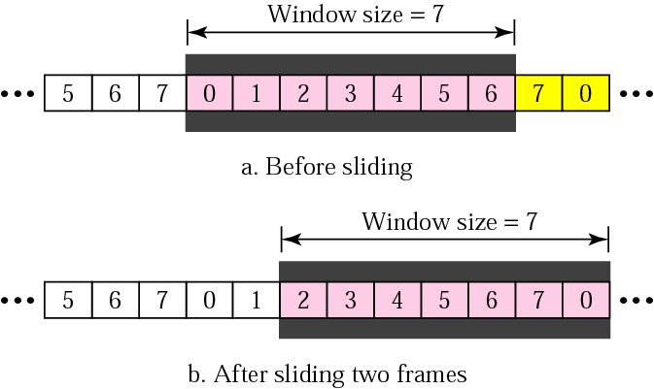
SENDING WINDOW
Sending more than one frame at once requires sender to buffer multiple frames
  Known as "sending window“
COMPUTER COMMUNICATIONS AND NETWORKS DR.M.SARANYA NAIR

Slide 20

SENDER SLIDING WINDOW
COMPUTER COMMUNICATIONS AND NETWORKS DR.M.SARANYA NAIR

Slide 21
SENDER SLIDING WINDOW
The first region, from the far left to the left wall of the window, defines the sequence numbers belonging to frames that are already acknowledged. The sender does not worry about these frames and keeps no copies of them.
The second region, colored in Figure, defines the range of sequence numbers belonging to the frames that are sent and have an unknown status. The sender needs to wait to find out if these frames have been received or were lost. We call these outstanding frames.
The third range, white in the figure, defines the range of sequence numbers for frames that can be sent; however, the corresponding data packets have not yet been received from the network layer.
Finally, the fourth region defines sequence numbers that cannot be used until the window slides.
COMPUTER COMMUNICATIONS AND NETWORKS DR.M.SARANYA NAIR

Slide 22
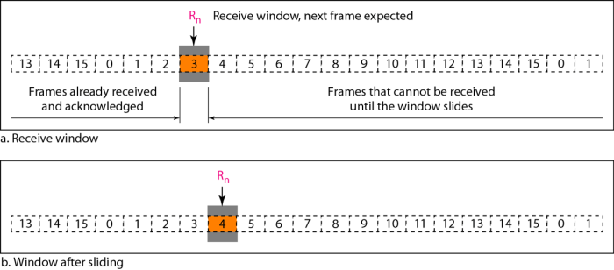
RECEIVING WINDOW
The receive window makes sure that the correct data frames are received and that the correct acknowledgments are sent.
The size of the receive window is always 1. The receiver is always looking for the arrival of a specific frame. Any frame arriving out of order is discarded and needs to be resent.
COMPUTER COMMUNICATIONS AND NETWORKS DR.M.SARANYA NAIR

Slide 23
Timers - Although there can be a timer for each frame that is sent, we use only one. The reason is that the timer for the first outstanding frame always expires first; we send all outstanding frames when this timer expires.
Acknowledgment - The receiver sends a positive acknowledgment if a frame has arrived safe and sound and in order. If a frame is damaged or is received out of order, the receiver is silent and will discard all subsequent frames until it receives the one it is expecting. The silence of the receiver causes the timer of the unacknowledged frame at the sender site to expire. This, in turn, causes the sender to go back and resend all frames, beginning with the one with the expired timer. The receiver does not have to acknowledge each frame received. It can send one cumulative acknowledgment for several frames.
Resending a Frame - When the timer expires, the sender resends all outstanding frames. For example, suppose the sender has already sent frame 6, but the timer for frame 3 expires. This means that frame 3 has not been acknowledged; the sender goes back and sends frames 3, 4,5, and 6 again. That is why the protocol is called Go-Back-NARQ.
COMPUTER COMMUNICATIONS AND NETWORKS DR.M.SARANYA NAIR

Slide 24
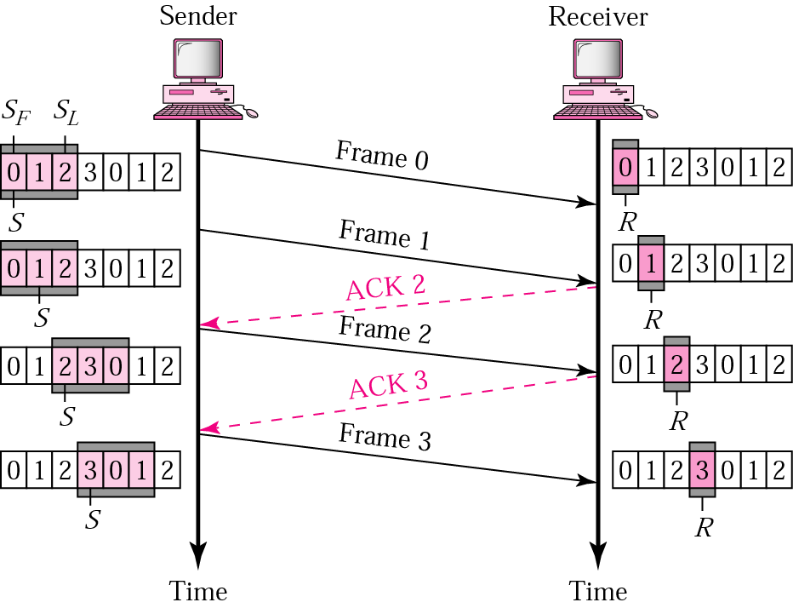
NORMAL OPERATION
COMPUTER COMMUNICATIONS AND NETWORKS DR.M.SARANYA NAIR

Slide 25
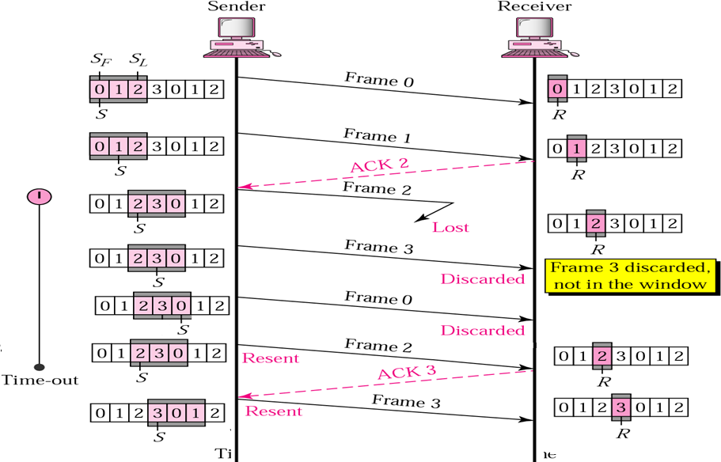
LOST FRAME
ACKs are cumulative
COMPUTER COMMUNICATIONS AND NETWORKS DR.M.SARANYA NAIR

Slide 26


WINDOW SIZE = 2^{m} ; LOST ACK
COMPUTER COMMUNICATIONS AND NETWORKS DR.M.SARANYA NAIR

Slide 27
LOST ACK: WINDOW SIZE < 2^{m}
COMPUTER COMMUNICATIONS AND NETWORKS DR.M.SARANYA NAIR

Slide 28
WINDOW SIZE
For m-bit sequence numbers
Send window size: at most 2^{m}-1
  → Up to 2^{m}-1 frames can be sent without ACK
Receive window size: 1
  Frames must be received in order
COMPUTER COMMUNICATIONS AND NETWORKS DR.M.SARANYA NAIR

Slide 29
Go-Back-N ARQ simplifies the process at the receiver site. The receiver keeps track of only one variable, and there is no need to buffer out-of-order frames; they are simply discarded.
However, this protocol is very inefficient for a noisy link. In a noisy link a frame has a higher probability of damage, which means the resending of multiple frames.
This resending uses up the bandwidth and slows down the transmission.
For noisy links, there is another mechanism that does not resend N frames when just one frame is damaged; only the damaged frame is resent. This mechanism is called Selective Repeat ARQ.
It is more efficient for noisy links, but the processing at the receiver is more complex.
COMPUTER COMMUNICATIONS AND NETWORKS DR.M.SARANYA NAIR

Slide 30
SELECTIVE REPEAT ARQ
Go-Back-N always discards out-of-order frames
  Losing one frame may result in retransmission of multiple frames
  Very inefficient in noisy link
Selective Repeat ARQ allows frames to be received out of order
  Therefore, receive window > 1
Sender and receiver share window space equally
For m-bit sequence numbers
  Send window: up to 2^{m-1}
  Receive window: up to 2^{m-1}
COMPUTER COMMUNICATIONS AND NETWORKS DR.M.SARANYA NAIR

Slide 31

SEND WINDOW
COMPUTER COMMUNICATIONS AND NETWORKS DR.M.SARANYA NAIR

Slide 32

RECEIVE WINDOW
COMPUTER COMMUNICATIONS AND NETWORKS DR.M.SARANYA NAIR

Slide 33
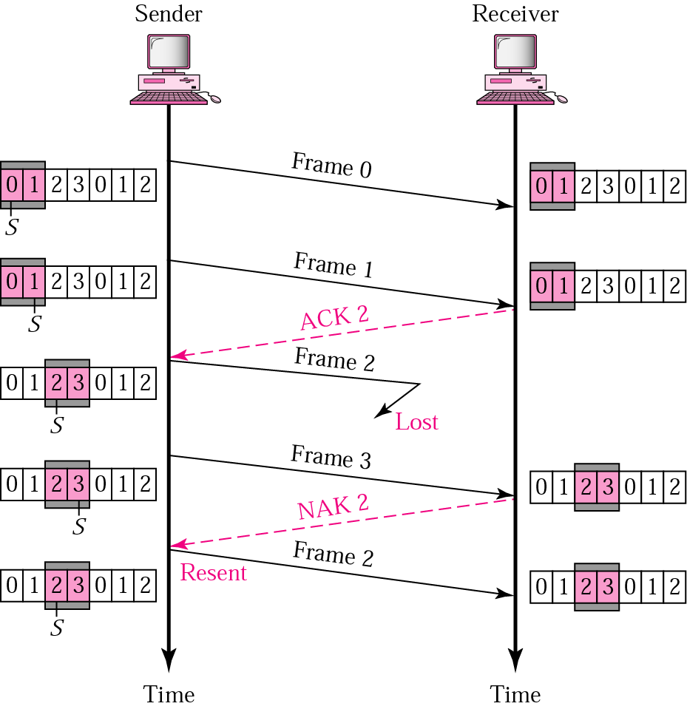
NEGATIVE ACK
COMPUTER COMMUNICATIONS AND NETWORKS DR.M.SARANYA NAIR

Slide 34

WINDOW SIZES
COMPUTER COMMUNICATIONS AND NETWORKS DR.M.SARANYA NAIR

Slide 35
1. Frames of 1000 bits are sent over a 1-Mbps channel using a geostationary satellite whose propagation time from the earth is 270 ms. What should be the optimal size of the send and receive windows for each of the following protocols to achieve maximum channel utilization.
a) Selective Repeat ARQ
b) Go back N ARQ
  Capacity of the channel = 1 x 10⁶ x 2 x 270 x 10⁻³ = 540000 bits
  540 frames can be transmitted; Value of m ??
9 bits – 512 ; m = 9;
10 bits - 1024
COMPUTER COMMUNICATIONS AND NETWORKS DR.M.SARANYA NAIR

Slide 36
Thank You
COMPUTER COMMUNICATIONS AND NETWORKS DR.M.SARANYA NAIR

