Slide 1
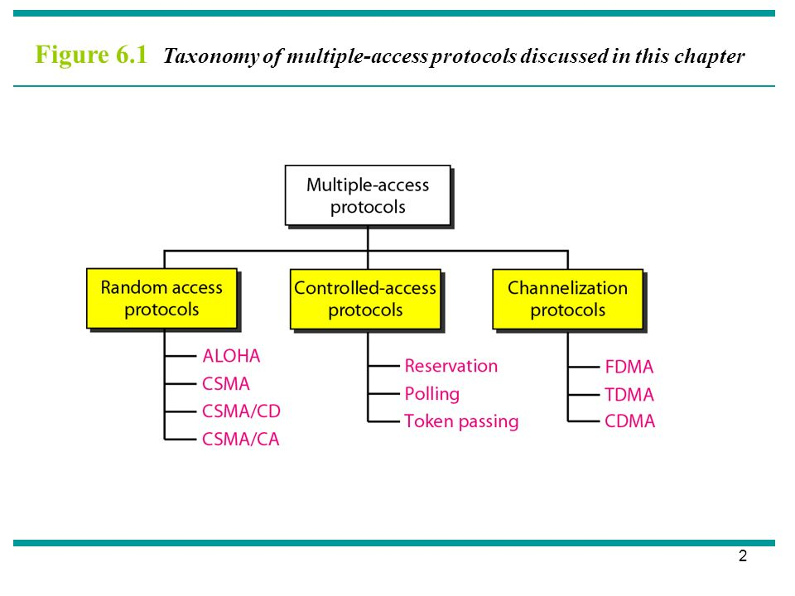
MEDIUM ACCESS PROTOCOLS
When nodes or stations are connected and use a common link, called a multipoint or broadcast link, we need a multiple-access protocol to coordinate access to the link.
COMPUTER COMMUNICATIONS AND NETWORKS DR.M.SARANYA NAIR

Slide 2
CONTROLLED ACCESS TECHNIQUES
In controlled access, the stations consult one another to find which station has the right to send.
A station cannot send unless it has been authorized by other stations.
        RESERVATION
        POLLING
        TOKEN PASSING
COMPUTER COMMUNICATIONS AND NETWORKS DR.M.SARANYA NAIR

Slide 3
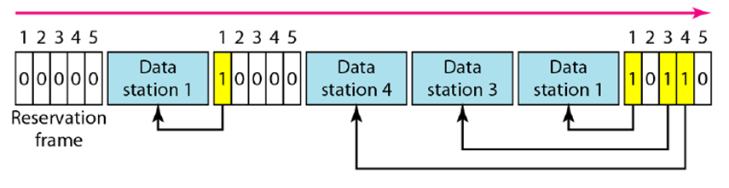
RESERVATION
A station needs to make a reservation before sending data.
Time is divided into intervals. In each interval, a reservation frame precedes the data frames sent in that interval.
If there are N stations in the system, there are exactly N reservation minislots in the reservation frame.
Each minislot belongs to a station. When a station needs to send a data frame, it makes a reservation only in its own minislot. The stations that have made reservations can send their data frames after the reservation frame.
Figure shows a situation with five stations and a five-minislot reservation frame. In the first interval, only stations 1, 3, and 4 have made reservations. In the second interval, only station 1 has made a reservation.
COMPUTER COMMUNICATIONS AND NETWORKS DR.M.SARANYA NAIR

Slide 4
POLLING
One device is designated as a primary station and the other devices are secondary stations
All data exchanges must be made through the primary device
The primary device controls the link; the secondary devices follow its instructions.
It is up to the primary device to determine which device is allowed to use the channel at a given time.
This method uses poll and select functions to prevent collisions.
However, the drawback is if the primary station fails, the system goes down.
The select function is used whenever the primary device has something to send. If it has something to send, the primary device sends it. What it does not know, however, is whether the target device is prepared to receive. So the primary must alert the secondary to the upcoming transmission and wait for an acknowledgment of the secondary’s ready status. Before sending data, the primary creates and transmits a select (SEL) frame, one field of which includes the address of the intended secondary.
COMPUTER COMMUNICATIONS AND NETWORKS DR.M.SARANYA NAIR

Slide 5
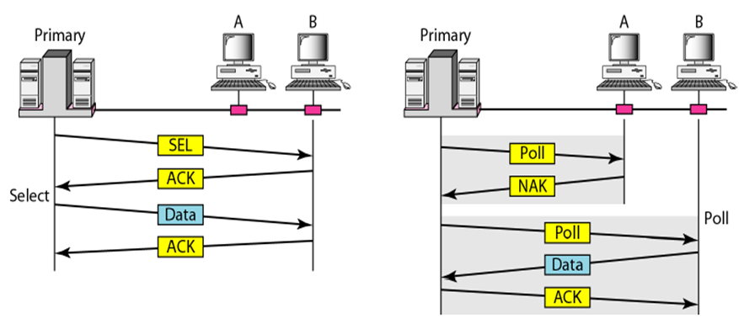
POLLING
The poll function is used by the primary device to solicit transmissions from the secondary devices. When the primary is ready to receive data, it must ask (poll) each device in turn if it has anything to send. When the first secondary is approached, it responds either with a NAK frame if it has nothing to send or with data (in the form of a data frame) if it does. If the response is negative (a NAK frame), then the primary polls the next secondary in the same manner until it finds one with data to send. When the response is positive (a data frame), the primary reads the frame and returns an acknowledgment (ACK frame), verifying its receipt.
COMPUTER COMMUNICATIONS AND NETWORKS DR.M.SARANYA NAIR

Slide 6
TOKEN PASSING
The stations in a network are organized in a logical /physical ring
A special packet called a token circulates through the ring.
Token gives the station the right to access the channel and send its data.
When a station has some data to send, it waits until it receives the token from its predecessor. It then holds the token and sends its data. When the station has no more data to send, it releases the token, passing it to the next logical station in the ring. The station cannot send data until it receives the token again in the next round. In this process, when a station receives the token and has no data to send, it just passes the token to the next station.
Token management is needed for this access method. Stations must be limited in the time they can have possession of the token. The token must be monitored to ensure it has not been lost or destroyed. For example, if a station that is holding the token fails, the token will disappear from the network.
Another function of token management is to assign priorities to the stations. And finally, token management is needed to make low-priority stations release the token to high-priority stations.
COMPUTER COMMUNICATIONS AND NETWORKS DR.M.SARANYA NAIR

Slide 7
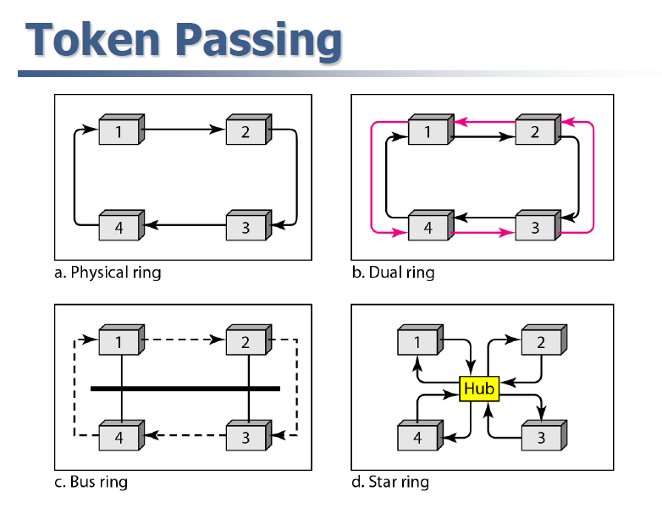
In the physical ring topology, a station sends the token to its successor; the successor is the next one in line. This means that the token does not have to have the address of the next successor.
The problem with this topology is that if one of the links-the medium between two adjacent stations fails, the whole system fails.
COMPUTER COMMUNICATIONS AND NETWORKS DR.M.SARANYA NAIR

Slide 8
The dual ring topology uses a second (auxiliary) ring which operates in the reverse direction compared with the main ring.
If one of the links in the main ring fails, the system automatically combines the two rings to form a temporary ring. After the failed link is restored, the auxiliary ring becomes idle again. The high-speed Token Ring network called FDDI (Fiber Distributed Data Interface) use this topology.
In the bus ring topology, also called a token bus, the stations are connected to a single cable called a bus. They, however, make a logical ring, because each station knows the address of its successor (and also predecessor for token management purposes).
When a station has finished sending its data, it releases the token and inserts the address of its successor in the token. Only the station with the address matching the destination address of the token gets the token to access the shared media.
COMPUTER COMMUNICATIONS AND NETWORKS DR.M.SARANYA NAIR

Slide 9
In a star ring topology, the physical topology is a star. There is a hub, however, that acts as the connector. The wiring inside the hub makes the ring;
The stations are connected to this ring through the two wire connections.
This topology makes the network less prone to failure because if a link goes down, it will be bypassed by the hub and the rest of the stations can operate.
COMPUTER COMMUNICATIONS AND NETWORKS DR.M.SARANYA NAIR

Slide 10
TOKEN RING LAN & FDDI
COMPUTER COMMUNICATIONS AND NETWORKS DR.M.SARANYA NAIR

Slide 11
IEEE 802.5 – TOKEN RING LAN
A
Stations are connected by point-point transmission links.
Unidirectional ring network
MAC – small frame called TOKEN
Maximum no. of stations – 250
4 Mbps and 16 Mbps on twisted pair
Token passing protocol provides access
  Fairness
  Access priorities
  Breaks in ring bring entire network down
Reliability by using star topology
Wiring Center
E
B
C
D
COMPUTER COMMUNICATIONS AND NETWORKS DR.M.SARANYA NAIR

Slide 12
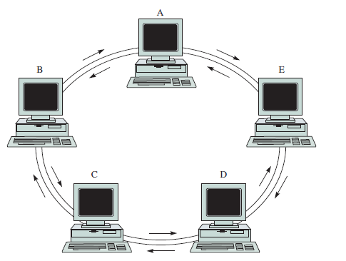
FDDI
Stations are connected by point-point transmission links.
Bidirectional ring network
MAC – small frame called TOKEN
Maximum no. of stations – 500
100 Mbps on optical fibre
  Reliability by using dual ring arrangement
COMPUTER COMMUNICATIONS AND NETWORKS DR.M.SARANYA NAIR

Slide 13
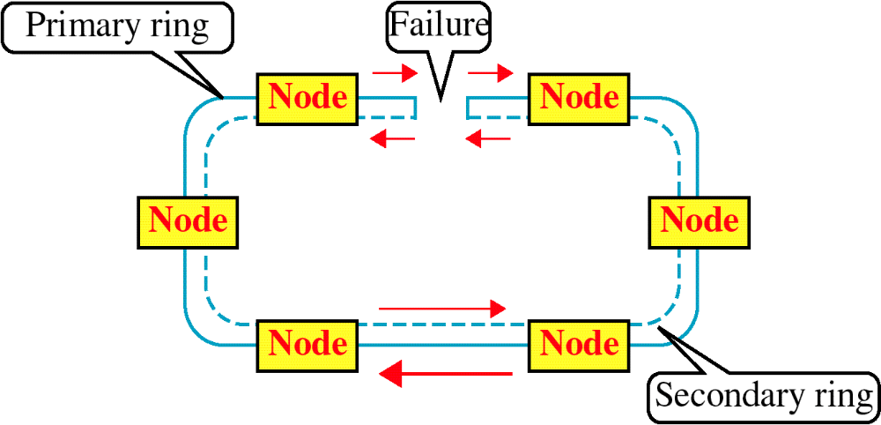
COMPUTER COMMUNICATIONS AND NETWORKS DR.M.SARANYA NAIR

Slide 14


TOKEN RING OPERATION
Possession of the free token grants the right to transmit
  No information, pass to next station
  If Yes, Change to Transmit mode
  Data packets circulate the ring
  Destination station copies the packets
COMPUTER COMMUNICATIONS AND NETWORKS DR.M.SARANYA NAIR

Slide 15


FRAME REMOVAL PROCESS
  Allow packet to travel back to sender
  Form of acknowledgement
  Sender reinserts token
COMPUTER COMMUNICATIONS AND NETWORKS DR.M.SARANYA NAIR

Slide 16
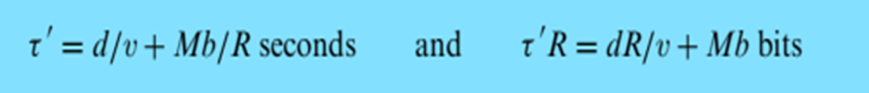
RING LATENCY & RING REINSERTION
M stations
b bit delay at each station
  b=2.5 bits (using Manchester coding)
Ring Latency:
  τ’ = d/ν + Mb/R s
Example
  Case 1: R=4 Mbps, M=20, 100 meter separation
    Case 2: R=16 Mbps, M=80
COMPUTER COMMUNICATIONS AND NETWORKS DR.M.SARANYA NAIR

Slide 17
  Case 1: R=4 Mbps, M=20, 100 meter separation
    Latency = (20 X 100 X 4 X 10^6)/(2X10^8) + 20X2.5 = 90 BITS
    Case 2: R=16 Mbps, M=80
    Latency = (80 X 100 X 16 X 10^6)/(2X10^8) + 80X2.5 = 840 BITS
    Frame length - 400 bits
COMPUTER COMMUNICATIONS AND NETWORKS DR.M.SARANYA NAIR

Slide 18
TOKEN REINSERTION STRATEGIES
After frame transmission
After frame return
After token (header) return
COMPUTER COMMUNICATIONS AND NETWORKS DR.M.SARANYA NAIR

Slide 19
(a) Low Latency (90 bit) Ring
A
A
A
A
t = 0, A begins frame
t = 90, return
of first bit
t = 210, return of header
t = 400, last bit enters ring, reinsert token
(b) High Latency (840 bit) Ring
A
A
A
A
t = 0, A begins frame
t = 400, transmit
last bit
t = 840, arrival
first frame bit
t = 960, reinsert
token
COMPUTER COMMUNICATIONS AND NETWORKS DR.M.SARANYA NAIR

Slide 20
After frame return:
Case 1:
1st bit – 90 bits
400th bit – 490 bits
Ring efficiency = 400/490 = 82%
Case 2:
1st bit – 840
400th bit – 1240
Ring efficiency = 400/1240= 32%
After header return – header – 15 bytes – 120 bits
Case 1:
1st bit – 90 bits
120th bit – 210 bits
Ring efficiency = 100%
Case 2:
1st bit – 840
120th bit – 960
Ring efficiency = 400/960= 42%
COMPUTER COMMUNICATIONS AND NETWORKS DR.M.SARANYA NAIR

