Slide 1
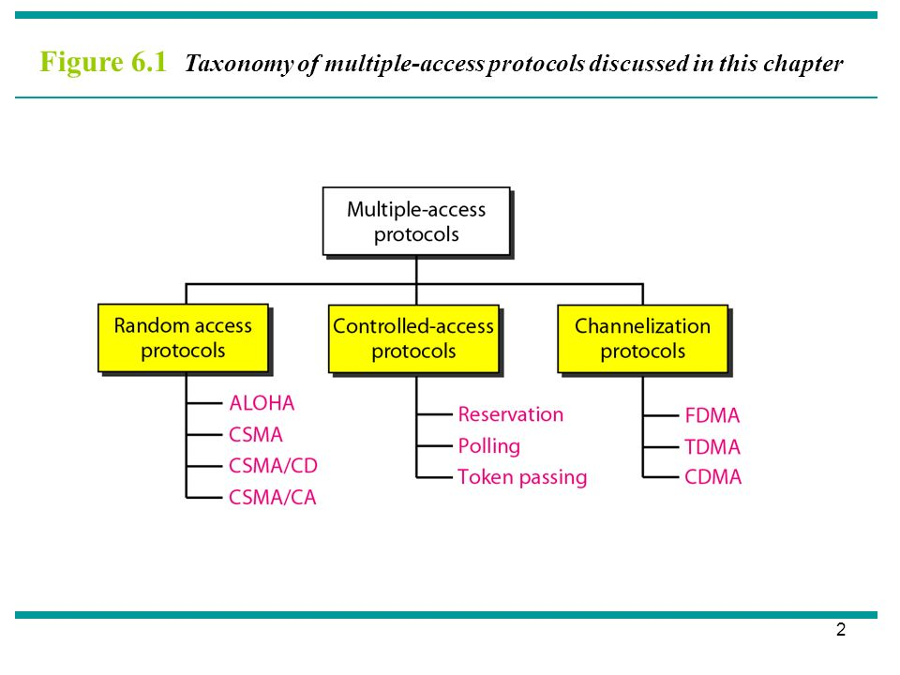
MEDIUM ACCESS PROTOCOLS
When nodes or stations are connected and use a common link, called a multipoint or broadcast link, we need a multiple-access protocol to coordinate access to the link.
COMPUTER COMMUNICATIONS AND NETWORKS DR.M.SARANYA NAIR

Slide 2
RANDOM ACCESS / CONTENTION PROTOCOLS
In random-access or contention methods, no station is superior to another station and none is assigned control over another.
At each instance, a station that has data to send uses a procedure defined by its protocol to make a decision on whether or not to send. This decision depends on the state of the medium (idle or busy).
There is no scheduled time for a station to transmit. Transmission is random among the stations. That is why these methods are called random access.
Stations compete with one another to access the medium. That is why these methods are also called contention methods.
In a random-access method, each station has the right to the medium without being controlled by any other station. However, if more than one station tries to send, there is an access conflict—collision—and the frames will be either destroyed or modified.
COMPUTER COMMUNICATIONS AND NETWORKS DR.M.SARANYA NAIR

Slide 3
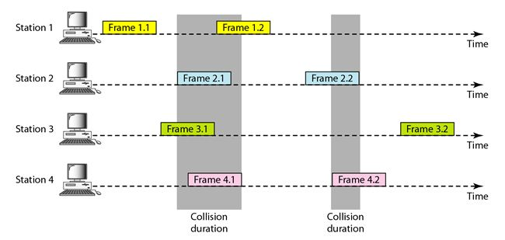
RANDOM ACCESS / CONTENTION PROTOCOLS
Pure ALOHA : The original ALOHA protocol is called pure ALOHA. The idea is that each station sends a frame whenever it has a frame to send (multiple access).
However, since there is only one channel to share, there is the possibility of collision between frames from different stations.
COMPUTER COMMUNICATIONS AND NETWORKS DR.M.SARANYA NAIR

Slide 4
ALOHA / MULTIPLE ACCESS
The pure ALOHA protocol relies on acknowledgments from the receiver.
When a station sends a frame, it expects the receiver to send an acknowledgment. If the acknowledgment does not arrive after a time-out period, the station assumes that the frame (or the acknowledgment) has been destroyed and resends the frame.
A collision involves two or more stations. If all these stations try to resend their frames after the time-out, the frames will collide again.
Pure ALOHA dictates that when the time-out period passes, each station waits a random amount of time before resending its frame. The randomness will help avoid more collisions. We call this time the back-off time T_{B}.
Again collision can happen; After max no. of retransmissions, station have to give up and try later.
COMPUTER COMMUNICATIONS AND NETWORKS DR.M.SARANYA NAIR

Slide 5
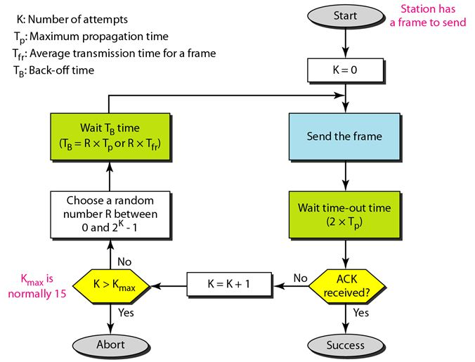
PURE ALOHA
COMPUTER COMMUNICATIONS AND NETWORKS DR.M.SARANYA NAIR

Slide 6
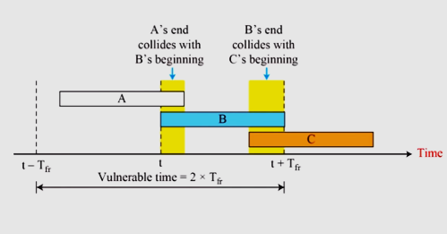
Vulnerable time:
Vulnerable time is the Length of time, in which there is a possibility of collision.
We assume that the stations send fixed-length frames with each frame taking T_{fr} seconds to send. Figure shows the vulnerable time for station B.
Pure ALOHA vulnerable time = 2 x T_{fr}
COMPUTER COMMUNICATIONS AND NETWORKS DR.M.SARANYA NAIR

Slide 7
A pure ALOHA network transmits 200-bit frames on a shared channel of 200 kbps. What is the requirement to make this frame collision-free?
Solution
Average frame transmission time T_{fr} is 200 bits/200 kbps or 1 ms.
The vulnerable time is 2 × 1 ms = 2 ms.
This means no station should send later than 1 ms before this station starts transmission and no station should start sending during the period (1 ms) that this station is sending.
COMPUTER COMMUNICATIONS AND NETWORKS DR.M.SARANYA NAIR

Slide 8
Throughput
Let us call G the average number of frames generated by the system during one frame transmission time.
Then the throughput for pure ALOHA is S = G × e^{−2G}. The maximum throughput Smax is 0.184, for G = 1/2. (by setting the derivative of S with respect to G to 0)
In other words, if a station generates only one frame in this vulnerable time (and no other stations generate a frame during this time), the frame will reach its destination successfully.
A pure ALOHA network transmits 200-bit frames on a shared channel of 200 kbps. What is the throughput if the system (all stations together) produces a. 1000 frames per second? b. 500 frames per second?
Solution The frame transmission time is 200/200 kbps or 1 ms.
If the system creates 1000 frames per second, or 1 frame per millisecond, then G = 1. In this case S = G × e−2G = 0.135 (13.5 percent). This means that the throughput is 1000 × 0.135 = 135 frames. Only 135 frames out of 1000 will probably survive.
If the system creates 500 frames per second, or 1/2 frames per millisecond, then G = 1/2. In this case S = G × e−2G = 0.184 (18.4 percent). This means that the throughput is 500 × 0.184 = 92 and that only 92 frames out of 500 will probably survive.
COMPUTER COMMUNICATIONS AND NETWORKS DR.M.SARANYA NAIR

Slide 9
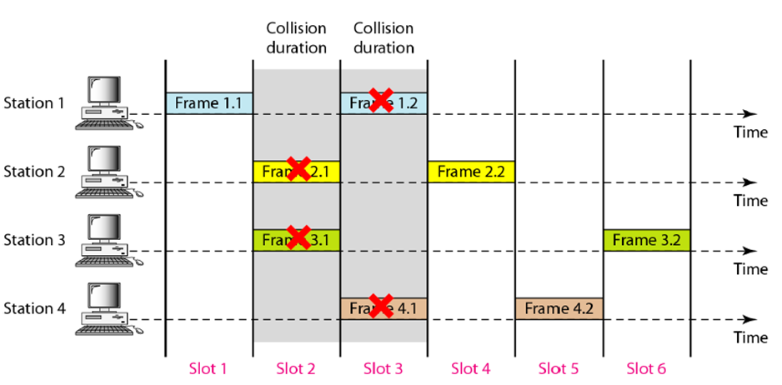
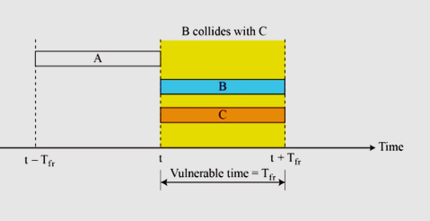
SLOTTED ALOHA
In slotted ALOHA we divide the time into slots of T_{fr} seconds and force the station to send only at the beginning of the time slot.
COMPUTER COMMUNICATIONS AND NETWORKS DR.M.SARANYA NAIR

Slide 10
Because a station is allowed to send only at the beginning of the time slot, if a station misses this moment, it must wait until the beginning of the next time slot.
This means that the station which started at the beginning of this slot has already finished sending its frame.
Of course, there is still the possibility of collision if two stations try to send at the beginning of the same time slot.
However, the vulnerable time is now reduced to one-half, equal to T_{fr}.
It can be proven that the average number of successful transmissions for slotted ALOHA is S = G × e^{−G}.
The maximum throughput Smax is 0.368, when G = 1.
COMPUTER COMMUNICATIONS AND NETWORKS DR.M.SARANYA NAIR

Slide 11
A slotted ALOHA network transmits 200-bit frames using a shared channel with a 200-kbps bandwidth. Find the throughput if the system (all stations together) produces a. 1000 frames per second. b. 500 frames per second.
Solution
The frame transmission time is 200/200 kbps or 1 ms.
In this case G is 1. So S = G × e^{−G} = 0.368 (36.8 percent). This means that the throughput is 1000 × 0.0368 = 368 frames. Only 368 out of 1000 frames will probably survive.
Here G is 1/2. In this case S = G × e^{−G} = 0.303 (30.3 percent). This means that the throughput is 500 × 0.0303 = 151. Only 151 frames out of 500 will probably survive.
COMPUTER COMMUNICATIONS AND NETWORKS DR.M.SARANYA NAIR

Slide 12
CSMA
CARRIER SENSE MULTIPLE ACCESS
COMPUTER COMMUNICATIONS AND NETWORKS DR.M.SARANYA NAIR

Slide 13

The chance of collision can be reduced if a station senses the medium before trying to use it.
In other words, CSMA is based on the principle “sense before transmit” or “listen before talk.”
CSMA can reduce the possibility of collision, but it cannot eliminate it.
COMPUTER COMMUNICATIONS AND NETWORKS DR.M.SARANYA NAIR

Slide 14
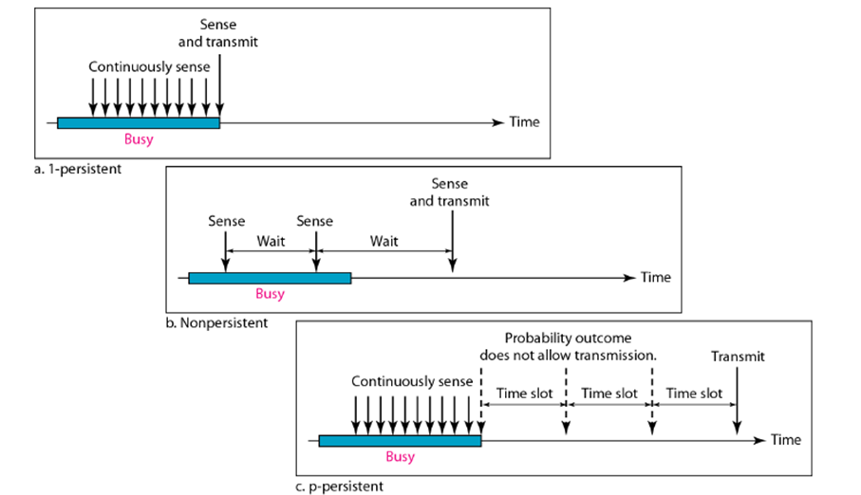
PERSISTENCE METHODS
What should a station do if the channel is busy?
What should a station do if the channel is idle?
In 1-persistent method, after the station finds the line idle, it sends its frame immediately (with probability 1).
This method has the highest chance of collision because two or more stations may find the line idle and send their frames immediately.
Standard Ethernet uses this method.
COMPUTER COMMUNICATIONS AND NETWORKS DR.M.SARANYA NAIR

Slide 15
In the nonpersistent method, a station that has a frame to send senses the line.
If the line is idle, it sends immediately.
If the line is not idle, it waits a random amount of time and then senses the line again.
The nonpersistent approach reduces the chance of collision because it is unlikely that two or more stations will wait the same amount of time and retry to send simultaneously.
However, this method reduces the efficiency of the network because the medium remains idle when there may be stations with frames to send.
COMPUTER COMMUNICATIONS AND NETWORKS DR.M.SARANYA NAIR

Slide 16
The p-persistent method is used if the channel has time slots with a slot duration equal to or greater than the maximum propagation time.
The p-persistent approach combines the advantages of the other two strategies. It reduces the chance of collision and improves efficiency.
In this method, after the station finds the line idle it follows these steps:
1. With probability p, the station sends its frame.
2. With probability q = 1 − p, the station waits for the beginning of the next time slot and checks the line again.
If the line is idle, it goes to step 1.
If the line is busy, it acts as though a collision has occurred and uses the backoff procedure.
COMPUTER COMMUNICATIONS AND NETWORKS DR.M.SARANYA NAIR

Slide 17
The possibility of collision still exists because of propagation delay; a station may sense the medium and find it idle, because the first bit sent by another station has not yet been received.
At time t1, station A senses the medium and finds it idle, so it sends a frame.
At time t2 (t2 > t1), station C senses the medium and finds it idle because, at this time, the first bits from station A have not reached station C. Station C also sends a frame. The two signals collide and both frames are destroyed.
The basic CSMA method does not specify the procedure following a collision.
CSMA/CD augments the algorithm to handle the collision. In this method, a station monitors the medium after it sends a frame to see if the transmission was successful. If, there is a collision, the frame is sent again.
COMPUTER COMMUNICATIONS AND NETWORKS DR.M.SARANYA NAIR

Slide 18
Station C detects a collision at time t3 when it receives the first bit of A’s frame. Station C immediately aborts transmission.
Station A detects collision at time t4 when it receives the first bit of C’s frame; it also immediately aborts transmission.
COMPUTER COMMUNICATIONS AND NETWORKS DR.M.SARANYA NAIR

Slide 19
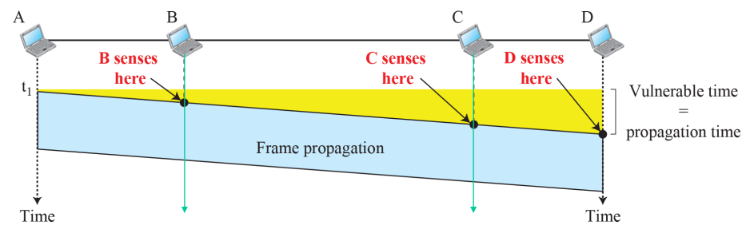
VULNERABLE TIME
The vulnerable time for CSMA is the propagation time Tp. This is the time needed for a signal to propagate from one end of the medium to the other.
When a station sends a frame and any other station tries to send a frame during this time, a collision will result.
But if the first bit of the frame reaches the end of the medium, every station will already have heard the bit and will refrain from sending.
COMPUTER COMMUNICATIONS AND NETWORKS DR.M.SARANYA NAIR

Slide 20
MINIMUM FRAME SIZE
For CSMA/CD to work, we need a restriction on the frame size
Before sending the last bit of the frame, the sending station must detect a collision, if any, and abort the transmission.
This is so because the station, once the entire frame is sent, does not keep a copy of the frame and does not monitor the line for collision detection.
Therefore, the frame transmission time Tfr must be at least two times the maximum propagation time Tp.
COMPUTER COMMUNICATIONS AND NETWORKS DR.M.SARANYA NAIR

Slide 21
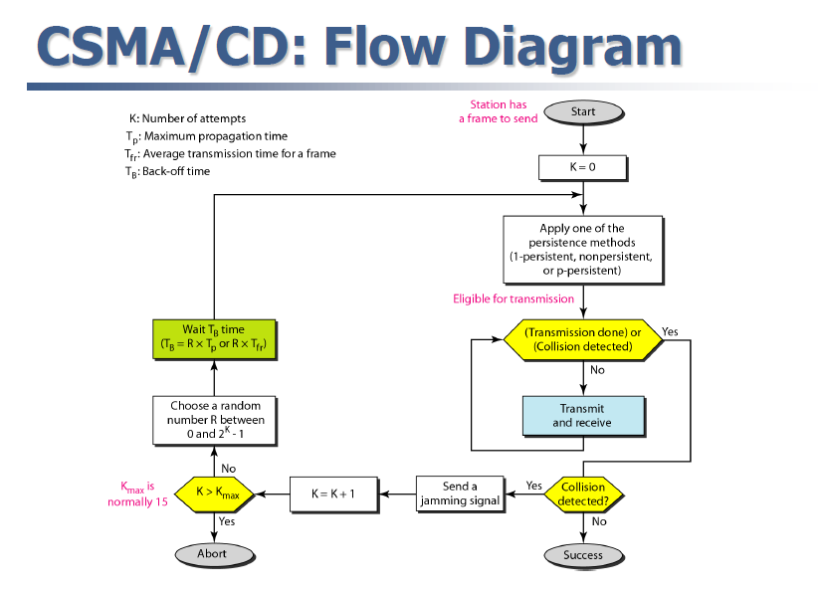
COMPUTER COMMUNICATIONS AND NETWORKS DR.M.SARANYA NAIR

Slide 22
In ALOHA, we first transmit the entire frame and then wait for an acknowledgment.
In CSMA/CD, transmission and collision detection are continuous processes. We do not send the entire frame and then look for a collision. The station transmits and receives continuously and simultaneously
We constantly monitor in order to detect one of two conditions: either transmission is finished or a collision is detected. Either event stops transmission.
When we come out of the loop, if a collision has not been detected, it means that transmission is complete; the entire frame is transmitted.
Otherwise, a collision has occurred.
The third difference is the sending of a short jamming signal to make sure that all other stations become aware of the collision.
COMPUTER COMMUNICATIONS AND NETWORKS DR.M.SARANYA NAIR

Slide 23
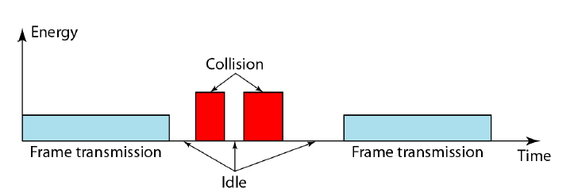
ENERGY LEVEL
Level of energy in a channel can have three values: zero, normal,
and abnormal.
At the zero level, the channel is idle.
At the normal level, a station has successfully captured the channel and is sending its frame.
At the abnormal level, there is a collision and the level of the energy is twice the normal level.
A station that has a frame to send or is sending a frame needs to monitor the energy level to determine if the channel is idle, busy, or in collision mode.
COMPUTER COMMUNICATIONS AND NETWORKS DR.M.SARANYA NAIR

Slide 24
One of the LAN protocols that used CSMA/CD is the traditional Ethernet with the data rate of 10 Mbps.
Traditional Ethernet was a broadcast LAN that used the 1-persistence method
An Ethernet frame needs to have a minimum length of 512 bits or 64 bytes.
A network using CSMA/CD has a bandwidth of 10 Mbps. If the maximum propagation time is 25.6 μs, what is the minimum size of the frame?
Solution
The minimum frame transmission time is Tfr = 2 × Tp = 51.2 μs. This means, in the worst case, a station needs to transmit for a period of 51.2 μs to detect the collision. The minimum size of the frame is 10 Mbps × 51.2 μs = 512 bits or 64 bytes.
COMPUTER COMMUNICATIONS AND NETWORKS DR.M.SARANYA NAIR

Slide 25
Collision detection in CSMA/CD serves two purposes.
If a collision is detected, it means that the frame has not been received and needs to be resent. If a collision is not detected, it is a kind of acknowledgment that the frame was received.
The CSMA/CD algorithm does not work in wireless LANs for three reasons:
To detect a collision, a host needs to send and receive at the same time (sending the frame and receiving the collision signal), which means the host needs to work in a duplex mode. Wireless hosts do not have enough power to do so (the power is supplied by batteries).
Because of the hidden station problem, in which a station may not be aware of another station’s transmission, collision may occur but not be detected.
The distance between stations can be great. Signal fading could prevent a station at one end from hearing a collision at the other end.
COMPUTER COMMUNICATIONS AND NETWORKS DR.M.SARANYA NAIR

Slide 26
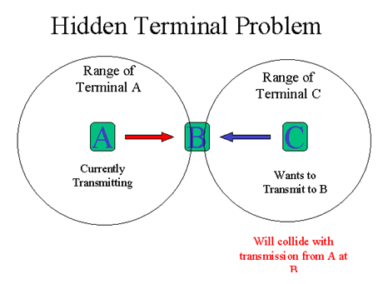
COMPUTER COMMUNICATIONS AND NETWORKS DR.M.SARANYA NAIR

Slide 27
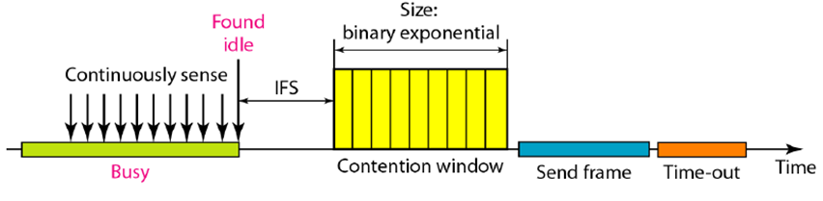
CSMA / CA
We need to avoid collisions on wireless networks because they cannot be detected. Carrier sense multiple access with collision avoidance (CSMA/CA) was invented for this network.
Collisions are avoided through the use of CSMA/CA's three strategies: the interframe space, the contention window, and acknowledgments
COMPUTER COMMUNICATIONS AND NETWORKS DR.M.SARANYA NAIR

Slide 28
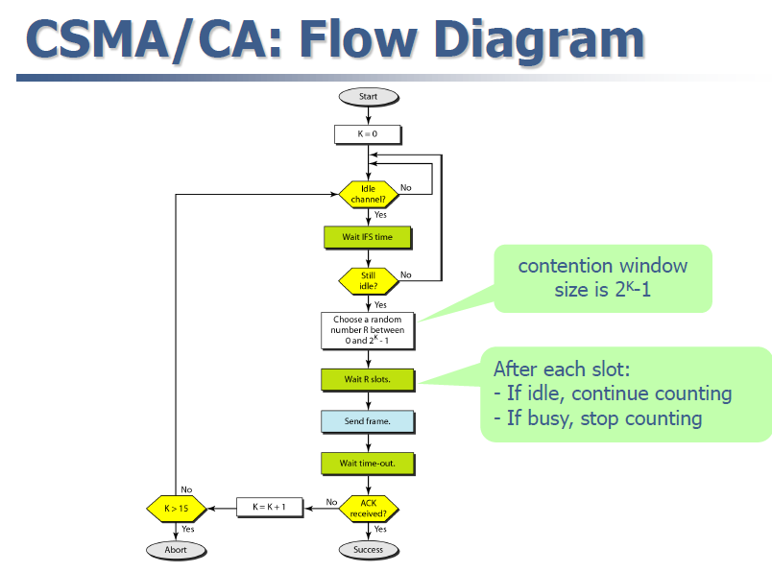
COMPUTER COMMUNICATIONS AND NETWORKS DR.M.SARANYA NAIR

Slide 29
Interframe Space (IFS):
When an idle channel is found, the station does not send immediately. It waits for a period of time called the interframe space or IFS.
Even though the channel may appear idle when it is sensed, a distant station may have already started transmitting.
The distant station’s signal has not yet reached this station.
The IFS time allows the first bit of the transmitted signal by the distant station to reach this station.
After waiting an IFS time, if the channel is still idle, the station can send, but it still needs to wait a time equal to the contention window (described next).
The IFS variable can also be used to prioritize stations or frame types. For example, a station that is assigned a shorter IFS has a higher priority.
COMPUTER COMMUNICATIONS AND NETWORKS DR.M.SARANYA NAIR

Slide 30
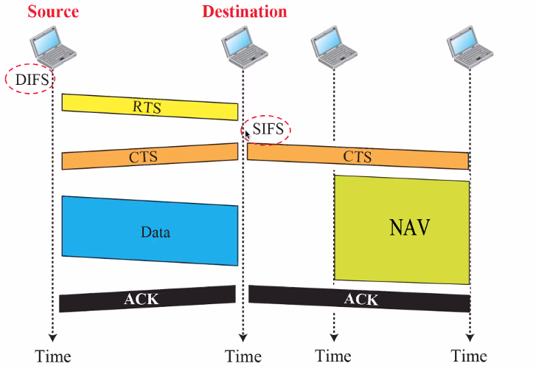
Before sending a frame, the source station senses the medium by checking the energy level at the carrier frequency.
The channel uses p-persistence strategy until the channel is idle.
After the station is found to be idle, the station waits for a period of time called the DCF interframe space (DIFS); then the station sends a control frame called the request to send (RTS).
After receiving the RTS and waiting a period of time called the short interframe space (SIFS), the destination station sends a control frame, called the clear to send (CTS), to the source station.
This control frame indicates that the destination station is ready to receive data.
The source station sends data after waiting an amount of time equal to SIFS.
The destination station, after waiting an amount of time equal to SIFS, sends an acknowledgment to show that the frame has been received.
Acknowledgment is needed in this protocol because the station does not have any means to check for the successful arrival of its data at the destination. On the other hand, the lack of collision in CSMA/CD is a kind of indication to the source that data have arrived.
COMPUTER COMMUNICATIONS AND NETWORKS DR.M.SARANYA NAIR

Slide 31
Network Allocation Vector
The key is a feature called NAV.
When a station sends an RTS frame, it includes the duration of time that it needs to occupy the channel.
The stations that are affected by this transmission create a timer called a network allocation vector (NAV) that shows how much time must pass before these stations are allowed to check the channel for idleness.
Each time a station accesses the system and sends an RTS frame, other stations start their NAV.
In other words, each station, before sensing the physical medium to see if it is idle, first checks its NAV to see if it has expired.
Collision During Handshaking
What happens if there is a collision during the time when RTS or CTS control frames are in transition, often called the handshaking period?
Two or more stations may try to send RTS frames at the same time. These control frames may collide. However, because there is no mechanism for collision detection, the sender assumes there has been a collision if it has not received a CTS frame from the receiver.
The sender tries again.
COMPUTER COMMUNICATIONS AND NETWORKS DR.M.SARANYA NAIR

Slide 32
Hidden-Station Problem
The solution to the hidden station problem is the use of the handshake frames (RTS and CTS). Figure also shows that the RTS message from A reaches B, but not C. However, because both A and C are within the range of B, the CTS message, which contains the duration of data transmission from A to B, reaches C. Station C knows that some hidden station is using the channel and refrains from transmitting until that duration is over.
Contention Window.
The contention window is an amount of time divided into slots.
A station that is ready to send chooses a random number of slots as its wait time.
The number of slots in the window changes according to the binary exponential backoff strategy. This means that it is set to one slot the first time and then doubles each time the station cannot detect an idle channel after the IFS time.
One interesting point about the contention window is that the station needs to sense the channel after each time slot. However, if the station finds the channel busy, it does not restart the process; it just stops the timer and restarts it when the channel is sensed as idle. This gives priority to the station with the longest waiting time.
COMPUTER COMMUNICATIONS AND NETWORKS DR.M.SARANYA NAIR

Slide 33
Acknowledgment.
With all these precautions, there still may be a collision resulting in destroyed data.
In addition, the data may be corrupted during the transmission.
The positive acknowledgment and the time-out timer can help guarantee that the receiver has received the frame.
COMPUTER COMMUNICATIONS AND NETWORKS DR.M.SARANYA NAIR

