Slide 1
BECE403E-Embedded System Design Lab
LAB-1
Introduction to STM32 Nucleo-64 Board & arm Keil Studio Cloud

Slide 2
INTRODUCTION TO STM32 NUCLEO-64
Nucleo Features
STM32L152RE ultra-low-power ARM Cortex-M3 based microcontroller
Two extension connectors: Arduino Uno and ST Morpho
Embedded ST –LINK/V2-1 Debugger/Programmer
Flexible board power supply: 3.3 V, 5 V, 7 - 12 V
User LED (LD2), Two push buttons: USER and RESET
MBED Enabled
Interfaces supported on USB: Virtual COM port, Debug port, Mass storage (USB Disk drive) for drag 'n’ drop programming
LAB - 1
BECE403E-Embedded Systems Design Lab
2

Slide 3
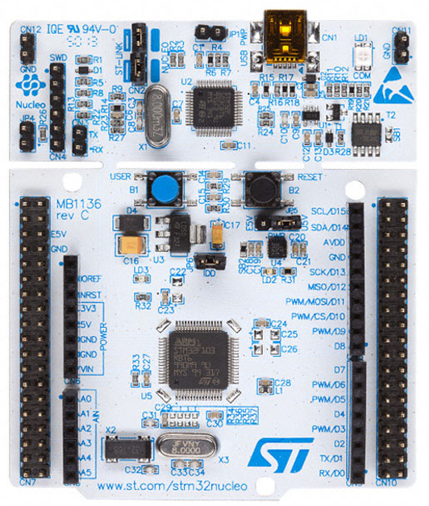
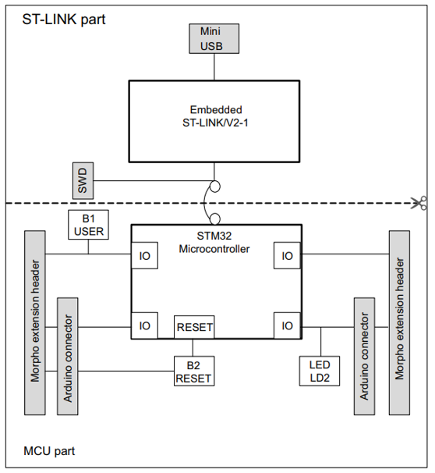
STM32 Nucleo-64 - Board Details
Image credit: Zephyr Ref. URL : https://docs.zephyrproject.org/latest/boards/arm/nucleo_l152re/doc/index.html
LAB - 1
BECE403E-Embedded Systems Design Lab
3

Slide 4
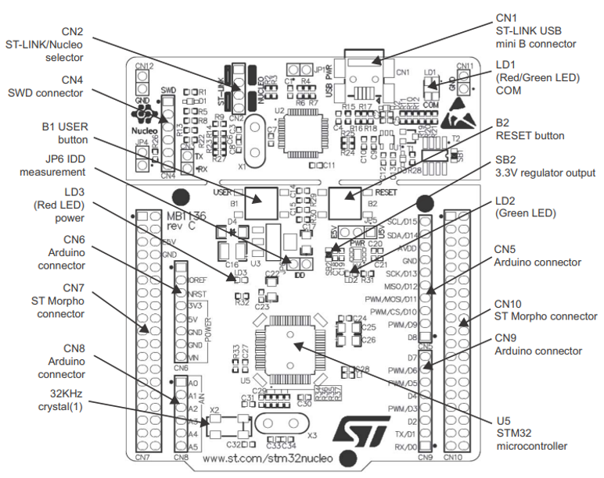
STM32 Nucleo-64 - Board Details
Image credit: Zephyr Ref. URL : https://docs.zephyrproject.org/latest/boards/arm/nucleo_l152re/doc/index.html
LAB - 1
BECE403E-Embedded Systems Design Lab
3

Slide 5
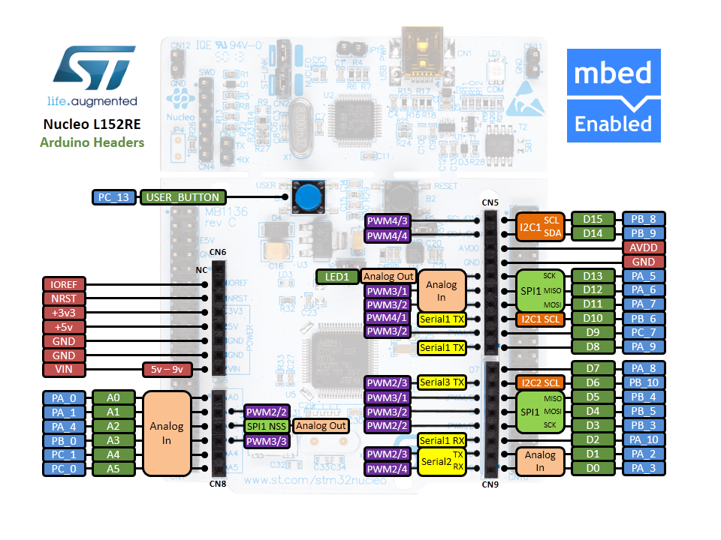
STM32 Nucleo-64 - Pin Details (Arduino Headers)
Image credit: arm MBED, Ref. URL : https://os.mbed.com/forum/electronics/topic/15346/?page=1#comment-52189
LAB - 1
BECE403E-Embedded Systems Design Lab
4

Slide 6
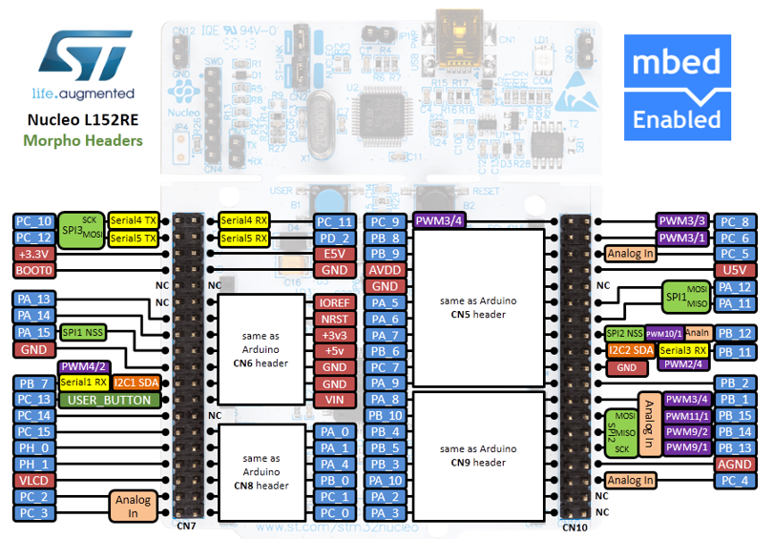




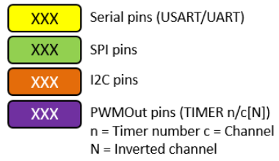
STM32 Nucleo-64 - Pin Details (Morpho Headers)
Pins Legend
Image credit: arm MBED, Ref. URL : https://os.mbed.com/forum/electronics/topic/15346/?page=1#comment-52189
LAB - 1
BECE403E-Embedded Systems Design Lab
4

Slide 7
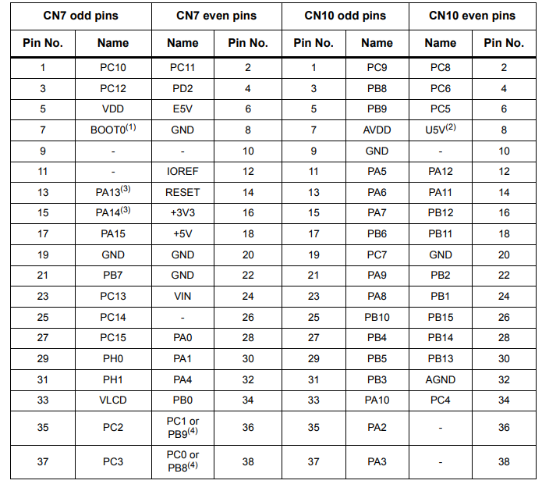
STM32 Nucleo-64 - Pin Details (Morpho Headers)
LAB - 1
BECE403E-Embedded Systems Design Lab
4

Slide 8
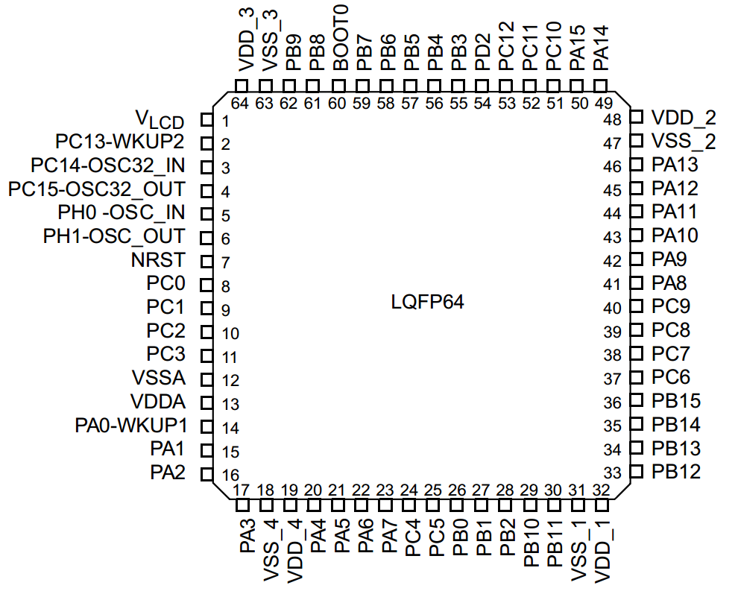
INTRODUCTION TO STM32L152RE
STM32L152RE Microcontroller Features
Package Type : LQFP64 (Low-profile Quad Flat Package)
Instruction set Architecture : RISC (Reduced Instruction Set Architecture)
Data bus size : 32-bit
Address bus size : 32-bit
Operating Frequency : 32 MHz max
Operating Voltage : 1.65 V to 3.6 V
Program memory (flash) : 512 KB
Data memory (SRAM) : 80 KB
Data memory (EEPROM) : 16 KB
Input/output ports : 51(Port A(16), B(16), C(16), D(1),H(2))
Timers : 9
Interrupts : 56
ADC modules (12-bit) : 21 channels
PWM modules : 10
Serial communication : SPI(8), USART(5), I2C(2)
LAB - 1
BECE403E-Embedded Systems Design Lab
5

Slide 9
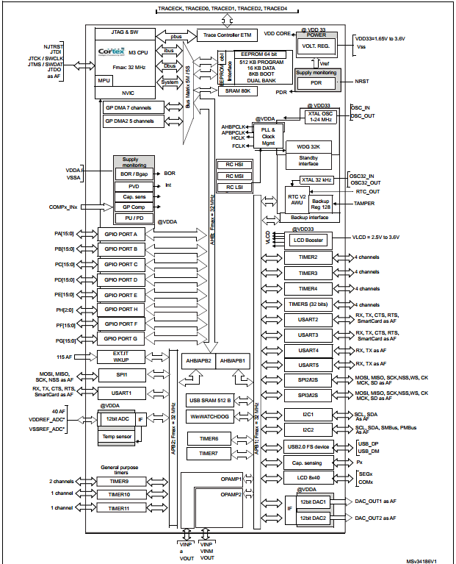
STM32L152RE - Architecture
STM32L152RE – Pin diagram
LAB - 1
BECE403E-Embedded Systems Design Lab
6

Slide 10
INTRODUCTION TO Keil Studio IDE
Keil Studio Cloud is the successor to the Mbed Online Compiler, and allows you to develop Mbed 2, Mbed OS 5 and 6 projects on supported Mbed-enabled boards.
Free to use, browser-based IDE for the evaluation and development of embedded, IoT, and Machine Learning software for Cortex-M devices.
You can compile projects using Arm Compiler 6, run the projects directly on supported development boards, and debug from supported browsers without the need to install any software.
You can access Keil Studio Cloud using an Arm or Mbed account (use below link) and get started by opening a reference design to evaluate.
https://studio.keil.arm.com
LAB - 1
BECE403E-Embedded Systems Design Lab
1

Slide 11
BECE403E-Embedded Systems Design Lab
LAB-1
Working with LED
LAB - 1
BECE403E-Embedded Systems Design Lab
7

Slide 12
LAB TASK-1
Blinking of LED on Board
Write a program to blink an on-board LED (LD2) of the STM32 Nucleo-64 board with 0.5s delay between ON and OFF state using Keil Studio Cloud IDE.
LAB - 1
BECE403E-Embedded Systems Design Lab
8

Slide 13
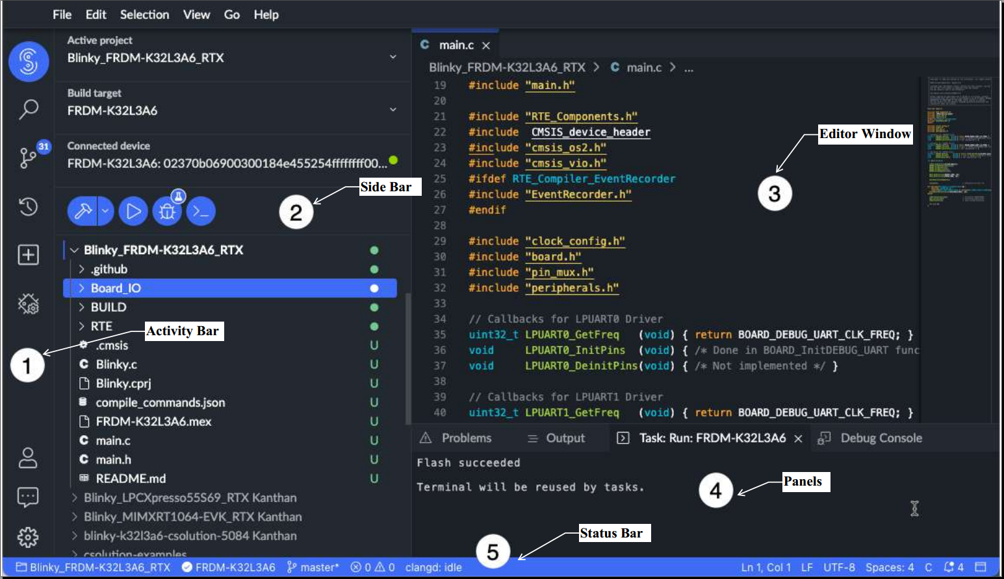
ARM Keil Studio Could IDE Demo for Blink LED
LAB - 1
BECE403E-Embedded Systems Design Lab
1

Slide 14

INTRODUCTION TO Keil Studio IDE
Procedure to create a mbed example project
Go to ARM Keil Studio (https://studio.keil.arm.com/auth/login/) and log in
Select File → New → Mbed Project
Click the Example project drop-down list and select “mbed2-example-blinky”
In Project name field, provide the name of the new project and click Add project
Double click on the “main.cpp” file from the newly created project folder
Modify the code in the editor window as per the logic of your application
Check for any errors in the program under the “Problems” tab of the panels window
If no errors, connect the Nucleo Board to the computer using Micro USB Cable
Click Play icon (Run project) to upload and start the code execution on the board.
LAB - 1
BECE403E-Embedded Systems Design Lab
1

Slide 15
INTRODUCTION TO Keil Studio IDE
Procedure (one-time) to connect Nucleo board to Keil Studio Cloud IDE
In Side bar, under Build target drop-down list select “NUCLEO-L152RE”
Then, click on the Connected device option to open the Device Manager
Connect Nucleo Board to the computer using Micro USB Cable
Click Add Device button and select device firmware (STLink) and then click Connect
Nucleo board is now ready to be used to run and debug a project
After the first successful connection, Keil Studio automatically detects the hardware
LAB - 1
BECE403E-Embedded Systems Design Lab
1

Slide 16
LAB TASK-1
API required:
DigitalOut Identifier(PinName) - Used configure GPIO pin as digital output pin
- Identifier: User defined name to access this digital pin
- PinName: Name of the pin as specified in the Nucleo board pin details
- Examples: DigitalOut myled(LED1); //LED1 is an onboard LED
DigitalOut myA3(PC_0); //PC_0 is 0th pin of port C
operator= (int value) - used to set the digital output as 0 or 1. A shorthand for write() API.
- Example: myA3=1; //set the PC_0 digital output pin value as HIGH or 1
wait(s) – Used to pauses the execution of a program for the amount of time (in seconds)
- s: Float value indicate the number of seconds to pause.
- Example: wait(1.0); //will pause the program for 1 second.
wait(0.5); //will pause the program for 0.5 second
LAB - 1
BECE403E-Embedded Systems Design Lab
8

Slide 17
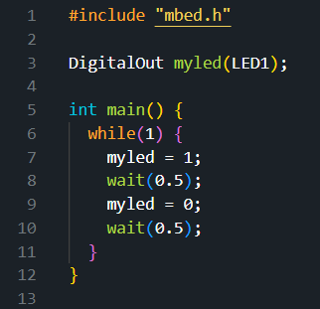
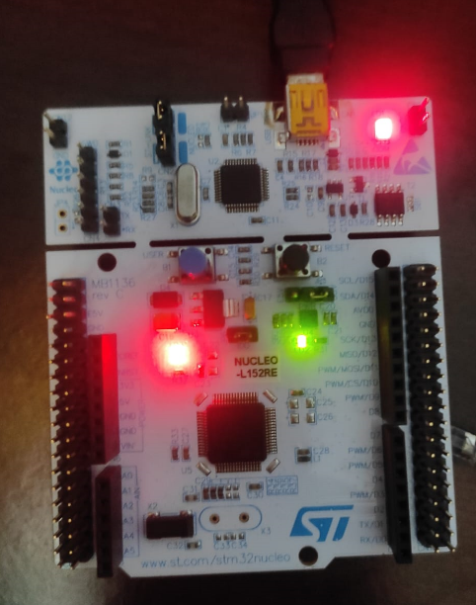
LAB TASK-1
Program: Output:
LAB - 1
BECE403E-Embedded Systems Design Lab
10

Slide 18
LAB TASK-2
Blinking of 4 LEDs alternatively in pairs
Write a program to blink four LEDs in alternatively in pairs (1010 and 0101 pattern) with 0.5 Sec delay between each. Implement and verify this logic on the STM32 Nucleo-64 board using Keil Studio Cloud IDE.
LAB - 1
BECE403E-Embedded Systems Design Lab
11

Slide 19
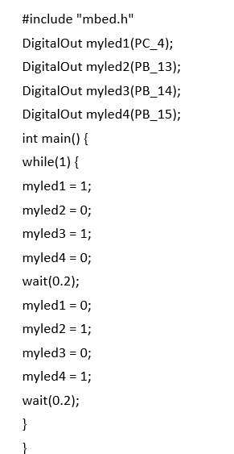
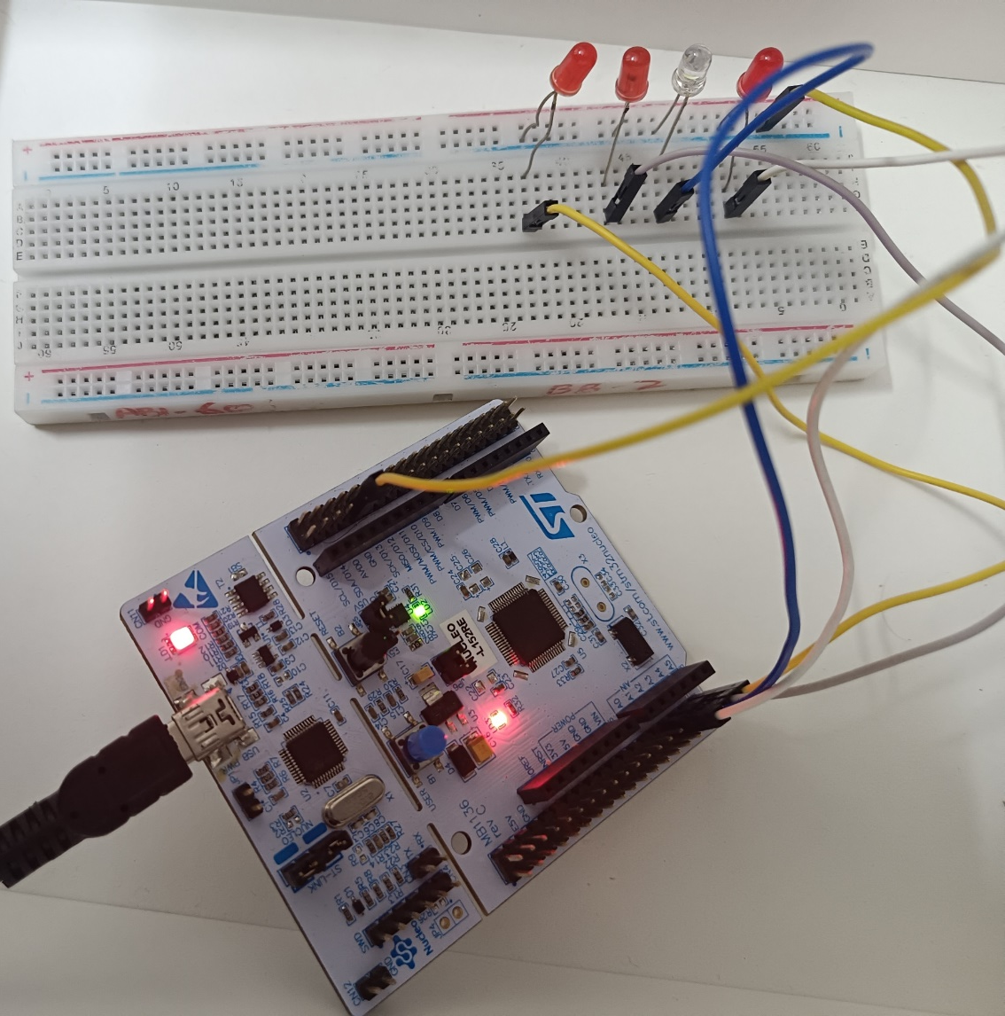
LAB TASK-1
Program: Connection diagram:
LAB - 1
BECE403E-Embedded Systems Design Lab
10

Slide 20
THANK YOU
by
prakash v

