Slide 1
BECE403E-Embedded System Design Lab
LAB-10
WORKING WITH KEYPAD
BECE403E - EMBEDDED SYSTEM DESIGN
1

Slide 2
KEYPAD
Keypads are input devices that are being widely used in many embedded system applications including ATM machines, door locks, and vending machines etc.,.
Keypads are used to take input from the user as numbers or characters for further processing such as password, menu selection and navigating among different options.
One of the most commonly used keypads is the matrix keypad with 4×4 or 4×3 buttons. The matrix keypad consists of pushbutton that are connected to the row and column lines.
There is one pin for each column and one pin for each row. So the 4×4 keypad has 4+4=8 pins, while the 4×3 keypad has 4+3=7 pins.
The column pins (Col 1–Col4) are connected to the microcontroller as the inputs pins and the rows pins (Row 1–Row 4) are connected to the output pins of the microcontroller.
LAB-10
BECE403E - EMBEDDED SYSTEM DESIGN
2

Slide 3
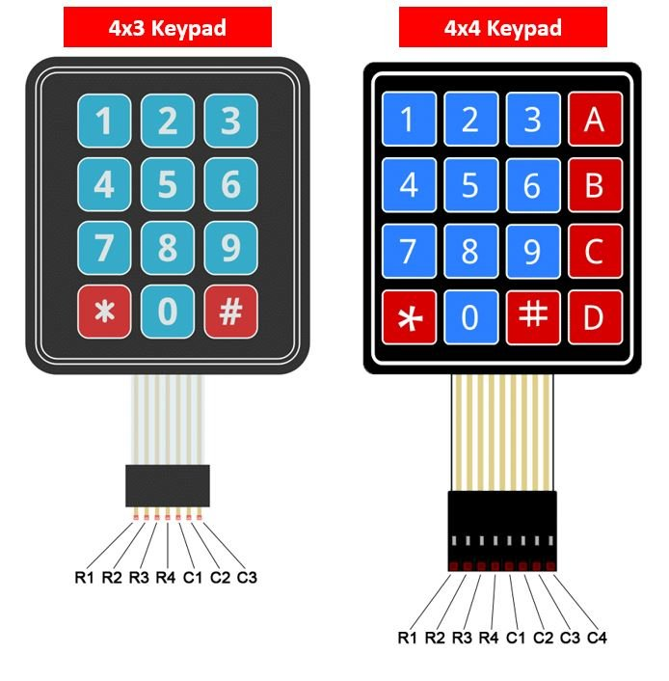
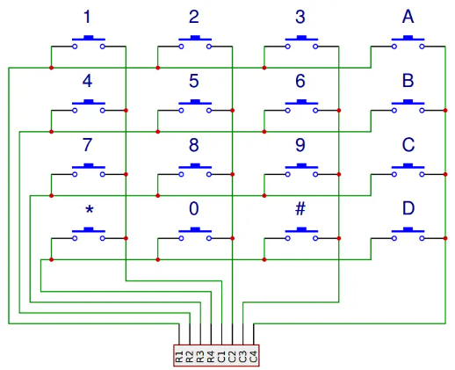
KEYPAD
Internal structure of 4x4 keypad
LAB-10
BECE403E - EMBEDDED SYSTEM DESIGN
3

Slide 4
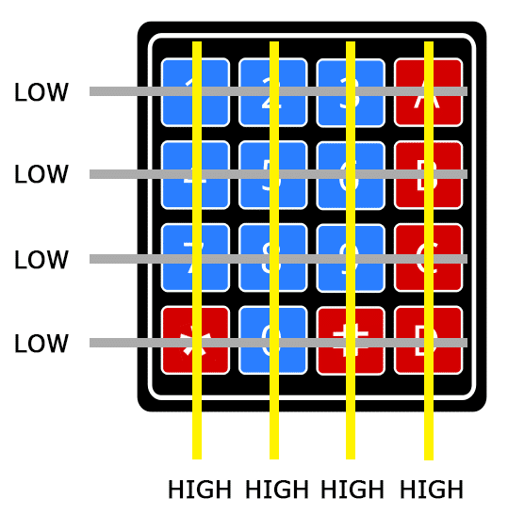
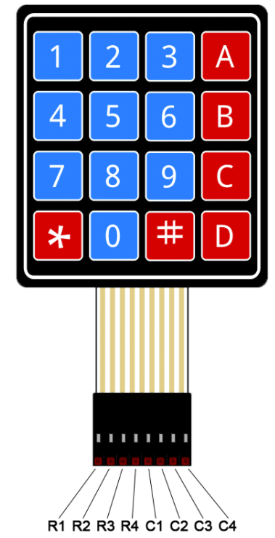
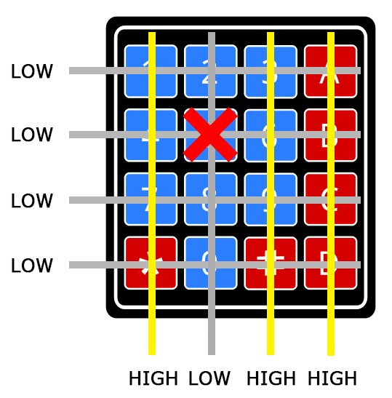
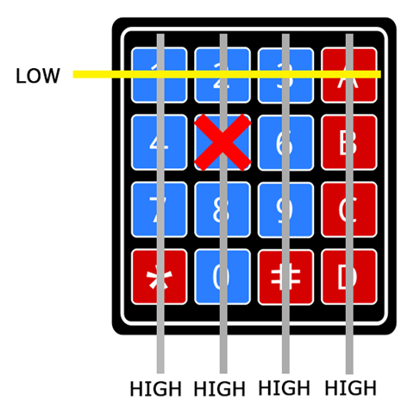
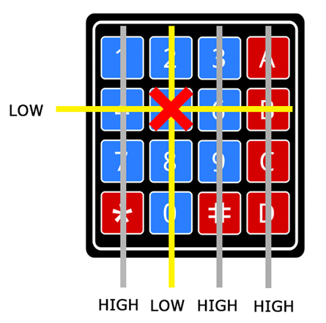
KEYPAD
STEP-1
STEP-2
STEP-3
STEP-4
MODULE-5
BECE403E - EMBEDDED SYSTEM DESIGN
4

Slide 5
KEYPAD
The status of each switch is determined by Scanning the rows or columns. If low logic is given to all the Rows and high logic is given to each Column.
Keypad Scanning
Find Column number
When a switch/key is pressed, the corresponding row and column will get short, allowing current to flow between them. When the key ‘4’ is pressed, for instance, column 1 and row 2 are connected.
The output of the corresponding column goes to go low.
Since we have made all the rows zero so this gives the column number of the pressed key.
Find Row number
After the detection of the column number, the controller each row is one by one set to low
Then, microcontroller checks the column than any pin is changed to Low.
The row due to which the column gets low is the row number of the pressed key.
LAB-10
BECE403E - EMBEDDED SYSTEM DESIGN
5

Slide 6
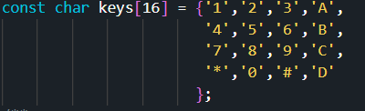
KEYPAD
#include “keypad.h” is a mbed library for using 4x4 matrix style keypads with the STM32 Nucleo and supports multiple keypresses.
Default keypad pin map is given below but pin map can be modified by editing the pin map details given in keypad.h header file.
Functions | Description
Keypad identifier (PinName col0, PinName col1, PinName col2, PinName col3, PinName row0, PinName row1, PinName row2, PinName row3) | Create a 4x4 (col, row) or 4x4 keypad interface
char getKey () | Returns the letter of the pressed key
bool getKeyPressed () | Detects if any key was pressed.
void enablePullUp () | Enables internal PullUp resistors on the columns pins.
For more details Refer: https://os.mbed.com/users/rlanghbv/code/KeypadLib/shortlog/
LAB-10
BECE403E - EMBEDDED SYSTEM DESIGN
6

Slide 7
KEYPAD
Lab Task 1: Read the input from keypad and display it in LCD & Serial monitor
Write a mbed C++ program to accepts input from a 4x3 keypad and displays it on the serial monitor and LCD. Assume LCD operates in 4-bit with EN and RS active state. Design and verify this logic on Nucleo 152RE board using online Keil Studio platform.
Procedure to add “Keypad” library in online compiler:
Visit this link https://os.mbed.com/users/rlanghbv/code/KeypadLib/shortlog/ and click on “Import into Keil studio” option and copy the link (http://os.mbed.com/users/rlanghbv/code/KeypadLib/)
In Keil studio, right clicking the project folder and select “Add Mbed Library…” option and paste the copied link in the URL field then click next
In the net pop window select “default” under “Release, branch, or tag” field and click finish
Now Check whether “keypad.cpp” and “keypad.h” files included in your project folder or not
LAB-10
BECE403E - EMBEDDED SYSTEM DESIGN
7

Slide 9
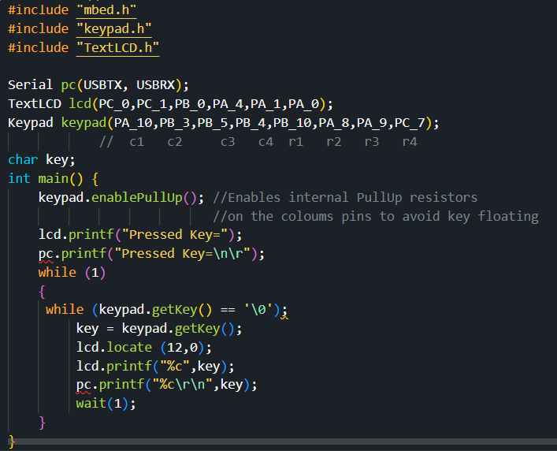
KEYPAD
Program
LAB-10
BECE403E - EMBEDDED SYSTEM DESIGN
9

Slide 10
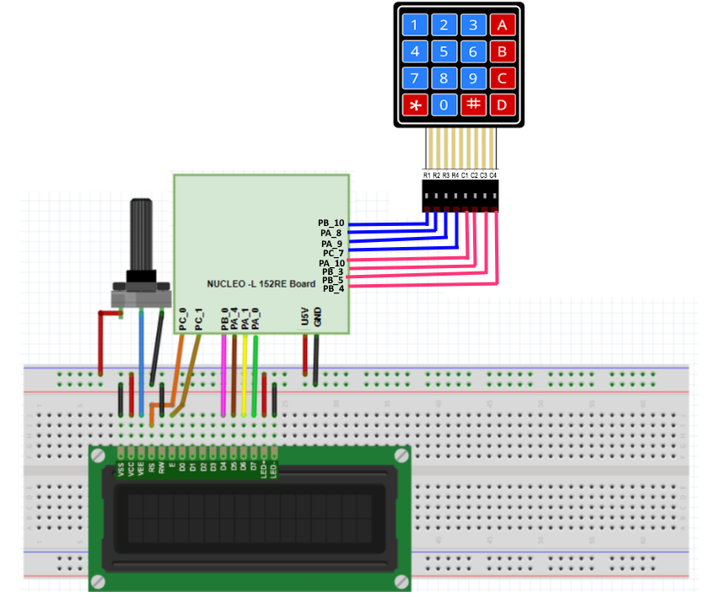
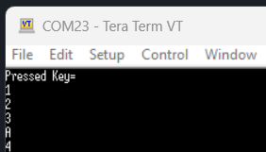
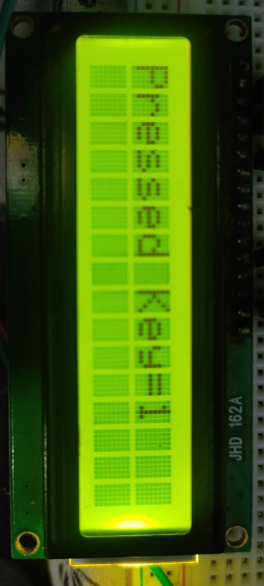
KEYPAD
Output
Connection diagram
LAB-10
BECE403E - EMBEDDED SYSTEM DESIGN
10

Slide 12
KEYPAD
Lab Task – 2: Password based door locking system
Write a mbed C++ program to design a password based door locking system in which the system accept 4-digit password (last 4-digit of your reg. no) via keypad. Use the LCD display to message “Enter Password” on the first line and display * symbol on the second line of the LCD to represent every digit of the password entered. Check whether entered password matches with actual password, if matched activate the servo to open the door else also display message “Correct Password” on LCD first line and “Door opening” message on the LCD second line. If password not matched, activate the buzzer also display message “Incorrect Password” on LCD first line and “Door can’t open” message on the LCD second line. Assume LCD operates in 4-bit with EN and RS active state. Design and verify this logic on Nucleo 152RE board using online Keil Studio platform.
LAB-10
BECE403E - EMBEDDED SYSTEM DESIGN
12

Slide 13
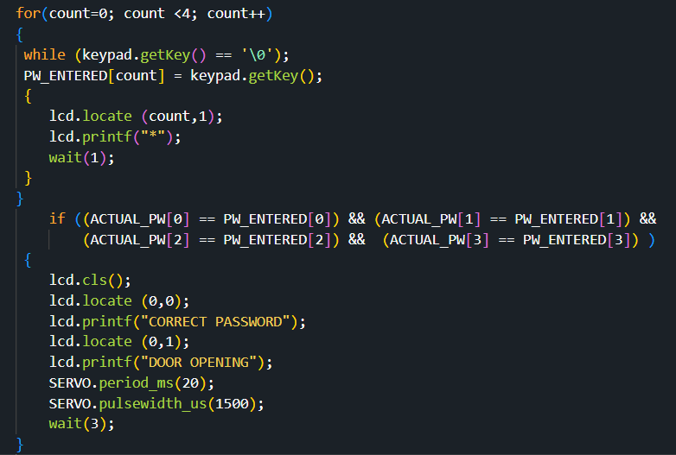
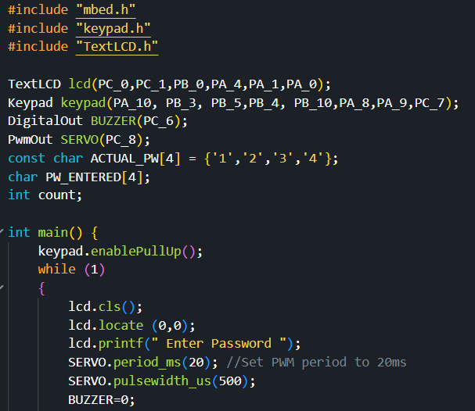
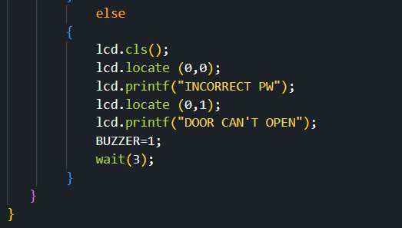
KEYPAD
Program
LAB-10
BECE403E - EMBEDDED SYSTEM DESIGN
13

Slide 15
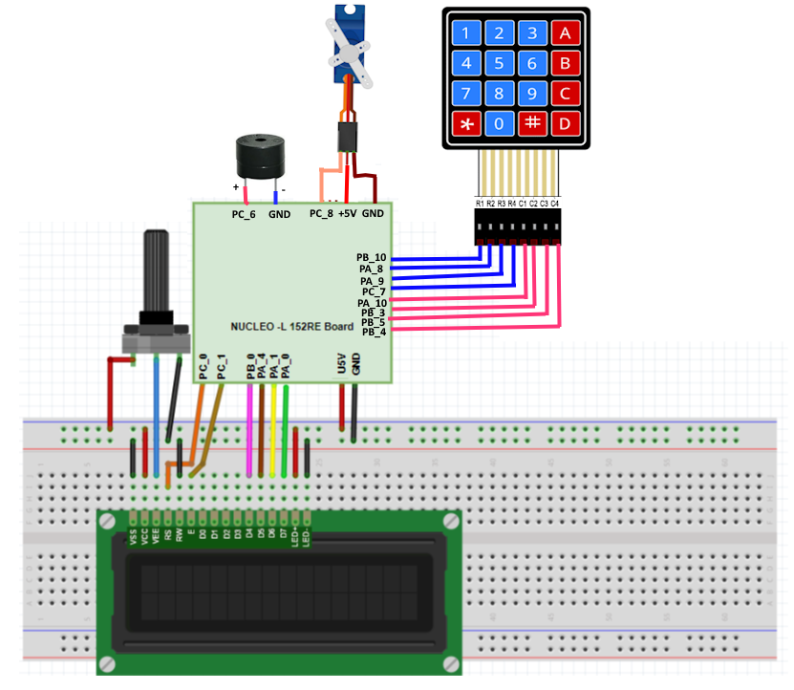
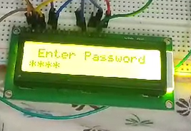
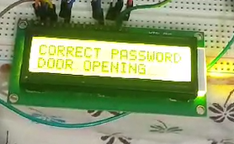
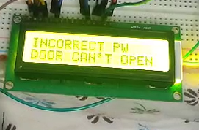
KEYPAD
Output
Connection diagram
LAB-10
BECE403E - EMBEDDED SYSTEM DESIGN
15

Slide 16
KEYPAD
Challenging Task: Home security system
Write a mbed C++program to design home security system that consists of three main modules (1) Intruder detection (2) Activate fence light during night time (2) password based door lock system.
The intruder detection system consists of PIR sensor interfaced with processing unit to detect and alert under human presence condition.
Automatically activate the fence lights during night time using LDR.
Password based door lock system uses numeric keypad to accept the password (last 4-digit of your reg. no) from user and LCD to display the message whether permission is granted or not. Upon receiving correct password signal, enable motor to open the door.
In case of password mismatch or intruder detection condition activate the buzzer. Assume LCD operates in 4-bit with EN and RS active state. Design and verify this logic on Nucleo 152RE board using online Keil Studio platform.
LAB-10
BECE403E - EMBEDDED SYSTEM DESIGN
16

