Slide 1
BECE403E-Embedded System Design Lab
LAB-11
Working with 7-Segment Display
LAB-11
BECE403E-Embedded System Design Lab
1

Slide 2
INTRODUCTION TO 7-SEGMENT DISPLAY
Most commonly used displays along with the microcontrollers are LCD, LEDs and seven segment displays etc.,
Seven segment displays are the output display devices that provide a way to display information in the form of alphanumeric characters and digits.
This is most commonly used in many gadgets, and electronic appliances like digital meters, digital clocks, microwave oven and electric stove, etc.
These displays consist of seven segments (indicated as A-G) of light emitting diodes (LEDs) and that is assembled into a structure like numeral 8.
In addition, an extra 8th segment is used to display dot (indicated as H/DP), which is useful while displaying non integer number.
LAB-11
BECE403E-Embedded System Design Lab
2

Slide 3
INTRODUCTION TO 7-SEGMENT DISPLAY
A seven segment displays are generally available in ten pin package, 8 pins relate to the 8 LEDs, the remaining two pins at middle are internally shorted.
These segments come in two outlines they are common cathode and common anode.
In common cathode configuration, the all LED’s negative terminals are connected to the common ground pin hence HIGH on corresponding positive pin glow particular LED.
In a common anode arrangement, the common pin is given to a logic HIGH and the pins of the LED are given LOW to display a number.
LAB-11
BECE403E-Embedded System Design Lab
3

Slide 4
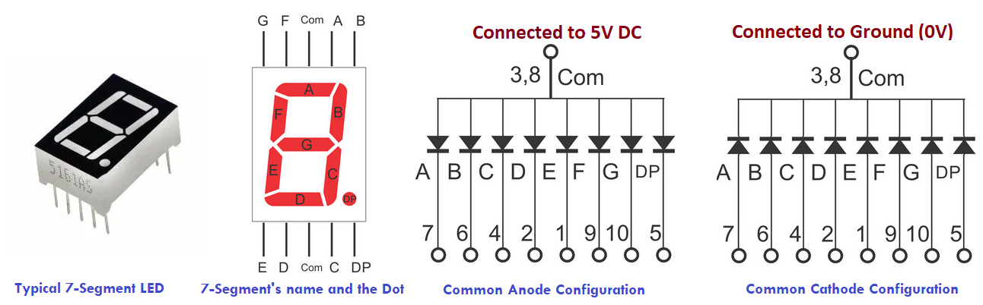
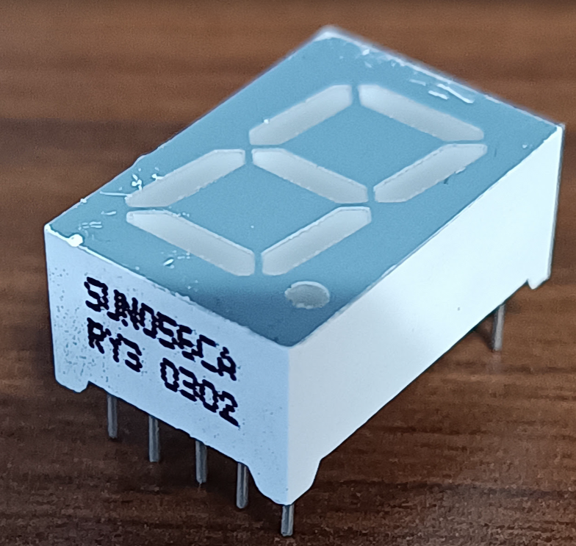
LAB-11
BECE403E-Embedded System Design Lab
3

Slide 5
Hexa Value | Decimal Digit | Individual Segments Illuminated for Common Cathode configuration
 |  | dp (PC_7) | g (PC_6) | f (PC_5) | e (PC_4) | d (PC_3) | c (PC_2) | b (PC_1) | a (PC_0)
0x3F | 0 | 0 | 0 | 1 | 1 | 1 | 1 | 1 | 1
0x06 | 1 | 0 | 0 | 0 | 0 | 0 | 1 | 1 | 0
0x5B | 2 | 0 | 1 | 0 | 1 | 1 | 0 | 1 | 1
0x4F | 3 | 0 | 1 | 0 | 0 | 1 | 1 | 1 | 1
0x66 | 4 | 0 | 1 | 1 | 0 | 0 | 1 | 1 | 0
0x6D | 5 | 0 | 1 | 1 | 0 | 1 | 1 | 0 | 1
0x7D | 6 | 0 | 1 | 1 | 1 | 1 | 1 | 0 | 1
0x07 | 7 | 0 | 0 | 0 | 0 | 0 | 1 | 1 | 1
0x7F | 8 | 0 | 1 | 1 | 1 | 1 | 1 | 1 | 1
0x6F | 9 | 0 | 1 | 1 | 0 | 1 | 1 | 1 | 1
LAB-11
BECE403E-Embedded System Design Lab
3

Slide 6
Hexa Value | Decimal Digit | Individual Segments Illuminated for Common Anode configuration
 |  | dp (PC_7) | g (PC_6) | f (PC_5) | e (PC_4) | d (PC_3) | c (PC_2) | b (PC_1) | a (PC_0)
0xC0 | 0 | 1 | 1 | 0 | 0 | 0 | 0 | 0 | 0
0xF9 | 1 | 1 | 1 | 1 | 1 | 1 | 0 | 0 | 1
0xA4 | 2 | 1 | 0 | 1 | 0 | 0 | 1 | 0 | 0
0xD0 | 3 | 1 | 0 | 1 | 1 | 0 | 0 | 0 | 0
0x99 | 4 | 1 | 0 | 0 | 1 | 1 | 0 | 0 | 1
0x92 | 5 | 1 | 0 | 0 | 1 | 0 | 0 | 1 | 0
0x82 | 6 | 1 | 0 | 0 | 0 | 0 | 0 | 1 | 0
0xF8 | 7 | 1 | 1 | 1 | 1 | 1 | 0 | 0 | 0
0x80 | 8 | 1 | 0 | 0 | 0 | 0 | 0 | 0 | 0
0x90 | 9 | 1 | 0 | 0 | 1 | 0 | 0 | 0 | 0
LAB-11
BECE403E-Embedded System Design Lab
3

Slide 7
LAB TASK-1
Display hexa decimal values from 0 to 9
Write a mbed C++ program to display decimal values from 0 to 9 on the 7-segment display interfaced with digital pins of Nucleo boards. Once the sequence completed from 0 to 9 then repeat the sequence again. Design and implement this logic on the STM 32 Nucleo L152RE board using Keil studio could platform.
Note: Try to perform the display of 0 to F by modifying above program
LAB-11
BECE403E-Embedded System Design Lab
7

Slide 8
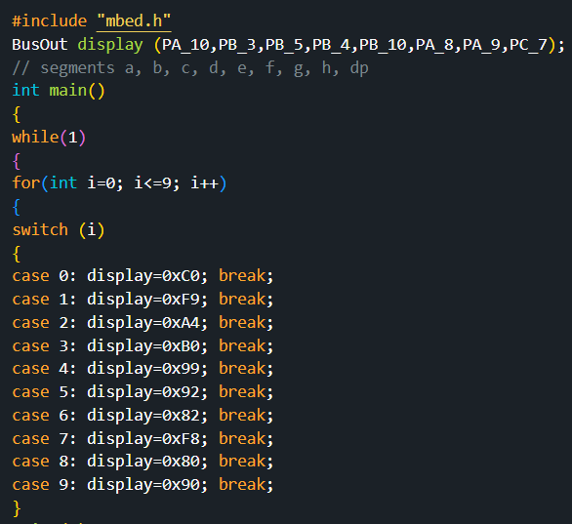
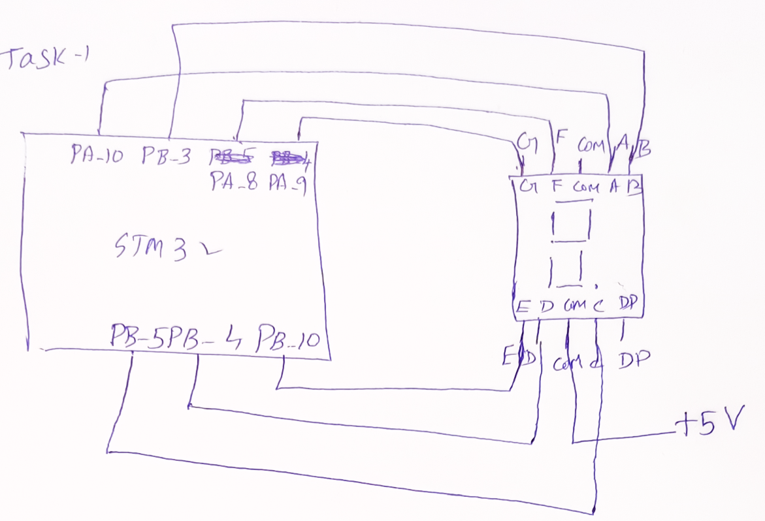
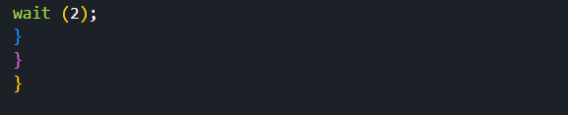
LAB TASK-1
Program Connection diagram
LAB-11
BECE403E-Embedded System Design Lab
8

Slide 9
LAB TASK-2
Display numbers from 00 to 99
Write a mbed C++ program to display a two digit decimal numbers from 00 to 99 using 7-segment LEDs. Use common digital pins of Nucleo board for both 7-segments LED connection and display the digit using multiplexing logic i.e one digit at a time on each 7-Segment with small delay values (few us). Use a switch to stop the number sequencing. Design and implement this logic on the STM 32 Nucleo L152RE board using Keil studio could platform.
LAB-11
BECE403E-Embedded System Design Lab
9

Slide 10
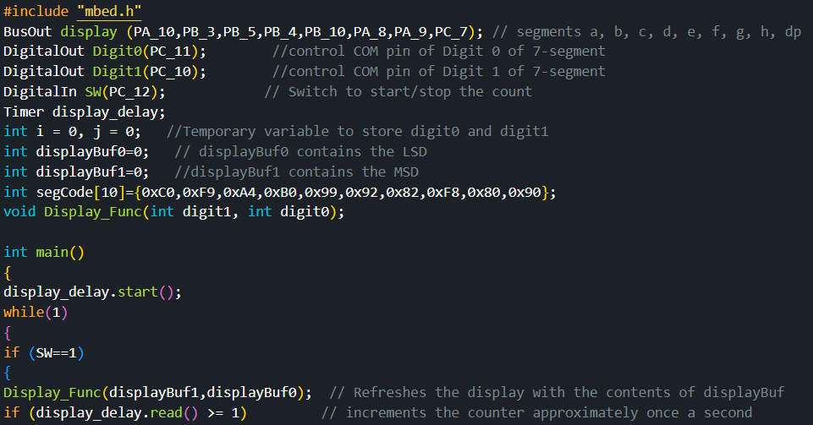
LAB TASK-2
Program
LAB-11
BECE403E-Embedded System Design Lab
10

Slide 11
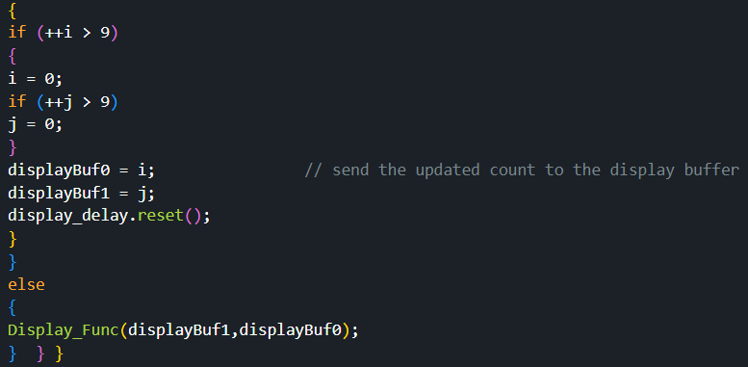
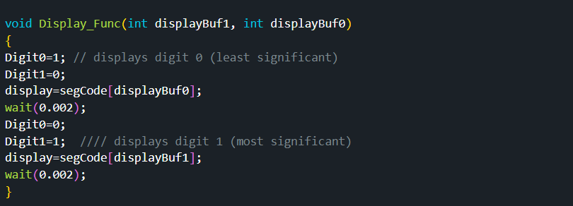
LAB TASK-2
LAB-11
BECE403E-Embedded System Design Lab
11

Slide 12
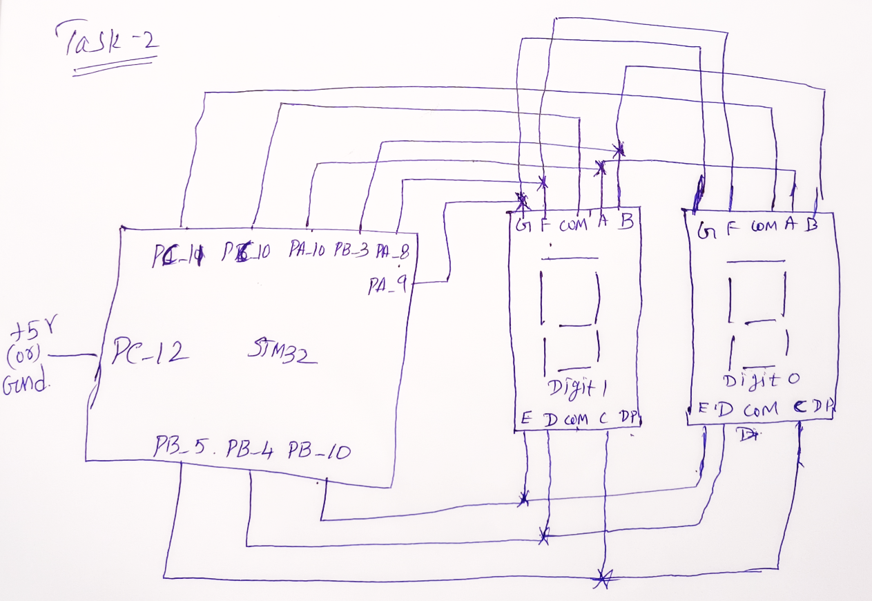
LAB TASK-2
Connection diagram
LAB-11
BECE403E-Embedded System Design Lab
12

Slide 13
CHALLENGING TASK
Token display system
Write a mbed C++ program to design a token display system which helps to serve the customer with out the need of standing in a queue. This display system consist of one 7-segment display to display token numbers from 0 to 9, and token numbers are received into Nucleo board via 4x3 keypad. Design and implement this logic on the STM 32 Nucleo L152RE board using Keil studio could platform.
LAB-11
BECE403E-Embedded System Design Lab
13

Slide 14
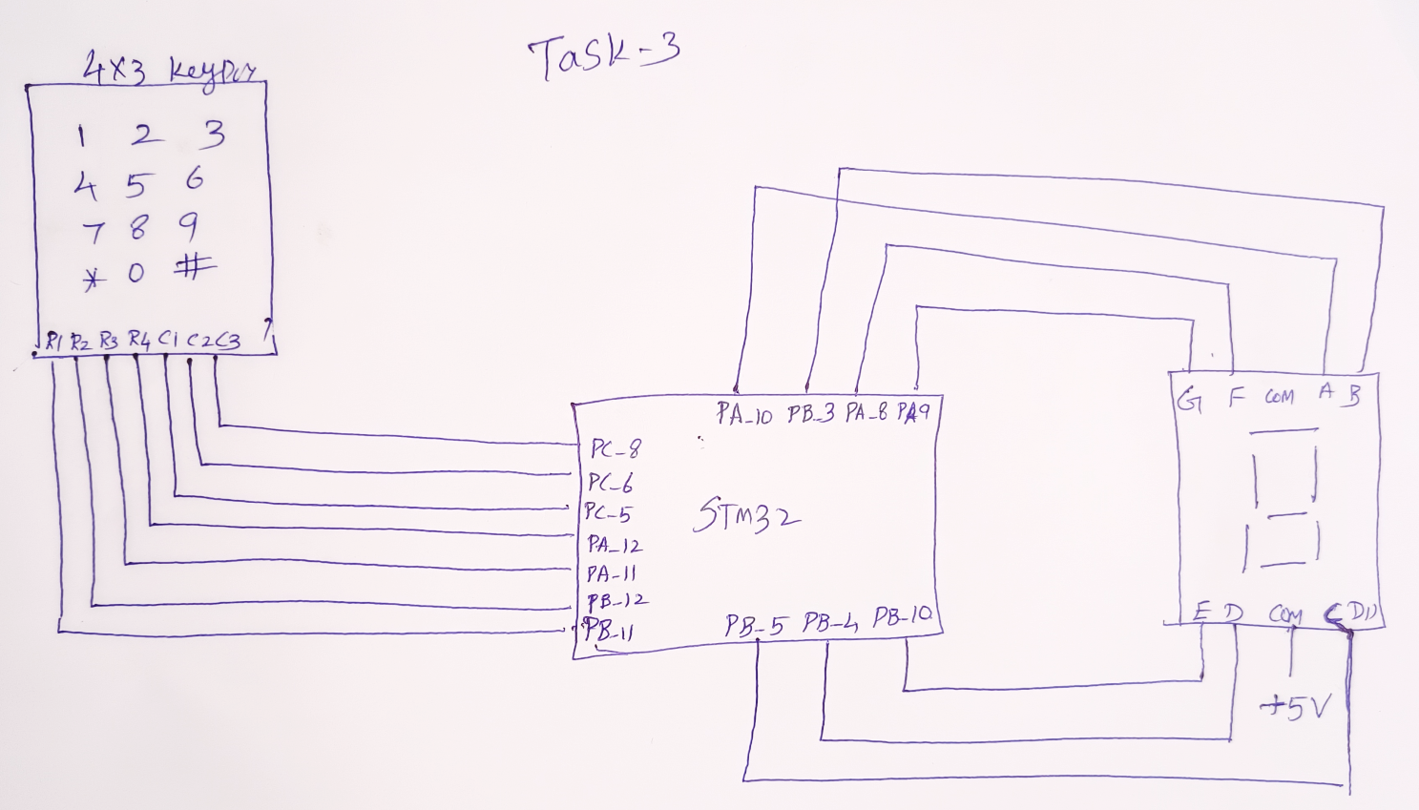
Challenging Task
Connection diagram
LAB-11
BECE403E-Embedded System Design Lab
14

Slide 15
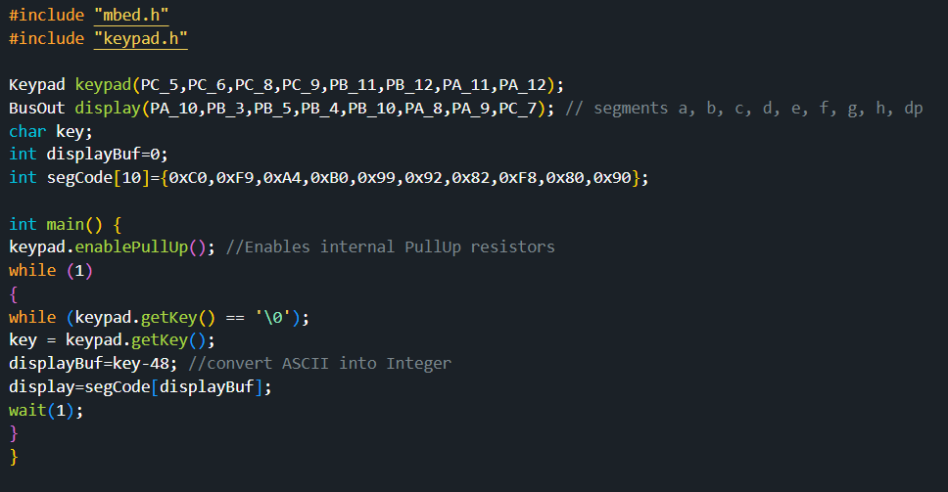
CHALLENGING TASK
Program
LAB-11
BECE403E-Embedded System Design Lab
15

Slide 16
THANK YOU
by
prakash v

