Slide 1
BECE403E-Embedded System Design Lab
LAB-13
Working with mbed RTOS
LAB-13
BECE403E-Embedded System Design Lab
1

Slide 2
Mbed RTOS
ARM Mbed OS is an open source embedded operating system designed specifically for the "things" in the Internet of Things.
It includes all the features to develop a product based on an Arm Cortex-M microcontroller, including security, connectivity, an RTOS and drivers for sensors and I/O devices.
mbed Real Time Operating System based on the RTX implementation of the CMSIS-RTOS API open standard.
One of the key features of mbed RTOS is that it supports preemptive interrupt-based scheduling.
Several tasks can be given different priorities, they can be scheduled to start, stop, communicate with other, and share resources.
Note that the RTOS function discussed in this lab experiments are refer to Mbed OS 2. Other mbed OS versions may have different functions and features.
LAB-13
BECE403E-Embedded System Design Lab
2

Slide 3
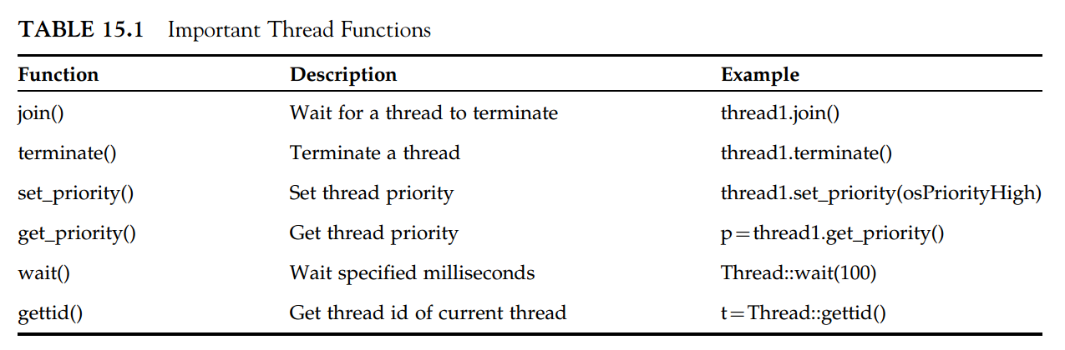
THREAD IN mbed RTOS
A thread is basically a function in a program which normally runs continuously after it is started.
The Thread class allows defining, creating, and controlling thread functions in the system.
Function thread.start(name) starts thread called name. Function Thread::wait(n) should be used to create “n” milliseconds of delay in a thread.
LAB-13
BECE403E-Embedded System Design Lab
3

Slide 4
LAB TASK-1
Multitasking application using LEDs
Write a mbed RTOS program to demonstrate a simple multitasking application. Create a two threads named Thread1 and Thread2. Perform blinking of LED1 connected to PC_10 for every one second in Thread1. Terminate the Thread1 operation after 10 seconds. Perform blinking of LED2 connected to PC_11 for every 0.5 second in Thread2. Design and implement this logic on the STM 32 Nucleo L152RE board using Keil studio could platform.
Important Note:
Add RTOS library into your project by right clicking on Add mbed library and copy past the below link in the URL field, then select default option on the next pop-up window Link: https://os.mbed.com/users/mbed_official/code/mbed-rtos
Refer detailed list of RTOS API: https://os.mbed.com/handbook/RTOS
LAB-13
BECE403E-Embedded System Design Lab
4

Slide 5
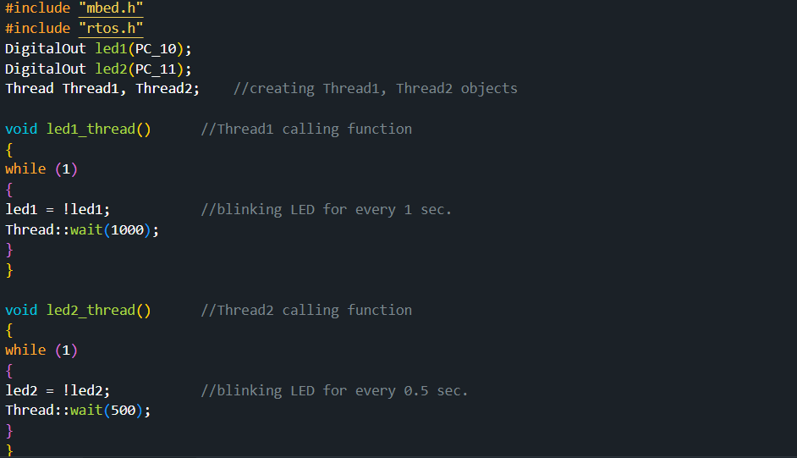
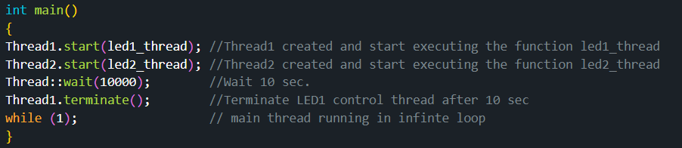
LAB TASK-1
Program
LAB-13
BECE403E-Embedded System Design Lab
5

Slide 6
MUTEX IN mbed RTOS
Mbed provides a number of functions for synchronizing threads when multiple threads need to access common global variables.
Mutexes (or mutual exclusion objects) are programming objects that allow multiple pro-gram threads to share the same resource in a orderly manner, such as data or file.
A mutex is given a unique name when it is created. The resource is shared in locked by a thread.
Once locked, other threads cannot access this resource until it is released by the thread that locked it. Therefore, a mutex is like a lock of a shared resource.
A mutex is owned by the thread that uses it to lock the resource and any other thread cannot unlock this mutex.
Mbed functions lock() and unlock()are used to lock and unlock a mutex, respectively.
LAB-13
BECE403E-Embedded System Design Lab
6

Slide 7
SEMAPHORE IN mbed RTOS
A semaphore is simply a nonnegative integer which increments and decrements and con-trolls access to a shared resource.
A Semaphore is particularly useful to manage thread access to a pool of shared resources of a certain type.
A semaphore is initially set to a count equivalent to the number of free resources. A semaphore’s value must be positive to allow access to the shared resource.
The semaphore count is decremented by one when a thread uses the semaphore. Similarly, the count is incremented by one when the thread releases the semaphore.
A zero count does not allow access to the shared resource. Semaphores with only one count are similar to mutexes. Such semaphores are also known as Binary Semaphores.
Mbed wait() and release() functions are used to lock and unlock a semaphore.
LAB-13
BECE403E-Embedded System Design Lab
7

Slide 8
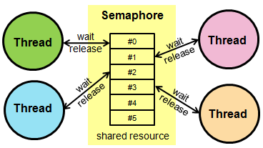
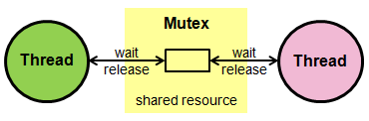
SEMAPPHORE vs MUTEX
KEY POINTS | SEMAPHORE | MUTEX
Basic | Semaphore is a signaling mechanism. | Mutex is a locking mechanism.
Existence | Semaphore is an integer variable. | Mutex is an object.
Function | Semaphore allow multiple program threads to access a finite instance of resources. | Mutex allow multiple program thread to access a single resource but not simultaneously.
Ownership | Semaphore value can be changed by any process acquiring or releasing the resource. | Mutex object lock is released only by the process that has acquired the lock on it.
Categorize | counting semaphore and binary semaphore. | Mutex is not categorized further.
Priority Inheritance | Not Available | Available
LAB-13
BECE403E-Embedded System Design Lab
8

Slide 9
LAB TASK-2
Interprocess communication (synchronization) - Mutex and Semaphore
Write a mbed RTOS program to demonstrate the use of Mutex and Semaphore functionality by creating two threads named Thread1 and Thread2 respectively. Create a common function named count that print the value of the variable “i” on serial monitor with 1 second delay apart. Assign initial value of variable of “i” as 10. Assume Thread1 perform increment by 1 operation on “i” and pass the incremented value to “count” function. Thread2 performs decrement by 1 on “i” and pass the decremented value to “count” function. Use Mutex/Semaphore to protect the common function “count” for Thread1 and Thread2. Design and implement this logic on the STM 32 Nucleo L152RE board using Keil studio could platform.
LAB-13
BECE403E-Embedded System Design Lab
9

Slide 10
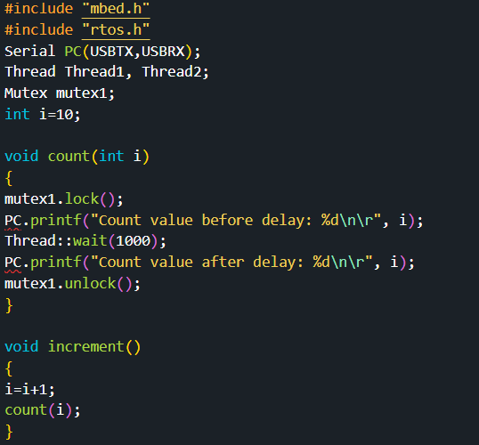
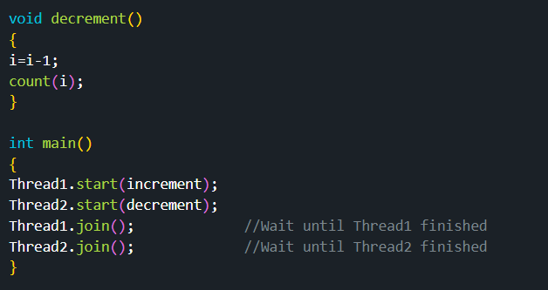


LAB TASK-2
Program
output
(without Mutex)
(with Mutex)
LAB-13
BECE403E-Embedded System Design Lab
10

Slide 11
SIGNALS IN mbed RTOS
Signals are also called event flags and they are used for thread synchronization.
A thread can be forced to wait for a signal to be set by another thread before it can continue.
Mbed function Thread::signal_wait() forces the issuing thread to wait until the specified signal is set. Function signal_set() sets a signal.
We can have up to 32 signal flags (or event flags) per thread.
Fig. shows an example where one task generates some data and another one reads this data.
The reading task waits for an event flag to indicate that data are available before it continues to read it.
LAB-13
BECE403E-Embedded System Design Lab
11

Slide 12
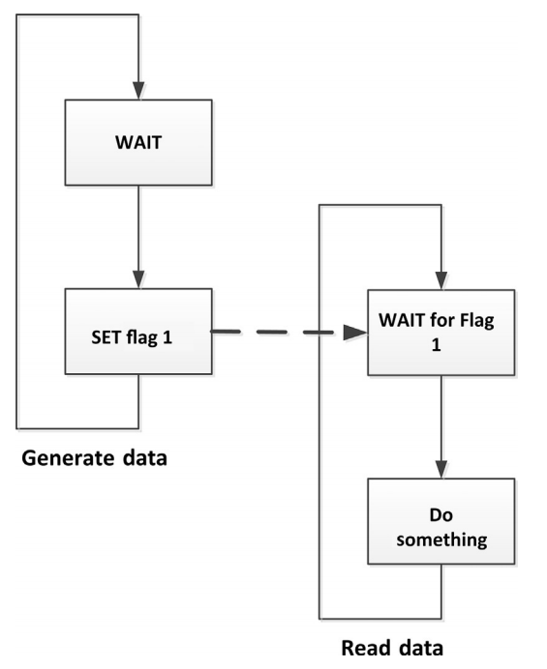
SIGNALS IN mbed RTOS
Signal Example
LAB-13
BECE403E-Embedded System Design Lab
12

Slide 13
LAB TASK-3
Interprocess communication (synchronization) – Signal(Event flag)
Write a mbed RTOS program to demonstrate the use of Signal (event flag) by using LED (PC_11) and button (PC_10). Create a thread called Flash which waits for event flag 1 to be set by calling function signal_wait(0x1). Event flag 1 is set when the button is pressed by calling function signal_set(0x1). After this point thread active and flashes the LED every second. Design and implement this logic on the STM 32 Nucleo L152RE board using Keil studio could platform.
LAB-13
BECE403E-Embedded System Design Lab
13

Slide 14
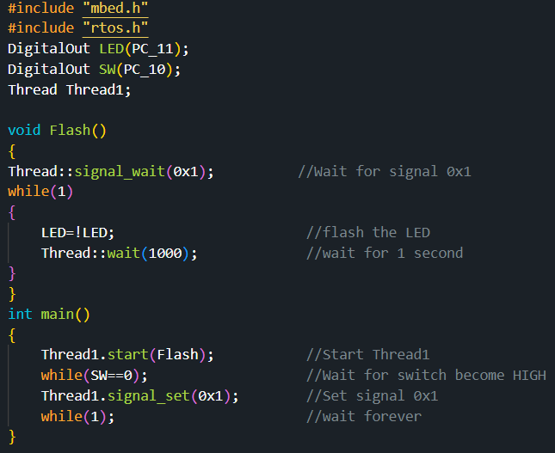
LAB TASK-3
Program
LAB-13
BECE403E-Embedded System Design Lab
14

Slide 15
THANK YOU
by
prakash v

