Slide 1
BECE403E-Embedded System Design Lab
LAB-2
WORKING WITH LEDs & SWITCHES

Slide 2
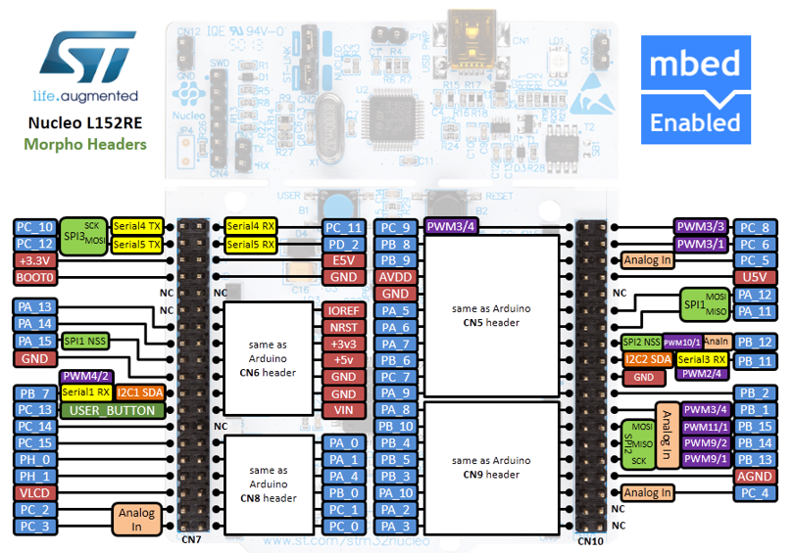




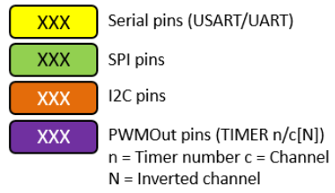
STM32 Nucleo-64 - Pin Details (Morpho Headers)
Pins Legend
Image credit: arm MBED, Ref. URL : https://os.mbed.com/forum/electronics/topic/15346/?page=1#comment-52189
LAB - 2
BECE403E-Embedded Systems Design Lab
4

Slide 3
LAB TASK-1
Display Hexadecimal counting sequence in LEDs
Write a C++ program with mbed APIs to display Hexadecimal Counting Pattern from 0 to 15 by blinking LEDs. Implement and verify this logic on the STM32 Nucleo-64 board using Keil Studio Cloud IDE.
API required:
BusOut Identifier(PinNames) - Used to combine a number of DigitalOut pins to write them at once. You can have up to 16 pins in a Bus.
- Identifier: User defined name to access this digital pin
- PinNames: Name of the pins as specified in the Nucleo board pin details
- Examples: BusOut myleds(a,b,c,d,e,f,g,h); //a-LSB and h-MSB
BusOut hexa(PA_3,PB_13,PAB_14,PB_15); //PA_3-LSB, PB_15-MSB
LAB - 2
BECE403E-Embedded Systems Design Lab
8

Slide 4
LAB TASK-2
Controlling LED Blinking Sequence using Switch
Write a C++ program with mbed APIs to blink one LED at a time serially in a group of 4 LEDs using switch.
If switch is LOW, blink the LEDs one at a time from left to right (1000, 0100, 0010, 0001 pattern) with 0.5 Sec delay between each.
If switch is HIGH, blink the LEDs one at a time from right to left (0001, 0010, 0100, 1000 pattern) with 0.5 Sec delay between each.
Implement and verify this logic on the STM32 Nucleo-64 board using Keil Studio Cloud IDE.
API required:
DigitalIn Identifier(PinName) - To read the value of a digital input pin (logic level 0 or 1).
- Identifier: User defined name to access this digital pin
- PinName: Name of the pins as specified in the Nucleo board pin details
- Examples: DigitalIn switch(PA_3); //PA_3 is configured as Digital input pin
LAB - 2
BECE403E-Embedded Systems Design Lab
8

Slide 5
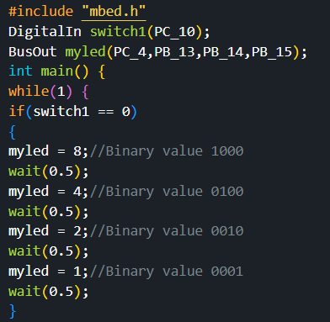
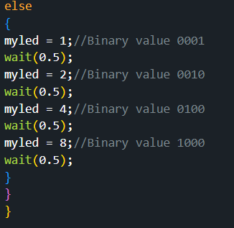
LAB TASK-2
Program:
LAB - 2
BECE403E-Embedded Systems Design Lab
10

Slide 6
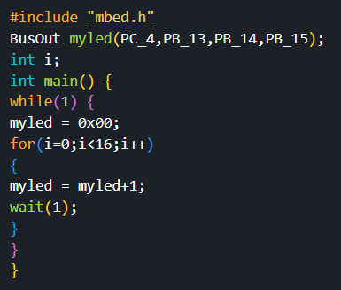
LAB TASK-1
Program:
LAB - 2
BECE403E-Embedded Systems Design Lab
10

Slide 7
CHALLENGING TASK
Write a C++ program with mbed APIs to design a traffic light controller system for a four lane junction (North, South, East, West) to coordinate the traffic moves.
Use 12 LEDs (3 for each direction) for traffic light signal indication and Switch decide the traffic light mode.
If Switch is LOW, traffic light operate in late night mode in which only yellow light (LED) in all lanes blink for every 2 seconds continuously.
If Switch is HIGH then traffic light operates in normal signalling operation in which similar signal sequence are applied in opposite lanes (for ex. east and west) with Green signal for 15 Sec. then Yellow for 2 Sec. and then Red. Meanwhile, north & south lane will be at red.
Once this sequence is completed, switch to next opposite lanes (i.e north & south) and carry out signalling with Green signal for 10 Sec. then Yellow signal for 2 Sec. and then Red meanwhile, east & west lane will be in red.
Continuously switch between these two signal sequence.
Implement and verify this logic on the STM32 Nucleo-64 board using Keil Studio Cloud IDE.
Hint: Use 6 Digital pins for lane signalling LEDs (3 for East & West, 3 for North & South) and one Switch for Mode selection
LAB - 2
BECE403E-Embedded Systems Design Lab
11

Slide 8
THANK YOU
by
prakash v

