Slide 1
BECE403E-Embedded System Design Lab
LAB-3
WORKING WITH PWM

Slide 2
INTRODUCTION TO PWM
LAB - 3
BECE403E-Embedded Systems Design Lab
2

Slide 3
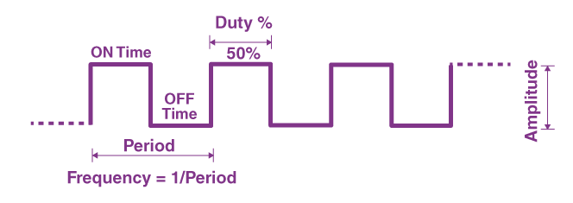
INTRODUCTION TO PWM
PWM signal stays “ON” for a given time and stays “OFF” for a certain time, the percentage of time for which the signal remains “ON” is known as the duty cycle.
If the signal is always “ON,” then the signal must have a 100 % duty cycle. The formula to calculate the duty cycle is given as follows:
Duty Cycle= Ton / (Ton +Toff) * 100 (percentage)
Period = Ton+Toff
Period = 1/Frequency
LAB - 3
BECE403E-Embedded Systems Design Lab
3

Slide 4
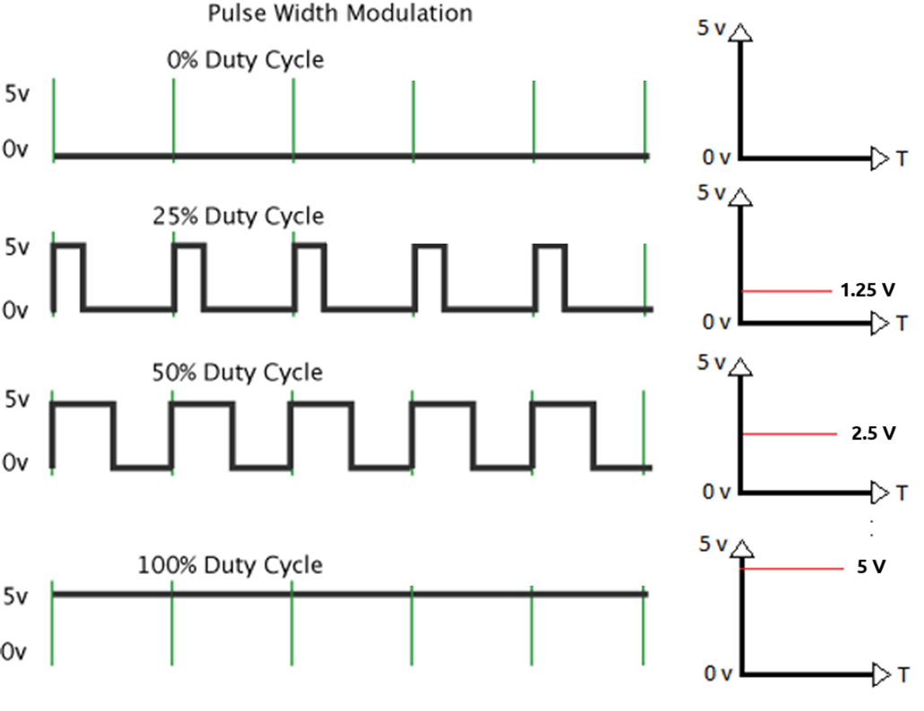
INTRODUCTION TO PWM
LAB - 3
BECE403E-Embedded Systems Design Lab
4

Slide 5
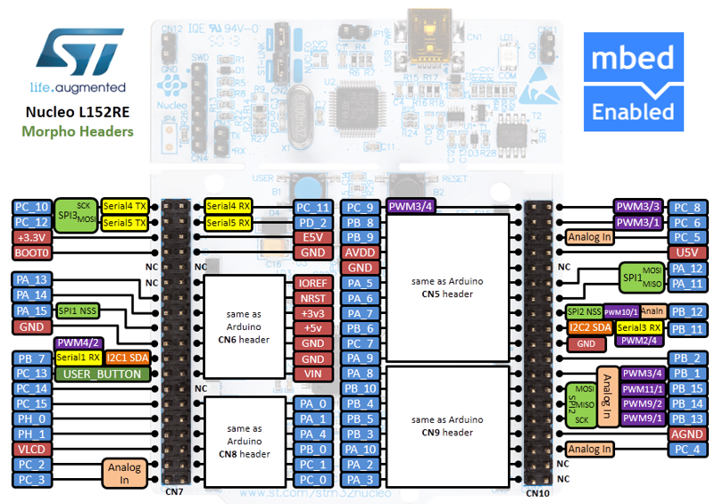




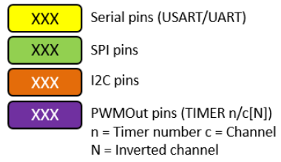
STM32 Nucleo-64 - Pin Details (Morpho Headers)
Pins Legend
Image credit: arm MBED, Ref. URL : https://os.mbed.com/forum/electronics/topic/15346/?page=1#comment-52189
LAB - 3
BECE403E-Embedded Systems Design Lab
5

Slide 6
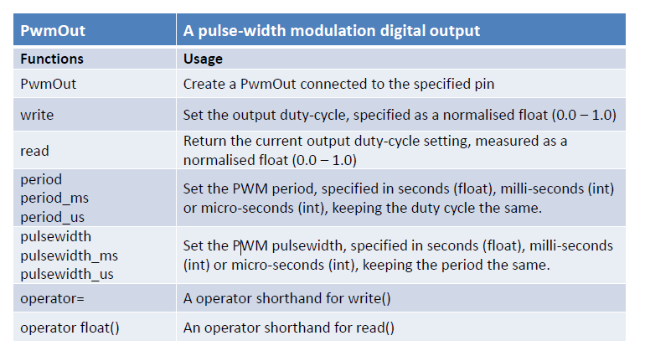
INTRODUCTION TO PWM
API required:
https://os.mbed.com/docs/mbed-os/v6.16/apis/pwmout.html
LAB - 3
BECE403E-Embedded Systems Design Lab
6

Slide 7
LAB TASK-1
Controlling LED brightness with 75% duty cycle
Write a C++ program with mbed APIs to control the brightness of the LED using a PWM signal with duty cycle 75%. Assume PWM period as 2 Seconds. Implement and verify this logic on the STM32 Nucleo-64 board using Keil Studio Cloud IDE.
LAB - 3
BECE403E-Embedded Systems Design Lab
7

Slide 8
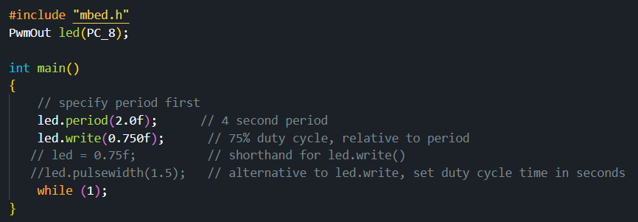
LAB TASK-1
Program:
LAB - 3
BECE403E-Embedded Systems Design Lab
8

Slide 9
LAB TASK-2
Increasing/decreasing LED brightness using variable duty cycle
Write a C++ program with mbed APIs to gradually increase and decrease LED brightness using PWM signal with variable duty cycle. Assume the LED is connected to PC_8 PWM pin, time period of the PWM signal as 10ms, increment/decrement duty cycle value is 10% and delay between each increment/decrement duty cycle is 0.5s. Implement and verify this logic on the STM32 Nucleo-64 board using Keil Studio Cloud IDE.
LAB - 3
BECE403E-Embedded Systems Design Lab
9

Slide 10
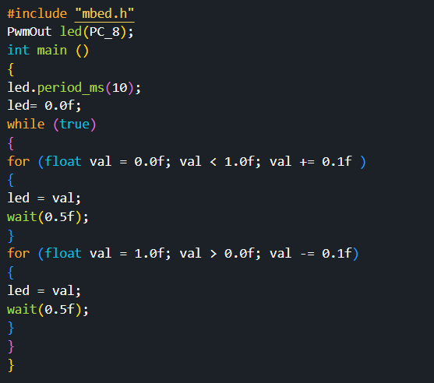
LAB TASK-2
Program:
LAB - 3
BECE403E-Embedded Systems Design Lab
10

Slide 11
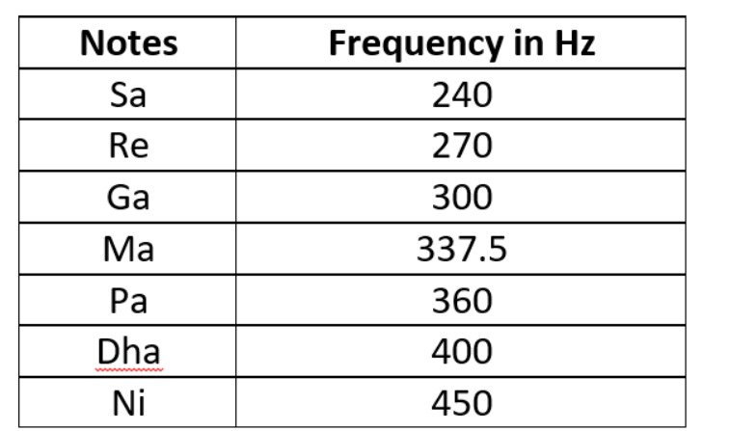
LAB TASK-3
Generate a music note SA-RE-GA-MA-PA-THA-NEE using PWM signal
Write a C++ code with mbed APIs to generate a music note SA-RE-GA-MA-PA-THA-NEE on the buzzer using PWM signal. Frequency for each music tone is listed below.
Implement and verify this logic on the STM32 Nucleo-64 board using Keil Studio Cloud IDE.
LAB - 3
BECE403E-Embedded Systems Design Lab
11

Slide 12
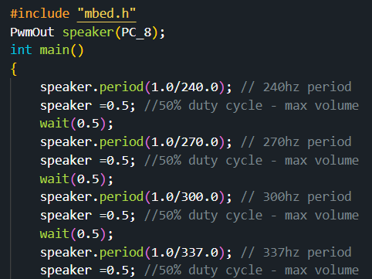
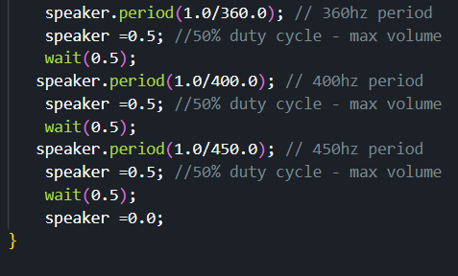
LAB TASK-3
Program:
LAB - 3
BECE403E-Embedded Systems Design Lab
12

Slide 13
CHALLENGING TASK
Write a C++ program with mbed APIs to design a warning signals system for Automotive with the following logic.
Use 4 switch and one buzzer to generate four warning signals such as indicator signal, horn sound, seat belt warning and reversing signal.
Assume each of these warning signals must have 50% duty cycle and 0.5s delay between their ON and OFF state.
Activate the respective warning signal as per the following switch status,
If Switch-1 is HIGH, generate a indicator signal (2 Hz)
If Switch-2 is HIGH, generate a Horn signal (400 Hz)
If Switch-3 is HIGH, generate a Seat belt warning signal (612 Hz)
If Switch-4 is HIGH, generate a Reversing signal (1000 Hz)
If all switches are LOW, the buzzer should be in OFF state
Implement and verify this logic on the STM32 Nucleo-64 board using Keil Studio Cloud IDE.
Hint: Use 4 Digital pins for switches to select the warning signal(Busin) & one buzzer to generate the different warning sound(PWM).
LAB - 3
BECE403E-Embedded Systems Design Lab
13

Slide 14
THANK YOU
by
prakash v

