Slide 1
BECE403E-Embedded System Design Lab
LAB-4
WORKING WITH SERIAL PORT & ADC

Slide 2
INTRODUCTION TO SERIAL PORT
Serial is a generic protocol used by computers and electronic modules to Transmit (Tx) and receive (Rx) control information and data.
The Serial link has two unidirection channels, one for sending and one for receiving.
The link is asynchronous, and so both ends of the serial link must be configured to use the same settings.
Serial channels have a number of configurable parameters Baud Rate, Data length, Parity and Stop Bits.
The default settings for the mbed microcontroller are described as 9600 baud rate (8 bits, 1 stop bit, no parity)
LAB - 4
BECE403E-Embedded Systems Design Lab
8

Slide 3
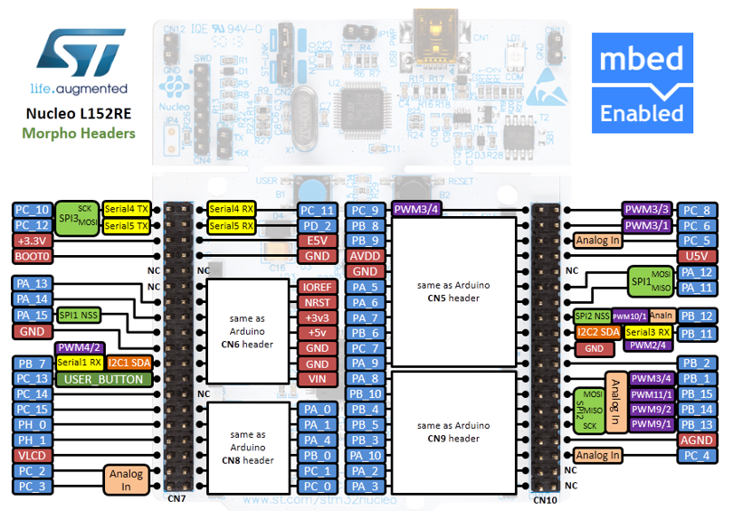




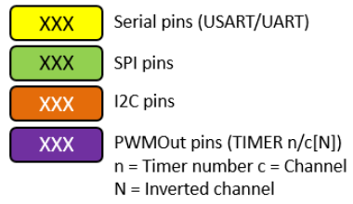
STM32 Nucleo-64 - Pin Details (Morpho Headers)
Pins Legend
Image credit: arm MBED, Ref. URL : https://os.mbed.com/forum/electronics/topic/15346/?page=1#comment-52189
LAB - 4
BECE403E-Embedded Systems Design Lab
4

Slide 4
INTRODUCTION TO SERIAL PORT
The mbed Microcontroller can communicate with a host PC through a "USB Virtual Serial Port" over the same USB cable that is used for programming.
This enables you to:
Print out messages to a host PC terminal
Read input from the host PC keyboard
Communicate with applications and programming languages running on the host PC that can communicate with a serial port, e.g. python, java and so on.
The Serial Interface can be used on supported pins and USBTX/USBRX
Note that USBTX/USBRX are not pins; they represent the pins that route to the interface USB Serial port so you can communicate with a host PC.
LAB - 4
BECE403E-Embedded Systems Design Lab
8

Slide 5
INTRODUCTION TO SERIAL PORT
API required:
Serial Identifier(PinName tx, PinName rx, int baud) – Used to access serial port
- Identifier: User defined name to access the specified serial port
- PinName Tx: Name of the pins as specified in the Nucleo board for serial transit
- PinName Rx: Name of the pins as specified in the Nucleo board for serial receive
- Examples: Serial BT(PC_10, PC_11, 9600); //Accessing serial port 4 of the Nucleo L152RE board with 9600 as baud rate
Serial Identifier(USBTX, USBRX) - Used to access “USB Virtual Serial Port”
- Identifier: User defined name to access this USB Virtual Serial Port
- Examples: Serial pc(USBTX, USBRX); //Accessing USB Virtual Serial Port using the identifier name pc
putc - Used to send a character from Nucleo board to host PC
getc - Used to read a character from host PC to Nucleo board
LAB - 4
BECE403E-Embedded Systems Design Lab
8

Slide 6
LAB TASK-1
Controlling on-board LED using USB Virtual serial port
Write a C++ code with mbed APIs to receive a character (H) from PC via host terminal application (Tera term) & switch ON the LED. For all other character LED1 must be in OFF state. Implement and verify this logic on the STM32 Nucleo-64 board using Keil Studio Cloud IDE.
LAB - 4
BECE403E-Embedded Systems Design Lab
8

Slide 7
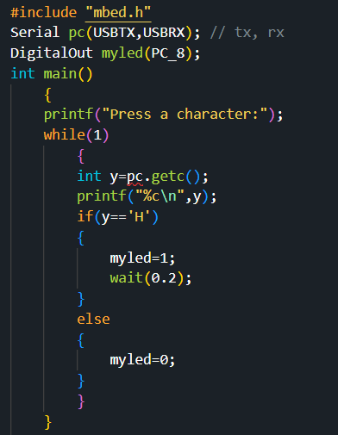
LAB TASK-1
Program:
LAB - 4
BECE403E-Embedded Systems Design Lab
10

Slide 8
LAB TASK-2
Increasing/Decreasing Brightness Using Serial Port
Write a C++ program with mbed APIs to gradually increase and decrease LED brightness by receiving a character (“i” for increase and “d” for decrease) from PC via host terminal application (Tera term) using PWM signal with variable duty cycle. Implement and verify this logic on the STM32 Nucleo-64 board using Keil Studio Cloud IDE.
LAB - 4
BECE403E-Embedded Systems Design Lab
8

Slide 9
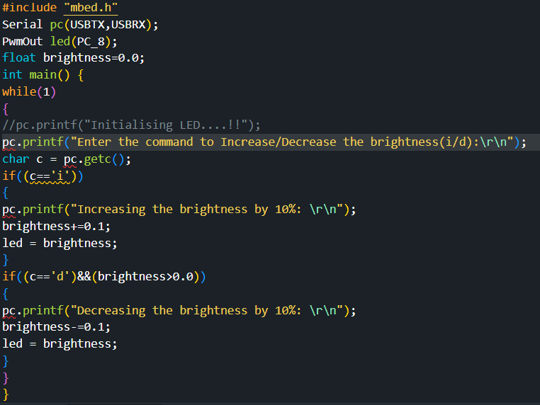
LAB TASK-2
Program:
The default period is 0.020s, and the default pulse width is 0.
LAB - 4
BECE403E-Embedded Systems Design Lab
10

Slide 10
INTRODUCTION TO ADC
An Analog to Digital Converter(ADC) is a electronic circuit that converts analog signal into digital form which could be understood by a digital device
The list of possible analog input signals is endless such as s light, temperature, speed, pressure etc.
ADC effectively measures the analog input voltage and gives a binary output number proportional to its size.
ADC types: Successive Approximation, Dual slope, delta-sigma, flash type etc.,
ADC has maximum and minimum permissible input values.
LAB - 4
BECE403E-Embedded Systems Design Lab
10

Slide 11
INTRODUCTION TO ADC
Not all the pins on a microcontroller have the ability to do analog to digital conversions.
On the Nucleo board, these pins have an ‘Analog In’ indicate these pins can read analog voltage
The ADC on the Nucleo is a 12-bit ADC meaning it has the ability to detect 4096 (2^12) discrete analog levels.
An input of 0 volts would result in a decimal 0 and an input of 5 volts would give the maximum of 4096.
LAB - 4
BECE403E-Embedded Systems Design Lab
11

Slide 12

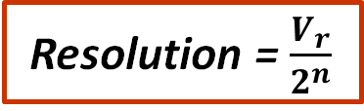
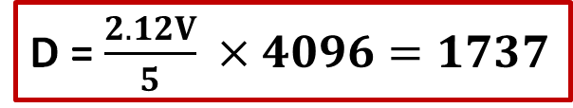
INTRODUCTION TO ADC
The resolution for an ADC is the smallest distinguishable change in analog input that causes the digital output to change.
Nucleo ADC is 12-bit. This leads to a resolution of 5/4096, or 1.2 mV.
ADC conversion
Where, D the digital output value, V_{i} is the input voltage, V_{r} the reference voltage, n no. of bits in the output
The output binary number D is an integer, for an n-bit number can take any value from 0 to (2^{n} - 1).
Resolution = $\frac{V_{r}}{2^{n}}$
D = $\frac{V_{i}}{V_{r}} × 2^{n}$
D = $\frac{2.12V}{5} ×4096=1737$
LAB - 4
BECE403E-Embedded Systems Design Lab
12

Slide 13
INTRODUCTION TO ADC
API required:
AnalogIn Identifier(PinName) – Used to access ADC of the specified pin name.
- Identifier: User defined name to access the specified ADC pin
- PinName: Name of the pins as specified in the Nucleo board for ADC pin
read() - Read the input voltage, represented as a float in the range 0 to 1. For example, if you have a 3.3V system and the applied voltage is 1.65V, then AnalogIn() reads 0.5 as the value.
read_voltage () - Read the input voltage in volts
get_reference_voltage () - Gets this AnalogIn instance's reference voltage.
operator float () - An operator shorthand for read()
LAB - 4
BECE403E-Embedded Systems Design Lab
8

Slide 14
LAB TASK-3
Increasing/Decreasing Brightness Using Potentiometer
Write a C++ program with mbed APIs to gradually increase and decrease LED brightness by changing the position of the Potentiometer via ADC. Also print it’s voltage value on serial monitor. Use Implement and verify this logic on the STM32 Nucleo-64 board using Keil Studio Cloud IDE.
LAB - 4
BECE403E-Embedded Systems Design Lab
8

Slide 15
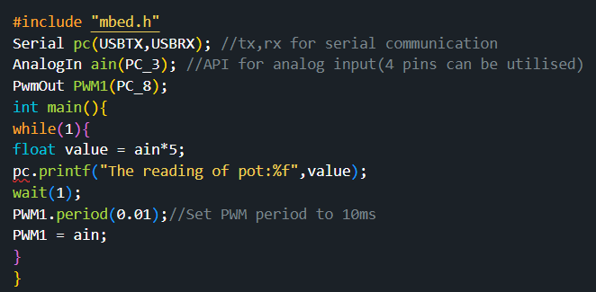
LAB TASK-3
Program:
LAB - 4
BECE403E-Embedded Systems Design Lab
10

Slide 16
CHALLENGING TASK
Battery level indicator
Write a C++ program with mbed APIs to design a battery level indicator system using potentiometer and LEDs. The system must display the different level of the voltage with the help of 5 LEDs as per following conditions.
If the voltage is between 0 to 1V glow LED1 and display “0 to 1V” in serial monitor
If the voltage is between 1 to 2V glow LED1 and LED2 “1 to 2V” in serial monitor
If the voltage is between 2 to 3V glow LED1 to LED3 “2 to 3V” in serial monitor
If the voltage is between 3 to 4V glow LED1 to LED4 “3 to 4V” in serial monitor
If the voltage is between 4 to 5V glow LED1 to LED5 “4 to 5V” in serial monitor
Implement and verify this logic on the STM32 Nucleo-64 board using Keil Studio Cloud IDE.
LAB - 4
BECE403E-Embedded Systems Design Lab
11

Slide 17
THANK YOU
by
prakash v

