Slide 1
ECE4003-Embedded System Design Lab
LAB-5
Working with LCD
LAB - 5
ECE4003-Embedded System Design Lab
1

Slide 2
INTRODUCTION TO LCD
LCD stands for Liquid Crystal Display and It is one kind of electronic display used in wide range of applications like CD/DVD players, Digital Watch etc.,
The main benefits of LCD are inexpensive; simply programmable, and there are no limitations for displaying custom characters, simple animations, etc.
The liquid crystals are made up of a part solid, part liquid substance that can be "twisted" by applying electrical voltage to them.
In the normal state, the crystals inside the liquid are twisted, and light can pass through, once the crystals are subjected to an electrical current, they untwist, blocking the light and makes the portion of the screen black.
LAB - 5
ECE4003-Embedded System Design Lab
2

Slide 3
INTRODUCTION TO LCD
Among different sizes of LCDs (16x1, 16x2, 16x4, 20x4), 16x2 LCD display is very basic module and is very commonly used in various devices and circuits.
A 16x2 LCD means it can display 16 characters per line and there are 2 such lines. In this LCD each character is displayed in 5x7 pixel matrix.
The 16x2 intelligent alphanumeric dot matrix display is capable of displaying 224 different characters and symbols.
This LCD has two registers, namely, Command and Data.
Command register stores various commands given to the display.
Data register stores data to be displayed.
LAB - 5
ECE4003-Embedded System Design Lab
3

Slide 4
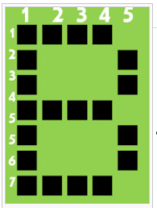
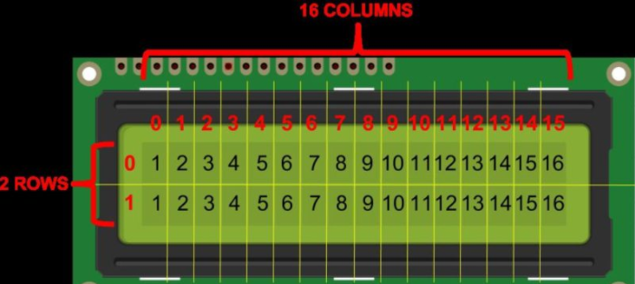
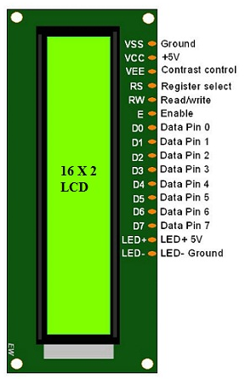
INTRODUCTION TO LCD
Vss- Ground pin
Vcc- Supply (+5V)
VEE- Contrast pin (0.4 to 0.9V)
RS- Register select (1- data register, 0 – command register)
R/W - Read/ Write mode ( 1-Read mode, 0- Write mode)
E- Enable the LCD module (high to low at this pin enable LCD)
DB0-DB7- Data pins (command and data are send to display)
LED+ & LED- - Anode and Cathode of backlight
LAB - 5
ECE4003-Embedded System Design Lab
4

Slide 5
TextLCD Library
This library allows an Nucleo board to control LiquidCrystal displays (LCDs) based on the Hitachi HD44780 chipset in 4-bit mode
In Nucleo board TextLCD library is used as #include "TextLCD.h"
The mbed TextLCD library performs the laborious LCD setup routine for us also tells the LCD object which pins are used for which functions.
To use the TextLCD library - create a named TextLCD object.
Syntax: TextLCD lcd(rs, enable, d4, d5, d6, d7);
Example: TextLCD lcd(PC_0,PC_1,PB_0,PA_4, PA_1, PA_0);
lcd.printf(“Text to print”)- the character to write to the display
For more details Refer: https://os.mbed.com/users/simon/code/TextLCD/
LAB - 5
ECE4003-Embedded System Design Lab
5

Slide 6
TextLCD Library
Functions | Description
TextLCD (PinName rs, PinName e, PinName d4, PinName d5, PinName d6, PinName d7) | Create a TextLCD interface.
putc (int c) | Write a character to the LCD.
printf (const char *format,...) | Write a formated string to the LCD.
locate (int column, int row) | Locate to a screen column and row.
cls () | Clear the screen and locate to 0,0.
For more details Refer: https://os.mbed.com/users/simon/code/TextLCD/docs/tip/classTextLCD.html
LAB - 5
ECE4003-Embedded System Design Lab
6

Slide 7
Procedure to add TextLCD Library
Method-1 for online compiler:
Download LCD library from https://os.mbed.com/users/simon/code/TextLCD/ as zip file and extract files
Add “TextLCD.cpp” and “Text.h” files into project created in Keil studio by right clicking the project folder and select “upload files…” option
Now Check whether “TextLCD.cpp” and “TextLCD.h” files included in your project folder or not
Method-2 for offline compiler:
In Keil studio, right clicking the project folder and select “Add Mbed Library…” option and provide the link https://os.mbed.com/users/simon/code/TextLCD/ in URL field then click next
In the net pop window select “default” under “Release, branch, or tag” field and click finish
Now Check whether “TextLCD.cpp” and “TextLCD.h” files included in your project folder or not
LAB - 5
ECE4003-Embedded System Design Lab
7

Slide 8
LAB TASK-1
Display Name and Register number on LCD
Write a program for 16x2 LCD to display your register number (ex: “20BEC1001”) at row-0 3rd position and your name (ex:“ABCDEFGH”) at beginning of the row-1. Assume LCD operates in 4-bit with EN and RS active state. Design and verify this logic on Nucleo 152RE board using online Keil Studio platform.
LAB - 5
ECE4003-Embedded System Design Lab
8

Slide 9
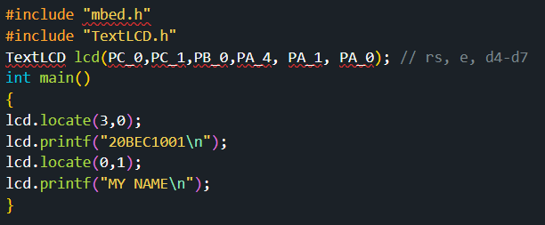
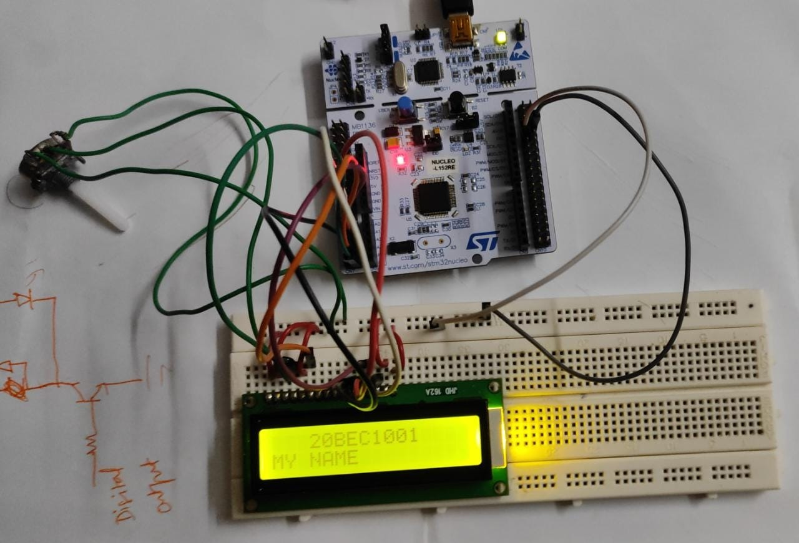
LAB TASK-1
Program
Output
LAB - 5
ECE4003-Embedded System Design Lab
9

Slide 10
LAB TASK-1
Pin connections
Connection diagram
LCD Pin No. | LCD pin Name | Nucleo pins
1 | VSS | GND
2 | VCC | U5V
3 | VEE | Pot middle pin
4 | RS | PC_0
5 | RW | GND
6 | E | PC_1
7 | D0 | not connected
8 | D1 | not connected
9 | D2 | not connected
10 | D3 | not connected
11 | D4 | PB_0
12 | D5 | PA_4
13 | D6 | PA_1
14 | D7 | PA_0
15 | LED+ | U5V
16 | LED- | GND
LAB - 5
ECE4003-Embedded System Design Lab
10

Slide 11
LAB TASK-2
Read the input from Serial Window and display it in LCD
Write a program to accepts serial input character via Teraterm software from a host computer and displays it on the LCD. Assume LCD operates in 4-bit with EN and RS active state. Design and verify this logic on Nucleo-152RE board using online Keil Studio platform.
LAB - 5
ECE4003-Embedded System Design Lab
11

Slide 12
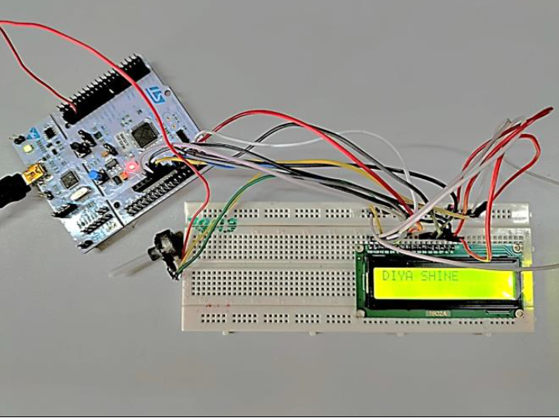
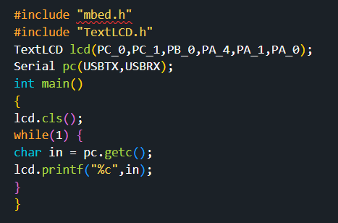
LAB TASK-2
Program
Output
LAB - 5
ECE4003-Embedded System Design Lab
12

Slide 13
LAB TASK-3
Display a POT value on the LCD
Write a program to display the potentiometer value with 4 decimal places on the LCD display on row-1 5th position. Assume LCD operates in 4 bit with EN and RS active state. Design and verify this logic on Nucleo 152RE board using online Keil Studio Platform
LAB - 5
ECE4003-Embedded System Design Lab
13

Slide 14
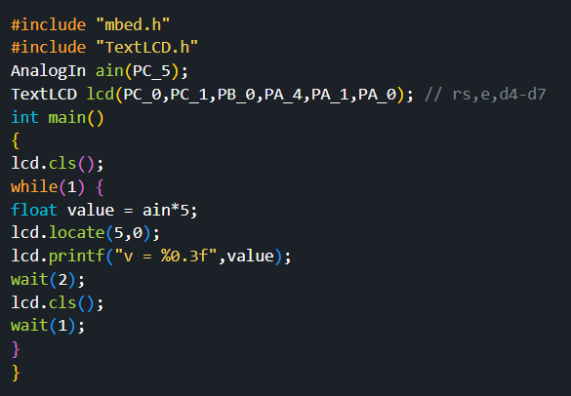
LAB TASK-3
Program to display POT Value
LAB - 5
ECE4003-Embedded System Design Lab
14

Slide 15
THANK YOU
by
prakash v

