Slide 1
INTRODUCTION TO SERVO MOTOR
A Servo Motor is a type of actuator that provides high precision control of linear or angular position.
A simple servo motor consists of a small DC motor, a potentiometer for providing position feedback, a gear system for increased torque and a control system.
Servo Motors are used in applications where very high precision motion is required like assembly robots, security cameras, solar tracking system etc.
Typically, simple servo motors consists of three wires, colour coded as Red(supply), Brown(ground) and Orange (control signal).
LAB - 6
BECE403E-Embedded System Design Lab
1

Slide 2
INTRODUCTION TO SERVO MOTOR
A servo motor is controlled by sending a series of pulses through the signal line. The frequency of the control signal should be 50Hz or a pulse of 20ms.
The control signal is usually a PWM signal, unlike PWM signal used to control the speed of DC Motor, it is used to determine the position of the servo motor and these type of servos can usually rotate 180 degrees
The DC Motor in servo motor is powered as per the control signal it receives.
As per the feedback from the position sensing system (potentiometer), when the servo achieves the desired position, the power to the motor is terminated.
LAB - 6
BECE403E-Embedded System Design Lab
2

Slide 3
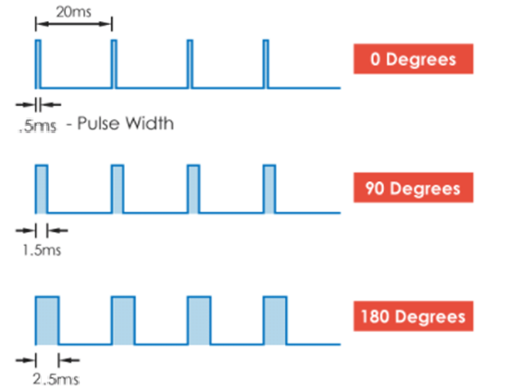
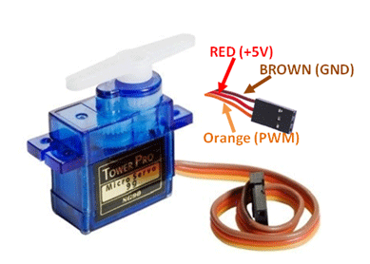
INTRODUCTION TO SERVO MOTOR
Generally pulses with 1ms duration correspond to 0° degrees position, 1.5ms duration to 90° and 2.5ms to 180° (may vary with different models) .
LAB - 6
BECE403E-Embedded System Design Lab
3

Slide 4
LAB TASK-1
Controlling the servo motor at one degree at a time
Write a program to control the servo motor by rotating slowly from 0 degrees to 180 degrees, 45 degree at a time. When the motor has to be rotated 180 degrees, it will return to the initial position. Implement and verify this logic on STM32 board.
LAB - 6
BECE403E-Embedded System Design Lab
4

Slide 5
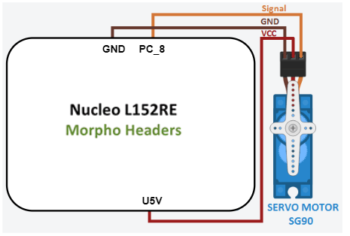
#include "mbed.h"
PwmOut PWM1(PC_8);
int main() {
while(1){
PWM1.period_ms(20);
PWM1.pulsewidth_us(500);
wait(1);
PWM1.pulsewidth_us(1000); // 45 degree
wait(1);
PWM1.pulsewidth_us(1500); // 90 degree
wait(1);
PWM1.pulsewidth_us(2000); // 135 degree
wait(1);
PWM1.pulsewidth_us(2500); // 180 degree
wait(1);
}
}
LAB TASK-1
Connection diagram
Program
LAB - 6
BECE403E-Embedded System Design Lab
5

Slide 6
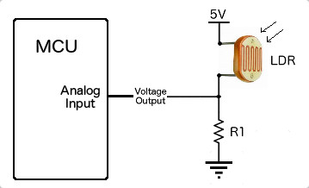
INTRODUCTION TO LDR
Light Dependent Resistor (LDR) or Photoresistor, is a passive electronic component, basically a resistor which has a resistance that varies depending of the light intensity.
The resistance is very high in darkness but when there is light that falls on the LDR, the resistance is falling down to low value.
LDRs are very useful in many electronic circuits, especially in alarms, switching devices, clocks, street lights and more.
LAB - 6
BECE403E-Embedded System Design Lab
6

Slide 7
LAB TASK-2
Auto intensity street light controller
Write a program to design auto intensity street light controller. This system helps the street light to get switched on automatically as per surrounding brightness. For example, sometimes when the weather become hazy its quite difficult to see anything then at that point this auto intensity street light gets switched on based on present lighting condition. Implement and verify this logic on STM32 board..
LAB - 6
BECE403E-Embedded System Design Lab
7

Slide 8
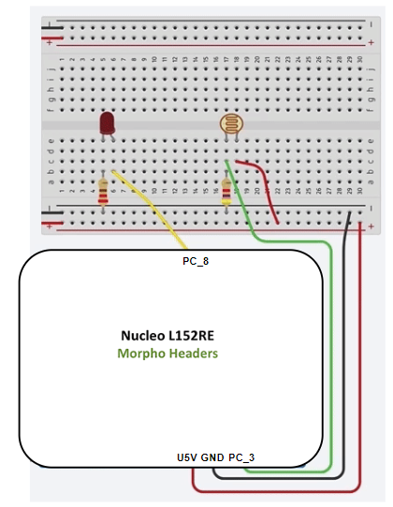
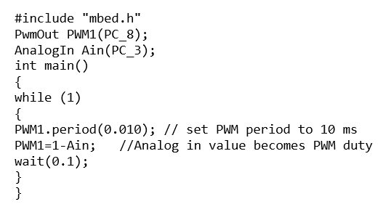
LAB TASK-2
Program
Connection diagram
LAB - 6
BECE403E-Embedded System Design Lab
8

Slide 9
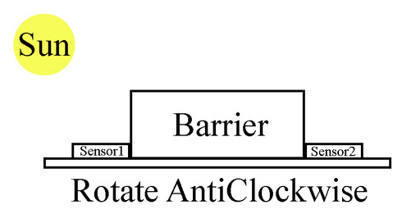
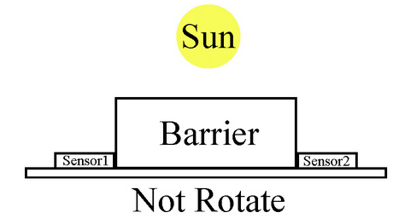
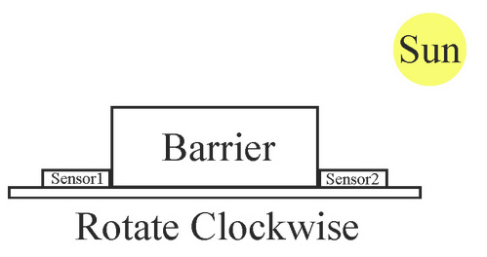
CHALLENGING TASK
Solar tracking system
Write a program to design a solar tracking system for harvesting solar energy efficiently by the solar panels. This system is constructed by fitting two LDRs, angled away from each other by around 90, to a servo. Continuously read the light value sensed by the two LDRs and rotates the servo so that each is receiving equal light. As a sun-tracking system will be located to track the sun from sunrise to sunset, i.e. not more than 180. Also, display both LDR values and present Servo motor position on LCD. Implement and verify this logic on STM32 board.
LAB - 6
BECE403E-Embedded System Design Lab
9

