Slide 1
BECE403E-Embedded System Design Lab
LAB-7
Working with Ultrasonic Sensor
LAB - 7
BECE403E-Embedded System Design Lab
1

Slide 2
INTRODUCTION TO ULTRASONIC SENSOR
An ultrasonic sensor is an electronic device that measures the distance of a target object by emitting ultrasonic sound waves, and converts the reflected sound into an electrical signal.
Ultrasonic sensors have two main components:
Transmitter (which emits the sound using piezoelectric crystals)
Receiver (which encounters the sound after it has travelled to and from the target).
In order to calculate the distance between the sensor and the object, the sensor measures the time it takes between the emission of the sound by the transmitter to its contact with the receiver.
The formula for this calculation is D = ½ T x C (where D is the distance, T is the time, and C is the speed of sound ~ 343 meters/second).
LAB - 7
BECE403E-Embedded System Design Lab
2

Slide 3
INTRODUCTION TO ULTRASONIC SENSOR
Ultrasonic sensors are used primarily as proximity sensors.
They can be found in automobile self-parking technology, anti-collision safety systems, robotic obstacle detection systems also used as level sensors to detect, monitor, and regulate liquid levels in closed containers.
The HC-SR04 ultrasonic sensor offers excellent non-contact range detection with high accuracy and stable readings from 2 cm to 400 cm.
It comes complete with ultrasonic transmitter and receiver module.
The HC-SR04 Ultrasonic Module has 4 pins, Ground (Gnd), VCC (5V) , Trig and Echo. The trig and echo pins to any Digital I/O pin on the Nucleo Board.
LAB - 7
BECE403E-Embedded System Design Lab
3

Slide 4
INTRODUCTION TO ULTRASONIC SENSOR
Steps involved in measuring distance using HC-SR04 Ultrasonic module are,
Transmit trigger pulse of at least 10 us to the HC-SR04 Trig Pin.
Then the HC-SR04 automatically sends Eight 40 kHz sound wave and generate the rising edge at Echo pin.
When the rising edge capture occurs at Echo pin, start the Timer and wait for falling edge on Echo pin.
As soon as the falling edge is captured at the Echo pin, read the count of the Timer. This time count is the time required by the sensor to detect an object and return back from an object (to and from).
LAB - 7
BECE403E-Embedded System Design Lab
4

Slide 5
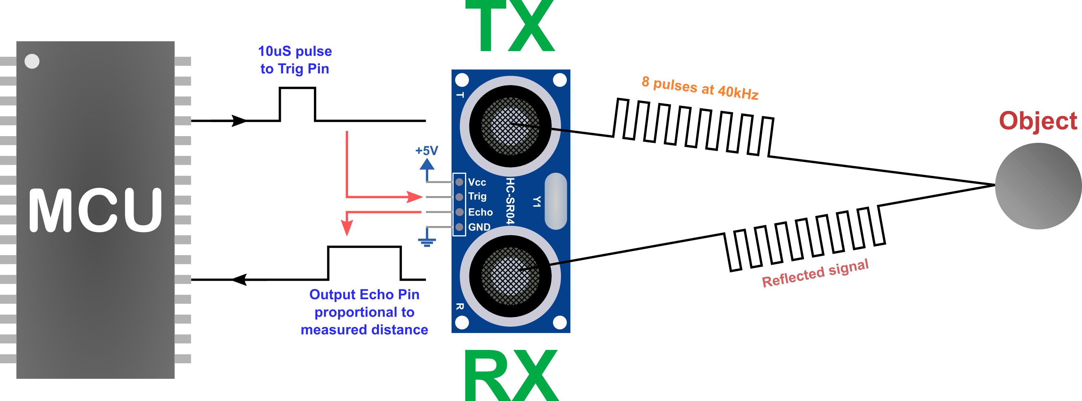
INTRODUCTION TO ULTRASONIC SENSOR
LAB - 7
BECE403E-Embedded System Design Lab
5

Slide 6
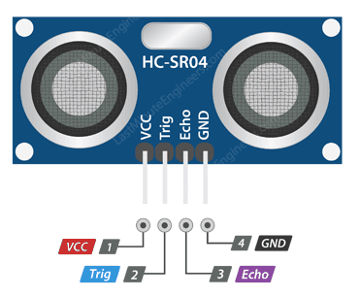
INTRODUCTION TO ULTRASONIC SENSOR
Distance = (Speed x Time)/ 2
Distance = (0.034 cm/µs x 500 µs) / 2
Distance = 8.5 cm
When no obstacles then timeout after 38ms
When obstacle detected pulse width of 50 µS to 25 mS received
LAB - 7
BECE403E-Embedded System Design Lab
6

Slide 7
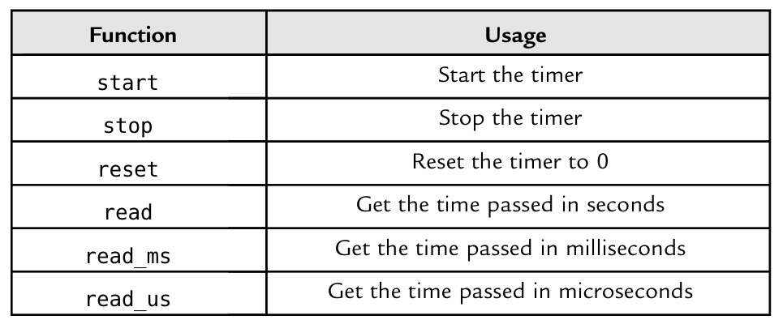
INTRODUCTION TO ULTRASONIC SENSOR
API Required – TIMER
LAB - 7
BECE403E-Embedded System Design Lab
7

Slide 8
LAB TASK-1
Read the distance value from HC-SR04 and print it on serial monitor
Write a program to read distance value from HC-SR04 ultrasonic sensor module in cm and print it on the serial monitor. Implement and verify this logic on the STM32 Nucleo-64 board using Keil Studio Cloud IDE.
LAB - 7
BECE403E-Embedded System Design Lab
8

Slide 9
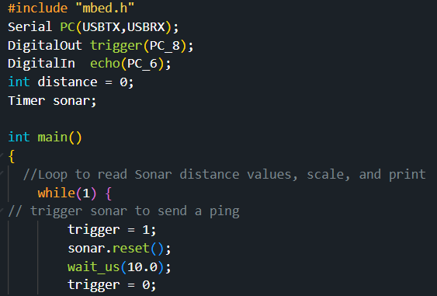
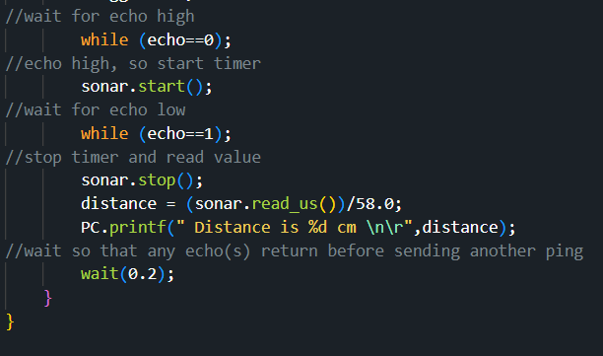
LAB TASK-1
Program
LAB - 7
BECE403E-Embedded System Design Lab
9

Slide 10
LAB TASK-2
Reverse parking sensor module (Exercise)
Write a program to design a reverse parking sensor module. This module consist of HC-SR04 ultrasonic sensor, LCD and buzzer interfaced with Nucleo. The ultrasonic sensor continuously measure the distance (in cm) between the car and obstacle, then display it on the first row of the LCD. Whenever the measured distance is lesser than 30cm generate warning signal to driver using buzzer also display a message “Obstacle !!!” on the second row of the LCD display. Implement and verify this logic on the STM32 Nucleo-64 board using Keil Studio Cloud IDE.
LAB - 7
BECE403E-Embedded System Design Lab
10

Slide 11
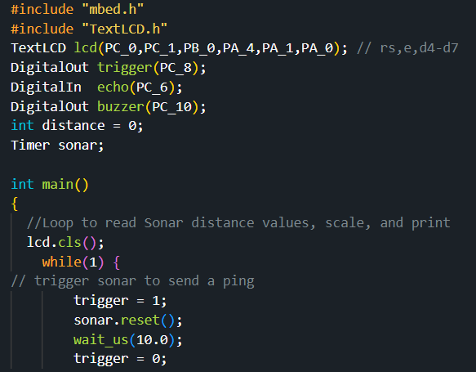
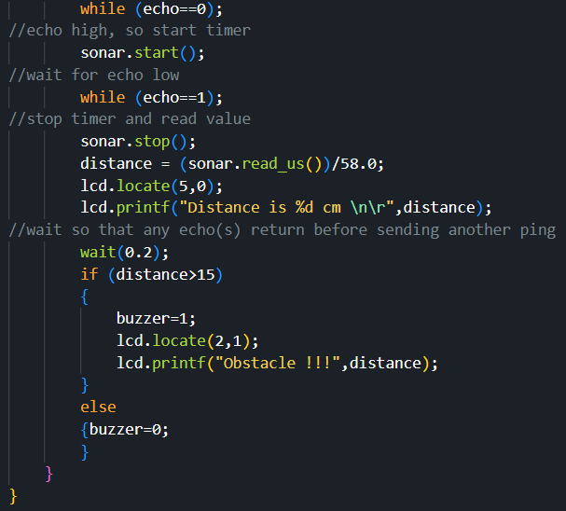
LAB TASK-2
Program
LAB - 7
BECE403E-Embedded System Design Lab
11

Slide 12
CHALLENGING TASK
Smart Parking system
Write a program to design smart parking system using HC-SR04 ultrasonic sensor, servo motor, buzzer, LCD and STM32 Nucleo-64 board.
The ultrasonic sensor module place near the gate entrance continuously check for the incoming vehicles. The LCD display “Smart Parking” on the first row and “Avail. slot: XY” in second row of the display.
When a vehicle comes closer to the ultrasonic sensor detection area and parking slot is available then the system open a gate barrier to 90° (close after 10 seconds) to allow the vehicle enter into the parking slot and decrement parking slot by 1.
If no parking slot available then display a message “No Parking slot” on LCD (2nd line) and switch on the buzzer (for 5 Seconds). Have a similar system on the exit and increment the free slot by 1 for every vehicle leaves the parking slot.
Simulate and verify this logic on Nucleo using Tinkercad circuits simulator.
Note: XY is number of available slot and initially assume total available parking slot is 5.
LAB - 7
BECE403E-Embedded System Design Lab
12

Slide 13
THANK YOU
by
prakash v

