Slide 1
BECE403E-Embedded System Design Lab
LAB-8
Working with SPI
LAB-8
BECE403E-Embedded System Design Lab
1

Slide 2
SERIAL PERIPHERAL INTERFACE
SPI (Serial Peripheral Interface) is a serial communication protocol
SPI is synchronous serial communication means the clock is required for communication purpose.
SPI has a full duplex connection, which means that the data is sent and received simultaneously between Master and Slave devices.
A SPI has a master/Slave communication by using four lines and it can have only one master and can have multiple slaves.
A master is usually a microcontroller and the slaves can be a another microcontroller, sensors, ADC, DAC, LCD etc.
LAB-8
BECE403E-Embedded System Design Lab
2

Slide 3
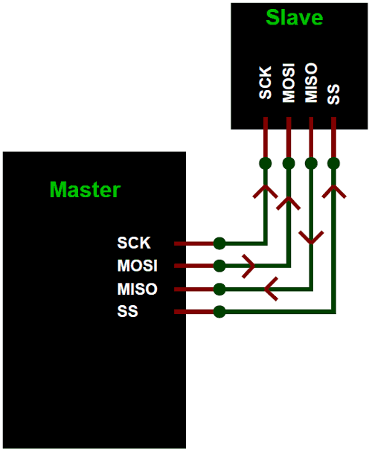
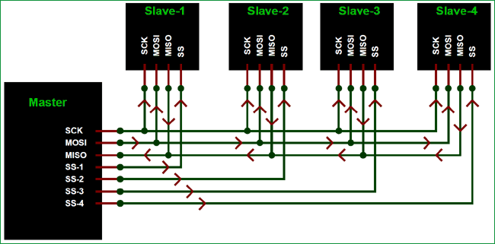
SERIAL PERIPHERAL INTERFACE
SPI has following four lines MISO, MOSI, SS, and CLK
MISO (Master in Slave Out) - The Slave line for sending data to the master.
MOSI (Master Out Slave In) - The Master line for sending data to the peripherals.
SCK (Serial Clock) - The clock pulses which synchronize data transmission generated by the master.
SS (Slave Select) –Master can use this pin to enable and disable specific devices.
LAB-8
BECE403E-Embedded System Design Lab
3

Slide 4
SERIAL PERIPHERAL INTERFACE
To start communication between master and slave set the required device's Slave Select (SS) pin to LOW, so that it can communicate with the master.
When it's high, it ignores the master. This allows you to have multiple SPI devices sharing the same MISO, MOSI, and CLK lines of master.
In SPI Master-Salve configuration SCK, MISO, MOSI are common connected to master and the SS of each slave is connected separately to individual SS pins (SS1, SS2, SS3) of master.
By setting the required SS pin LOW a master can communicate with that slave.
LAB-8
BECE403E-Embedded System Design Lab
4

Slide 5
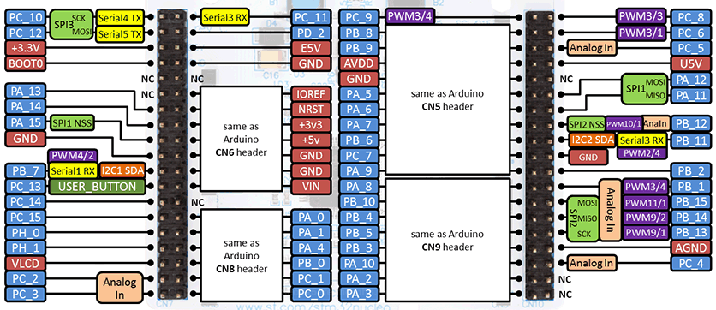
SPI IN MBED
NucleoL152RE has three SPI Interface and default settings of SPI interface is: –Default clock frequency of 1 MHz
–Default data length of 8 bits
–Default mode of 0
Refer. URL for detailed pin details of CN7 & CN10 headers :https://os.mbed.com/platforms/ST-Nucleo-L152RE/
LAB-8
BECE403E-Embedded System Design Lab
5

Slide 6
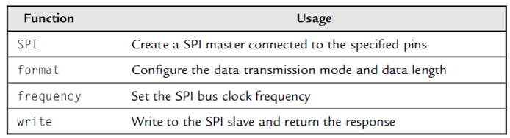
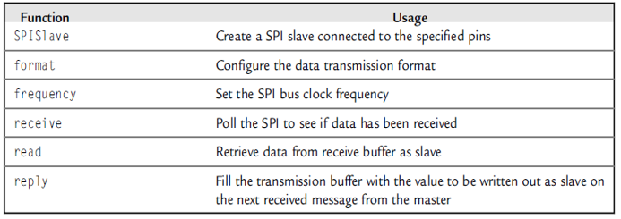
SPI IN MBED
The mbed SPI master library functions are shown in the table below:
The mbed SPI slave library functions are shown in the table below:
LAB-8
BECE403E-Embedded System Design Lab
6

Slide 7
LAB TASK-1
Read the input from Master and display on Slave
Write a program to implement a SPI communication between two Nucleo boards. Configure one of the Nucleo as master and other as slave. Establish a SPI communication between master and slave display each key press on the master’s Teraterm to the slave Teraterm terminal. Design and implement this logic on the STM 32 Nucleo L152RE board using Keil studio could platform.
LAB-8
BECE403E-Embedded System Design Lab
7

Slide 8
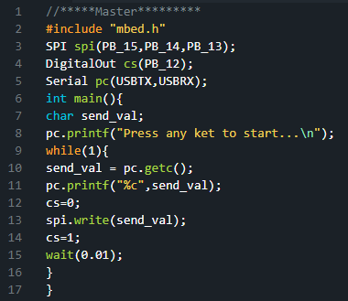
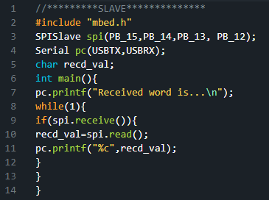
LAB TASK-1
Program (Master)
Program (Slave)
LAB-8
BECE403E-Embedded System Design Lab
8

Slide 9
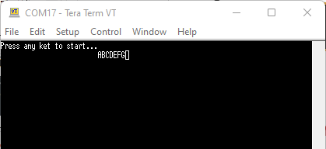
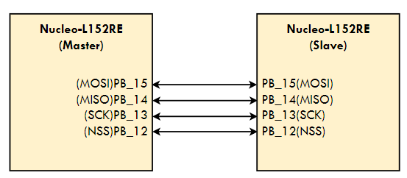
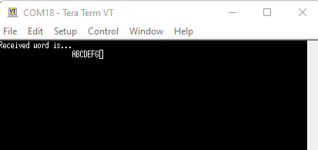
LAB TASK-1
Output (Master)
Connection Diagram
Output (Slave)
LAB-8
BECE403E-Embedded System Design Lab
9

Slide 10
LAB TASK-2
Exchange of button press state between Master and Slave
Write a program to implement a SPI communication between two Nucleo boards. Configure one of the Nucleo as master and other as slave. Both Nucleo are attached with a LED & a push button separately. Master LED can be controlled by using slave Nucleo’s push button and slave Nucleo’s LED can be controlled by master Nucleo’s push button using SPI communication protocol. Design and implement this logic on the STM 32 Nucleo L152RE board using Keil studio could platform.
LAB-8
BECE403E-Embedded System Design Lab
10

Slide 11
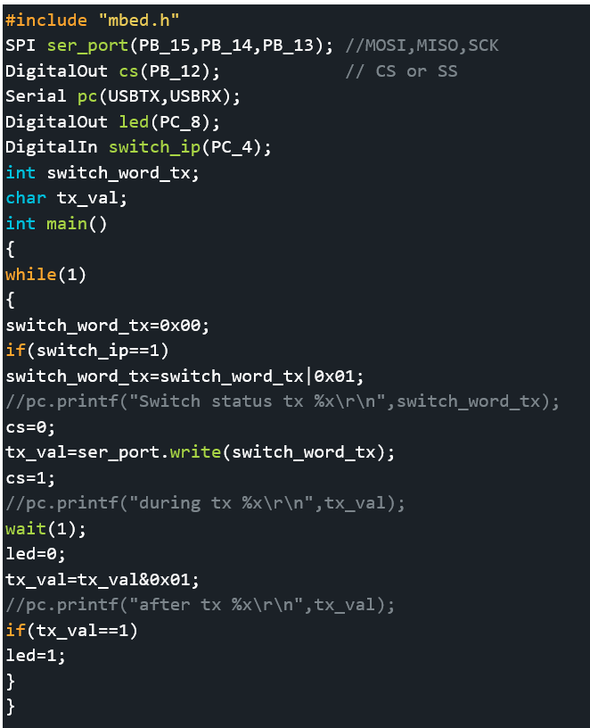
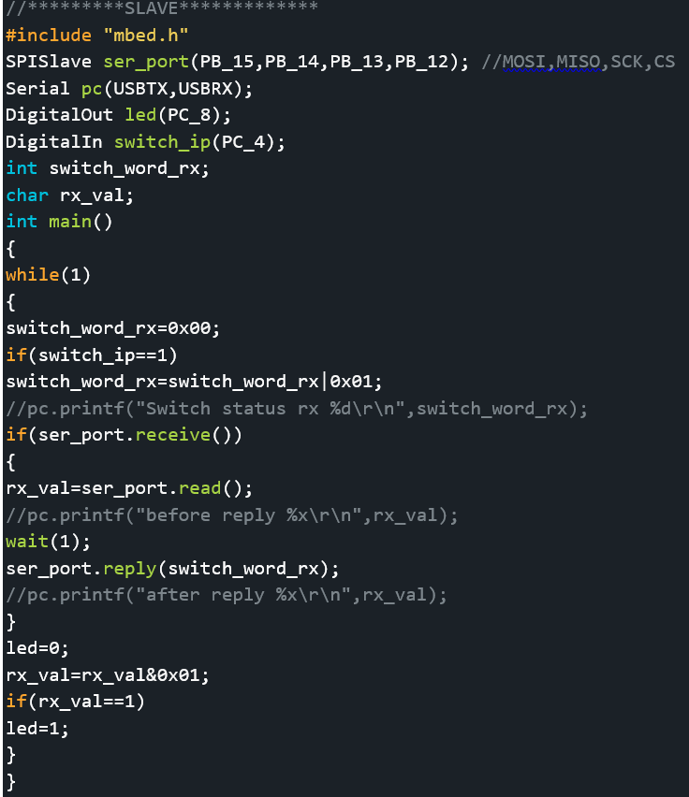
LAB TASK-2
Program (Master)
Program (Slave)
LAB-8
BECE403E-Embedded System Design Lab
11

Slide 12
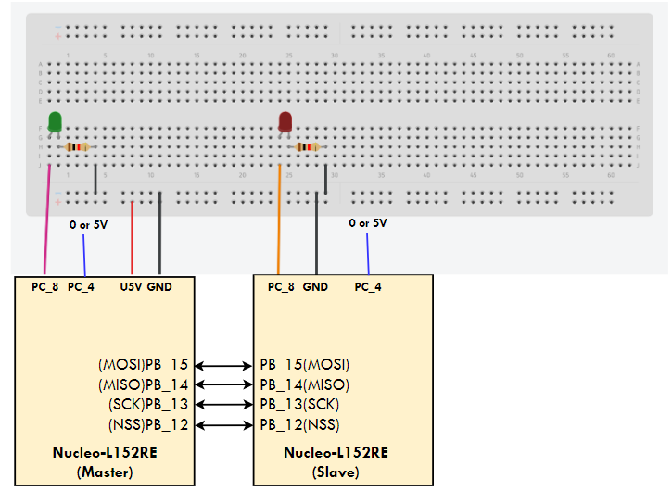
LAB TASK-2
Connection Diagram
LAB-8
BECE403E-Embedded System Design Lab
12

Slide 13
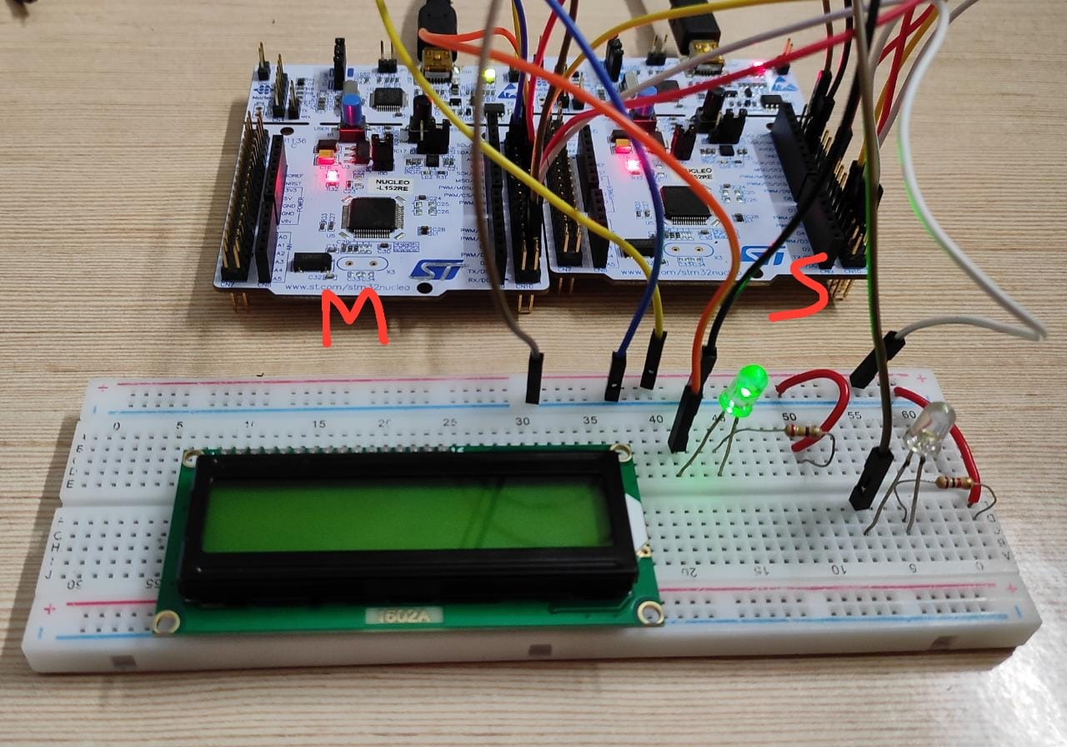
LAB TASK-2
Output (Master switch is Low and Slave switch is High)
LAB-8
BECE403E-Embedded System Design Lab
13

Slide 14
CHALLENGING TASK
Read temperature sensor value of slave and display on master LCD
Write a program to implement a SPI communication between two STM32 Nucleo boards. Configure one of the Nucleo board as master and other as slave. Master Nucleo board connected with LCD and Nucleo board connected with temperature sensor LM35. Transfer temperature value read by slave to master and display it on LCD using SPI communication protocol. Design and implement this logic on the STM 32 Nucleo L152RE board using Keil studio could platform.
LAB-8
BECE403E-Embedded System Design Lab
14

Slide 15
THANK YOU
by
prakash v

