Slide 1
BECE403E-Embedded System Design Lab
LAB-9
Working with BLUETOOTH HC-05
LAB - 7
BECE403E-Embedded System Design Lab
1

Slide 2
INTRODUCTION TO BLUETOOTH MODULE HC-05
Bluetooth low energy (BLE) is a low power wireless technology standard for personal area networks.
BLE, unlike the classic Bluetooth standard, reduces power consumption, allowing your BLE device to run for months or years on a coin-cell battery.
Typical applications of BLE are health care, fitness trackers, beacons, smart home, security, entertainment, proximity sensors, industrial and automotive.

Slide 3
INTRODUCTION TO BLUETOOTH MODULE HC-05
HC-05 Bluetooth Module is a simple Wireless Communication device based on the Bluetooth Protocol.
This module is based on BC417 Single Chip Bluetooth IC that is compliant with Bluetooth v2.0 standard and with support for both UART and USB interfaces.
It communicates with microcontrollers using serial communication (USART).
Bluetooth Module, generally, four pins are sufficient for successfully enabling a wireless communication link but the modules produced now-a-days come with six pins namely: VCC, GND, TX, RX, EN and STATE.
LAB - 7
BECE403E-Embedded System Design Lab
3

Slide 4
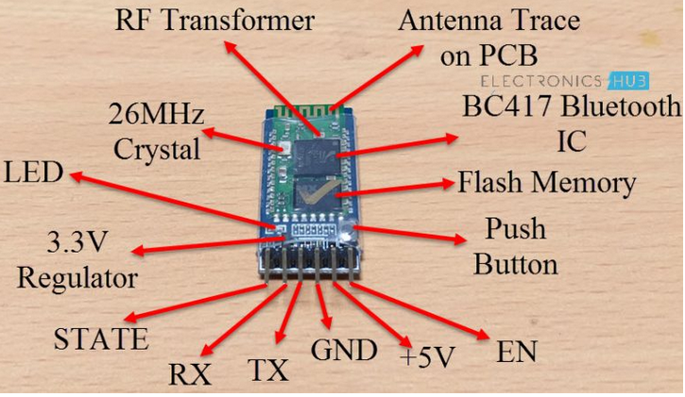
INTRODUCTION TO ULTRASONIC SENSOR
LAB - 7
BECE403E-Embedded System Design Lab
4

Slide 5
INTRODUCTION TO BLUETOOTH MODULE HC-05
EN: It is the enable pin. When this pin is floating or connected to 3.3V, the module is enabled. If this pin is connected to GND, the module is disabled.
+5V: This is the supply pin for connecting +5V. As the Module has on-board 3.3V regulator, you can provide +5V supply.
GND: It is the ground pin.
TX: It is the Transmitter pin of the UART Communication.
RX: It is the Receive Pin of UART.
STATE: This is a status indicator pin. This pin goes LOW when the module is not connected to any device. When the module is paired with any device, this pin goes HIGH.
Note: The on-board LED is used to indicate the status of the connection. When the module is not paired, the LED blinks or flashes repeatedly. Once the module is paired, the LED blinks at a constant delay of 2 seconds.
LAB - 7
BECE403E-Embedded System Design Lab
5

Slide 6
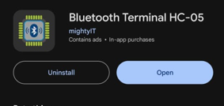
LAB TASK-1
Print name & reg.No in smart phone and serial monitor via Bluetooth
Write a program to transmit your Name and register number from serial monitor to smart phone via bluetooth HC-05 module and vice versa. Implement and verify this logic on the STM32 Nucleo-64 board using Keil Studio Cloud IDE.
Note: Download Bluetooth module-HC05 app in your smart phone
LAB - 7
BECE403E-Embedded System Design Lab
6

Slide 7
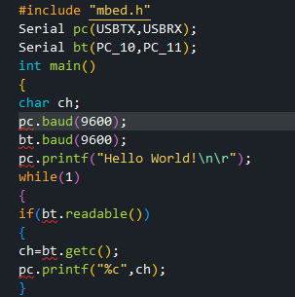
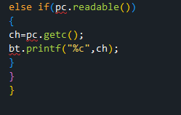
LAB TASK-1
Program
LAB - 7
BECE403E-Embedded System Design Lab
7

Slide 8
LAB TASK-2
Home Automation System
Write a program to design a Home automation system to control the home appliances through smart phone. This System consist of HC-05 Bluetooth module, LCD and buzzer interfaced with Nucleo. The system receives the input from smart phone through bluetooth app : based on the value, it controls the LED and buzzer as per the below:
If the received character is ‘1’ , LED should be ON and display the message ‘LED ON’ on serial monitor.
If the received character is ‘2’ , LED should be OFF and display the message ‘LED OFF’ on serial monitor.
LAB - 7
BECE403E-Embedded System Design Lab
8

Slide 9
LAB TASK-2
If the received character is ‘3’ , Buzzer should be ON and display the message ‘Buzzer ON’ on serial monitor.
If the received character is ‘4’ , Buzzer should be OFF and display the message ‘Buzzer OFF’ on serial monitor.
Implement and verify this logic on the STM32 Nucleo-64 board using Keil Studio Cloud IDE

Slide 10
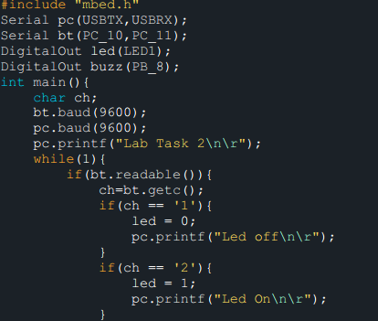
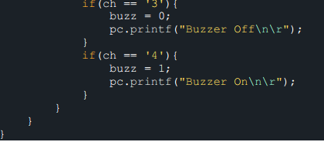
LAB TASK-2
Program
LAB - 7
BECE403E-Embedded System Design Lab
10

Slide 11
CHALLENGING TASK
Temperature sensor LM35 interfacing
Write a program to design a temperature monitoring system using LM 35 and HC-05 Bluetooth module, buzzer and STM32 Nucleo-64 board.
Read the temperature continuously from LM35 temperature sensor and display it on smart phone
When the temperature goes above 35 C, turn on the buzzer.
Design and verify this logic on Nucleo 152RE board using online Keil Studio platform.
LAB - 7
BECE403E-Embedded System Design Lab
11

Slide 12
THANK YOU

