Slide 1
Week - 1
Introduction to Verilog coding
Introduction to INTEL Quartus Prime tool and ModelSim for simulation
Task:
Write a Verilog code to verify the half adder and full adder circuits.
Write a test bench to simulate the above.

Slide 2
Week - 2
Tool flow and demo for implementation in Altera DE2 board.
Task
Write a Verilog code for 4-bit Ripple Carry Adder using Full Adder instances in behavioral modelling.
Implement the same and verify the output using Altera DE2 board.

Slide 3
Week - 3
Task - 1
Write a Verilog code for 4*4 Array multiplier with AND gates, Half Adder and Full Adder instances in behavioral modelling.
Implement the same and verify the output using Altera DE2 board.
Task – 2
Write a Verilog code for Quadrable 2 x 1 Multiplexer in behavioral modelling.
Implement the same and verify the output using Altera DE2 board.

Slide 4
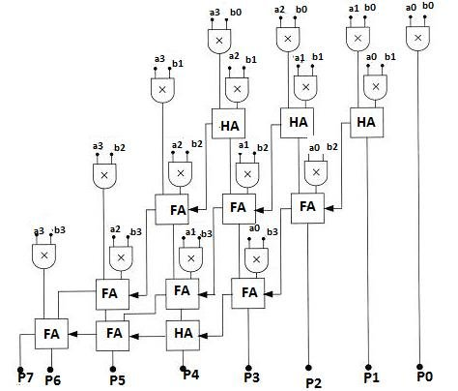
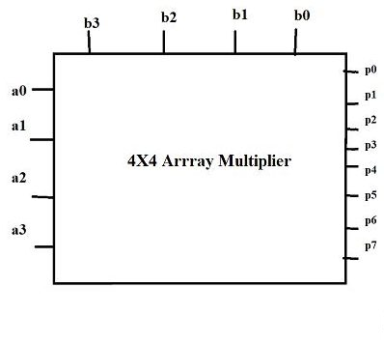
4*4 Array Multiplier

Slide 5
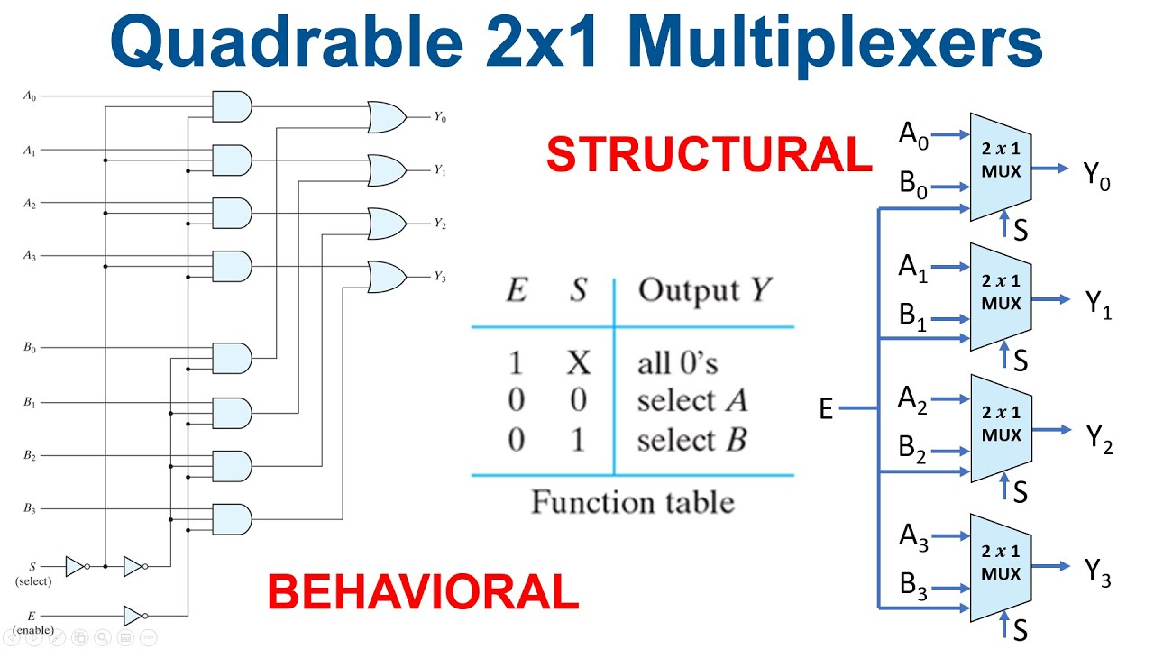

Slide 6
Week - 4
Task - 1
Write a Verilog code for 8-bit Carry Lookahead Adder in behavioral modelling.
Implement the same and verify the output using Altera DE2 board.
Task - 2
Write a Verilog code to display BCD numbers (0-9) using 7-segment LED display available in Altera DE2 board.
Task – 3
Write a Verilog code to add two decimal numbers (0-9) and display the output as BCD using 7-segment LED display available in Altera DE2 board.

Slide 7
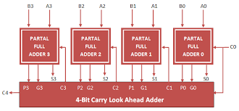
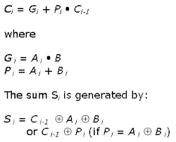
Depth-4 carry-lookahead

Slide 8
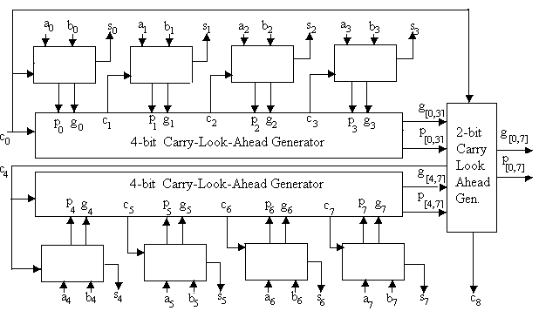
Depth-8 carry-lookahead

Slide 9
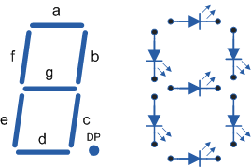
Seven Segment Display
Common anode
LED will glow if we give logic 0 to the segment
logic 0 is for enable or logic 1 is for disable the seven segment display

Slide 10
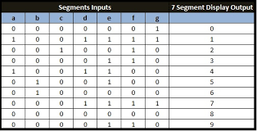
Truth Table

Slide 11
Verilog Code
module bcd7segmentBehavioral(
input [3:0] bcd,
output reg [6:0] seg);
always @ (bcd)
begin
case(bcd)
0: seg = 7'b100_0000;
1: seg = 7'b111_1001;
2: seg = 7'b010_0100;
3: seg = 7'b011_0000;
4: seg = 7'b001_1001;
5: seg = 7'b001_0010;
6: seg = 7'b000_0010;
7: seg = 7'b111_1000;
8: seg = 7'b000_0000;
9: seg = 7'b001_0000;
default: seg=7'b111_1111;
endcase
end
endmodule

Slide 12
BCD ADDER
BCD stands for binary coded decimal.
It is used to perform the addition of BCD numbers.
A BCD digit can have any of ten possible four-bit representations.
Suppose, we have two 4-bit numbers A and B.
The value of A and B can vary from 0(0000 in binary) to 9(1001 in binary) because we are considering decimal numbers.

Slide 13
BCD ADDER
module bcd_adder(
a,b,carry_in,sum,sum_temp,carry);
input [3:0] a,b;
input carry_in;
output reg [3:0] sum, sum_temp;
output reg carry;
always @(a,b,carry_in)
begin
sum_temp = a+b+carry_in;
if(sum_temp > 9)
begin
sum_temp = sum_temp+6;
carry = 1;
sum = sum_temp[3:0];
end
else
begin
carry = 0;
sum = sum_temp[3:0];
end
end
endmodule

Slide 14
Write a Verilog code to add two decimal numbers (0-9) along with carry and display the output as BCD using 7-segment LED display available in Altera DE2 board.
num1
sum[3:0]
sum
7-SEGMENT DISPLAY
BCD ADDER
num2
carry
carry out
7-SEGMENT DISPLAY
carry out

Slide 15
WEEK-5
Implement 4-bit up counter in Altera DE2 FPGA board.
Simulation of 4-bit counter using behavioral modeling
Simulation of clock divider to generate slow_clock (50M) for ALTERA DE2 FPGA board

Slide 16
module counter(clk, reset,count);
input clk,reset;
output reg [3:0] count;
always @ (posedge clk)
begin
if (reset == 0)
count = 4'b0000;
else
count = count + 1;
end
endmodule

Slide 17
module clock_divider(clk,rst,slowclk,count);
input clk,rst;
output slowclk;
output reg[25:0]count;
always@(posedge clk)
begin
if(rst)
count =0;
else
count =count+1;
end
assign slowclk=count[25];
endmodule

Slide 18
module counter_implementation(clk,reset,count_imp);
input clk,reset;
output reg [3:0] count_imp;
wire slow_clk;
wire [25:0]count;
clock_divider uut1(clk,reset,slow_clk,count);
counter uut2(slow_clk,reset,count);
endmodule

Slide 19
WEEK-6
Write a Verilog code to implement
Full adder using Multiplexer
3:8 Decoder (structural and behavioral)
Priority Encoder (Behavioral)
Implement 4-bit up/down counter in Altera DE2 FPGA board.

Slide 20
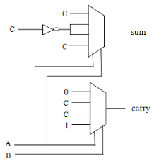
Full adder using Multiplexer

Slide 21
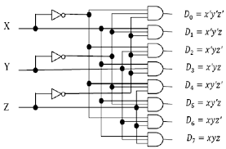
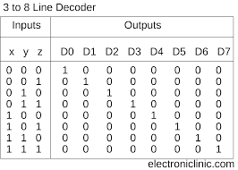
3:8 Decoder (structural and behavioral)

Slide 22
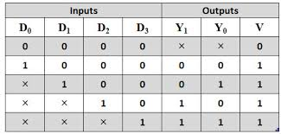
Priority Encoder

