Slide 1
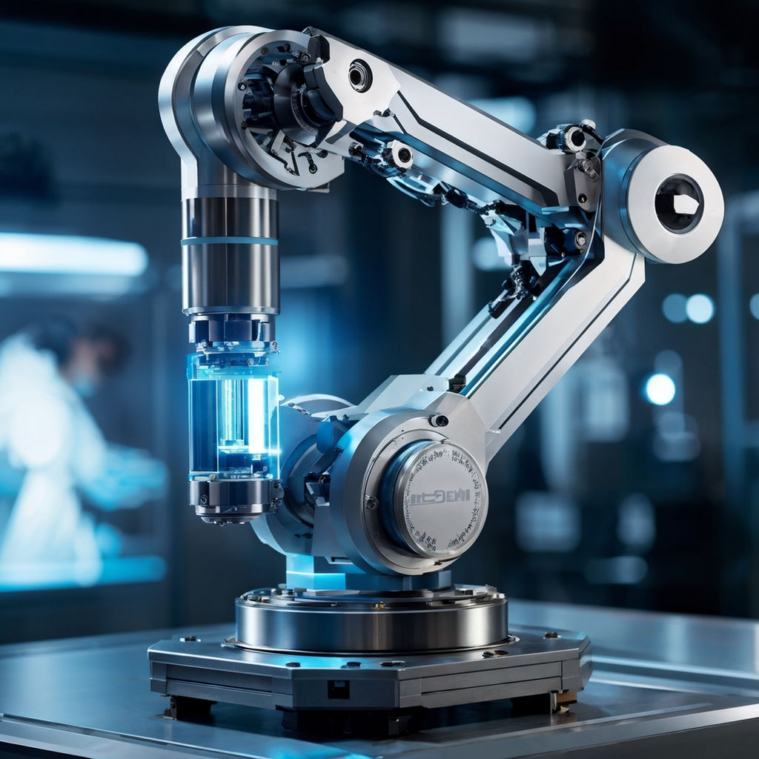

Sensors Technology
BECE409E
Module-1
Lecture 1&2:

Slide 2
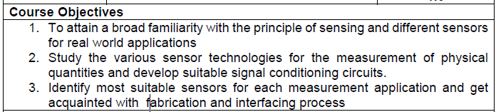
Objectives

Slide 3
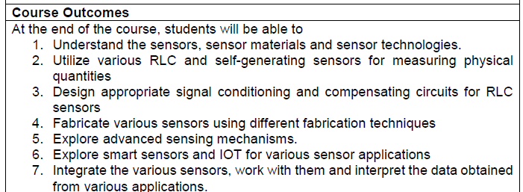
Course Outcomes

Slide 4
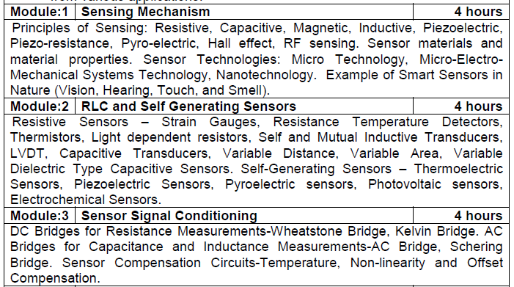
Course- modules

Slide 5
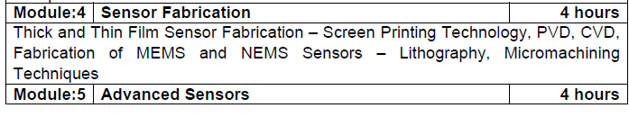
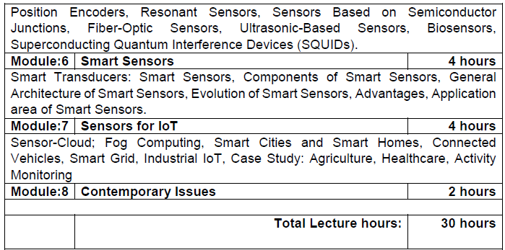
Course-modules

Slide 6
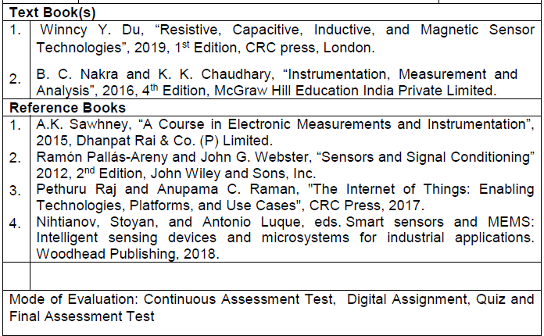
Books to follow

Slide 7
Some general statements
Sensors/actuators are common
Usually integrated in a system (never alone)
A system of any complexity cannot be designed without them
Very difficult to classify
Difficult to get good data on them
Definitions and terms are confusing

Slide 8
Definitions
What are sensors and actuators?
Why are they so difficult to classify?
Too many principles involved
Multi-discipline devices
A mix of approaches to their design
A mix of units and a range of complexities

Slide 9
Definitions - Sensors
Also called: transducer, probe, gauge, detector, pick-up etc.
Start with the dictionary:
A device that responds to a physical stimulus and transmits a resulting impulse. (New Collegiate Dictionary)
A device, such as a photoelectric cell, that receives and responds to a signal or stimulus. (American Heritage Dictionary, 3rd ed., 1996)
A device that responds to a physical stimulus (as heat, light, sound, pressure, magnetism, or a particular motion) and transmits a resulting impulse (as for measurement or operating a control) . (Webster, 3rd ed., 1999)

Slide 10
Definitions - Transducer
A device that is actuated by power from one system and supplies power usually in another form to a second system. (New Collegiate Dictionary)
A substance or device, such as a piezoelectric crystal, that converts input energy of one form into output energy of another. (from: Trans-ducere – to transfer, to lead) (American Heritage Dictionary, 3rd ed., 1996)
A device that is actuated by power from one system and supplies power usually in another form to a second system (a loudspeaker is a transducer that transforms electrical signals to sound energy) . (Webster, 3rd ed., 1999)

Slide 11
Definitions - Actuator
A mechanism for moving or controlling something indirectly instead of by hand. (New Collegiate Dictionary)
One that activates, especially a device responsible for actuating a mechanical device such as one connected to a computer by a sensor link (American Heritage Dictionary, 3rd ed., 1996)
One that actuates; a mechanical device for moving or controlling something. (Webster, 3rd ed., 1999)

Slide 12
More confusion
Transducer can mean:
sensor
actuator
transducer can be part of a sensor
sensor can be part of a transducer
Many sensors can work as actuators (duality)
Many actuators can work as sensors
What is it then? - All of the above!

Slide 13
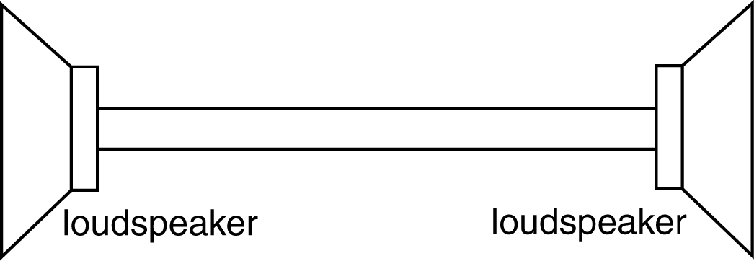
Example
Direct sensor actuator link (not always possible)
Two transduction steps (sound-electrical and vice versa)
Note: sensor/transducer are one and the same

Slide 14
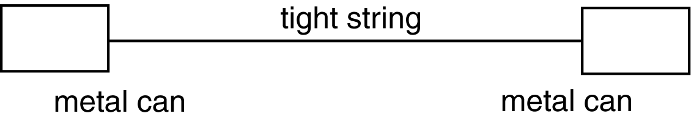
Example
Direct sensor actuator link
Two transduction steps (sound-vibration and vice versa)
What is the sensor sensor/actuator and what is the transducer?

Slide 15
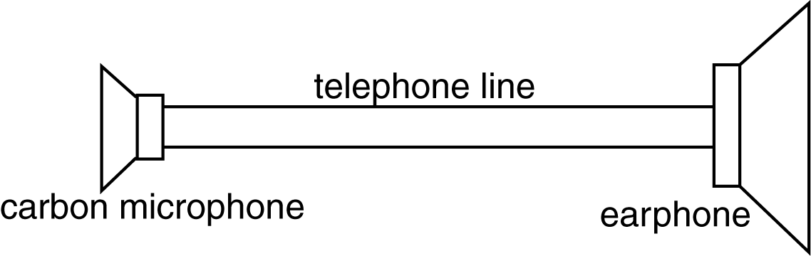
Example
Direct sensor actuator link
Does not work:
Sound is converted into change of resistance
No transduction takes place (no change of energy)!
Must add power to affect transduction
Cannot work in opposite direction either

Slide 16
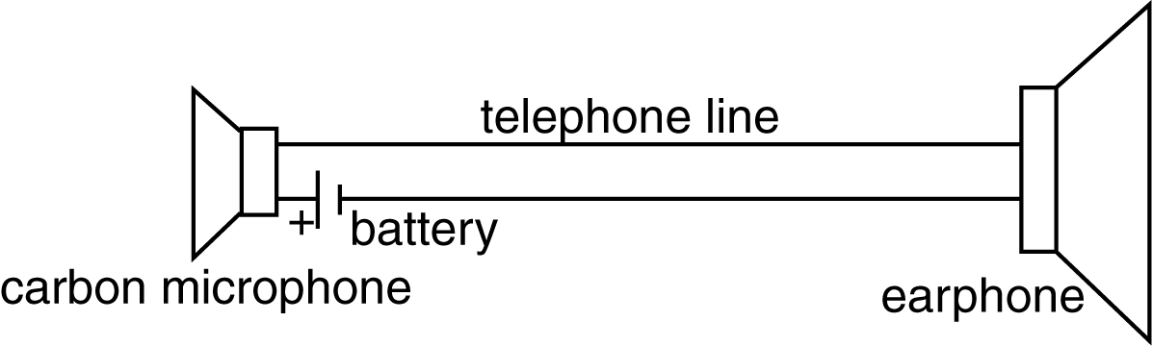
Example
Transduction: pressure to current
A telephone system has two of these!

Slide 17
Our definitions:
Sensor
A device that responds to a physical stimulus.
Transducer
A device that converts energy of one form into energy of another form.
Actuator
A device or mechanism capable of performing a physical action

Slide 18
Our definitions:
Stimulus
The quantity that is sensed.
Sometimes called the measurand.

Slide 19
Classification of Sensors and Actuators
Based on physical laws
Based on any convenient distinguishing property
Possible to a certain extent - some devices defy classification
Active and Passive sensors
Contact and non-contact sensors
Absolute and relative sensors
Other schemes

Slide 20
1. Active and passive sensors
Active sensor: a sensor that requires external power to operate. Examples: the carbon microphone, thermistors, strain gauges, capacitive and inductive sensors, etc.
Other name: parametric sensors (output is a function of a parameter - like resistance)
Passive sensor: generates its own electric signal and does not require a power source. Examples: thermocouples, magnetic microphones, piezoelectric sensors.
Other name: self-generating sensors
Note: some define these exactly the other way around

Slide 21
2. Contact and noncontact sensors
Contact sensor: a sensor that requires physical contact with the stimulus. Examples: strain gauges, most temperature sensors
Non-contact sensor: requires no physical contact. Examples: most optical and magnetic sensors, infrared thermometers, etc.

Slide 22
3. Absolute and relative sensors
Absolute sensor: a sensor that reacts to a stimulus on an absolute scale: Thermistors, strain gauges, etc., (thermistor will always read the absolute temperature)
Relative scale: The stimulus is sensed relative to a fixed or variable reference. Thermocouple measures the temperature difference, pressure is often measured relative to atmospheric pressure.

Slide 23
4. Other schemes
Classification by broad area of detection
Electric sensors
Magnetic
Electromagnetic
Acoustic
Chemical
Optical
Heat, Temperature
Mechanical
Radiation
Biological
Etc.

Slide 24
4. Other schemes (cont.)
Classification by physical law
Photoelectric
Magnetoelectric
Thermoelectric
Photoconductive
Magnitostrictive
Electrostrictive
Photomagnetic
Thermoelastic
Thermomagnetic
Thermooptic
Electrochermical
Magnetoresistive
Photoelastic
Etc.

Slide 25
4. Other schemes (cont.)
Classification by specifications
Accuracy
Sensitivity
Stability
Response time
Hysteresis
Frequency response
Input (stimulus) range
Resolution
Linearity
Hardness (to environmental conditions, etc.)
Cost
Size, weight,
Construction materials
Operating temperature
Etc.

Slide 26
4. Other schemes (cont.)
Classification by area of application
Consumer products
Military applications
Infrastructure
Energy
Heat
Manufacturing
Transportation
Automotive
Avionic
Marine
Space
Scientific
Etc.

Slide 27
Classification of actuators
All of the above
In addition:
Classification of actuators by type of motion
Linear
Rotary
One-axis
Two-axes
Three-axes
Etc.

Slide 28
Classification of actuators
Low power actuators
High power actuators
Micropower actuators
Etc.

Slide 29
Sensing and actuating strategies
Look at sensors based on broad area of detection
Discuss actuators wherever they fit with sensors
Concentrate on the major classes
Emphasize compatibility of classes of sensors and actuators.

Slide 30
Requirements for interfacing
Needs:
Matching (impedances, voltages, currents, power)
Transformations (AC/DC, DC/AC, A/D, D/A, VtoF, etc.)
Matching of specifications (temperature ranges, environmental conditions, etc.)
Alternative designs
Etc.

Slide 31
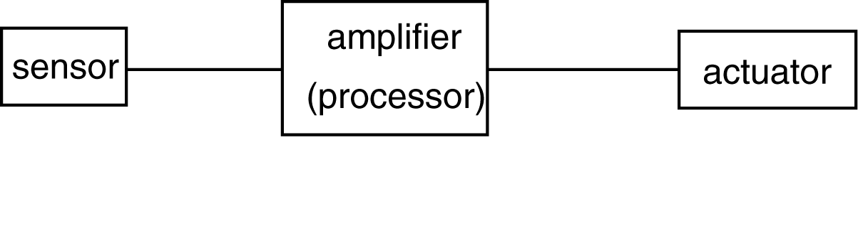
Connection of sensors/actuators
The processor should be viewed as a general block
Microprocessor
Amplifier
Driver
Etc.
Matching: between sensor/processor and processor/actuator

Slide 32
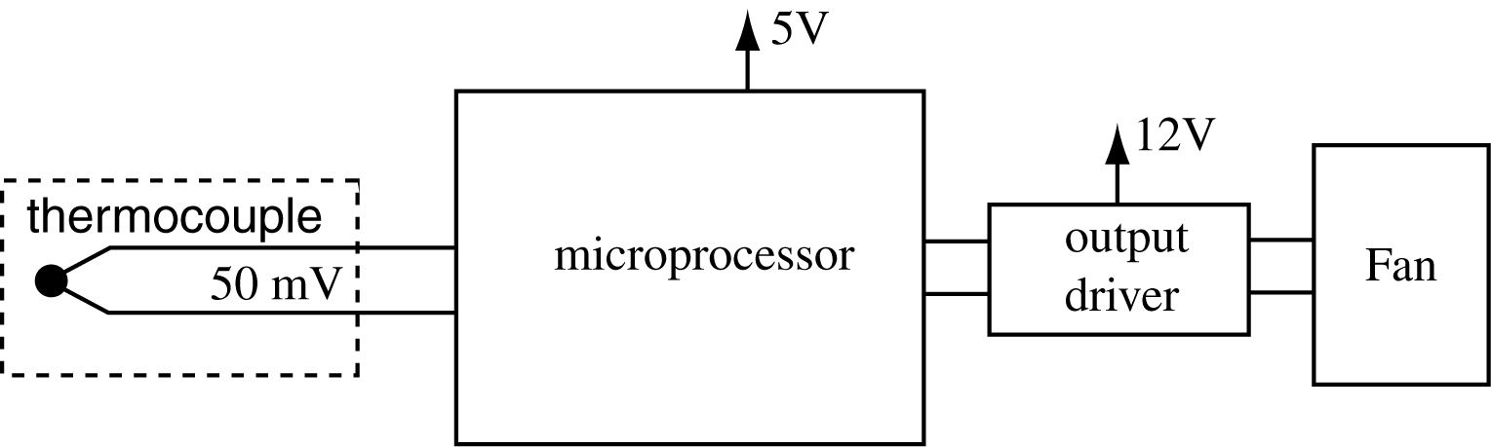
Example - Temperature control
Sense the temperature of a CPU
Control the speed of the fan to keep the temperature constant

Slide 33
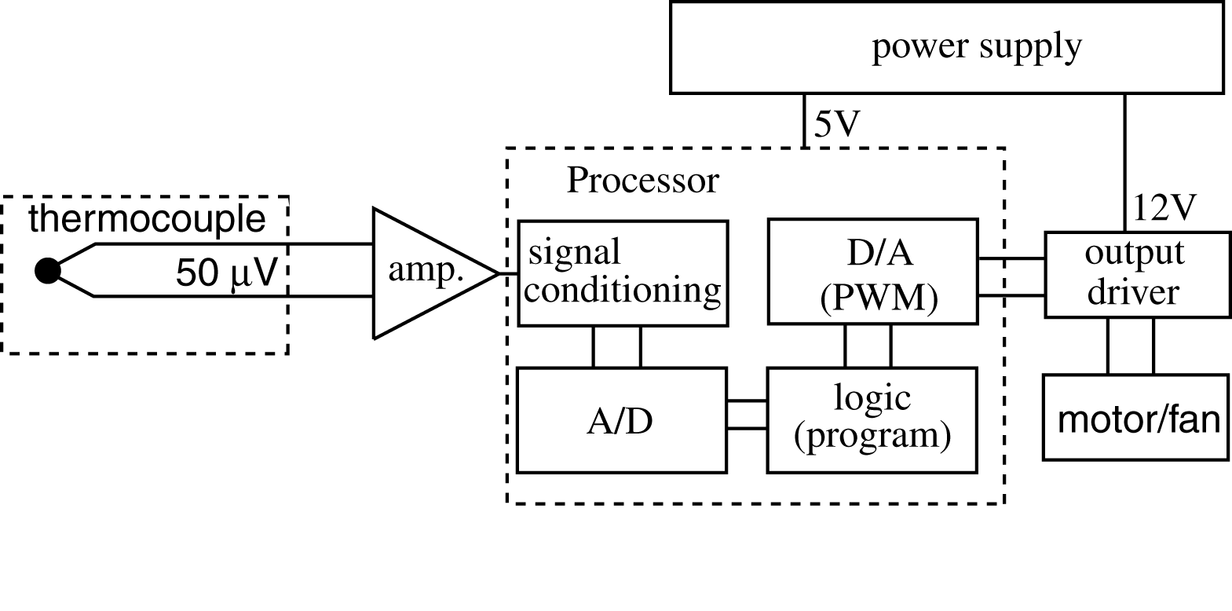
Temperature control - implementation
Sometimes the A/D and signal conditioning are separate from the processor
The whole circuitry may be integrated into a “smart sensor”
Match: impedance at input to amplifier and at processor

Slide 34
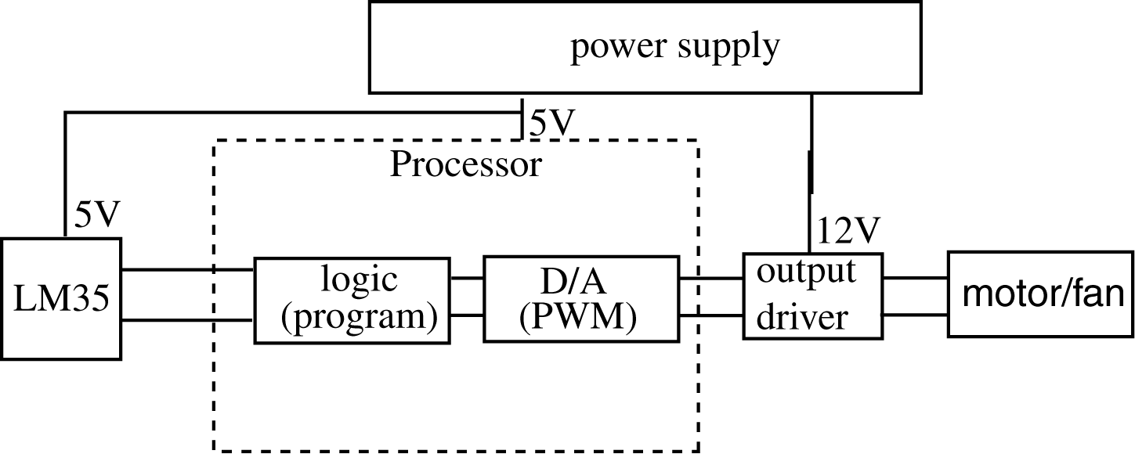
Temperature control - Alternative design
Simpler (uses an integrated sensor that contains some of the necessary circuitry). May still require an A/D
The performance of this design is not the same (range is 0-85°C while the previous design was −200 to 2000 °C or more)

Slide 35
Units
SI units in most cases
Standard units when understanding warrants it (e.g. psi for pressure)
Will avoid mixed units (a common problem in sensors and actuators)

Slide 36
Magnetic sensors
Magnetic sensors are used to detect magnetic fields in the form of flux, strength and directions.
So far, different types of magnetic sensors such as Hall sensors, semiconducting magnetoresistors, ferromagnetic magnetoresistors, fluxgate sensors, superconducting quantum interference device (SQUID), resonant sensors, Eddy current sensors, etc., have been developed for different applications.

Slide 37
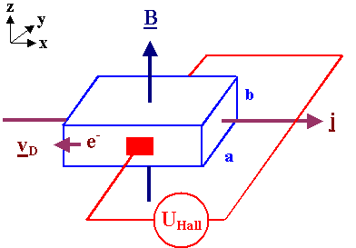
Hall Effect
The Hall effect is the production of a voltage difference (the Hall voltage) across an electrical conductor, transverse to an electric current in the conductor and to an applied magnetic field perpendicular to the current.

Slide 38
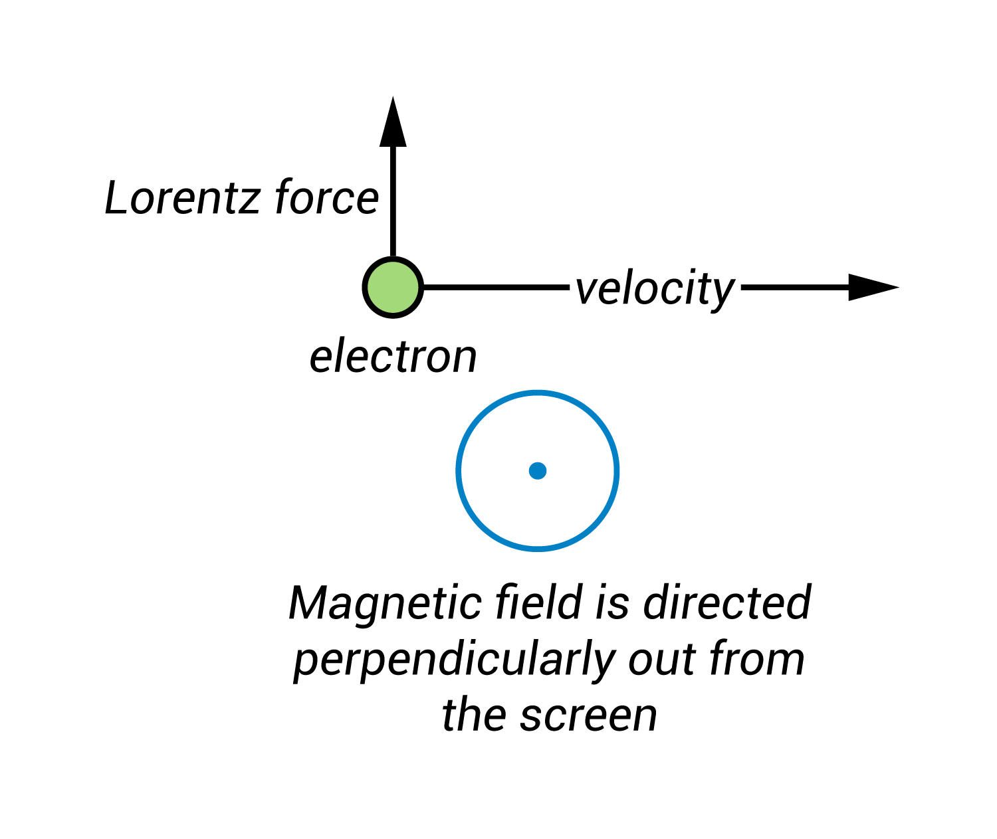
From Lorentz to Hall
The Hall effect is an extension of the Lorentz force, which describes the force exerted on a charged particle—such as an electron—moving through a magnetic field.
If the magnetic field is oriented perpendicular to the direction of the electron’s motion, the electron experiences a force that is perpendicular to both the direction of motion and the orientation of the magnetic field

Slide 39
Hall effect sensors
Hall effect was discovered in 1879 by Edward H. Hall
Exists in all conducting materials
Is particularly pronounced and useful in semiconductors.
One of the simplest of all magnetic sensing devices
Used extensively in sensing position and measuring magnetic fields

Slide 40
Materials
The key factor determining sensitivity of Hall effect sensors is high electron mobility. As a result, the following materials are especially suitable for Hall effect sensors:
gallium arsenide (GaAs)
indium arsenide (InAs)
indium phosphide (InP)
indium antimonide (InSb)
graphene

Slide 41
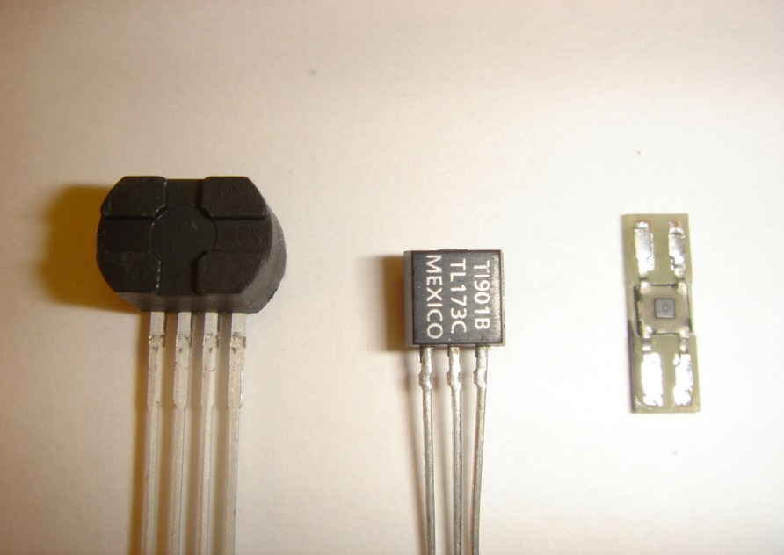
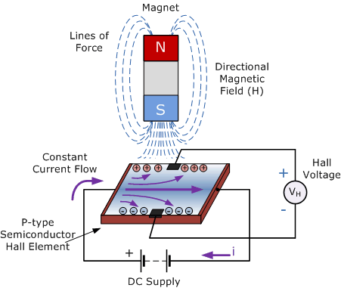
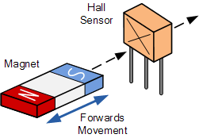
Hall effect sensors

Slide 42
Hall effect sensors
Hall Effect Sensors consist basically of a thin piece of rectangular p-type semiconductor material such as gallium arsenide (GaAs), indium antimonide (InSb) or indium arsenide (InAs) passing a continuous current through itself.
When the device is placed within a magnetic field, the magnetic flux lines exert a force on the semiconductor material which deflects the charge carriers, electrons and holes, to either side of the semiconductor slab.
This movement of charge carriers is a result of the magnetic force they experience passing through the semiconductor material.

Slide 43
Hall effect sensors
As these electrons and holes move side wards a potential difference is produced between the two sides of the semiconductor material by the build-up of these charge carriers.
Then the movement of electrons through the semiconductor material is affected by the presence of an external magnetic field which is at right angles to it and this effect is greater in a flat rectangular shaped material.
The output voltage, called the Hall voltage, (VH) of the basic Hall Element is directly proportional to the strength of the magnetic field passing through the semiconductor material (output ∝ H).

Slide 44
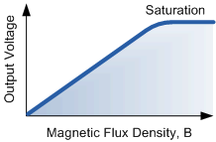
Hall effect - principles
A voltage develops between the back (positive) and front (negative) surface. This voltage is the Hall voltage and is given by:
d is the thickness of the hall plate,
n is the carrier density [charges/m³]
q is the charge of the electron [C]

Slide 45
Hall effect - principles
If the current changes direction or the magnetic field changes direction, the polarity of the Hall voltage flips.
The Hall effect sensor is polarity dependent,
may be used to measure direction of a field
or direction of motion if the sensor is properly set up.
The term 1/qn [m³/C] is material dependent and is called the Hall coefficient K_{H}.

Slide 46
Hall coefficient
The hall voltage is usually represented as:
Hall coefficients vary from material to material
Are particularly large in semiconductors.
Hall voltage is linear with respect to the field for given current and dimensions.
Hall coefficient is temperature dependent and this must be compensated if accurate sensing is needed.

Slide 47
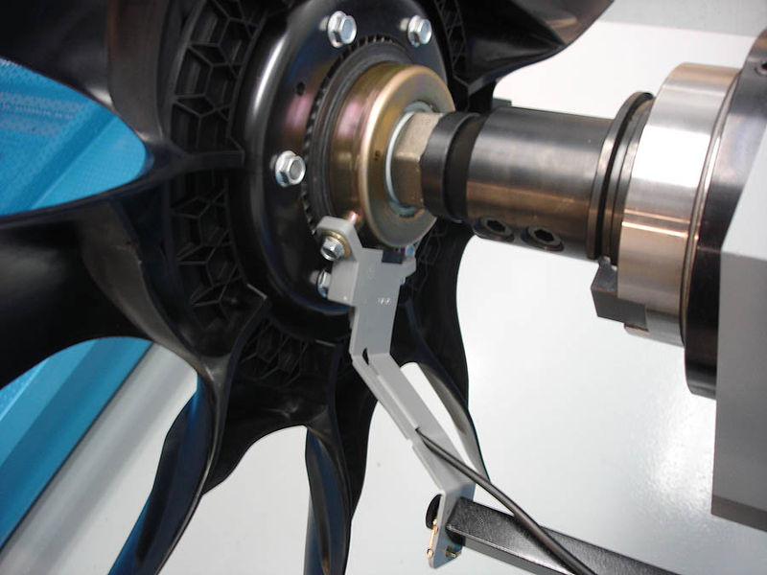
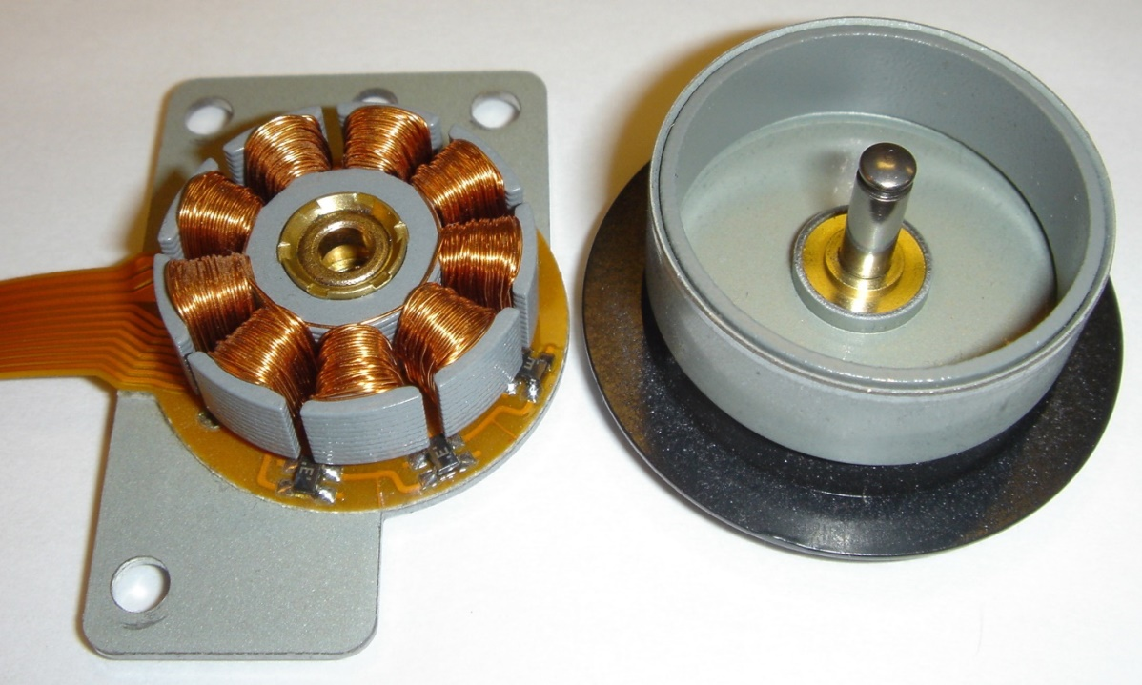
Few applications
Engine fan with Hall effect sensor
Hall sensors used to control a CDROM motor

Slide 48
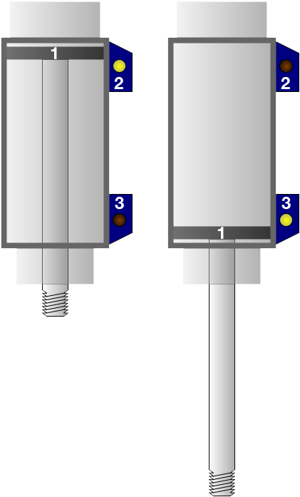
A Hall effect sensor is a transducer that varies its output voltage in response to a magnetic field. Hall effect sensors are used for proximity switching, positioning, speed detection, and current sensing applications
A wheel containing two magnets passing by a Hall effect sensor
The magnetic piston (1) in this pneumatic cylinder will cause the Hall effect sensors (2 and 3) mounted on its outer wall to activate when it is fully retracted or extended.

Slide 49
Applications
Position sensing
Sensing the presence of magnetic objects (connected with the position sensing) is the most common industrial application of Hall effect sensors, especially those operating in the switch mode (on/off mode). The Hall effect sensors are also used in the brushless DC motor to sense the position of the rotor and to switch the transistors in the right sequence.
Direct current (DC) transformers
Hall effect sensors may be utilized for contactless measurements of DC current in current transformers. In such a case the Hall effect sensor is mounted in the gap in magnetic core around the current conductor. As a result, the DC magnetic flux can be measured, and the DC current in the conductor can be calculated.
Automotive fuel level indicator
The Hall sensor is used in some automotive fuel level indicators. The main principle of operation of such indicator is position sensing of a floating element. This can either be done by using a vertical float magnet or a rotating lever sensor.
In a vertical float system a permanent magnet is mounted on the surface of a floating object. The current carrying conductor is fixed on the top of the tank lining up with the magnet. When the level of fuel rises, an increasing magnetic field is applied on the current resulting in higher Hall voltage. As the fuel level decreases, the Hall voltage will also decrease. The fuel level is indicated and displayed by proper signal condition of Hall voltage.

