Slide 1
Module:3 Sensor Signal Conditioning

Slide 2
Signal Conditioning-Introduction
•Definition: The method of manipulating an analog or digital signal such that it satisfies the requirements of next stage of measurement system for further processing. (or)
•Signal conditioning is the technique of making a signal from a sensor or transducer suitable for processing by data acquisition equipment.
Types:
1)Analog Signal conditioning; Analog signals in &out
2)Digital signal conditioning; Digital signals in &out

Slide 3
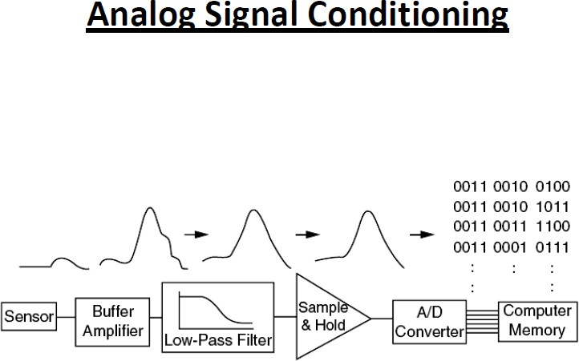

Slide 4
Some sensors require particular signal conditioning circuits for various purposes.
Thermistors require for linearization.
Strain gauges require interference cancellation.
Sensors that yield small outputs require large gains in order for the dynamic range of the output signal to match the input range of the ADC
Conditioners for remote sensors must be insensitive to connecting lead resistance or compensate for it.

Slide 5
Signal Conditioning-Objectives
To provide sufficient voltage or current to drive the sensors in order to obtain the suitable output form such as voltage, current, frequency, time etc
To compensate the influence of interference occurs in measurement system
To improve the performance
of the
measurement system with respect
to the
acquisition, linearity, sensitivity, resolution, accuracy etc.
To compensate the errors occur due to self heating, lead resistance, contact resistance, stray capacitance, inductive coupling effects.

Slide 6
DC BRIDGES FOR RESISTANCE MEASUREMENTS

Slide 7
A DC bridge typically uses a constant voltage drive, and it is often used to measure resistance changes in resistive sensors.
A DC bridge has a typical Wheatstone bridge configuration.
The Wheatstone bridge was originally developed in 1833 by Samuel H. Christie, a mathematics teacher and scientist, to measure and compare wire conductance. It was Charles Wheatstone, a physicist and inventor, who first recognized the value of Christie’s circuit and used it extensively in many significant measurements

Slide 8
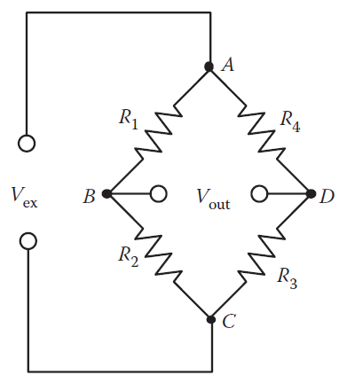
A Wheatstone bridge structure
A typical bridge consists of four arms connected to form a quadrilateral.
Each arm has one or more components, either constant components (resistors, capacitors, inductors, or their combination)
A source of excitation (DC or AC voltage or current) is supplied across one of the diagonals and a bridge voltage output is measured across the other diagonal.

Slide 9
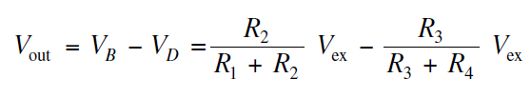
consists of an excitation voltage source (V_{ex}) and four resistors (R1, R2, R3, and R4). One of the four resistors is the resistive sensor (a variable resistor).

Slide 10
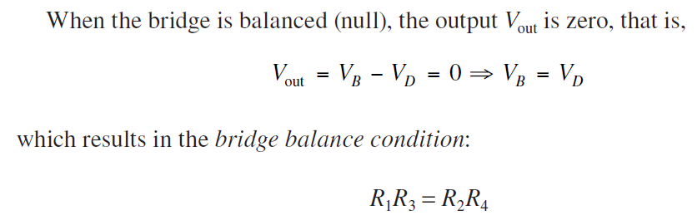

If the resistance values undergo small changes

Slide 11
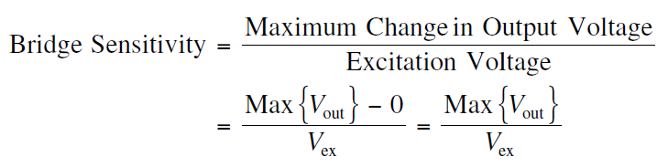
Sensitivity of a Wheatstone Bridge
Sensitivity of a Wheatstone bridge is defined as the ratio of the maximum expected change in the output voltage to the excitation voltage.
If Vex = 10 V and the full scale bridge output is 12 mV, find the bridge’s sensitivity.?

Slide 12
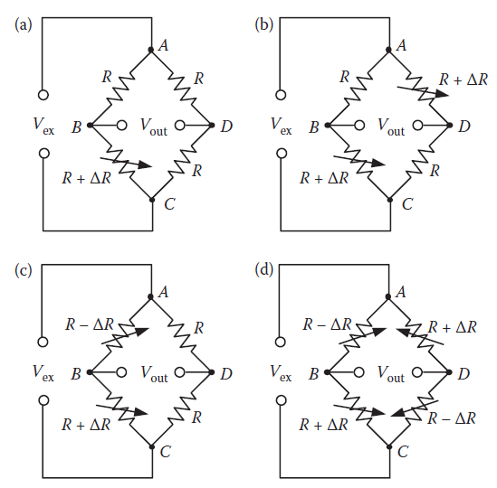
Wheatstone Bridge Driven by a Constant Voltage
Four common Wheatstone bridge configurations under a constant voltage
drive:
single-element;
two-diagonal-element;
two-adjacent-element;
(d) Four element variations.

Slide 13
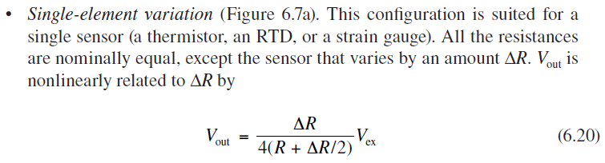
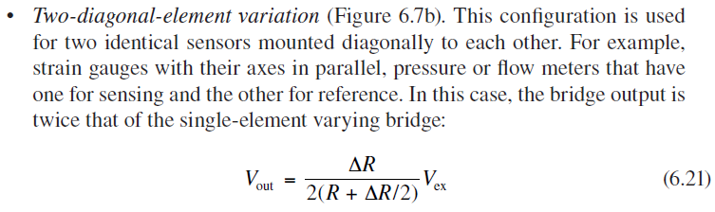

Slide 14
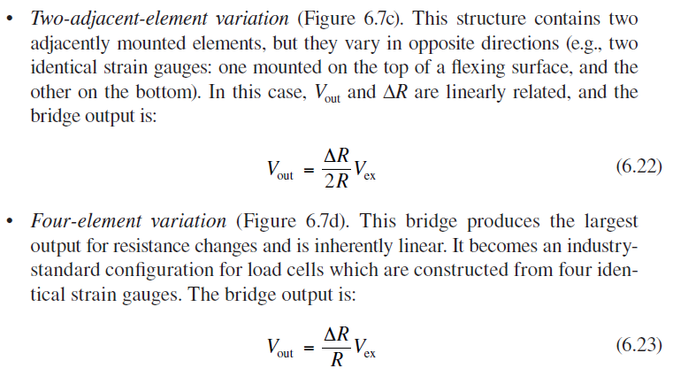

Slide 15
Wheatstone Bridge Driven by a Constant current
The current drive, though not as popular as the
voltage drive, has two advantages:
• The measurement will not be affected by the voltage drop in wire or excitation line resistance. Thus, the bridge can be located remotely from the source of excitation.
• The bridge output is more linear over a large range of ΔR than that of the voltage drive.

Slide 16
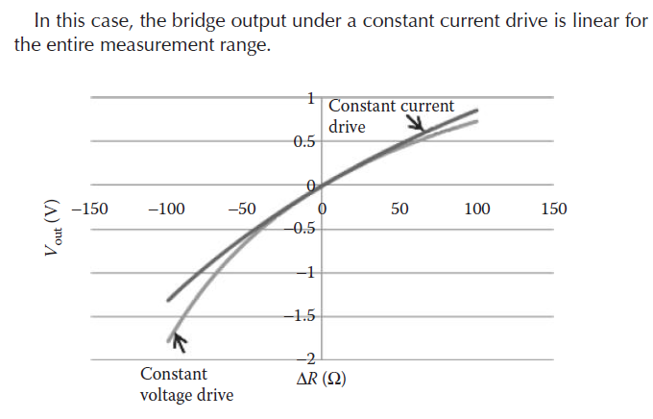

Slide 17
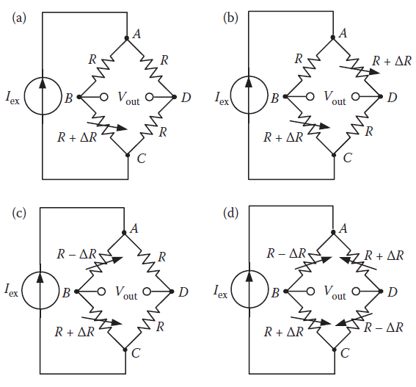



Four common Wheatstone bridge configurations under a constant current
drive:
(a) single-element;
(b) two-diagonal-element;
(c) two-adjacent-element; and
(d) four element variations.

Slide 18
Compare the performance of a Wheatstone bridge driven by a constant voltage and a constant current with the configuration of: (1) the single-element variation; (2) the two-element variation (diagonally mounted). Assume that the nominal resistance R is 120 Ω, ΔR changes from −100 Ω to +100 Ω. The constant voltage source is 5 VDC, and the constant current source is 41.67 mA

Slide 19
One of the major drawbacks of the Wheatstone bridge is that although it can measure the resistance from few ohm to several mega ohm – it gives significant errors when measuring low resistances.
Kelvin bridge, which is not only suitable for measuring low value of resistance but has wide range of applications in the industrial world

Slide 20
Kelvin bridge
Kelvin bridge (also known as Kelvin network, double bridge, Thomson bridge) is a special version of the Wheatstone bridge designed to eliminate the effect of lead and contact resistance and provide accurate measurement of low resistance

Slide 21
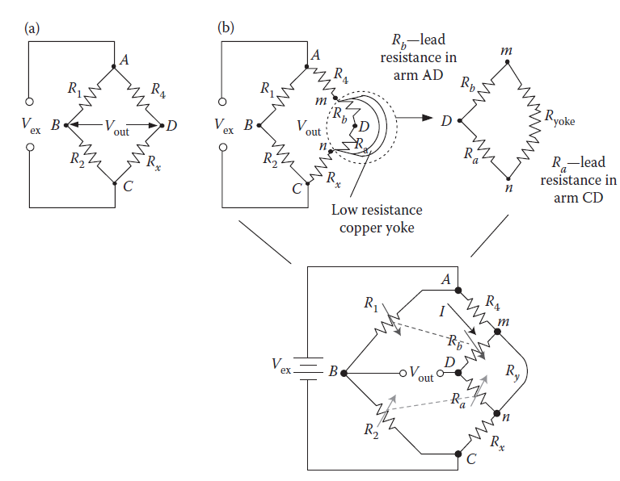
(a) A standard Wheatstone bridge; (b) a Kelvin double bridge.

Slide 22
Both R1 and R2 are high resistance arms, thus their lead resistances are negligible.
Rx (the sensor) and R4 are low resistance arms, whose lead resistances, Ra and Rb respectively, are not negligible.
Ra is added to the unknown Rx resulting in a higher evaluation of Rx. Rb is added to R4, making the measurement of Rx lower than its actual value.
The Kelvin bridge shown in Figure overcomes the lead resistance effect. Ry is a heavy copper yoke of low resistance connected between Rx and R4.

Slide 23

Thus, the Kelvin bridge eliminates the lead resistance effect on the bridge measurement by introducing two ratio arms R2/R1 (main ratio) and Ra/Rb (auxiliary ratio)

Slide 24
AC BRIDGES FOR CAPACITANCE AND INDUCTANCE MEASUREMENTS

Slide 25
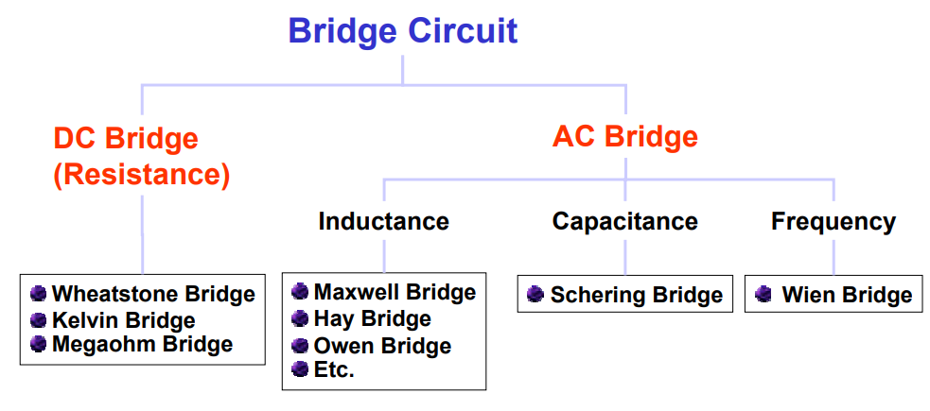
Types of bridges
T!o types of bridge are used in measurement"#$ DC bridge"a$ %heatstone Bridgeb$ elvin Bridge'$ AC bridge"a$ (imilar Angle Bridgeb$ Opposite Angle Bridge)*ay Bridgec$ +a!ell Bridged$ %ein Bridgee$ -adio re/uency Bridgef$ (chering Bridge

Slide 26
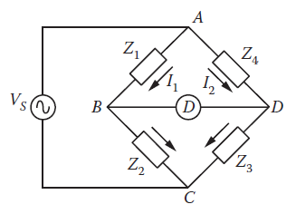
An AC bridge has the same structure as a DC bridge, except that: The excitation source is an AC voltage or current at a desired frequency.
All four bridge arms are considered as impedance (Z1, Z2, Z3, and Z4) and consist of either resistors or frequency-dependent components, such as capacitors and inductors, or their combination.
The detector that measures the bridge output is an AC responding device.

Slide 27

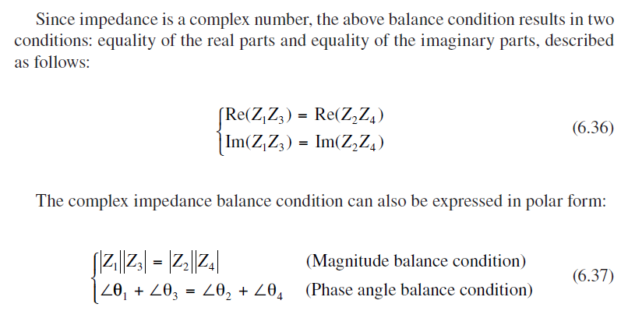
For the balance condition: V_{B} = V_{D}

Slide 28


Slide 29
Schering bridge
The Schering bridge use for measuring the capacitance of the capacitor, dissipation factor, properties of an insulator, capacitor bushing, insulating oil and other insulating materials.

Slide 30
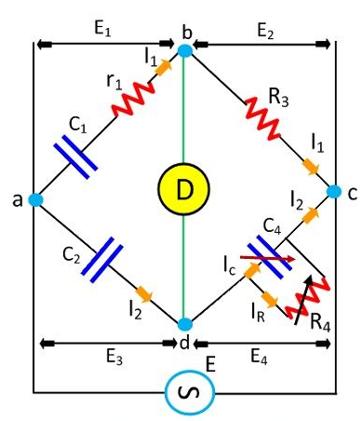
C₁ – capacitor whose capacitance is to be determined

Slide 31
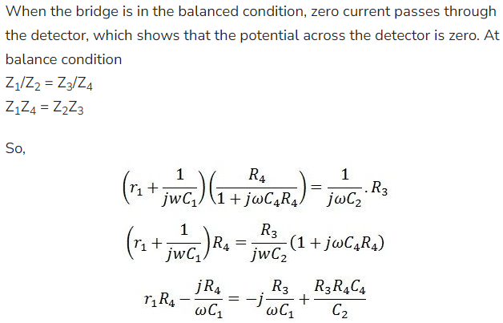

Slide 32
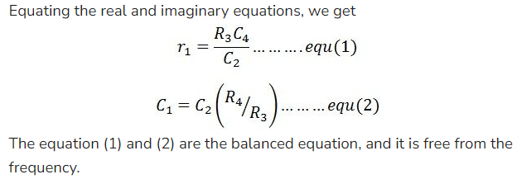
Advantages of Schering Bridge
Balance equations are free from frequency.
The arrangement of the bridge is less costly as compared to the other bridges.

