Slide 1
SQUID - Superconducting QUantum Interference Device
Introduction History Operation Applications
●
●
●

Slide 2
Introduction
Very sensitive magnetometer
Superconducting quantum interference device – based on quantum effects in superconducting loop
Useful for many purposes in physics, biology and medicine
●
●
●

Slide 3
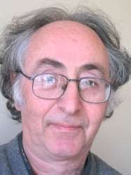
History
●
1962: British physicist Brian David Josephson discovers Josephson effect, invents Josephson junction, SQUID
1973 Nobel Prize (with Leo Esaki and Ivar Giaever)
●
http://www.tcm.phy.cam.ac.uk/~bdj10/

Slide 4
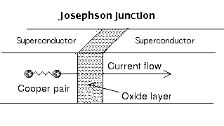
Operation – Josephson effect
The Josephson effect occurs when an electric current (Cooper pairs) flows between two superconductors separated by a thin non- superconducting layer through quantum tunnelling.
Junction is called a Josephson junction.
Can only support a certain maximum (critical) current in a superconducting state.
http://www.albanet.com.mx/articulos/josephson.gif (modified)

Slide 5
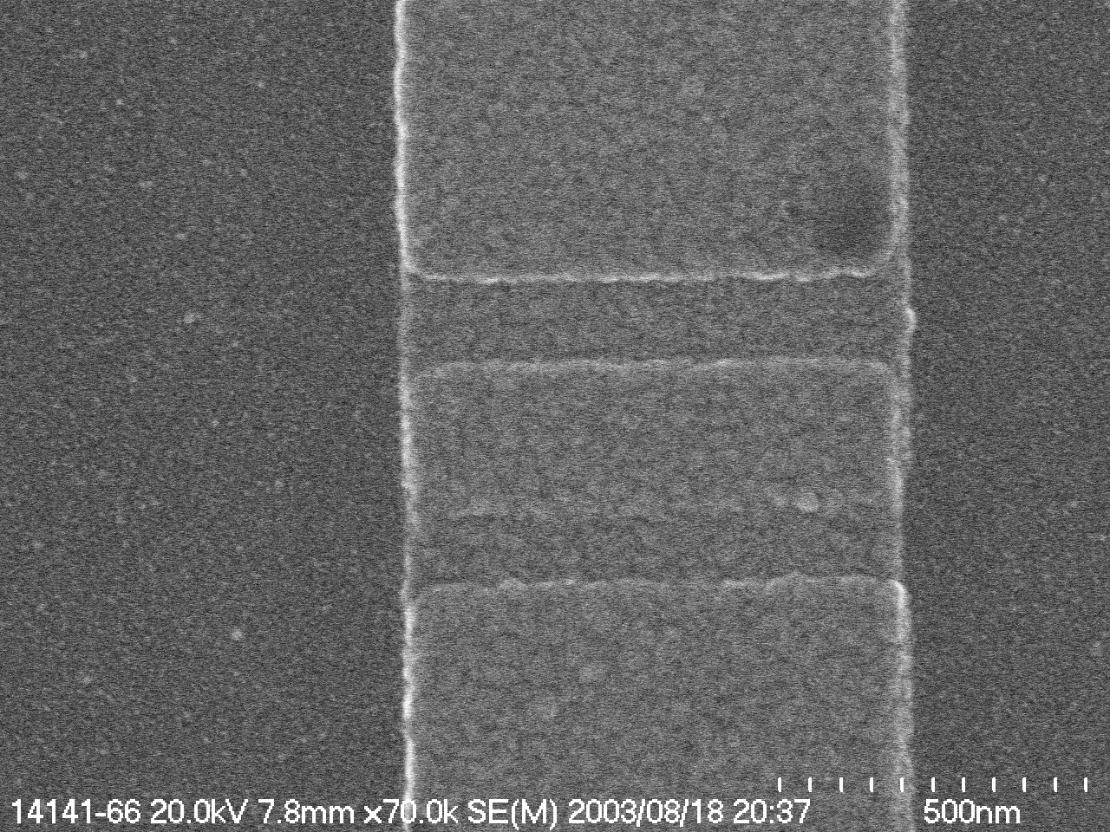
Operation – Josephson junctions
●
Types of Josephson junctions:
Tunnel junctions, barrier is an oxide insulator
Semiconductor junctions
Dayem bridge junctions, based on a constriction.
Josephson junction
http://cr.physics.ed.ynu.ac.jp/labs/magne/shimazu/031101/results.html

Slide 6
Operation – Superconducting loop
●
A SQUID consists of a loop of superconductor with one or more Josephson junctions, called weak links.
Inner diameter of loop ~ 100 µm..
Generally made from either an alloy of lead and gold or indium, or pure niobium.
Ceramic superconductors such as yttrium-barium- copper-oxide also possible, but difficult to manufacture.
●
●
●

Slide 7
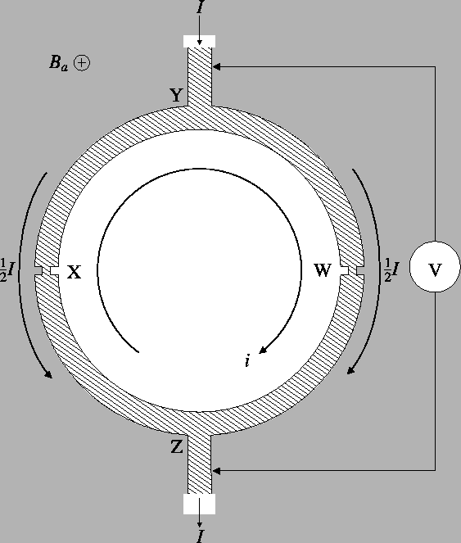
Operation – DC SQUID
●
Current made to flow around the loop through both Josephson junctions.
Electrons tunnel through the junctions, interfere.
Magnetic field through the loop causes a phase difference between electrons, affects current through the loop.
●
●
http://www.cmp.liv.ac.uk/frink/thesis/thesis/node47.html

Slide 8
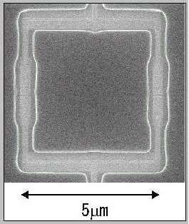
Operation – DC SQUID
●
Flux (magnetic field) through the loop induces a current around the loop. This affects the current flowing through the loop, because the net current through each junction is no longer the same.
Resulting potential difference across the loop can be measured.
●
DC SQUID
http://cr.physics.ed.ynu.ac.jp/labs/magne/shimazu/031101/results.html

Slide 9
Operation – RF SQUID
Also called AC SQUID
Only one Josephson junction. Radio frequency oscillating current Measure interactions between the
superconducting ring and an external resonant LC circuit
– External inductor induces current in SQUID ring, and when the Josephson junction enters the resistive state it damps the LC circuit.
●
●
●
●

Slide 10
Operation – Interference
Background magnetic fields can be a problem.
Shielded room: expensive and cannot easily be moved.
Gradiometer measures gradient of field rather than absolute value. Interfering magnetic sources generally much further away, so vary less.
Measure ambient magnetic field and subtract from measurements.
Damping coils to cancel out the background field.
Johnson noise: magnetic field created by thermal motion of surrounding particles.
●

Slide 11
Applications
Biomagnetism
Scanning SQUID microscopy Geophysics
●
●
●

Slide 12
Applications – Biomagnetism
●
Processes in animals produce small magnetic fields (10⁻¹² – 10⁻⁹ tesla).
Fields associated with neural activity can be imaged by machines based on an array of SQUIDs, magnetoencephalography (MEG).
Generally use gradiometer DC SQUIDs.
Advantage: higher temporal resolution – images can be acquired in millisecond intervals, and respond rapidly to changes in neural activity. PET and MRI have a temporal resolution on the order of 1 second, higher spatial resolution.
●

Slide 13
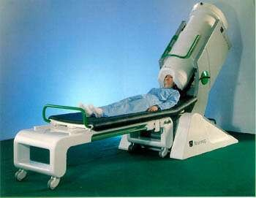
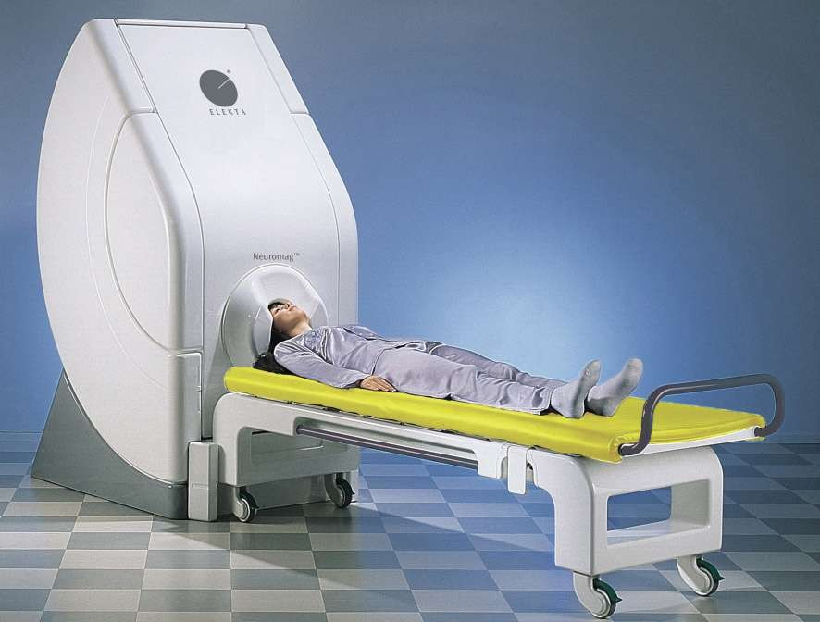
Applications – Biomagnetism
Neuromag-122™
Neuromag Vectorview™
http://www.neuromag.com/products/122hw.html
http://www.neuromag.com/pdf/viivibrochyr_apr03_v4.pdf

Slide 14
Applications – Biomagnetism
●
SQUIDs can also be used to measure heartbeat; called a magnetocardiogram.

Slide 15
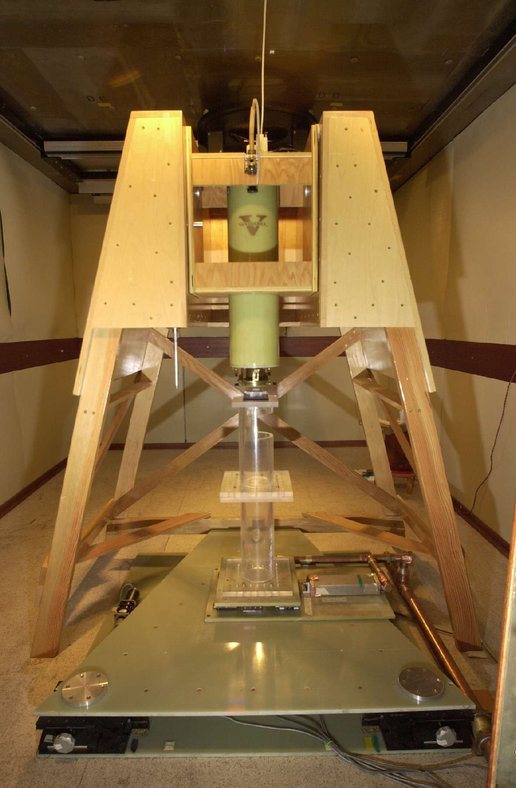
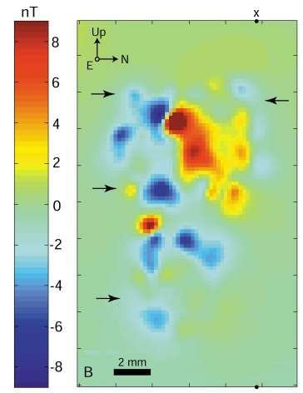
Applications – Scanning SQUID microscopy
●
By scanning a SQUID probe over a sample, a
high-resolution image of its magnetic field structure can
be obtained.
SQUID microscopy image of 1mm slice of Martian meteorite
http://www.gps.caltech.edu/tempfiles/magnetic_microscopy/
http://www.gps.caltech.edu/tempfiles/magnetic_microscopy/SQUIDmicro scope.jpg

Slide 16
Applications - Geophysics
●
Measure movement of the Earth's magnetic poles, variations in the thickness of the crust.
Oil prospecting, earthquake prediction, geothermal energy surveying.
Require portable containers with sufficient insulation to carry liquid helium.
– High temperature superconductors would help.
Methods of reducing magnetic noise needed.
●
●
●

Slide 17
Conclusions
SQUIDs are likely to be used increasingly in the future as they become cheaper and more versatile due to the development of high-temperature superconductors and better cooling systems.
●

Slide 18
Notes
●
Notes and copies of these slides are available at http://www.mcs.vuw.ac.nz/~walbraandr/squid.html

Slide 19
References
●
http://en.wikipedia.org/wiki/SQUID http://en.wikipedia.org/wiki/Josephson_effect http://en.wikipedia.org/wiki/Josephson_junction http://en.wikipedia.org/wiki/B._D._Josephson http://www.cmp.liv.ac.uk/frink/thesis/thesis/node47.html http://www.finoag.com/fitm/squid.html http://homepages.nildram.co.uk/~phekda/richdawe/squid/popular/ http://www.abdn.ac.uk/physics/case/99/squid.html http://www.neuromag.com/main.html
●
●
●
●
●
●
●
●

