Slide 1

Basic Electrical Engineering (BEEE101L)
Presented By
Dr. Maddela Chinna Obaiah
Assistant Professor (Sr)
School of Electrical Engineering

Slide 2
Module – 2: AC circuits
Alternating voltages and currents,
RMS, average, form factor, peak factor
Single Phase RL, RC, RLC Series circuits,
Power in AC circuits –Power Factor
Balanced three phase systems

Slide 3
Introduction:
The interconnection of electrical elements (e.g. Resistance, Inductance, and Capacitance) is called electric circuits.
In Module 1, we studied about the analysis of electric circuits with DC sources (e.g. Constant Voltage and Current).
In Module 2, we are going to analyze the circuits with time-varying voltage and current sources (AC sources). Particularly interested in sinusoidally time-varying excitation or simply excited by a sinusoid.
A sinusoidal current is usually referred aa alternating current (AC).
Circuits driven by sinusoidal current and voltage sources are called AC circuits.
A sinusoid is a signal that has the form of the sine or cosine function.

Slide 4
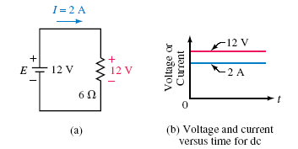

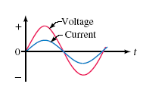
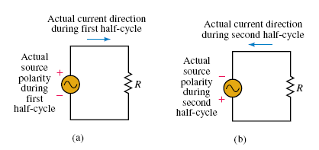
DC and AC
Direct Current (DC) is one kind of electricity flowing in a constant direction, and/or possessing a voltage with constant polarity
Alternating Current (AC) is another kind of electricity which produce voltages alternating in polarity, reversing positive and negative over time. Either as a voltage switching polarity or as a current switching direction back and forth.

Slide 5
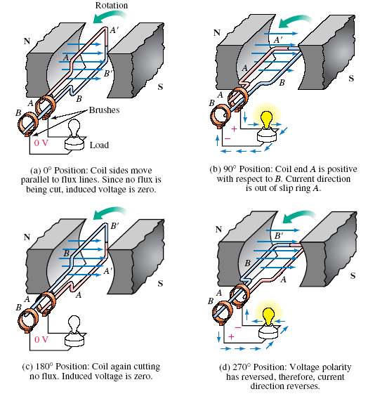
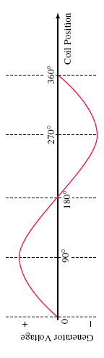
AC Generation
Let us understand how AC generator produces electricity:
It is a device used to convert mechanical energy into electrical energy. Designed by Nikola Tesla
Working of generator is based on the principle of faradays law of electro-magentic induction.
According to this principle: the change in the flux link to the conductor or coil induces an electric current in the conductor or coil.
The direction of the current in the coil can be given by Fleming’s left/right hand rule.

Slide 6
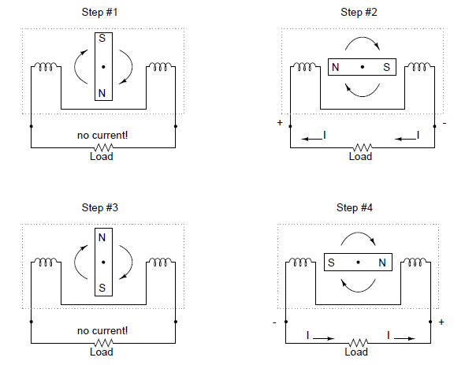
AC Generation (another constructional way)

Slide 7
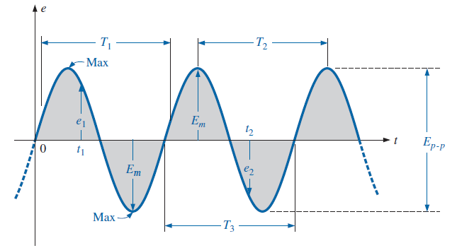
Definitions of Basic terms
Waveform: The path traced by a quantity, such as the voltage in Fig., plotted as a function of some variable such as time.
Instantaneous value: The magnitude of a waveform at any instant of time; denoted by lowercase letters (e1, e2 in Fig.).
Peak value: The amplitude of a sine wave is the distance from its average to its peak. Thus, the amplitude of the voltage is E_{m}.
Peak-to-peak value: Denoted by Ep-p (as shown in Fig.), the full voltage between positive and negative peaks of the waveform, that is, the sum of the magnitude of the positive and negative peaks

Slide 8
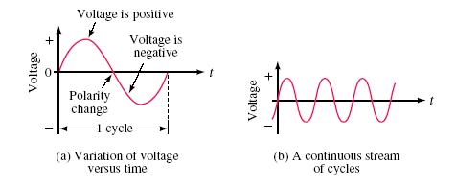
Starting at zero, the voltage increases to a positive maximum, decreases to zero, changes polarity, increases to a negative maximum, then returns again to zero.
One complete variation is referred to as a cycle.
Since the waveform repeats itself at regular intervals as in (b), it is called a periodic waveform.
A periodic function is one that satisfies $f\left(t\right)=f\left(t+nT\right)$ for all t and for all integers n.

Slide 9
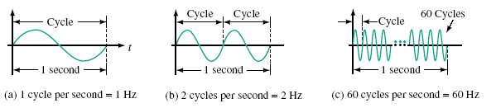
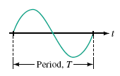


Frequency:
The number of cycles per second of a waveform is defined as its frequency.
Period:
The period, T, of a waveform, is the duration of one cycle. It is the inverse of frequency.

Slide 10
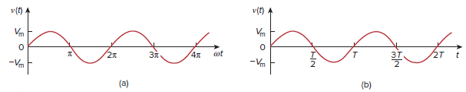
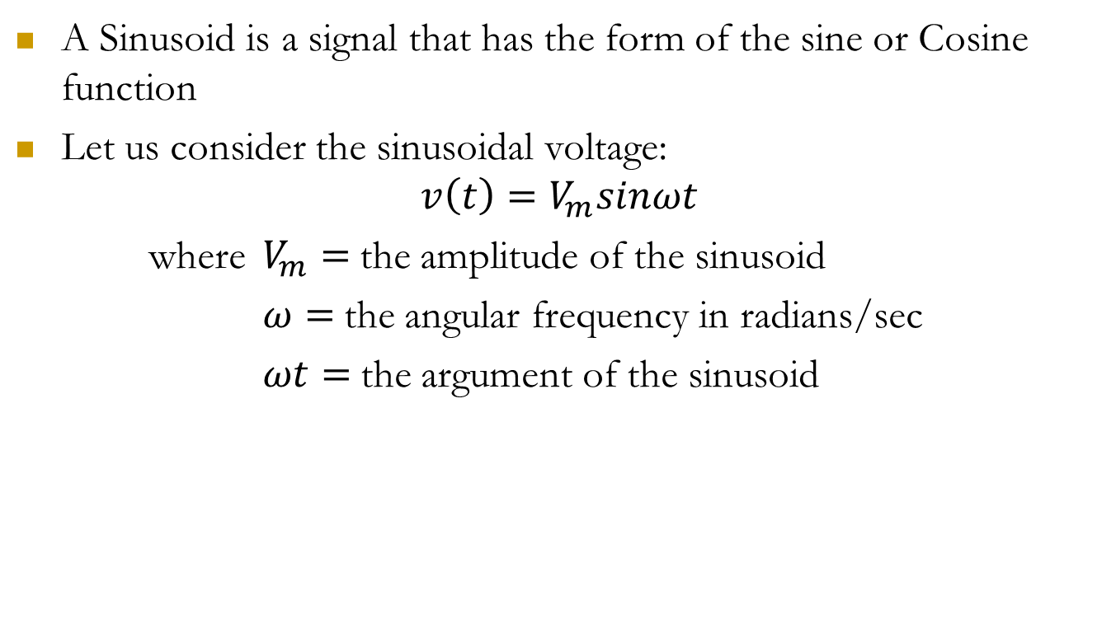
Sinusoids
A Sinusoid is a signal that has the form of the sine or Cosine function
Let us consider the sinusoidal voltage:
$$v\left(t\right)=V_{m}sinωt$$
where $V_{m}=$the amplitude of the sinusoid
$ω=$the angular frequency in radians/sec
$ωt=$the argument of the sinusoid

Slide 11


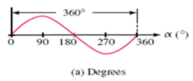
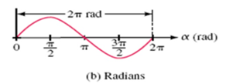


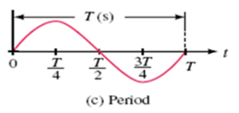
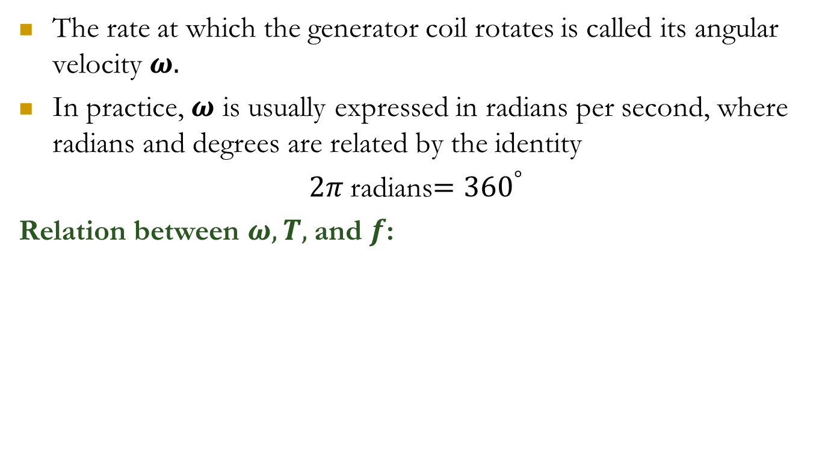

Angular Velocity $ω$:
The rate at which the generator coil rotates is called its angular velocity $ω.$
In practice, $ω$ is usually expressed in radians per second, where radians and degrees are related by the identity
$2π$radians$={360}^{°}$
Relation between $ω, T,$and $f$:

Slide 12
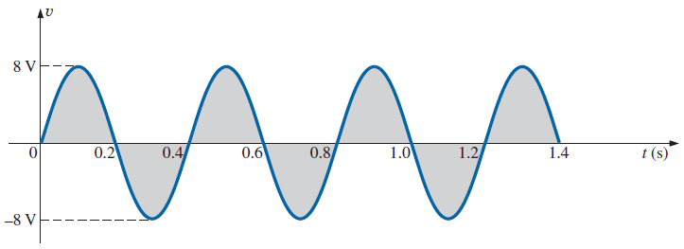
Problem: For a given sinusoidal waveform
a. What is the peak value?
b. What is the instantaneous value at 0.3 s and 0.6 s?
c. What is the peak-to-peak value of the waveform?
d. What is the period of the waveform?
e. How many cycles are shown?
f. What is the frequency of the waveform?
g. What is the angular frequency?

Slide 13
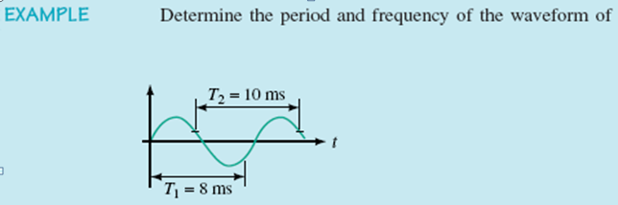
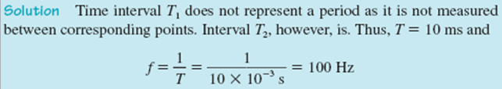

Slide 14
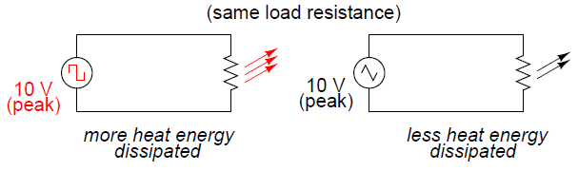
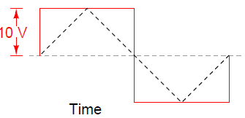
Measurements of AC magnitude
Peak value and peak-to-peak values are one of the ways to express the intensity or magnitude of an AC quantity.
Unfortunately, either one of these expressions of waveform amplitude can be misleading when comparing two different types of waves.
For example: A square wave peaking at 10 volts is obviously a greater amount of voltage for a greater amount of time than a triangle wave peaking at 10 volts. The effects of these two AC voltages powering a load would be quite different.

Slide 15
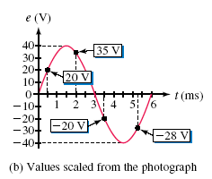
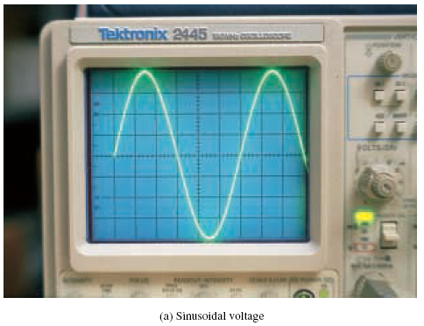
Instantaneous Value
Instantaneous values are the values of the alternating quantities at any instant of time. They are represented by small letters, i, υ, e, etc.

Slide 16
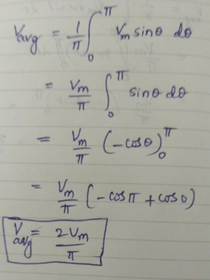
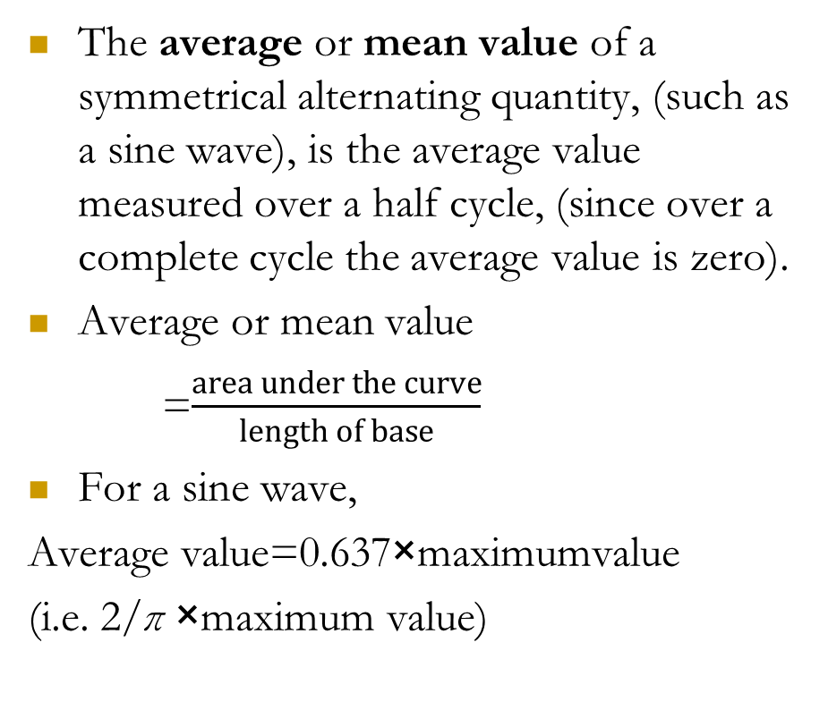
Average Value:
The average or mean value of a symmetrical alternating quantity, (such as a sine wave), is the average value measured over a half cycle, (since over a complete cycle the average value is zero).
Average or mean value
=$\frac{area under the curve}{length of base}$
For a sine wave,
Average value=0.637×maximumvalue
(i.e. 2/π ×maximum value)

Slide 17
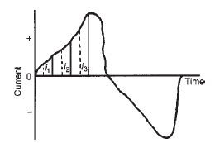
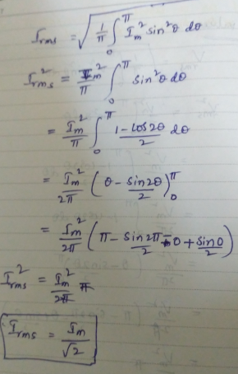

RMS Value:
The RMS value or effective value of alternating current gives the value of direct current that produces the same heating effect as that produced by the alternating current.
For example, the domestic mains supply is 240V and is assumed to mean 240Vr.m.s.
RMS value of AC current
For a sine wave, r.m.s. value =0.707×maximum value(i.e. 1/√2×maximumvalue)

Slide 18
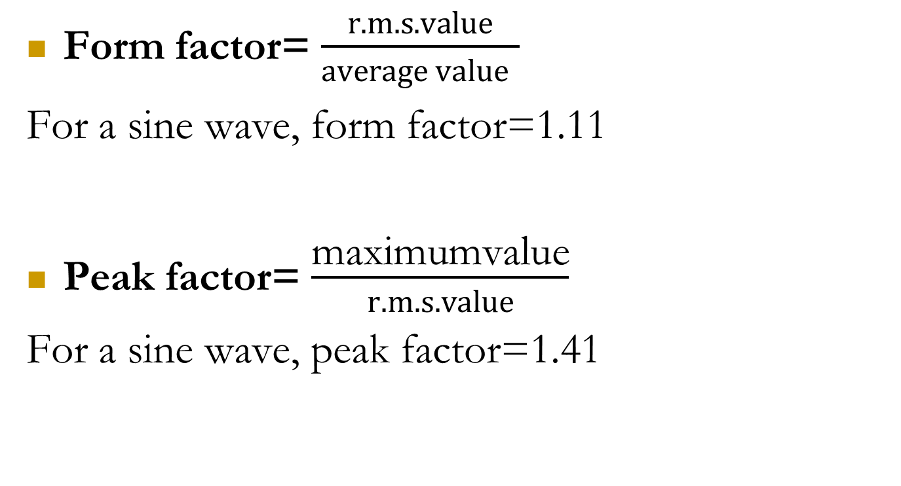
Form factor= $\frac{r.m.s. value}{average value }$
For a sine wave, form factor=1.11
Peak factor= $\frac{\text{maximumvalue}}{r.m.s. value}$
For a sine wave, peak factor=1.41

Slide 19

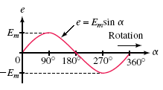


Sinusoidal Voltages and Currents as Functions of Time

Slide 20

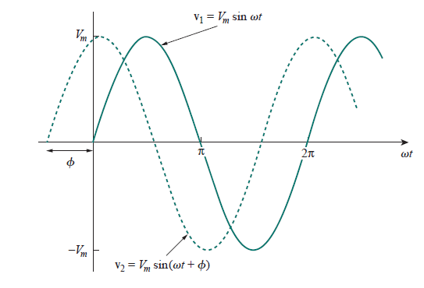
Let us now consider a more general expression for the sinusoid,
where (ωt + φ) is the argument and φ is the phase. Both argument and phase can be in radians or degrees.
Let us examine the two sinusoids
The starting point of v2 in Figure occurs first in time.
Therefore, we say that v2 leads v1 by φ or that v1 lags v2 by φ.
If φ = 0, then v1 and v2 are said to be in phase; they reach their minima and maxima at exactly the
same time.

Slide 21

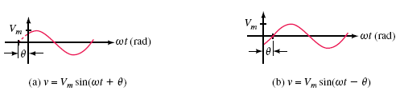
Voltages and Currents with Phase Shifts
If a sine wave does not pass through zero at t = 0 s it has a phase shift. Waveforms may be shifted to the left or to the right

Slide 22

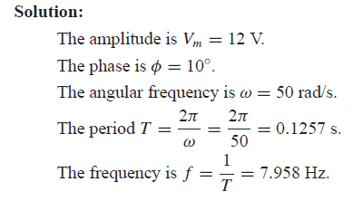
Example:
Find the amplitude (Vm), phase (Φ) , period (T), and frequency (F) of the sinusoid

Slide 23

Example:
Find the amplitude (Vm), phase (Φ) , period (T), and frequency (F) of the sinusoid

