Slide 1

Basic Electrical Engineering (BEEE101L)
Presented By
Dr. Maddela Chinna Obaiah
Assistant Professor (Sr)
School of Electrical Engineering

Slide 2
Module – 2: AC circuits
Alternating voltages and currents, AC values,
Single Phase RL, RC, RLC Series circuits,
Power in AC circuits –Power Factor
Three Phase Systems – Star and Delta Connection

Slide 3

Power in AC circuits
Instantaneous & average power
The instantaneous power p(t) absorbed by an element is the product of the instantaneous voltage v(t) across the element and the instantaneous current i(t) through it.
The instantaneous power is the power at any instant of time. It is the rate at which an element absorbs energy.
The Average power is the average of the instantaneous power over a one cycle.

Slide 4

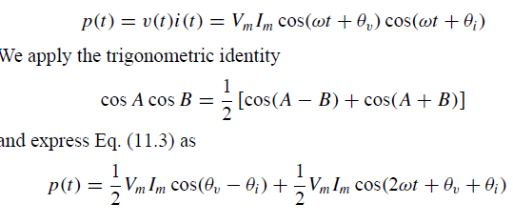
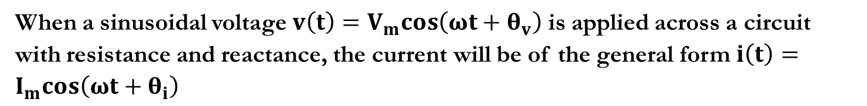
Instantaneous & average power in R-L or R-C or R-L-C series Circuit
When a sinusoidal voltage $v\left(t\right)=V_{m}cos\left(ωt+θ_{v}\right)$ is applied across a circuit with resistance and reactance, the current will be of the general form $i\left(t\right)=I_{m}cos\left(ωt+θ_{i}\right)$

Slide 5

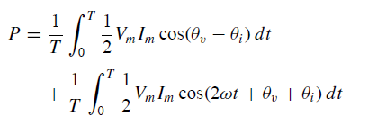
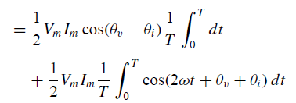
Average power

Slide 6




For a resistive network
For a reactive network,

Slide 7

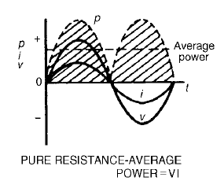
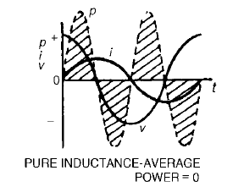
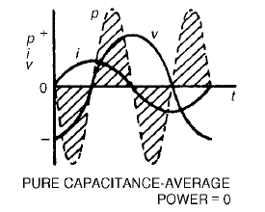



Power in Resistive, Inductive and Capacitive Circuit
$$θ_{v}=0, and θ_{i}=0$$
$$θ_{v}=0, and θ_{i}=−90$$
$$θ_{v}=0, and θ_{i}=90$$

Slide 8
The expression for p has two components
The second part oscillates at 2ω and has an average value of zero over a complete cycle
this is the power that is stored in the reactive elements and then returned to the circuit within each cycle
The first part represents the power dissipated in resistive components. Average power dissipation is

Slide 9
The average power dissipation given by
is termed the active power in the circuit and is measured in watts (W)
The product of the r.m.s. voltage and current VI is termed the apparent power, S. To avoid confusion this is given the units of volt amperes (VA)

Slide 10
From the above discussion it is clear that
In other words, the active power is the apparent power times the cosine of the phase angle.
This cosine is referred to as the power factor

Slide 11
Active and Reactive Power
When a circuit has resistive and reactive parts, the resultant power has 2 parts:
The first is dissipated in the resistive element. This is the active power, P
The second is stored and returned by the reactive element. This is the reactive power, Q , which has units of volt amperes reactive or var
While reactive power is not dissipated it does have an effect on the system
for example, it increases the current that must be supplied and increases losses with cables

Slide 12
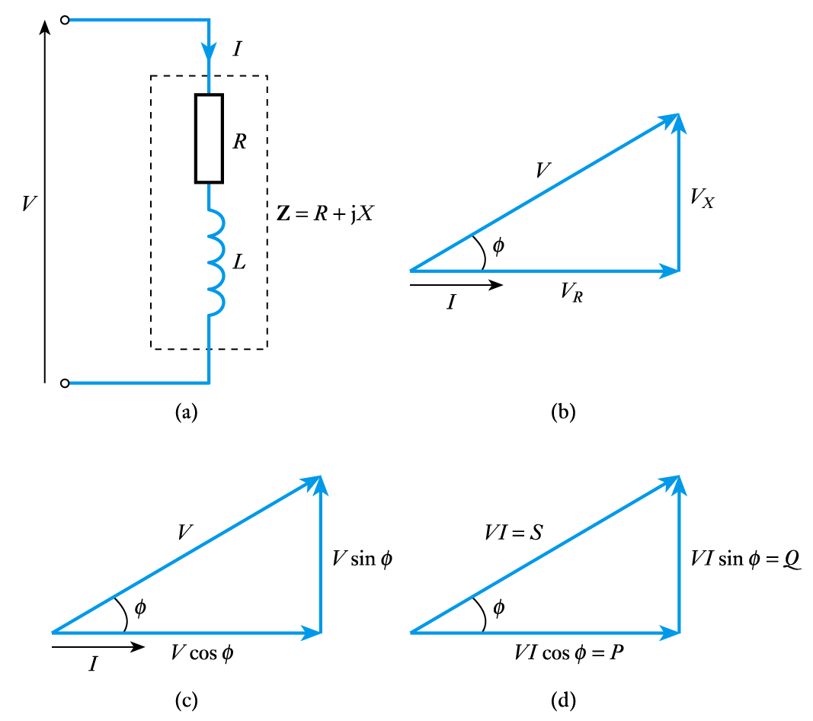
Power triangle
Consider an RL circuit
the relationship between the various forms of power can be illustrated using a power triangle

Slide 13
Therefore
Active Power P = VI cos φ watts
Reactive Power Q = VI sin φ var
Apparent Power S = VI VA
S² = P² + Q²

Slide 14
Power Factor Correction
Power factor is particularly important in high-power applications
Inductive loads have a lagging power factor
Capacitive loads have a leading power factor
Many high-power devices are inductive
a typical AC motor has a power factor of 0.9 lagging
the total load on the national grid is 0.8-0.9 lagging
this leads to major efficiencies
power companies therefore penalise industrial users who introduce a poor power factor

Slide 15
The problem of poor power factor is tackled by adding additional components to bring the power factor back closer to unity
a capacitor of an appropriate size in parallel with a lagging load can ‘cancel out’ the inductive element
this is power factor correction
a capacitor can also be used in series but this is less common (since this alters the load voltage)

Slide 16
Power Transfer
When looking at amplifiers, we noted that maximum power transfer occurs in resistive systems when the load resistance is equal to the output resistance
this is an example of matching
When the output of a circuit has a reactive element maximum power transfer is achieved when the load impedance is equal to the complex conjugate of the output impedance
this is the maximum power transfer theorem

Slide 17
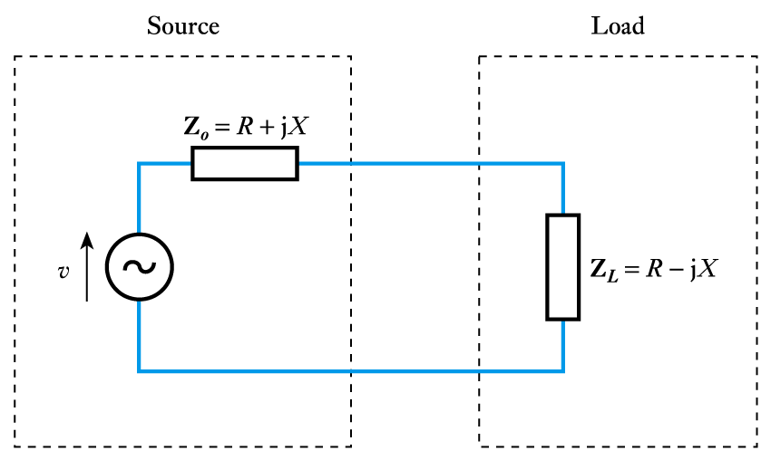
Thus if the output impedance Z_{o} = R + jX, maximum power transfer will occur with a load Z_{L} = R - jX

Slide 18
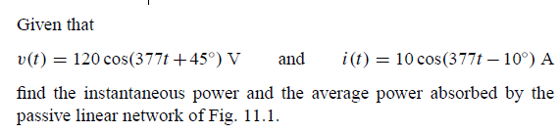
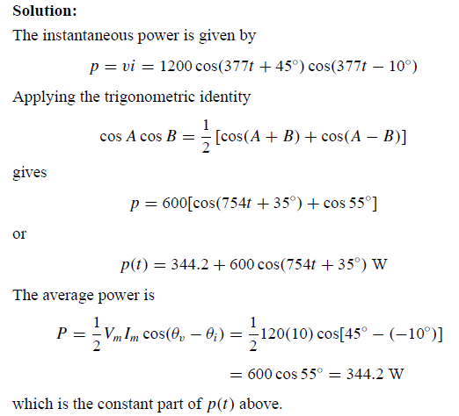
Example

Slide 19

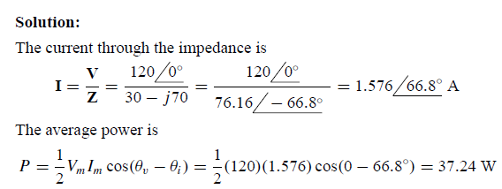

Slide 20
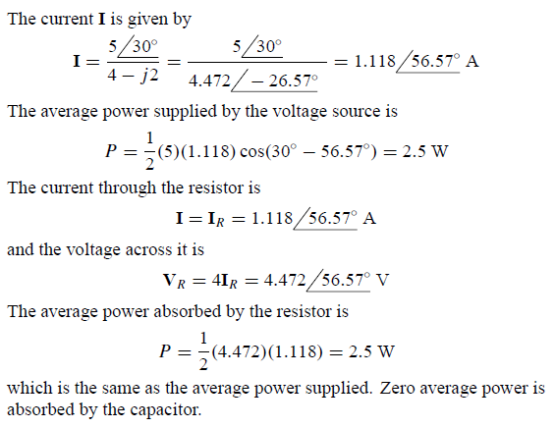
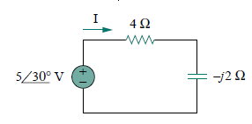

Slide 21
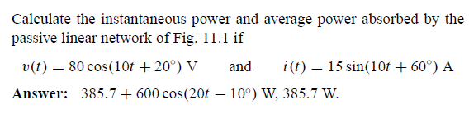
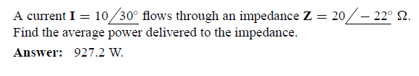
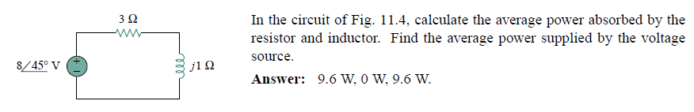
Practice problems

