Slide 1
Basic Electrical Engineering BEEE101L

Slide 2
Module 6 Electrical Supply Systems & Safety
Concepts of electrical power generation, transmission and distribution systems;
Wiring;
Electrical safety;
Earthing;
Protective devices

Slide 3
Basic idea of generation
Prior to the discovery of Faraday’s Laws of electromagnetic, electrical power was available from batteries with limited voltage and current levels.
Although complicated in construction, D.C generators were developed first to generate power in bulk.
However, due to limitation of the D.C machine to generate voltage beyond few hundred volts, it was not economical to transmit large amount of power over a long distance.
For a given amount of power, the current magnitude (I = P/V), hence section of the copper conductor will be large.
Thus generation, transmission and distribution of d.c power were restricted to area of few kilometer radius with no interconnections between generating plants.
Therefore, area specific generating stations along with its distribution networks had to be used.

Slide 4
Changeover from D.C to A.C
In later half of eighties, in nineteenth century, it was proposed to have a power system with 3-phase, 50 Hz A.C generation, transmission and distribution networks.
Once a.c system was adopted, transmission of large power (MW) at higher transmission voltage become a reality by using transformers.
Level of voltage could be changed virtually to any other desired level with transformers – which was impossible with D.C system.
Nicola Tesla suggested that constructionally simpler electrical motors (induction motors, without the complexity of commutator segments of D.C motors) operating from 3-phase a.c supply could be manufactured.
In fact, his arguments in favor of A.C supply system own the debate on switching over from D.C to A.C system.

Slide 5
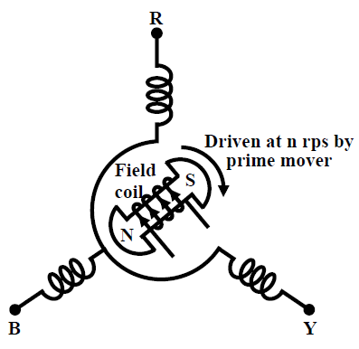
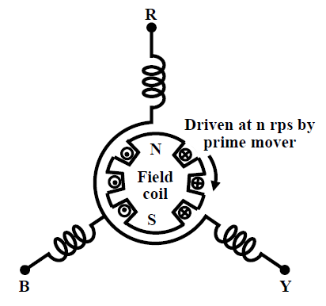
A.C generator
A.C power can be generated as a single phase or as a balanced poly-phase system.
However, it was found that 3-phase power generation at 50 Hz will be economical and most suitable.
Present day three phase generators, used to generate 3-phase power are called alternators (synchronous generators).
An alternator has a balanced three phase winding on the stator and called the armature. The three coils are so placed in space that there axes are mutually 120° apart. From the terminals of the armature, 3-phase power is obtained.
Rotor houses a field coil and excited by D.C. The field coil produces flux and electromagnetic poles on the rotor surface.
If the rotor is driven by an external agency, the flux linkages with three stator coils becomes sinusoidal function of time and sinusoidal voltage is induced in them.
A salient pole alternator has projected poles as shown in figure (a). It has non uniform air gap and is generally used where speed is low. On the other hand a non salient pole alternator has uniform air gap figure (b) and used when speed is high.
(a)
(b)

Slide 6
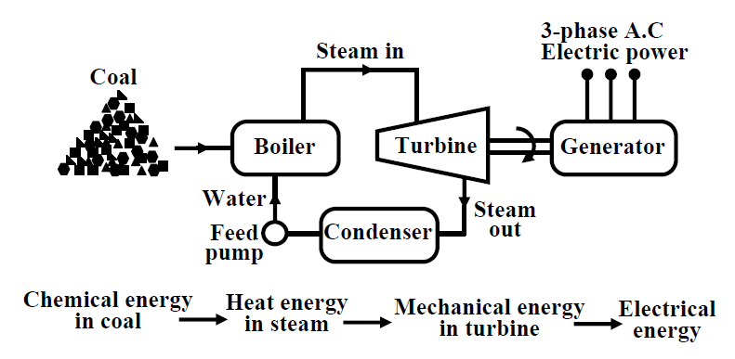
Thermal plant
To generate voltage at 50 Hz we have to run the generator at some fixed rpm by some external agency. A turbine is used to rotate the generator.
Turbine may be of two types, namely steam turbine and water turbine.
In a thermal power station coal is burnt to produce steam which in turn, drives the steam turbine hence the generator.
In a thermal power plant coal is burnt to produce high temperature and high pressure steam in a boiler.
The steam is passed through a steam turbine to produce rotational motion.
The generator, mechanically coupled to the turbine, thus rotates producing electricity.
Chemical energy stored in coal after a couple of transformations produces electrical energy at the generator terminals as depicted in the figure.
Figure: Basic components of a thermal generating unit.

Slide 7
Thermal plant
Thus proximity of a generating station nearer to a coal reserve and water sources will be most economical as the cost of transporting coal gets reduced.
In our country coal is available in abundance and naturally thermal power plants are most popular.
However, these plants pollute the atmosphere because of burning of coals.
A large amount of ash is produced every day in a thermal plant and effective handling of the ash adds to the running cost of the plant.
Nonetheless 57% of the generation in out country is from thermal plants.
The speed of alternator used in thermal plants is 3000 rpm which means 2-pole alternators are used in such plants.

Slide 8
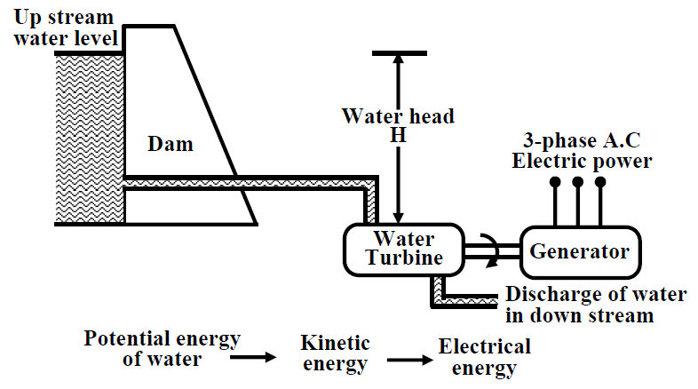
Hydel plants
In a hydel power station, water head is used to drive water turbine coupled to the generator.
Water head may be available in hilly region naturally in the form of water reservoir (lakes etc.) at the hill tops.
The potential energy of water can be used to drive the turbo generator set installed at the base of the hills through piping called pen stock.
Water head may also be created artificially by constructing dams on a suitable river.
In contrast to a thermal plant, hydel power plants are eco-friendly, neat and clean as no fuel is to be burnt to produce electricity.
While running cost of such plants are low, the initial installation cost is rather high compared to a thermal plants due to massive civil construction necessary.
Also sites to be selected for such plants depend upon natural availability of water reservoirs at hill tops or availability of suitable rivers for constructing dams.
Water turbines generally operate at low rpm, so number of poles of the alternator are high. For example a 20-pole alternator the rpm of the turbine is only 300 rpm.
Figure: Basic components of a hydel generating unit.

Slide 9
Nuclear plants
As coal reserve is not unlimited, there is natural threat to thermal power plants based on coal.
It is estimated that within next 30 to 40 years, coal reserve will exhaust if it is consumed at the present rate.
Nuclear power plants are thought to be the solution for bulk power generation.
At present the installed capacity of unclear power plant is about 4300 MW and expected to expand further in our country.
The present day atomic power plants work on the principle of nuclear fission of ²³⁵U.
In the natural uranium, ²³⁵U constitutes only 0.72% and remaining parts is constituted by 99.27% of ²³⁸U and only about 0.05% of ²³⁴U.
The concentration of ²³⁵U may be increased to 90% by gas diffusion process to obtain enriched ²³⁵U.
When ²³⁵U is bombarded by neutrons a lot of heat energy along with additional neutrons are produced. These new neutrons further bombard ²³⁵U producing more heat and more neutrons. Thus a chain reaction sets up.
However this reaction is allowed to take place in a controlled manner inside a closed chamber called nuclear reactor. To ensure sustainable chain reaction, moderator and control rods are used.
Moderators such as heavy water (deuterium) or very pure carbon ¹²C are used to reduce the speed of neutrons.
To control the number neutrons, control rods made of cadmium or boron steel are inserted inside the reactor. The control rods can absorb neutrons. If we want to decrease the number neutrons, the control rods are lowered down further and vice versa.

Slide 10
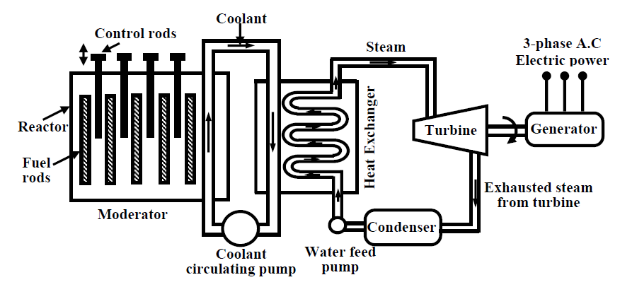
Nuclear plants
The heat generated inside the reactor is taken out of the chamber with the help of a coolant such as liquid sodium or some gaseous fluids.
The coolant gives up the heat to water in heat exchanger to convert it to steam as shown in figure. The steam then drives the turbo set and the exhaust steam from the turbine is cooled and fed back to the heat exchanger with the help of water feed pump.
Calculation shows that to produce 1000 MW of electrical power in coal based thermal plant, about 6 × 10⁶ Kg of coal is to be burnt daily while for the same amount of power, only about 2.5 Kg of ²³⁵U is to be used per day in a nuclear power stations.
The initial investment required to install a nuclear power station is quite high but running cost is low.
Although, nuclear plants produce electricity without causing air pollution, it remains a dormant source of radiation hazards due to leakage in the reactor.
Also the used fuel rods are to be carefully handled and disposed off as they still remain radioactive.
The reserve of ²³⁵U is also limited and can not last longer if its consumption continues at the present rate.
Naturally search for alternative fissionable material continues. For example, plutonium (²³⁹Pu) and (²³³U) are fissionable.

Slide 11
Non conventional sources of energy
The bulk generation of power by thermal, hydel and nuclear plants are called conventional methods for producing electricity.
Search for newer avenues for harnessing eco friendly electrical power has already begun to meet the future challenges of meeting growing power demand.
Compared to conventional methods, the capacity in terms of MW of each non-conventional plant is rather low, but most of them are eco friendly and self sustainable.
Wind power, solar power,, fuel cell and power from tidal waves are some of the promising alternative sources of energy for the future.

Slide 12
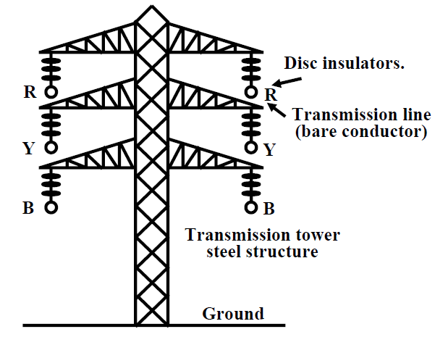
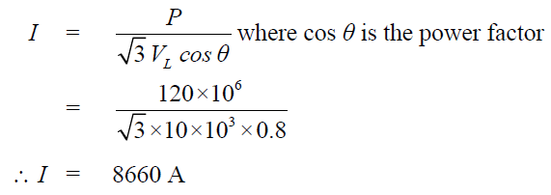
Transmission of power
The huge amount of power generated in a power station (hundreds of MW) is to be transported over a long distance (hundreds of kilometers) to load centers to cater power to consumers with the help of transmission line and transmission towers as shown in figure.
To give an idea, let us consider a generating station producing 120 MW power and we want to transmit it over a large distance. Let the voltage generated (line to line) at the alternator be 10 kV. Then to transmit 120 MW of power at 10 kV, current in the transmission line can be easily calculated by using power formula circuit (which you will learn in the lesson on A.C circuit analysis) for 3-phases follows:

Slide 13
Instead of choosing 10 kV transmission voltage, if transmission voltage were chosen to be 400 kV, current value in the line would have been only 261.5 A.
So sectional area of the transmission line (copper conductor) will now be much smaller compared to 10 kV transmission voltage.
In other words the cost of conductor will be greatly reduced if power is transmitted at higher and higher transmission voltage.
The use of higher voltage (hence lower current in the line) reduces voltage drop in the line resistance and reactance. Also transmission losses is reduced.
Standard transmission voltages used are 132 kV or 220 kV or 400 kV or 765 kV depending upon how long the transmission lines are.
Therefore, after the generator we must have a step up transformer to change the generated voltage (say 10 kV) to desired transmission voltage (say 400 kV) before transmitting it over a long distance with the help of transmission lines supported at regular intervals by transmission towers.
It should be noted that while magnitude of current decides the cost of copper, level of voltage decides the cost of insulators.
At the load centers voltage level should be brought down at suitable values for supplying different types of consumers. Consumers may be (1) big industries, such as steel plants, (2) medium and small industries and (3) offices and domestic consumers.
Electricity is purchased by different consumers at different voltage level. To do this we require obviously step down transformers.

Slide 14
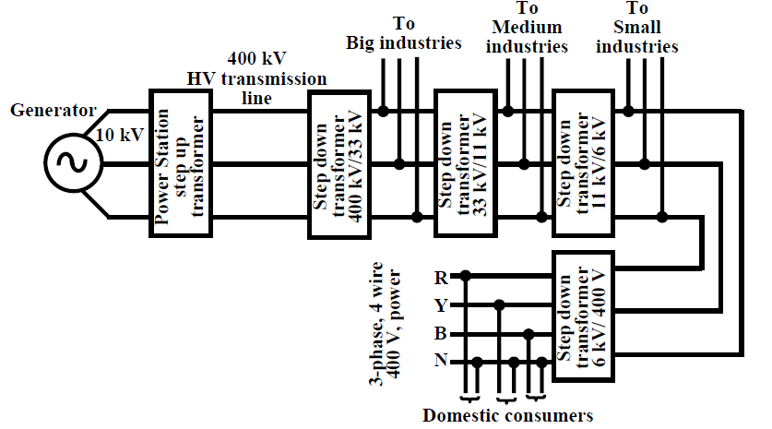
Substations
Substations are the places where the level of voltage undergoes change with the help of transformers. Apart from transformers a substation will house switches (called circuit breakers), meters, relays for protection and other control equipment.
Broadly speaking, a big substation will receive power through incoming lines at some voltage (say 400 kV) changes level of voltage (say to 132 kV) using a transformer and then directs it out wards through outgoing lines.
At the lowest voltage level of 400 V, generally 3-phase, 4-wire system is adopted for domestic connections. The fourth wire is called the neutral wire (N) which is taken out from the common point of the star connected secondary of the 6 kV/400 V distribution transformer.

Slide 15
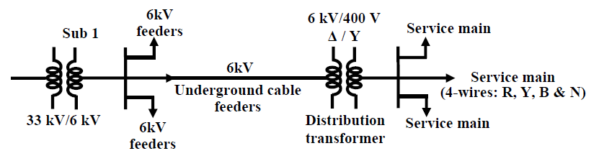
Distribution system
Power at somewhat high voltage (say 33 kV) is received in a substation situated near load center (a big city). The loads of a big city are primarily residential complexes, offices, schools, hotels, street lighting etc.
These types of consumers are called LT (low tension) consumers. Apart from this there may be medium and small scale industries located in the outskirts of the city.
LT consumers are to be supplied with single phase, 220 V, 50 Hz.
Power receive at a 33 kV substation is first stepped down to 6 kV and with the help of under ground cables (called feeder lines), power flow is directed to different directions of the city.

Slide 16
At the last level, step down transformers are used to step down the voltage form 6 kV to 400 V. These transformers are called distribution transformers with 400 V, star connected secondary.
You must have noticed such transformers mounted on poles in cities beside the roads. These are called pole mounted substations.
From the secondary of these transformers 4 terminals (R, Y, B and N) come out. N is called the neutral and taken out from the common point of star connected secondary. Voltage between any two phases (i.e., R-Y, Y-B and B-R) is 400 V and between any phase and neutral is 230 V.
The distribution of power from the pole mounted substation can be done either by (1) overhead lines (bare conductors) or by (2) underground cables.
Use of overhead lines although cheap, is often accident prone and also theft of power by hooking from the lines take place.
Although costly, in big cities and thickly populated areas underground cables for distribution of power, are used.

