Slide 1


Problems on dot convention

Slide 2
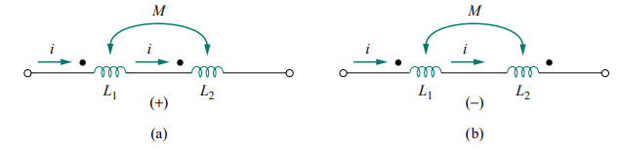
Dot convention for coils in series
For the coils in Fig. (a), the total inductance is
L = L1 + L2 + 2M (Series-aiding connection)
For the coil in Fig. (b)
L = L1 + L2 − 2M (Series-opposing connection)

Slide 3
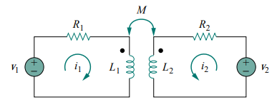


Time-domain analysis of a circuit containing coupled coils
Applying KVL to coil 1 gives
For coil 2, KVL gives

Slide 4
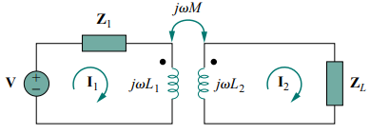


Frequency-domain analysis of a circuit containing coupled coils
Applying KVL to coil 1 gives
For coil 2, KVL gives

Slide 5
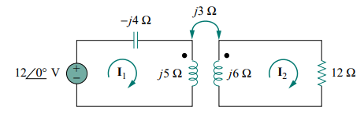
Example 1
Calculate the phasor currents I1 and I2 in the circuit

Slide 6
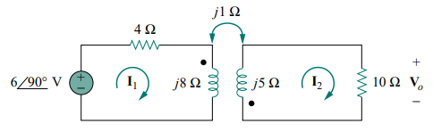
Example 2
Determine the voltage Vo in the circuit

Slide 7
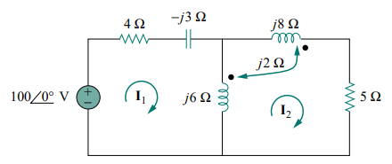
Example 3
Calculate the mesh currents in the circuit

Slide 9
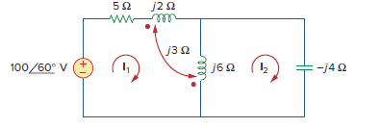
Example 4
Determine the phasor currents I1 and I2 in the circuit

Slide 10
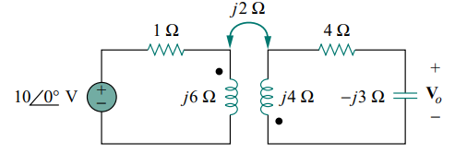
Example 5
Obtain Vo in the circuit

