Slide 1

Basic Electrical Engineering (BEEE101L)
Presented By
Dr. Maddela Chinna Obaiah
Assistant Professor (Sr)
School of Electrical Engineering

Slide 2
Circuit Topology
Topology: How a circuit is laid out.
A branch represents a single circuit (network) element; that is, any two terminal element.
A node is the point of connection between two or more branches.
A loop is any closed path in a circuit (network).
A loop is said to be independent if it contains a branch which is not in any other loop.

Slide 3
Fundamental Theorem of Network Topology
For a network with b branches, n nodes and l independent loops:
9
5
5

Slide 4










Passive Sign Convention
When we analyze an electrical circuit, we write mathematical relationships that describes the circuit behavior.
For passive circuit elements, we need to define voltage polarities and current directions according to the Passive sign convention.
Assumed positive current enters the assumed positive voltage terminal of passive elements.
Either voltage polarity or current direction can be chosen arbitrarily.
Once one is chosen (either voltage or current), it dictates the choice of the other.
$$+$$
$$R_{1}$$
$$+$$
$$R_{1}$$
$$V_{1}$$
$$V_{1}$$
$$−$$
$$R_{2}$$
$$−$$
$$R_{2}$$

Slide 5
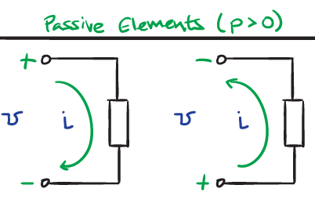





Passive Sign Convention
Power flowing in to a component is considered to be positive and power flowing out of a component is considered negative.
If PSC is satisfied, Power P=vi
If PSC is not satisfied, Power P=-vi
Passive sign convention is satisfied when the current enters through the positive terminal of an element and p = +vi. If the current enters through the negative terminal, p = −vi.
Passive elements $(P<0)$
$$+$$
$$−$$
$$−$$
$$+$$

Slide 6
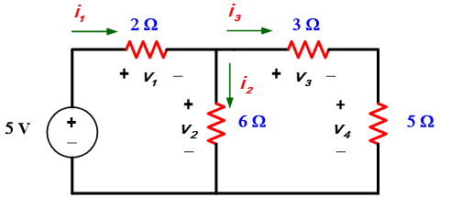
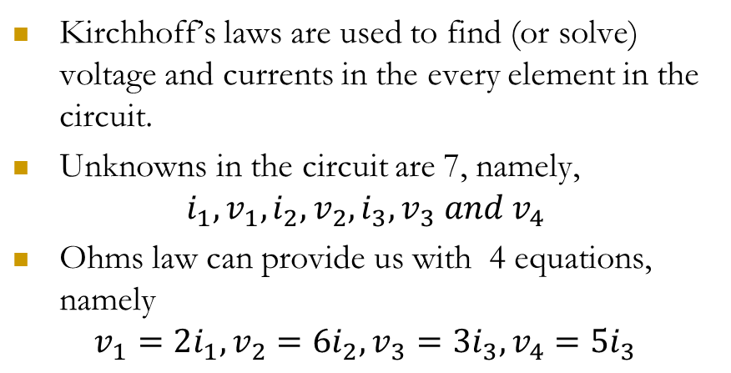
Kirchhoff’s Laws
Kirchhoff’s laws are used to find (or solve) voltage and currents in the every element in the circuit.
Unknowns in the circuit are 7, namely,
$$i_{1},v_{1},i_{2},v_{2},i_{3},v_{3} and v_{4}$$
Ohms law can provide us with 4 equations, namely
$$v_{1}=2i_{1}, v_{2}=6i_{2}, v_{3}={3i}_{3}, v_{4}={5i}_{3}$$
However Ohms equations can not be sufficient to solve for the 7 unknown, we need still 3 equations , what are these equations ?
Kirchhoff’s Laws stated by Russian scientist Gustav Kirchhoff.

Slide 7
Kirchhoff’s Laws
Kirchhoff’s Current Law (KCL)
sum of all currents entering a node is zero
sum of currents entering node is equal to sum of currents leaving node
Conservation of charge
Kirchhoff’s Voltage Law (KVL)
sum of voltages around any loop in a circuit is zero
Conservation of energy

Slide 8
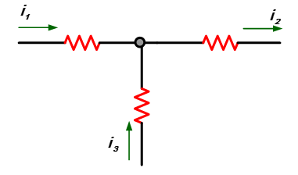
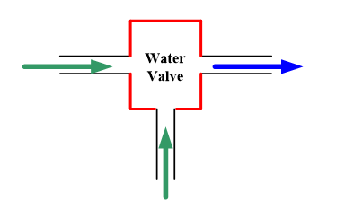
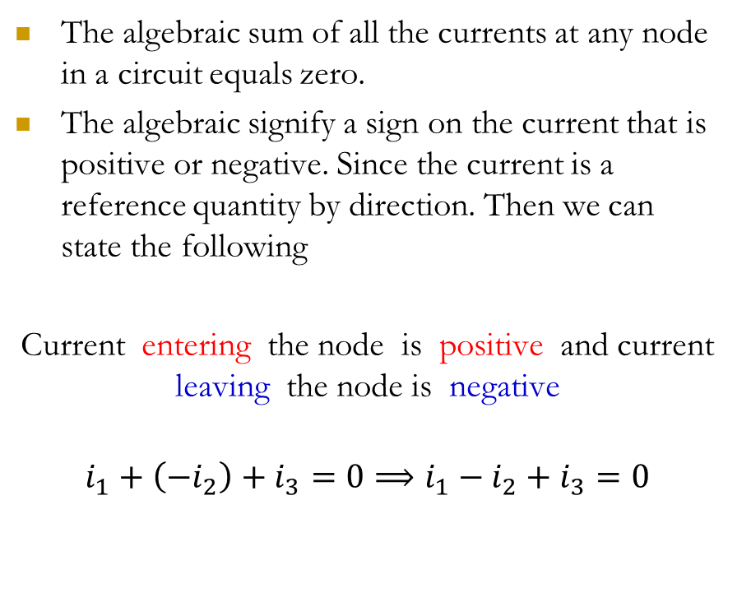
Kirchhoff’s Current Law (KCL)
The algebraic sum of all the currents at any node in a circuit equals zero.
The algebraic signify a sign on the current that is positive or negative. Since the current is a reference quantity by direction. Then we can state the following
Current entering the node is positive and current leaving the node is negative
$$i_{1}+\left({−i}_{2}\right)+i_{3}=0⟹i_{1}−i_{2}+i_{3}=0$$

Slide 9
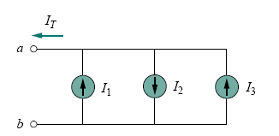

KCL

Slide 10
In Electric Circuit Analysis, there are two types of circuit analysis based on a systematic application of Kirchhoff’s laws (KCL and KVL).
Mesh Current Analysis
Nodal Voltage Analysis
Node analysis and Mesh analysis are both circuit analysis methods which are systematic and apply to most circuits.
Analysis of circuits using node or loop analysis requires solutions of systems of linear equations.
These equations can usually be written by inspection of the circuit.

Slide 11
Nodal Voltage Analysis
Steps to Determine Node Voltages:
Identify the number nodes (n) in circuit and select one node as the reference node (more number of braches are connected).
Assign voltages v₁, v₂, . . . , v_{n−1} to the remaining n − 1 nodes. The voltages are referenced with respect to the reference node.
Apply KCL to each of the n − 1 nonreference nodes. Use Ohm’s law to express the branch currents in terms of node voltages.
Solve the resulting simultaneous equations to obtain the unknown node voltages.

Slide 12
Reference Node
500Ω
500Ω
+
I₁
V
1kΩ
500Ω
I₂
500Ω
–
The reference node is called the ground node.

Slide 13
Steps to Determine Node Voltages:
Identify the number nodes (n) in circuit and select one node as the reference node (more number of braches are connected).
Assign voltages v₁, v₂, . . . , v_{n−1} to the remaining n − 1 nodes. The voltages are referenced with respect to the reference node.
Apply KCL to each of the n − 1 nonreference nodes. Use Ohm’s law to express the branch currents in terms of node voltages.
Solve the resulting simultaneous equations to obtain the unknown node voltages.

Slide 14
Node Voltages
500Ω
500Ω
V₁
V₂
V₃
1
2
3
I₁
1kΩ
500Ω
I₂
500Ω
V₁, V₂, and V₃ are unknowns for which we solve using KCL.

Slide 15
Steps to Determine Node Voltages:
Select a node as the reference node.
Assign voltages v₁, v₂, . . . , v_{n−1} to the remaining n − 1 nodes. The voltages are referenced with respect to the reference node.
Apply KCL to each of the n − 1 nonreference nodes. Use Ohm’s law to express the branch currents in terms of node voltages.
Solve the resulting simultaneous equations to obtain the unknown node voltages.

Slide 16
Currents and Node Voltages
500Ω
500Ω
V₁
V₂
V₃
1
2
3
I₁
1kΩ
500Ω
I₂
500Ω
V₁
500Ω
V₂
V₁
500Ω

Slide 17
KCL at Node 1
V₁
500Ω
V₂
500Ω
I₁

Slide 18
KCL at Node 2
V₁
500Ω
V₂
500Ω
V₃
1kΩ

Slide 19
KCL at Node 3
V₂
500Ω
V₃
500Ω
I₂

Slide 20
Steps to Determine Node Voltages:
Select a node as the reference node.
Assign voltages v₁, v₂, . . . , v_{n−1} to the remaining n − 1 nodes. The voltages are referenced with respect to the reference node.
Apply KCL to each of the n − 1 nonreference nodes. Use Ohm’s law to express the branch currents in terms of node voltages.
Solve the resulting simultaneous equations to obtain the unknown node voltages.

Slide 21
System of Equations
Node 1:
Node 2:
Node 3:

Slide 22
Equations
These equations can be written by inspection.
The left side of the equation:
The node voltage is multiplied by the sum of conductances of all resistors connected to the node.
Other node voltages are multiplied by the conductance of the resistor(s) connecting to the node and subtracted.
The right side of the equation:
The right side of the equation is the sum of currents from sources entering the node.

Slide 23
Matrix Notation
The three equations can be combined into a single matrix/vector equation.
The equation can be written in matrix-vector form as
Av = i
The solution to the equation can be written as
v = A⁻¹ i

Slide 24
Solving the Equation with MATLAB
Assume: I₁ = 3mA, I₂ = 4mA
>> A = [1/500+1/500 -1/500 0;
-1/500 1/500+1/1000+1/500 -1/500;
0 -1/500 1/500+1/500];
>> i = [3e-3; 0; 4e-3];
>> v = inv(A)*i
v =
1.3333
1.1667
1.5833
Ans: V₁ = 1.33V, V₂=1.17V, V₃=1.58V

Slide 25
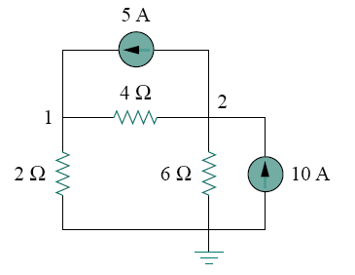





Problem: Calculate the node voltages in the circuit shown in Fig.
At node 1, applying KCL and Ohm’s law gives
Multiplying each term in the last equation by 4, we obtain
At node 2, we do the same thing and get
$$\frac{v_{2}−v_{1}}{4}+\frac{v_{2}}{6}+5=10$$
(1)
Multiplying each term by 12 results in
(2)

Slide 26

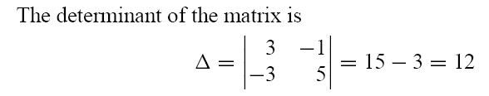
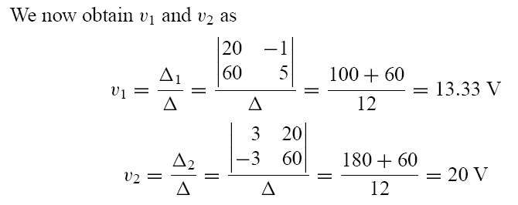
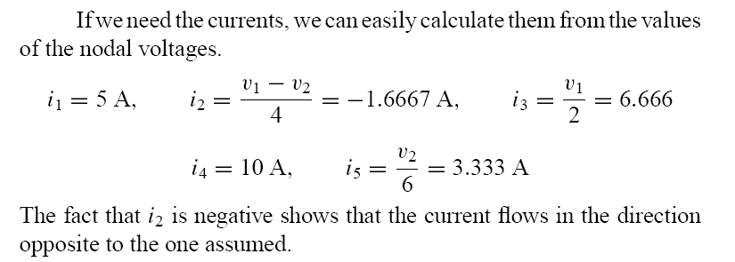
To use Cramer’s rule, we need to put Eqs. (1) and (2) in matrix form as

Slide 27
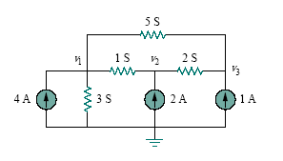
Problem: Using node voltage analysis in the circuit of figure, find the node voltages.

Slide 28
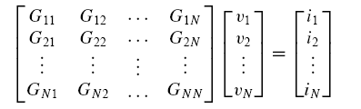
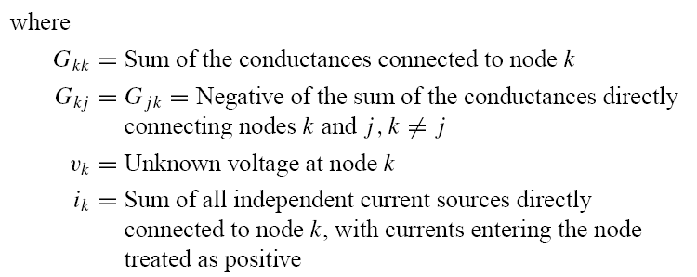
In general, if a circuit with independent current sources has N nonreference nodes, the node-voltage equations can be written in terms of the conductances as

