Slide 1

Basic Electrical Engineering (BEEE101L)
Presented By
Dr. Maddela Chinna Obaiah
Assistant Professor (Sr)
School of Electrical Engineering

Slide 2










Passive Sign Convention
When we analyze an electrical circuit, we write mathematical relationships that describes the circuit behavior.
For passive circuit elements, we need to define voltage polarities and current directions according to the Passive sign convention.
Assumed positive current enters the assumed positive voltage terminal of passive elements.
Either voltage polarity or current direction can be chosen arbitrarily.
Once one is chosen (either voltage or current), it dictates the choice of the other.
$$+$$
$$R_{1}$$
$$+$$
$$R_{1}$$
$$V_{1}$$
$$V_{1}$$
$$−$$
$$R_{2}$$
$$−$$
$$R_{2}$$

Slide 3
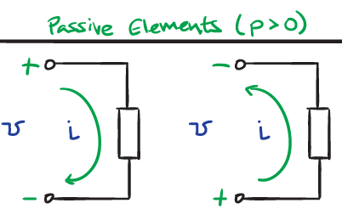





Passive Sign Convention
Power flowing in to a component is considered to be positive and power flowing out of a component is considered negative.
If PSC is satisfied, Power P=vi
If PSC is not satisfied, Power P=-vi
Passive sign convention is satisfied when the current enters through the positive terminal of an element and p = +vi. If the current enters through the negative terminal, p = −vi.
Passive elements $(P<0)$
$$+$$
$$−$$
$$−$$
$$+$$

Slide 4
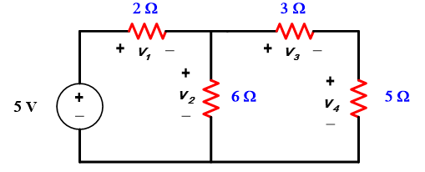


Kirchhoff’s Voltage Law (KVL)
The algebraic sum of all the voltages around any closed path in a circuit equals zero
The "algebraic" correspond to the reference direction to each voltage in the loop.
Assigning a positive sign to a voltage drop ( + to - )
Assigning a negative sign to a voltage rise ( - to + )
$$Loop 1: V_{1}+V_{2}−5$$
$$Loop 2: V_{3}+V_{4}−V_{2}$$

Slide 5
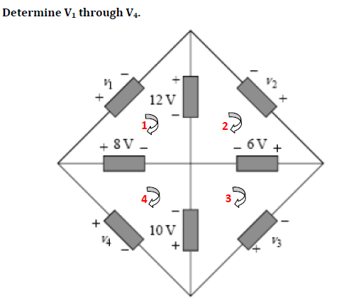

Slide 6
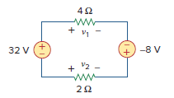





Find v1 and v2 in the circuit of Fig.
Solution:
$$v_{1}=4×i; v_{2}=−2×i$$
From KVL,
$$−32+v_{1}−\left(−8\right)−v_{2}=0$$
$$−32+4i+8−\left(−2i\right)=0$$
$$i=4$$
$$v_{1}=16V, v_{2}=−8$$

Slide 7
Mesh Analysis
Nodal analysis was developed by applying KCL at each non-reference node.
Loop analysis is developed by applying KVL around loops in the circuit.
Loop (mesh) analysis results in a system of linear equations which must be solved for unknown currents.

Slide 8
Steps of Mesh Analysis
Identify mesh (loops).
Assign mesh currents i₁, i₂, . . . , i_{n} to the n meshes.
Apply KVL to each of the n meshes. Use Ohm’s law to express the voltages in terms of the mesh currents.
Solve the resulting n simultaneous equations to get the mesh currents.

Slide 9
Identifying the Meshes
1kΩ
1kΩ
1kΩ
+
–
Mesh 1
Mesh 2
+
–
V₁
V₂

Slide 10
Steps of Mesh Analysis
Identify mesh (loops).
Assign mesh currents i₁, i₂, . . . , i_{n} to the n meshes.
Apply KVL to each of the n meshes. Use Ohm’s law to express the voltages in terms of the mesh currents.
Solve the resulting n simultaneous equations to get the mesh currents.

Slide 11
Assigning Mesh Currents
1kΩ
1kΩ
1kΩ
+
–
+
–
V₁
V₂
I₁
I₂

Slide 12
Steps of Mesh Analysis
Identify mesh (loops).
Assign mesh currents i₁, i₂, . . . , i_{n} to the n meshes.
Apply KVL to each of the n meshes. Use Ohm’s law to express the voltages in terms of the mesh currents.
Solve the resulting n simultaneous equations to get the mesh currents.

Slide 13
Voltages from Mesh Currents
+
V_{R}
–
+
V_{R}
–
I₂
R
R
I₁
I₁
V_{R} = I₁ R
V_{R} = (I₁ - I₂ ) R

Slide 14
KVL Around Mesh 1
1kΩ
1kΩ
1kΩ
+
–
+
–
V₁
V₂
I₁
I₂
-V₁ + I₁ 1kΩ + (I₁ - I₂) 1kΩ = 0
I₁ 1kΩ + (I₁ - I₂) 1kΩ = V₁

Slide 15
KVL Around Mesh 2
1kΩ
1kΩ
1kΩ
+
–
+
–
V₁
V₂
I₁
I₂
(I₂ - I₁) 1kΩ + I₂ 1kΩ + V₂ = 0
(I₂ - I₁) 1kΩ + I₂ 1kΩ = -V₂

Slide 16
Steps of Mesh Analysis
Identify mesh (loops).
Assign mesh currents i₁, i₂, . . . , i_{n} to the n meshes.
Apply KVL to each of the n meshes. Use Ohm’s law to express the voltages in terms of the mesh currents.
Solve the resulting n simultaneous equations to get the mesh currents.

Slide 17
Matrix Notation
The two equations can be combined into a single matrix/vector equation.
Solving the Equations
Let: V₁ = 7V and V₂ = 4V
Results:
I₁ = 3.33 mA
I₂ = -0.33 mA
Finally
V_{out} = (I₁ - I₂) 1k = 3.66V

Slide 18
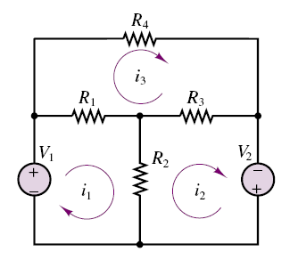
Problem. Using the mesh current method, find the loop currents.
V₁ = 12 V; V₂ = 6 V;
R₁ = 3 ; R₂ = 8 ; R₃ = 6 ; R₄ = 4 .
From loop 1
From loop 2
From loop 3

Slide 19
KVL Around Mesh 2
1kΩ
1kΩ
1kΩ
+
–
+
–
V₁
V₂
I₁
I₂
(I₂ - I₁) 1kΩ + I₂ 1kΩ + V₂ = 0
(I₂ - I₁) 1kΩ + I₂ 1kΩ = -V₂

Slide 20
Steps of Mesh Analysis
Identify mesh (loops).
Assign mesh currents i₁, i₂, . . . , i_{n} to the n meshes.
Apply KVL to each of the n meshes. Use Ohm’s law to express the voltages in terms of the mesh currents.
Solve the resulting n simultaneous equations to get the mesh currents.

Slide 21
Matrix Notation
The two equations can be combined into a single matrix/vector equation.
Solving the Equations
Let: V₁ = 7V and V₂ = 4V
Results:
I₁ = 3.33 mA
I₂ = -0.33 mA
Finally
V_{out} = (I₁ - I₂) 1k = 3.66V

Slide 22



Problem. Using the mesh current method, find the loop currents.
V₁ = 12 V; V₂ = 6 V;
R₁ = 3 ; R₂ = 8 ; R₃ = 6 ; R₄ = 4 .
From loop 1
From loop 2
From loop 3
Ans: I1 = 6.9 A
I2 = 6.3 A
I3 = 4.5 A

Slide 23
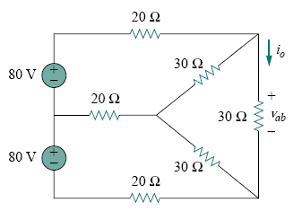
Problem. Use mesh and nodal analysis to find vab and io in the circuit in Fig.
Ans: I1 = 2.66 A I2 = 2.66 A I3 = 1.78A Vab = 53.3 V

Slide 24
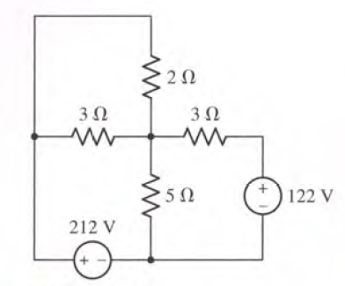
Problem: Determine current flowing through the resistances 2 ohm and 5 ohm using Mesh Analysis?

Slide 25
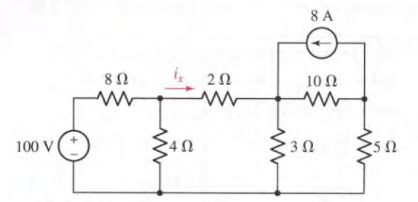
Problem: Use Mesh Analysis to find i_{x}

Slide 26
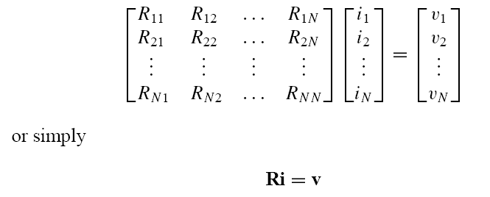
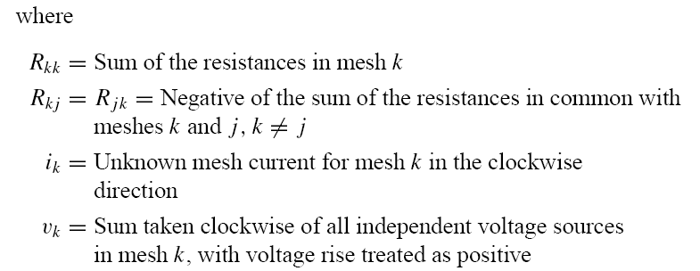
In general, if the circuit has N meshes, the mesh-current equations can be expressed in terms of the resistances as

