Slide 1

Outline
What is Semiconductor ?
Properties of Semiconductor
Summary of Charge Carriers
Doped Semiconductor
Evolution of Solid State Semiconductor Devices
Basic Device Structures
PN Junction (Diode)
1.2 Basic Semiconductor Concepts
1.3 The pn Junction
1.4 Analysis of diode circuits
1.5 Applications of diode circuits

Slide 2
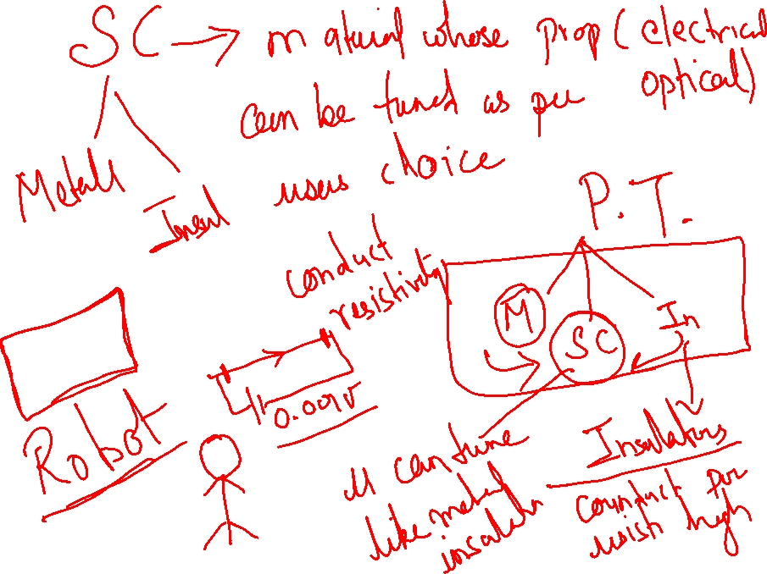

Slide 3
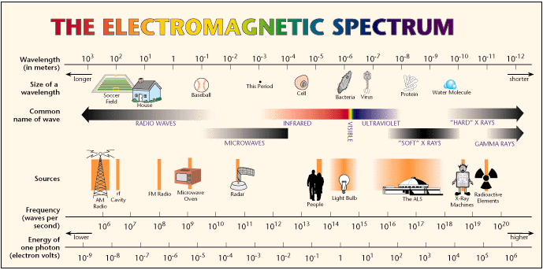
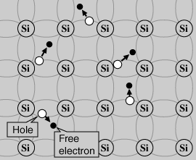
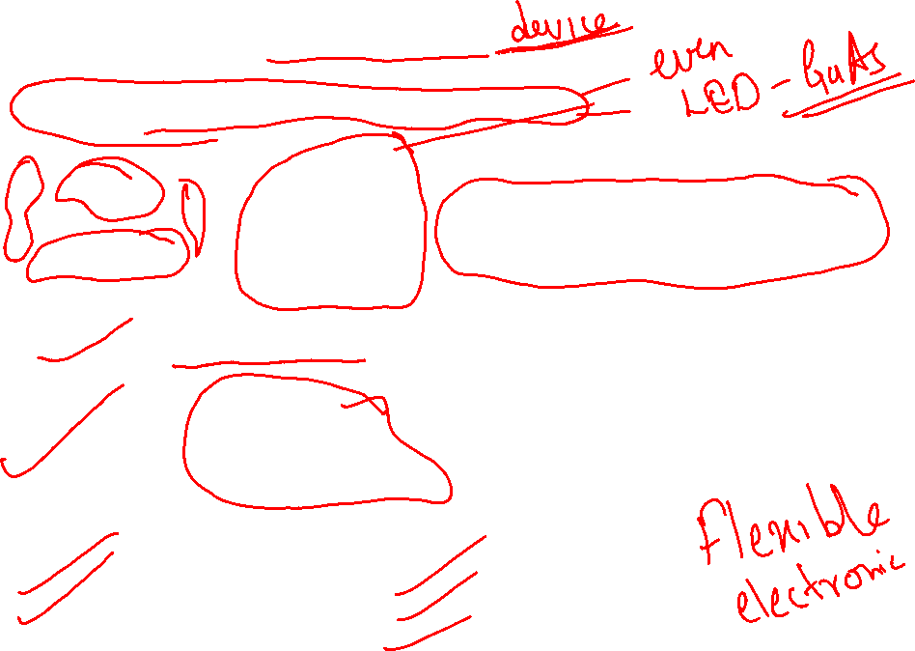
What is Semiconductor ?
Semiconductor is a material oriented Hi-Technology
Raw material
Lattice structure
Processing
(Under stringent conditions)
Useful Product
High reliability
Lower Cost
Improved Performance
Semiconductor Classification/Applications
Small Signal Devices
Power Devices
Optoelectronics Devices
High Frequency Devices
Low Frequency Devices
Discrete Devices

Slide 4


Properties of Semiconductor
Metals
Polarities of charge carriers
Concentration of charge carriers
Transport of charge carriers
Interaction with electromagnetic field
semiconductors
Insulator
$${10}^{21}/cc$$
Concentration of charge
$${10}^{6}/cc$$
Semiconductor
R
Conductor
Metal → Current Flow → Drift
Semiconductor → Current Flow → Drift + Diffusion + Thermoelectric current
T
Si Atom
e
H
hV2
hV
hV1
H
hV
H
e
e
(a) Photoconductivity,
Photovoltaic
(b) Electroluminescence
(c) Photoluminescence

Slide 5
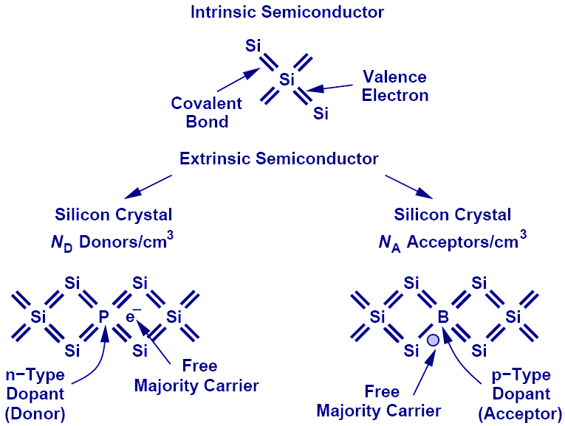
Summary of Charge Carriers
Depends on temperature
The aim is to produce an excess of either electrons (n-type) or holes (p-type).
Typical doping concentrations are one part in ten million.

Slide 6
Doped Semiconductor
1:10¹¹ Lightely doped
1: 10⁶to10⁸ Moderately doped
1:10⁵ Heavily doped
Majority carrier is only determined by the impurity, but independent of temperature.
Minority carrier is strongly affected by temperature.
If the temperature is high enough, characteristics of doped semiconductor will decline to the one of intrinsic semiconductor.
Terminal Characteristics
(DC, AC, Transient Response)
Geometry
Doping
Energy gap
Mobility
Illumination
Life time
Dielectric Constant
Ambient condition
Temperature

Slide 7
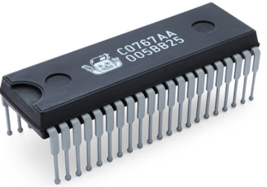
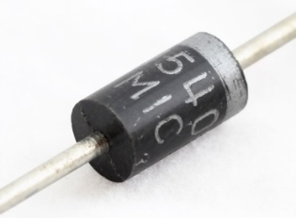
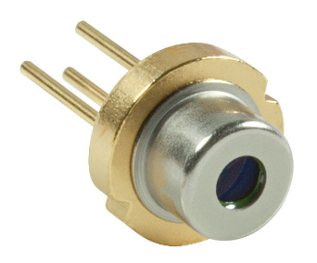
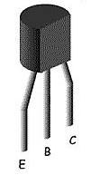
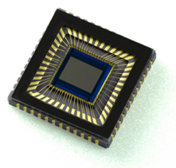
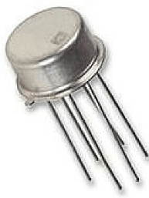
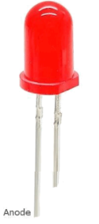
Evolution of Solid State Semiconductor Devices
2000- Nano
1990- 3D Integration of Optoelectronics
1980- VLSI (HEMT, 64KB RAM).Quantum Dot
Integrated Circuit
1970- MSI (256-RAM, Register, Filters, A/D
1900- MESFET (Mead E), Gates, Op-Amp(SSI)
Size Decreasing
Package density Increasing
1960- Integrated Circuit (Noyce, kilby)
1947- BJT (Shockley, Bardeen)
PN Diode
1930- Energy band model
1920- Quantum Mechanism(Debroglee)
1910- Semiconductor)
1900 - Photoelectric effect (Einstein)
Laser Diode
1880- Hall effect (Hall)
1870- Photoconductivity (Smith)
1830- Photovoltaic Effect (Faraday )
BJT
1820- Thermoelectric effect (Seebeck)
CMOS
MOSFET
LED

Slide 8

Basic Device Structures
+
D
E
B
C
-
G
n
-
+
+
n
+
P
n
n
P
P
SiO2
P
METAL
P
pn Diode
n
B
BJT
+
+
S
D
D
n
P
n
P
MOSFET
G
-
-
G
METAL
P
S
G
S
B
JFET
MESFET
n

Slide 9
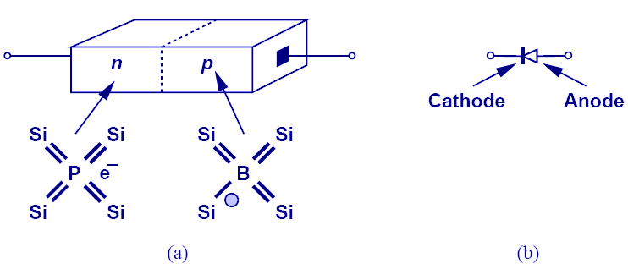
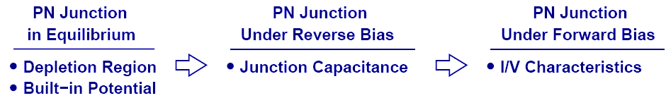
PN Junction (Diode)
Simplest electronic device, a diode (bipolar device).
Unlike resistor, it has a nonlinear I-V characteristics.
Its main electrical property is that it rectifies (allows current to flow easily in one direction only).
Diode’s Three Operation Regions
In order to understand the operation of a diode, it is necessary to study its three operation regions.

Slide 10
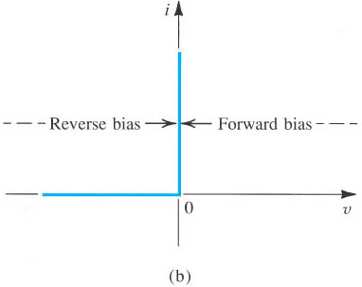
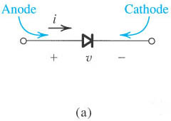
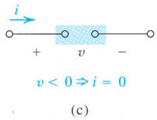
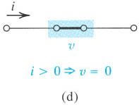
Symbol and Characteristic for the Ideal Diode
(a) Diode circuit symbol; (b) i–v characteristic; (c) equivalent circuit in the reverse direction; (d) equivalent circuit in the forward direction.

Slide 11
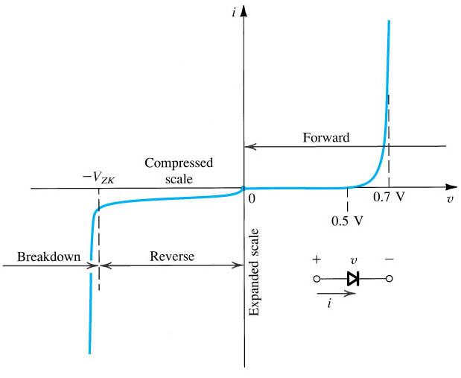
Practical I-V Characteristics
I = I₀(e^{qV/ηkT}-1)
The diode i–v relationship with some scales expanded and others compressed in order to reveal details
Recall Ohm’s Law (V=IR) Put it into slope-intercept form to get I = V/R. The slope of the graph is 1/R. Large slopes mean small R.

Slide 12
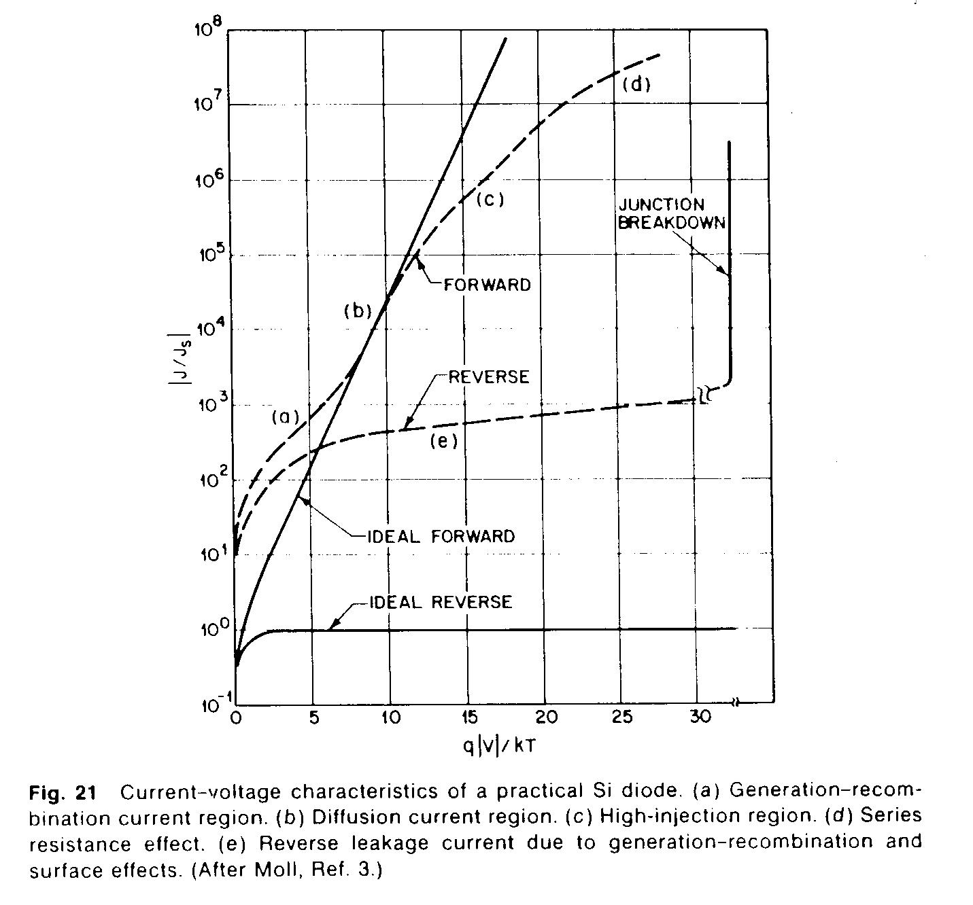
Comparative Ideal Vs Real I-V characteristics

Slide 13
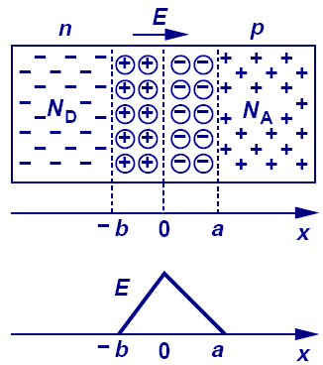
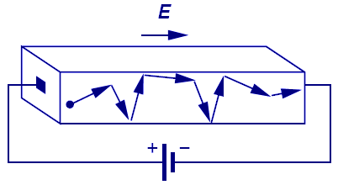
Carriers Movement
There are two mechanisms by which holes and free electrons move through a silicon crystal.
Drift: The process in which charge particles move because of an electric field is called drift.
Diffusion
Total drift current density:
Charge particles will move at a velocity that is proportional to the electric field.
Resistivities are inversely proportional to the concentration of doped impurities.

Slide 14
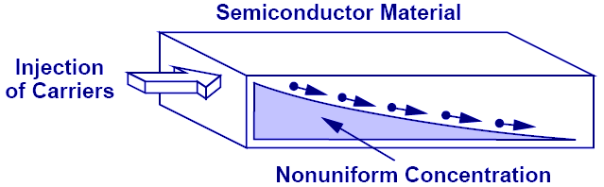
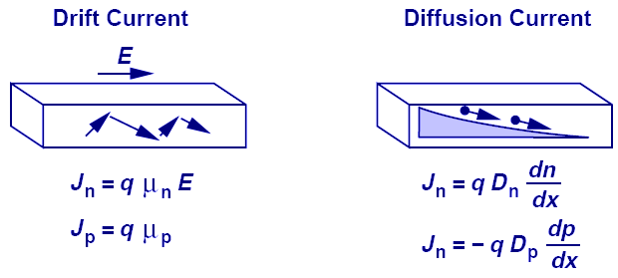
Second Charge Transportation Mechanism: Diffusion
Diffusion is analogous to an every day example of an ink droplet in water.
Einstein's Relation:
The underlying physics behind drift and diffusion currents are totally different and Einstein’s relation provides us a link between the two.
Einstein relationship exists between the carrier diffusivity and mobility.

Slide 15
Junction breakdown or reverse breakdown
An applied reverse bias (voltage) will result in a small current to flow through the device.
At a particular high voltage value, which is called as breakdown voltage V_{B}, large currents start to flow. If there is no current limiting resistor which is connected in series to the diode, the diode will be destroyed. There are two physical effects which cause this breakdown.
Zener breakdown
Avalanche breakdown

Slide 16
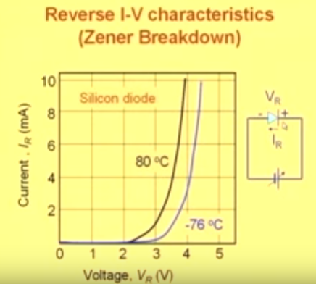
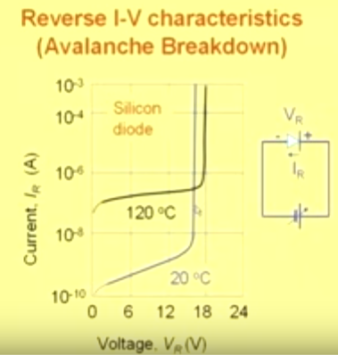
Breakdown Mechanisms
Zener effect
Occurs in heavily doping semiconductor
Breakdown voltage is less than 5 V.
Carriers generated by electric field.
TC is negative.
Avalanche effect
Occurs in lightly doping semiconductor
Breakdown voltage is more than 7 V.
Carriers generated by collision.
TC is positive.

Slide 17
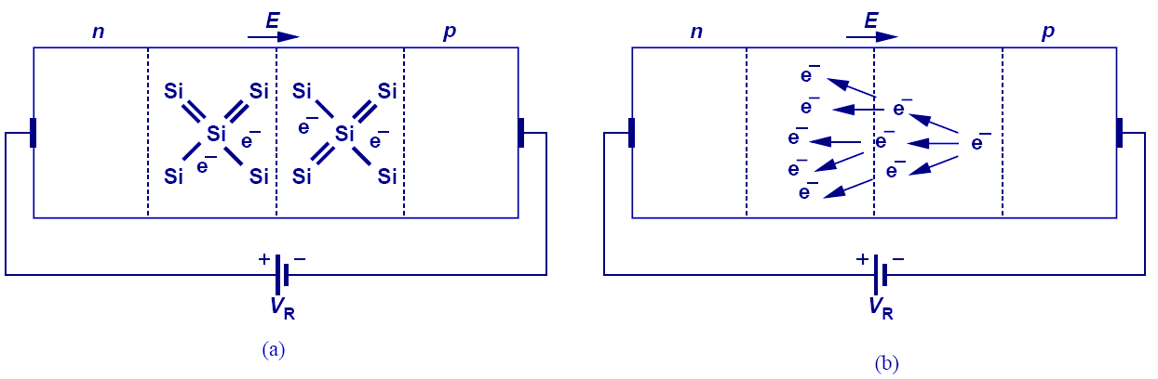
Avalanche and Zener mechanism
Zener breakdown
Avalanche breakdown
Zener breakdown is a result of the large electric field inside the depletion region that breaks electrons or holes off their covalent bonds.
Zener breakdown occurs with a tunneling mechanism.
Avalanche breakdown mechanism occurs when electrons and holes moving through the DR and acquire sufficient energy from the electric field to break a bond i.e. create electron-hole pairs by colliding with atomic electrons within the depletion region.
In Avalanche breakdown the newly created electrons and holes move in opposite directions due to the electric field and thereby add to the existing reverse bias current. This is the most important breakdown mechanism in p-n junction.

Slide 18
Formation of a PN-junction
Ionized acceptors
Ionized donors
Junction
P
N
-
-
+
+
-
-
+
+
-
-
+
+
-
-
+
+
Space charge region
(DR)
Depletion region
Potential barrier height(V₀)
Potential barrier width
(W)
Gradients drive diffusion: But charges can’t venture too far from the interface because their Coulomb forces pull them back!

Slide 19
How much is the Built-in Voltage?
P side
N side
N_{a} acceptor level on the p side
N_{d} donor level on the n side
It depends on doping concentration and temperature.
Its TC is negative.

Slide 20
Special Case: One-sided Junctions
One side very heavily doped so that Fermi level is at band edge.
e.g. p⁺-n junction (heavy B implant into lightly doped substrate)
Means V_{bi} depends on Eg and Eg varies matreial to material. For Eg: V_{bi} (Si)= 0.7 V & V_{bi} (Ge)= 0.3 V

Slide 21
How far does W_{d} extend into each junction?
Depletion width on the n-side depends on the doping on the p-side
Depletion width on the p-side depends on the doping on the n-side
e.g. if N_{A}>>N_{D} then x_{n}>>x_{p} One-sided junction

Slide 22
P-N Junctions - Equilibrium
What happens when these band structures collide?
Thermal equilibrium equation:

Slide 23
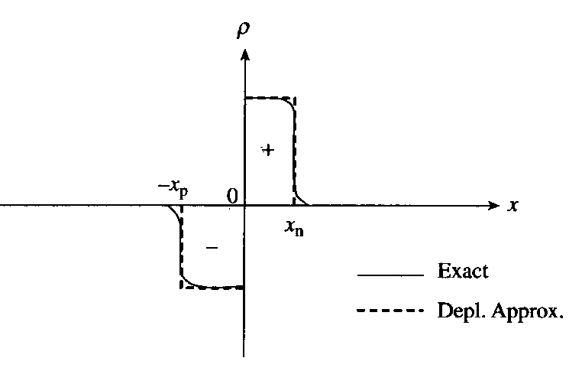
Depletion Approximation, Electric Field and Potential for pn junction
₋ ₋ ₋ ₋
₋ ₋ ₋ ₋
₊ ₊ ₊
₊ ₊ ₊
_{p-type}
_{n-type}
₊ ₊ ₊
₊ ₊ ₊
_{x}
₋ ₋ ₋ ₋
₋ ₋ ₋ ₋
Exponentials replaced with step-functions
At equilibrium, there is no bias, i.e. no applied voltage.
The field takes the same sign as the charge.
The sign of the electric field is opposite to that of the potential ;
Potential Electric field Charge density
_{x}
_{x}
_{Depletion Region}

Slide 24
Energy level diagram for the p-n junction in thermal equilibrium
p-type
n-type
_{Electron Drift}
E_{C}
_{Electron Diffusion}
_{Neutral p-region}
E_{C}
E_{f}
E_{f}
E_{V}
_{Hole Diffussion}
_{Neutral n-region}
E_{V}
_{Hole Drift}
Depletion region

Slide 25
P
Open circuit PN -junction
N
-
-
+
+
-
-
+
+
-
-
+
+
-
-
+
+
Space charge region
P
N
-
+
-
+
-
+
-
+
Forward bias
V_{F}

Slide 26
There is no turn-on voltage because current flows in any case. However , the turn-on voltage can be defined as the forward bias required to produce a given amount of forward current.
If 1 m A is required for the circuit to work, 0.7 volt can be called as turn-on voltage.

Slide 27
Qualitative explanation of forward bias
Junction potential is reduced from V_{bi} to V_{bi}-V_{F.}
By forward biasing a large number of electrons are injected from n-side to p-side accross the depletion region and these electrons become minority carriers on p-side, and the minority recombine with majority holes so that the number of injected minority electrons decreases (decays) exponentially with distance into the p-side.
+ -
-
-
+
+
p n
p_{n}
np
Carrier Density
p_{no}
n_{po}
p-n junction in forward bias

Slide 28
Forward-bias diode; injection of minority carriers across DR
+ -
-
-
+
+
p n
p_{po}
n_{no}
B
A
When a F.B. is applied; majority carriers are injected across DR and appear as a minority carrier at the edge of DR on opposite side. These minorities will diffuse in field free opposite-region towards ohmic contact. Since ohmic contact is a long way away, minority carriers decay exponentially with distance in this region until it reaches to its equilibrium value.
p_{no}
n_{po}
l_{p}
l_{n}

Slide 29
Forward Bias Current Densities
+ -
p n
J_{total} is constant through the whole diode.
Minority current densities decreases exponentially into the the neutral sides whereas the current densities due to the majorities increase into the neutral sides.
Ohmic contact
Current density
l_{p}=0
l_{n}=0

Slide 30
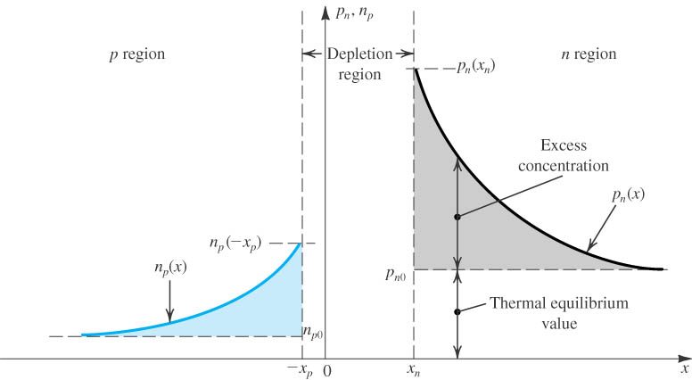
The pn Junction Under Forward-Bias Conditions
Excess minority carrier concentration:
Exponential relationship
Small voltage incremental give rise to great incremental of excess minority carrier concentration.
Minority-carrier distribution in a forward-biased pn junction. It is assumed that the p region is more heavily doped than the n region; N_{A} >>N_{D}.

Slide 31
P
Open circuit PN -junction
N
-
-
+
+
-
-
+
+
-
-
+
+
-
-
+
+
Space charge region
P
N
-
-
-
+
+
+
-
-
-
+
+
+
-
-
-
+
+
+
-
-
-
+
+
+
Reverse bias
V_{R}

Slide 32
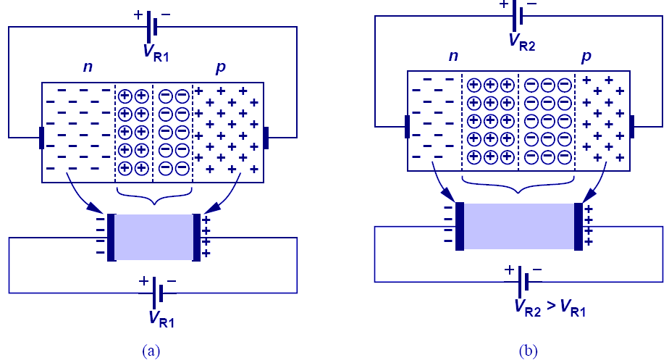
Reverse Biased Diode’s Application: Voltage-Dependent Capacitor
The PN junction can be viewed as a capacitor. By varying V_{R}, the depletion width changes, changing its capacitance value; therefore, the PN junction is actually a voltage-dependent capacitor.

Slide 33
Junction Capacitance
Diffusion Capacitance
Charge stored in bulk region changes with the change of voltage across pn junction gives rise to capacitive effect.
Small-signal diffusion capacitance
Depletion capacitance
Charge stored in depletion layer changes with the change of voltage across pn junction gives rise to capacitive effect.
Small-signal depletion capacitance

Slide 34
Appliying bias to p-n junction
Zero Bias
Forward Bias
Reverse Bias
+ -
- +
- -
- -
+ +
+ +
-
-
+
+
- -
- -
+ +
+ +
p n
p n
p n
E_{c}
E_{c}
E_{c}
E_{v}
E_{v}
E_{v}
Potential Energy

Slide 35
General Expression
Convention = V_{appl}= + for forward bias
V_{appl}= - for reverse bias
The depletion layer narrows and the barrier voltage decreases by V volts, which appears as an external voltage in the forward direction.

Slide 36
The pn Junction Under Reverse-Bias Conditions
I-V characteristic equation:
Where I_{s} is the saturation current, it is proportional to n_{i}² which is a strong function of temperature.
(Independent of voltage)

Slide 37


Introduction to Device Fabrication
Oxidation
Lithography &
Etching
Ion Implantation
Annealing &
Diffusion

Slide 38
Device Fabrication Example
Ion Implantation
Wafer
Oxidation
Annealing &
Diffusion
UV
Al
Sputtering
Lithography
UV
Lithography
Etching

Slide 39
Device Fabrication Example
Metal
etching
Back side metallization
CVD
nitride
deposition
Lithography
and etching
Back Side
milling
Dicing, wire bonding,
and packaging

Slide 40
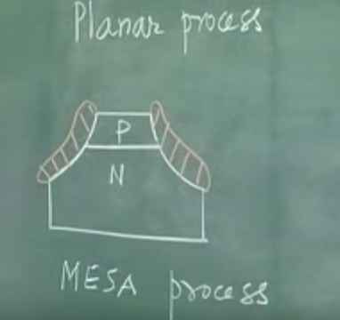
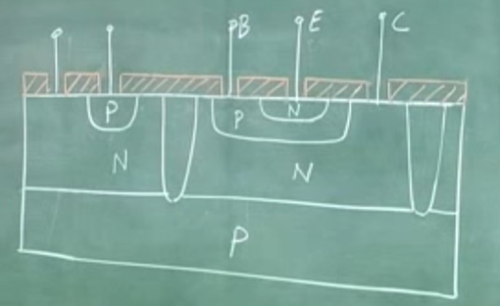
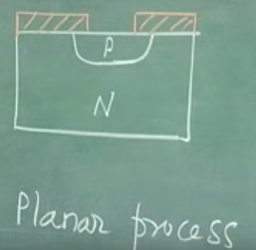
Planar Process Fabrication procedure
(a) p-n junction
(c) p-n junction & n-p-n transistor on same Si Subatrate
(b) p-n junction

