Slide 1
Electrical Machines
By Dr. M. Chinna Obaiah,
Assistant Professor (Sr), SELECT, VIT Vellore.

Slide 2
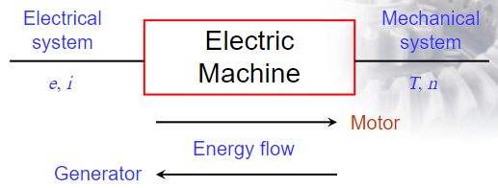
Introduction to Electrical Machines
Rotating electric machines are energy-conversion devices (i.e. electrical to mechanical or mechanical to electrical energy)
Rotating electric machines can be used as motors and generators
Conversion from mechanical to electrical energy : Generators
Conversion from electrical to mechanical energy : Motors

Slide 3
Five Electromagnetic Principles
Need to know them to understand the operation of electric machines.
An electromotive force (EMF) will produce a current that is proportional to the conductivity of the path. This is commonly known as Ohm’s law.
An electric current constitutes a magnetomotive force (MMF) that produces magnetic flux proportional to the permeability of the path. This is often referred to as Ohm’s law for magnetic circuits.
When a conductor moves in a magnetic field, e.m.f induced in the conductor, which further induces the current in the closed circuit. This is Faraday’s law which is the basis for generator action.
The polarity of the EMF induced in a coil will cause a current that will oppose any change in the magnetic flux. This is known as Lenz’s law.
When a current carrying conductor is placed in a magnetic field, the conductor experiences a mechanical force. This is the basis for motor action.
3

Slide 4
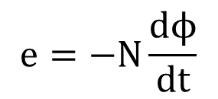
Faraday’s laws of electromagnetic induction
Electromagnetic Induction: It is the relative movement of the magnetic flux and the coil that causes an e.m.f. and thus current, to be induced in the coil.
Faraday’s Law states:
An induced e.m.f. is set up whenever the magnetic field linking that circuit changes.
The magnitude of the induced e.m.f. in any circuit is proportional to the rate of change of the magnetic flux linking the circuit.
$$e=−N\frac{dϕ}{dt}$$
Lenz’s law states:
The direction of an induced e.m.f. is always such that it tends to set up a current opposing the motion or the change of flux responsible for inducing that e.m.f.’.

Slide 5
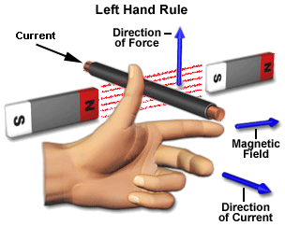
Fleming’s left hand rule
Used to determine the direction of force acting on a current carrying conductor placed in a magnetic field .
The middle finger , the fore finger and thumb of the left hand are kept at right angles to one another .
The middle finger represent the direction of current
The fore finger represent the direction of magnetic field
The thumb will indicate the direction of force acting on the conductor .
This rule is used in motors.

Slide 6
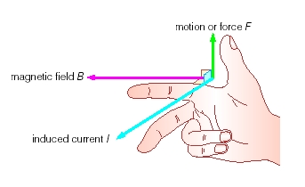
Fleming’s Right hand rule
Used to determine the direction of emf induced in a conductor
The middle finger , the fore finger and thumb of the left hand are kept at right angles to one another.
The fore finger represent the direction of magnetic field
The thumb represent the direction of motion of the conductor
The middle finger will indicate the direction of the inducted emf
This rule is used in Generators

Slide 7
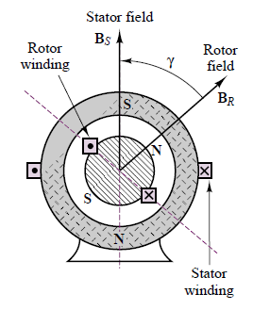
Electric machines can be divided into 2 types:
AC machines (electrical system is AC)
Synchronous machines
Induction machines/Asynchronous machines
DC machines (electrical systems is DC)
Self excited DC machines
Separately excited DC machines
All Electric machines have two parts:
Stationary parts (stator)
Does not move and normally is the outer frame of the machine.
rotating parts (rotor)
Is free to move and normally is the inner part of the machine.
Air gap which separate stator and rotor
Both stator and rotor are made of ferromagnetic materials.

Slide 8
In electrical machines, two types of windings are there, depending on the purpose of the current they carry.
If the purpose of the current in a winding only to produce magnetic field and independent of the load, that winding is called Field Winding.
Field currents are nearly always DC.
If the winding to carries only the load current , it is called Armature winding.

Slide 9
DC Machines
Construction
Working Principle
EMF Equation
Applications

Slide 10
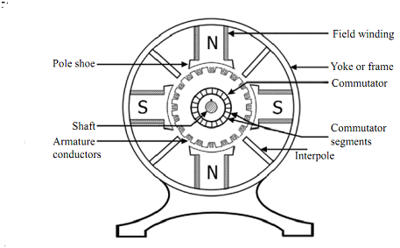
Construction of DC Machine
The main parts of DC Machine (motor or generator) are as follows:
Yoke
Pole core and pole shoes
Pole coil and field coil
Armature core
Armature winding or conductor
Commutator
Brushes and bearings

Slide 11
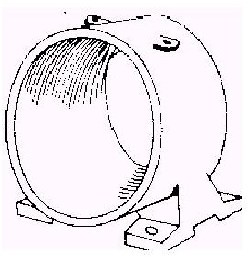
Yoke or Frame
Function
It provide mechanical Support for poles
It also provide protection to whole machine from dust, moisture etc.
It also carries magnetic flux produced by the poles
Yoke is also called as frame.
Material used
For small M/C yoke is made of cast iron.
For large M/C it is made of cast steel or rolled steel.

Slide 12
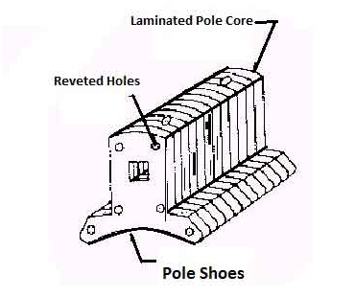
Pole Core and Pole Shoe
Pole Core:
Function
Pole of a generator is an electromagnet.
The field winding is winding over pole.
Pole provides magnetic flux when field winding is excited.
Material used
Pole core or pole made of cast iron or cast steel.
It built of these laminations of annealed steel. The laminations is done to reduce the power lose due to eddy currents.
Pole Shoe:
Function
It is extended part of pole. It enlarge area of pole
Due to this enlarged area, flux is spread out in the air gap and more flux can pass through the air gap to armature.
Material used
It is made of cast iron or cast steel.
It built of lamination of annealed steel. the lamination is done to reduce power loss due to eddy currents

Slide 13
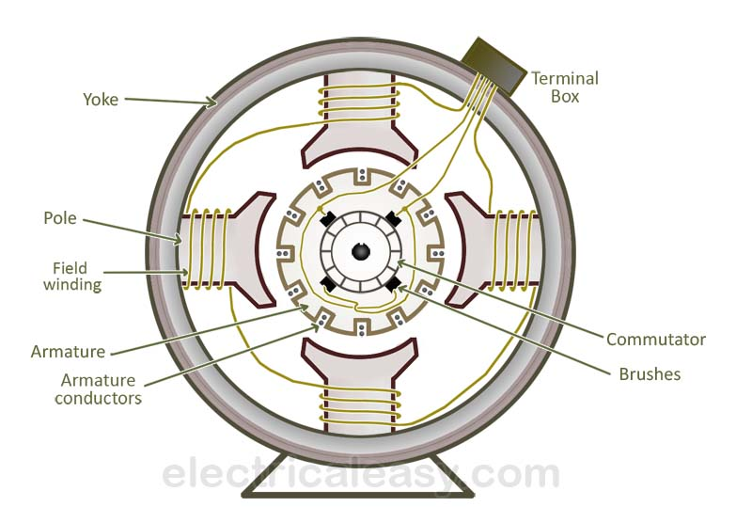
Pole coil or field windings
Function
It is wound around pole core and called as field coil
it is connected in series to from field winding
When Current is passed through field winding it electro magnetize the poles which produce necessary flux.
Material used
The material used for field conductor is copper.

Slide 14
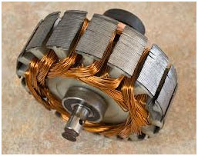
Armature Core
Function
It has large number of slots in its periphery
Armature conductor, are placed in this slots
It is also provide path of low reluctance to the flux produced by field winding
Material used
High permeability low reluctance materials such as cast iron are used for armature core.
The lamination is provided so as to reduce the loss due to eddy current.

Slide 15
Armature Winding
Function
Armature conductor are inter connected to form armature Winding
When armature winding is rotated using prime mover. the magnetic flux linking with conductors and voltage gets induced in it
Armature winding is connected to external circuit
Material used
It is made of conducting material such as coppers.
The armature winding is mainly classified into types, i.e., the lap winding and the wave winding.

Slide 16
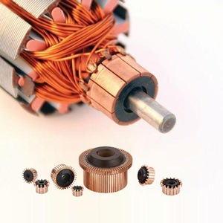
Commutator
Function
It Convert alternating current induce in the conductor in a unidirectional current
It collects the current from armature conductor and pass it load with the help of brushes
It also provide unidirectional torque for dc motor
Material used
It is made of a large number of edge shaped segments of hard drawn copper.
The Segments are insulated from each other by thin layer of mica.

Slide 17
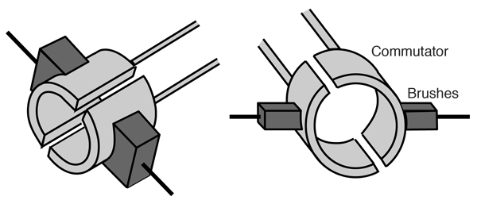
Brushes
Function
Brushes collect the current from commutator and apply it to external load.
Brushes wear with time and it is should be inspected regularly.
Material used
Brushes are made of carbon or graphite it is rectangular in shape.

Slide 18
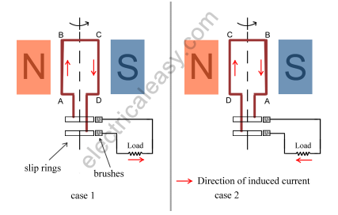
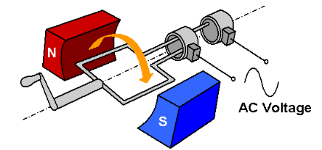
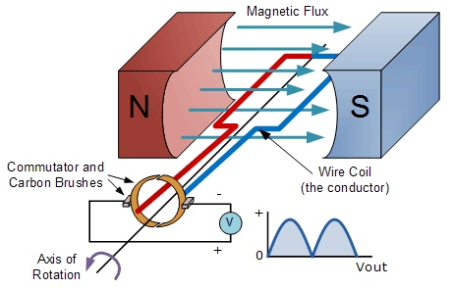
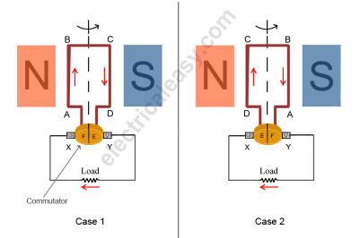
AC Generator
DC Generator

Slide 19
Working Principle Of A DC Generator
According to Faraday’s laws of electromagnetic induction, whenever a conductor is placed in a varying magnetic field (OR a conductor is moved in a magnetic field), an emf (electromotive force) gets induced in the conductor.
The magnitude of induced emf can be calculated from the emf equation of dc generator.
If the conductor is provided with a closed path, the induced current will circulate within the path.
In a DC generator, field coils produce an electromagnetic field and the armature conductors are rotated into the field.
Thus, an electromagnetically induced emf is generated in the armature conductors.
The direction of induced current is given by Fleming’s right hand rule.

Slide 20
Working Principle Of A DC Generator
Need of a Split ring commutator:
Voltage induced in the armature winding is alternating in nature.
The armature winding is connected to rotating commutator which rectifies the induced voltage to unidirectional voltage (but pulsating).
The brushes which are connected to the armature winding, ride on commutator collect the current from the commutator and deliver it to the external load circuit

