Slide 1
Electrical Machines
By Dr. M. Chinna Obaiah,
Assistant Professor (Sr), SELECT, VIT Vellore.

Slide 2
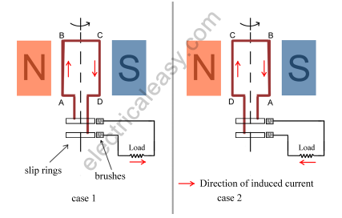
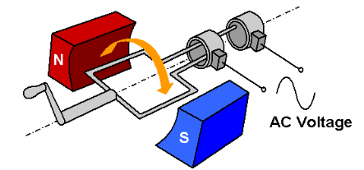
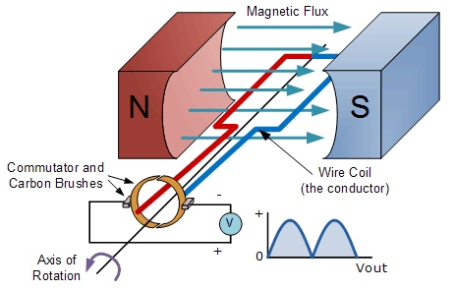
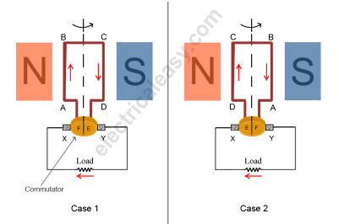
AC Generator
DC Generator

Slide 3
Working Principle Of A DC Generator
According to Faraday’s laws of electromagnetic induction, whenever a conductor is placed in a varying magnetic field (OR a conductor is moved in a magnetic field), an emf (electromotive force) gets induced in the conductor.
The magnitude of induced emf can be calculated from the emf equation of dc generator.
If the conductor is provided with a closed path, the induced current will circulate within the path.
In a DC generator, field coils produce an electromagnetic field and the armature conductors are rotated into the field.
Thus, an electromagnetically induced emf is generated in the armature conductors.
The direction of induced current is given by Fleming’s right hand rule.

Slide 4
Working Principle Of A DC Generator
Need of a Split ring commutator:
Voltage induced in the armature winding is alternating in nature.
The armature winding is connected to rotating commutator which rectifies the induced voltage to unidirectional voltage (but pulsating).
The brushes which are connected to the armature winding, ride on commutator collect the current from the commutator and deliver it to the external load circuit

Slide 5
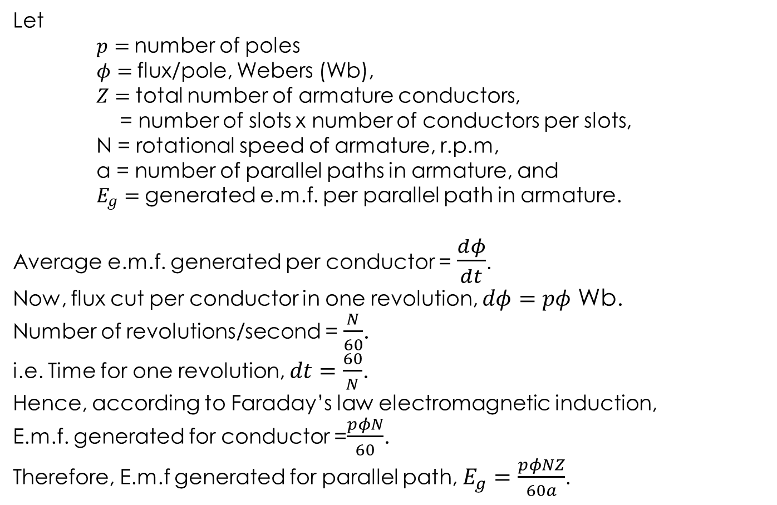
Generated EMF
Let
$p=$number of poles
$φ=$flux/pole, Webers (Wb),
$Z=$total number of armature conductors,
= number of slots x number of conductors per slots,
N = rotational speed of armature, r.p.m,
a = number of parallel paths in armature, and
$E_{g}=$generated e.m.f. per parallel path in armature.
Average e.m.f. generated per conductor = $\frac{dφ}{dt}$.
Now, flux cut per conductor in one revolution, $dφ=pφ$ Wb.
Number of revolutions/second = $\frac{N}{60}$.
i.e. Time for one revolution, $dt=\frac{60}{N}$.
Hence, according to Faraday’s law electromagnetic induction,
E.m.f. generated for conductor =$\frac{pφN}{60}$.
Therefore, E.m.f generated for parallel path, $E_{g}=\frac{pφNZ}{60a}$.

Slide 6
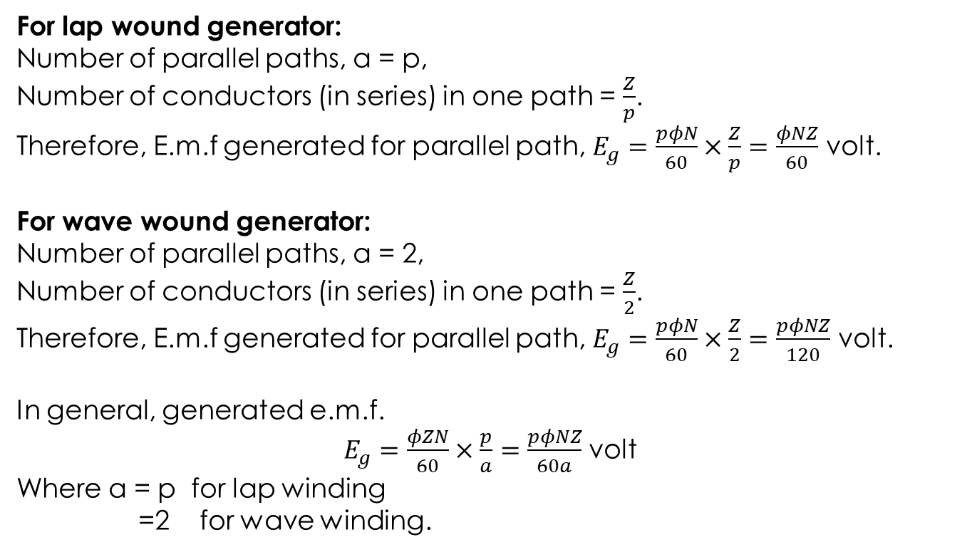
Generated EMF (contd.,)
For lap wound generator:
Number of parallel paths, a = p,
Number of conductors (in series) in one path = $\frac{Z}{p}$.
Therefore, E.m.f generated for parallel path, $E_{g}=\frac{pφN}{60}×\frac{Z}{p}=\frac{φNZ}{60}$ volt.
For wave wound generator:
Number of parallel paths, a = 2,
Number of conductors (in series) in one path = $\frac{Z}{2}$.
Therefore, E.m.f generated for parallel path, $E_{g}=\frac{pφN}{60}×\frac{Z}{2}=\frac{pφNZ}{120}$ volt.
In general, generated e.m.f.
$E_{g}=\frac{φZN}{60}×\frac{p}{a}=\frac{pφNZ}{60a}$ volt
Where a = p for lap winding
=2 for wave winding.

Slide 7
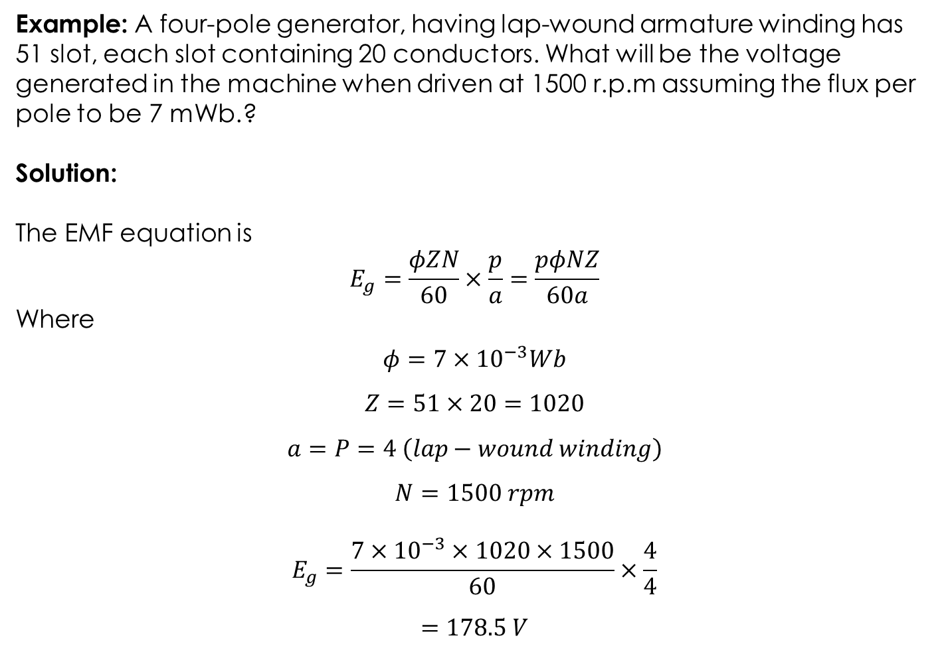
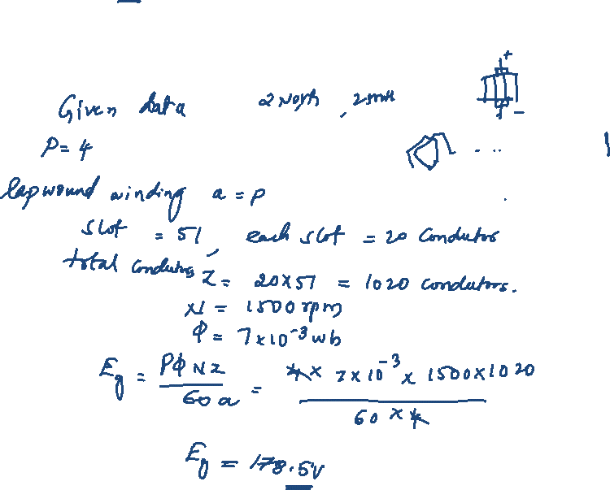
Example: A four-pole generator, having lap-wound armature winding has 51 slot, each slot containing 20 conductors. What will be the voltage generated in the machine when driven at 1500 r.p.m assuming the flux per pole to be 7 mWb.?
Solution:
The EMF equation is
$$E_{g}=\frac{φZN}{60}×\frac{p}{a}=\frac{pφNZ}{60a}$$
Where
$$φ=7×{10}^{−3}Wb$$
$$Z=51×20=1020$$
$$a=P=4 \left(lap−wound winding\right)$$
$$N=1500 rpm$$
$$E_{g}=\frac{7×{10}^{−3}×1020×1500}{60}×\frac{4}{4}$$
$$=178.5 V$$

Slide 8
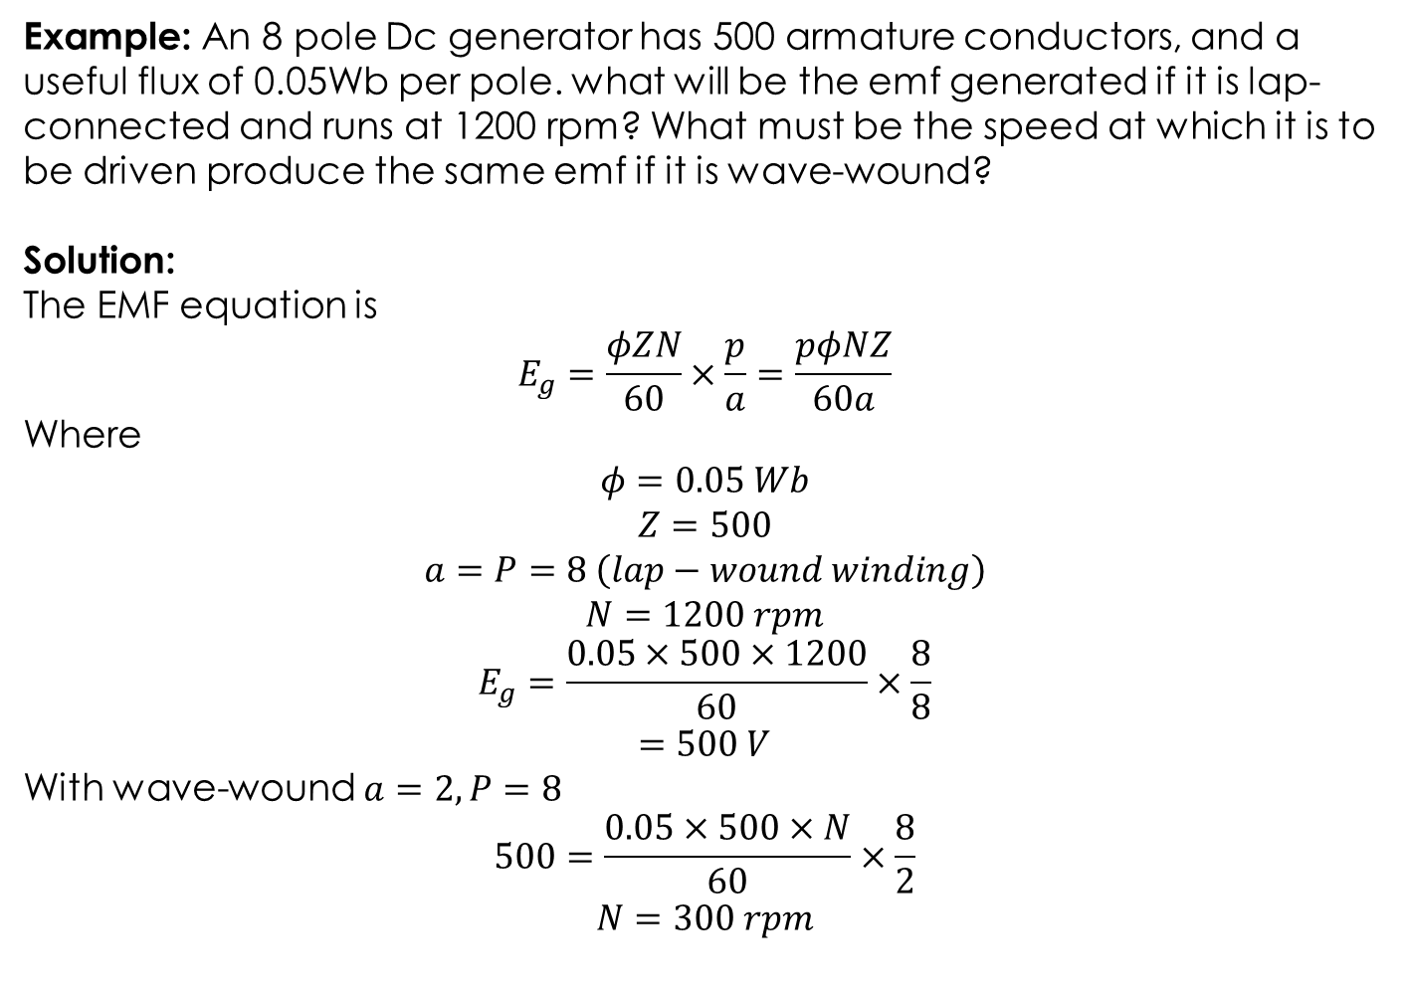
Example: An 8 pole Dc generator has 500 armature conductors, and a useful flux of 0.05Wb per pole. what will be the emf generated if it is lap-connected and runs at 1200 rpm? What must be the speed at which it is to be driven produce the same emf if it is wave-wound?
Solution:
The EMF equation is
$$E_{g}=\frac{φZN}{60}×\frac{p}{a}=\frac{pφNZ}{60a}$$
Where
$$φ=0.05 Wb$$
$$Z=500$$
$$a=P=8 \left(lap−wound winding\right)$$
$$N=1200 rpm$$
$$E_{g}=\frac{0.05×500×1200}{60}×\frac{8}{8}$$
$$=500 V$$
With wave-wound $a=2, P=8$
$$500=\frac{0.05×500×N}{60}×\frac{8}{2}$$
$$N=300 rpm$$

Slide 9
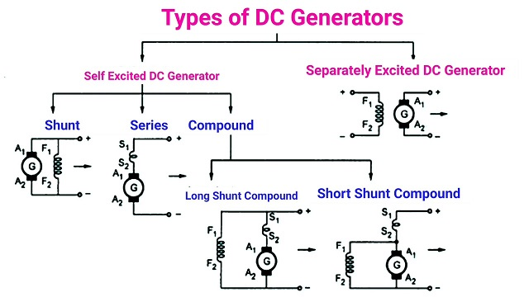
DC generators are classified based on how their fields are excited (i.e. produced).

